Slide 1

Conference 9
ECG STAMPEDE

Slide 2
64-year-old male presents with bradycardia
34

Slide 3
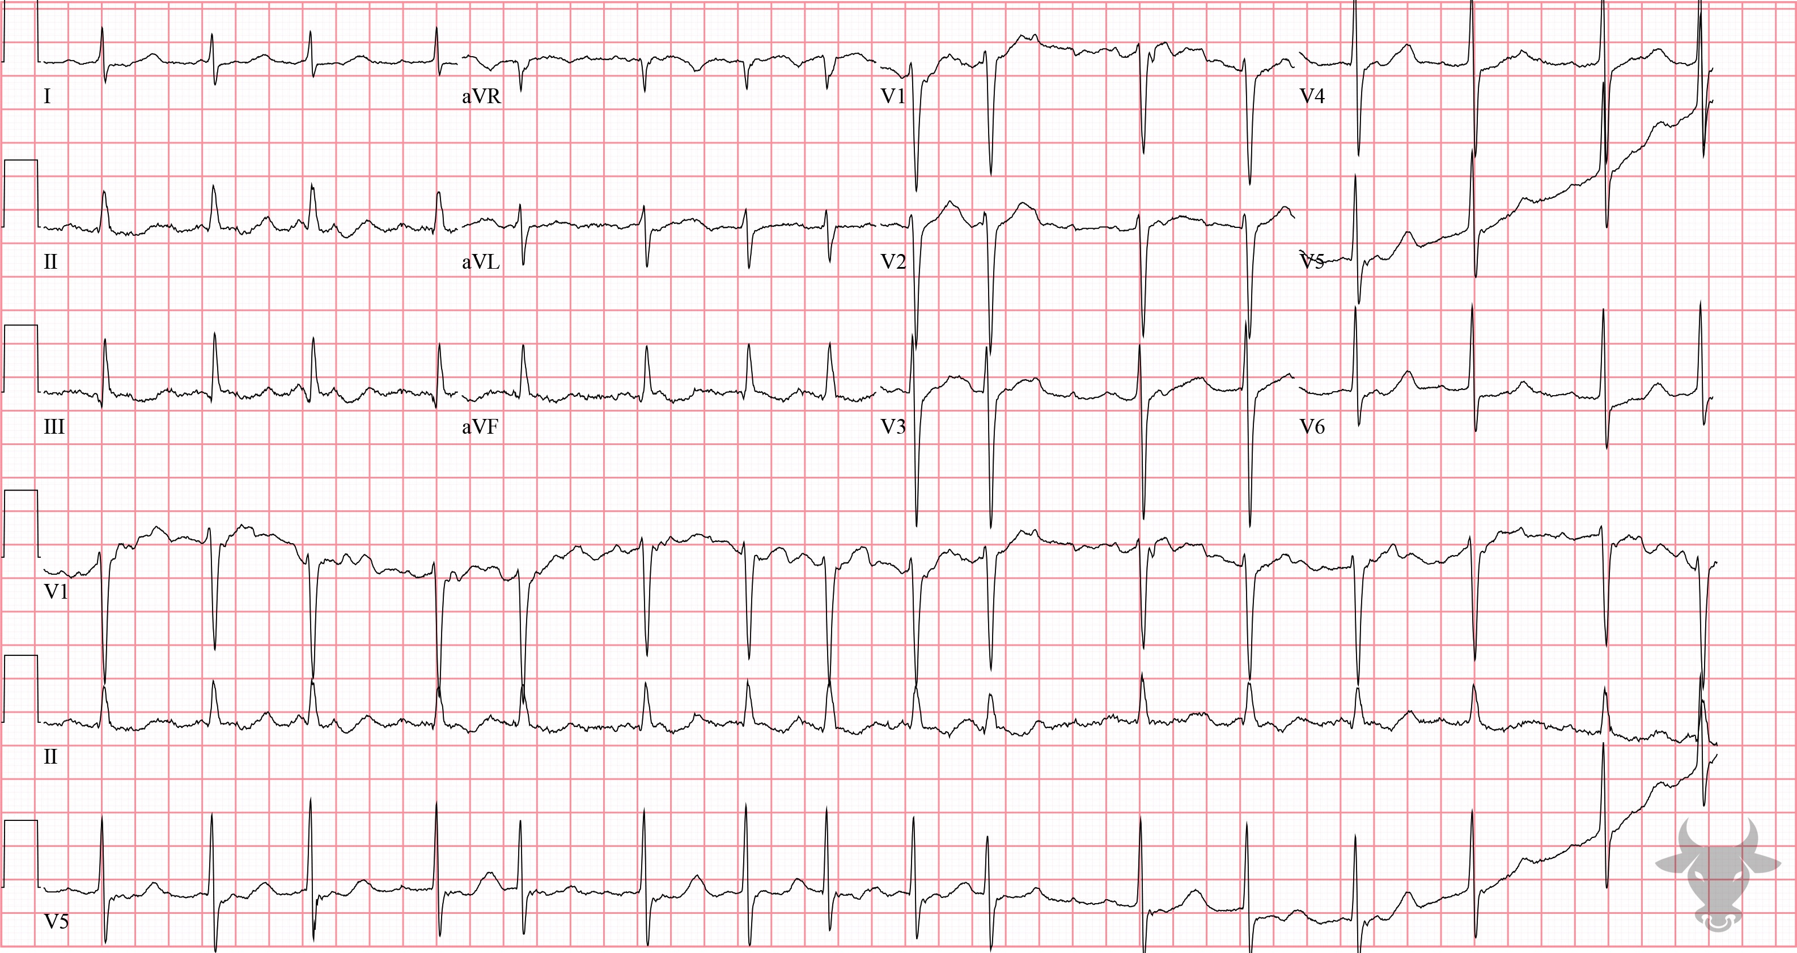
Notes:
Junctional Escape.
Junctional Escape, Sinus Node Dysfunction. This junctional escape rhythm alternates with atrial fibrillation, classic for sick sinus syndrome – a collection of maladies related to sinus node dysfunction from degenerative disease.

Slide 4
71-year-old male presents with dyspnea & chest pain
35

Slide 5
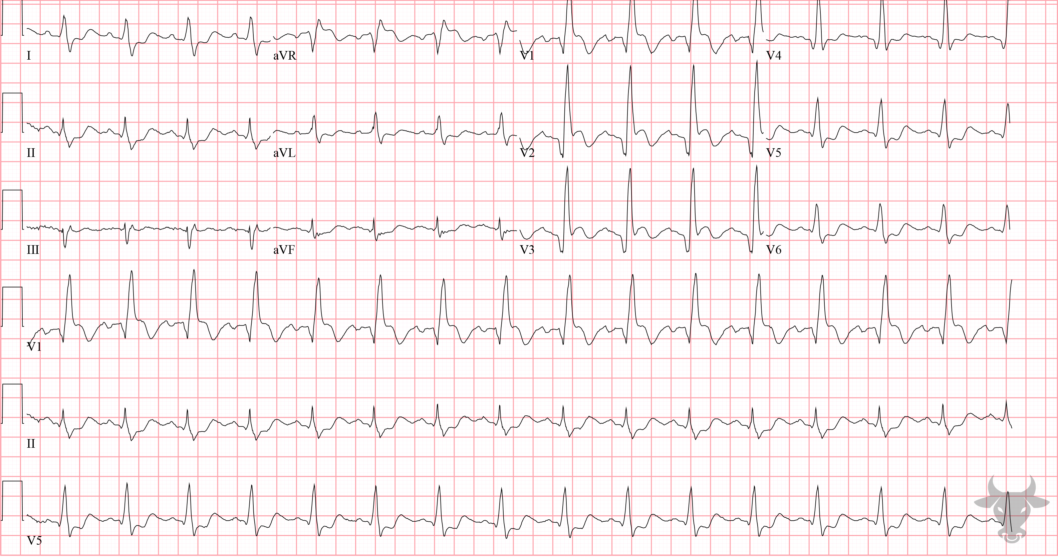
Notes:
Anterior ST-elevation Myocardial Infarction.
Anterior ST-elevation Myocardial Infarction, Right Bundle Branch Block. Typically, with a right bundle branch block, the ST-segments are slightly depressed in leads V1-3; therefore, any degree of ST-segment elevation in these leads is concerning for anterior myocardial infarction. Left heart catheterization revealed a 95% culprit lesion to the left main and percutaneous coronary intervention was successful.

Slide 6
29-year-old male presents with pleuritic chest pain
36

Slide 7
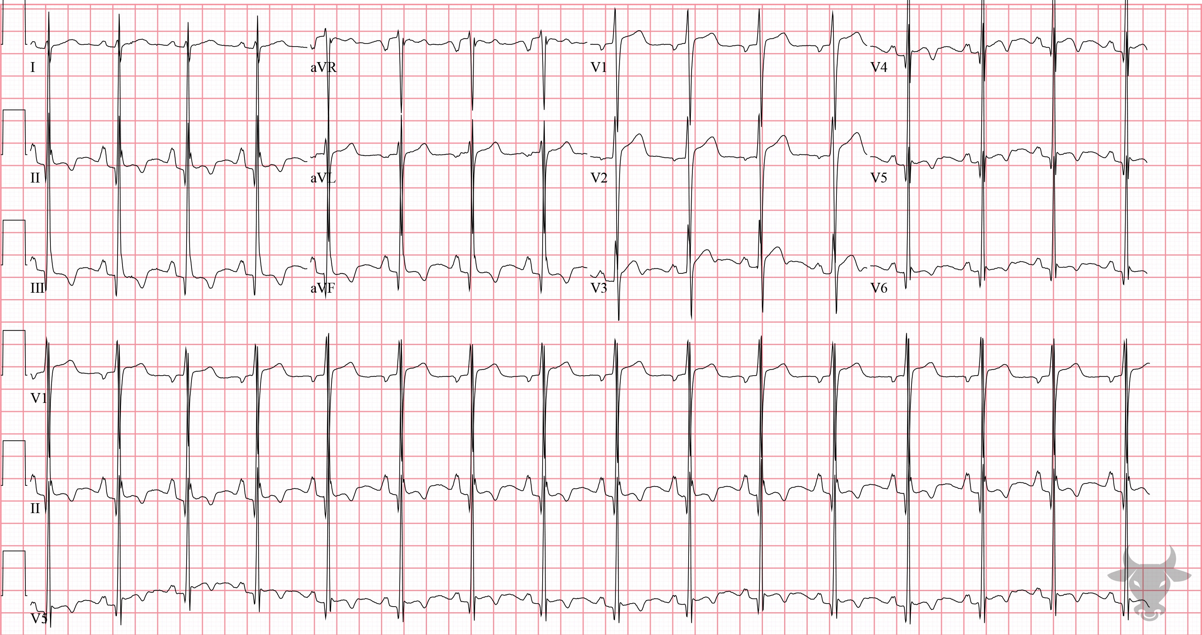
Notes:
Pseudo-Left Ventricular Hypertrophy.
Pseudo-Left Ventricular Hypertrophy, Pseudo-Right Atrial Enlargement, T-wave Inversions. This ECG is a mimic of left ventricular hypertrophy and right atrial enlargement in a very young, thin individual. Just as increased soft-tissue impedance from adipose or edema can influence the surface ECG by dampening the conduction of electrical impulses, an especially slender body habitus can have the inverse effect. In this case, the various electrocardiographic abnormalities were simply amplifications of normal cardiac activity. One potentially helpful hint is the combination of left ventricular hypertrophy with right axis deviation – the former when truly representative of ventricular hypertrophy being more commonly associated with leftward axis deviation.

Slide 8
False Positive Activation
Left Ventricular Hypertrophy
McCabe JM, Armstrong EJ, Kulkarni A, et al. Prevalence and factors associated with false-positive ST-segment elevation myocardial infarction diagnoses at primary percutaneous coronary intervention–capable centers: a report from the Activate-SF registry. Arch Intern Med. 2012;172(11):864-871.

Slide 9


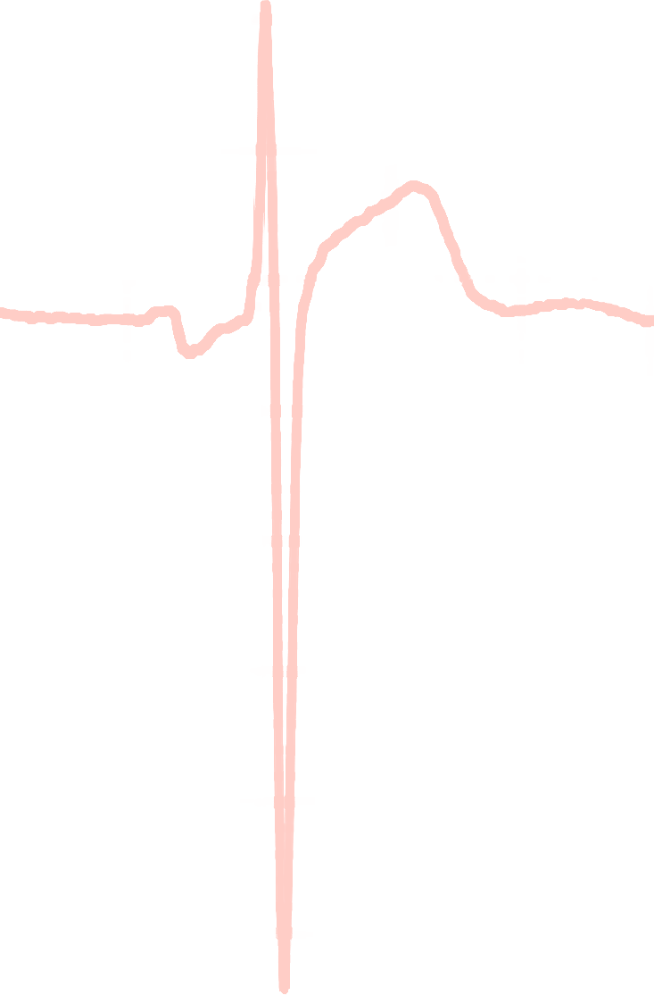

Armstrong Algorithm for STE in LVH
V1-V3
91%
Specificity
STE
R-S
STE/R-S
> 0.25?
77%
Sensitivity
Armstrong EJ, Kulkarni AR, Bhave PD, et al. Electrocardiographic criteria for ST-elevation myocardial infarction in patients with left ventricular hypertrophy. Am J Cardiol. 2012;110(7):977-983.
Notes:
Sensitivity 77%
Specificity 91%

Slide 10
30-year-old male presents with amytriptiline and olanzapine OD
37

Slide 11
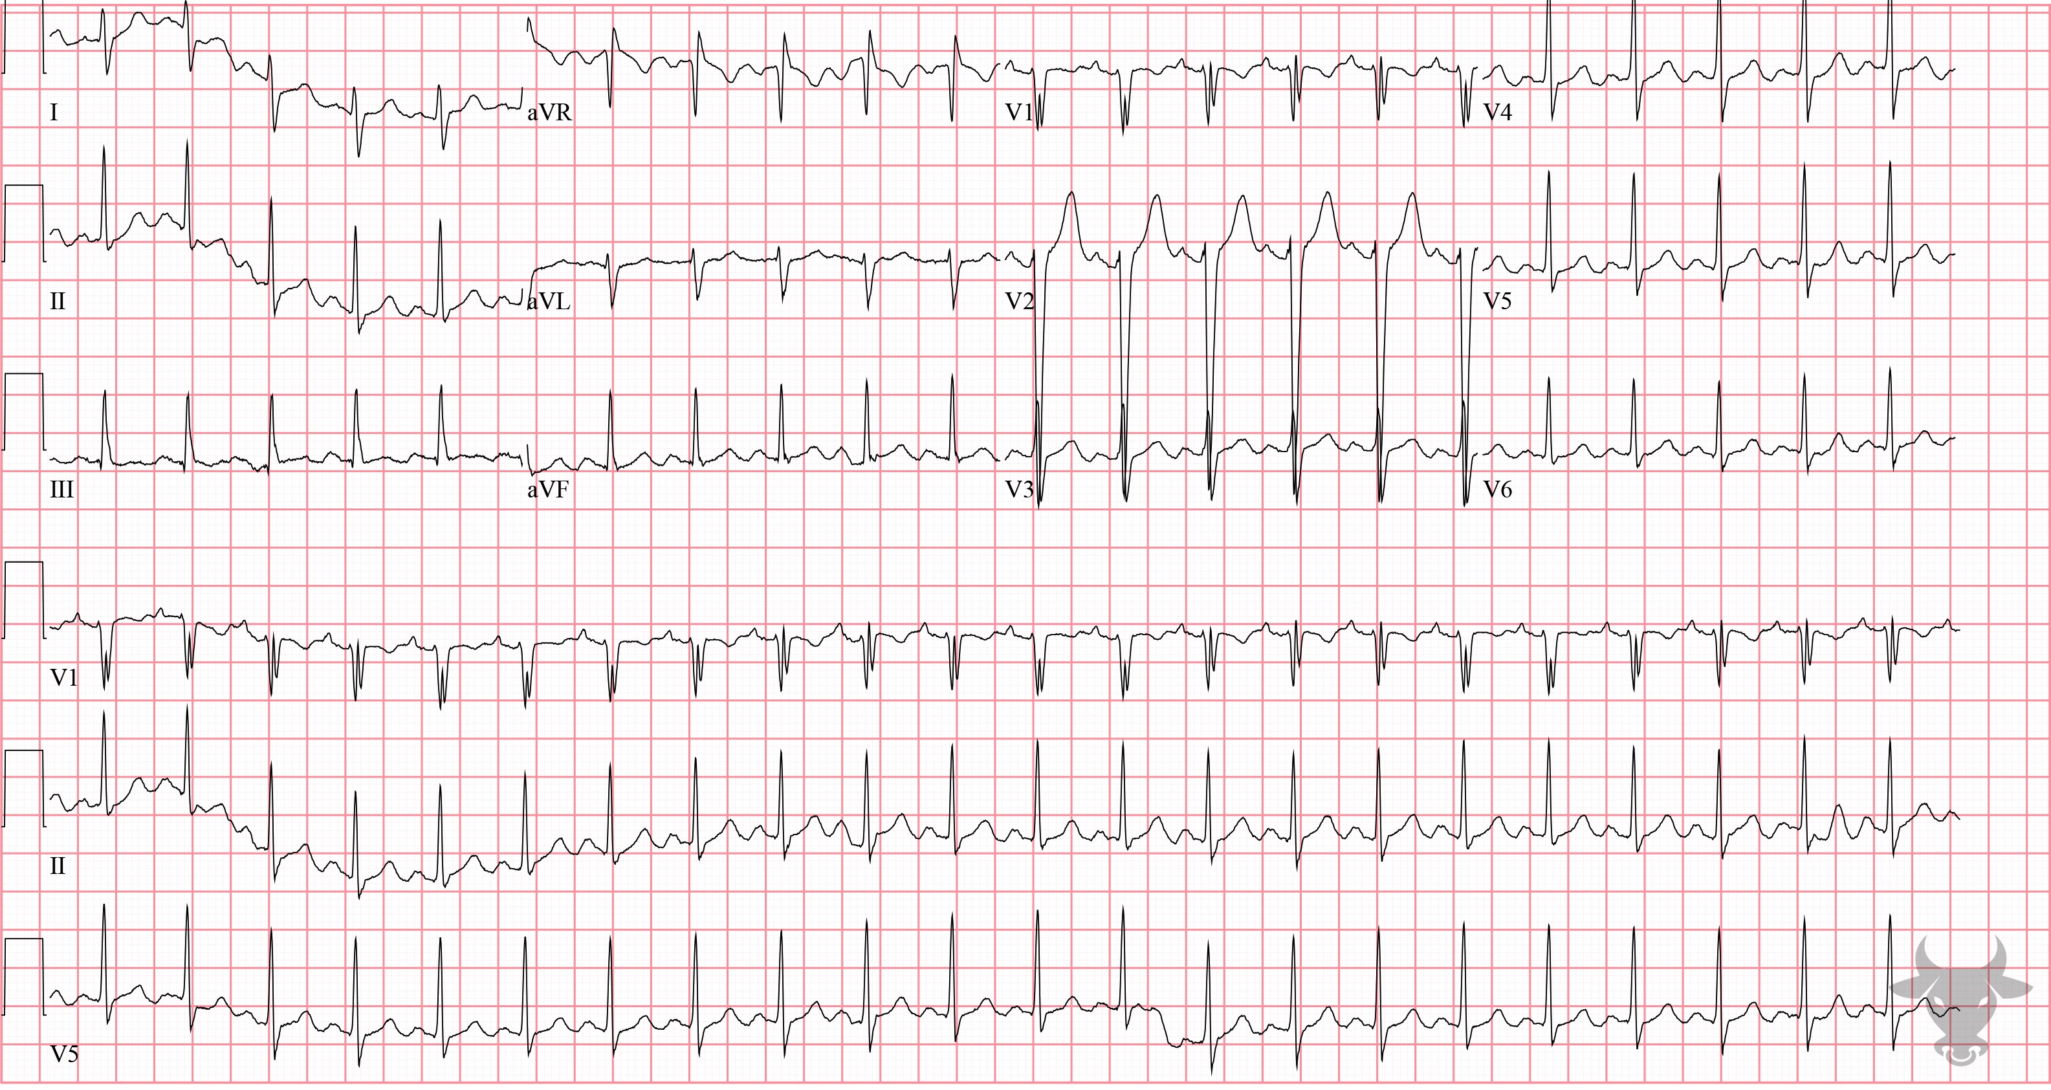
Notes:
Sodium Channel Toxicity.
Sodium Channel Toxicity. This ECG represents sodium channel toxicity in a patient with tricyclic antidepressant overdose. Features of sodium channel toxicity include right axis deviation, tall terminal R wave in aVR (Figure 16), and a slightly widened QRS complex.

Slide 12
38-year-old female presents with upper abdominal pain
38

Slide 13
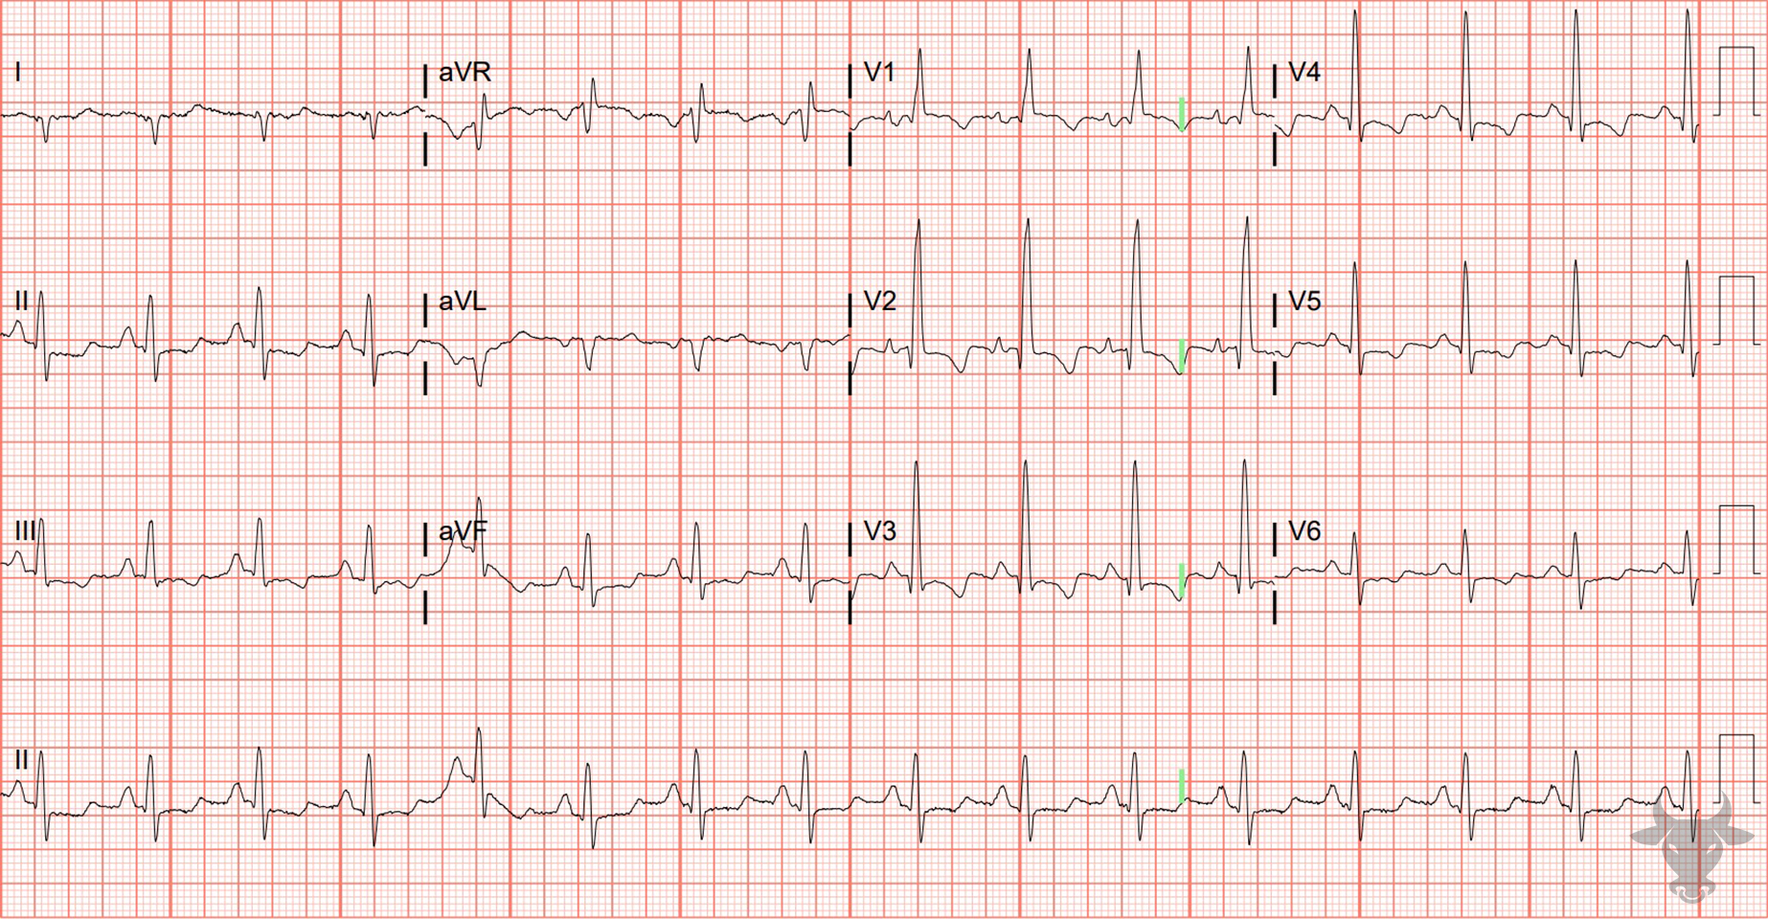
Notes:
Right Heart Strain.
Right Heart Strain, Right Atrial Enlargement, Pulmonary Embolism. This patient was diagnosed with a submassive pulmonary embolism. Findings of right heart strain in this ECG include early R wave progression, right axis deviation, right atrial enlargement, ST-segment depressions, and T-wave inversions in inferolateral leads.

