Slide 1

Conference 8
ECG STAMPEDE

Slide 2
52-year-old male presents with palpitations
29

Slide 3
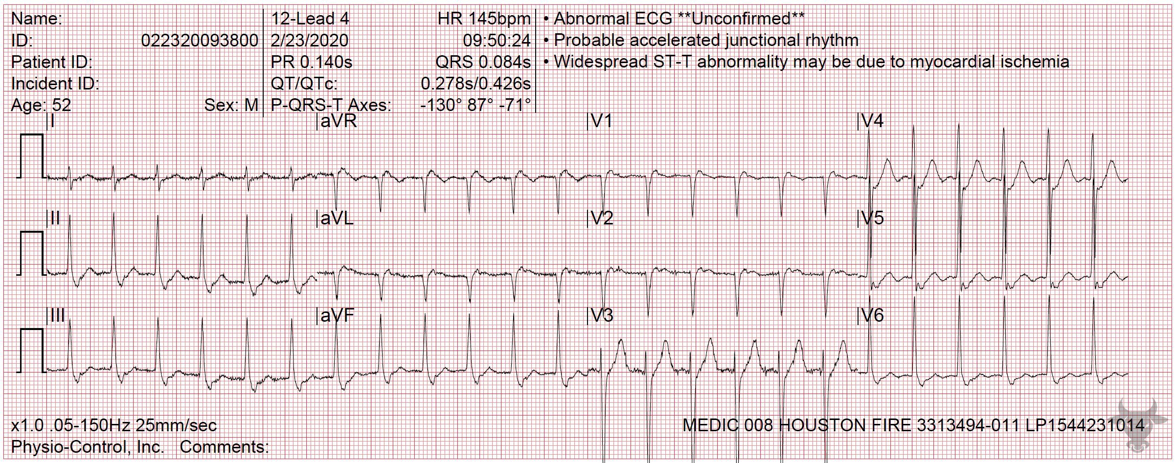
Notes:
Atrioventricular Nodal Reentrant Tachycardia.
Atrioventricular Nodal Reentrant Tachycardia. This rhythm is regular with a narrow QRS complex, and a rate of 200 beats per minute. The differential includes sinus tachycardia, atrioventricular nodal reentrant tachycardia, atrioventricular reentrant tachycardia, atrial flutter, and atrial tachycardia. The presence of retrograde P’ waves, seen immediately following the QRS complexes in lead V1 (pseudo-R waves, Figure 13) confirms the diagnosis of atrioventricular nodal reentrant tachycardia. Adenosine was administered, and the rhythm converted to sinus.

Slide 4
46-year-old male presents with ICD firing
30

Slide 5
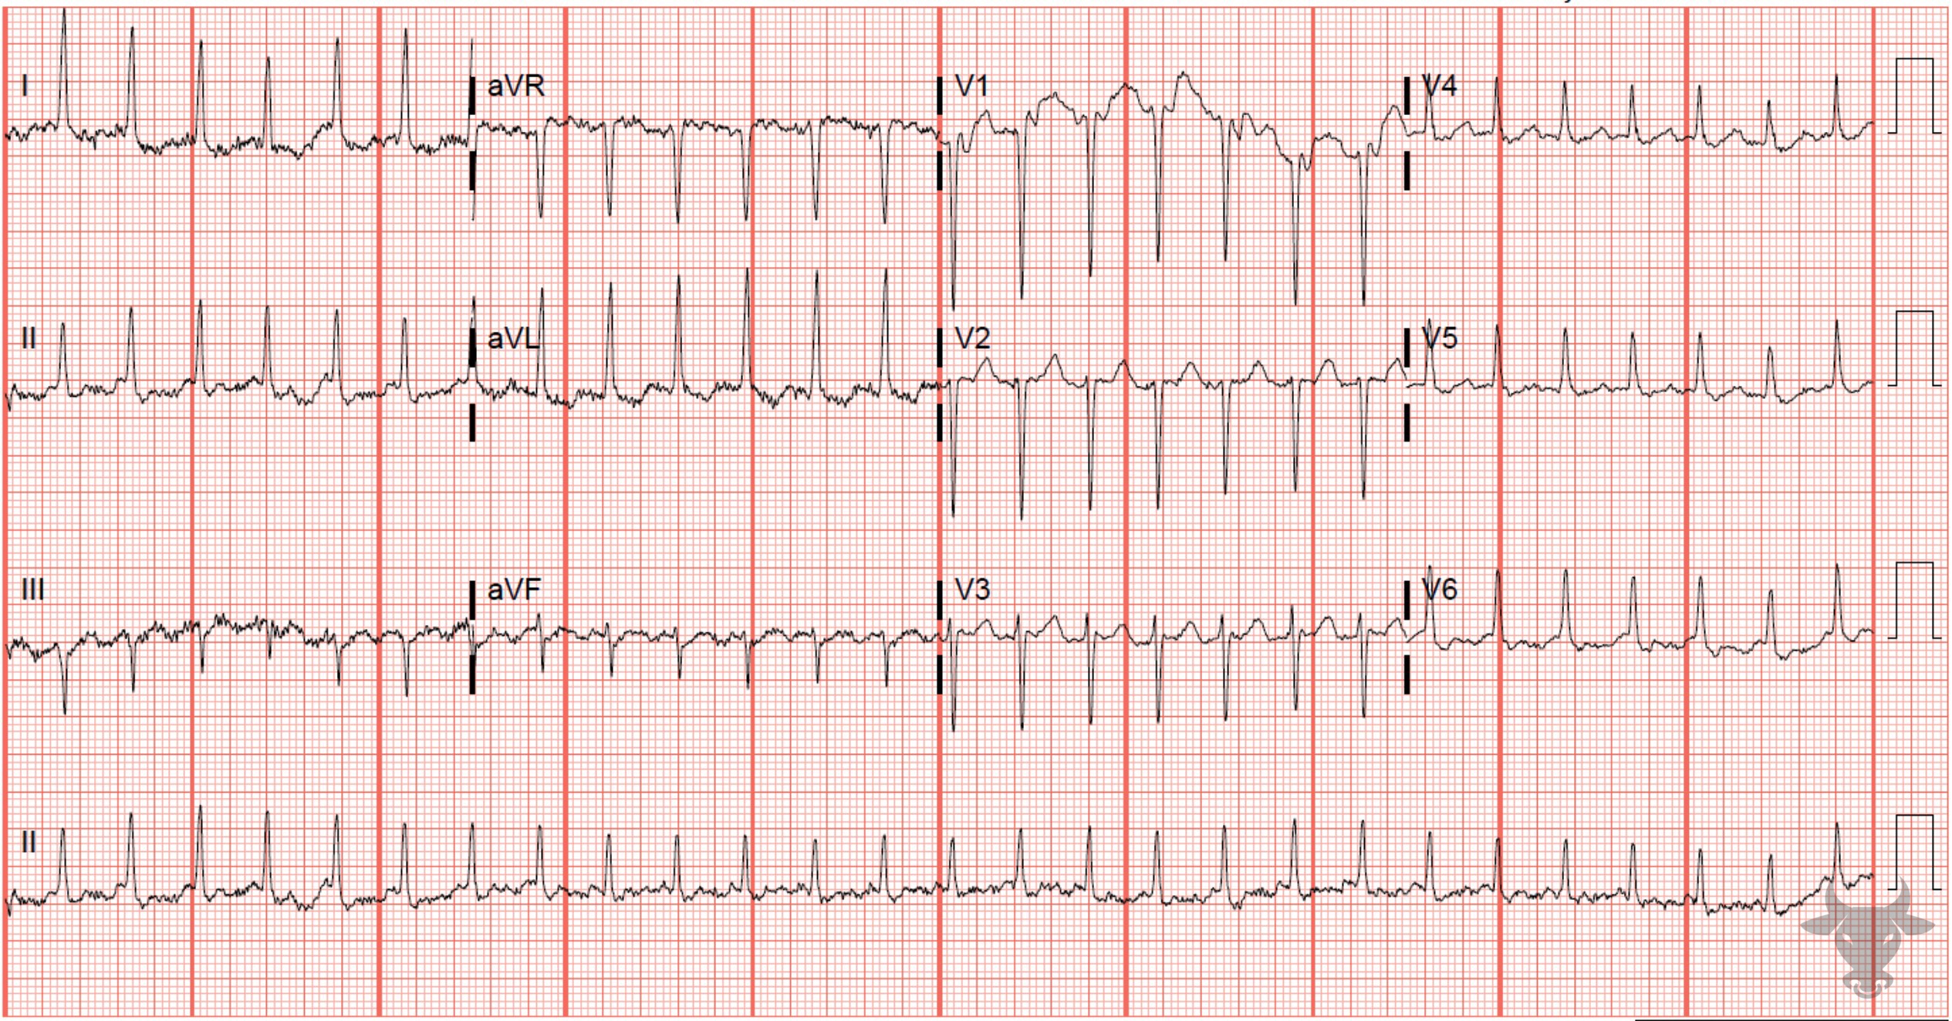
Notes:
Atrial Flutter with 2:1 Conduction.
Atrial Flutter with 2:1 Conduction. The subsequent ECG was performed with the Lewis lead and unmasked the underlying 2:1 conduction. The Lewis lead describe a different positioning of the limb leads in order to better visualize atrial activity (Figure 14). Upright P waves with an atrial rate of about 280 bpm are best visualized in leads I and II (Figure 15).

Slide 6
26-year-old male presents with palpitations
31

Slide 7

Notes:
Atypical right bundle branch block, Atrial Fibrillation.
Atypical right bundle branch block, Atrial Fibrillation with Rapid Ventricular Response. Atypical right bundle branch block pattern in a patient with known Ebstein anomaly (i.e., downward displacement of the tricuspid valve). Right bundle branch block is present in most cases of Ebstein anomaly, but the pattern is usually atypical (i.e., the QRS complex in the right precordial leads, V1 through V3, tends to be polyphasic and Q waves are often present in V1).

Slide 8
36-year-old male presents with palpitations
32

Slide 9
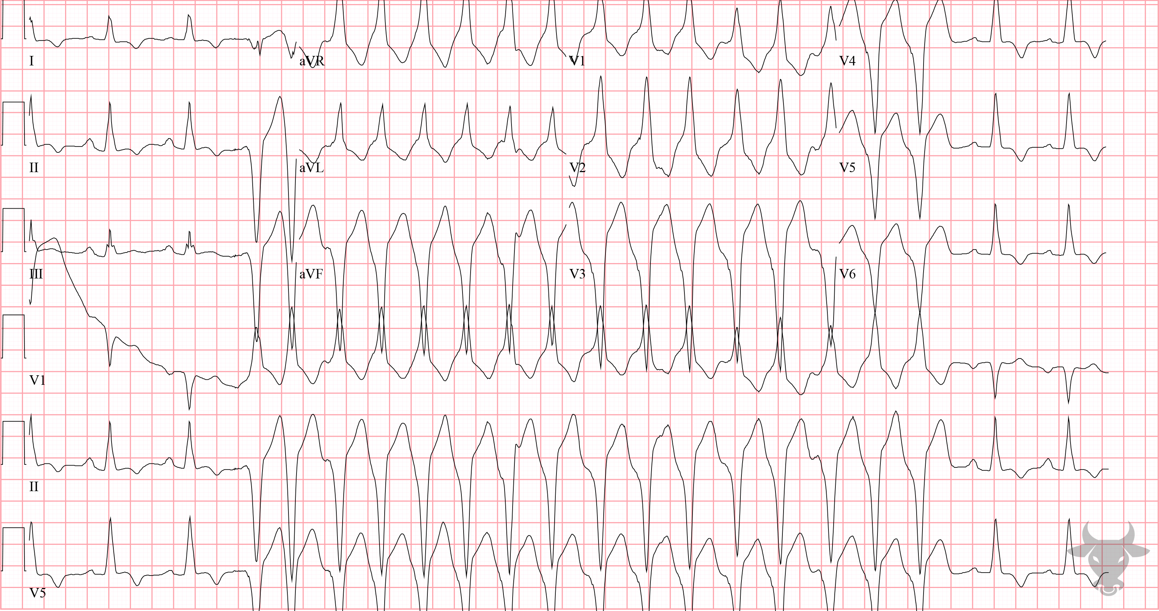
Notes:
Nonsustained Ventricular Tachycardia.
Nonsustained Ventricular Tachycardia. There is a run of nonsustained ventricular tachycardia in a patient with known hypertrophic cardiomyopathy. Nonsustained ventricular tachycardia is defined by at least three beats and no more than 30 seconds of consecutive complexes originating from the ventricles at a rate of greater than 100 beats per minute.

Slide 10
60-year-old male presents with confusion & chest pain
33

Slide 11
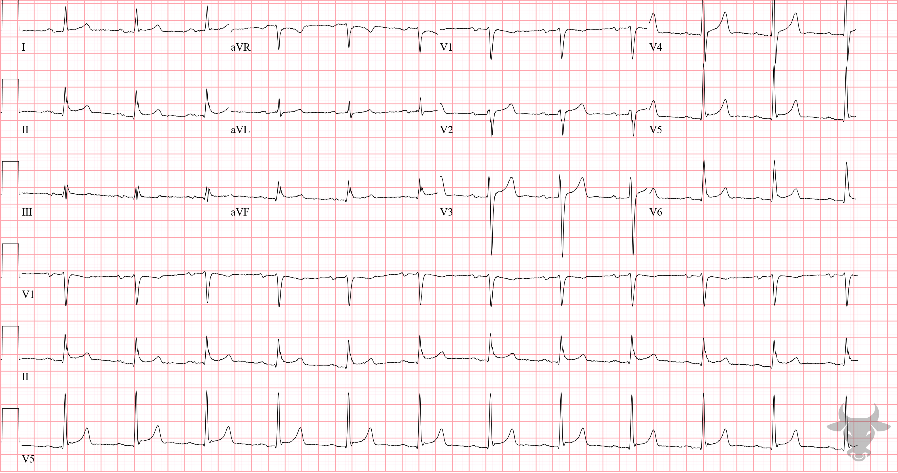
Notes:
Acute Pericarditis.
Acute Pericarditis. Features of acute pericarditis include diffuse, concave up ST-segment elevations without reciprocal changes, and PR depression (with PR elevation in aVR). The diagnosis is made by meeting two of four criteria:
Typical symptoms (pleuritic, sharp chest pain relieved when leaning forward)
New pericardial effusion
Presence of friction rub
Typical ECG findings
This patient had worsening renal failure associated with profound uremia, typical symptoms of acute pericarditis, and a new pericardial effusion. He was diagnosed with uremic encephalopathy and uremic pericarditis, both of which improved with serial dialysis sessions.

Slide 12
STEMI vs Pericarditis Odds Ratios
ST Dep
Witting, M. D., Hu, K. M., Westreich, A. A., Tewelde, S., Farzad, A., & Mattu, A. (2020). Evaluation of Spodick’s Sign and Other Electrocardiographic Findings as Indicators of STEMI and Pericarditis. The Journal of Emergency Medicine. https://doi.org/10.1016/j.jemermed.2020.01.017

Slide 13

ECG Stages of Pericarditis
Stage 1
Stage 2
Stage 3
Stage 4

