Slide 1

Conference 7
ECG STAMPEDE

Slide 2
59-year-old male presents with presents status post arrest
25

Slide 3
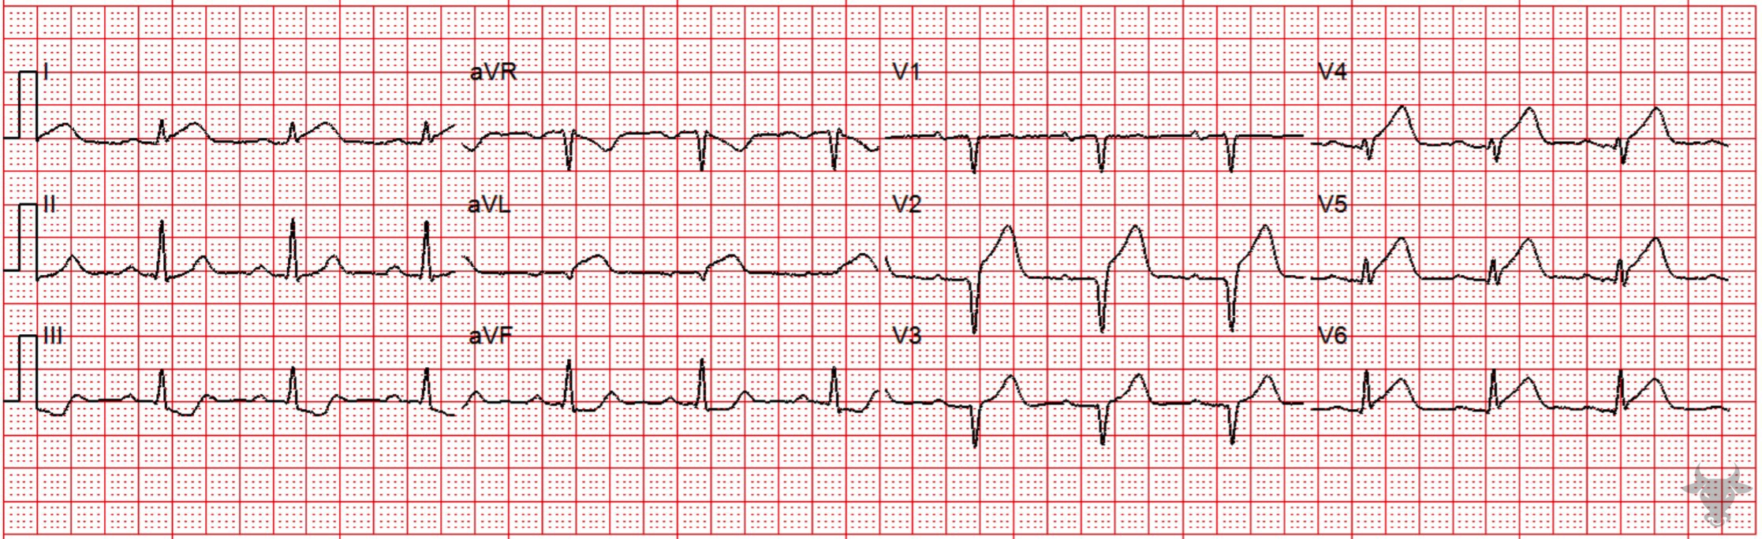

Notes:
Anterior ST-elevation Myocardial Infarction.
Anterior ST-elevation Myocardial Infarction, Hyperacute T Waves. Hyperacute T waves, ST-segment elevation, and ST-segment straightening are present across the precordium. Note that the amplitudes of the T waves in V4 and V5 are greater than the QRS complexes. The relative size of the T waves makes them “hyperacute,” an early indicator of coronary occlusion. This patient had a proximal left anterior descending artery occlusion and received successful percutaneous coronary intervention.

Slide 4
79-year-old female presents with syncope
26

Slide 5
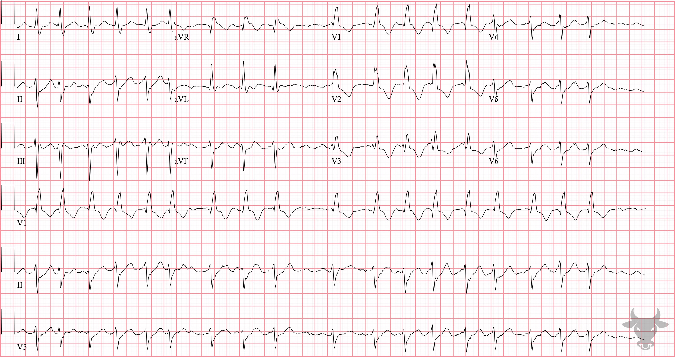
Notes:
Right Bundle Branch Block.
Right Bundle Branch Block, Atrial Fibrillation. The irregularly irregular rhythm is the result of atrial fibrillation. There is a rate-dependent right bundle branch block that resolves at lower rates (see the post-conversion ECG). At higher rates, diseased fascicles can fail.

Slide 6
67-year-old female presents with syncope
27

Slide 7
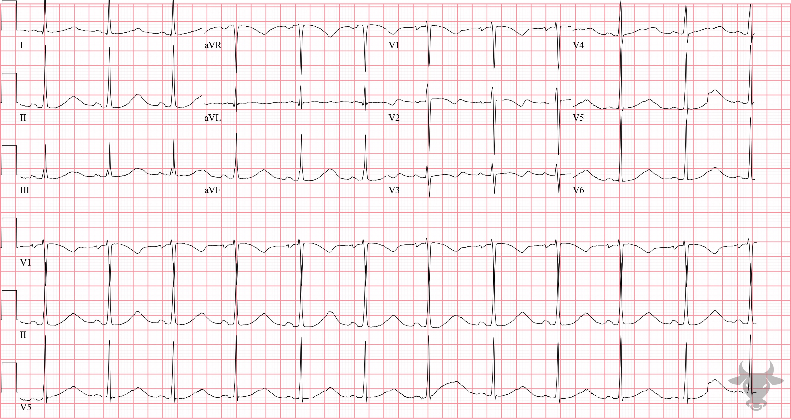
Notes:
Prolonged QT.
Prolonged QT. The prolonged QT interval was likely drug-induced. This patient was on several QT-prolonging medications including amiodarone, metoclopramide, and ondansetron. Measuring the QT can be challenging, and many different methods exist. One simple method is the “half the RR” rule – the QT interval is prolonged if it occupies more than half the R-R interval (Figure 12).

Slide 8
89-year-old male presents with dyspnea
28

Slide 9
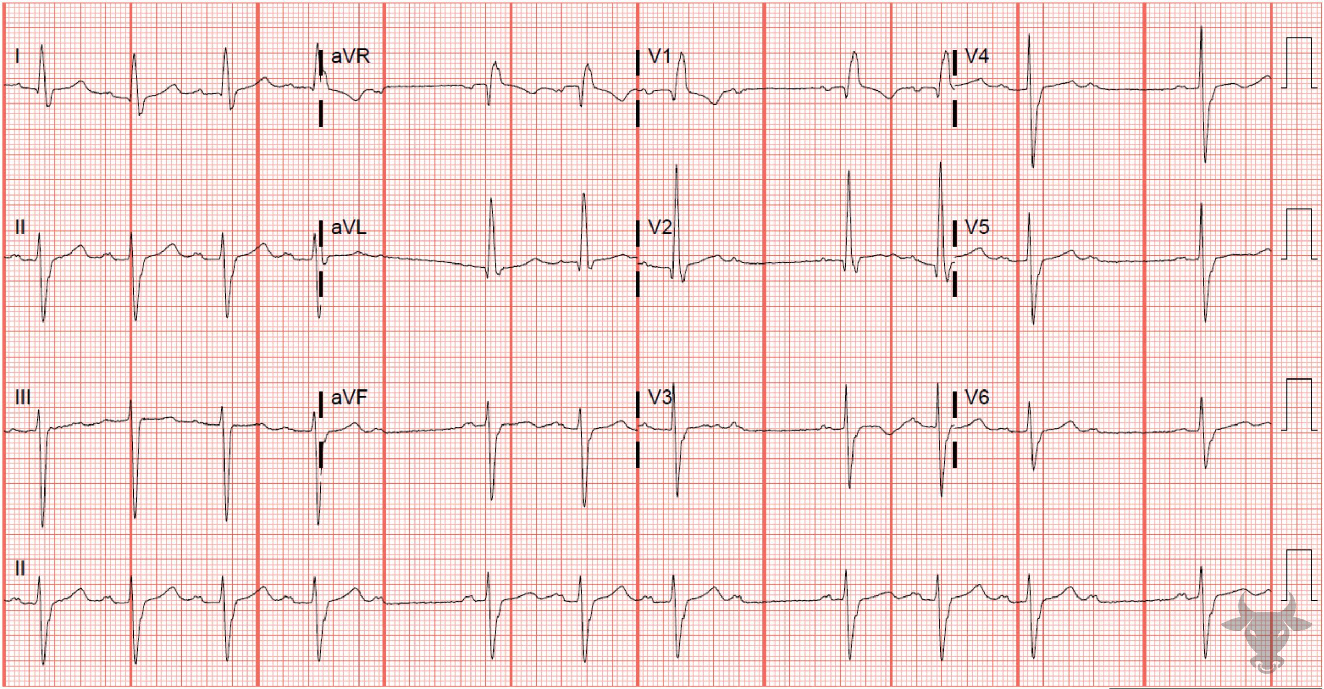
Notes:
Second Degree Atrioventricular Block - Mobitz I.
Second Degree Atrioventricular Block - Mobitz I, Trifascicular Disease. Second degree atrioventricular block, Mobitz I associated with right bundle branch block and left anterior fascicular block. This represents trifascicular disease, and the patient is at risk for progression to complete heart block. The subsequent ECG demonstrates progression to complete heart block with junctional escape.

