Slide 1

Conference 6
ECG STAMPEDE

Slide 2
62-year-old male presents with dyspnea
21

Slide 3
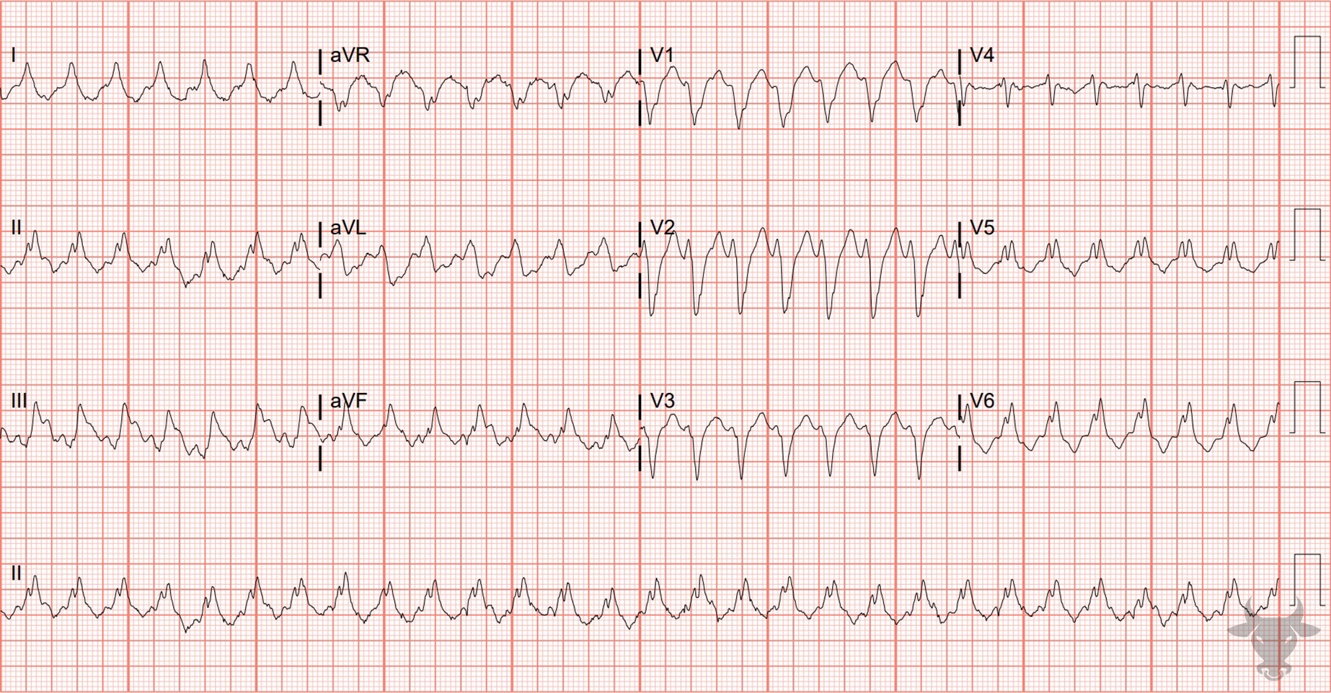

Notes:
Ventricular Tachycardia.
Ventricular Tachycardia. The differential for regular wide complex tachycardia includes ventricular tachycardia, supraventricular tachycardia with aberrancy, antidromic atrioventricular reentrant tachycardia, and toxicologic/metabolic disturbances. Josephson's sign, notching near the nadir of the S wave, can be seen in V1 and V2, and suggests ventricular tachycardia (Figure 11). This patient was ultimately diagnosed with ventricular tachycardia.

Slide 4
73-year-old male presents with palpitations
22

Slide 5
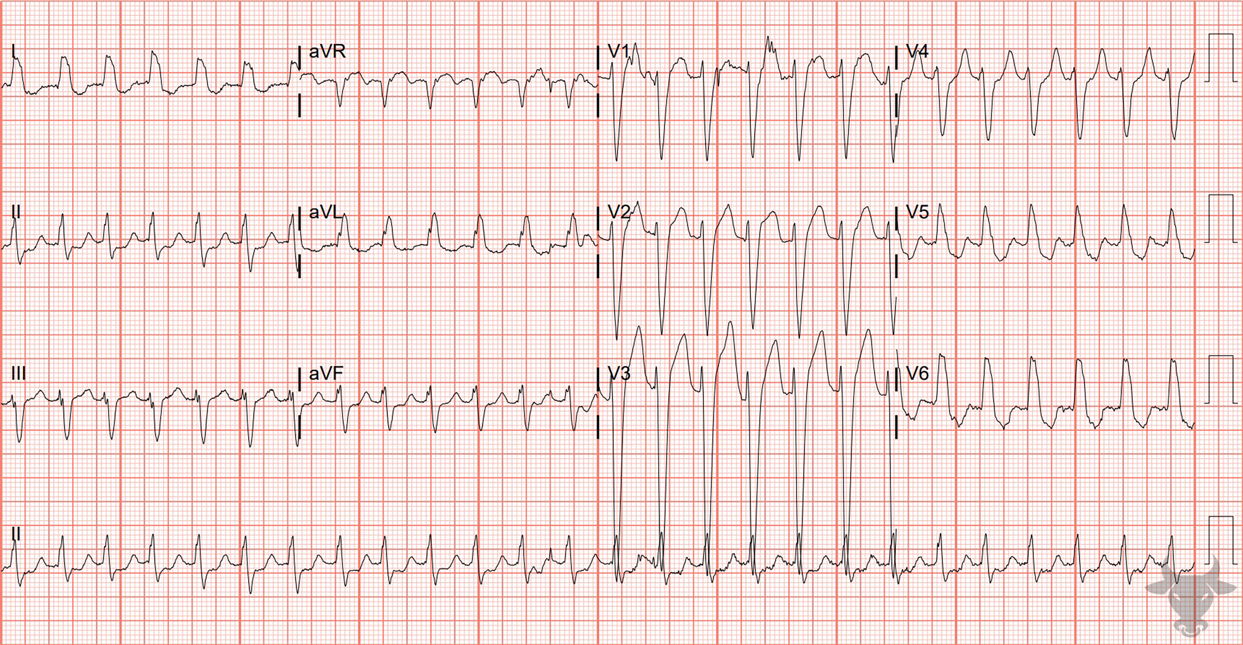
Notes:
Supraventricular Tachycardia with Aberrancy.
Supraventricular Tachycardia with Aberrancy. The differential for regular wide complex tachycardia includes ventricular tachycardia, supraventricular tachycardia with aberrancy, antidromic atrioventricular reentrant tachycardia, and toxicologic/metabolic disturbances. The wide complex seen here was exactly consistent with the patient's known left bundle branch block. This is one instance when supraventricular tachycardia with aberrancy can be reliably diagnosed. This patient was successfully converted with adenosine. The prior ECG shows a left bundle branch block pattern with a wide and negatively deflected QRS complex in V1, and broad, monophasic R waves in the lateral leads (I, aVL, V5, V6). Note the expected discordant ST changes (i.e., ST deviations in the opposite direction of the QRS complexes).

Slide 6
47-year-old male presents with chest pain
23

Slide 7
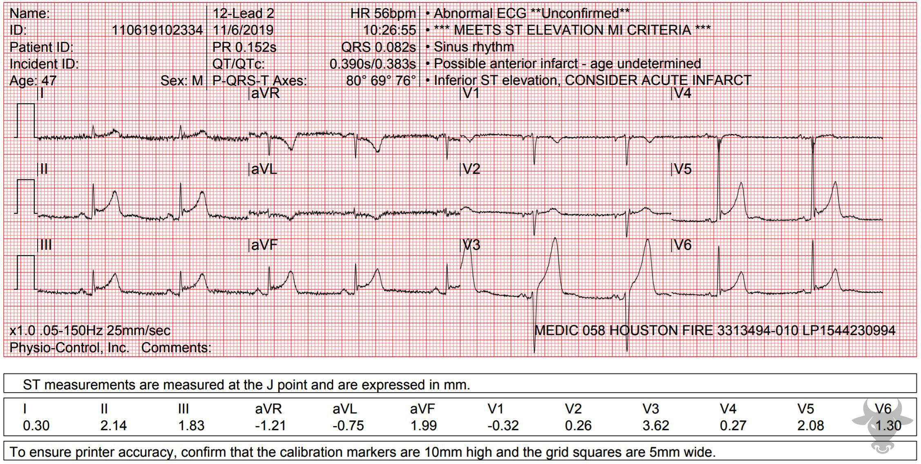
Notes:
Inferior ST-elevation Myocardial Infarction.
Inferior ST-elevation Myocardial Infarction. The concave up ST-segment morphology along with the J wave notching might suggest early repolarization; however, the T wave inversion and slight ST-segment depression in aVL strongly suggests inferior myocardial infarction. Left heart catheterization revealed an occluded distal right coronary artery and percutaneous intervention was successful.

Slide 8
82-year-old female presents with episodic syncope
24

Slide 9
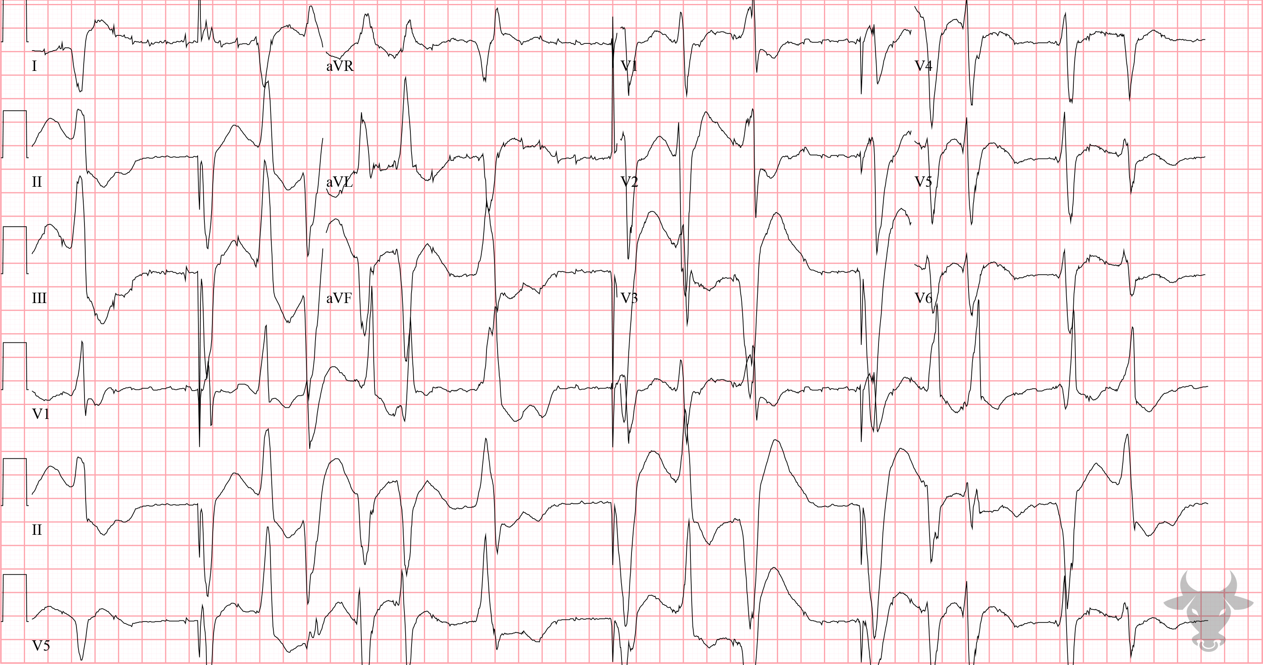
Notes:
Hypokalemia.
Hypokalemia. This bizarre rhythm was due to severe hypokalemia, which is known to increase automaticity. Frequent ventricular ectopy in the setting of severe hypokalemia places this patient at risk for torsade de pointes. This patient’s potassium was 1.8 mEq/L at the time of the ECG likely related to overuse of diuretics. The ectopy resolved with electrolyte repletion and a normal rhythm was restored.

