Slide 1

Conference 5
ECG STAMPEDE

Slide 2
69-year-old female presents with post-op infection
17

Slide 3
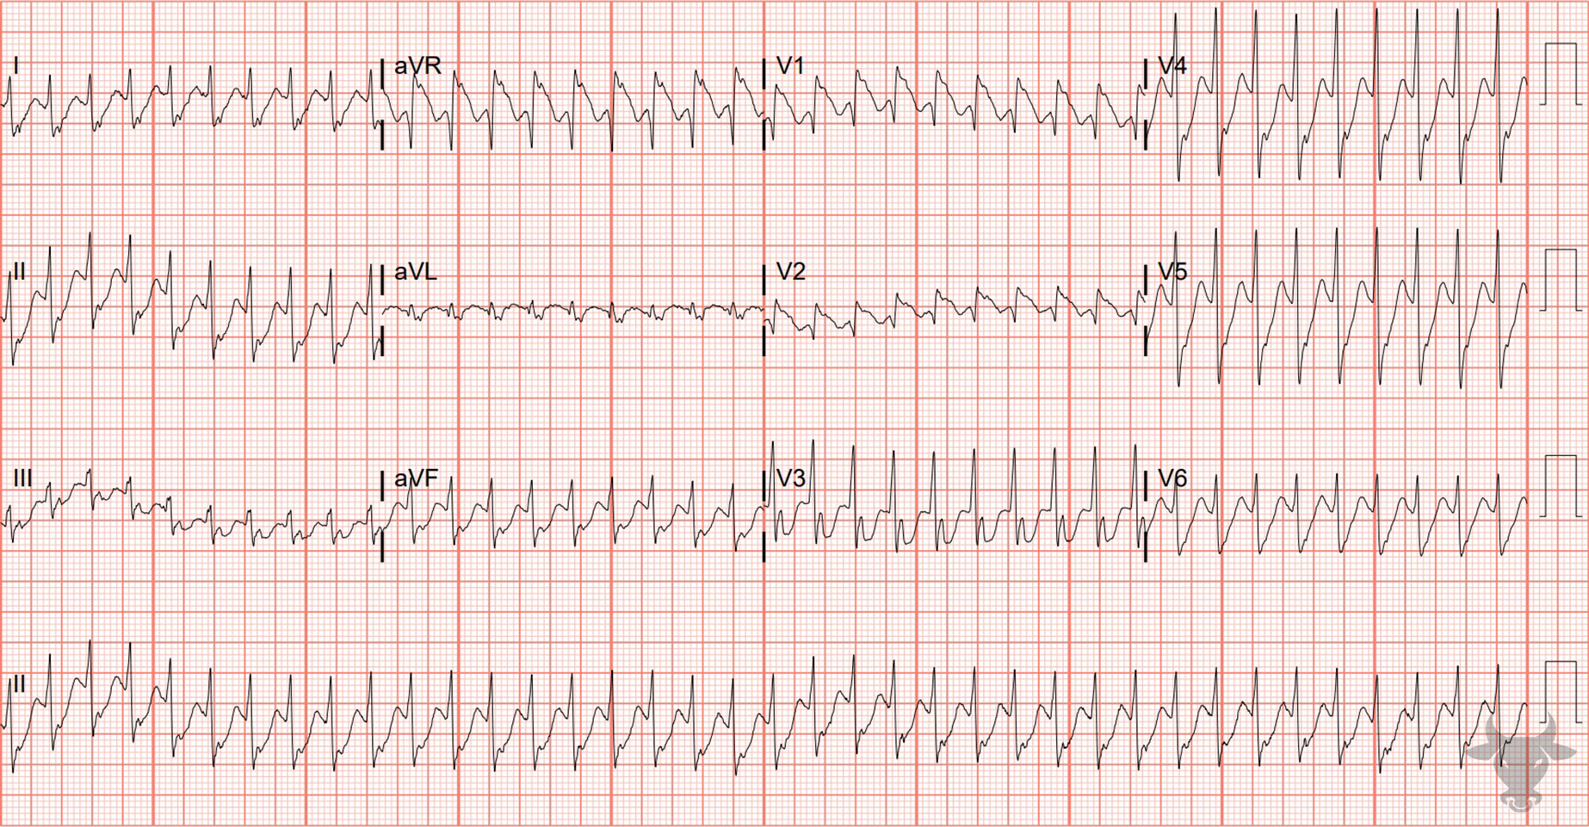

Notes:
Ventricular Tachycardia.
Ventricular Tachycardia. The differential for regular wide complex tachycardia includes ventricular tachycardia, supraventricular tachycardia with aberrancy, antidromic atrioventricular reentrant tachycardia, and toxicologic/metabolic disturbances. The right bundle branch block pattern with the first R larger than the r' in V1 is very specific for ventricular tachycardia.

Slide 4
61-year-old female presents with inactive chest pain
18

Slide 5
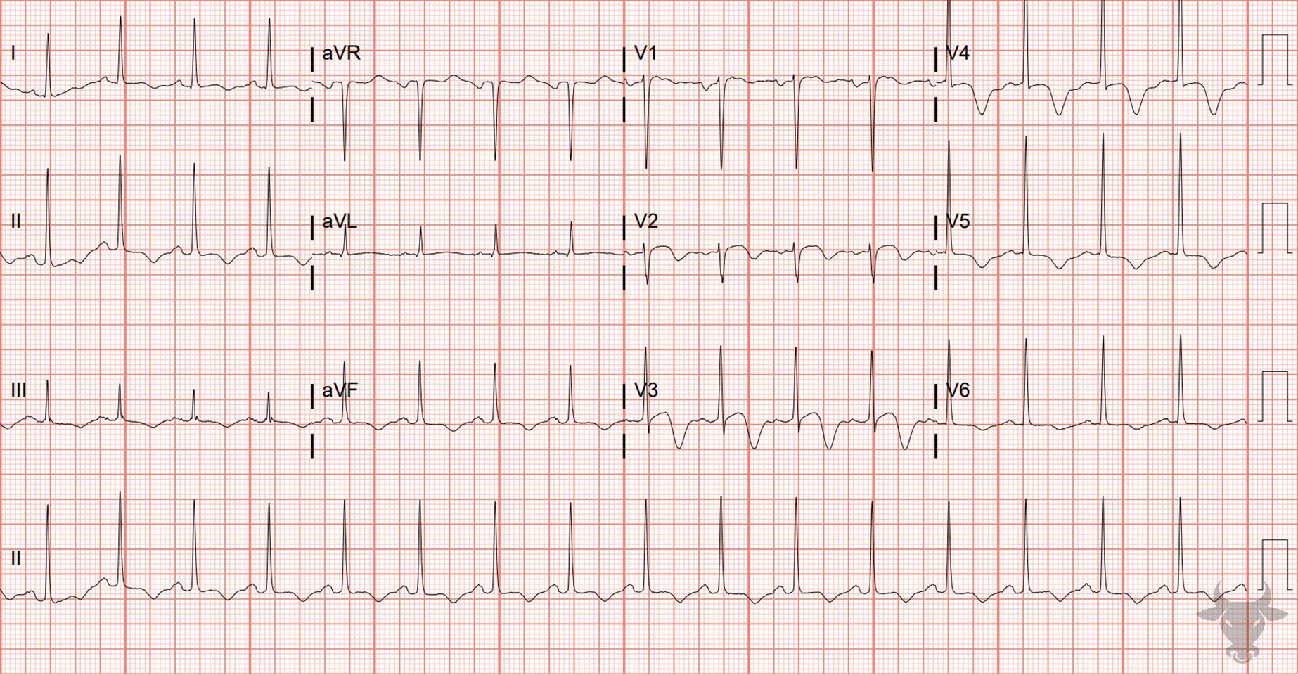
Notes:
Wellens Syndrome.
Wellens Syndrome. The presence of deep, symmetric T wave inversions in anterior precordial leads (Figure 9) is suggestive of Wellens syndrome in the appropriate clinical context.
Wellens syndrome is characterized by:
Biphasic T-waves with a terminal negative deflection (Type A) or deep and symmetric inverted T-waves in V2/V3 (Type B),
ECG findings present in pain-free state, and
normal or minimally elevated cardiac biomarkers.
The syndrome is suggestive of critical left anterior descending artery stenosis. Left heart catheterization revealed a 95% proximal left anterior descending artery stenosis.

Slide 6
83-year-old female presents with palpitations
19

Slide 7
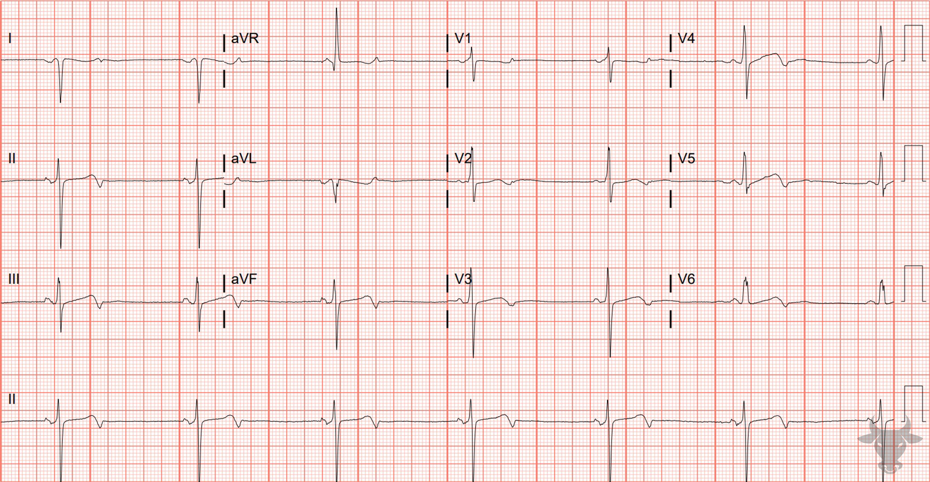
Notes:
Limb Lead Reversal.
Limb Lead Reversal, Sinus Bradycardia. The extreme right axis, abnormal P wave axis (i.e., positively deflected in aVR), and concordance of complexes in aVR and V6 strongly suggest limb lead reversal (i.e., when opposing leads like aVR and V6 show QRS complexes traveling in the same direction, limb lead reversal is likely). The subsequent ECG was performed with corrected lead placement. The rhythm is sinus bradycardia and there are terminal T wave inversions that suggest ischemia; however, left heart catheterization revealed coronary ectasia without obstructive disease.

Slide 8
67-year-old male presents with syncope
20

Slide 9
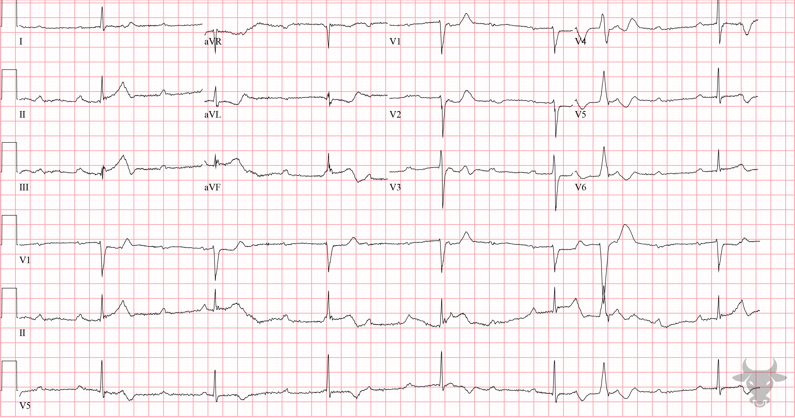
Notes:
Inferior ST-elevation Myocardial Infarction.
Inferior ST-elevation Myocardial Infarction, Third Degree Atrioventricular Block. The inferior ST segments are “straightened,” and take-off directly from the R wave - an early finding of evolving ST-segment elevation (Figure 10). There are reciprocal ST-segment depressions in aVL and V2. In the setting of inferior myocardial infarction, atrioventricular block is usually transient, due to ischemia or edema of the atrioventricular node, and resulting in a junctional escape rhythm. Left heart catheterization revealed right coronary artery occlusion and percutaneous intervention was successful. The atrioventricular block resolved, and permanent pacing was not required.

