Slide 1

Conference 4
ECG STAMPEDE

Slide 2
31-year-old male presents with weakness
13

Slide 3
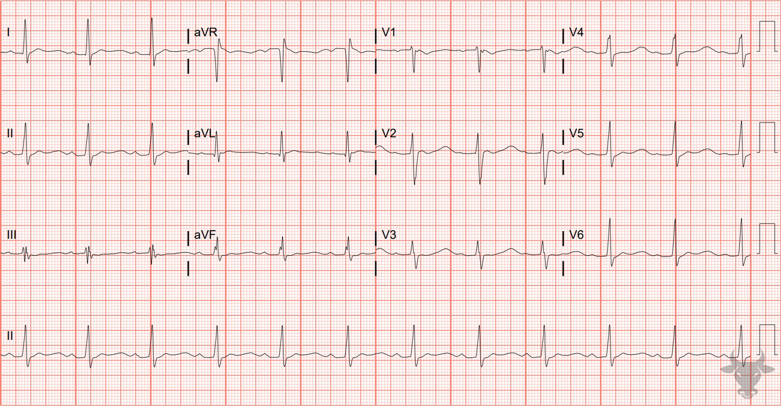

Notes:
Hypokalemia.
Hypokalemia, Prolonged QT. Hypokalemia prolongs the QT interval by way of delaying repolarization, creating a broad-based T wave, U waves, and T-U fusions (Figure 6). This patient’s potassium was 1.9 mEq/L. The repolarization changes resolved after potassium repletion.

Slide 4
81-year-old female presents with dizziness
14

Slide 5
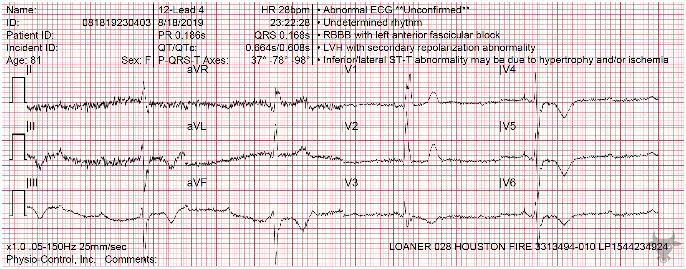
Notes:
Third Degree Atrioventricular Block with Ventricular Escape.
Third Degree Atrioventricular Block with Ventricular Escape. There is atrioventricular dissociation with QRS complexes occurring at regular intervals. The wide, and slow (<40 bpm) QRS complexes suggest a ventricular escape rhythm.

Slide 6
50-year-old male presents with chest pain
15

Slide 7
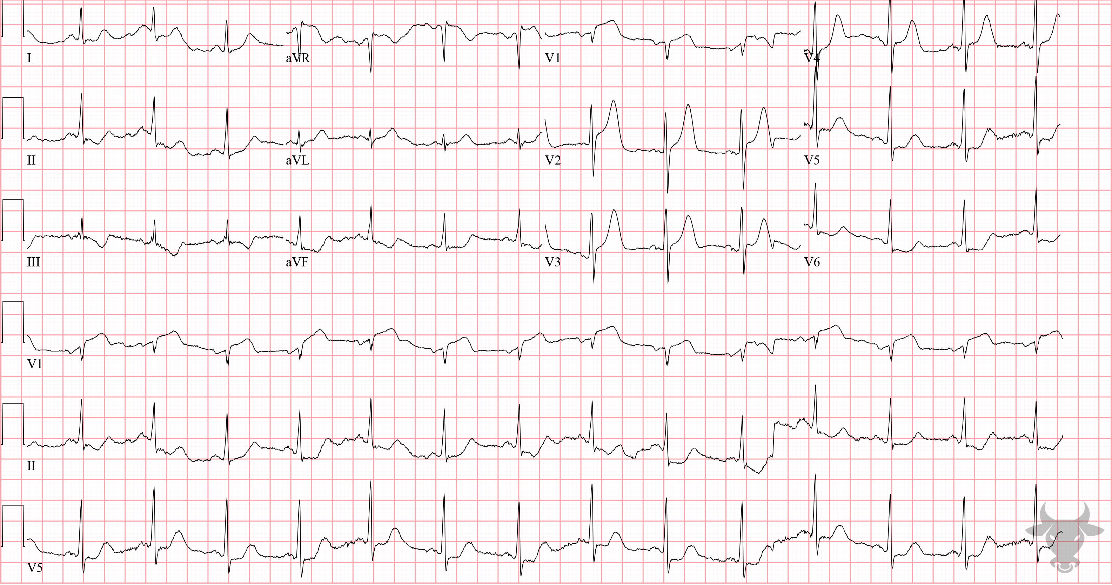
Notes:
Hyperacute T Waves.
Hyperacute T Waves, ST-elevation Myocardial Infarction. Large amplitude T waves in the anterior precordium approach the size of the QRS complexes, making them “hyperacute.” Some authors have proposed identifying hyperacute T waves using proportional T-wave “bulk,” defined by the increased area under the curve (AUC) of the T-wave relative to the QRS amplitude – meaning, when the area under the T wave is relatively large compared to the QRS complex, hyperacute T waves are likely. Hyperacute T waves, even in the absence of ST-segment elevation, can be a subtle sign of vessel occlusion and an indication for emergent reperfusion. Additional features of myocardial infarction include (reciprocal) ST-segment depressions in the inferolateral leads. Left heart catheterization revealed an acute left anterior descending artery occlusion.

Slide 8
40-year-old female presents with palpitations
16

Slide 9
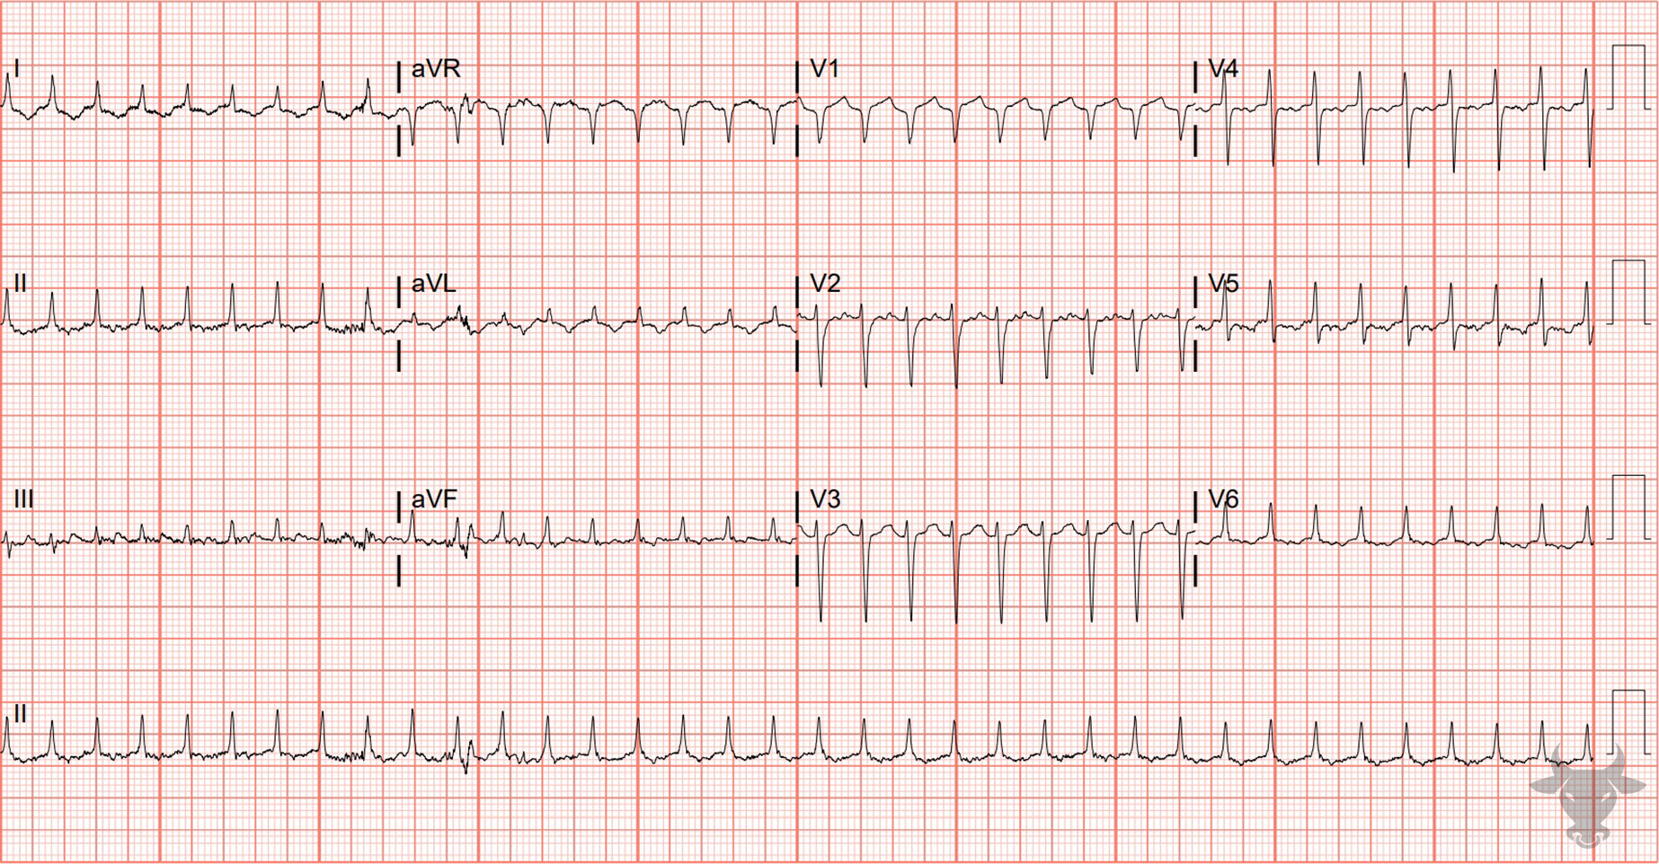
Notes:
Orthodromic Atrioventricular Tachycardia.
Orthodromic Atrioventricular Tachycardia. This regular, narrow complex tachycardia looks like any other supraventricular tachycardia; however, the post-conversion ECG clearly shows evidence of ventricular pre-excitation including a short PR interval, a slurred QRS upstroke (i.e., delta wave), and a slightly widened QRS complex (Figure 7).
The presence of ventricular pre-excitation suggests this rhythm was orthodromic conduction (Figure 8), a fact later confirmed via an electrophysiology study.

