Slide 1

Conference 36
ECG STAMPEDE

Slide 2
59-year-old male presents with dyspnea
194

Slide 3
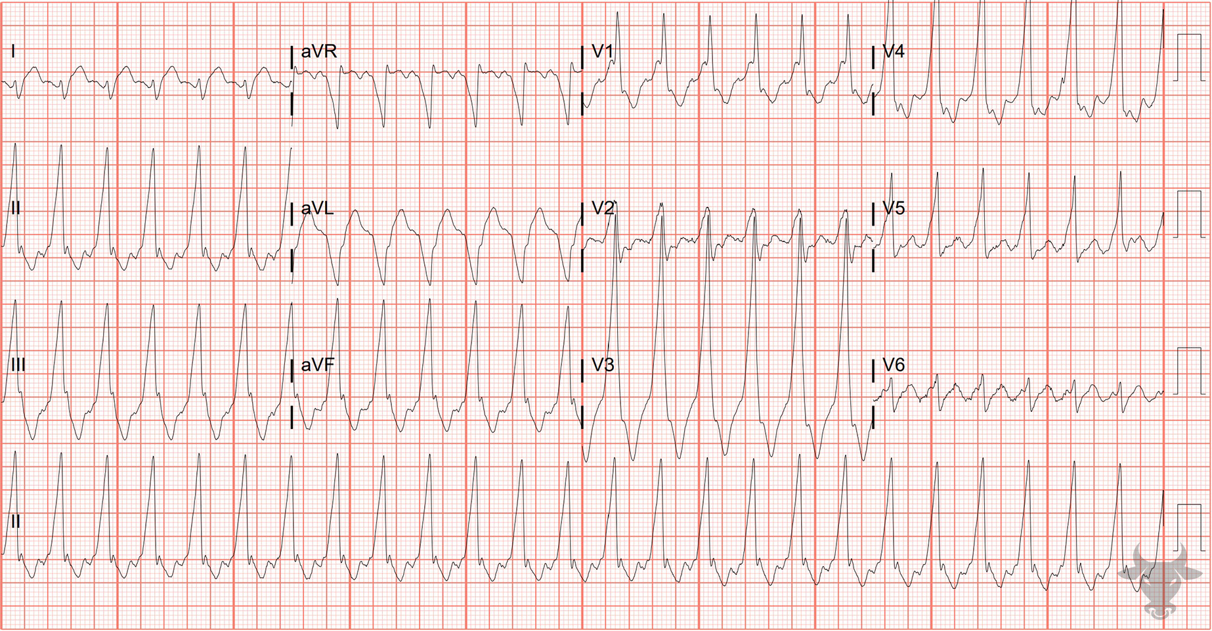
Notes:
Antidromic Atrioventricular Tachycardia.
Antidromic Atrioventricular Tachycardia. The differential for regular wide complex tachycardia includes ventricular tachycardia, supraventricular tachycardia with aberrancy, antidromic atrioventricular reentrant tachycardia, and toxicologic/metabolic disturbances. This wide complex tachycardia is essentially indistinguishable from ventricular tachycardia. The post conversion ECG demonstrates ventricular pre-excitation evidenced by the short PR interval and slurred upstroke (i.e., delta wave). Antidromic atrioventricular tachycardia is a macro reentrant circuit in which the signal travels anterograde through accessory pathway and retrograde through the atrioventricular node (Figure 8). The rhythm was subsequently confirmed via an electrophysiology study.

Slide 4
57-year-old male presents with altered mental status
195

Slide 5
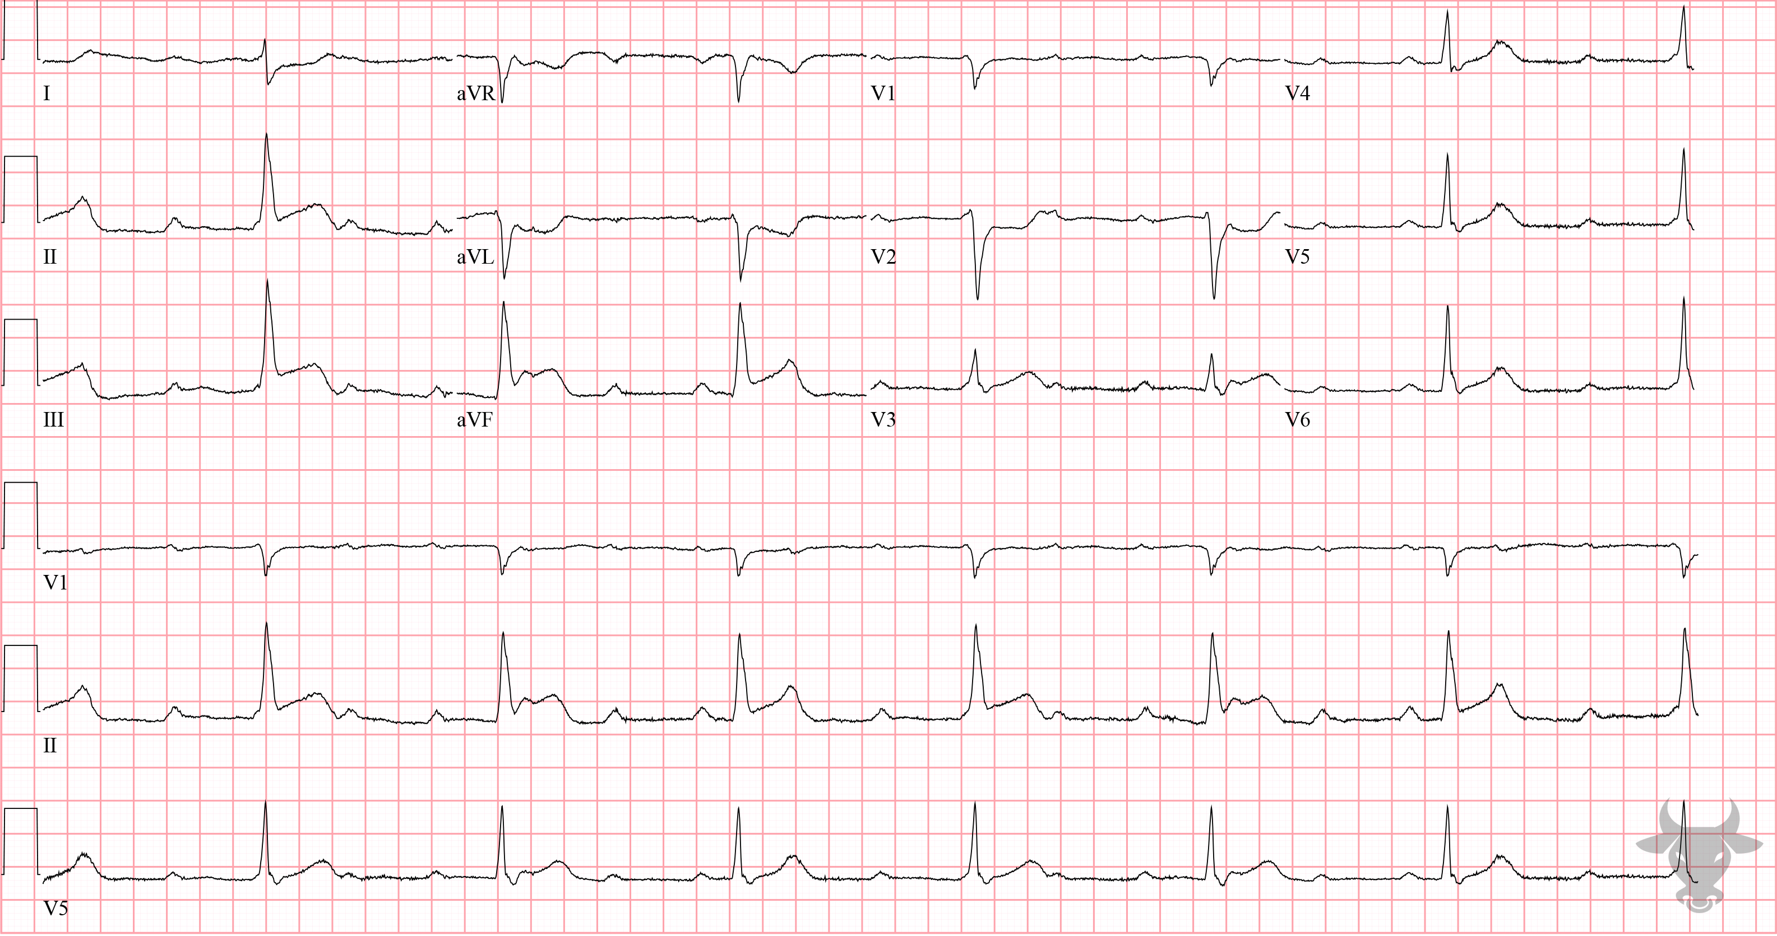
Notes:
Inferior ST-elevation Myocardial Infarction.
Inferior ST-elevation Myocardial Infarction, Third Degree Atrioventricular Block. There are inferior ST-segment elevations with reciprocal changes in I, aVL, and V2 along with atrioventricular dissociation. The narrow QRS (<120 ms) confirms junctional escape. In the setting of inferior myocardial infarction, atrioventricular block is usually transient, due to ischemia or edema of the atrioventricular node. Left heart catheterization revealed an occluded right coronary artery.

Slide 6
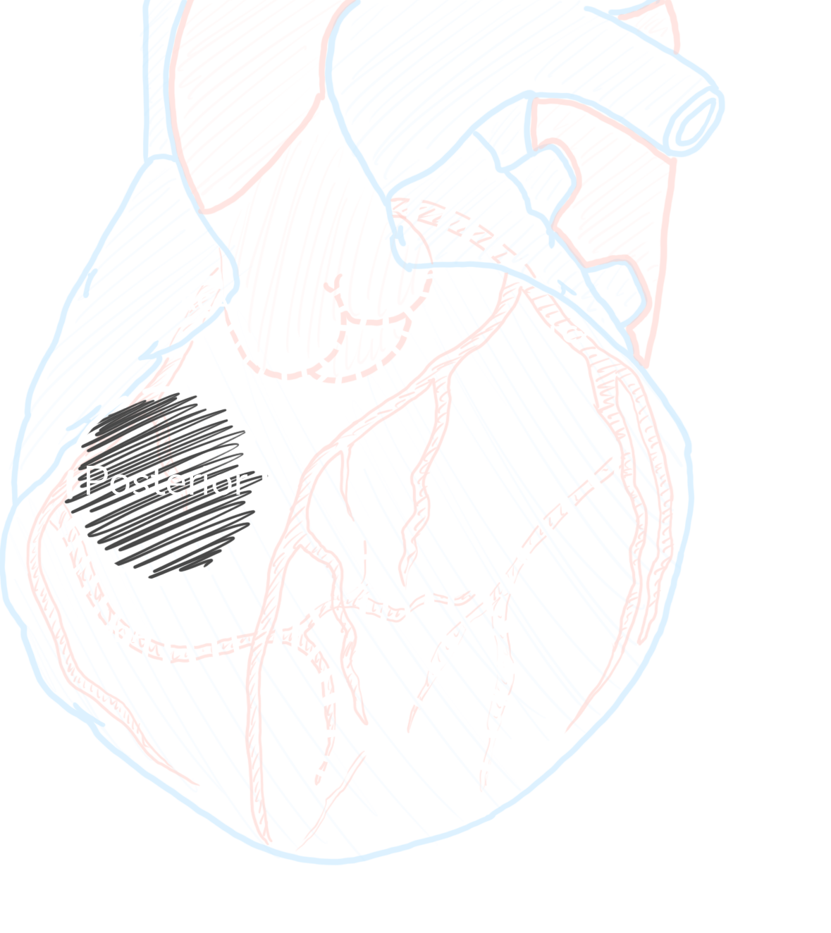


Posterior STEMI
V2 or V3
6%
Isolated Posterior
R/S ≥ 1
↑ t wave
30%
Reperfusion
< 90 min
STD
Waldo SW, Armstrong EJ, Kulkarni A, et al. Clinical characteristics and reperfusion times among patients with an isolated posterior myocardial infarction. J Invasive Cardiol. 2013;25(8):371-5.

Slide 7
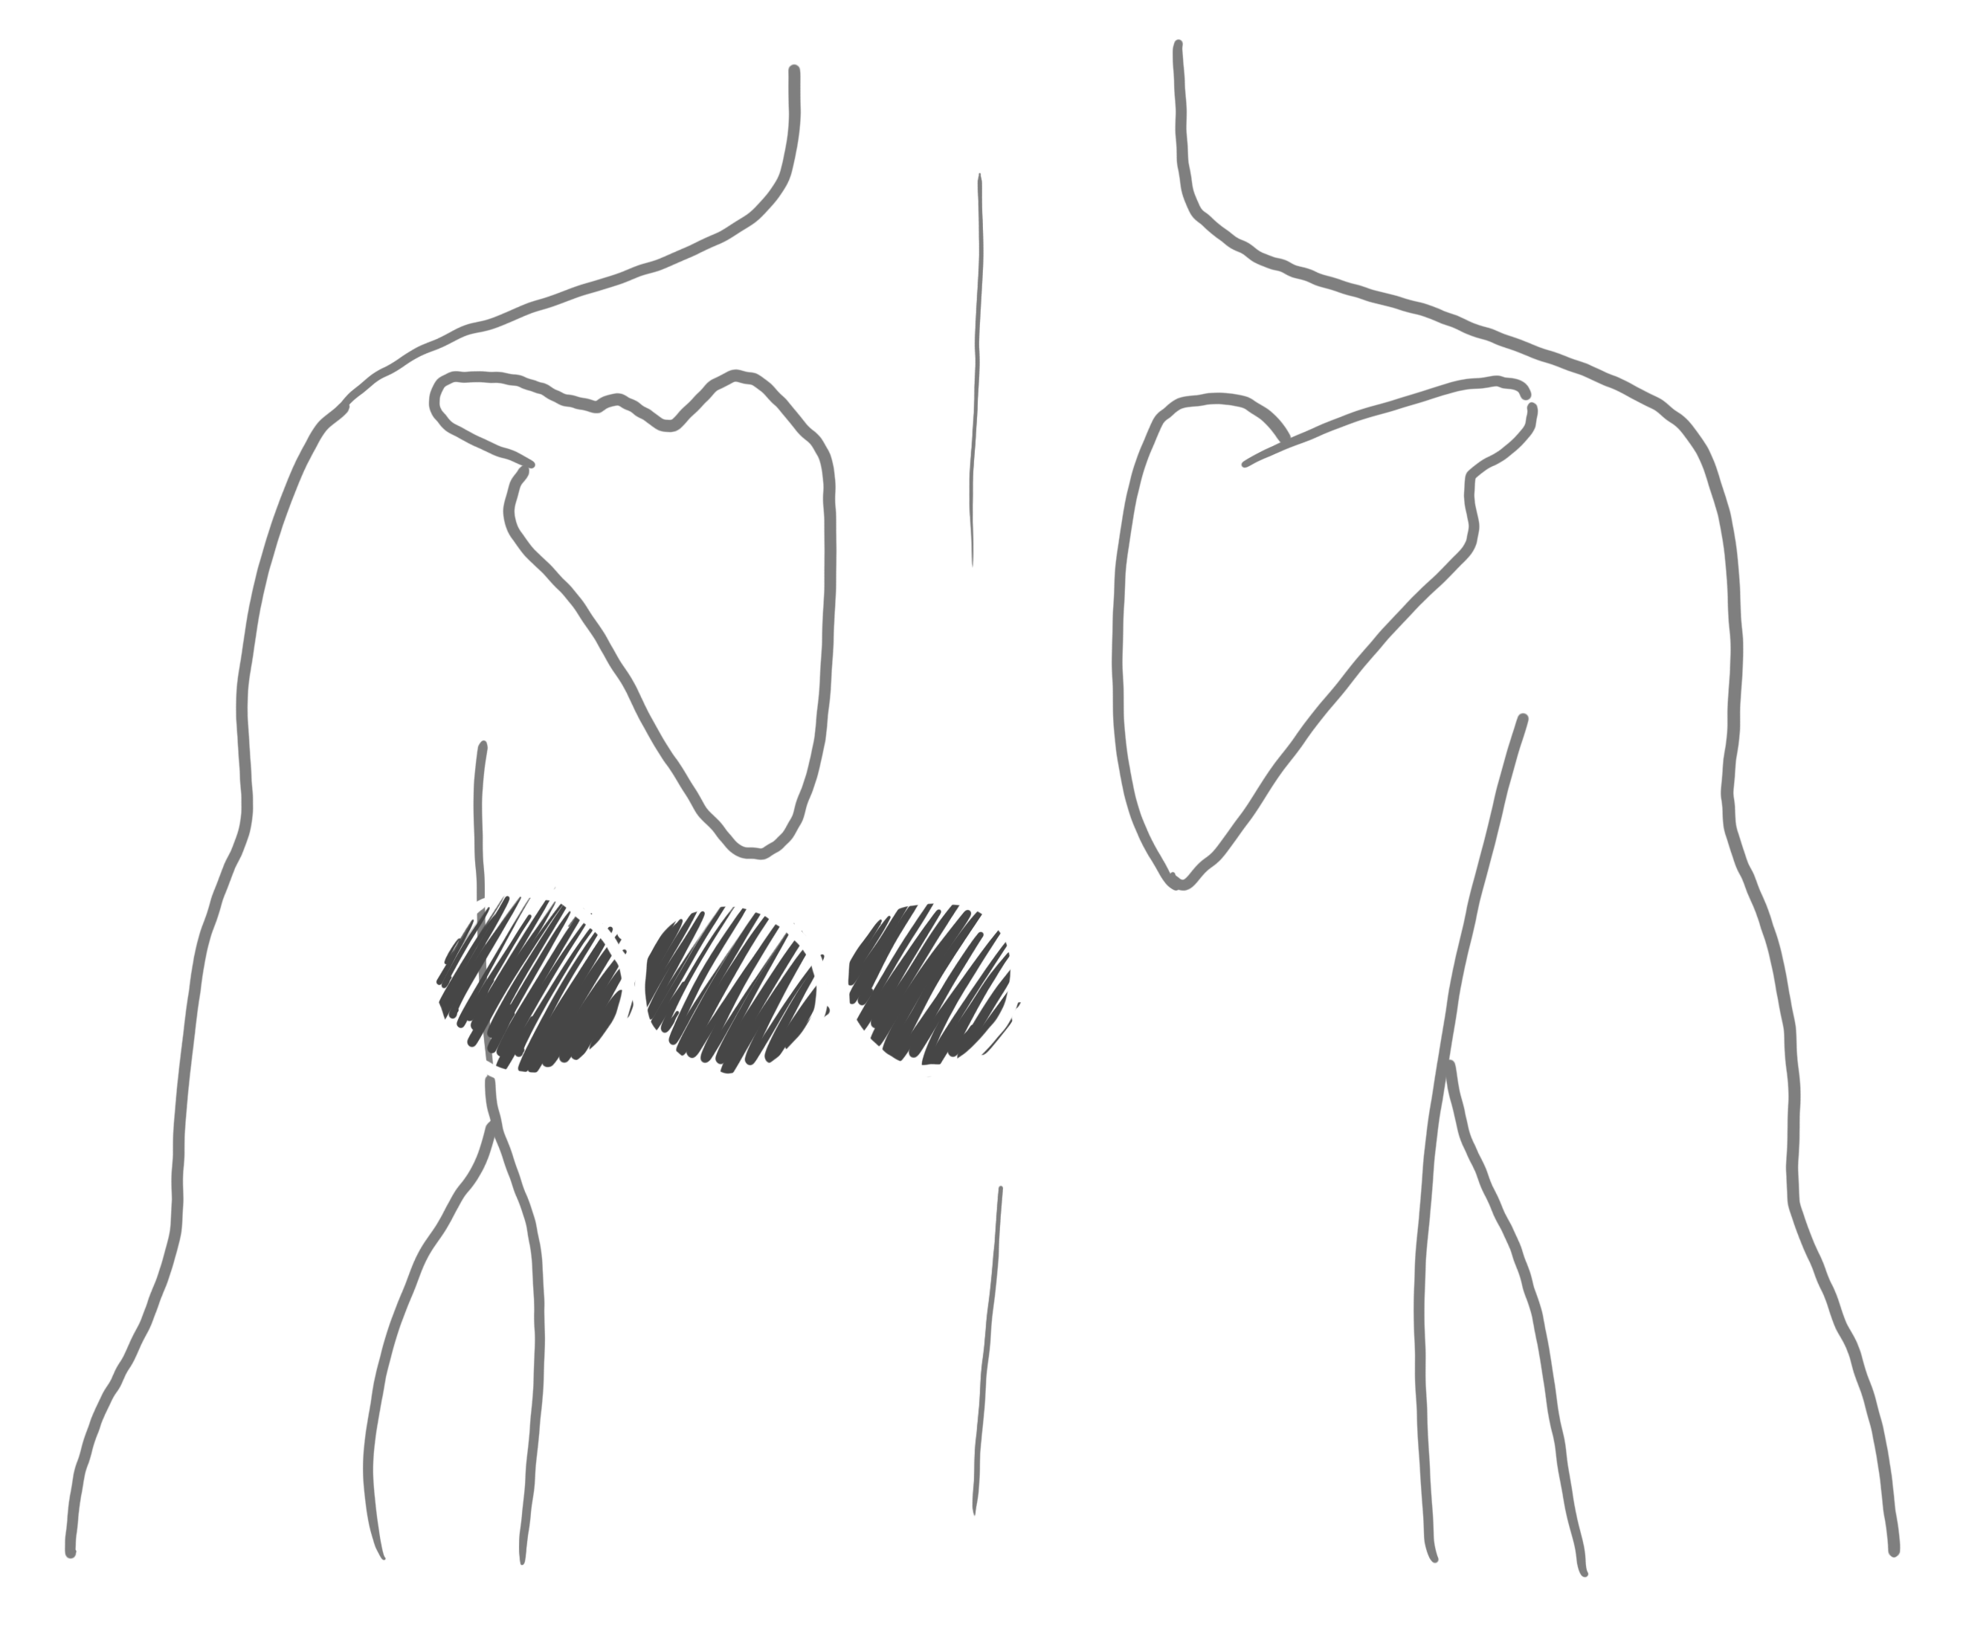
Posterior Lead Placement
V7
V8
V9

Slide 8
69-year-old female presents with chest pain
196

Slide 9
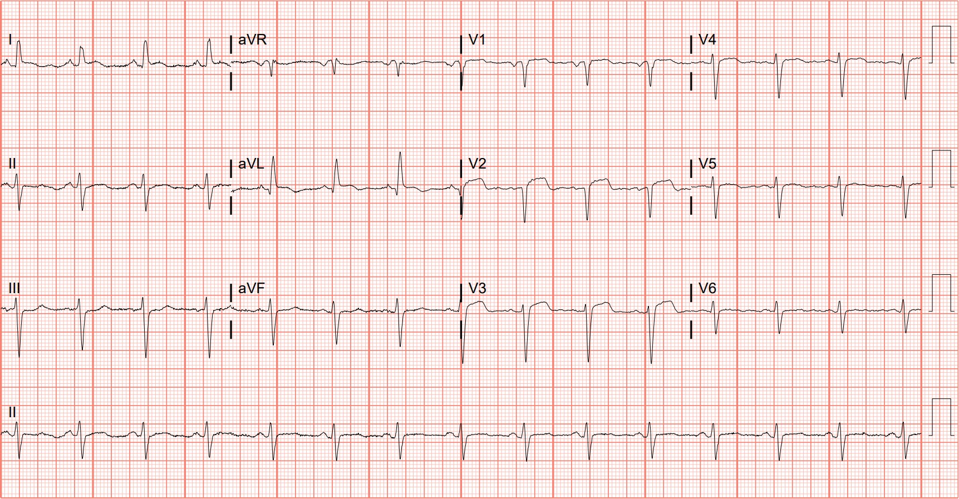
Notes:
Anterior ST-elevation Myocardial Infarction.
Anterior ST-elevation Myocardial Infarction, Left Ventricular Hypertrophy. There are ST-segment elevations in V2 and V3. In the setting of Cornell criteria for left ventricular hypertrophy (see case 84). Although the degree of ST-segment elevation in V2 and V3 is not out of proportion to the amplitude of the R-S complex, the convex morphology is suspicious (Figure 72). Left heart catheterization revealed mid-left anterior descending artery occlusion.

Slide 10
38-year-old male presents with dyspnea
197

Slide 11
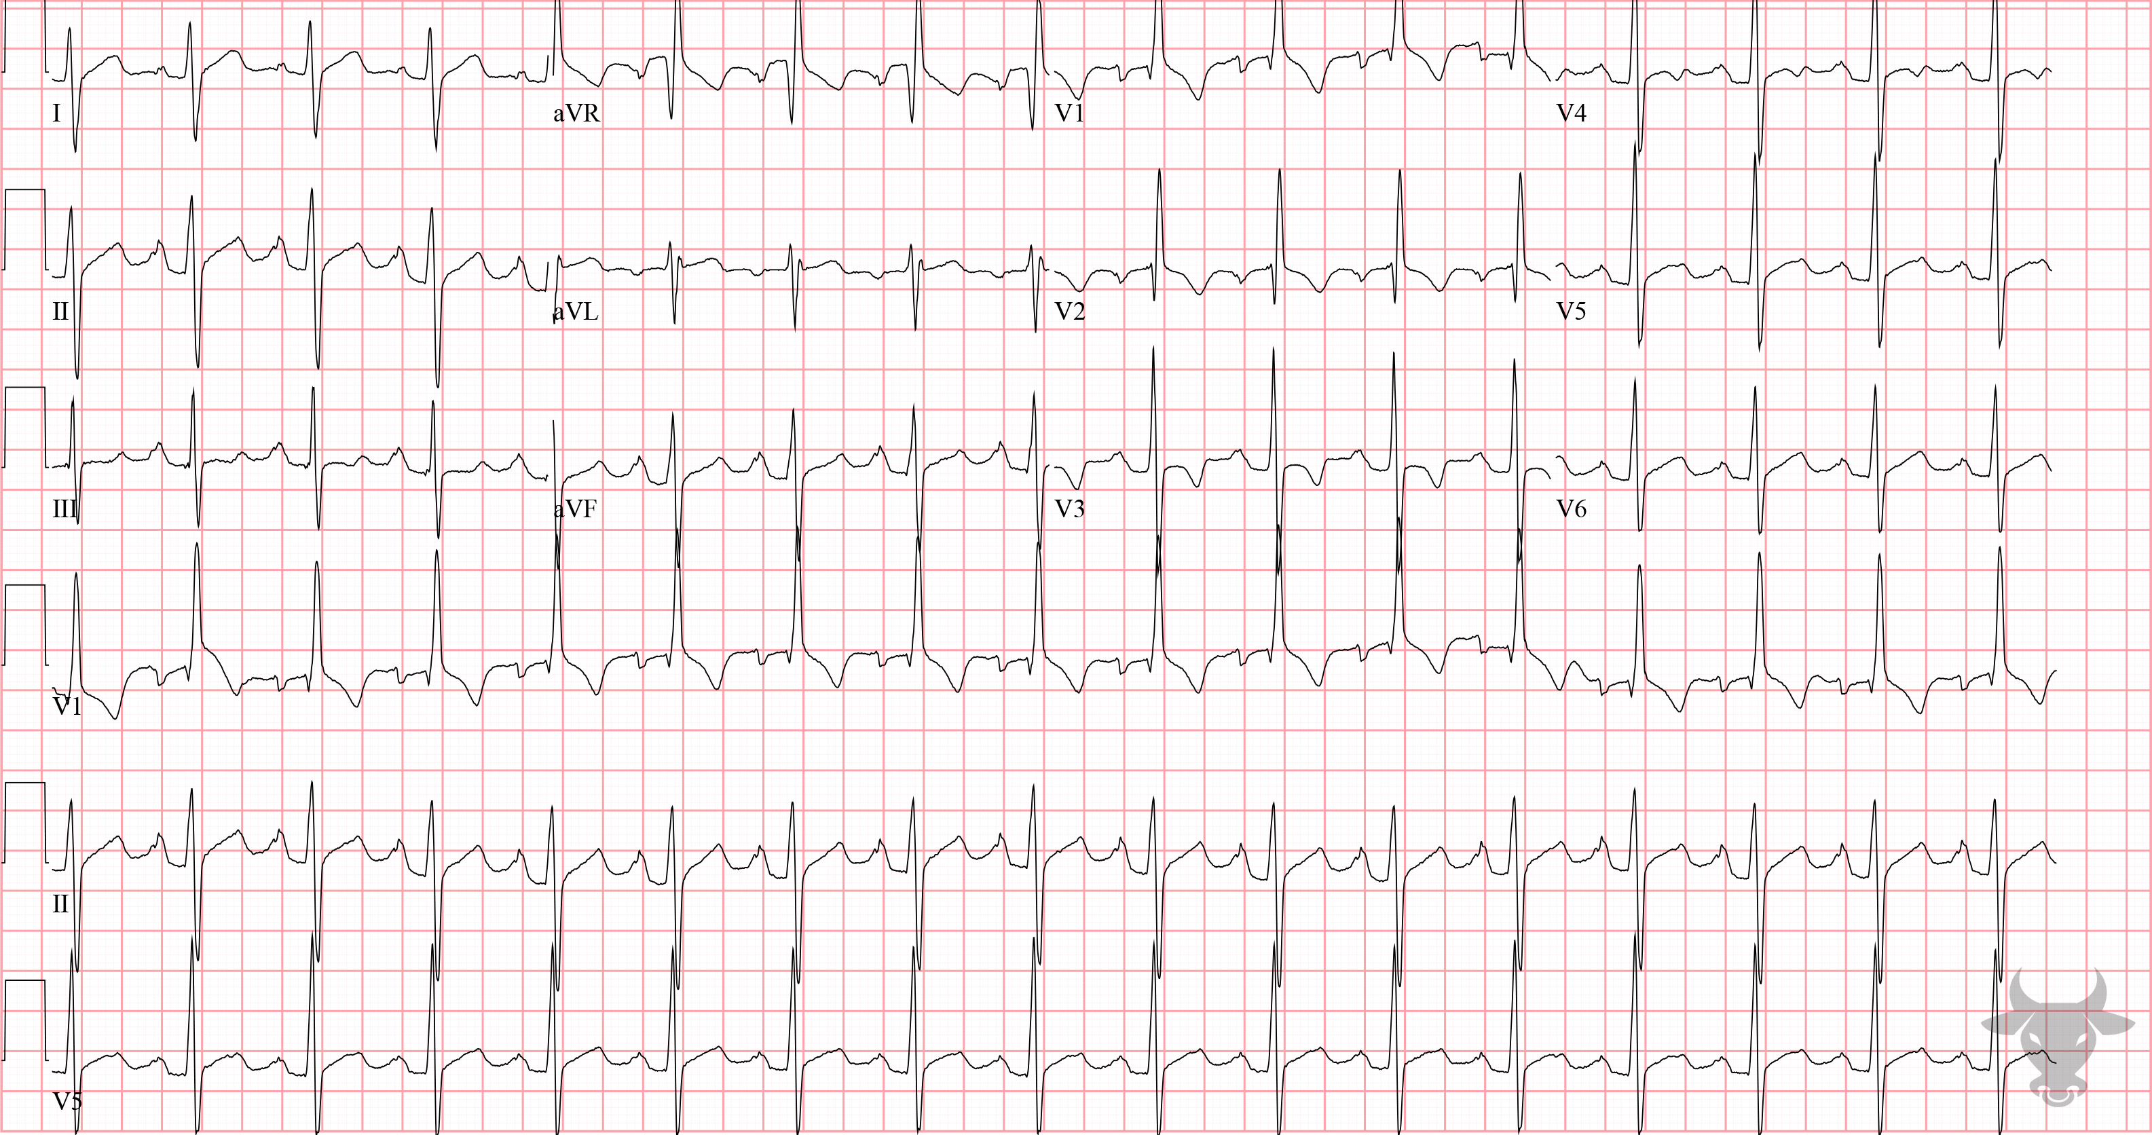
Notes:
Right Ventricular Hypertrophy.
Right Ventricular Hypertrophy, Biatrial Enlargement. Rightward forces predominate in this ECG taken from a patient with known chronic thromboembolic pulmonary hypertension. The extreme right axis deviation (Figure 5), tall P wave in lead II, anterior precordial T-wave inversions, and tall R wave in V1 are all findings of right heart strain. The qR pattern in V1 is one of the most specific signs of severe right ventricular hypertrophy.

Slide 12
80-year-old male presents with chest pain
198

Slide 13
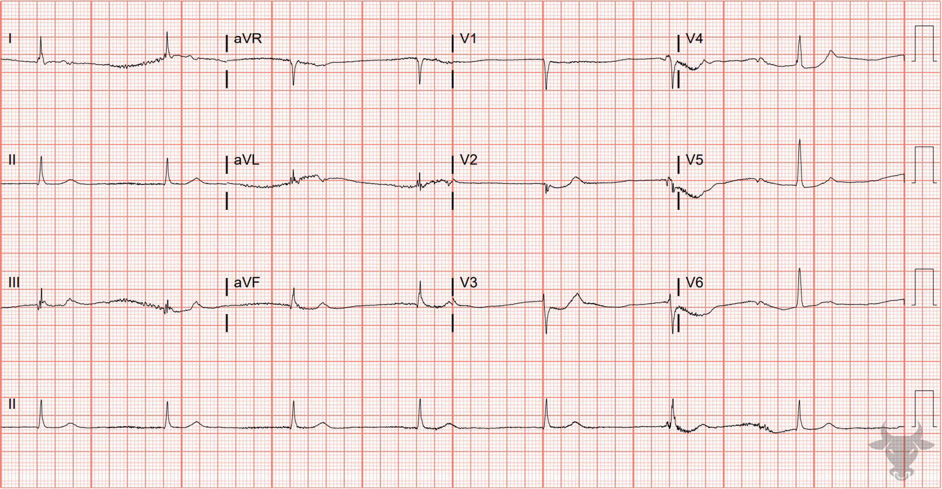
Notes:
Posterior Myocardial Infarction.
Posterior Myocardial Infarction, Junctional Bradycardia. There is a junctional bradycardia, absence of atrial activity, and ST-segment depressions in the anterior precordial leads (V2 through V4) with upright T waves, suggesting posterior myocardial infarction. Typical anterior precordial findings of posterior myocardial infarctions are R/S ratio greater than 1 (later finding), ST depressions, and upright T waves. The appearance of tall R waves is the posterior equivalent of Q waves. 5-10% of all myocardial infarctions are isolated posterior and not associated with inferior ST-segment elevation. Isolated posterior myocardial infarctions are associated with longer door-to-balloon times and worse outcomes because they are frequently missed. Left heart catheterization revealed an occluded left circumflex artery.

Slide 14
52-year-old male presents with epigastric pain
199

Slide 15
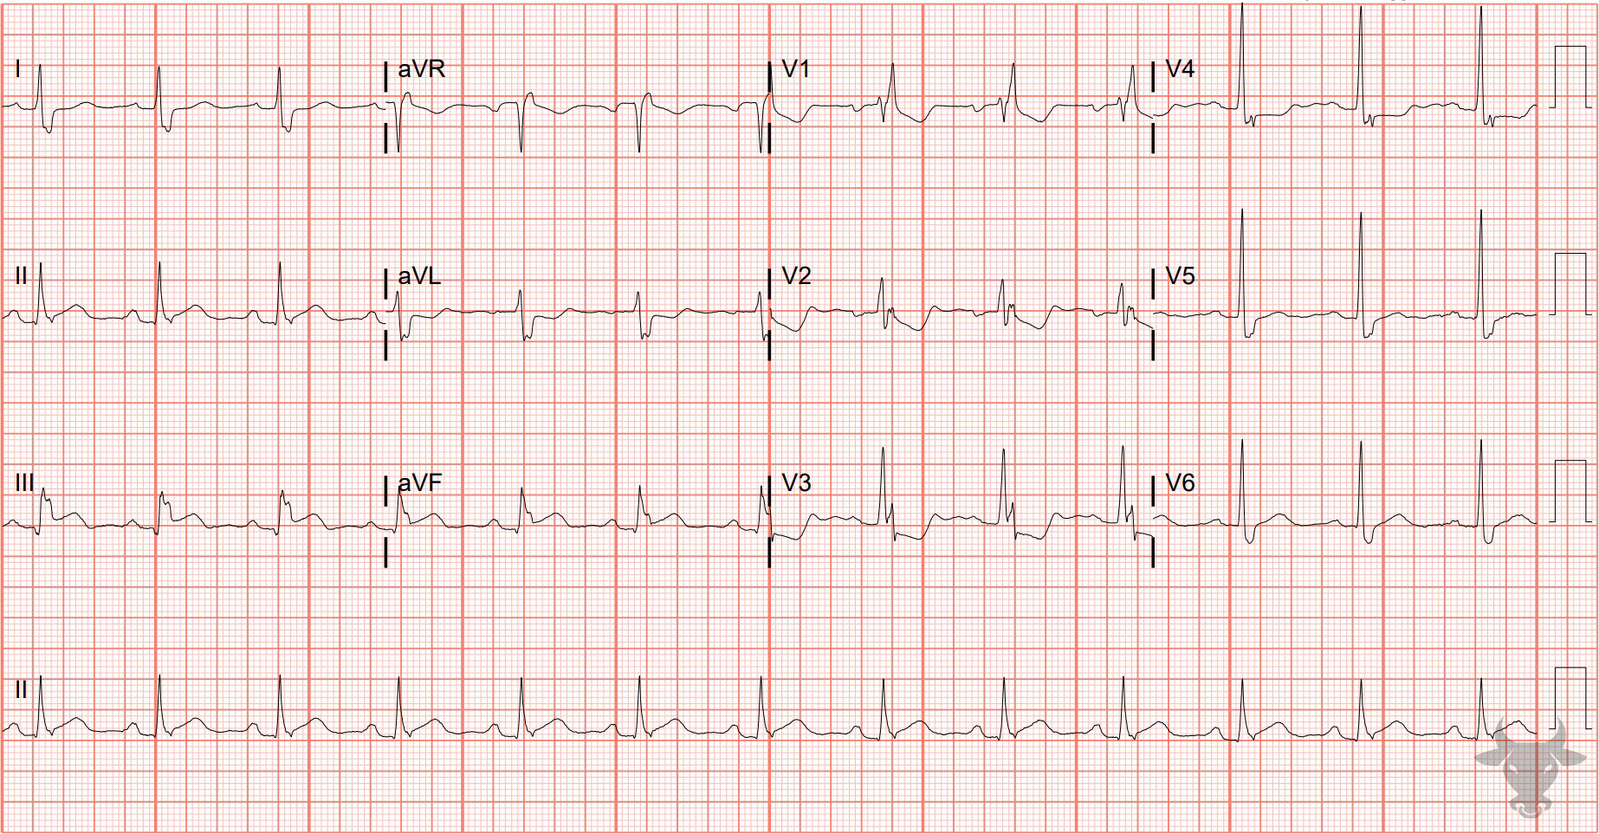
Notes:
Inferior ST-elevation Myocardial Infarction.
Inferior ST-elevation Myocardial Infarction, Right Bundle Branch Block. There are subtle ST-segment elevations in the inferior leads associated with reciprocal ST-segment depression in aVL. While this ECG does not meet the formal criteria for ST-elevation myocardial infarction, the reciprocal changes are concerning for an occlusive process. This patient was diagnosed with an ascending aortic dissection with retrograde dissection into the right coronary artery upon left heart catheterization.

Slide 16
Posterior STEMI
V2 or V3
6%
Isolated Posterior
R/S ≥ 1
↑ t wave
30%
Reperfusion
< 90 min
STD
Waldo SW, Armstrong EJ, Kulkarni A, et al. Clinical characteristics and reperfusion times among patients with an isolated posterior myocardial infarction. J Invasive Cardiol. 2013;25(8):371-5.

Slide 17
Posterior Lead Placement
V7
V8
V9

