Slide 1

Conference 35
ECG STAMPEDE

Slide 2
47-year-old male presents with chest pain
188

Slide 3
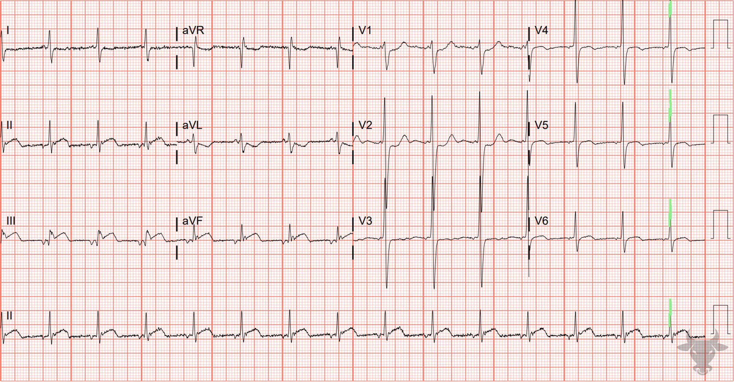
Notes:
Inferior ST-elevation Myocardial Infarction.
Inferior ST-elevation Myocardial Infarction with Posterior Extension. ST-segment elevation with straightening in the inferior leads suggests inferior wall myocardial infarction. The V2 ST-segment depression, large R wave, and upright T wave all suggest posterior extension. Left heart catheterization revealed an occluded distal right coronary artery.

Slide 4
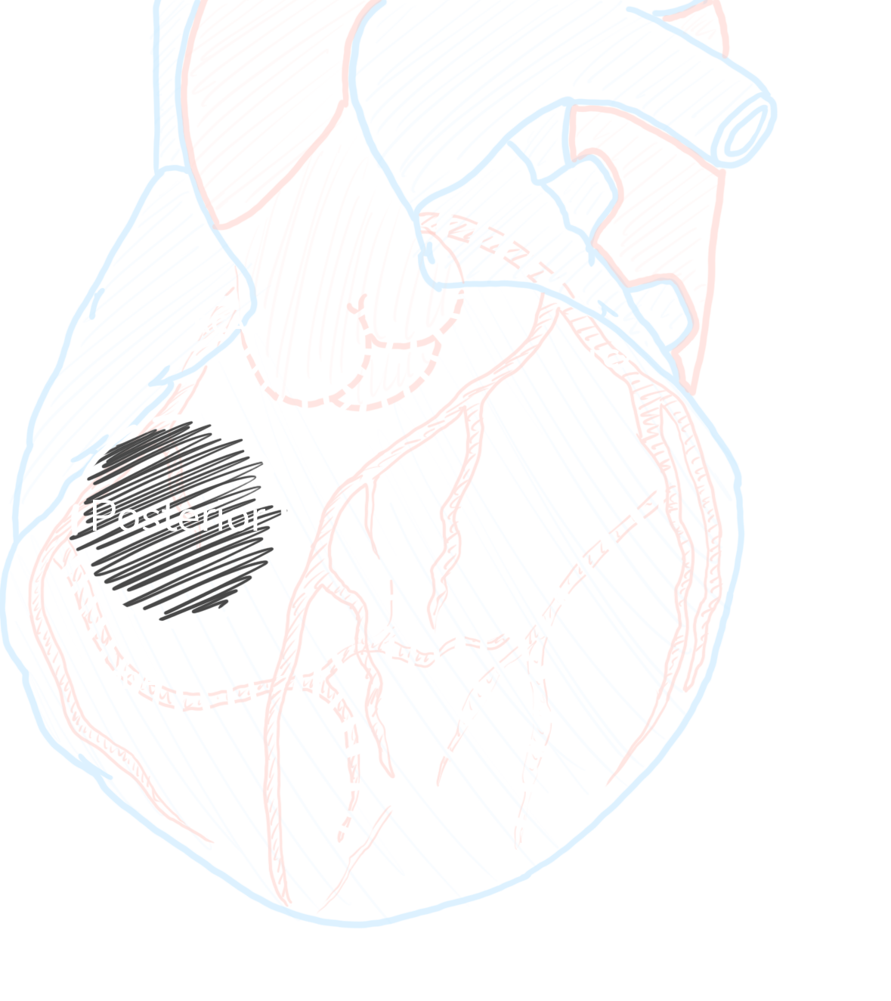
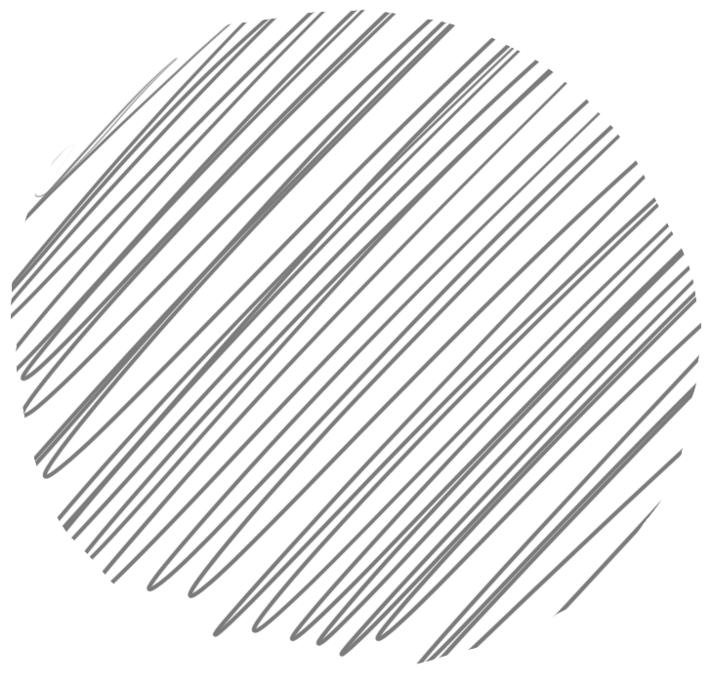
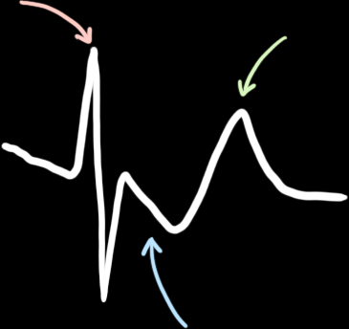
Posterior STEMI
V2 or V3
6%
Isolated Posterior
R/S ≥ 1
↑ t wave
30%
Reperfusion
< 90 min
STD
Waldo SW, Armstrong EJ, Kulkarni A, et al. Clinical characteristics and reperfusion times among patients with an isolated posterior myocardial infarction. J Invasive Cardiol. 2013;25(8):371-5.

Slide 5
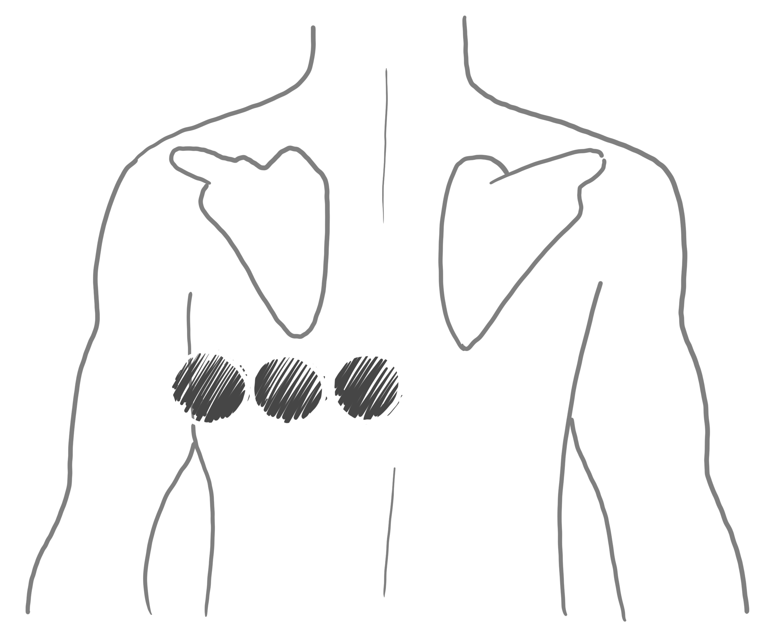
Posterior Lead Placement
V7
V8
V9

Slide 6
73-year-old male presents with chest pain
189

Slide 7
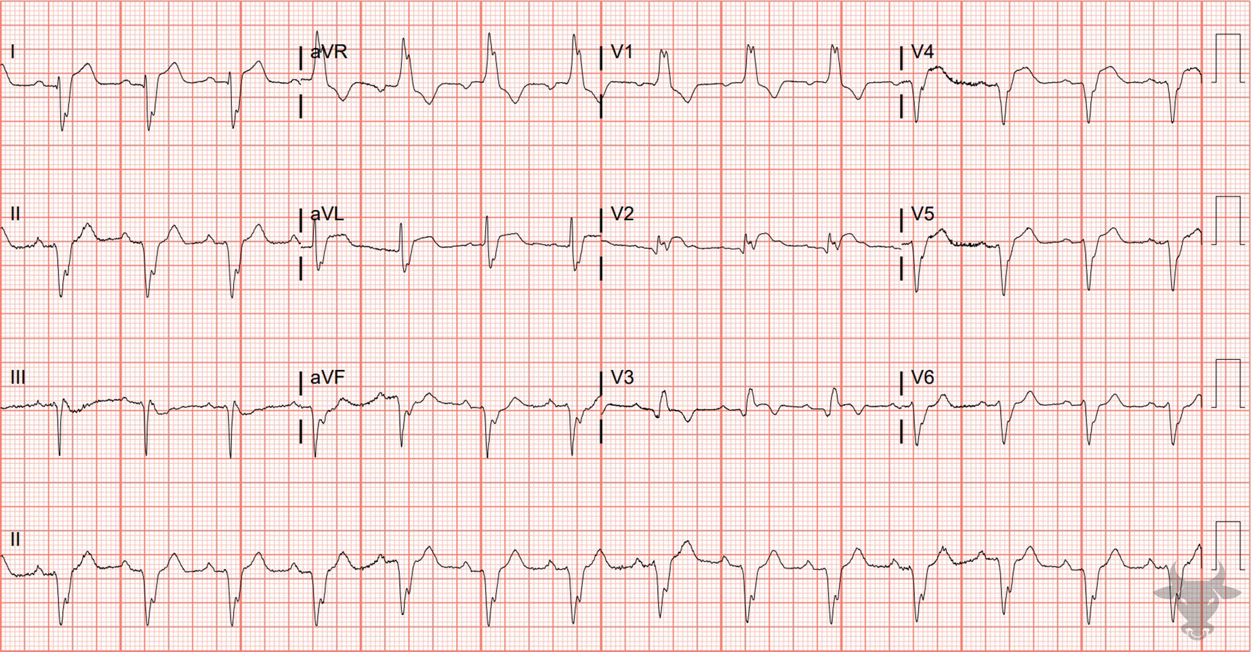
Notes:
Anterior ST-elevation Myocardial Infarction.
Anterior ST-elevation Myocardial Infarction, Right Bundle Branch Block, Left Posterior Fascicular Block. The is a right bundle branch block pattern (Figure 2) with a right axis deviation, indicating the presence of a left posterior fascicular block (Figure 50). Additionally, inferior Q waves give this ECG an unusual extreme right axis, or “northwest” axis deviation (Figure 5). Typically, a right bundle branch block has either isoelectric or slight ST-segment depressions in the anterior precordial leads (V1 through V3). Any degree of ST-segment elevation in V1 through V3 in the setting of a right bundle branch block is worrisome for acute occlusion (Figure 69).
Despite not meeting classic ST-elevation myocardial infarction criteria, left heart catheterization revealed a left anterior descending artery occlusion.

Slide 8
67-year-old male presents with fatigue
190

Slide 9
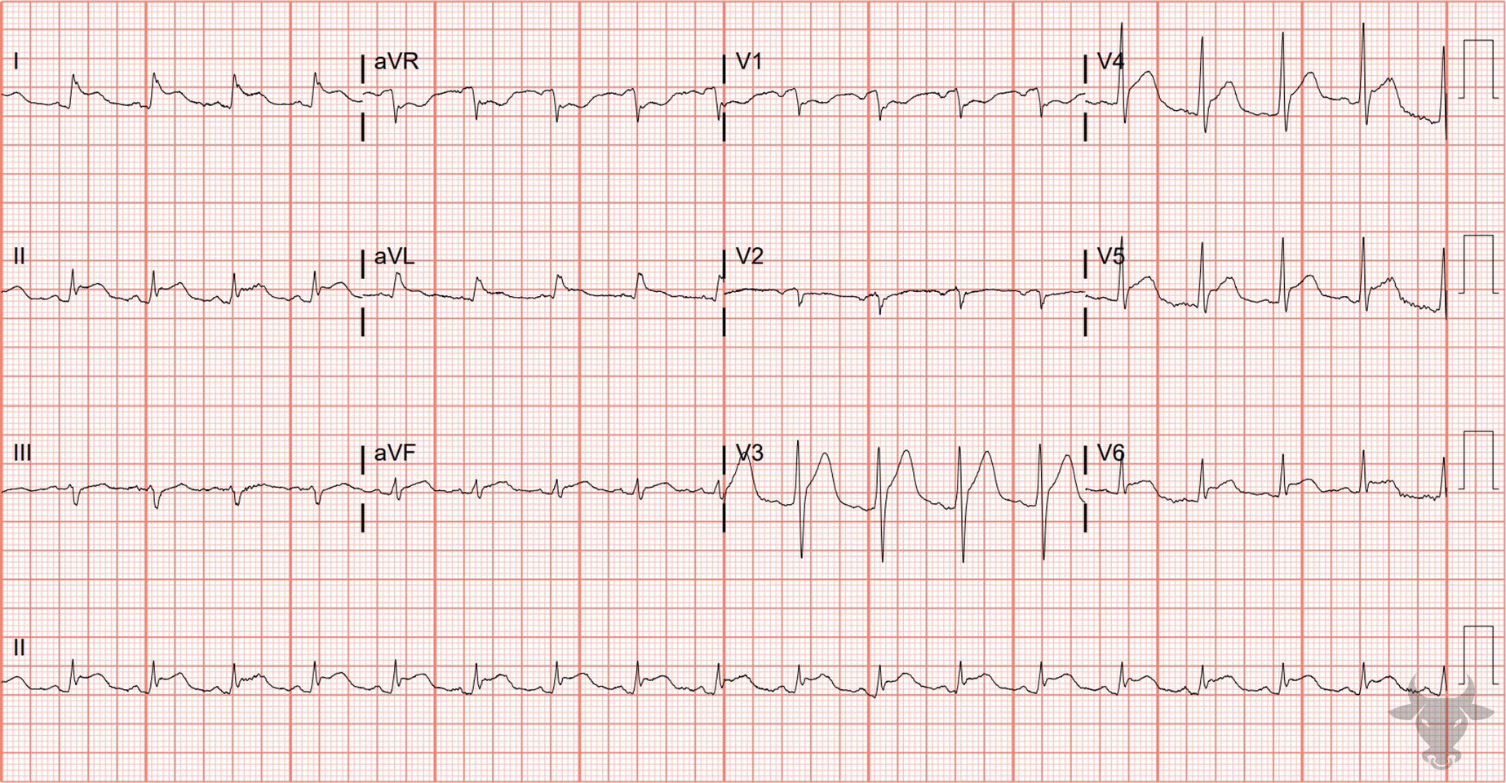
Notes:
Acute Pericarditis.
Acute Pericarditis. Differentiating pericarditis from ST-elevation myocardial infarction can be challenging, but features that suggest acute pericarditis include any of the following:
diffuse concave up ST elevations without reciprocal changes,
PR depression,
PR elevation in aVR,
ST-elevation in lead II greater than lead III, and
Spodick’s sign – down-sloping of the TP segment.
This patient developed symptoms of pericarditis during an inpatient admission and was discovered to have a new pericardial effusion. Note the diffuse concave ST-segment elevations without reciprocal changes, slight PR-segment depressions (best seen in the limb leads), and down-sloping T-P segment (best seen in the precordial leads) – so-called Spodick's sign. Left heart catheterization revealed non-obstructive coronary artery disease and the patient was diagnosed with acute pericarditis. Months later, the ST-segments normalized.

Slide 10
STEMI vs Pericarditis Odds Ratios
ST Dep
Witting, M. D., Hu, K. M., Westreich, A. A., Tewelde, S., Farzad, A., & Mattu, A. (2020). Evaluation of Spodick’s Sign and Other Electrocardiographic Findings as Indicators of STEMI and Pericarditis. The Journal of Emergency Medicine. https://doi.org/10.1016/j.jemermed.2020.01.017

Slide 11
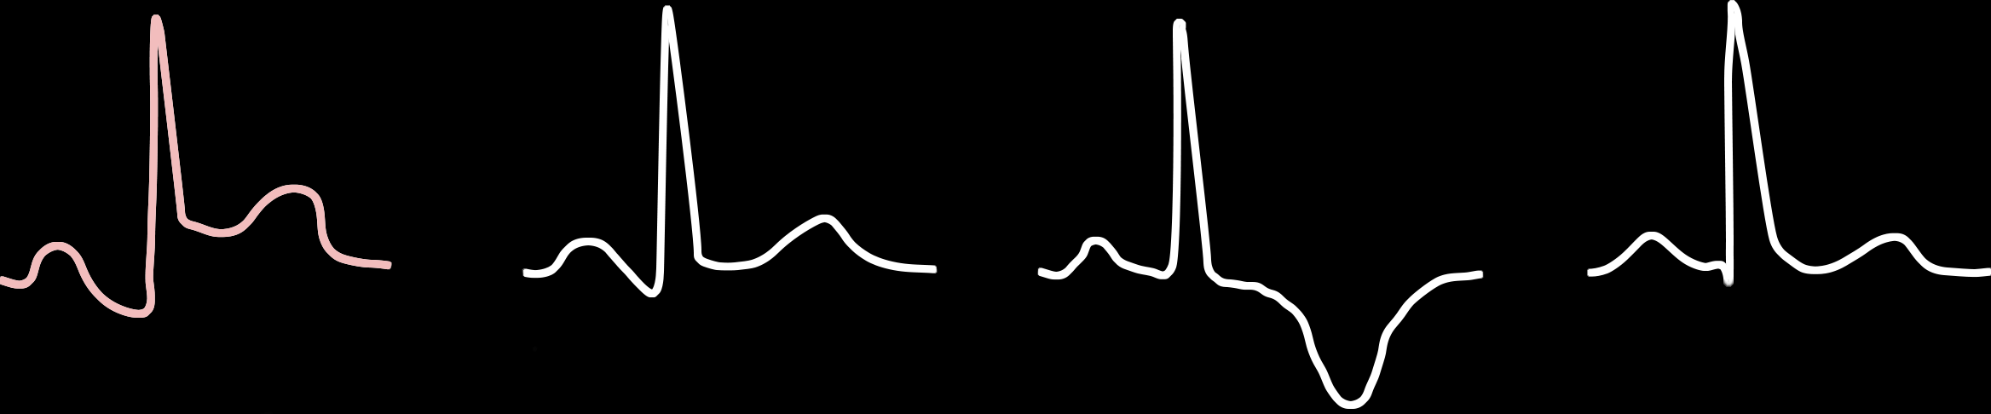
ECG Stages of Pericarditis
Stage 1
Stage 2
Stage 3
Stage 4

Slide 12
64-year-old female presents with epistaxis
191

Slide 13
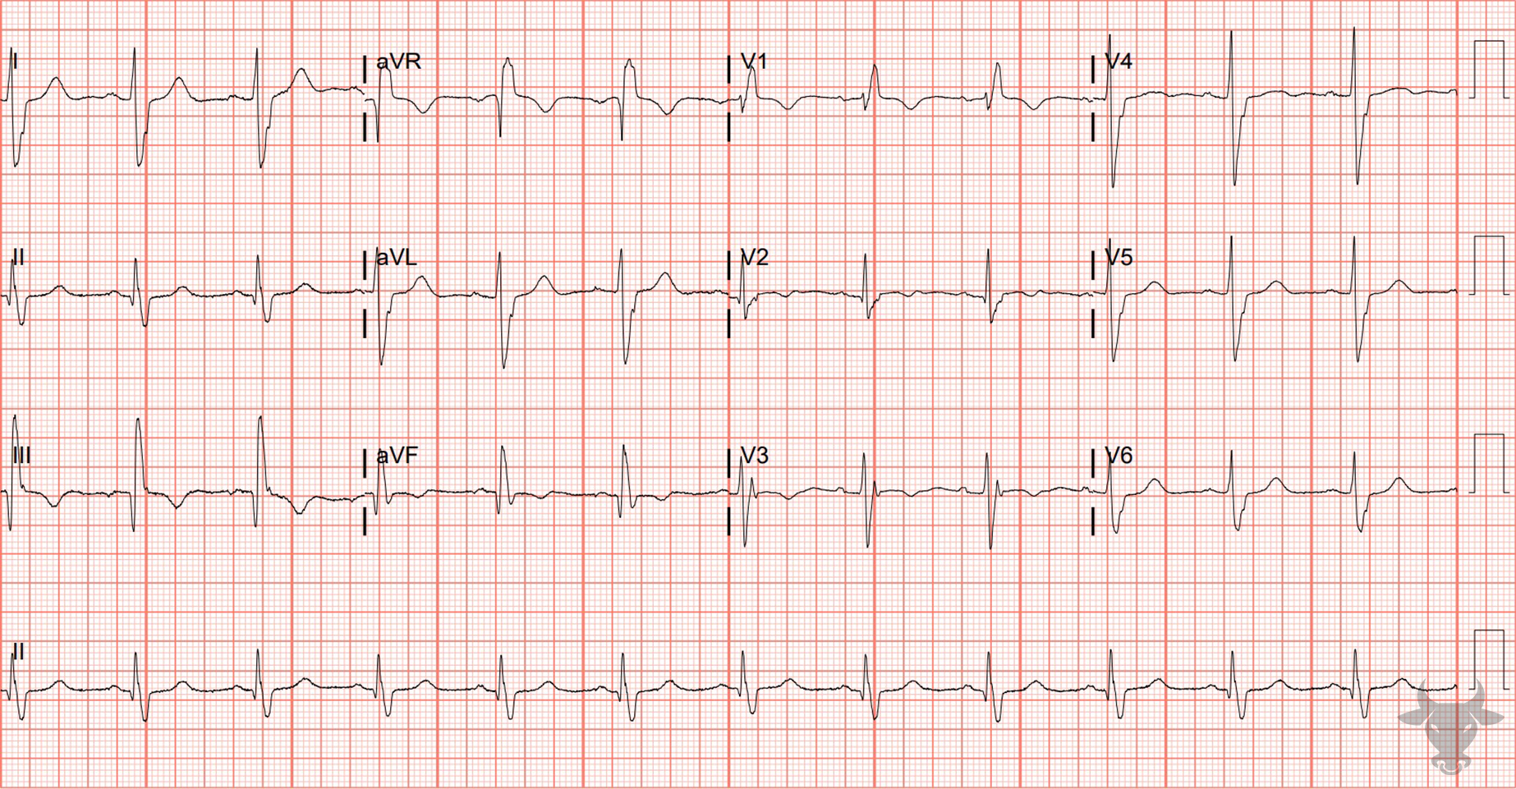
Notes:
Right Bundle Branch Block.
Right Bundle Branch Block & Left Posterior Fascicular Block. Right bundle branch blocks do not typically cause axis deviation because the right ventricle lacks enough myocardium to cause an axis shift (in contrast to left bundle branch blocks). When a right axis deviation accompanies a right bundle branch block, there is often an associated left posterior fascicular block (Figure 50), as with this case.

Slide 14

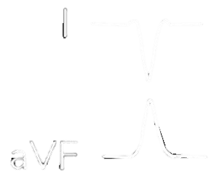
Causes of right axis deviation
1. Ventricular ectopy
2. Lateral myocardial infarction
3. Right ventricular hypertrophy
4. Accessory Pathway/Wolf-Parkinson-White
5. Left posterior fascicular block
6. Hyperkalemia
7. Sodium channel toxicity
8. Pulmonary embolism
9. Chronic lung disease (e.g., COPD)
10. Normal in children

Slide 15
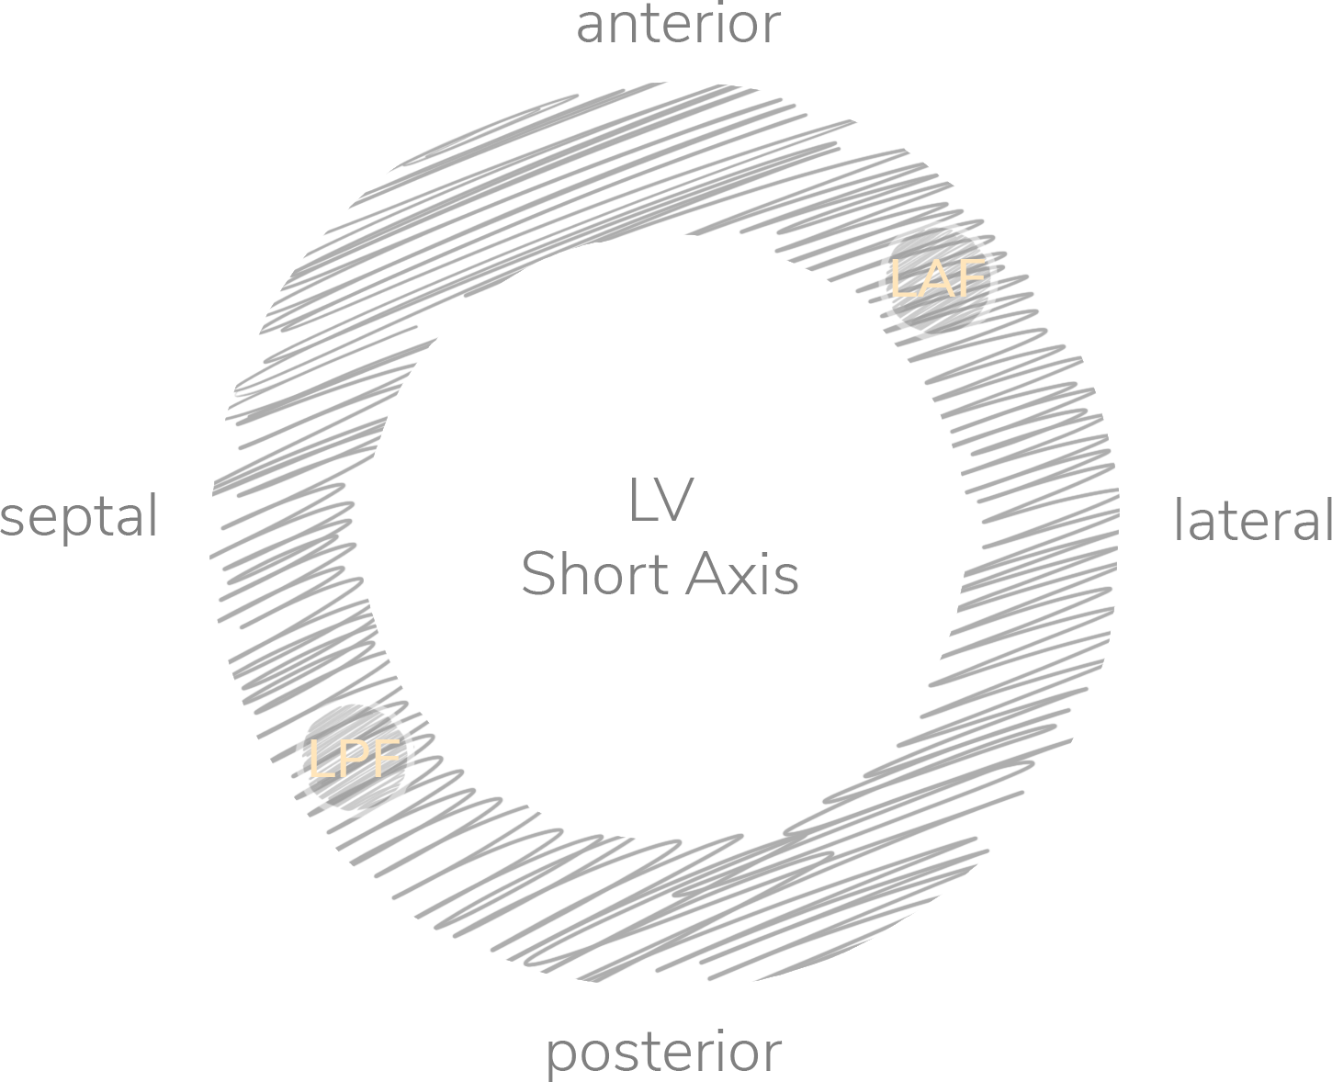
Conduction System Fascicular Blocks

Slide 16
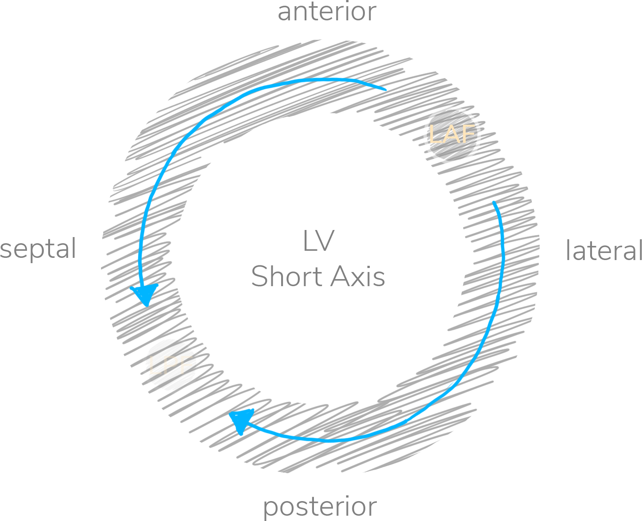


Conduction System Fascicular Blocks
QRS < 100 ms
RAD > 90 deg
I, aVL
II, III, aVF

Slide 17
68-year-old male presents with dyspnea
192

Slide 18
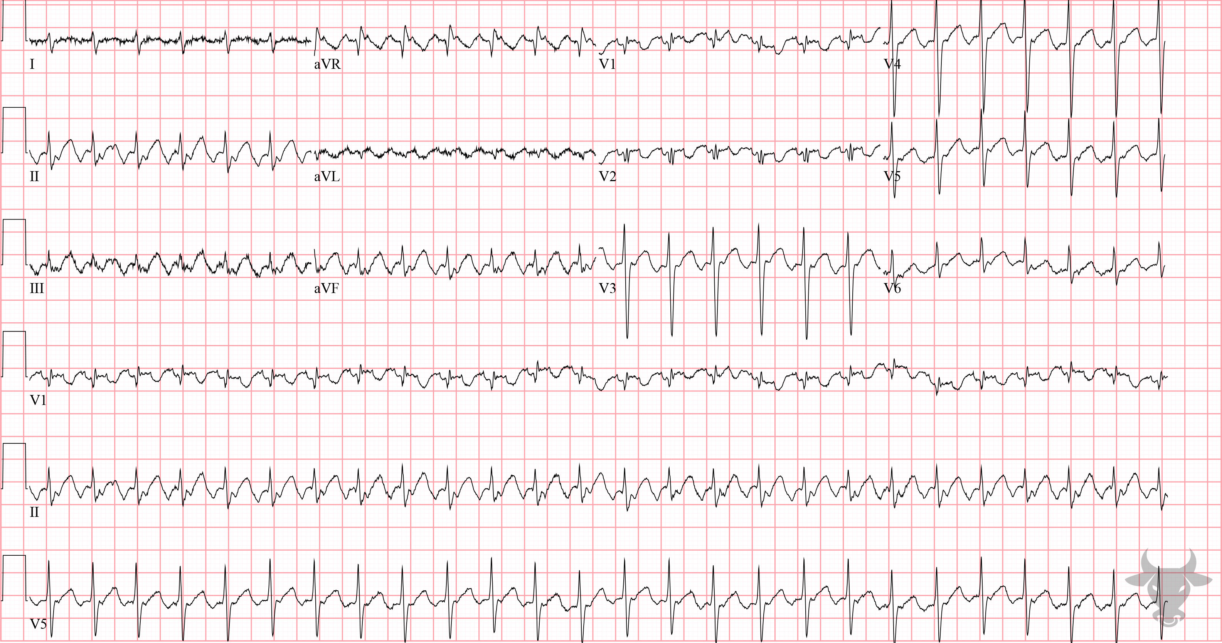
Notes:
Atrial Flutter with 2:1 Conduction.
Atrial Flutter with 2:1 Conduction. Atrial flutter occurs when a reentrant circuit forms in the right atrium. It is an organized rhythm that is generally characterized by an atrial rate of around 300 beats per minute. It more commonly occurs in a counterclockwise fashion, leading to inverted flutter waves in the inferior leads (II, III, and aVF). In the absence of treatment, the most common conduction is 2:1 (atrial to ventricular conduction). Notice the sawtooth pattern in the inferior leads (II, III, and aVF), with inverted flutter waves (Figure 70).

Slide 19
59-year-old male presents with dizziness
193

Slide 20
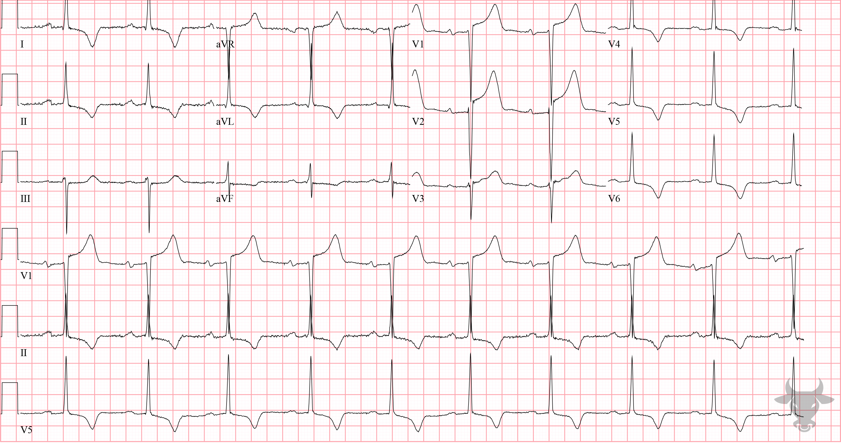
Notes:
Left Ventricular Hypertrophy.
Left Ventricular Hypertrophy. There are large QRS complexes with repolarization abnormalities (i.e., T-wave inversions) in the lateral leads (I, II, aVL, V4, V5, and V6). Despite nearly 4 mm of ST-segment elevation in V2, it does not rise to the level of inappropriate discordance (Figure 71). In fact, this patient had a left heart catheterization that revealed non-obstructive coronary artery disease and percutaneous intervention was not performed.

Slide 21
False Positive Activation
Left Ventricular Hypertrophy
McCabe JM, Armstrong EJ, Kulkarni A, et al. Prevalence and factors associated with false-positive ST-segment elevation myocardial infarction diagnoses at primary percutaneous coronary intervention–capable centers: a report from the Activate-SF registry. Arch Intern Med. 2012;172(11):864-871.

Slide 22
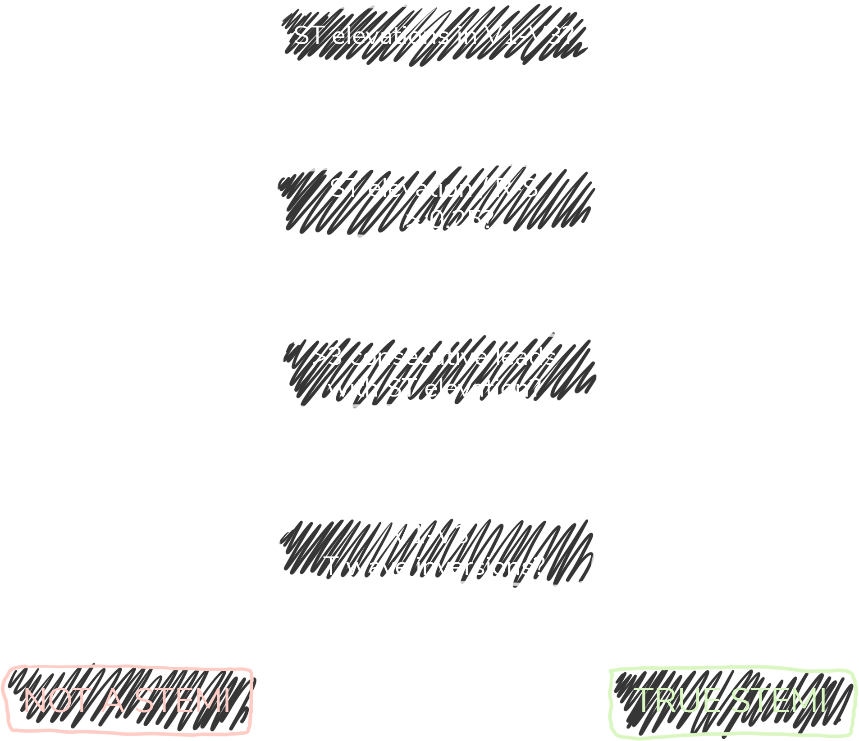
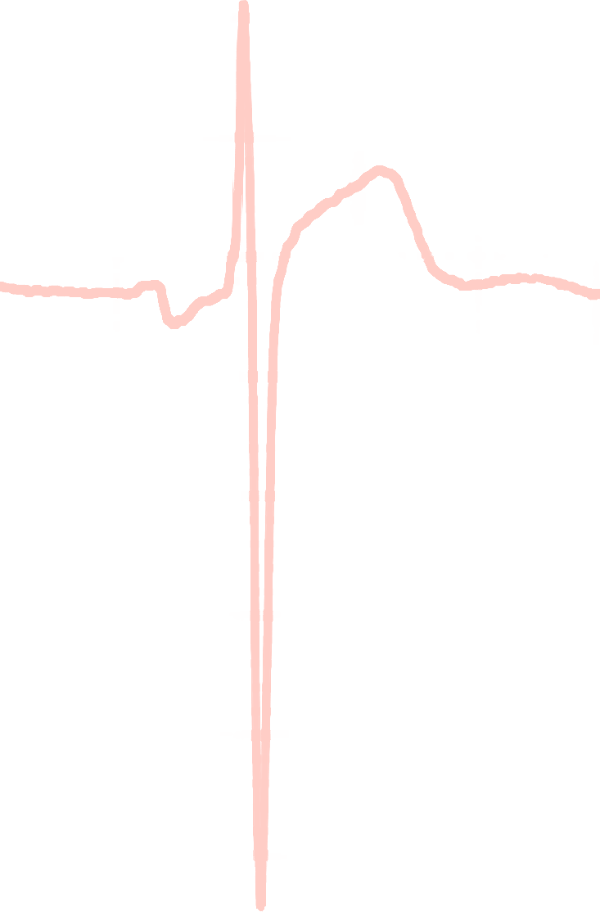
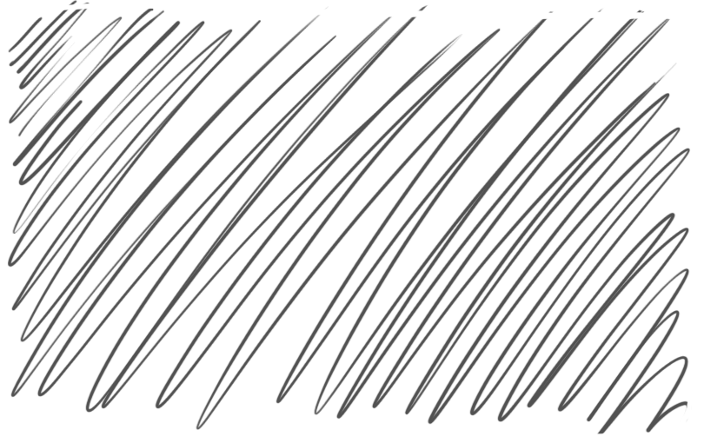
Armstrong Algorithm for STE in LVH
V1-V3
91%
Specificity
STE
R-S
STE/R-S
> 0.25?
77%
Sensitivity
Armstrong EJ, Kulkarni AR, Bhave PD, et al. Electrocardiographic criteria for ST-elevation myocardial infarction in patients with left ventricular hypertrophy. Am J Cardiol. 2012;110(7):977-983.
Notes:
Sensitivity 77%
Specificity 91%

