Slide 1

Conference 34
ECG STAMPEDE

Slide 2
42-year-old female presents with fatigue and syncope
182

Slide 3

Notes:
Hypokalemia. Notice the ST-segment depressions and wavy appearance of the ST-segment and T wave, which represents T-U wave fusion.²⁶ The prolonged repolarization phase is a risk for the development of dysrhythmias, specifically torsade de pointes. The potassium level was 1.6 mEq/L.

Slide 4
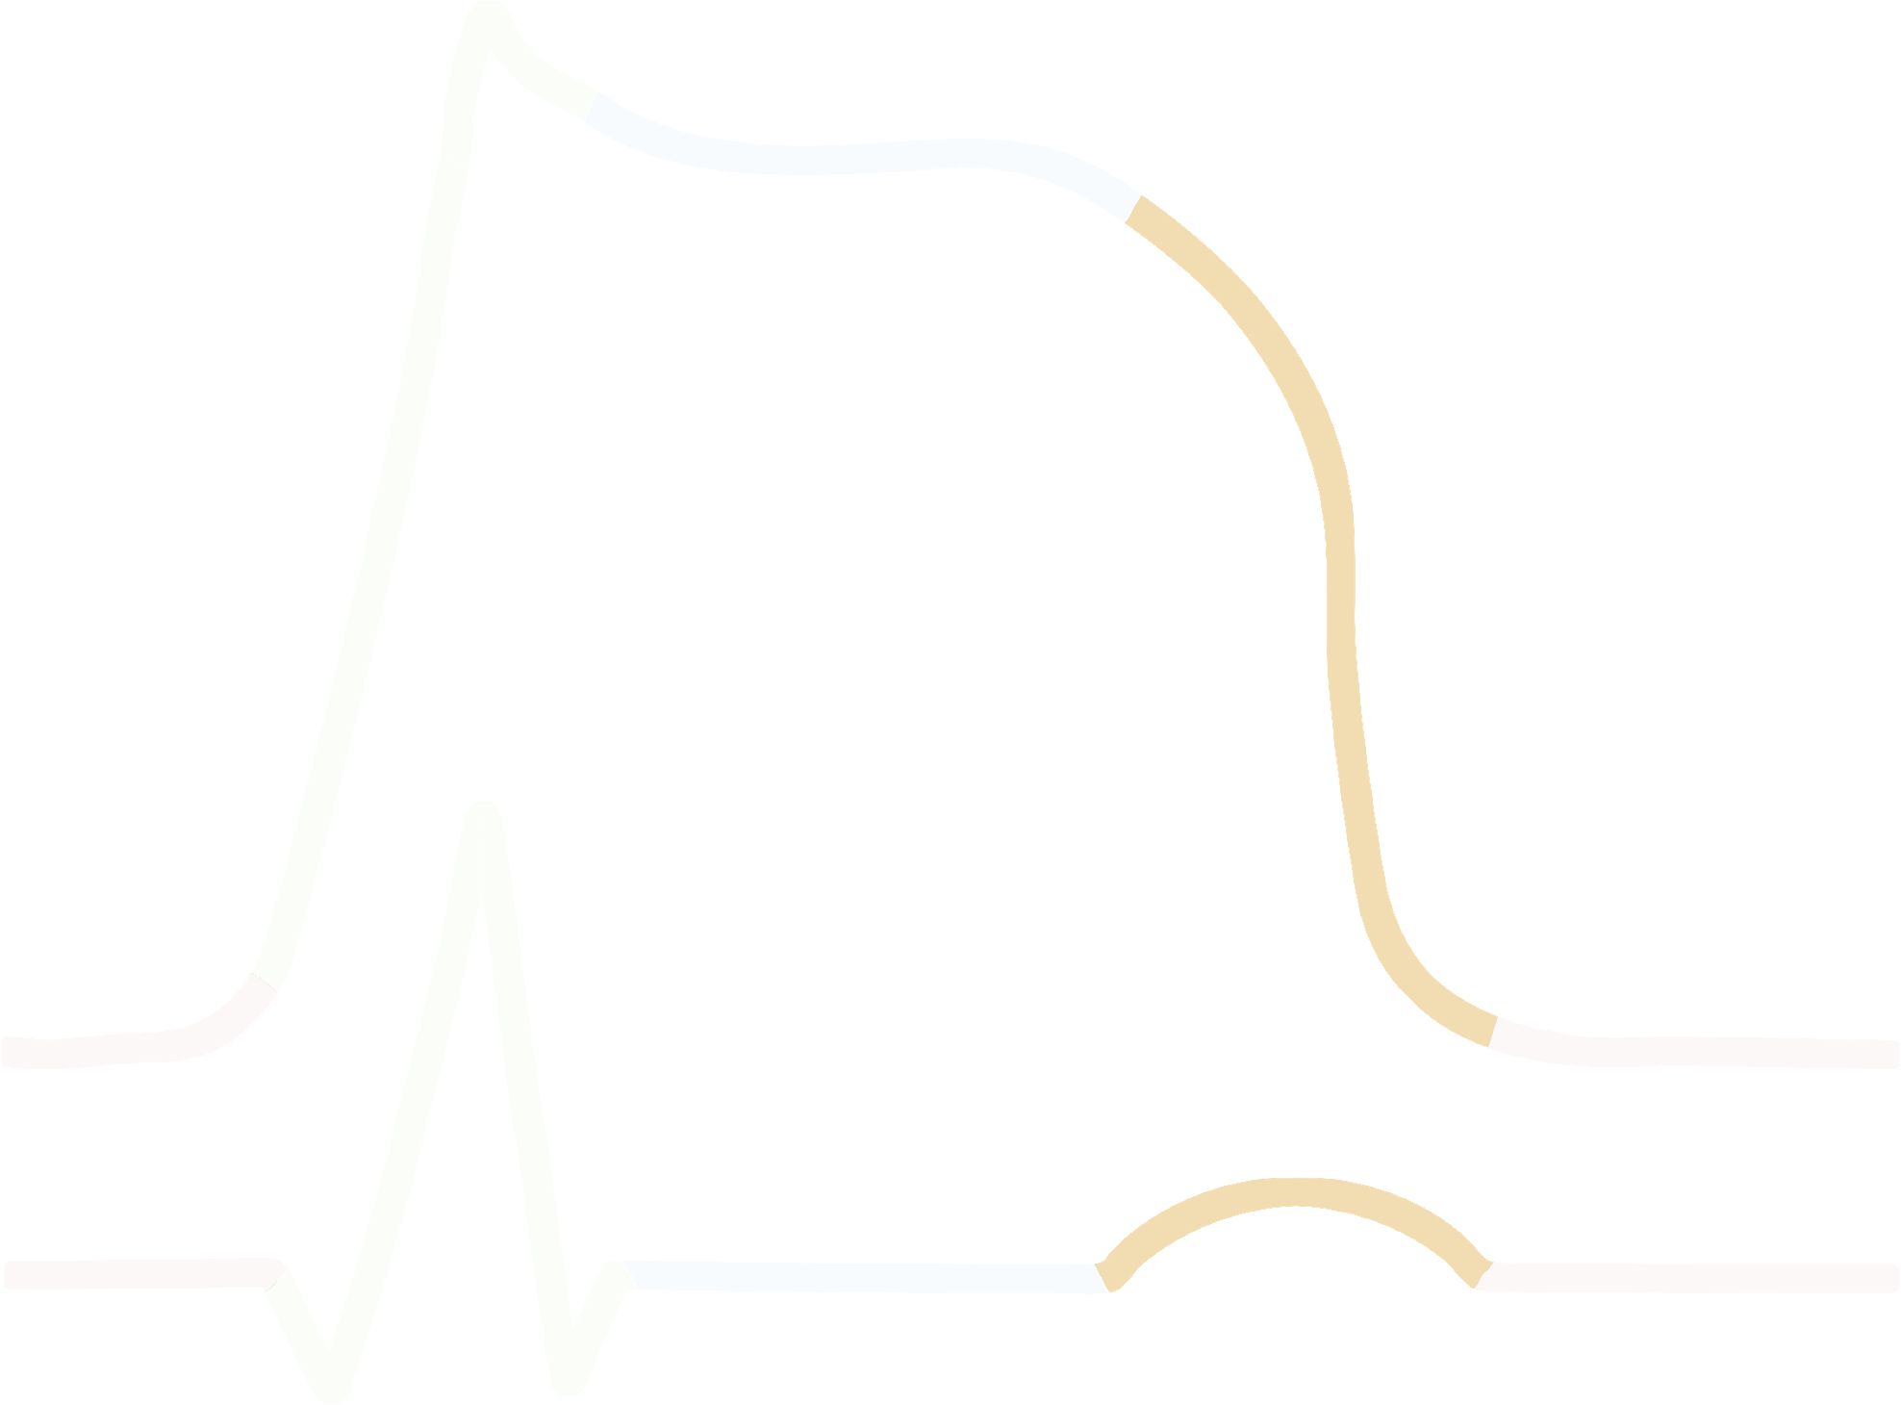

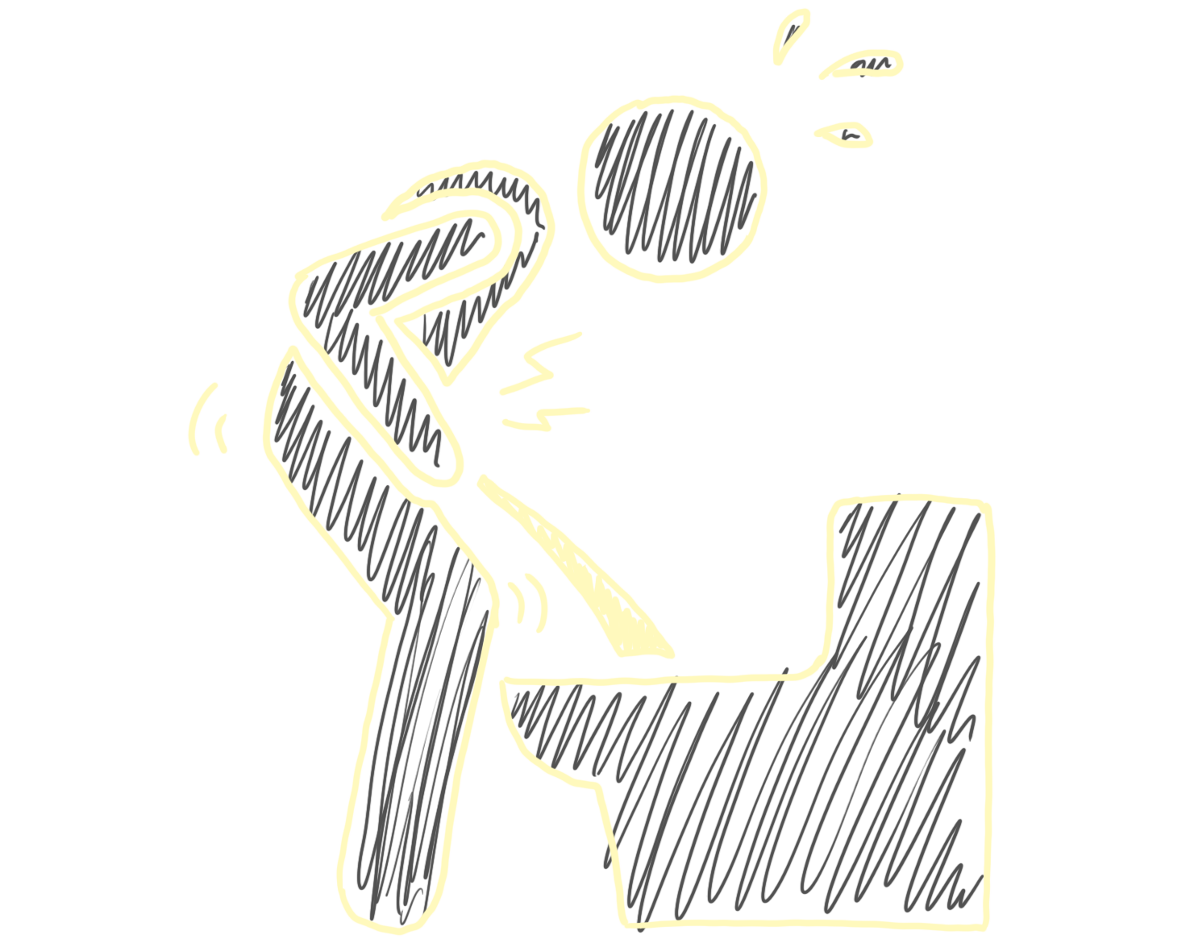

Cardiac Action Potential Phase 3
↓K+
↑ T-U wave
Notes:
Phase 3 (Repolarization): The membrane potential returns to the resting state due to continued potassium efflux.

Slide 5
What’s the risk?

Slide 6
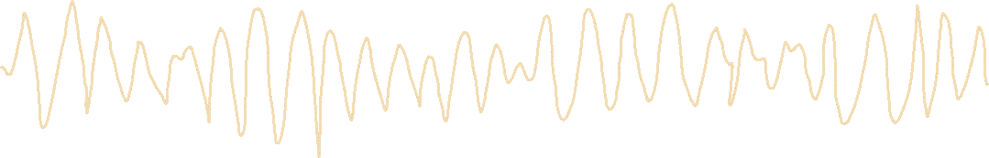
Torsades de Pointes

Slide 7
62-year-old male presents with dyspnea
183

Slide 8
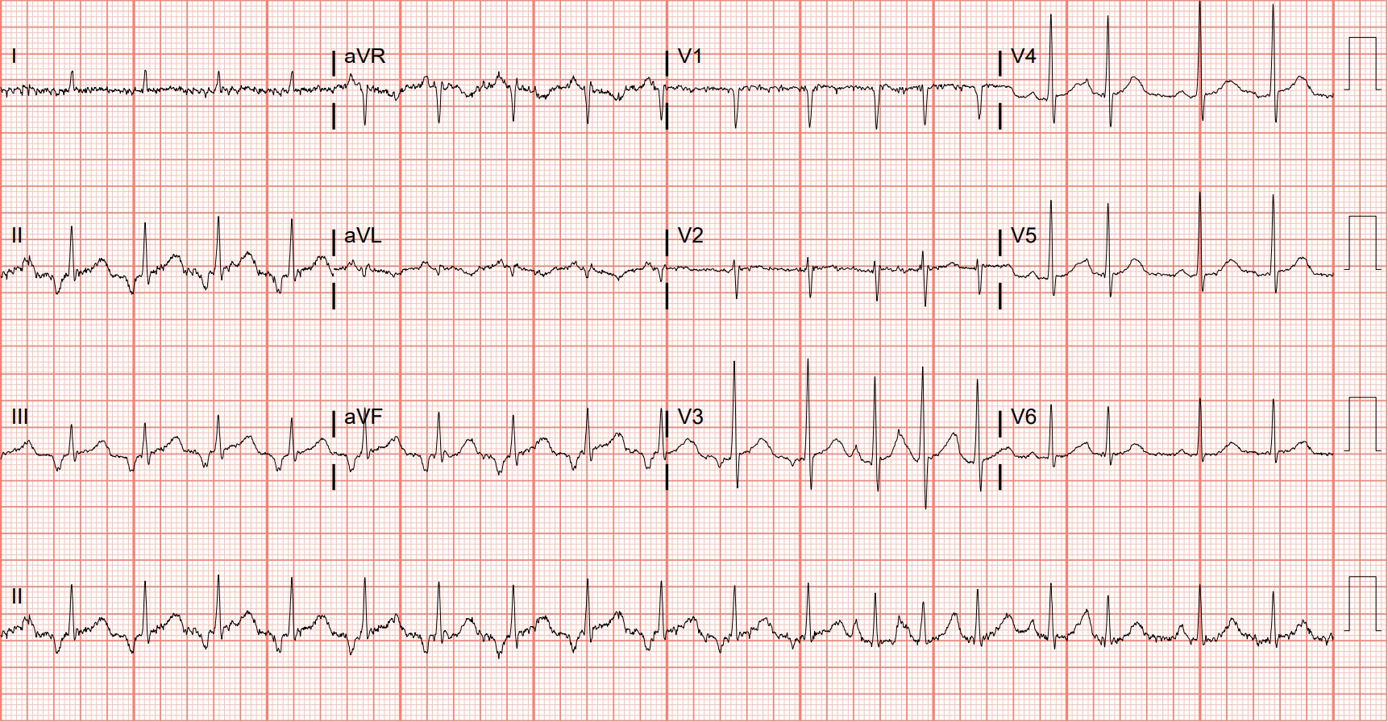
Notes:
Multifocal Atrial Tachycardia. Multifocal atrial tachycardia is an irregularly irregular rhythm previously described in case 147. It is most often seen in patients with advanced lung disease, such as chronic obstructive pulmonary disease. The presence of three different P wave morphologies confirms the diagnosis in this patient with chronic obstructive lung disease.

Slide 9

Fast & Narrow
Slow & Narrow
Irregular
Atrial fibrillation
Atrial flutter w/ VC
MAT
Irregular
Atrial fibrillation
Sinus node dysfunction
2nd deg AVB
Regular
AVNRT
AVRT
Sinus tachycardia
Atrial flutter w/ FC
Atrial tachycardia
Regular
Sinus node dysfunction
Hyperkalemia/tox
2nd deg AVB
3rd deg AVB w/ JE
Junctional
Fast & Wide
Slow & Wide
Ventricular tachycardia
SVT w/ aberrancy
Sodium channel toxicity
Hyperkalemia
AVRT
SND w/ aberrancy
Hyperkalemia/tox
2nd deg AVB w/ aberrancy
3rd deg AVB w/ VE

Slide 10
44-year-old male presents with palpitations
184

Slide 11
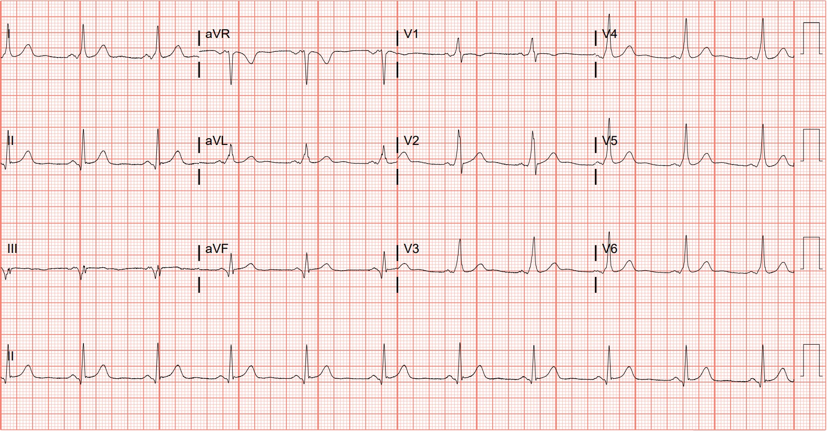
Notes:
Ventricular Pre-excitation. This ECG displays the classic features of pre-excitation: the delta wave, shortened PR interval, and slightly widened QRS. The dominant R wave in V1 is consistent with a left-sided accessory pathway, referred to as "type A."^{5,32}

Slide 12
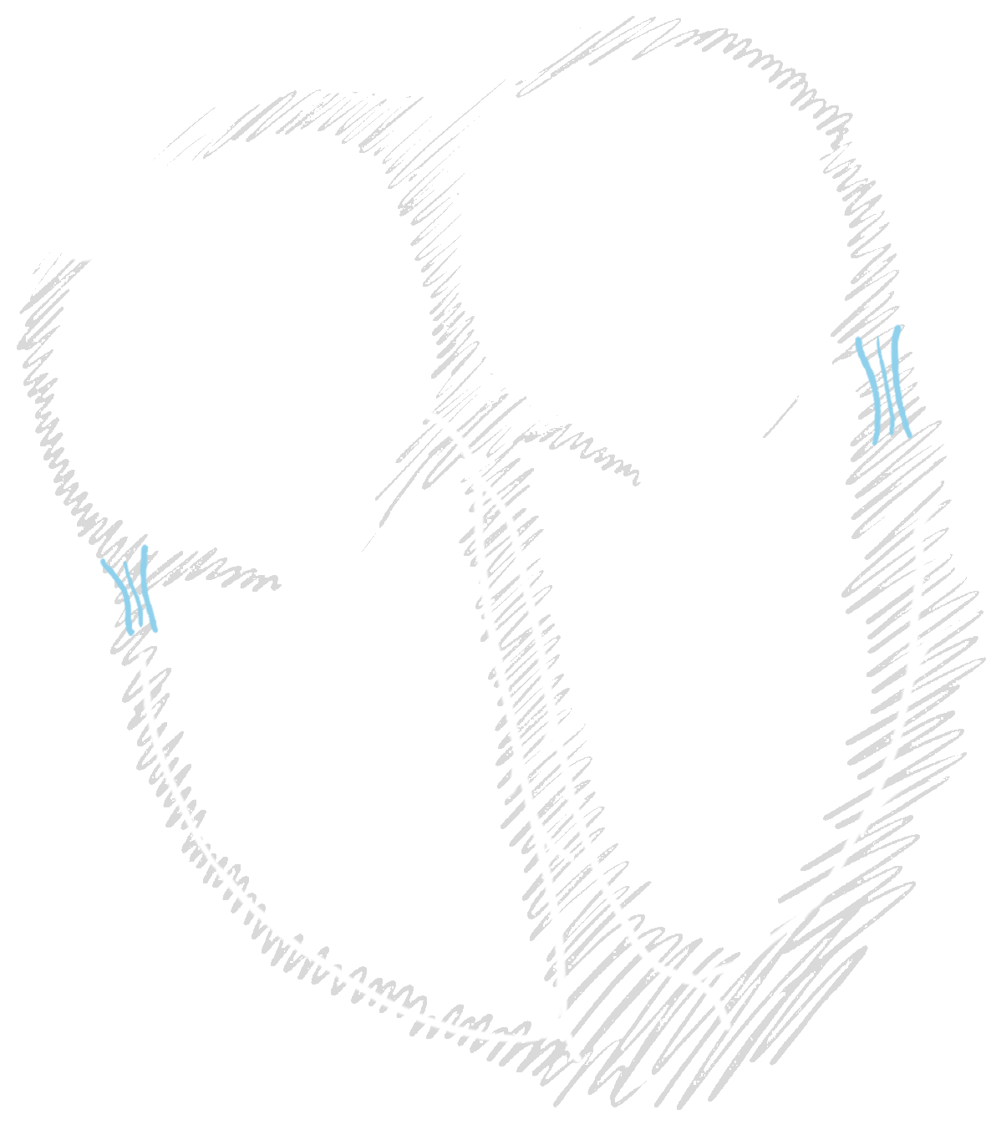


Ventricular Pre-excitation
Accessory Pathway
delta wave

Slide 13
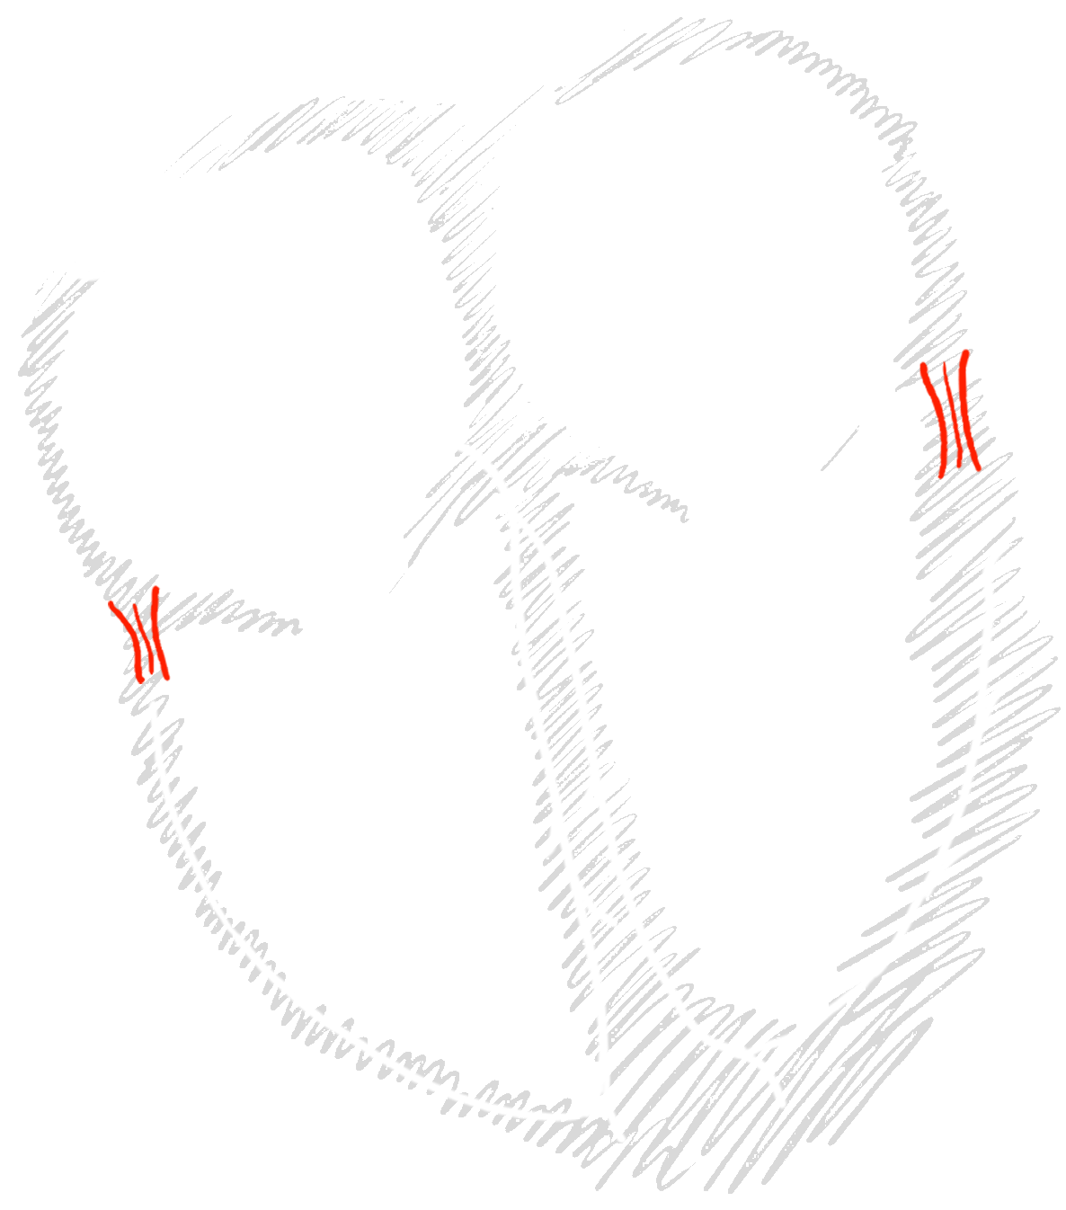
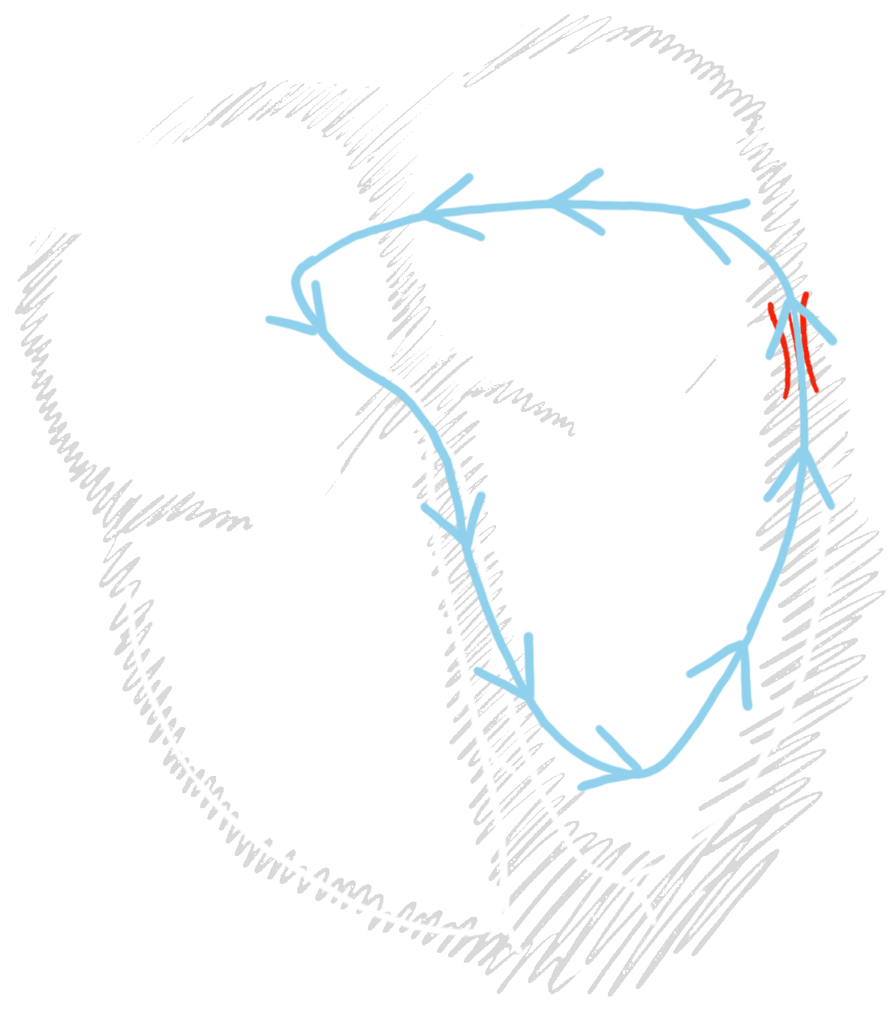
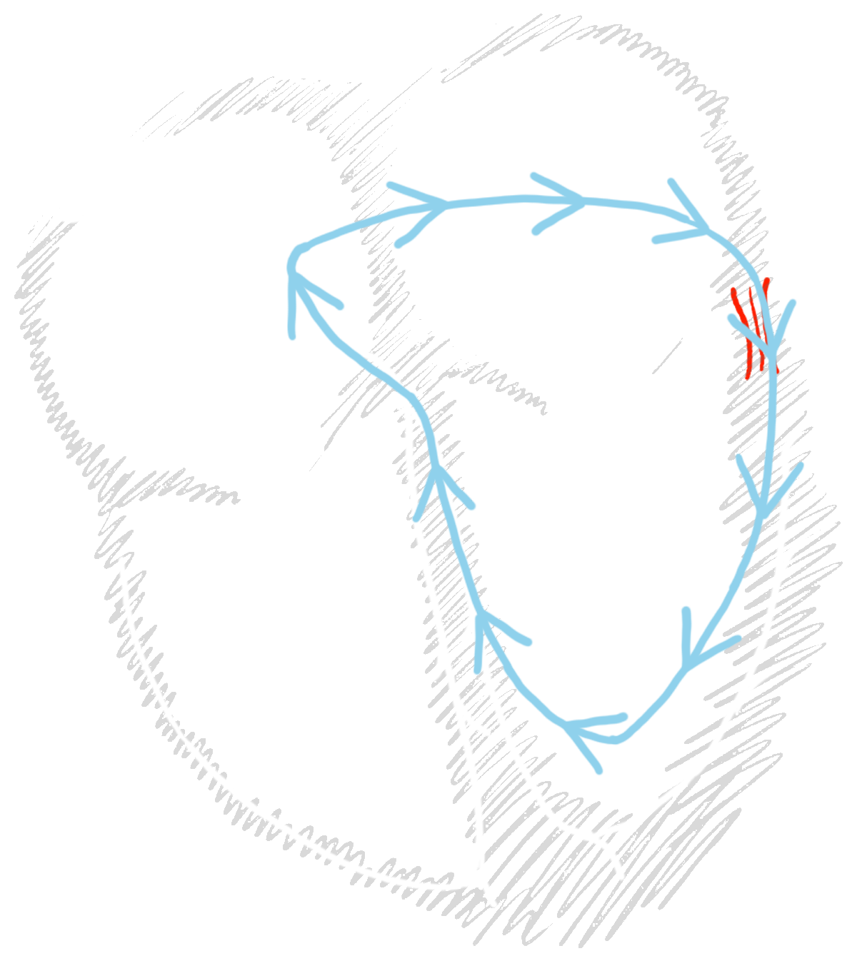
AVRT Orthodromic
Notes:
Orthodromic

Slide 14
AVRT Antidromic
Notes:
Orthodromic

Slide 15
62-year-old male presents with chest pain
185

Slide 16
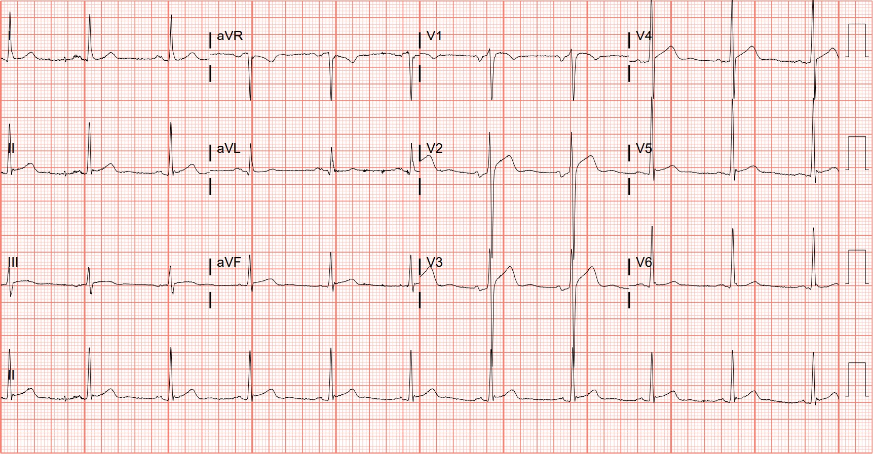
Notes:
Left Ventricular Hypertrophy. Cornell criteria for left ventricular hypertrophy is met via the large S wave in V3 (see case 84). The discordant ST-segment elevation in leads V2 through V4 is not out of proportion given the amplitude of the R-S complex. One paper by Armtstrong, et al., defines an abnormal amount of ST-segment elevation (in leads V1 through V3 and in the setting of left ventricular hypertrophy) as greater than 25% of the R-S amplitude (Figure 67).¹³⁰

Slide 17
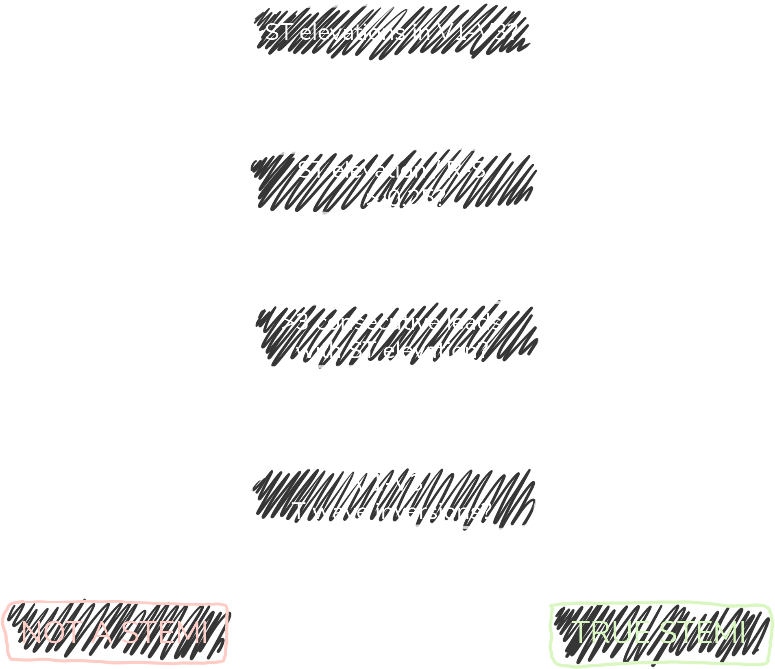
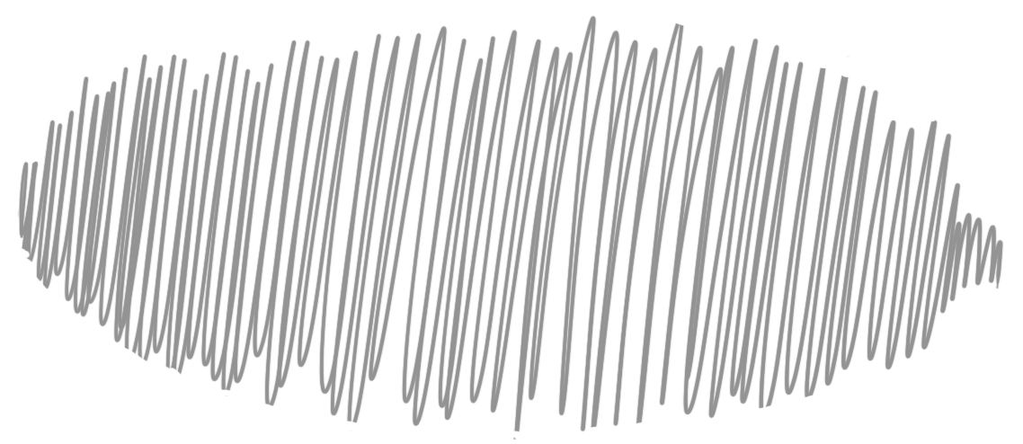


Left Ventricular Hypertrophy
Sokolow-Lyon
criteria
S_{V1} + R_{V5,6} > 35 mm
R_{aVL} > 11 mm
Cornell criteria
R_{aVL} + S_{V3} >
28 mm (M) or 20 mm (W)

Slide 18

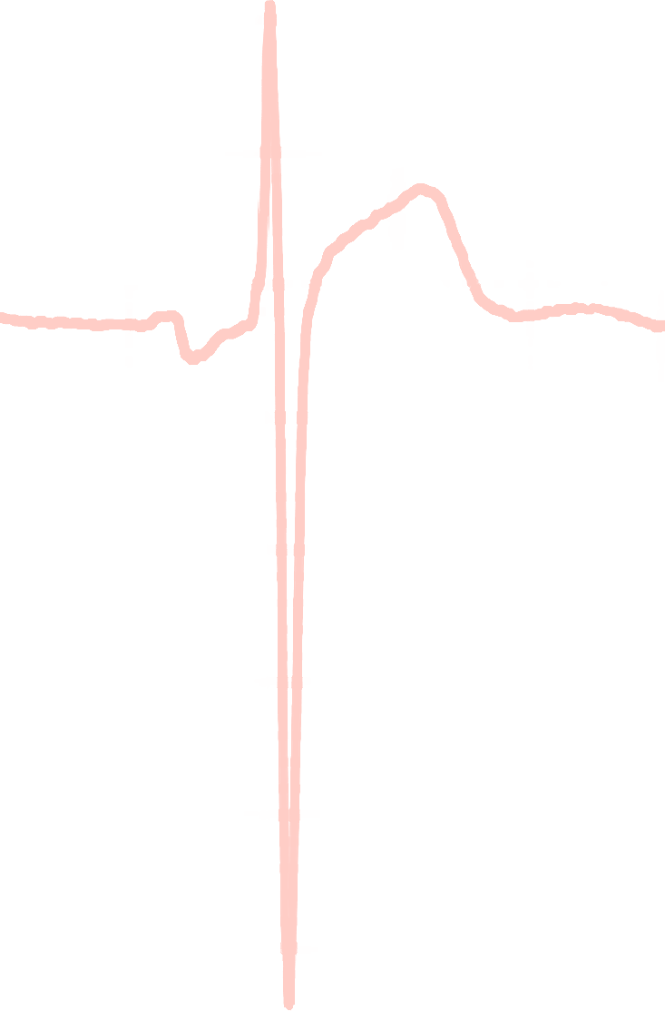

Armstrong Algorithm for STE in LVH
V1-V3
91%
Specificity
STE
R-S
STE/R-S
> 0.25?
77%
Sensitivity
Armstrong EJ, Kulkarni AR, Bhave PD, et al. Electrocardiographic criteria for ST-elevation myocardial infarction in patients with left ventricular hypertrophy. Am J Cardiol. 2012;110(7):977-983.
Notes:
Sensitivity 77%
Specificity 91%

Slide 19
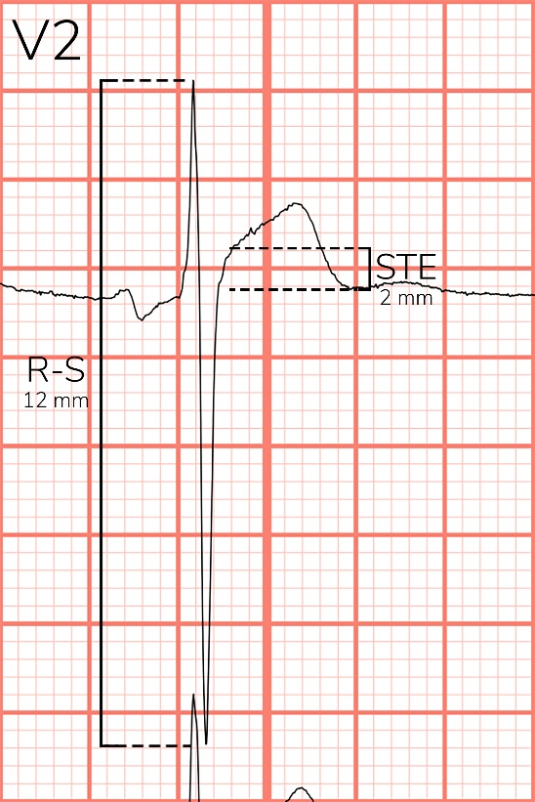
Notes:
Left Ventricular Hypertrophy. Cornell criteria for left ventricular hypertrophy is met via the large S wave in V3 (see case 84). The discordant ST-segment elevation in leads V2 through V4 is not out of proportion given the amplitude of the R-S complex. One paper by Armtstrong, et al., defines an abnormal amount of ST-segment elevation (in leads V1 through V3 and in the setting of left ventricular hypertrophy) as greater than 25% of the R-S amplitude (Figure 67).¹³⁰

Slide 20
71-year-old male presents with chest pain
186

Slide 21
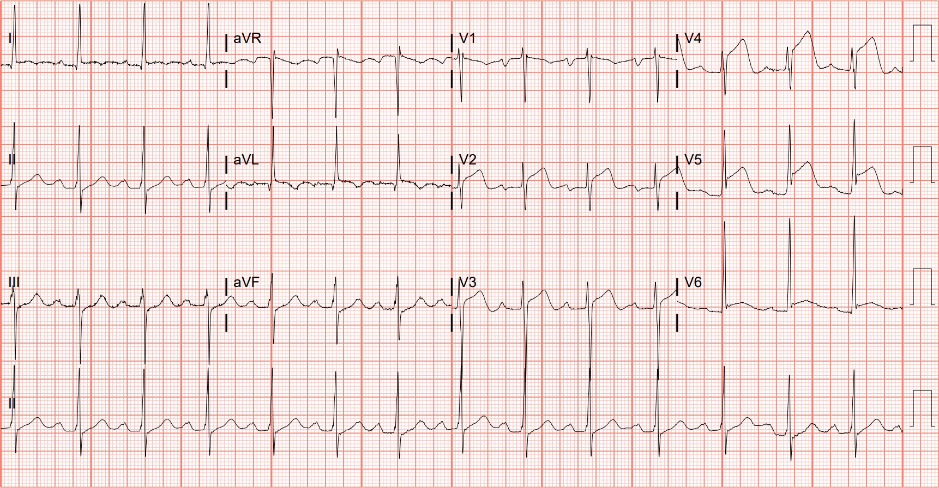
Notes:
Anterior ST-elevation Myocardial Infarction, Left Ventricular Hypertrophy. Left ventricular hypertrophy is diagnosed via the Sokolow Lyon criteria (see case 84). The degree of ST-segment elevation in the anterolateral precordial leads is more than expected for appropriate discordance (Figure 68).¹³⁰ Left heart catheterization revealed complete left anterior descending occlusion and percutaneous coronary intervention was successful.

Slide 22


Notes:
Left ventricular hypertrophy is present given the large QRS complexes. The degree of ST-segment elevation in the anterior precordial leads is more than expected for appropriate discordance. Left heart catheterization revealed complete left anterior descending occlusion.

Slide 23
60-year-old male presents with chest pain
187

Slide 24
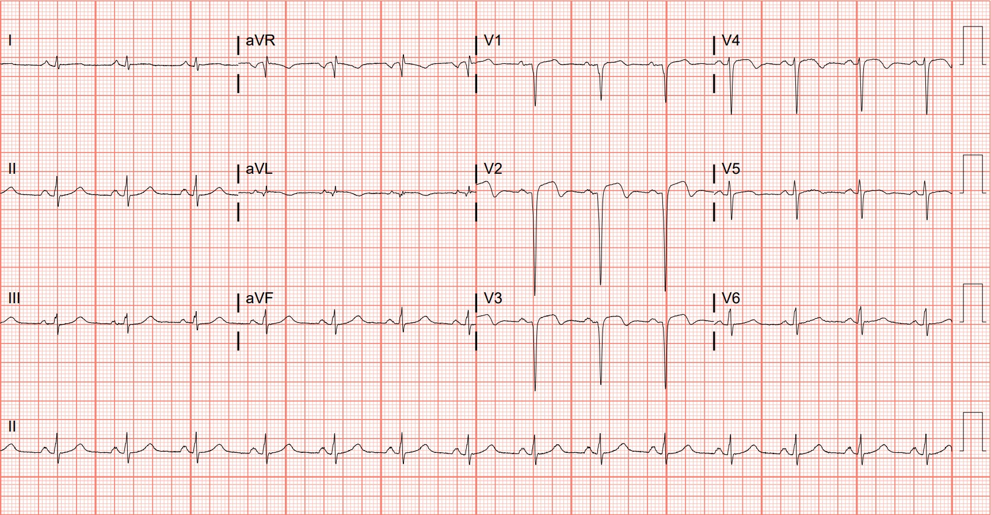
Notes:
Left Ventricular Aneurysm. In the absence of reperfusion therapy, left ventricular aneurysm is a common structural complication of anterior myocardial infarction.^{80,82} Usual ECG findings include ST-segment elevation that persists more than two weeks after STEMI, deep Q waves, and the absence of reciprocal ST-segment depressions.⁸¹ Large Q waves in the anterior precordial leads with associated ST-segment depression (consistent with prior ECGs) is consistent with anterior left ventricular aneurysm, confirmed via echocardiography.^{81,131,132}

Slide 25
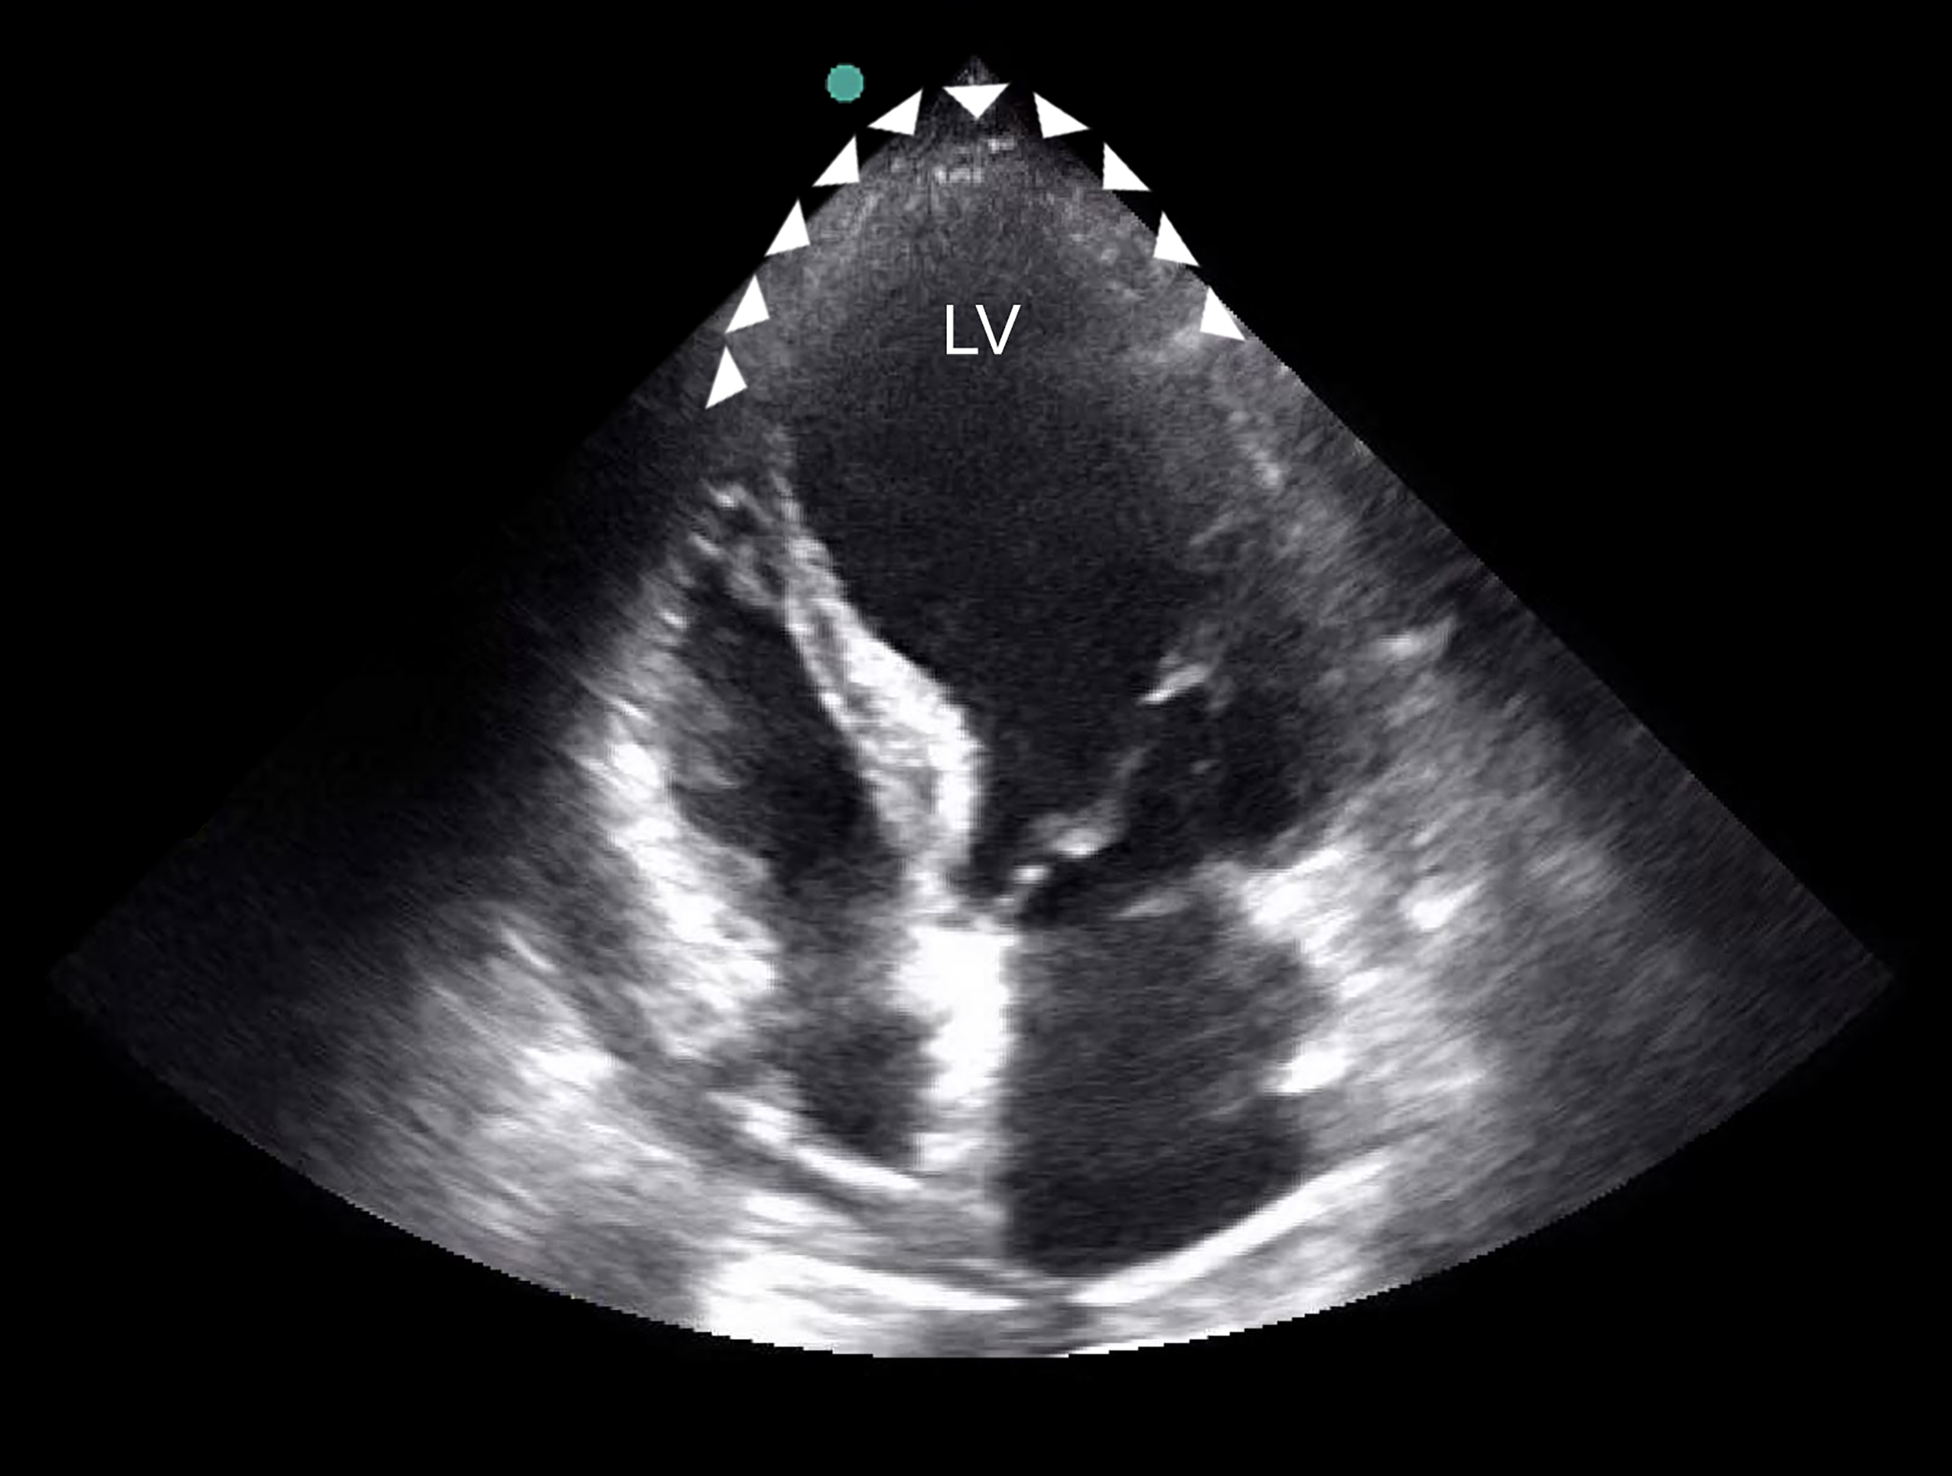
LV Aneurysm

