Slide 1

Conference 33
ECG STAMPEDE

Slide 2
33-year-old male presents with GSW
176

Slide 3
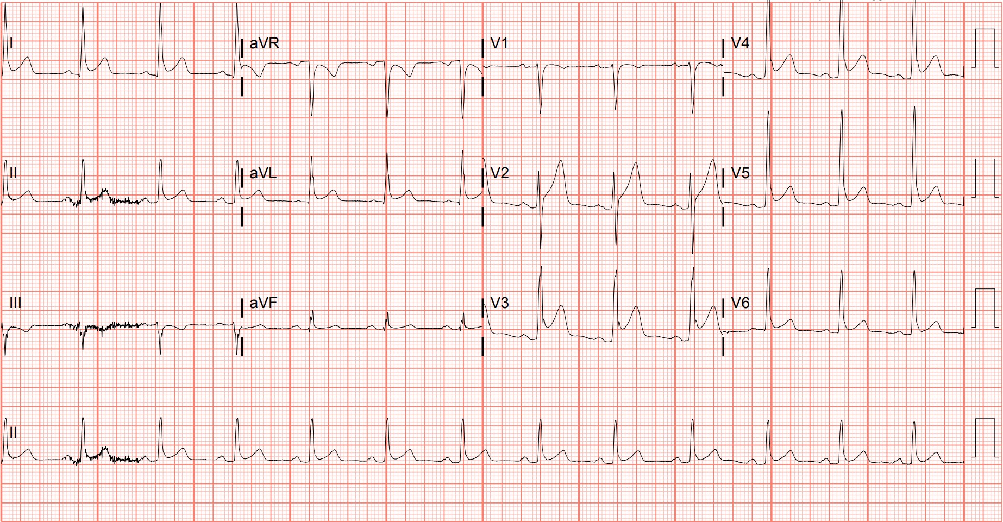
Notes:
Early Repolarization. This patient received an ECG for reasons unrelated to his presentation and was incidentally noted to have diffuse, concave ST-segment elevation. The degree of ST-segment elevation is greater in the precordial leads, and a prominent J-point notch (or “fishhook”) can be visualized in V3, characteristic of early repolarization.^{84,129}

Slide 4
40-year-old female presents with chest pain
177

Slide 5
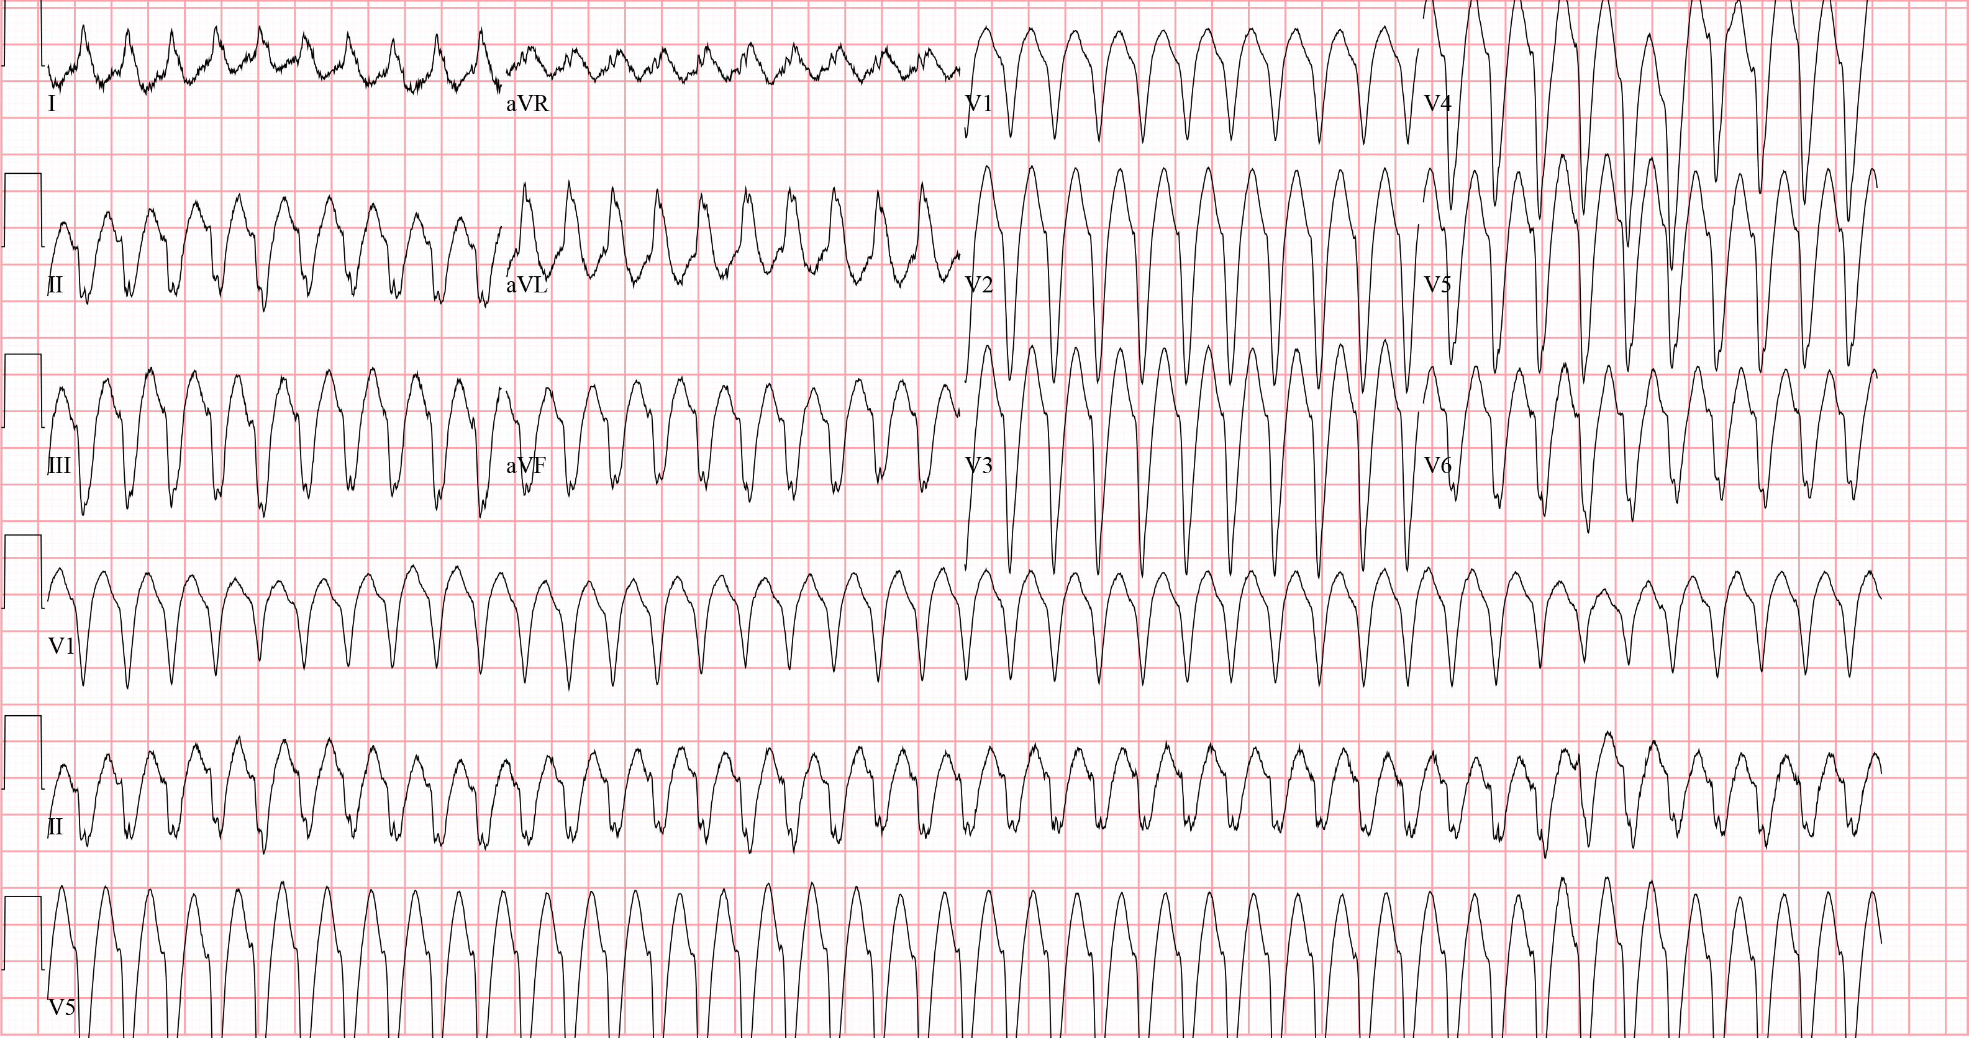
Notes:
Ventricular Tachycardia. The differential for regular wide complex tachycardia includes ventricular tachycardia, supraventricular tachycardia with aberrancy, antidromic atrioventricular reentrant tachycardia, and toxicologic/metabolic disturbances.¹¹ This ECG shows concordance across all precordial leads (i.e., the QRS complexes are going in the same direction - downwards), favoring ventricular tachycardia.¹² The patient was electrically cardioverted.

Slide 6

Fast & Narrow
Slow & Narrow
Irregular
Atrial fibrillation
Atrial flutter w/ VC
MAT
Irregular
Atrial fibrillation
Sinus node dysfunction
2nd deg AVB
Regular
AVNRT
AVRT
Sinus tachycardia
Atrial flutter w/ FC
Atrial tachycardia
Regular
Sinus node dysfunction
Hyperkalemia/tox
2nd deg AVB
3rd deg AVB w/ JE
Junctional
Fast & Wide
Slow & Wide
Ventricular tachycardia
SVT w/ aberrancy
Sodium channel toxicity
Hyperkalemia
AVRT
SND w/ aberrancy
Hyperkalemia/tox
2nd deg AVB w/ aberrancy
3rd deg AVB w/ VE

Slide 7
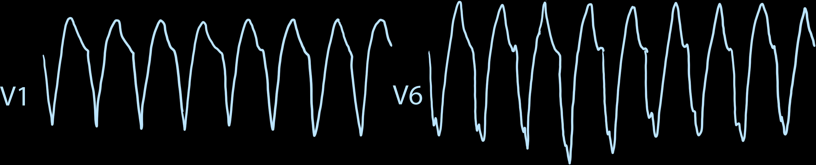

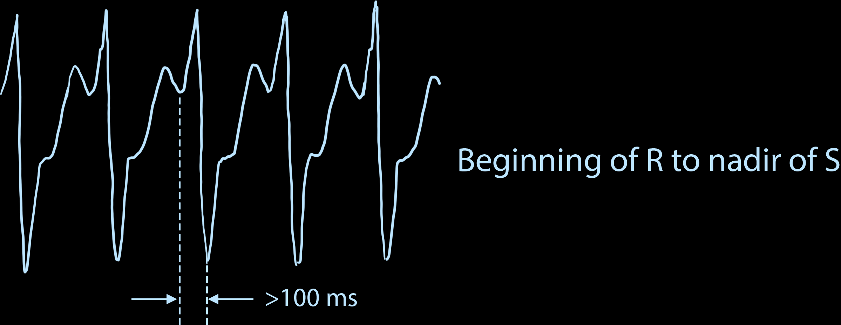
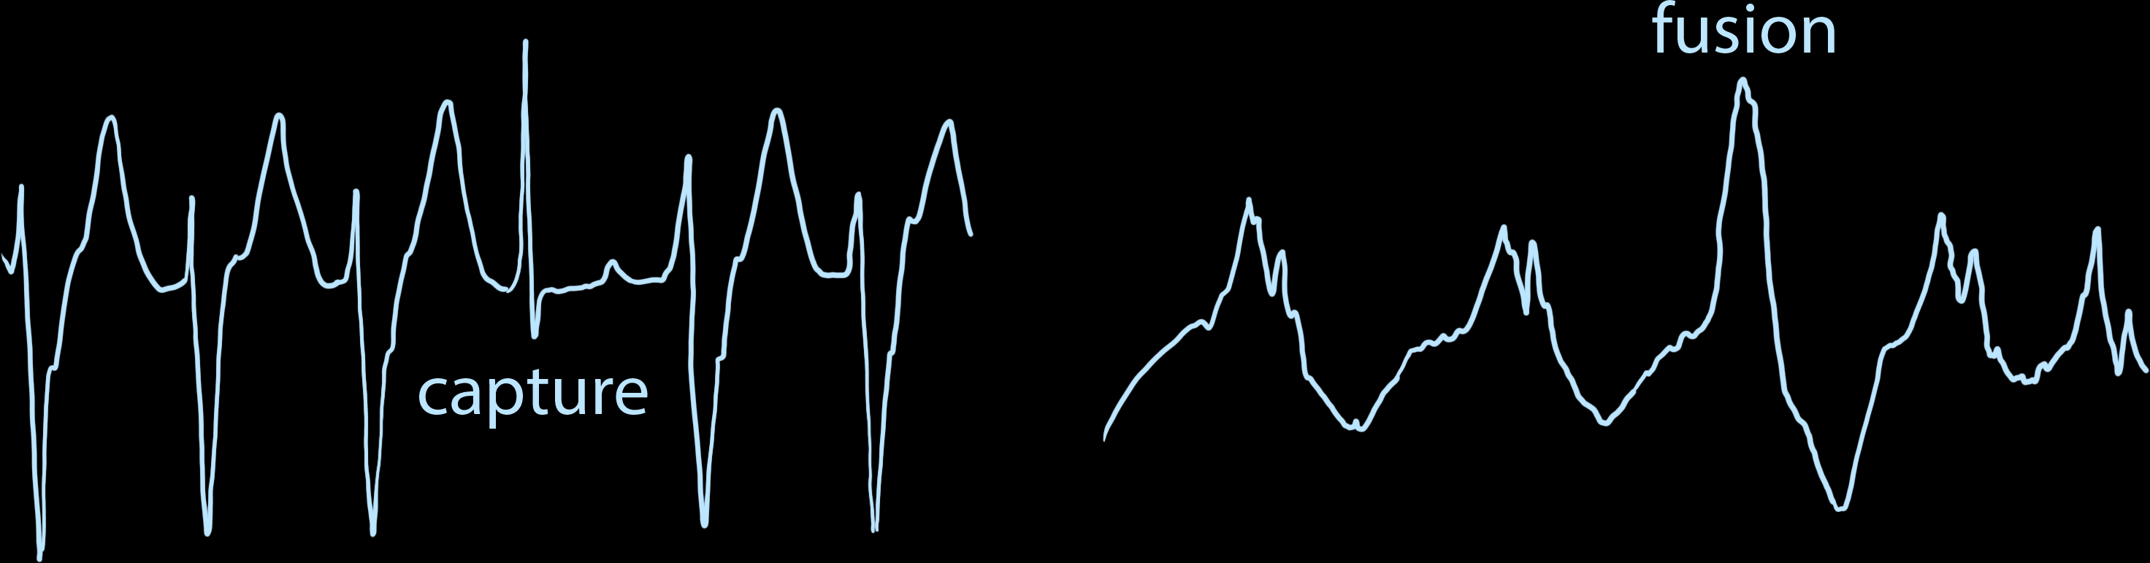
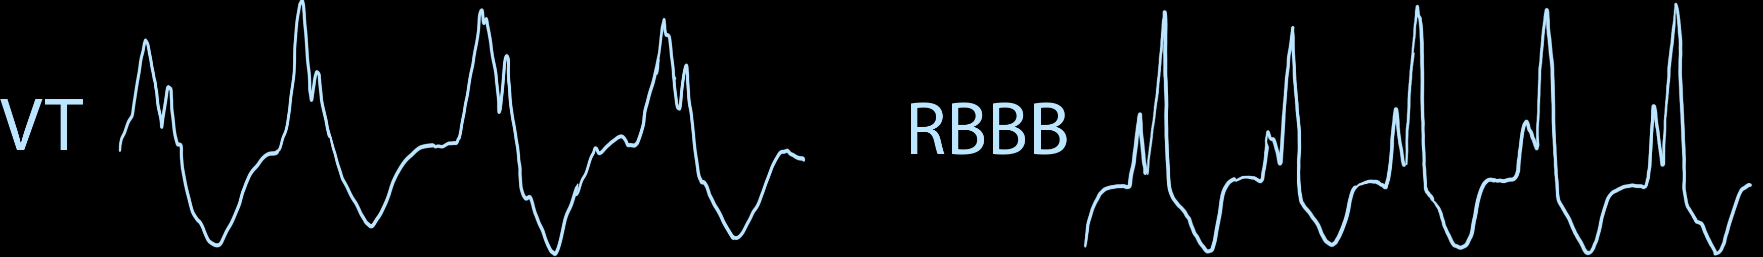
VT vs SVT with aberrancy (Brugada Algorithm)
Concordance
R-S > 100
AV Dissociation
Morphology

Slide 8
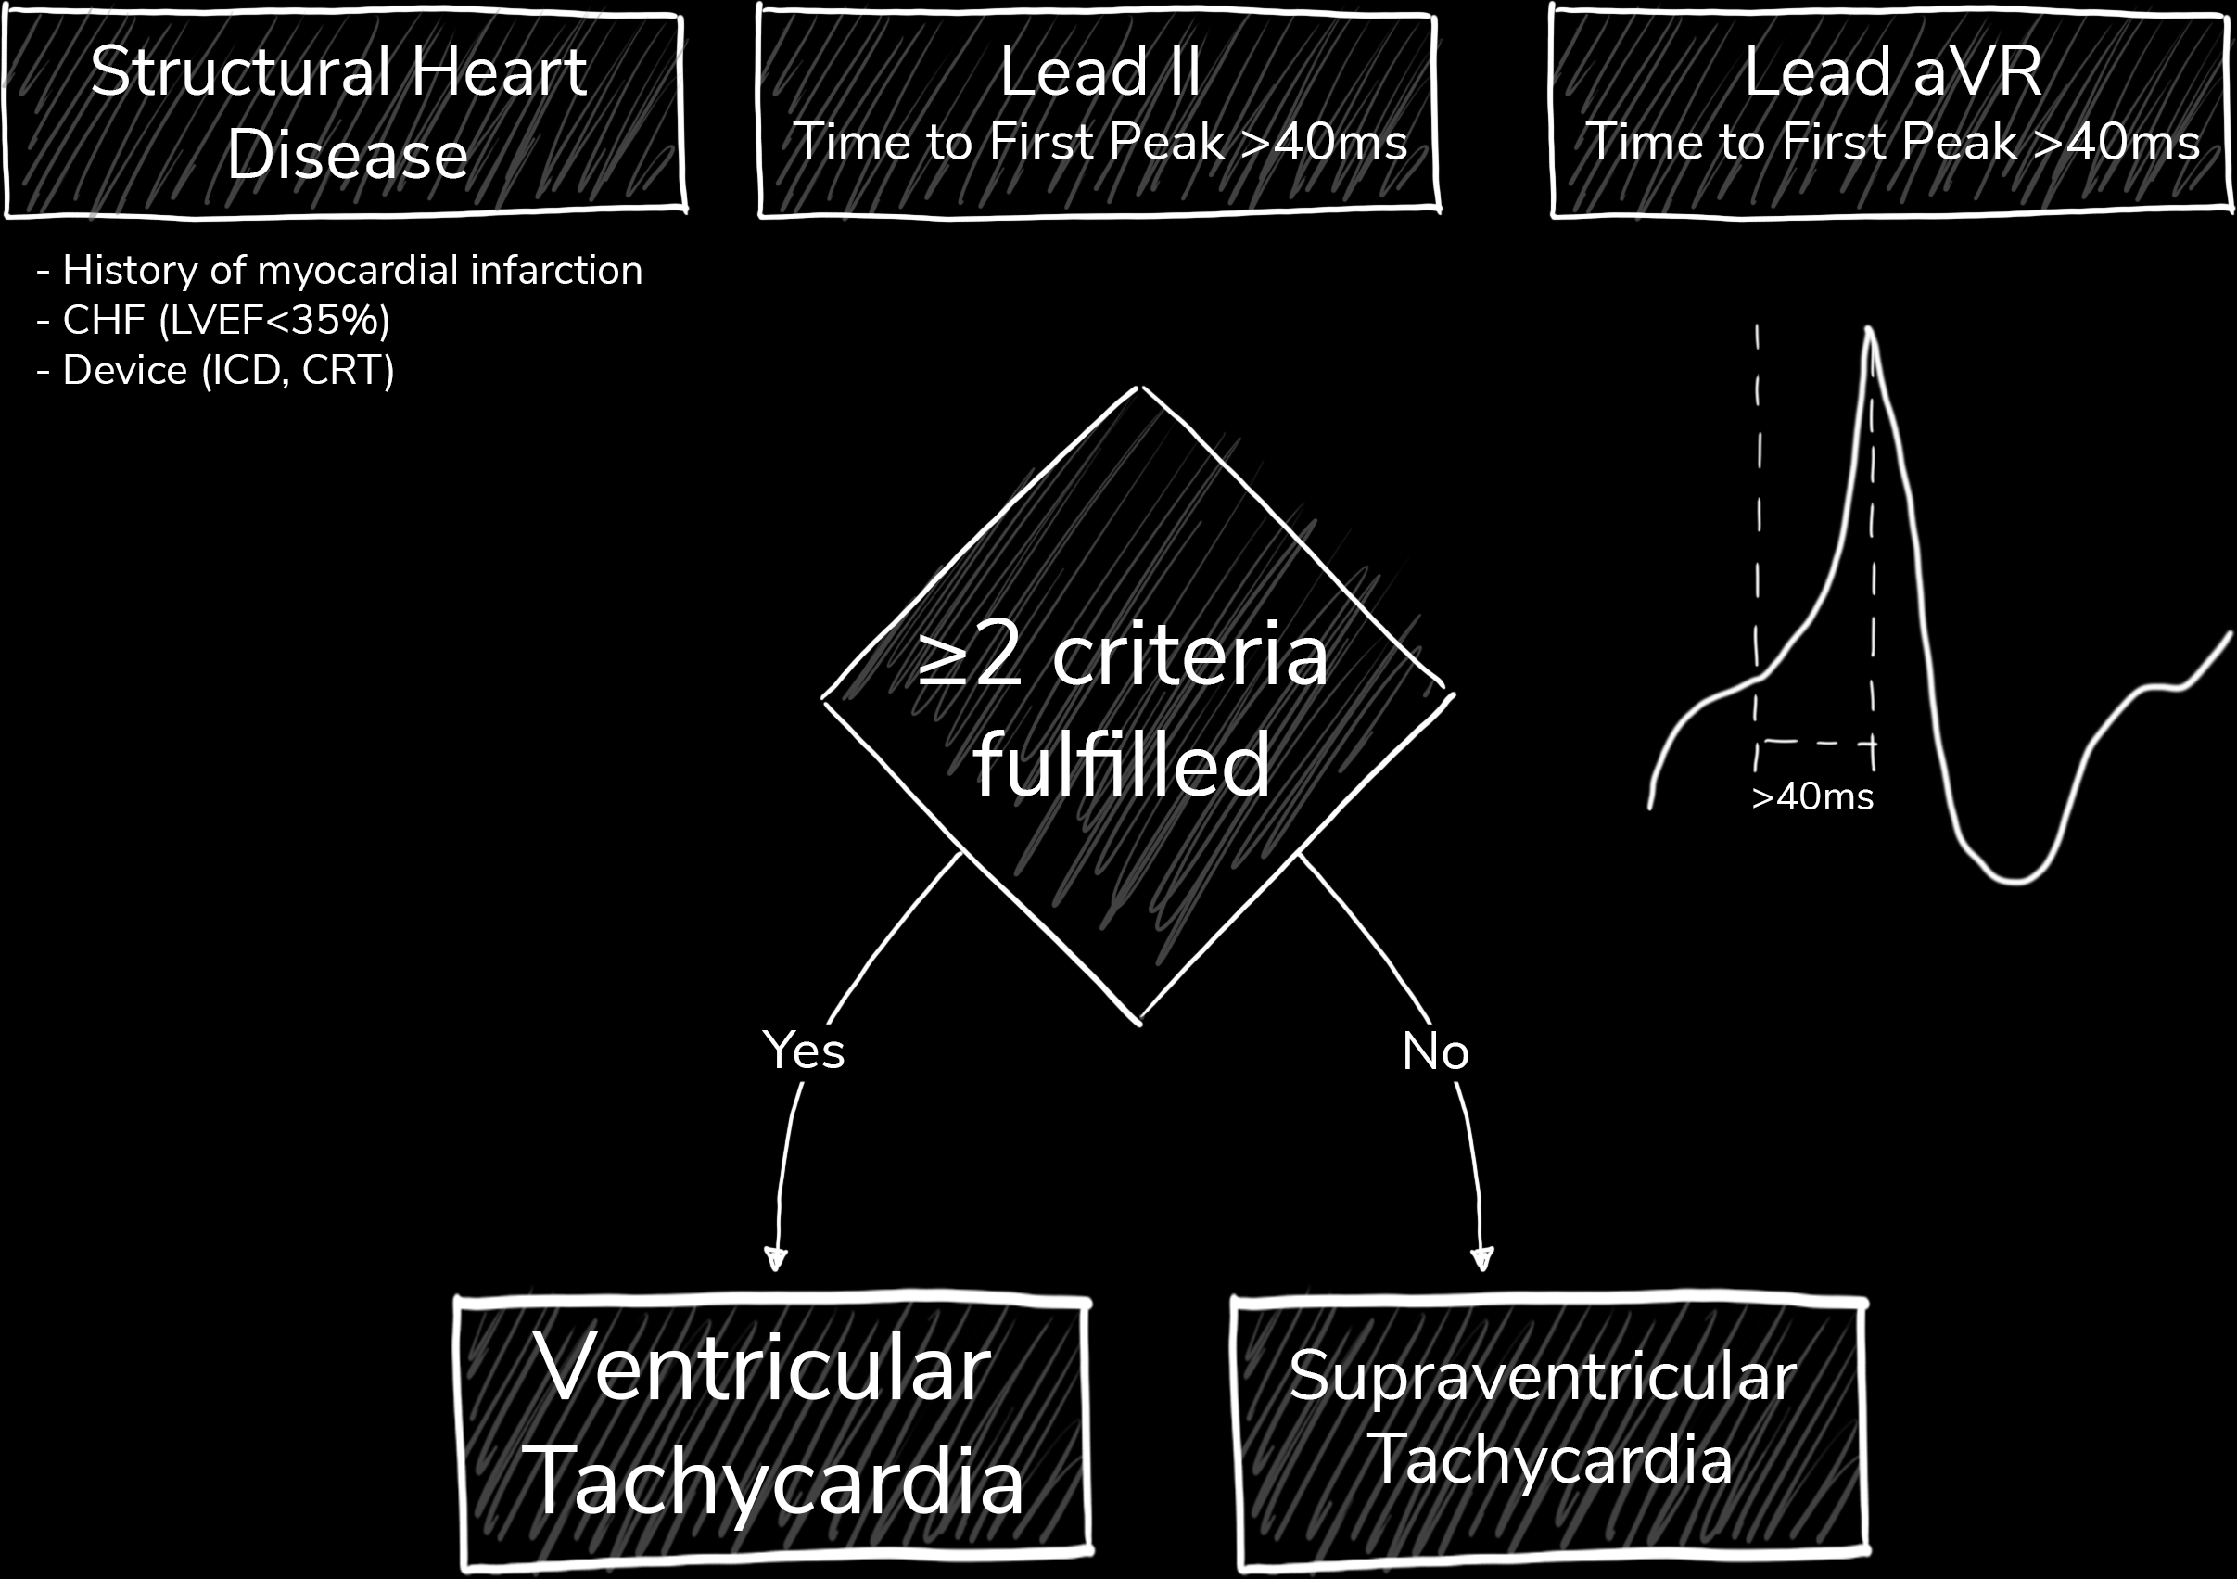
VT vs SVT with aberrancy (Basel Algorithm)

Slide 9
61-year-old male presents with exertional chest pain
178

Slide 10
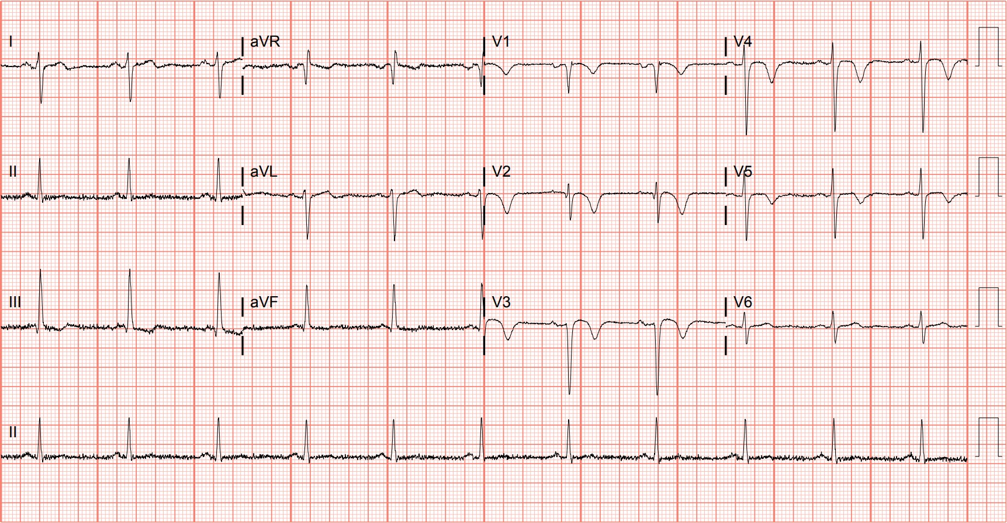
Notes:
Wellens Syndrome. Wellens syndrome, previously described in case 18, represents a special category of high-risk acute coronary syndrome that should receive urgent catheterization.^{30,31} This is type B Wellens pattern with deeply inverted precordial T waves obtained while the patient was pain-free. Left heart catheterization revealed a 90% proximal left anterior descending stenosis.

Slide 11

ECG Patterns of OMI
Ricci F, Martini C, Scordo DM, Rossi D, Gallina S, Fedorowski A, Sciarra L, Chahal CAA, Meyers HP, Herman R, Smith SW. ECG Patterns of Occlusion Myocardial Infarction: A Narrative Review. Ann Emerg Med. 2025 Apr;85(4):330-340. doi: 10.1016/j.annemergmed.2024.11.019. Epub 2025 Jan 17. PMID: 39818676.

Slide 12

ECG Patterns of OMI
Ricci F, Martini C, Scordo DM, Rossi D, Gallina S, Fedorowski A, Sciarra L, Chahal CAA, Meyers HP, Herman R, Smith SW. ECG Patterns of Occlusion Myocardial Infarction: A Narrative Review. Ann Emerg Med. 2025 Apr;85(4):330-340. doi: 10.1016/j.annemergmed.2024.11.019. Epub 2025 Jan 17. PMID: 39818676.

Slide 13
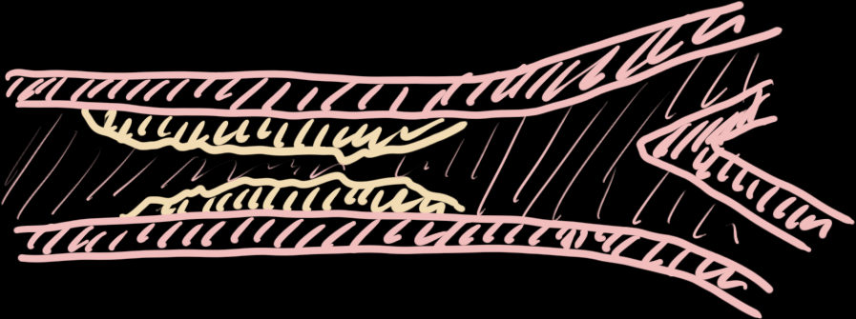
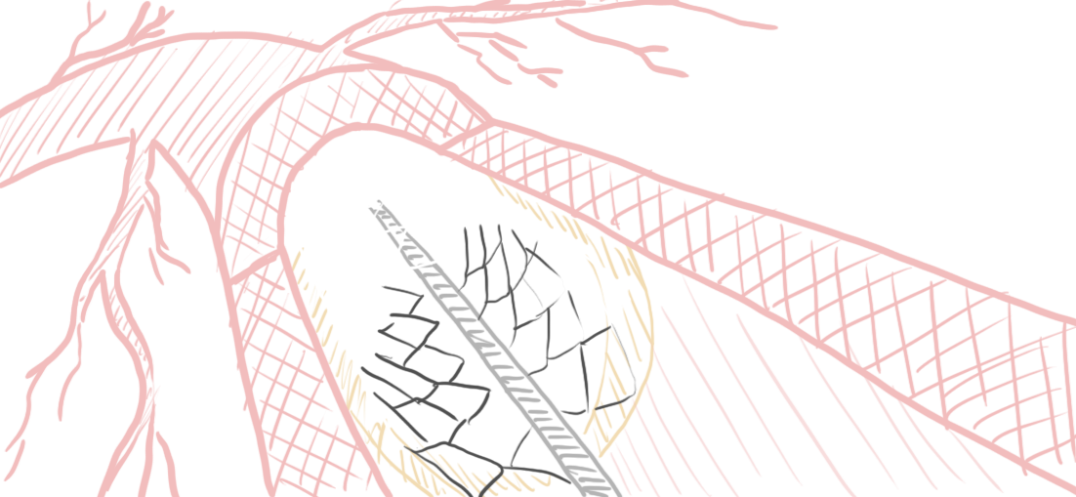
Wellens Syndrome
Critical LAD stenosis
Urgent PCI

Slide 14
62-year-old male presents with altered mental status
179

Slide 15
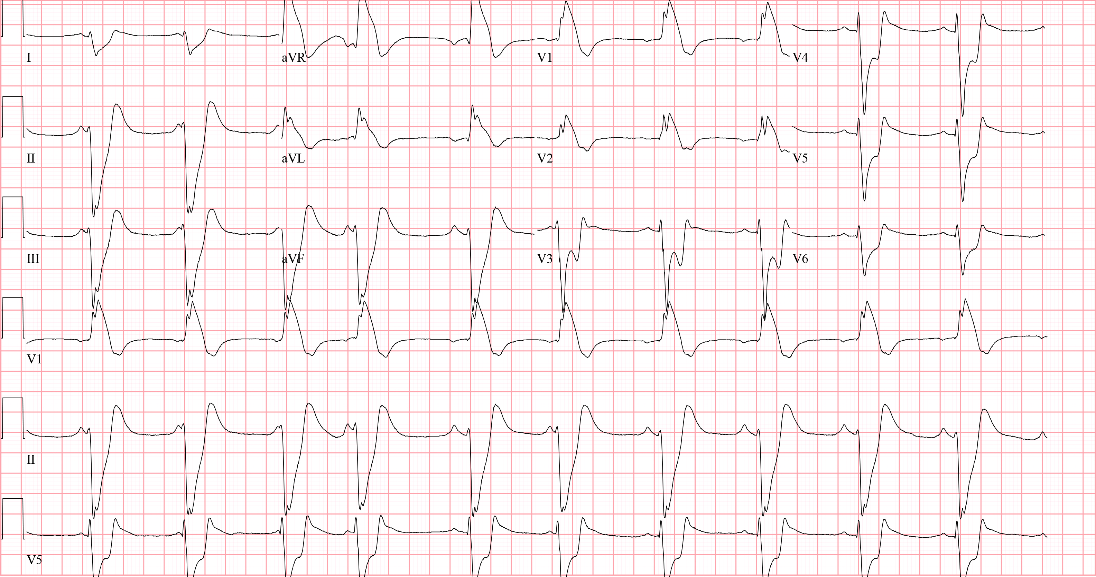
Notes:
Hyperkalemia. This patient presented with altered mental status and was found to have ECG changes of profound hyperkalemia. The rhythm is sinus, although it is unclear whether the initial several P waves are conducted through to the ventricles because of the inconsistent PR interval. There is a right axis deviation, a right bundle branch block pattern, and a widened QRS (~240 ms, more than expected for a typical right bundle branch block).

Slide 16
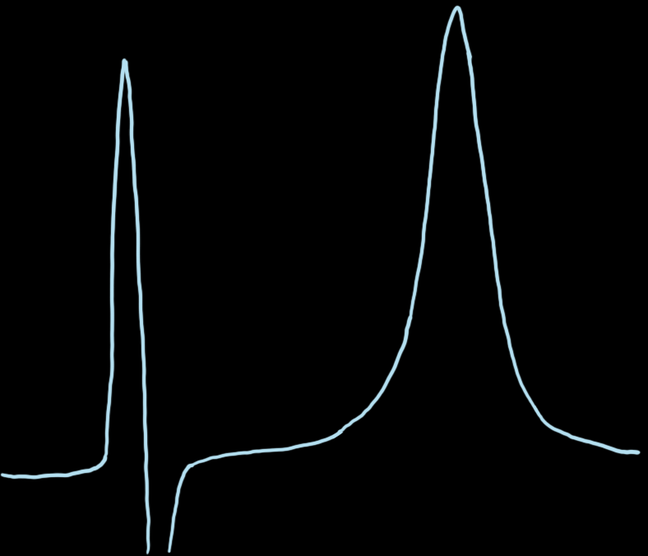
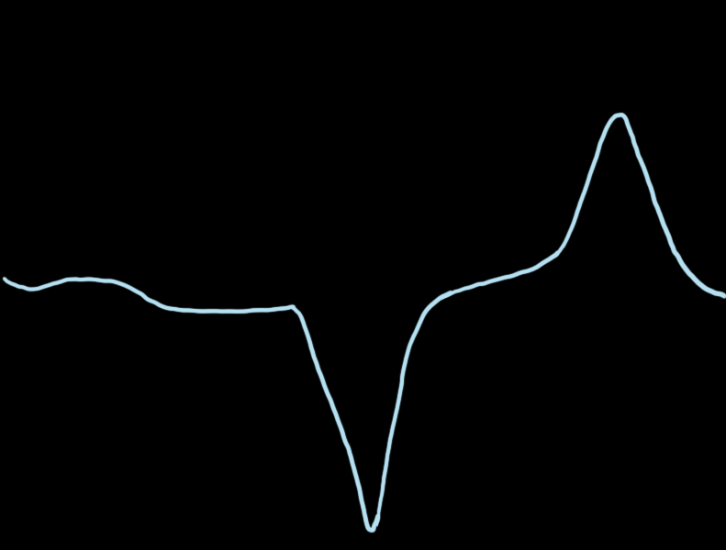
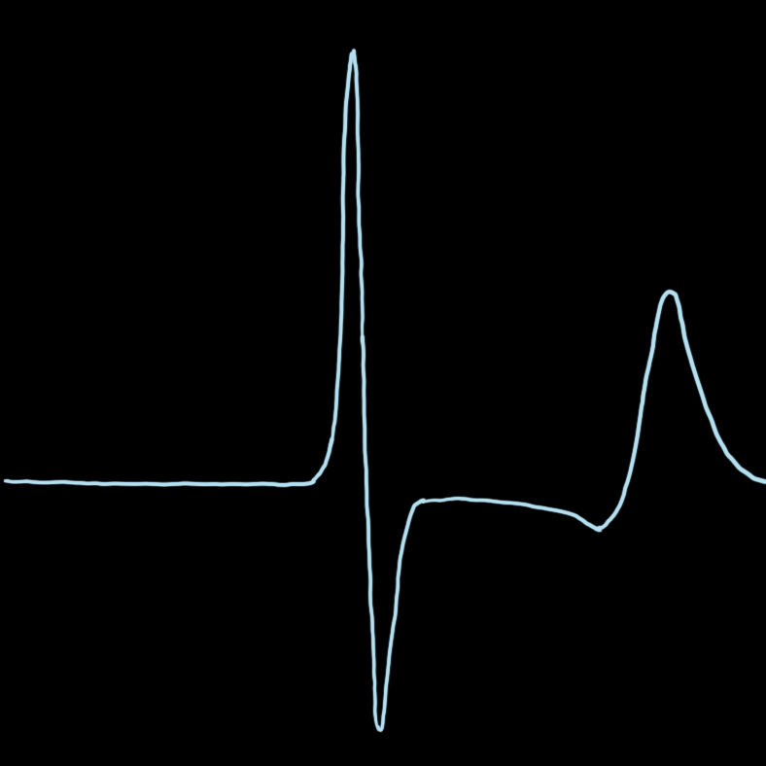
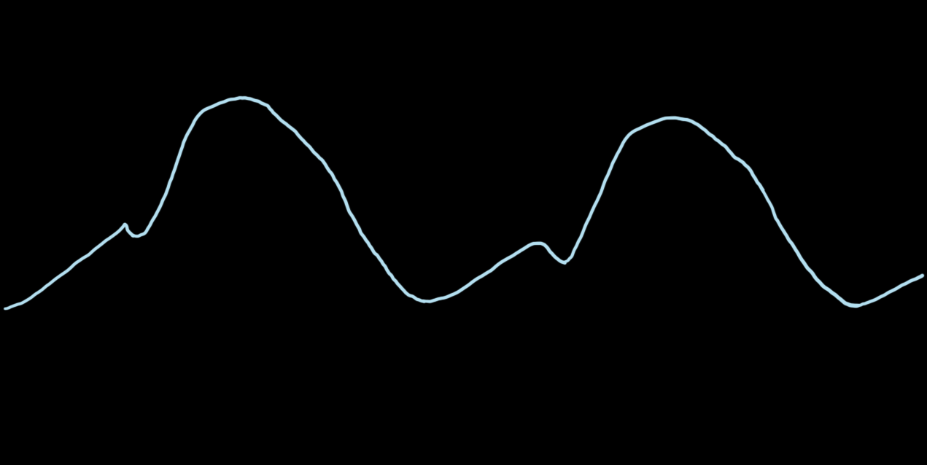
Hyperkalemia ECG Changes
Potassium Lvl | Potential ECG Changes
5.5-6.5 mEq/L | Tall, peaked T waves with narrow base QT interval shortening ST-segment depression
6.5-8.0 mEq/L | Peaked T waves PR-interval prolongation P wave decreased amplitude or disappearance QRS widening R-wave amplification
> 8.0 mEq/L | P-wave absence QRS widening Intraventricular/fascicular/bundle branch blocks Sine wave

Slide 17



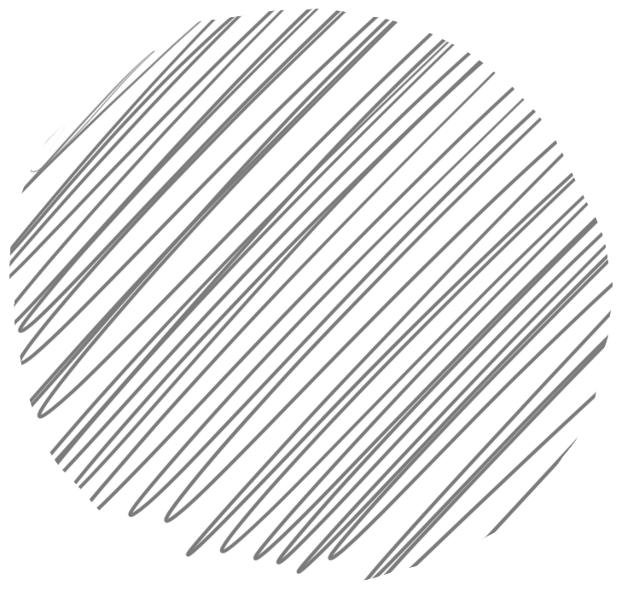
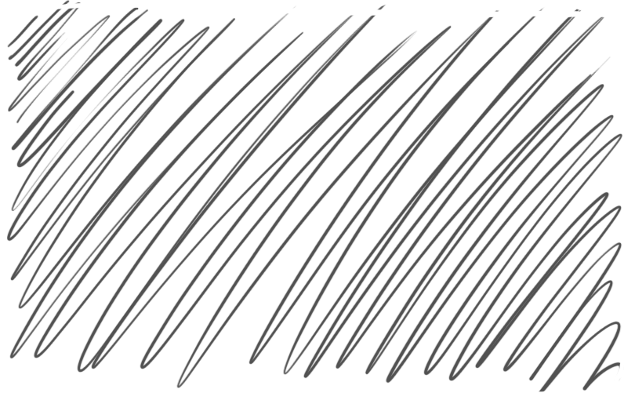
Hyperkalemia Short Term Adverse Events
Heart Rate
<50
QRS
>110
Junctional
Durfey, N., Lehnhof, B., Bergeson, A., Durfey, S., Leytin, V., McAteer, K., Schwam, E., & Valiquet, J. (2017). Severe Hyperkalemia: Can the Electrocardiogram Risk Stratify for Short-term Adverse Events? Western Journal of Emergency Medicine, 18(5), 963–971. https://doi.org/10.5811/westjem.2017.6.33033

Slide 18
61-year-old male presents with syncope
180

Slide 19
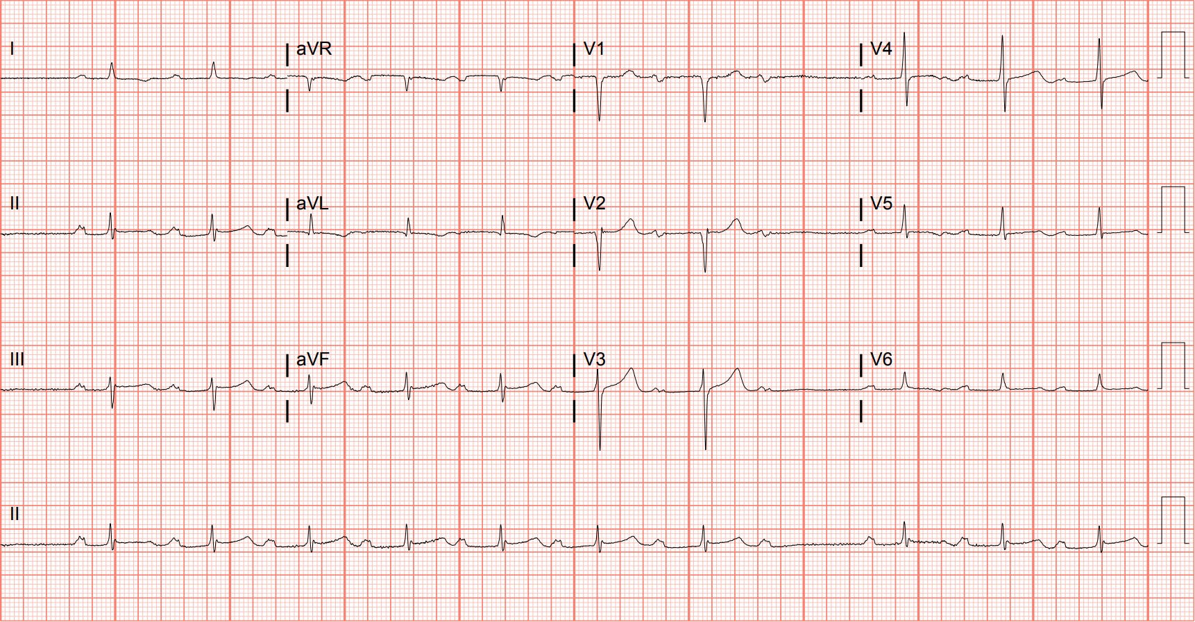
Notes:
Second Degree Atrioventricular Block - Mobitz I. Mobitz I occurs when conduction is progressively delayed through the atrioventricular node and eventually fails. The PR interval is prolonged and progressively lengthens until a P wave is “dropped,” or fails to conduct to the ventricular system, resulting in the absence of an associated QRS complex. There are eight P waves for every seven QRS complexes, representing 8:7 conduction.

Slide 20







Notes:
Adapted from Wagner GS, Strauss DG. Marriott’s Practical Electrocardiography. 12th ed. Philadelphia, PA: Lippincott Williams & Wilkins; 2014.

Slide 21
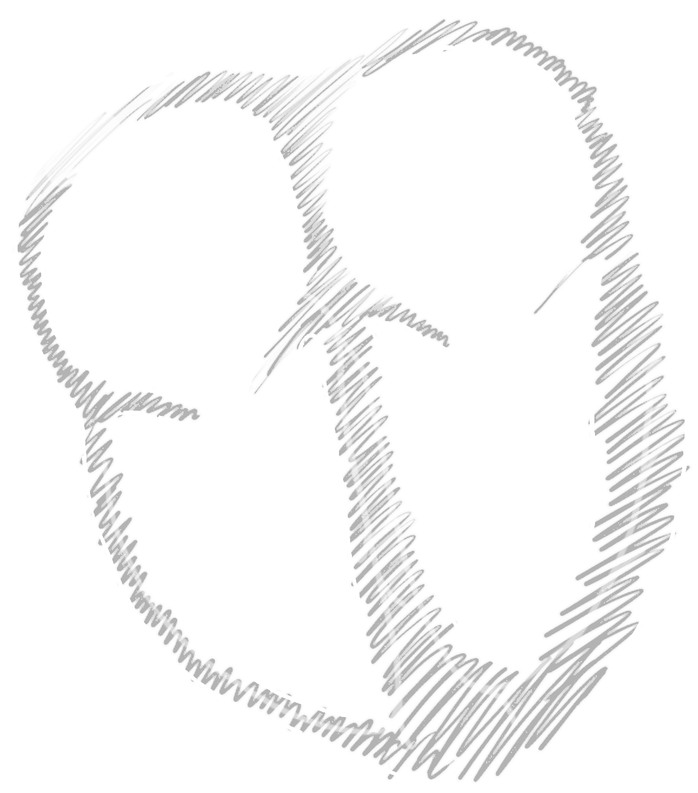


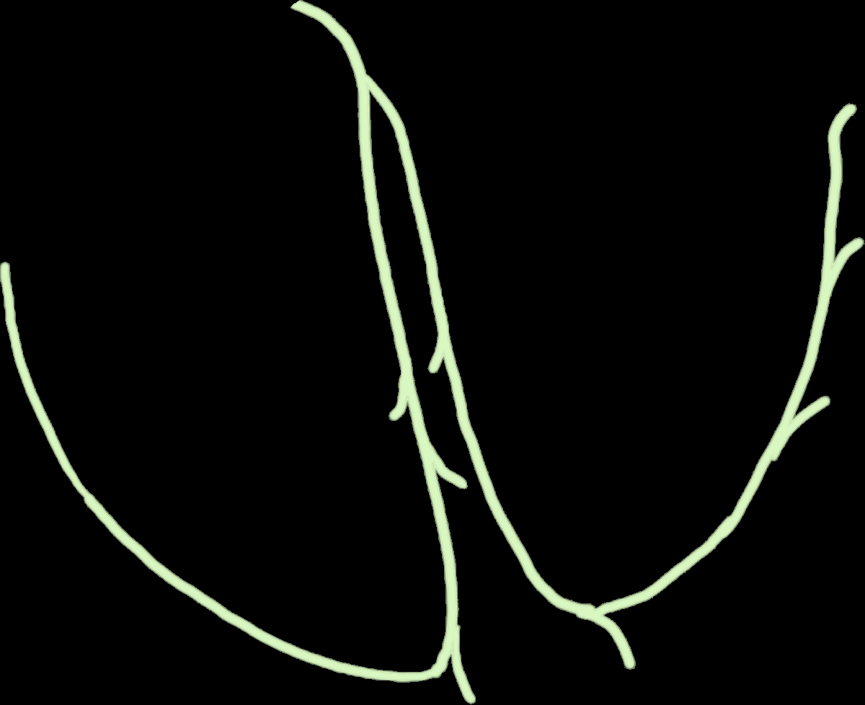





Acute Management
SND
Inferior MIs
Toxicologic
SA
atropine
AV
CB
1st degree AVB
2nd degree AVB – Mobitz I
3rd degree AVB w/ JE
LB
RB
2nd degree AVB – Mobitz II
3rd degree AVB w/ VE
atropine
Pacing

Slide 22
57-year-old male presents with dyspnea
181

Slide 23
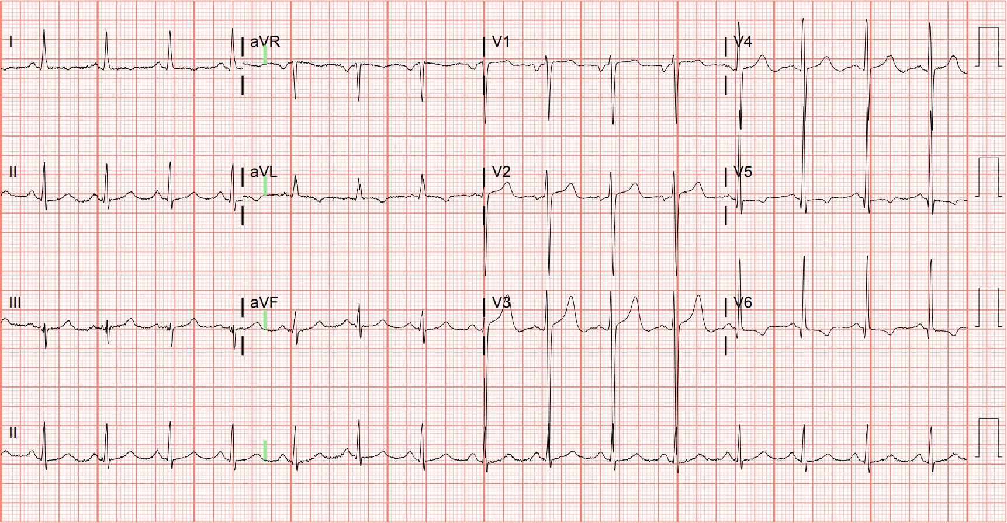
Notes:
Left Ventricular Hypertrophy, Left Atrial Enlargement. The large QRS complexes and asymmetric repolarization abnormalities (i.e., T wave inversions) in the lateral leads are consistent with the "strain" pattern of left ventricular hypertrophy. Additionally, notice that the terminal negative deflection of the P wave in V1 is greater than 1 mm deep and 40 ms in duration, meeting criteria for left atrial enlargement (Figure 44).²⁰ This patient was discovered to have severe aortic stenosis.

Slide 24
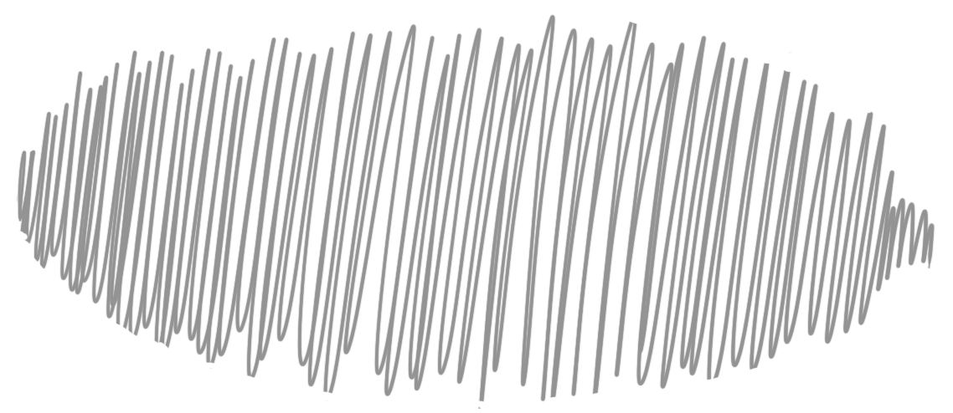
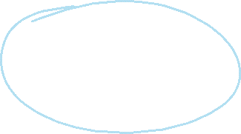
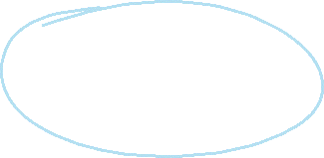
Sokolow-Lyon
criteria
S_{V1} + R_{V5,6} > 35 mm
R_{aVL} > 11 mm
Cornell criteria
R_{aVL} + S_{V3} >
28 mm (M) or 20 mm (W)
Notes:
Left Ventricular Hypertrophy, Left Atrial Enlargement. The large QRS complexes and asymmetric repolarization abnormalities (i.e., T wave inversions) in the lateral leads are consistent with the "strain" pattern of left ventricular hypertrophy. Additionally, notice that the terminal negative deflection of the P wave in V1 is greater than 1 mm deep and 40 ms in duration, meeting criteria for left atrial enlargement (Figure 44).²⁰ This patient was discovered to have severe aortic stenosis.

Slide 25

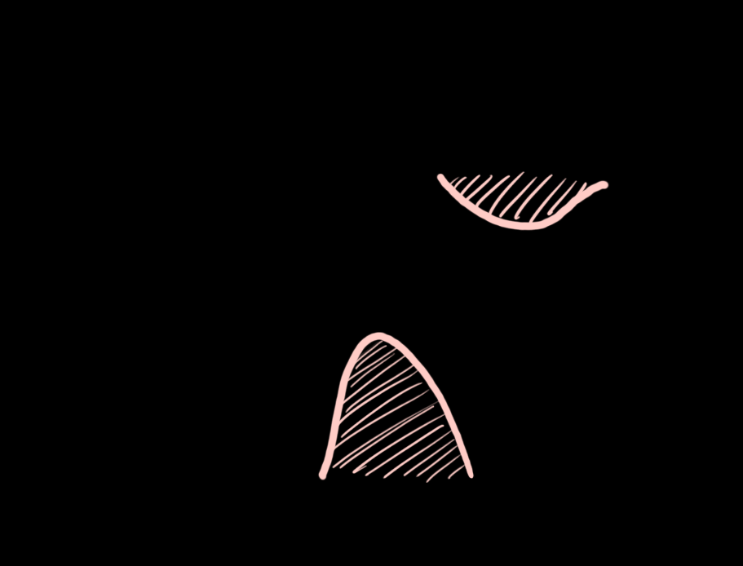
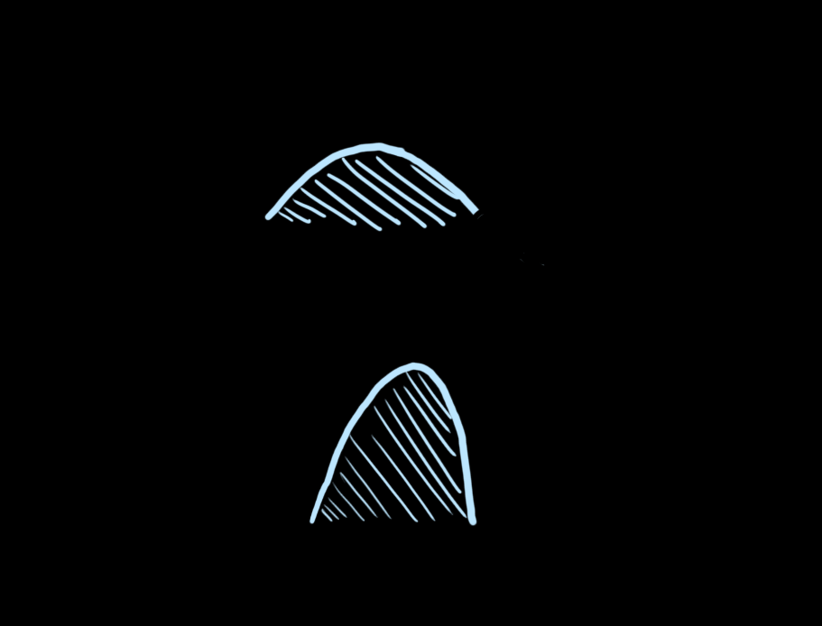
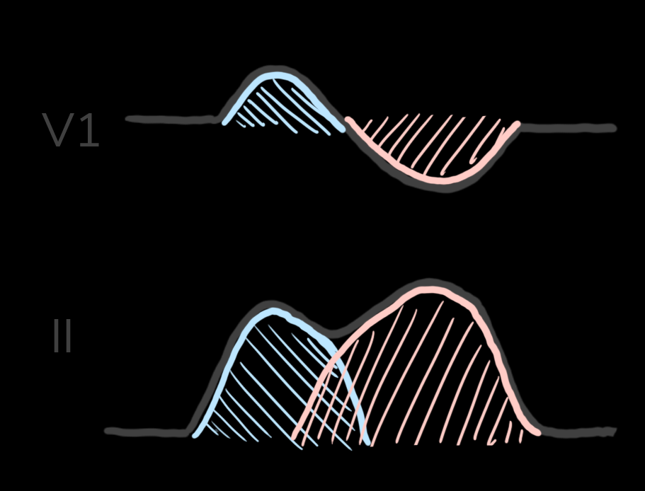
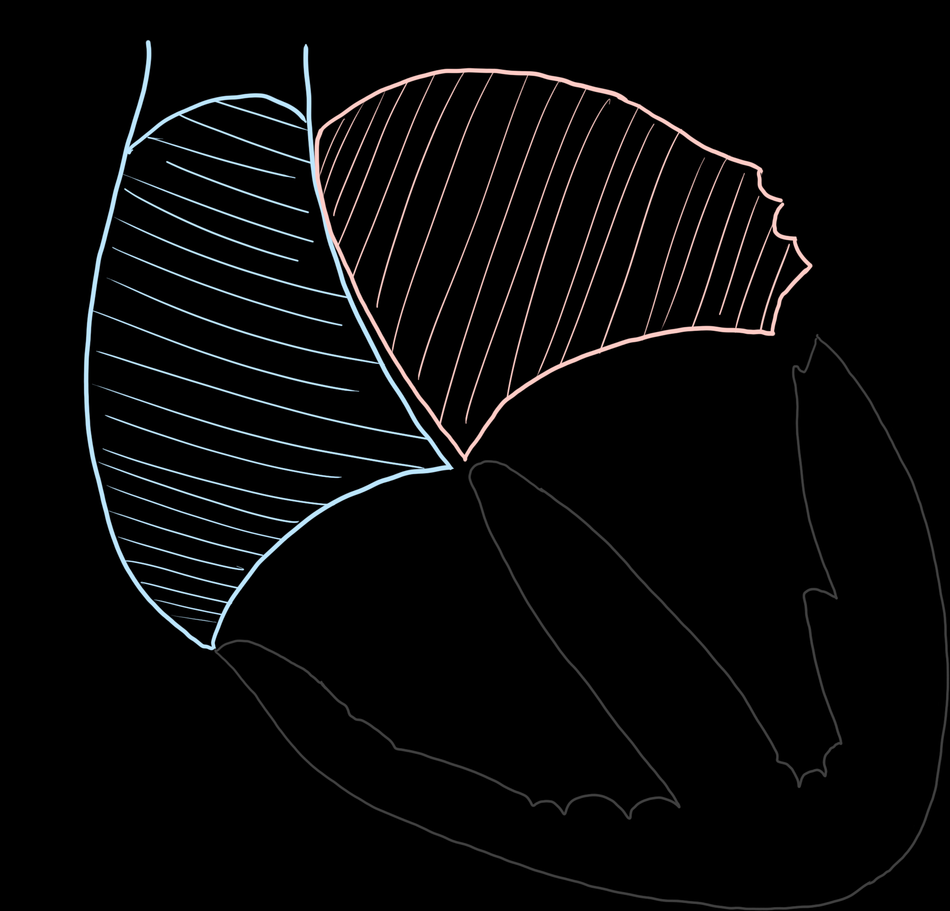
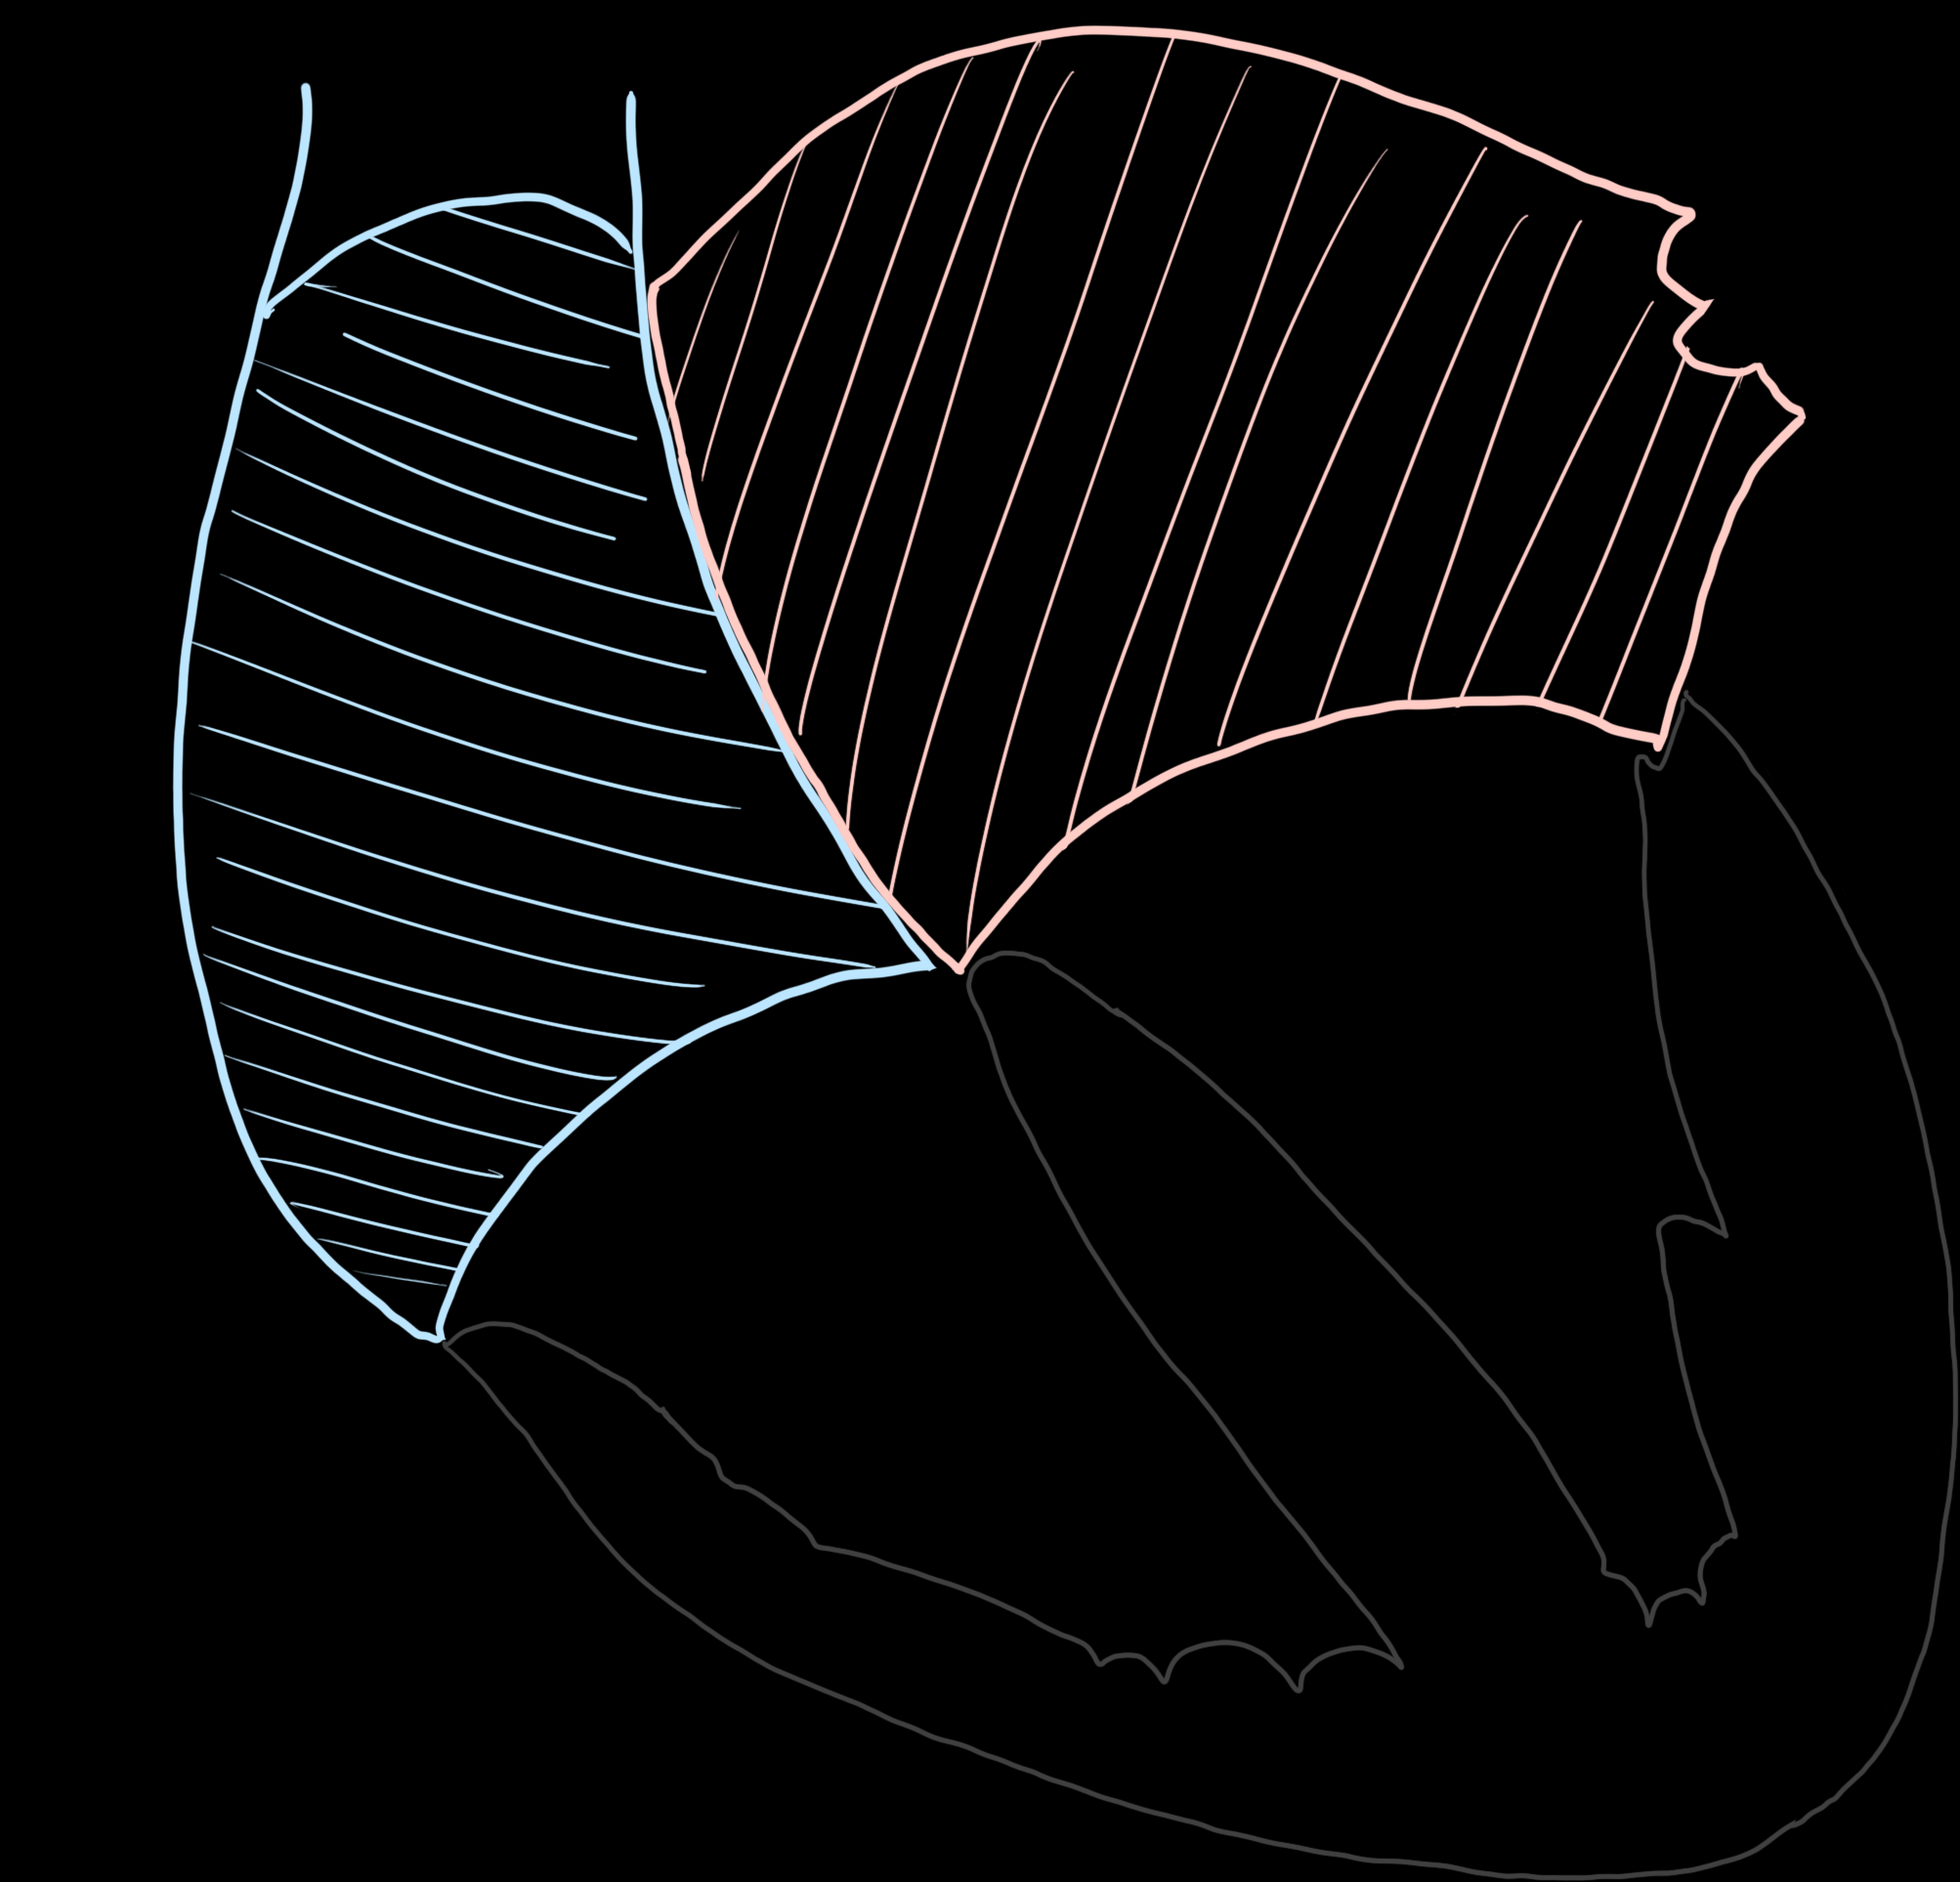
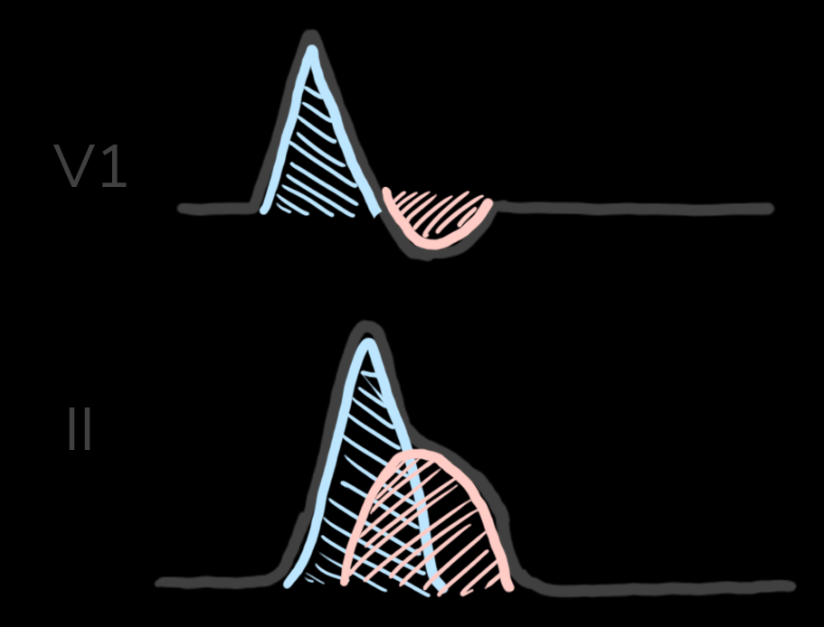
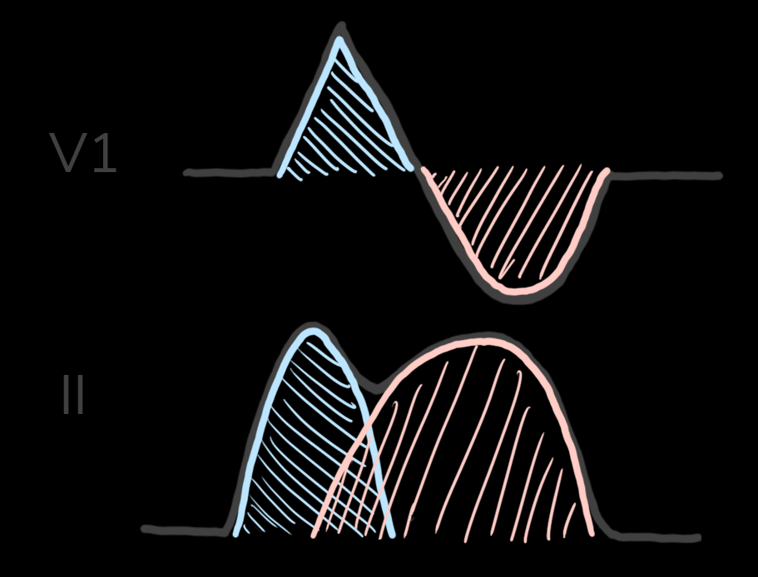
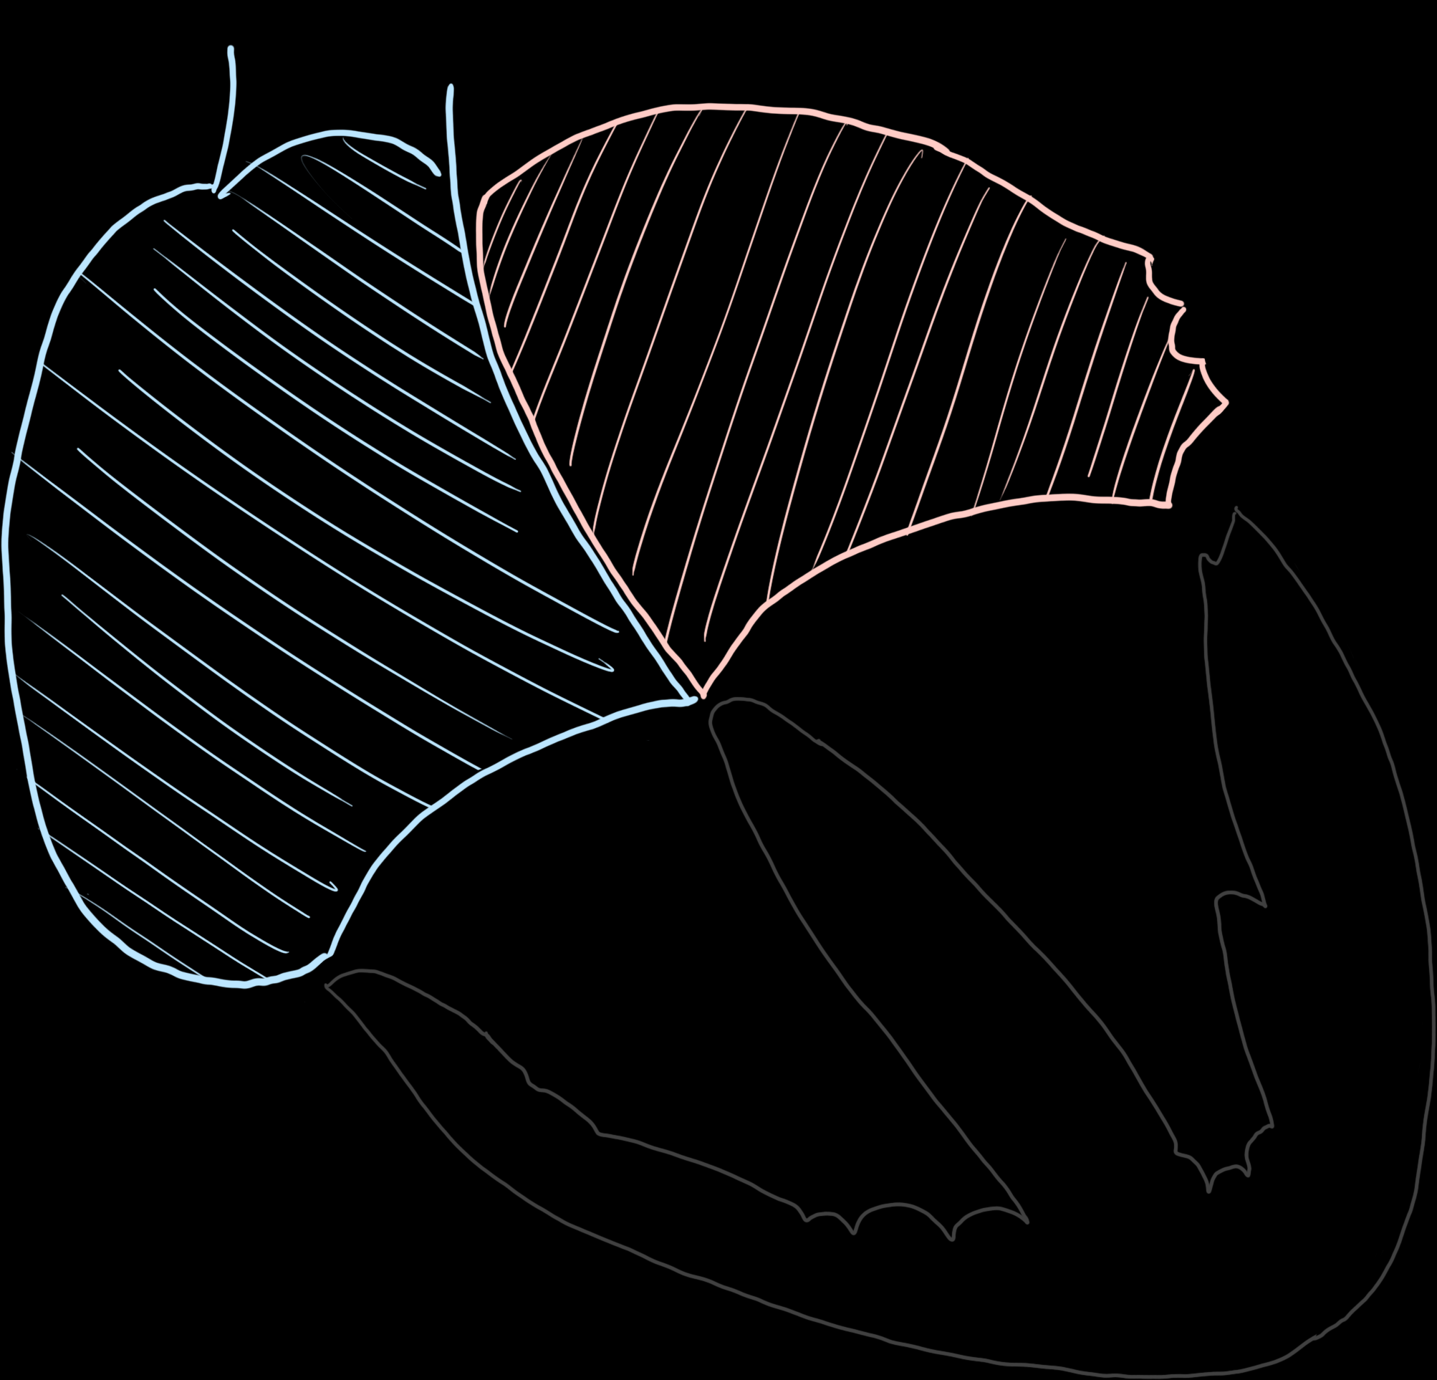
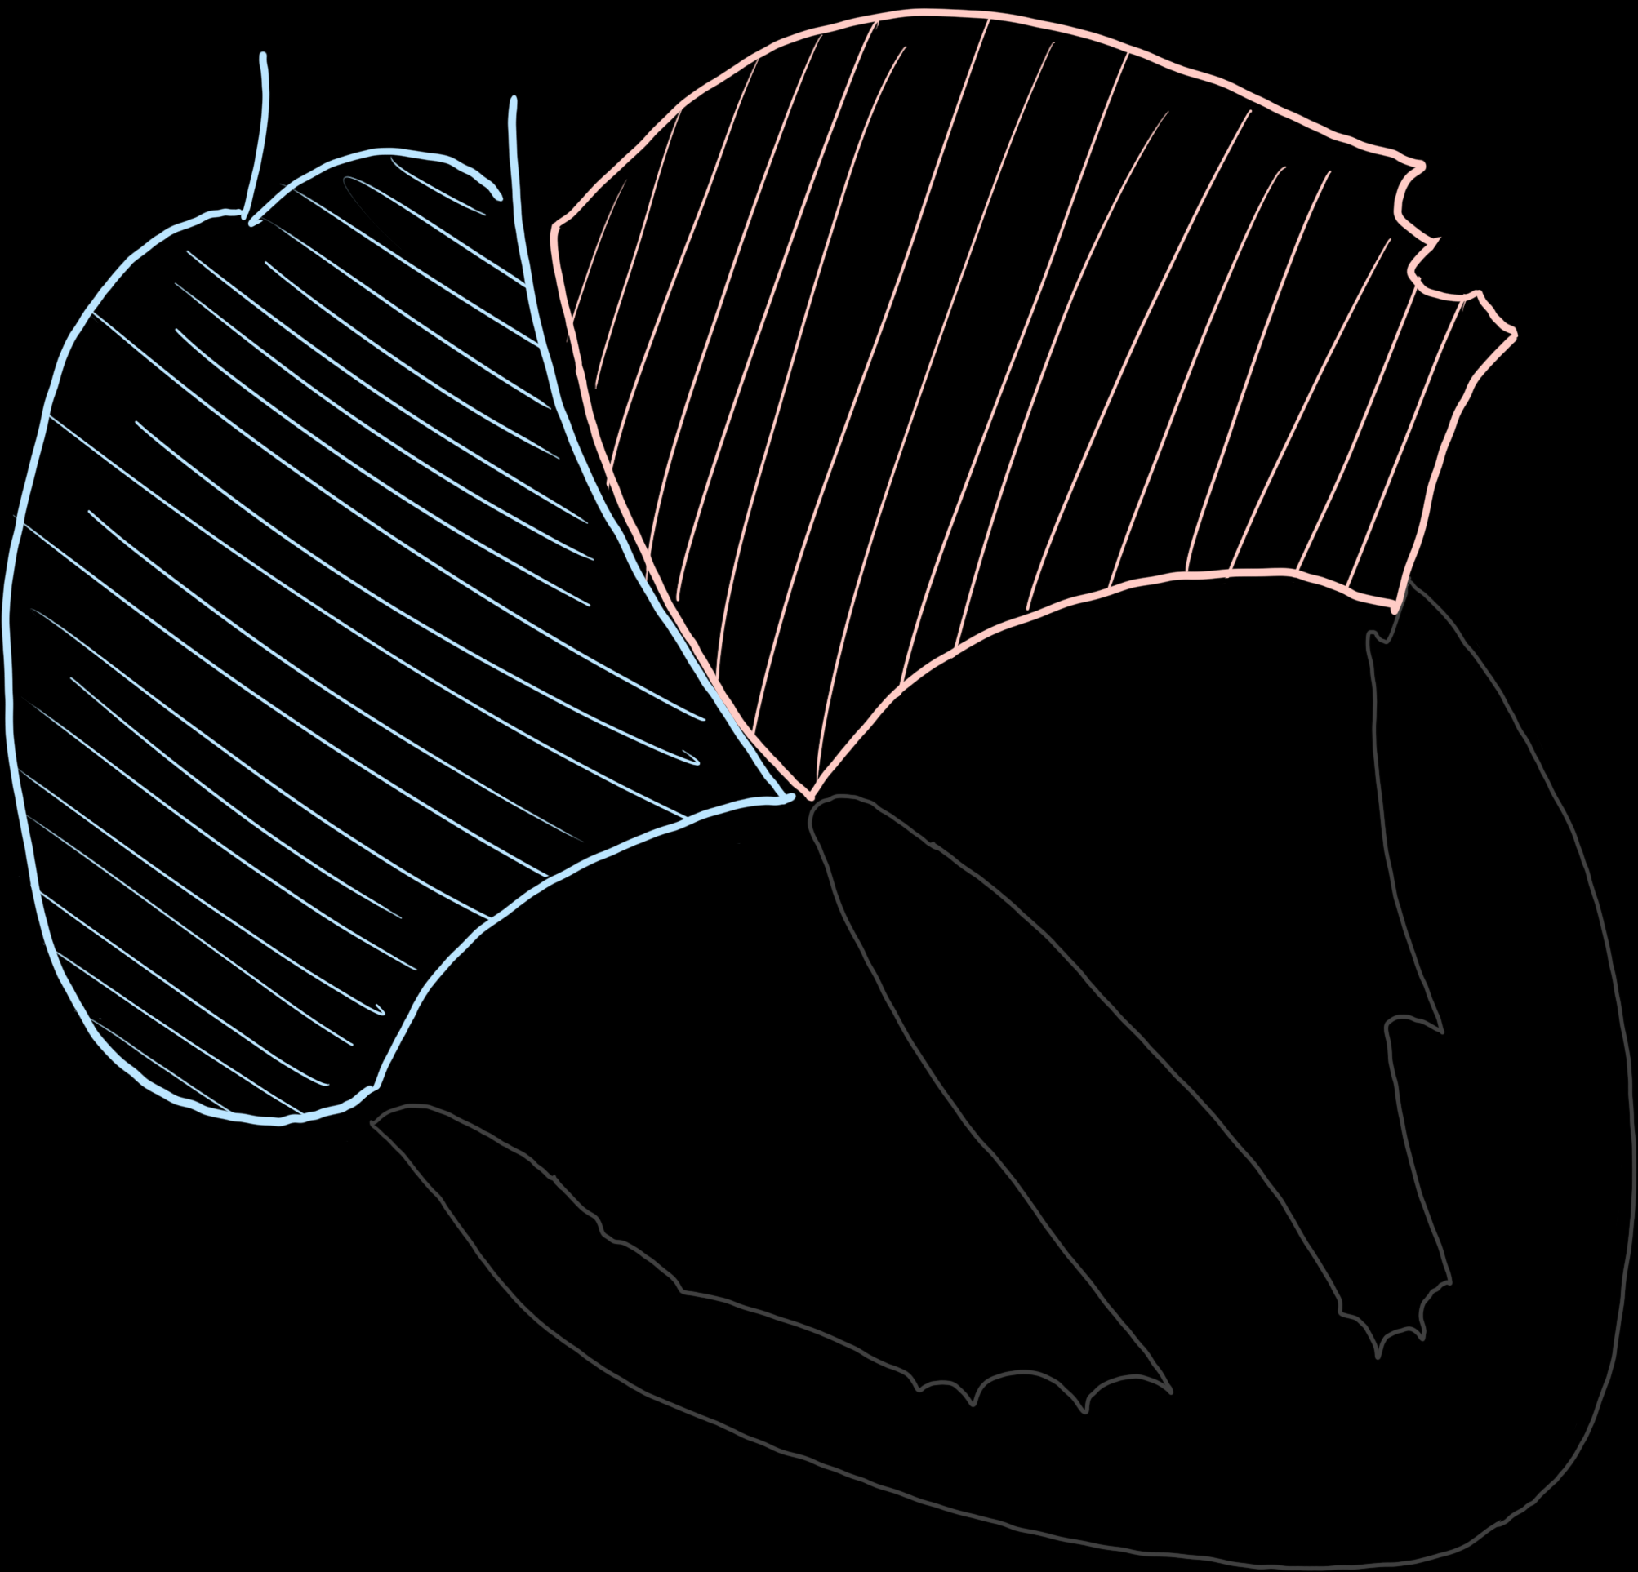
Atrial Enlargement
Left Atrial Enlargement
Right Atrial Enlargement
Biatrial Enlargement

Slide 26
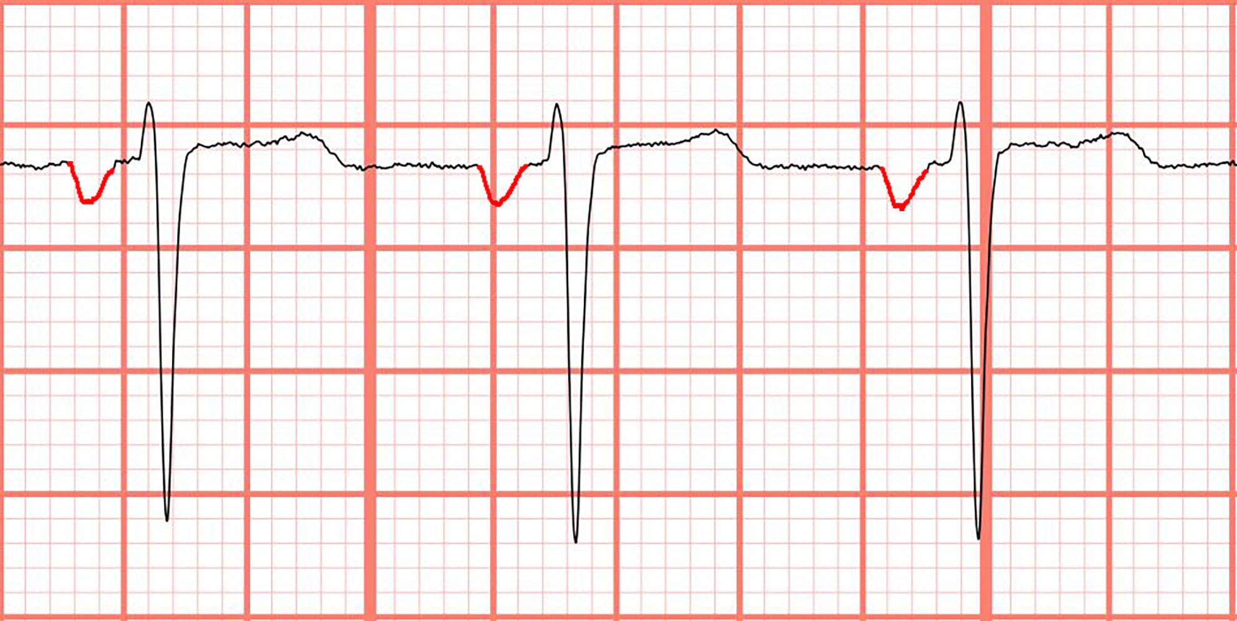
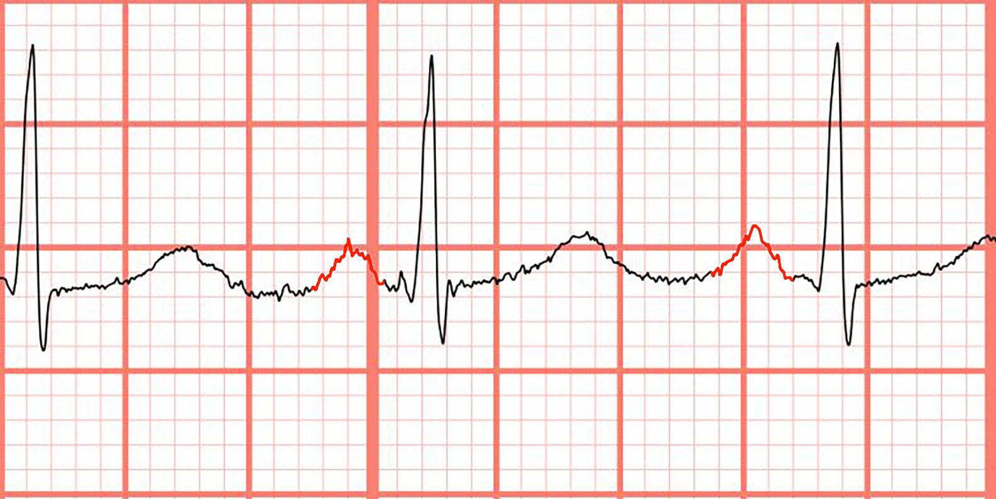
Notes:
Left Ventricular Hypertrophy, Left Atrial Enlargement. The large QRS complexes and asymmetric repolarization abnormalities (i.e., T wave inversions) in the lateral leads are consistent with the "strain" pattern of left ventricular hypertrophy. Additionally, notice that the terminal negative deflection of the P wave in V1 is greater than 1 mm deep and 40 ms in duration, meeting criteria for left atrial enlargement (Figure 44).²⁰ This patient was discovered to have severe aortic stenosis.

Slide 27

ECG STAMPEDE
Notes:
Reminder that this exists, and everyone should have access. Let me know if you don’t and want it. Also, shameless plug for 2nd edition of textbook now out and available on Amazon.

