Slide 1

Conference 32
ECG STAMPEDE

Slide 2
76-year-old female presents with dyspnea
170

Slide 3
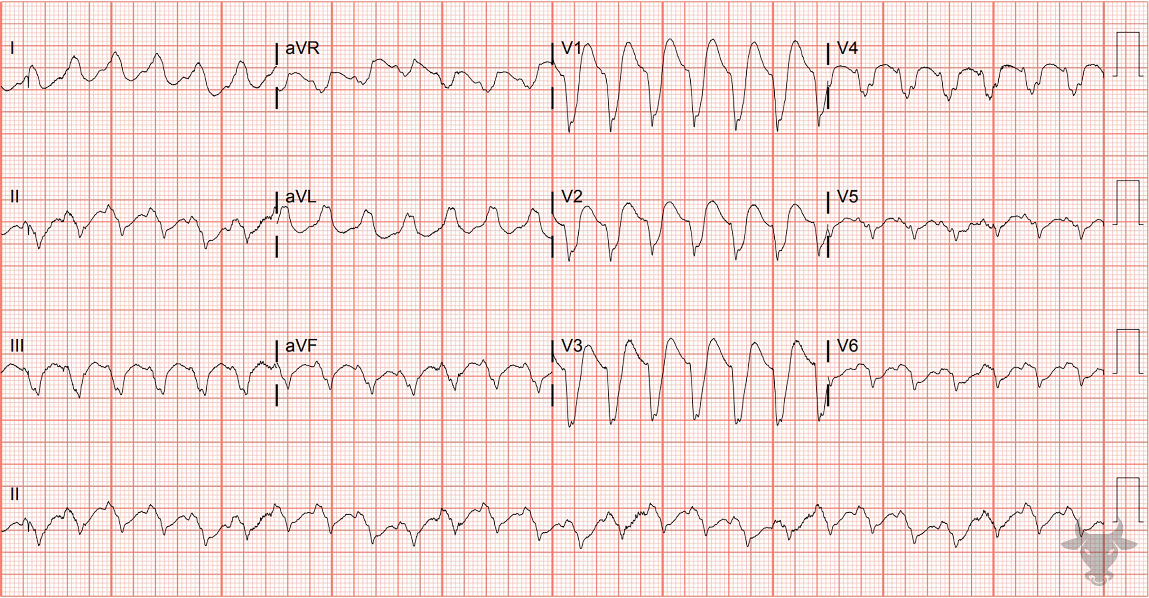

Notes:
Ventricular Tachycardia.
Ventricular Tachycardia. Negative QRS concordance across the precordium (i.e. QRS complexes are all pointing downward) strongly favors ventricular tachycardia. This patient was unstable and was electrically cardioverted. A post-cardioversion ECG showed anterior ST-elevation and left heart catheterization revealed a left anterior descending artery occlusion.

Slide 4
61-year-old male presents with dyspnea
171

Slide 5
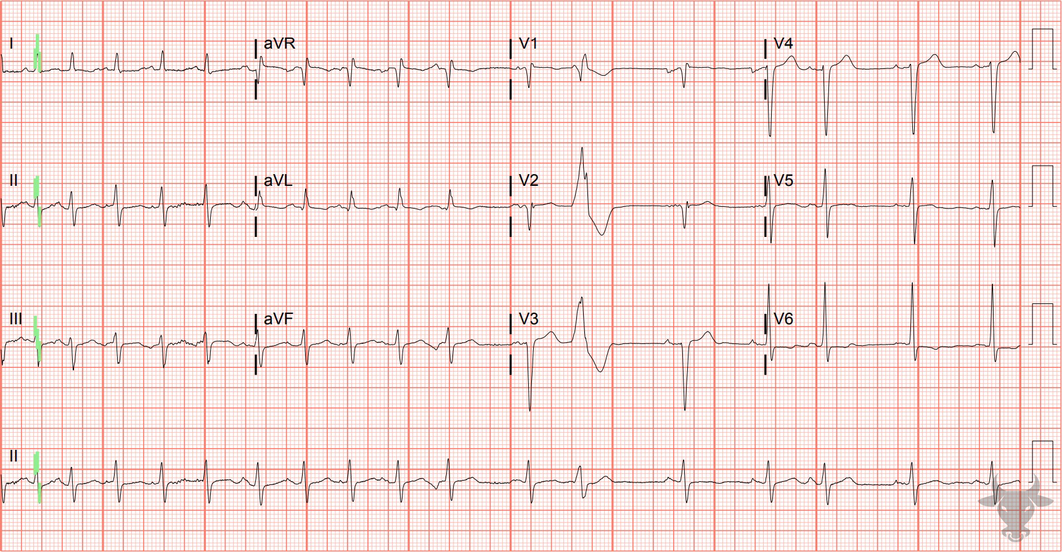
Notes:
Multifocal Atrial Tachycardia.
Multifocal Atrial Tachycardia. This ECG shows multifocal atrial tachycardia in a patient with heart failure and chronic obstructive pulmonary disease. Multifocal atrial tachycardia was previously described in case 147.

Slide 6
41-year-old female presents with presyncope
172

Slide 7
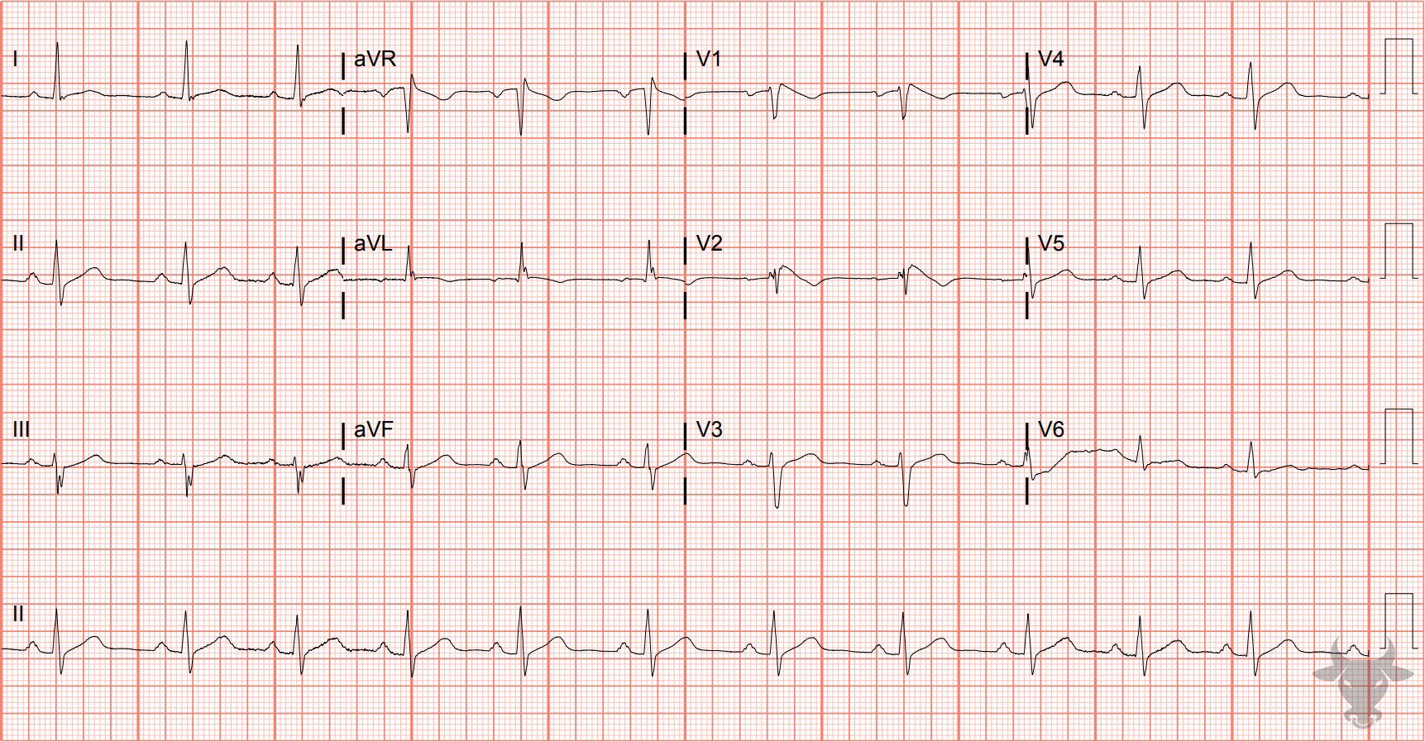
Notes:
Brugada Syndrome.
Brugada Syndrome. This is the Type 1 or coved-type Brugada pattern in a patient with a family history of sudden cardiac death. This patient was admitted for successful defibrillator placement. Brugada syndrome was previously described in case 59.

Slide 8
29-year-old male presents with weakness
173

Slide 9
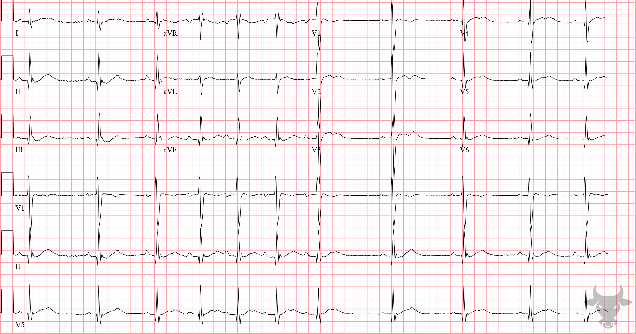
Notes:
Hypokalemia.
Hypokalemia. This patient presented with global weakness and was diagnosed with hypokalemic periodic paralysis. The potassium level was 1.9 mEq/L. There are T-U fusion complexes across the precordium (Figure 66).

Slide 10
87-year-old female presents with fall
174

Slide 11
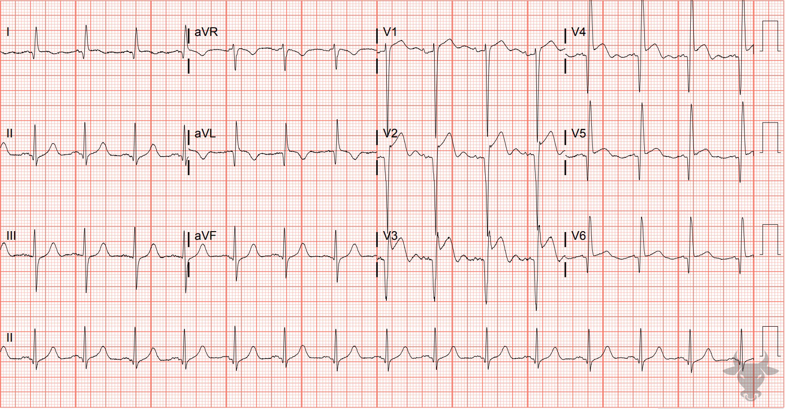
Notes:
Left Ventricular Aneurysm.
Left Ventricular Aneurysm. In the absence of reperfusion therapy, left ventricular aneurysm is a common structural complication of anterior myocardial infarction. Usual ECG findings include ST-segment elevation that persists more than two weeks after ST elevation myocardial infarction, deep Q waves, and the absence of reciprocal ST-segment depressions. This patient presented with left sided body pain after a fall. There are large Q waves in the precordial leads V2-V4 with associated ST-segment elevation. A bedside (and then formal) echocardiogram confirmed the left ventricular aneurysm. Catheterization revealed non-obstructive coronary artery disease.

Slide 12
45-year-old male presents with dyspnea
175

Slide 13
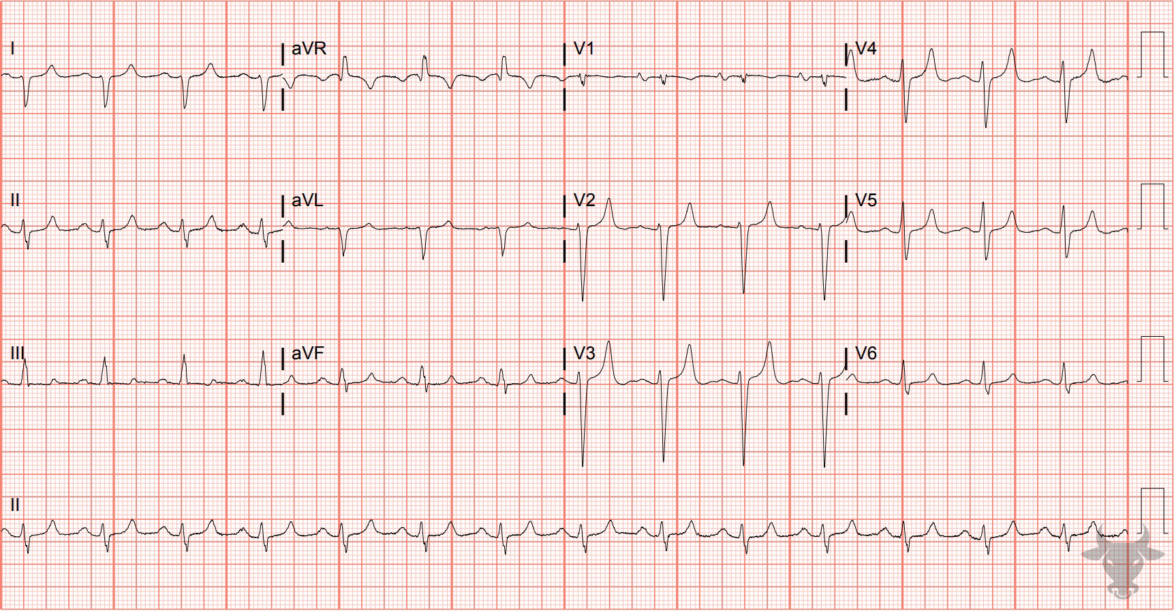
Notes:
Hyperkalemia.
Hyperkalemia. Note the "peaked" morphology of the T waves (e.g., narrow base and pointed at the top) and slightly widened QRS. This patient's potassium was 7.5 mmol/L.

