Slide 1

Conference 31
ECG STAMPEDE

Slide 2
65-year-old female presents with chest pain, dyspnea
164

Slide 3
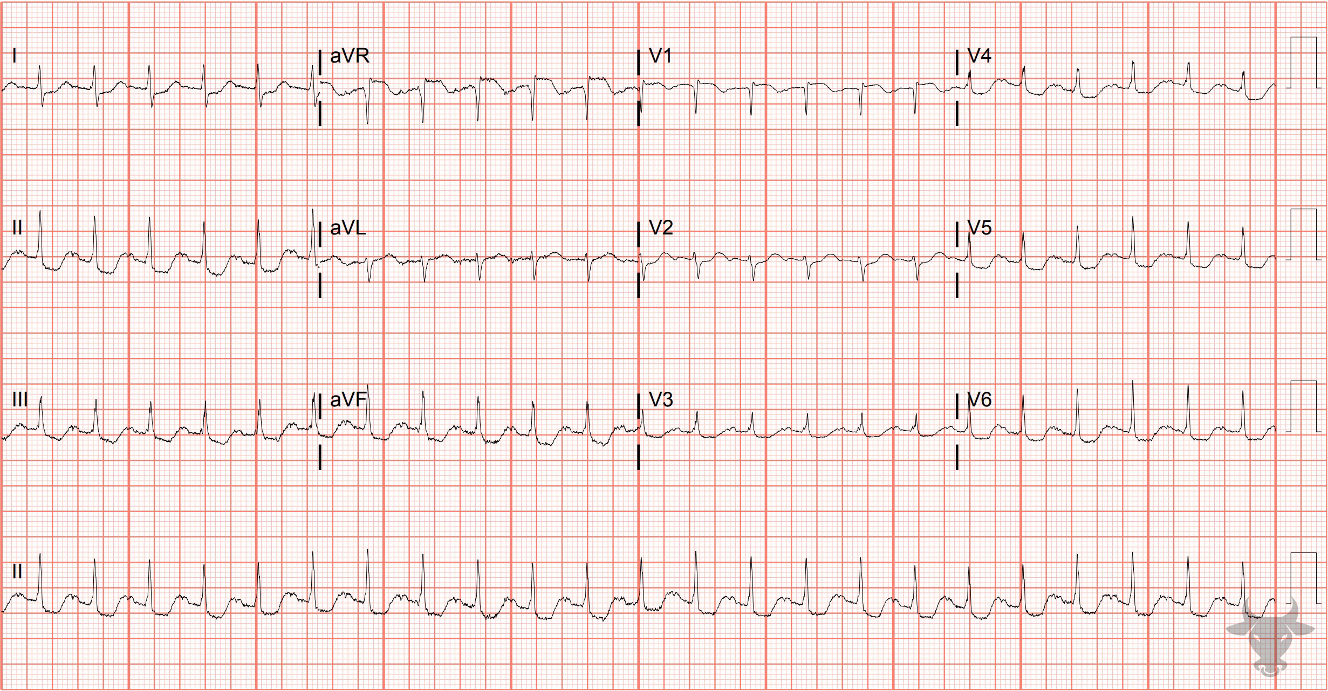
Notes:
Global Subendocardial Ischemia.
Global Subendocardial Ischemia from Submassive Pulmonary Embolism. There are diffuse ST-segment depressions along with ST-segment elevation in aVR. As previously discussed in case 5, the differential diagnosis for the is pattern is broad, and includes any condition that creates and supply/demand mismatch. This patient was discovered to have a saddle pulmonary embolism for which thrombectomy was performed. The ST changes and tachycardia resolved after mechanical retrieval of the embolus.

Slide 4
62-year-old male presents with dyspnea
165

Slide 5
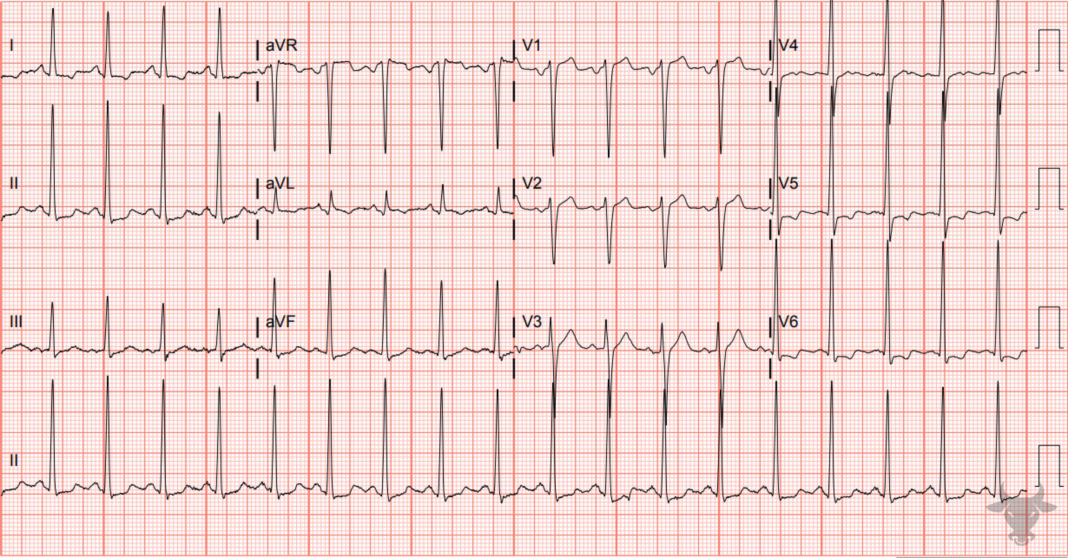
Notes:
Left Ventricular Hypertrophy.
Left Ventricular Hypertrophy. Large amplitude QRS complexes, ST-segment depressions, and asymmetric T wave inversions primarily in the lateral leads (I, aVL, V5, V6) are classic for left ventricular hypertrophy. Criteria for left ventricular hypertrophy was previously described in case 84. This patient had newly discovered heart failure with eccentric hypertrophy on echocardiography.

Slide 6
False Positive Activation
Left Ventricular Hypertrophy
McCabe JM, Armstrong EJ, Kulkarni A, et al. Prevalence and factors associated with false-positive ST-segment elevation myocardial infarction diagnoses at primary percutaneous coronary intervention–capable centers: a report from the Activate-SF registry. Arch Intern Med. 2012;172(11):864-871.

Slide 7
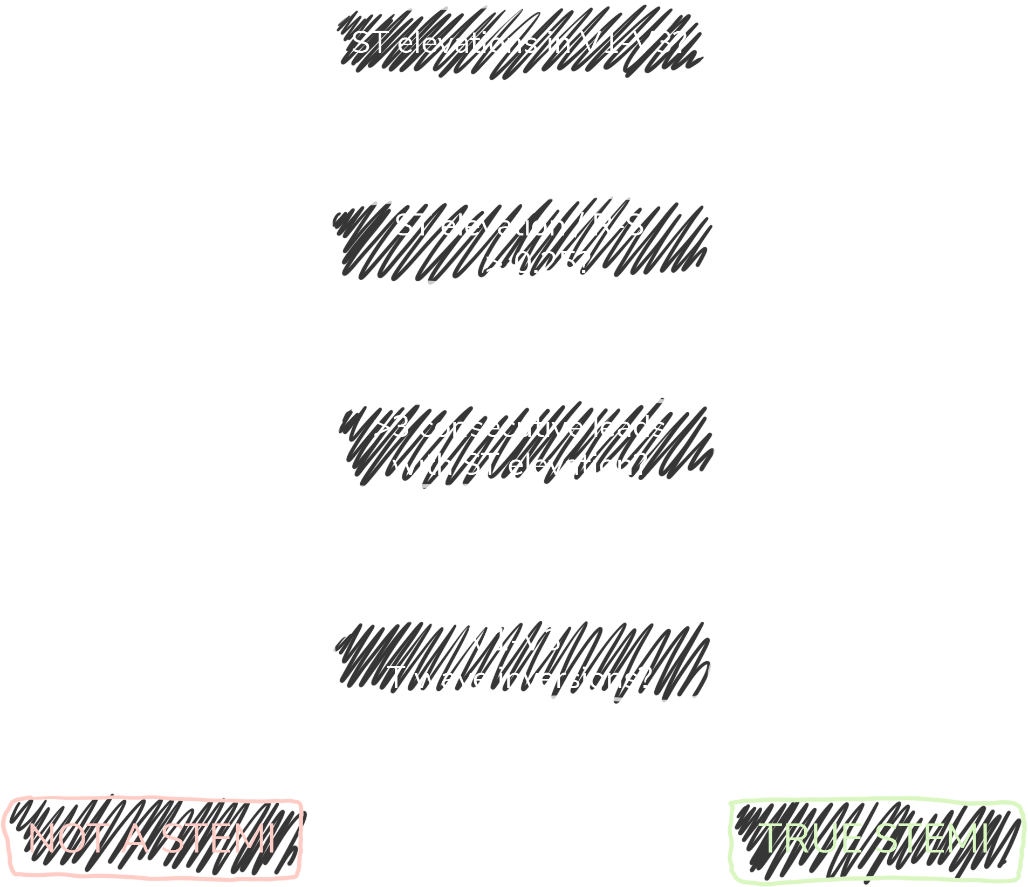

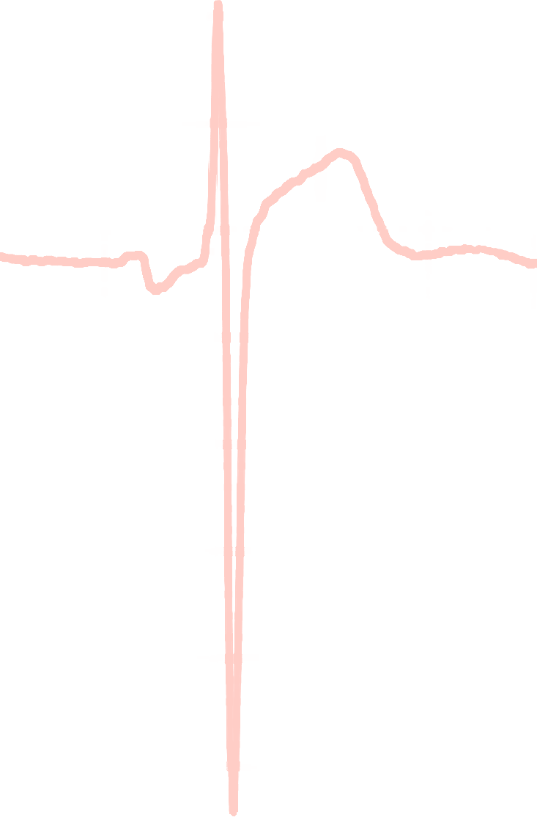

Armstrong Algorithm for STE in LVH
V1-V3
91%
Specificity
STE
R-S
STE/R-S
> 0.25?
77%
Sensitivity
Armstrong EJ, Kulkarni AR, Bhave PD, et al. Electrocardiographic criteria for ST-elevation myocardial infarction in patients with left ventricular hypertrophy. Am J Cardiol. 2012;110(7):977-983.
Notes:
Sensitivity 77%
Specificity 91%

Slide 8
87-year-old female presents with melena
166

Slide 9
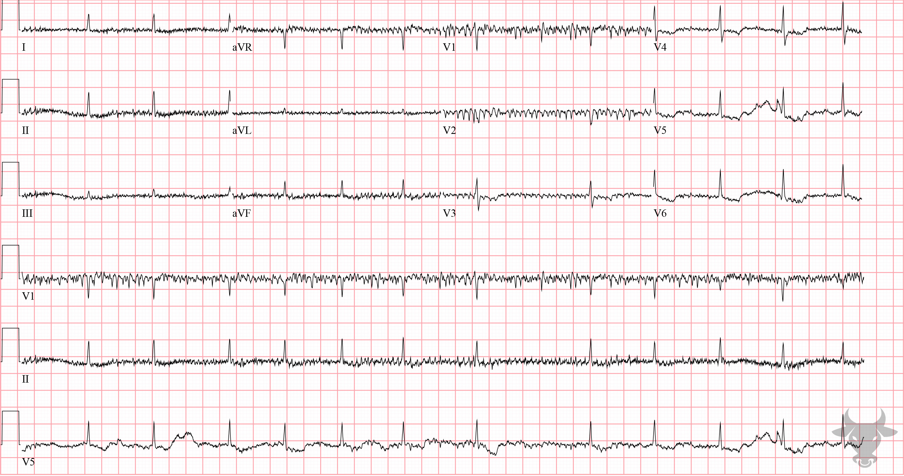
Notes:
Digoxin toxicity, Slow Atrial Fibrillation.
Digoxin toxicity, Slow Atrial Fibrillation. There is atrial fibrillation with baseline artifact and sagging or scooped ST segments best seen in the lateral precordial leads. These expected findings of digoxin, which this patient took. Digoxin toxicity can cause virtually any dysrhythmia, but common dysrhythmias associated with digoxin toxicity are frequent premature ventricular contractions, slow atrial fibrillation, sinus bradycardia, junctional rhythm, atrial tachycardia, atrioventricular blocks, and ventricular tachycardia (bi-directional or polymorphic).

Slide 10
31-year-old male presents with dyspnea
167

Slide 11
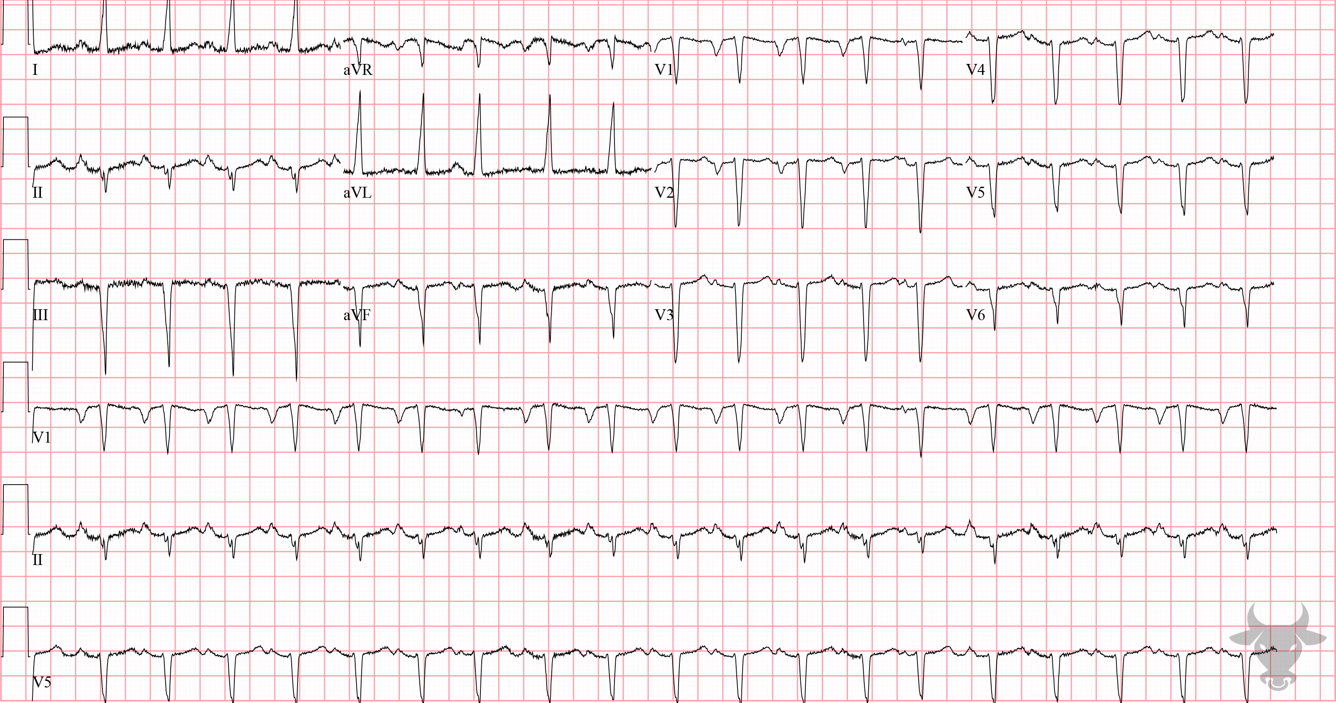
Notes:
Left Ventricular Hypertrophy.
Left Ventricular Hypertrophy, Left Atrial Enlargement, Poor R Wave Progression. The large R wave in aVL (>11 mm) is diagnostic for left ventricular hypertrophy (see case 84 for criteria). The left axis deviation, slight intraventricular conduction delay, and absent R wave progression across the precordium are all explained by left ventricular hypertrophy. The large, downward deflected P wave in V1 and wide P wave in lead II (greater than 120 ms) indicates left atrial enlargement (Figure 44).

Slide 12
False Positive Activation
Left Ventricular Hypertrophy
McCabe JM, Armstrong EJ, Kulkarni A, et al. Prevalence and factors associated with false-positive ST-segment elevation myocardial infarction diagnoses at primary percutaneous coronary intervention–capable centers: a report from the Activate-SF registry. Arch Intern Med. 2012;172(11):864-871.

Slide 13
Armstrong Algorithm for STE in LVH
V1-V3
91%
Specificity
STE
R-S
STE/R-S
> 0.25?
77%
Sensitivity
Armstrong EJ, Kulkarni AR, Bhave PD, et al. Electrocardiographic criteria for ST-elevation myocardial infarction in patients with left ventricular hypertrophy. Am J Cardiol. 2012;110(7):977-983.
Notes:
Sensitivity 77%
Specificity 91%

Slide 14
64-year-old female presents with vomiting
168

Slide 15
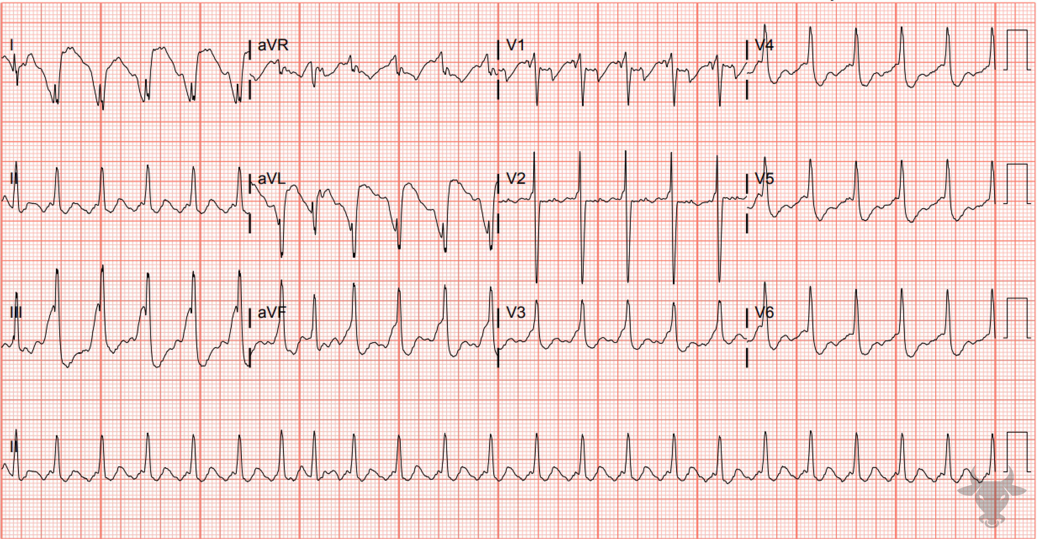
Notes:
Atrial flutter with 2:1 Conduction.
Atrial flutter with 2:1 Conduction, Sodium Channel Toxicity. Sodium channel blockers slow phase 0 of the action potential resulting in slowing of intraventricular conduction, an effect of which the right bundle is most susceptible to. Electrocardiographically, sodium channel toxicity manifests as a widened QRS (> 100 ms) and right axis deviation. In this ECG, note the wide and fragmented QRS, right axis deviation, and tall terminal R wave in aVR – all consistent with sodium channel toxicity. This case was due to cocaine toxicity.

Slide 16
54-year-old male presents with chest pain
169

Slide 17
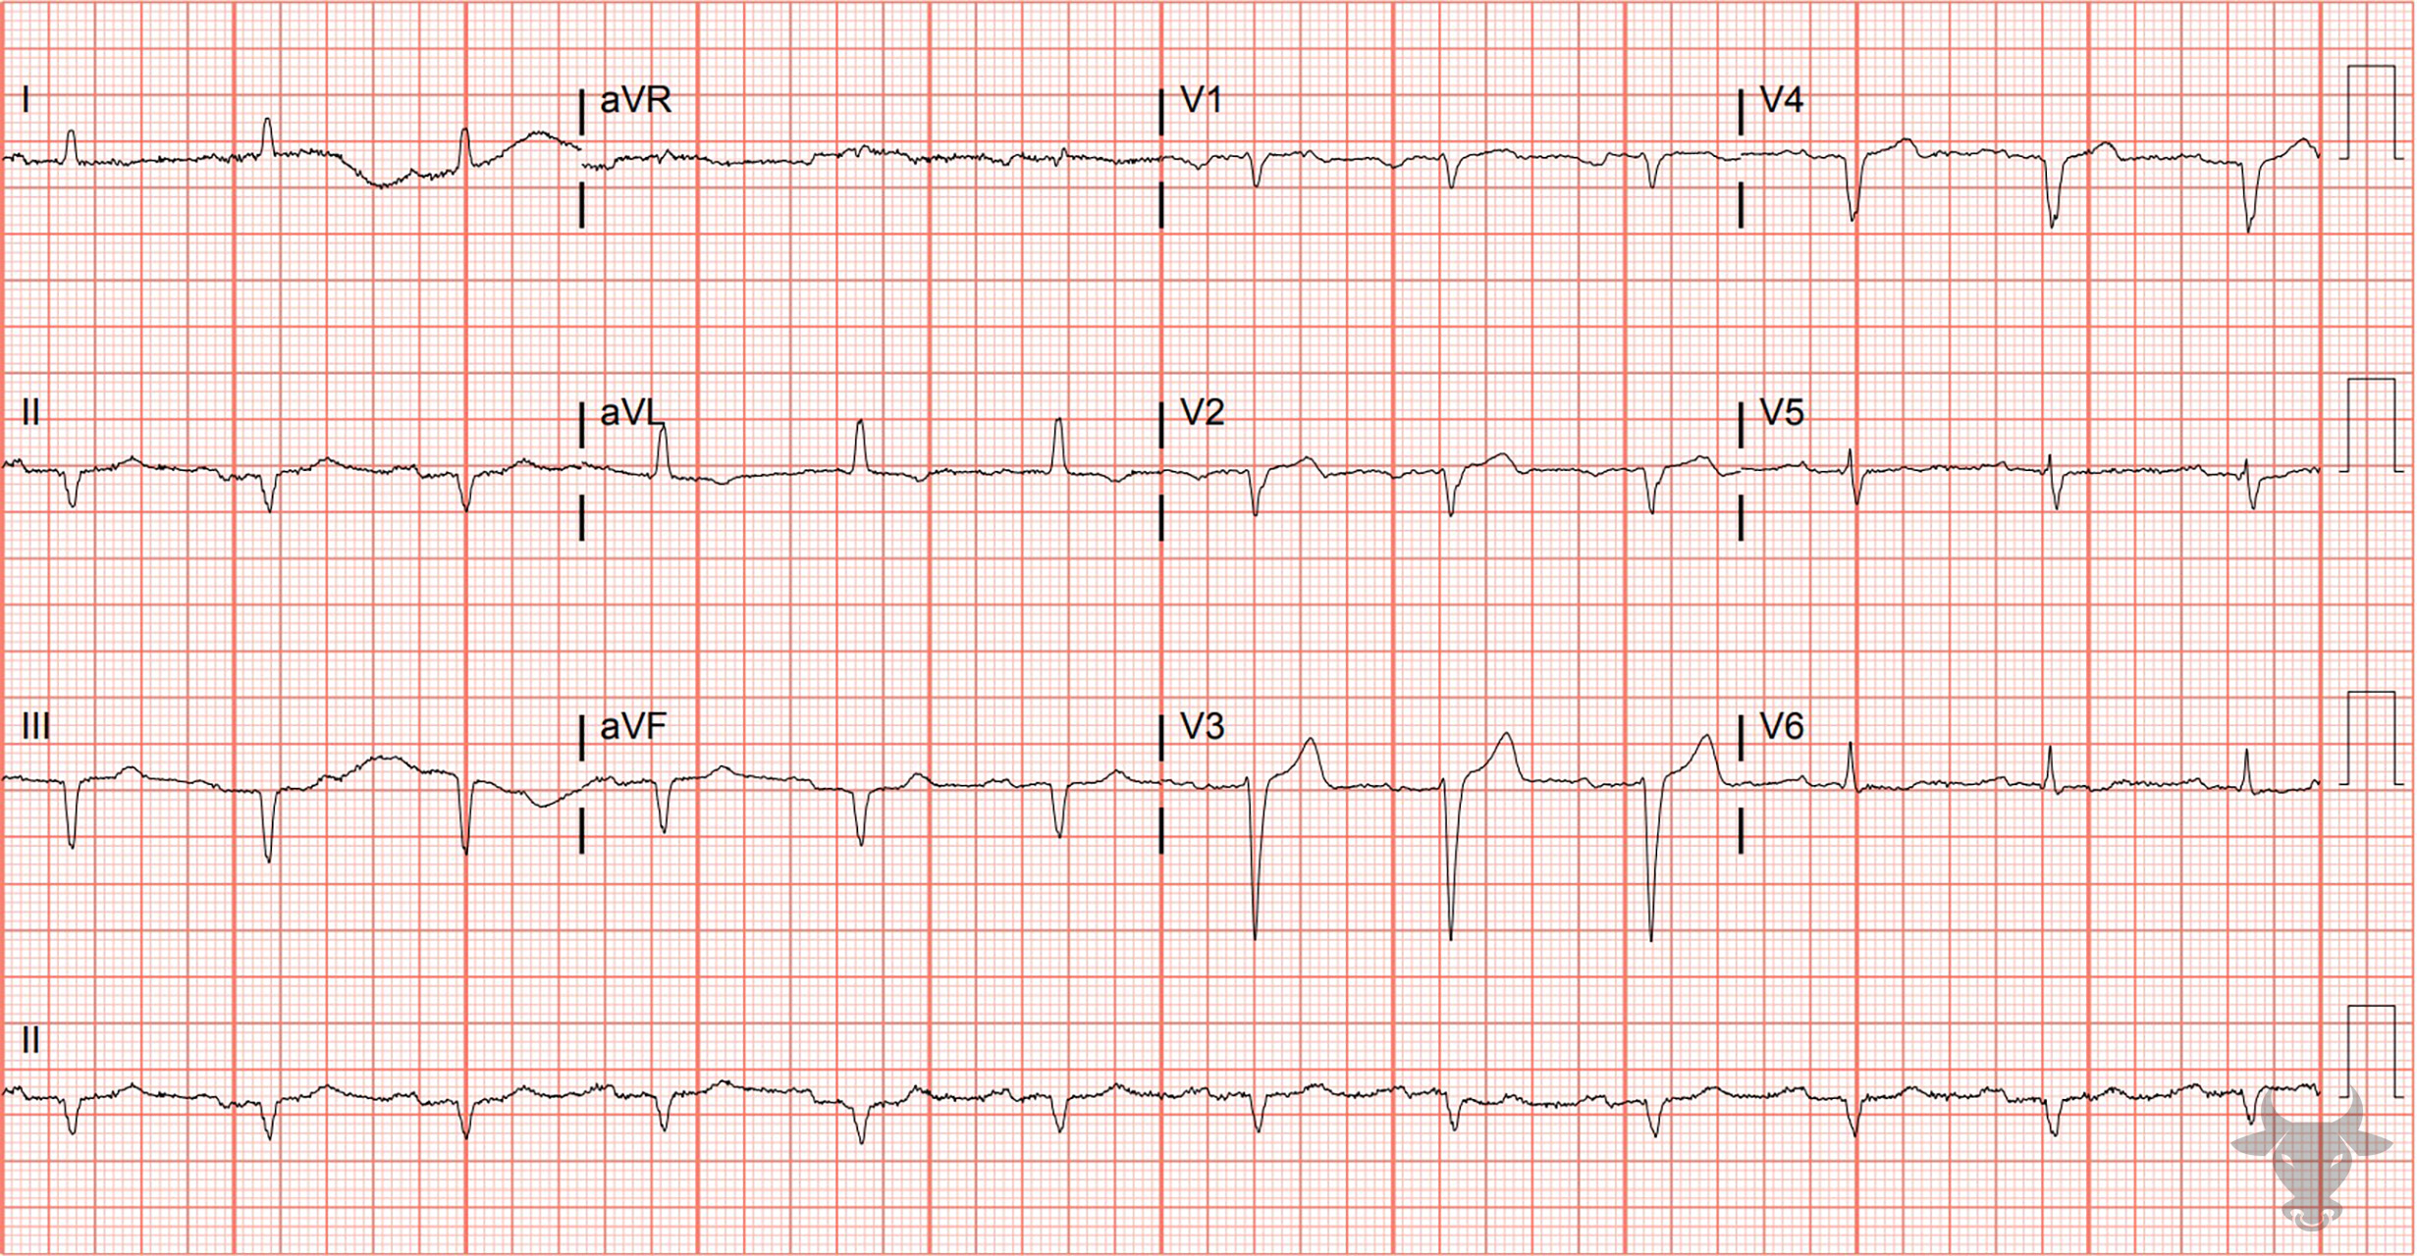
Notes:
Poor R Wave Progression.
Poor R Wave Progression. There is poor R wave progression and Q waves in the inferior leads. Poor R wave progression is a non-specific finding that is suggestive of prior anterior myocardial infarction. It is a poorly defined term that implies diminished amplitude of the R wave in the precordium. It has been defined as an R wave less than 3 mm in lead V3 or decreasing R wave amplitude from V2 to V3 or V3 to V4. Poor R wave progression has been implicated in left ventricular hypertrophy, right ventricular hypertrophy and can be a normal variant. This patient had prior myocardial infarctions in both the anterior and inferior distributions.

