Slide 1

Conference 30
ECG STAMPEDE

Slide 2
8-year-old female presents with palpitations
158

Slide 3
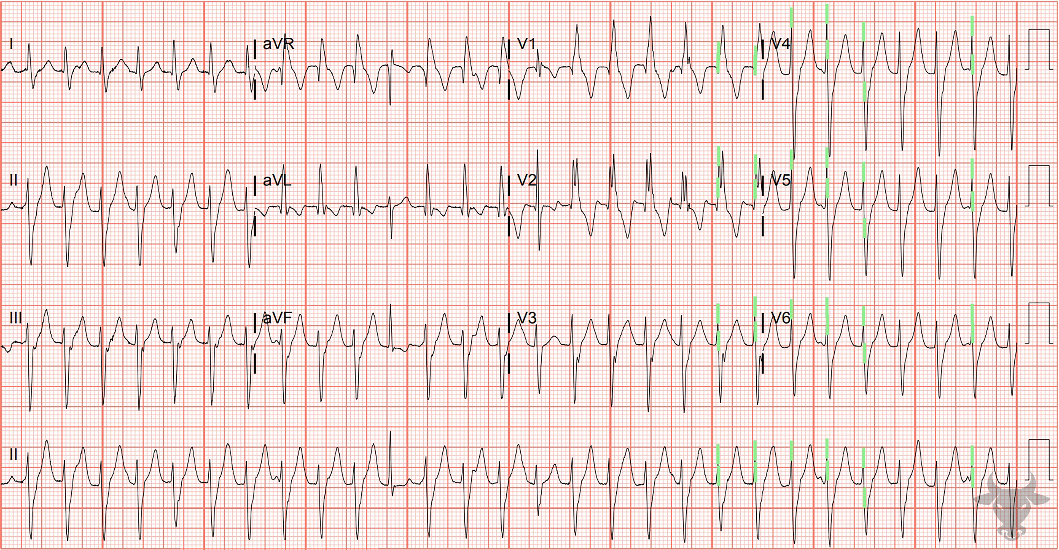

Notes:
Ventricular Tachycardia.
Ventricular Tachycardia. The presence of a narrow capture beat about a third of the way through the rhythm strip confirms atrioventricular dissociation – a specific criterion for ventricular tachycardia (Figure 64). Capture beats occur when the sinoatrial node transiently “captures” the ventricles during atrioventricular dissociation, producing a normal-appearing QRS complex. (The vertical green bars can be ignored).

Slide 4
32-year-old male presents with palpitations
159

Slide 5
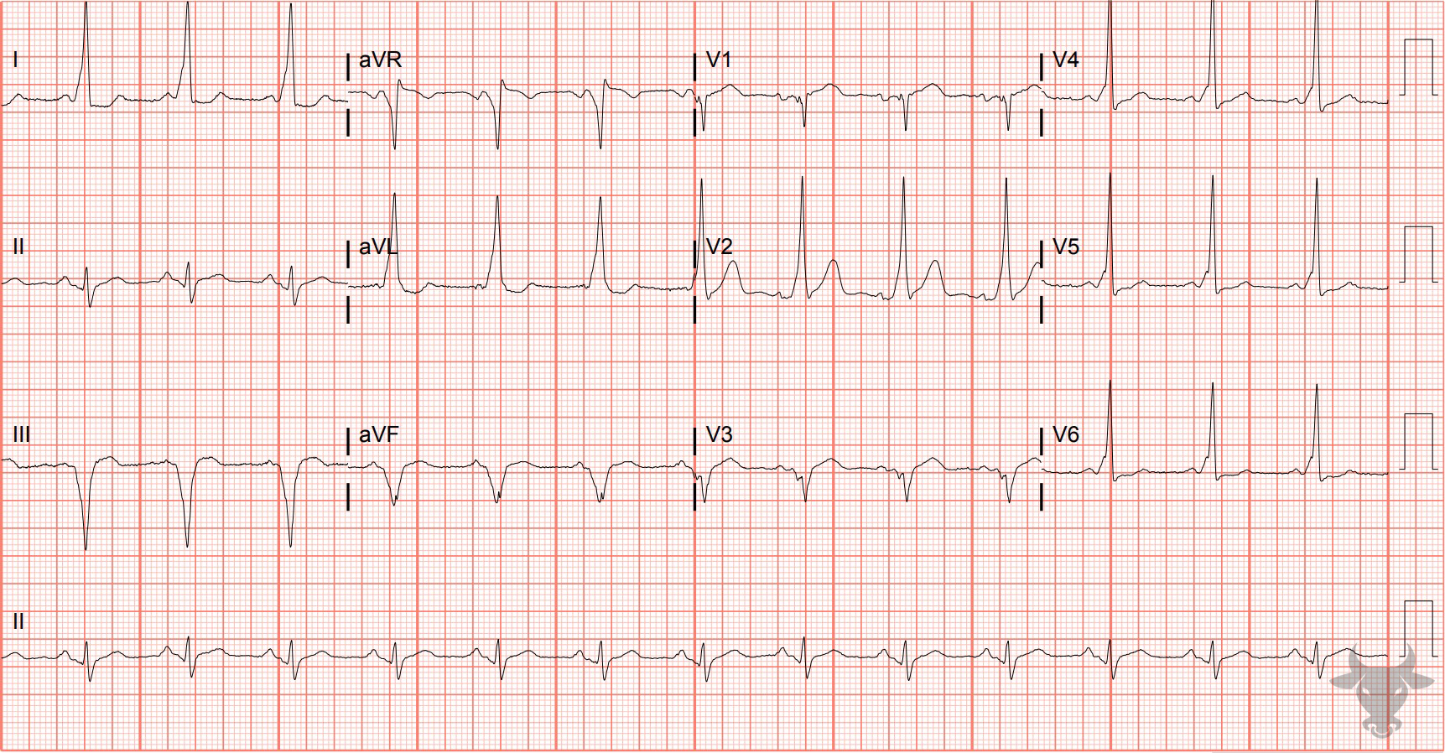
Notes:
Pre-excited Atrial Fibrillation.
Pre-excited Atrial Fibrillation. Pre-excited atrial fibrillation was previously described in case 102. Notice the more-rapid-than-usual rate for atrial fibrillation and changing QRS morphologies consistent with conduction through an accessory pathway (i.e., Wolf-Parkinson-White). Rates this fast are not seen with atrial fibrillation unless an accessory pathway exists. This patient was electrically cardioverted and admitted for a successful accessory pathway ablation. On prior ECG, notice the short PR interval, delta wave, and slightly widened QRS complex.

Slide 6
50-year-old female presents with s/p cardiac arrest
160

Slide 7
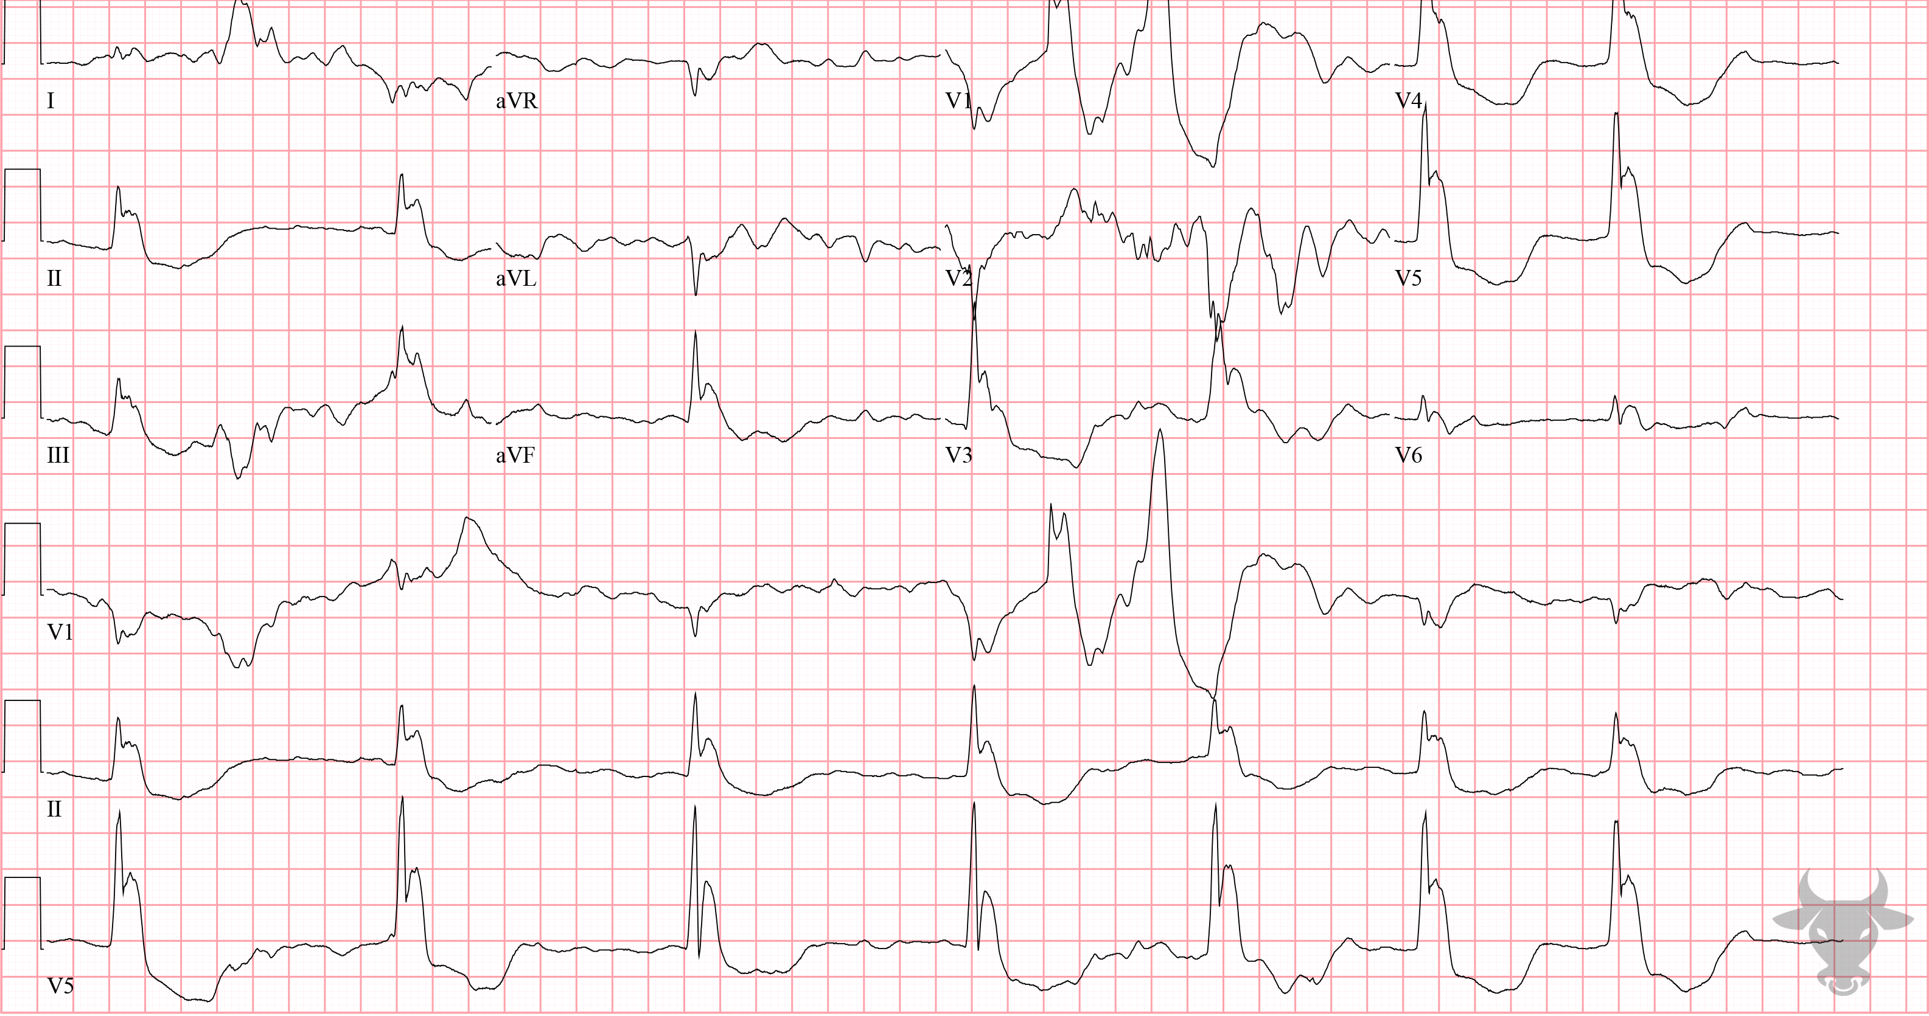
Notes:
Hypothermia.
Hypothermia, Atrial Fibrillation. Osborn waves, or J waves, are upright deflections between the end of the QRS complex and the early portion of the ST segment seen during hypothermia. They can mimic ST-segment elevation, as with this post-arrest ECG. Slow atrial fibrillation is another hallmark of hypothermia. The core temperature was 76°F (24.4°C).

Slide 8
50-year-old male presents with chest pain
161

Slide 9
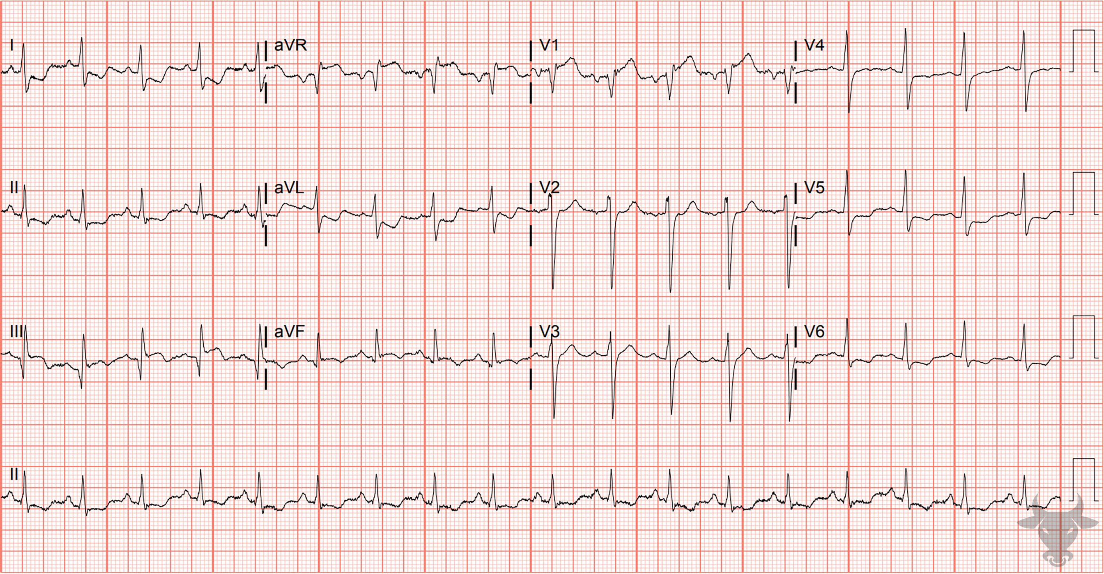
Notes:
Inferior ST-elevation Myocardial Infarction.
Inferior ST-elevation Myocardial Infarction (Aslanger Pattern). This pattern is eponymously known as the Aslanger pattern. This pattern of isolated ST-segment elevation in lead III, ST-segment depression in V4 through V6, and ST-segment elevation in V1 greater than V2 was first introduced and published in 2020. It is a strong predictor of acute coronary occlusion in the inferior distribution (left circumflex >> right coronary artery) in patients with concomitant multi-vessel disease and is an indication for emergent reperfusion. This patient had an occluded graft (from prior bypass) in the right coronary distribution.

Slide 10
55-year-old male presents with frequent falls
162

Slide 11
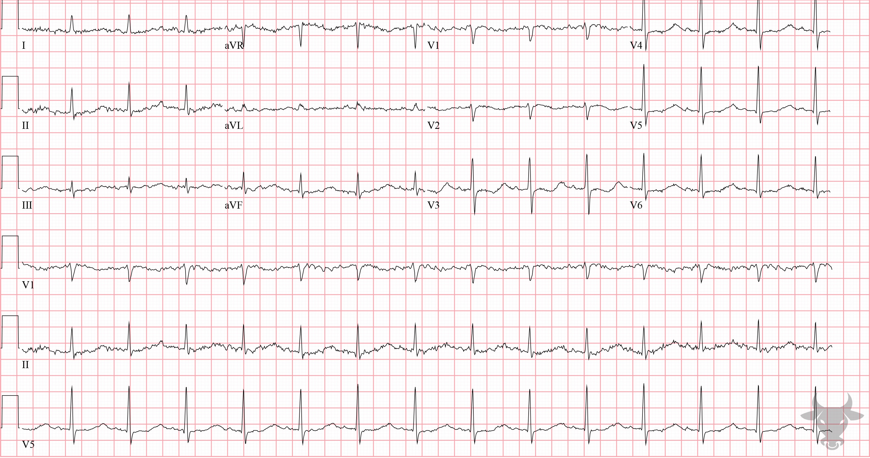
Notes:
Hypokalemia.
Hypokalemia. This patient presented with frequent falls and had a potassium of 1.5 mEq/L. Notice the prolonged repolarization phase (i.e., QU interval). The downward deflected T wave in the anterior precordial leads fuse with U wave and create a wavy pattern characteristic of hypokalemia (Figure 65).

Slide 12
64-year-old male presents with chest pain
163

Slide 13
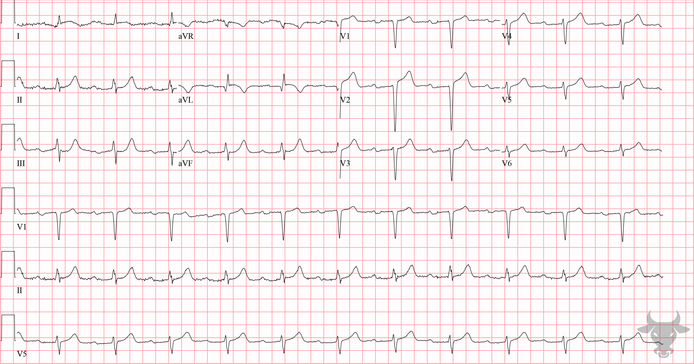
Notes:
High Lateral ST-elevation Myocardial Infarction.
High Lateral ST-elevation Myocardial Infarction. There are subtle ST-segment elevations in the high lateral leads (I, aVL) with reciprocal ST-segment depression in the inferior leads (III, aVF). While the amplitude of ST-segment elevation is sub-millimeter, it is important to consider proportionality when interpreting ST-segments (i.e., the amplitude of ST-elevation when compared to the size of the QRS complex). Lead aVL has a symmetric, terminal negative T wave deflection that is consistent with an ischemic T wave. Left heart catheterization revealed an occluded proximal left anterior descending artery.

