Slide 1

Conference 3
ECG STAMPEDE

Slide 2
49-year-old female presents with weakness
9

Slide 3
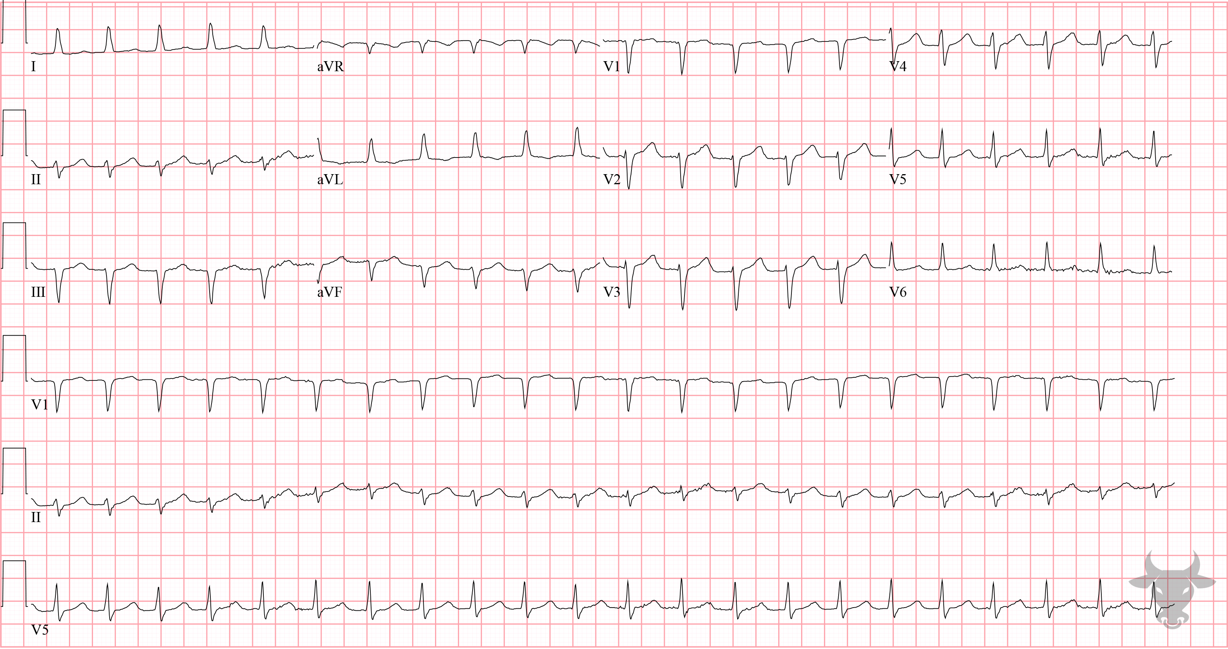
Notes:
Hyperkalemia.
Hyperkalemia, Left Ventricular Hypertrophy. There are signs of left ventricular hypertrophy including large QRS complexes and associated repolarization abnormalities (i.e., asymmetric T wave inversions primarily in the lateral leads). Additionally, peaked T waves indicate hyperkalemia.

Slide 4
19-year-old male presents with chest pain
10

Slide 5
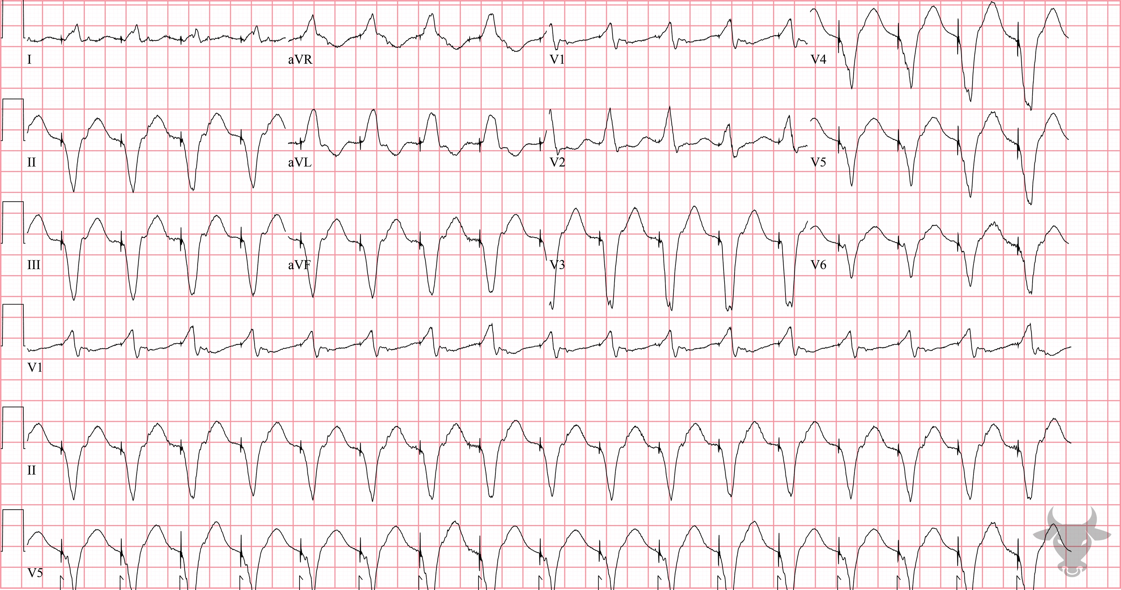
Notes:
Dextrocardia.
Dextrocardia, Sinus Tachycardia. Typically, the QRS complexes increase in amplitude across the precordium, however they decrease across the precordium in this ECG due to increased distance from the site of the cardiac impulse in this patient with dextrocardia. To obtain a more familiar appearing ECG in patients with dextrocardia, all leads (limb and precordial) should simply be reversed. The convex ST segments (especially in the inferior leads) and significantly elevated troponin prompted emergent catheterization, which revealed clean coronaries. This patient was ultimately diagnosed with myopericarditis.

Slide 6
63-year-old male presents with dizziness
11

Slide 7
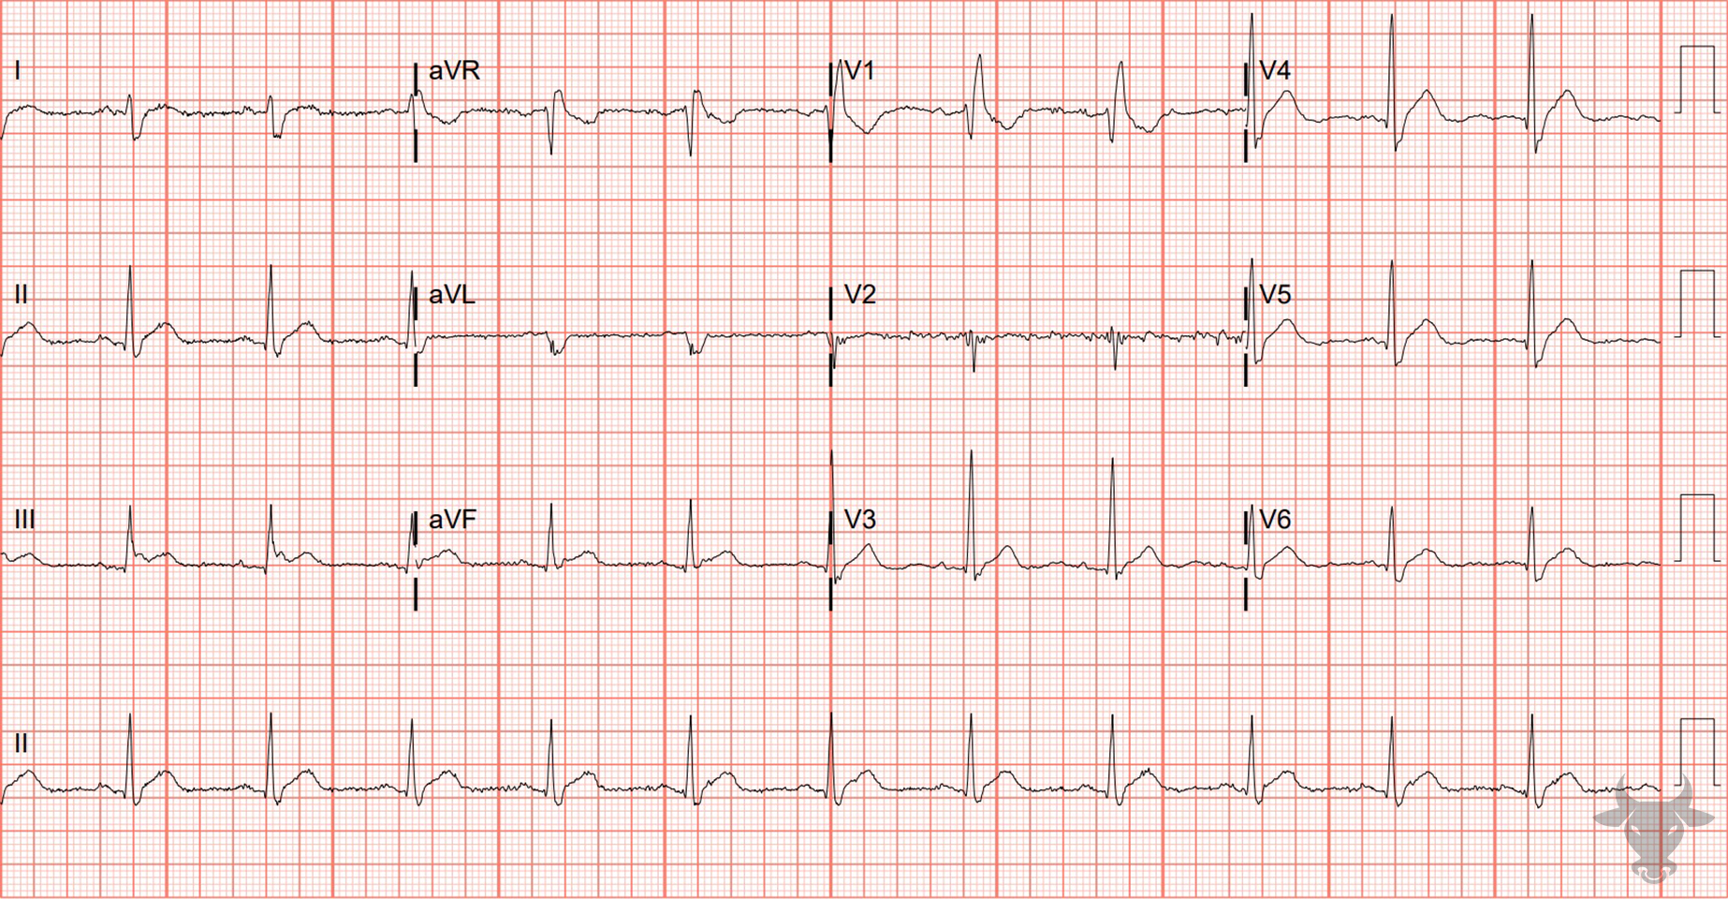
Notes:
Hypercalcemia.
Hypercalcemia, Right Bundle Branch Block. The QT interval is short with essentially zero ST segment, and there is a right bundle branch block. Shortening of the QT interval can result in a “high-takeoff” of the ST-segment, mimicking myocardial ischemia or infarction. The identification of ECG changes associated with hypercalcemia is critical as these are manifestations of conduction abnormalities with a rare risk of progression to potentially fatal ventricular dysrhythmias such as ventricular fibrillation. The ECG findings commonly associated with hypercalcemia are QT interval shortening and Osborn J waves.

Slide 8
67-year-old male presents with chest pain
12

Slide 9
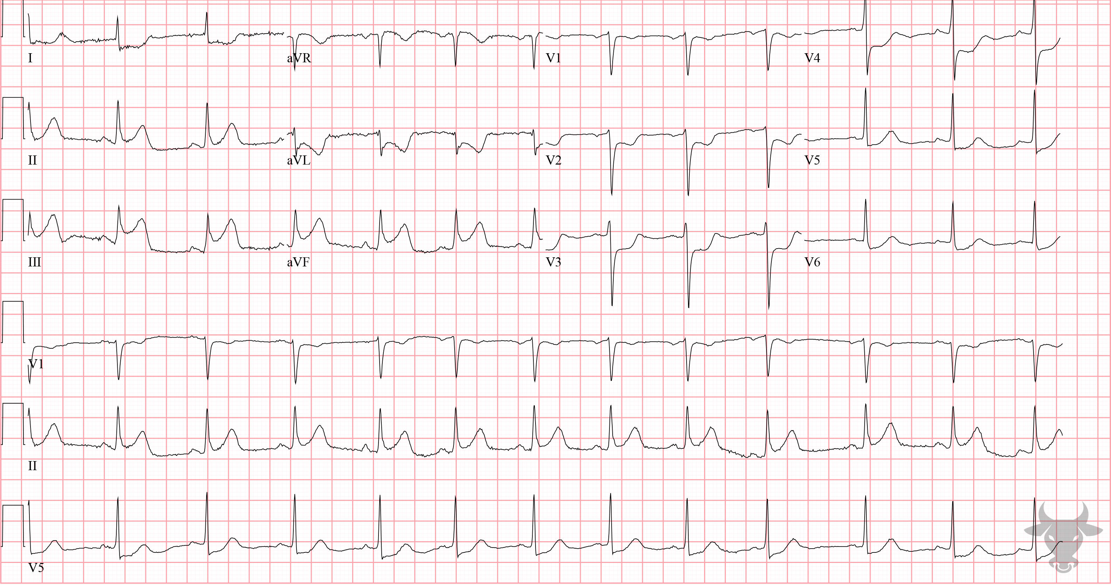
Notes:
Inferior ST-elevation Myocardial Infarction.
Inferior ST-elevation Myocardial Infarction. There is ST-segment elevation in the inferior leads (II, III, aVF) with reciprocal changes in the anterolateral leads (I, aVL, V2 through V6). Left heart catheterization revealed an occluded right coronary artery and percutaneous coronary intervention was performed.

