Slide 1

Conference 29
ECG STAMPEDE

Slide 2
66-year-old male presents with weakness
152

Slide 3
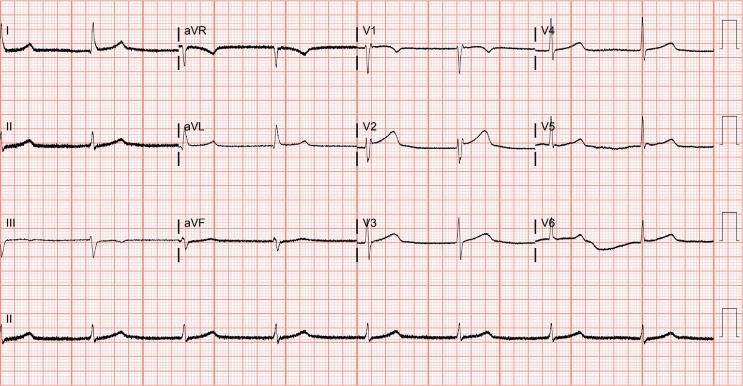
Notes:
Junctional Bradycardia.
Junctional Bradycardia. Junctional bradycardia in a patient with beta blocker toxicity. There is no evidence of atrial activity (i.e., absent P waves). The junction refers to the part of the conduction system involving the atrioventricular node and the proximal His bundle (immediately inferior to the atrioventricular node). It is the only part of the conduction system capable of producing a narrow QRS complex, provided that the bundle branches are intact. Junctional escape rhythms generally produce a rate of 40 to 60 beats per minute, whereas more distal ventricular pacemakers are slower and less reliable.

Slide 4
66-year-old male presents with weakness
153

Slide 5
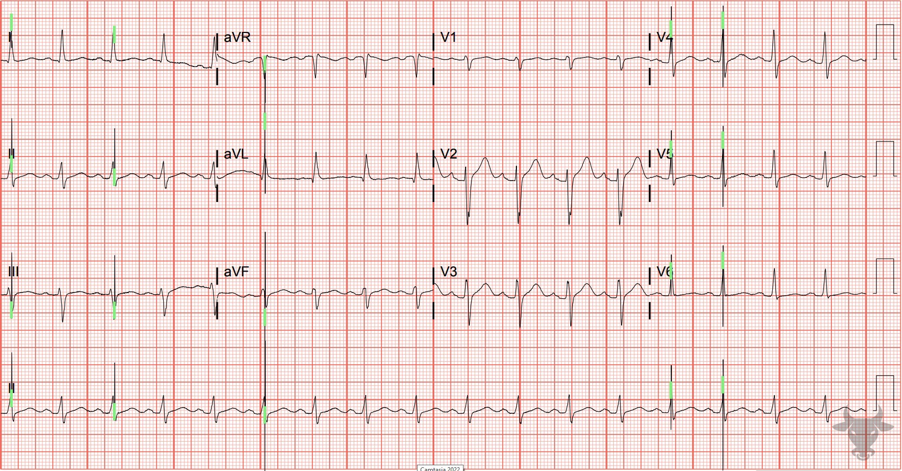
Notes:
Pacemaker Malfunction.
Pacemaker Malfunction. Failure to sense occurs when the pacemaker fails to sense native cardiac activity, leading to asynchronous pacing. It can be caused by a lead insulation break, new intrinsic bundle branch blocks, electrolyte abnormalities, and Class IC antiarrhythmics. Pacing spikes (green vertical bars) can be seen within QRS complexes (Figure 62).
This case was caused by a temporary pacemaker that became mechanically dislodged during transport.

Slide 6
69-year-old male presents with chest pain
154

Slide 7
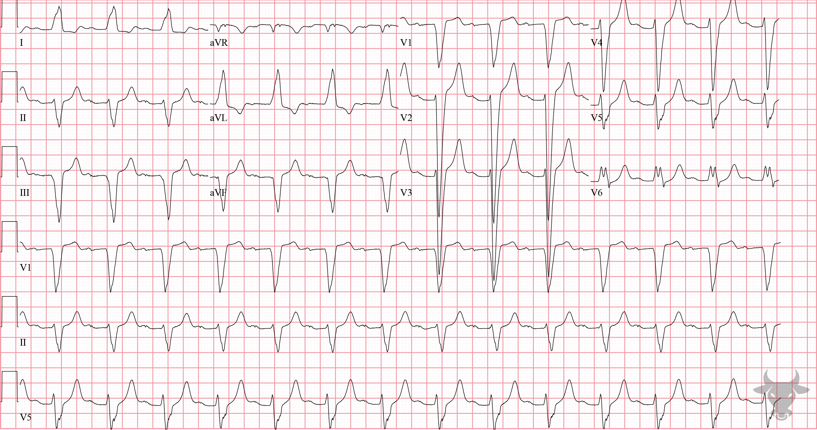
Notes:
Left Bundle Branch Block.
Left Bundle Branch Block, First Degree Atrioventricular Block. Classic left bundle branch block pattern with a wide and negatively deflected QRS complex in V1, a positively deflected and notched QRS complex in V6, and left axis deviation. There is also a first-degree atrioventricular block (i.e., prolonged PR interval), which likely represents delayed conduction through a diseased right bundle (i.e., trifascicular disease).

Slide 8
26-year-old male presents with abdominal pain
155

Slide 9
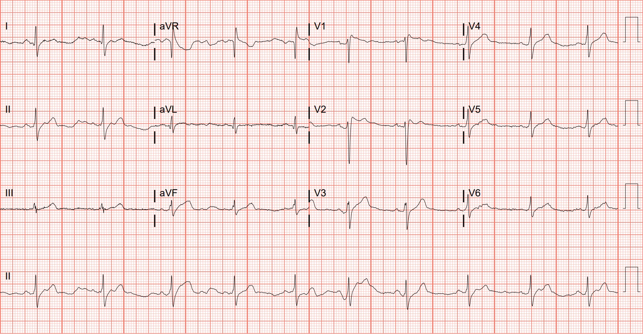
Notes:
Brugada Pattern, Type 2, or saddleback-type.
Brugada Pattern, Type 2, or saddleback-type. Brugada syndrome was previously described in case 59. This patient had the type 2 saddleback pattern on the resting ECG with J point elevation of greater than 2 mm that gives rise to a gradually descending ST-segment that remains 1 mm above the baseline followed by a positive T wave that gives a saddleback appearance in ≥1 right precordial lead (Figure 26). During fever, the patient developed the type 1, or coved-type pattern. Fever or drug-induced type 1 Brugada with other high-risk features might be an indication for internal defibrillator placement even in the absence of arrhythmia.

Slide 10
56-year-old male presents with chest pain
156

Slide 11
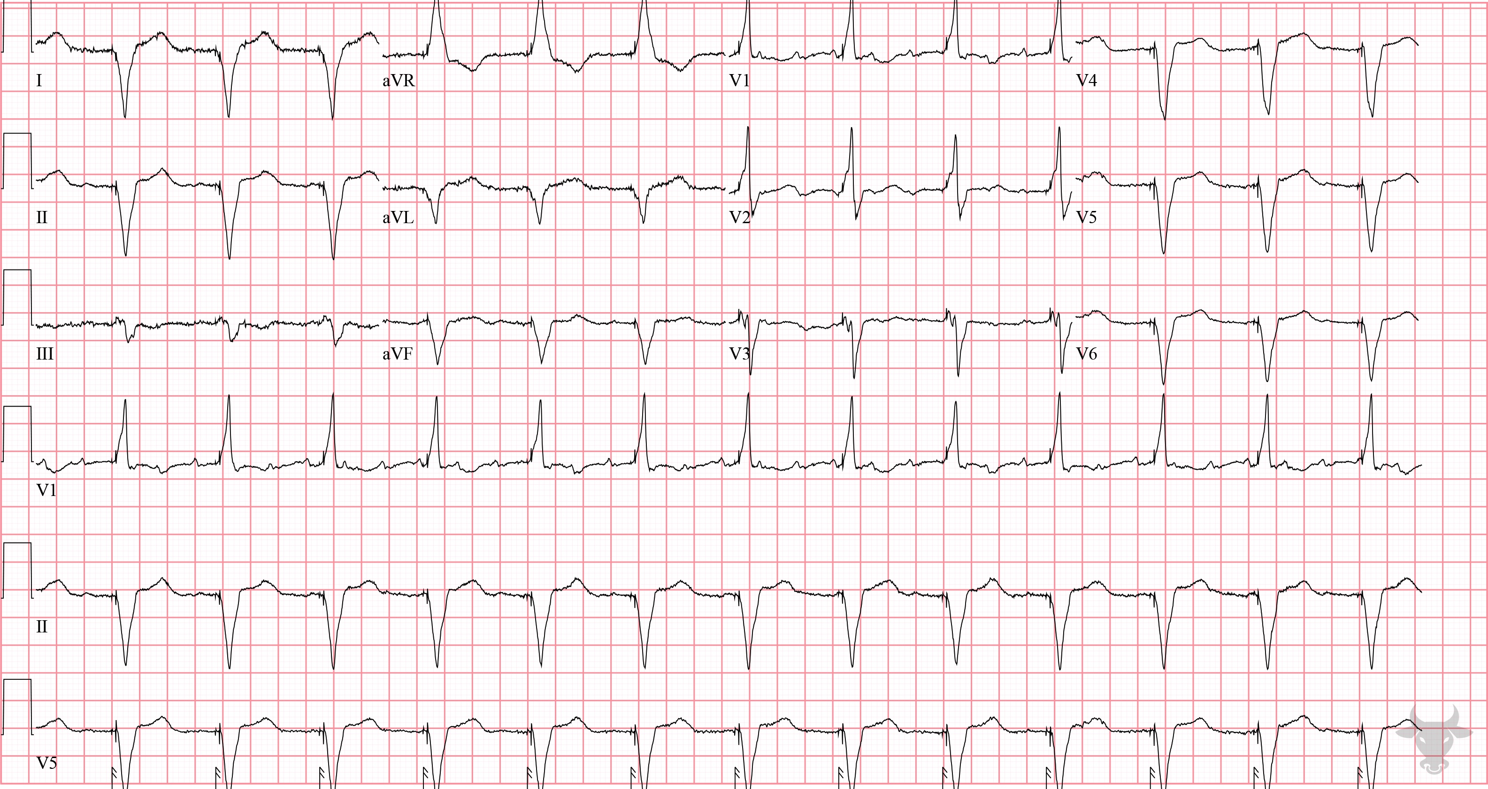
Notes:
Ventricular Paced Rhythm.
Ventricular Paced Rhythm. Pacer spikes can be seen preceding the QRS complexes. Right ventricular pacing characteristically has a left bundle branch block appearance with negatively deflected complexes across the precordium. Biventricular pacemakers like this one often have a right bundle branch block appearance (i.e., positively deflected complex in V1) because an additional lead in the coronary sinus paces the left ventricle (Figure 63). This is called cardiac resynchronization therapy.

Slide 12
67-year-old male presents with dyspnea and fever
157

Slide 13
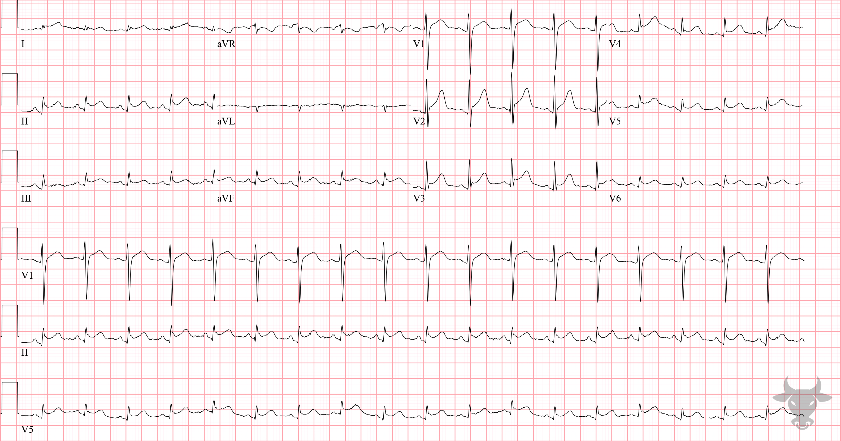
Notes:
Acute Pericarditis.
Acute Pericarditis. There are diffuse, concave up ST-segment elevation without reciprocal changes in a cancer patient with a new pericardial effusion. PR depressions and PR elevation in aVR are typical of acute pericarditis. Diagnostic criteria were previously described in case 33.

Slide 14
STEMI vs Pericarditis Odds Ratios
ST Dep
Witting, M. D., Hu, K. M., Westreich, A. A., Tewelde, S., Farzad, A., & Mattu, A. (2020). Evaluation of Spodick’s Sign and Other Electrocardiographic Findings as Indicators of STEMI and Pericarditis. The Journal of Emergency Medicine. https://doi.org/10.1016/j.jemermed.2020.01.017

Slide 15
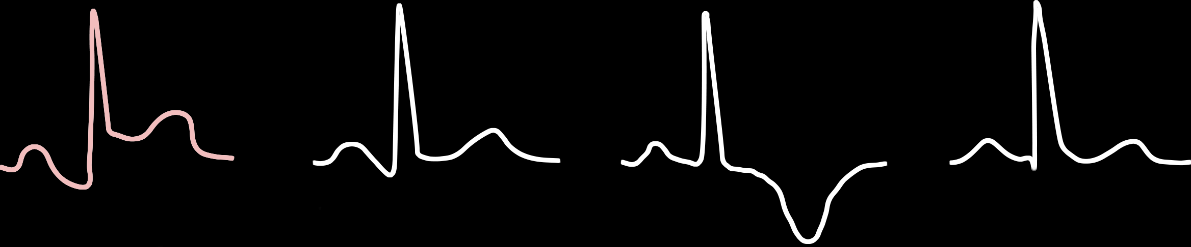
ECG Stages of Pericarditis
Stage 1
Stage 2
Stage 3
Stage 4

