Slide 1

Conference 28
ECG STAMPEDE

Slide 2
64-year-old male presents with palpitations
146

Slide 3
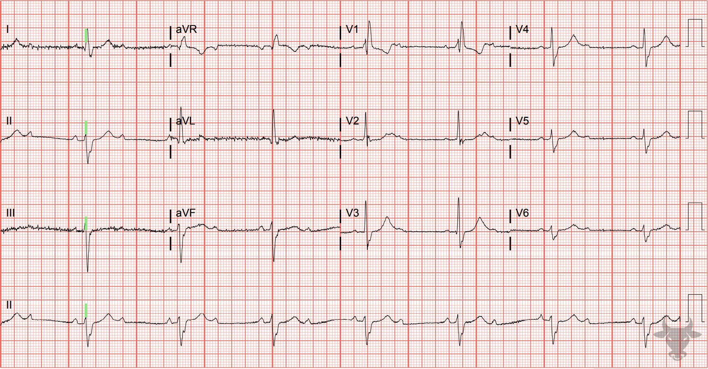
Notes:
Second Degree Atrioventricular Block with 2:1 Conduction.
Second Degree Atrioventricular Block with 2:1 Conduction, Right Bundle Branch Block, Left Anterior Fascicular Block. P waves are conducted in a 2:1 ratio, with every other P wave “dropped”, or failing to conduct through the atrioventricular node. When P waves are conducted but intermittently “dropped,” it is referred to as second degree atrioventricular block. When atrioventricular block occurs in a 2:1 ratio, it is impossible to distinguish between Mobitz I and Mobitz II (previously described in case 77); therefore, it is simply referred to as “2:1 atrioventricular block.” Given this patient’s extensive conduction disease, a permanent pacemaker was placed.

Slide 4
64-year-old female presents with dyspnea
147

Slide 5
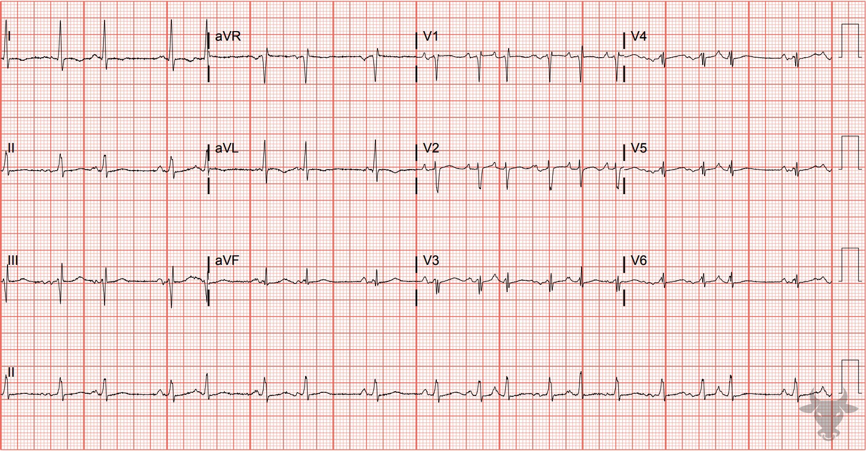
Notes:
Multifocal Atrial Tachycardia.
Multifocal Atrial Tachycardia, Low Voltage. Multifocal atrial tachycardia is an irregularly irregular rhythm, typically between 100-150 beats per minute, that arises from multiple ectopic foci within the atria. It is most often seen in patients with advanced lung disease, such as chronic obstructive pulmonary disease. It is defined by a rate greater than 100 beats per minute with at least three morphologically distinct atrial complexes, varying P-P intervals, and an isoelectric baseline between P waves (Figure 59). This patient had chronic obstructive lung disease, and the low voltage (previously defined in case 51) was due to increased impedance from hyperinflated lungs.

Slide 6
50-year-old male presents with palpitations
148

Slide 7
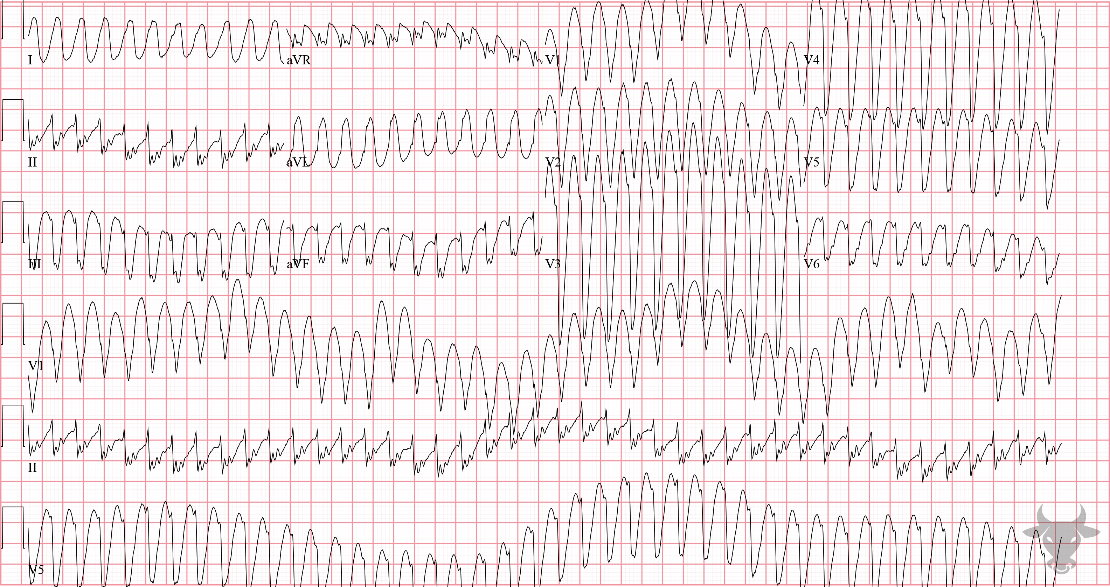
Notes:
Ventricular Tachycardia.
Ventricular Tachycardia. Concordance of the complexes across the precordium (i.e., all the QRS complexes are going in the same direction) and the presence of Josephson's sign – notching of the S wave near its nadir, best seen in the inferior leads (II, III, aVF) and previously described in case 21 – favors ventricular tachycardia. Up to 80% of cases of all wide complex tachycardia are ventricular tachycardia, and none of the available algorithms for differentiating wide complex tachycardia perform well in the acute setting. When in doubt, it is safest to assume that regular wide complex tachycardia is ventricular tachycardia.

Slide 8
54-year-old female presents with chest pain
149

Slide 9
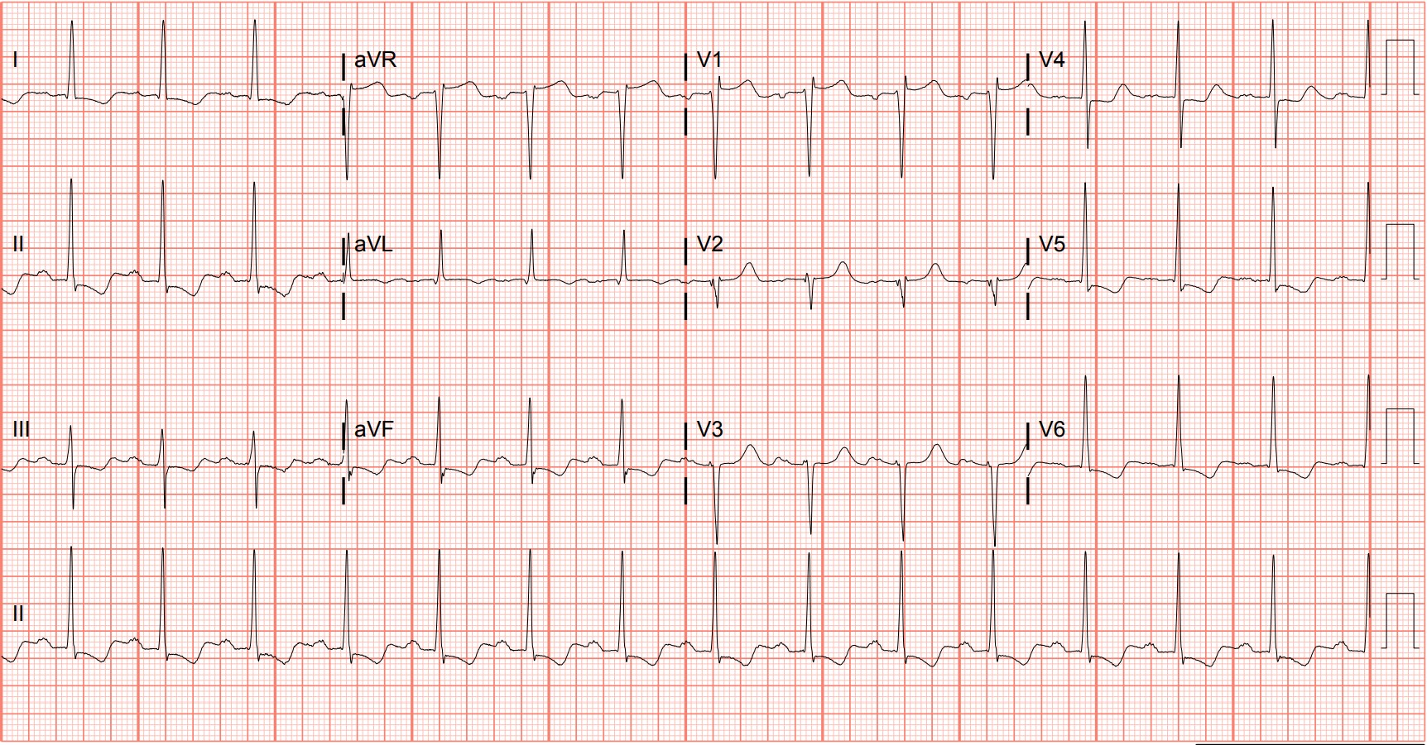
Notes:
Left Ventricular Hypertrophy.
Left Ventricular Hypertrophy, T-wave Inversions. Left ventricular hypertrophy with associated inferolateral ST-segment depressions, repolarization abnormalities, and large QRS complexes. The T-wave inversions are asymmetric consistent with a "strain" appearance (Figure 60).

Slide 10
False Positive Activation
Left Ventricular Hypertrophy
McCabe JM, Armstrong EJ, Kulkarni A, et al. Prevalence and factors associated with false-positive ST-segment elevation myocardial infarction diagnoses at primary percutaneous coronary intervention–capable centers: a report from the Activate-SF registry. Arch Intern Med. 2012;172(11):864-871.

Slide 11

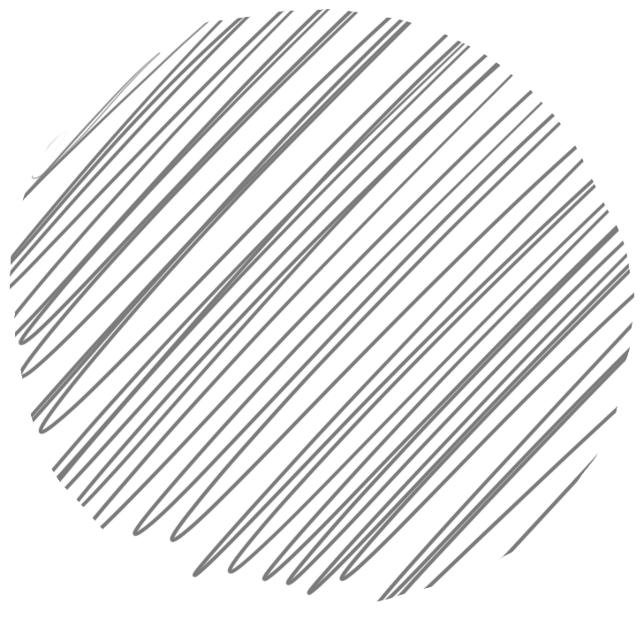
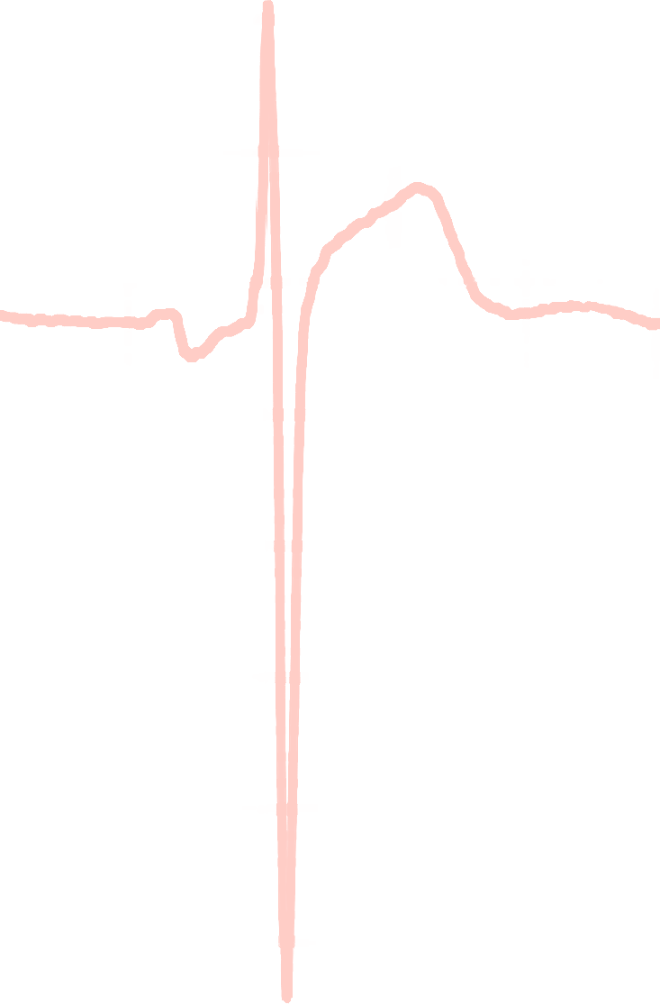
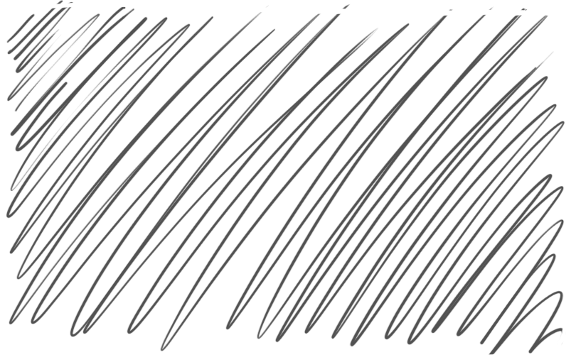
Armstrong Algorithm for STE in LVH
V1-V3
91%
Specificity
STE
R-S
STE/R-S
> 0.25?
77%
Sensitivity
Armstrong EJ, Kulkarni AR, Bhave PD, et al. Electrocardiographic criteria for ST-elevation myocardial infarction in patients with left ventricular hypertrophy. Am J Cardiol. 2012;110(7):977-983.
Notes:
Sensitivity 77%
Specificity 91%

Slide 12
52-year-old female presents with palpitations
150

Slide 13
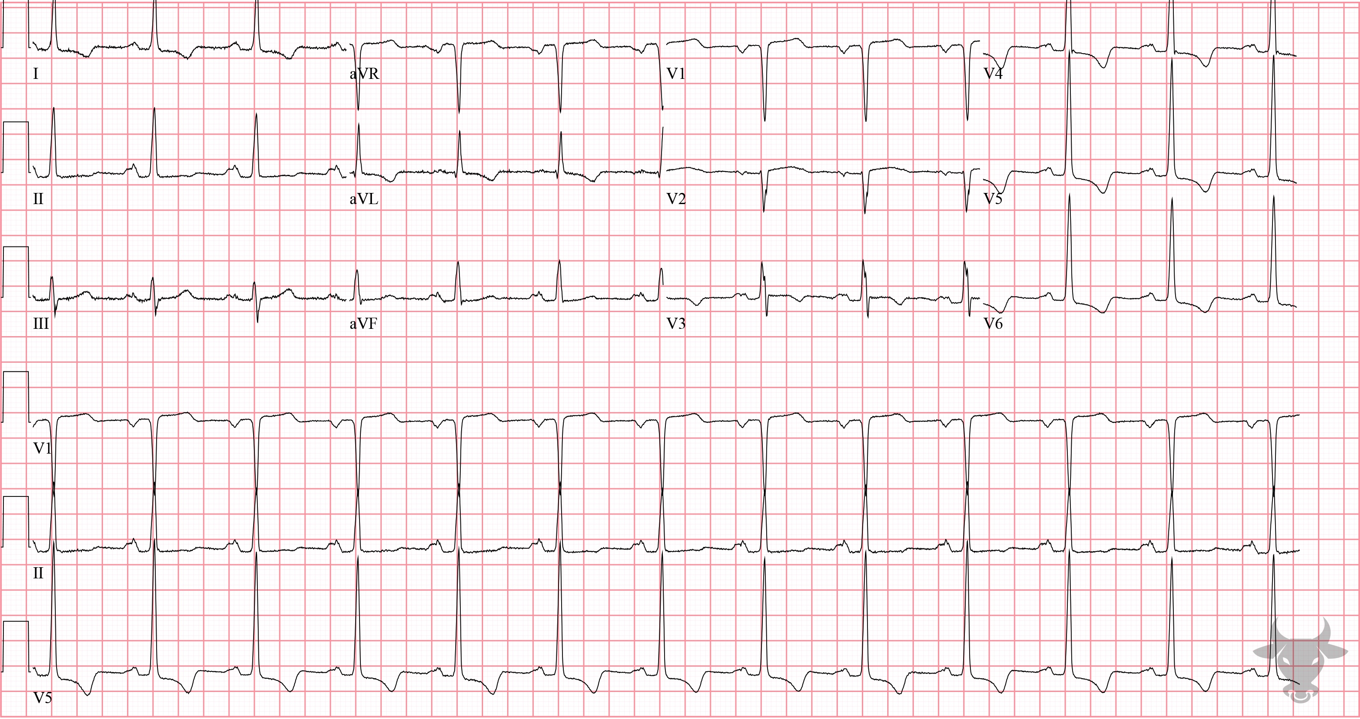
Notes:
Pacemaker Mediated Tachycardia.
Pacemaker Mediated Tachycardia, Pacemaker Malfunction. Pacemaker-mediated tachycardia (PMT), or endless loop tachycardia, is a reentrant tachycardia in which the pacemaker forms the anterograde pathway, and the atrioventricular node forms the retrograde pathway, leading to a pacemaker-sensed retrograde P’ wave. It occurs in patients with dual chamber pacemakers. The rate is usually at or near the programmed upper limit and can be terminated by slowing conduction through the atrioventricular node (e.g., adenosine) or activating asynchronous mode of the pacemaker by placing a magnet over the pacing generator. This patient received amiodarone and the arrhythmia ceased.

Slide 14
55-year-old male presents with dyspnea
151

Slide 15
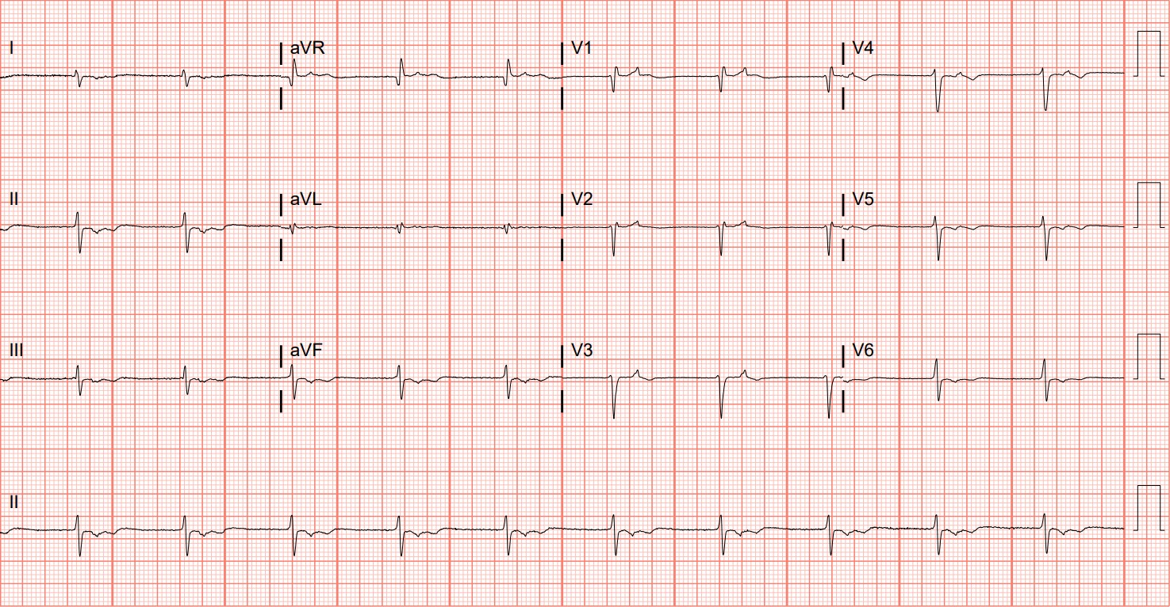
Notes:
Junctional Bradycardia.
Junctional Bradycardia. This is a junctional rhythm with retrograde atrial conduction. Notice the retrograde P’ waves immediately following the QRS complexes. P waves conducted via sinoatrial activity are negatively deflected in V1 and upright in the inferior leads; retrograde conduction depolarizes the atria in the opposite direction, leading to upright P’ waves in V1 and negatively deflected P’ waves in the inferior leads (Figure 61).

