Slide 1

Conference 27
ECG STAMPEDE

Slide 2
86-year-old female presents with confusion
140

Slide 3
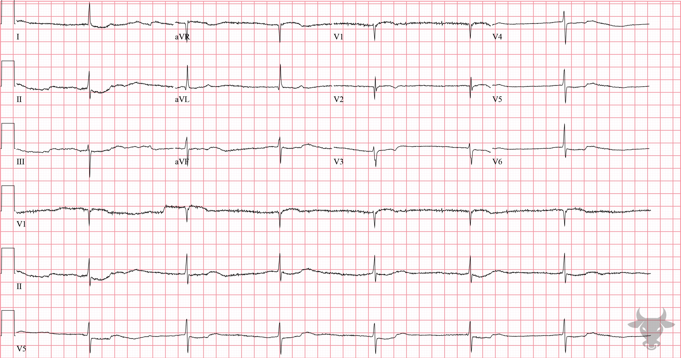

Notes:
Digoxin Toxicity.
Digoxin Toxicity, Hyperkalemia. This ECG shows the classic "dig effect" (i.e., scooped ST segment previously described in case 85) and a junctional bradycardia in a patient with acute renal failure and hyperkalemia. Digoxin is a cardiac glycoside most used in the management of systolic heart failure and atrial arrhythmias. It is a reversible inhibitor of the Na-K ATPase pump, primarily in the myocardium, leading to increased intracellular calcium and enhanced contractility. In toxic doses, digoxin can cause a multitude of arrhythmias owing to increased automaticity, shortened refractory period, and decreased atrioventricular nodal conduction. Digoxin toxicity can cause virtually any dysrhythmia, but common dysrhythmias associated with digoxin toxicity are frequent PVCs, slow atrial fibrillation, sinus bradycardia, junctional rhythm, atrial tachycardia, atrioventricular blocks, and ventricular tachycardia (bi-directional or polymorphic).

Slide 4
50-year-old male presents with dyspnea
141

Slide 5
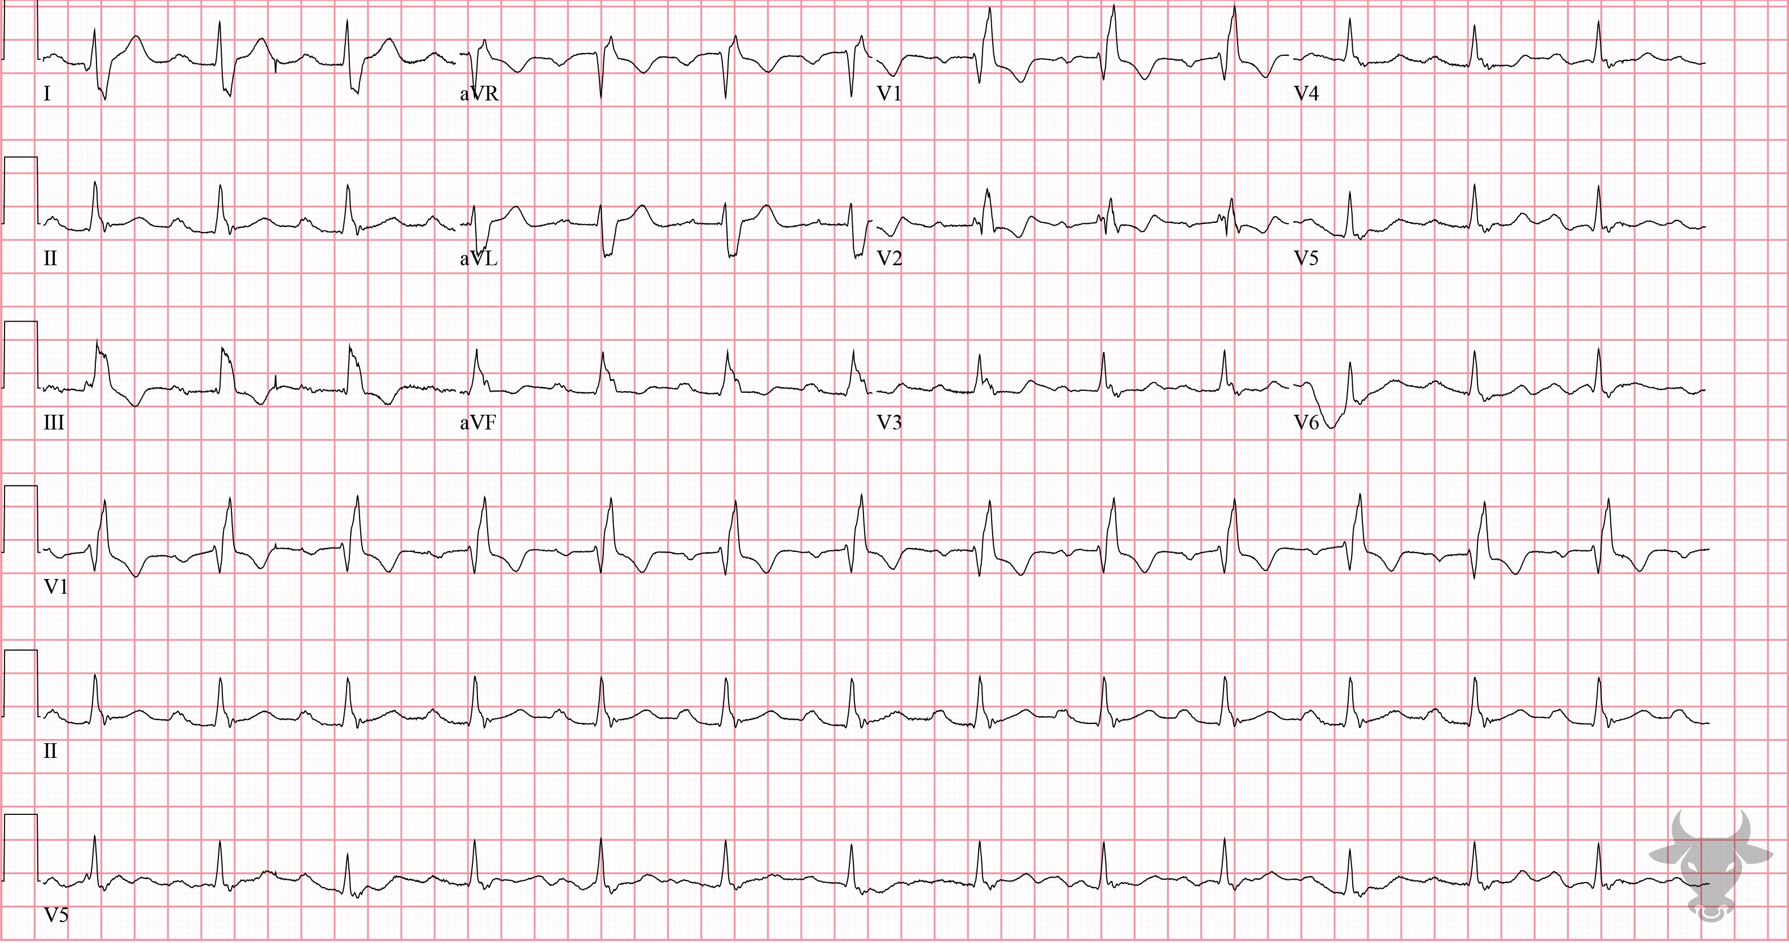
Notes:
Right Bundle Branch Block.
Right Bundle Branch Block, First Degree Atrioventricular Block. Classic right bundle branch block pattern with rSR' in V1 and a wide S wave in the lateral leads (I, aVL, V5, V6) in addition to first degree atrioventricular block (i.e., prolonged PR interval). This patient had right heart failure from obesity hypoventilation syndrome.

Slide 6
87-year-old female presents with cardiac arrest
142

Slide 7
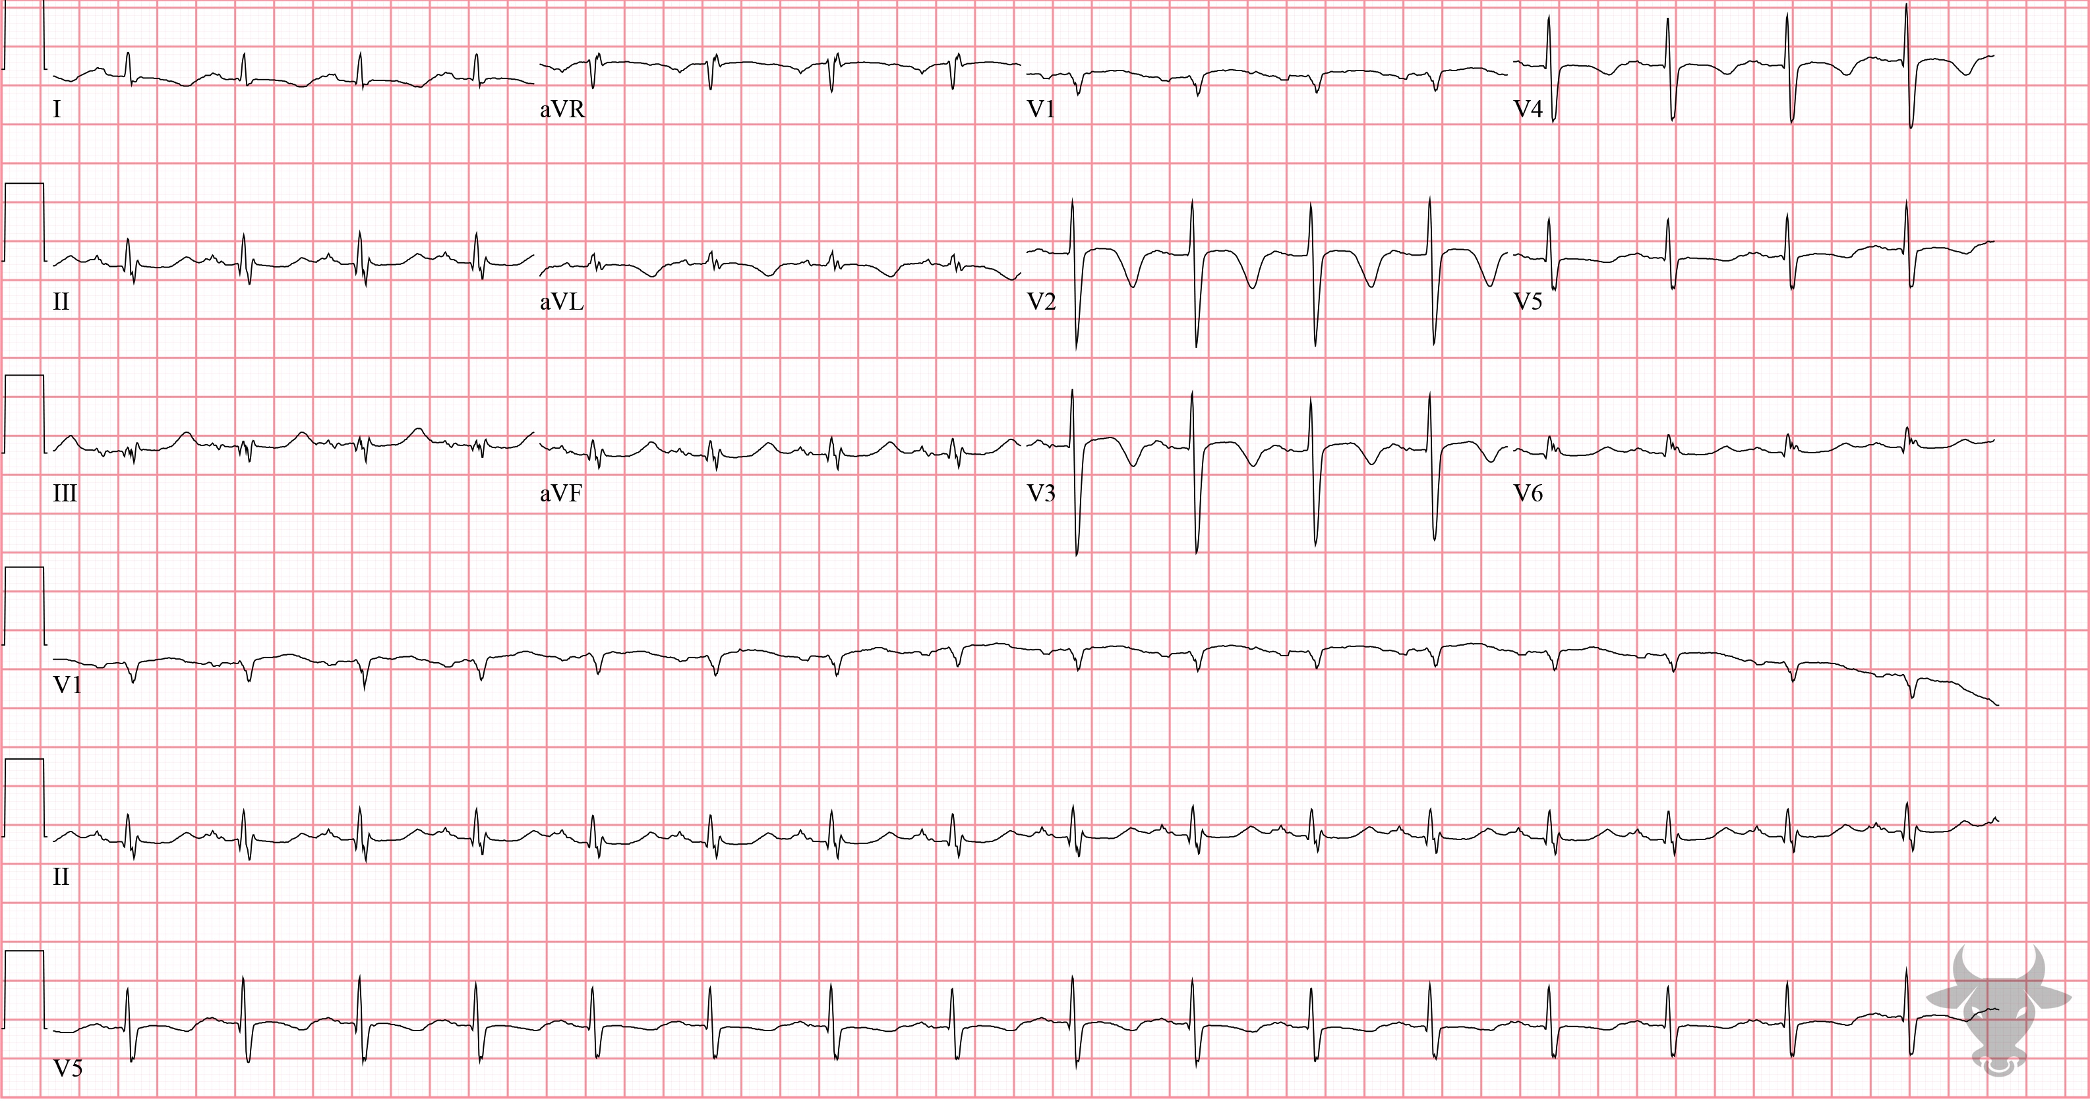
Notes:
Cerebral T waves.
Cerebral T waves. The precordial T wave inversions were due to increased intracranial pressure from an acute subarachnoid hemorrhage – so called “cerebral T waves.” Cerebral T waves are diffuse, symmetric, deep, and associated with a prolonged QT; they are thought to be the result of a sympathetic surge causing repolarization abnormalities. They are rare and generally resolve over time.

Slide 8
35-year-old male presents with sickle cell pain crisis
143

Slide 9
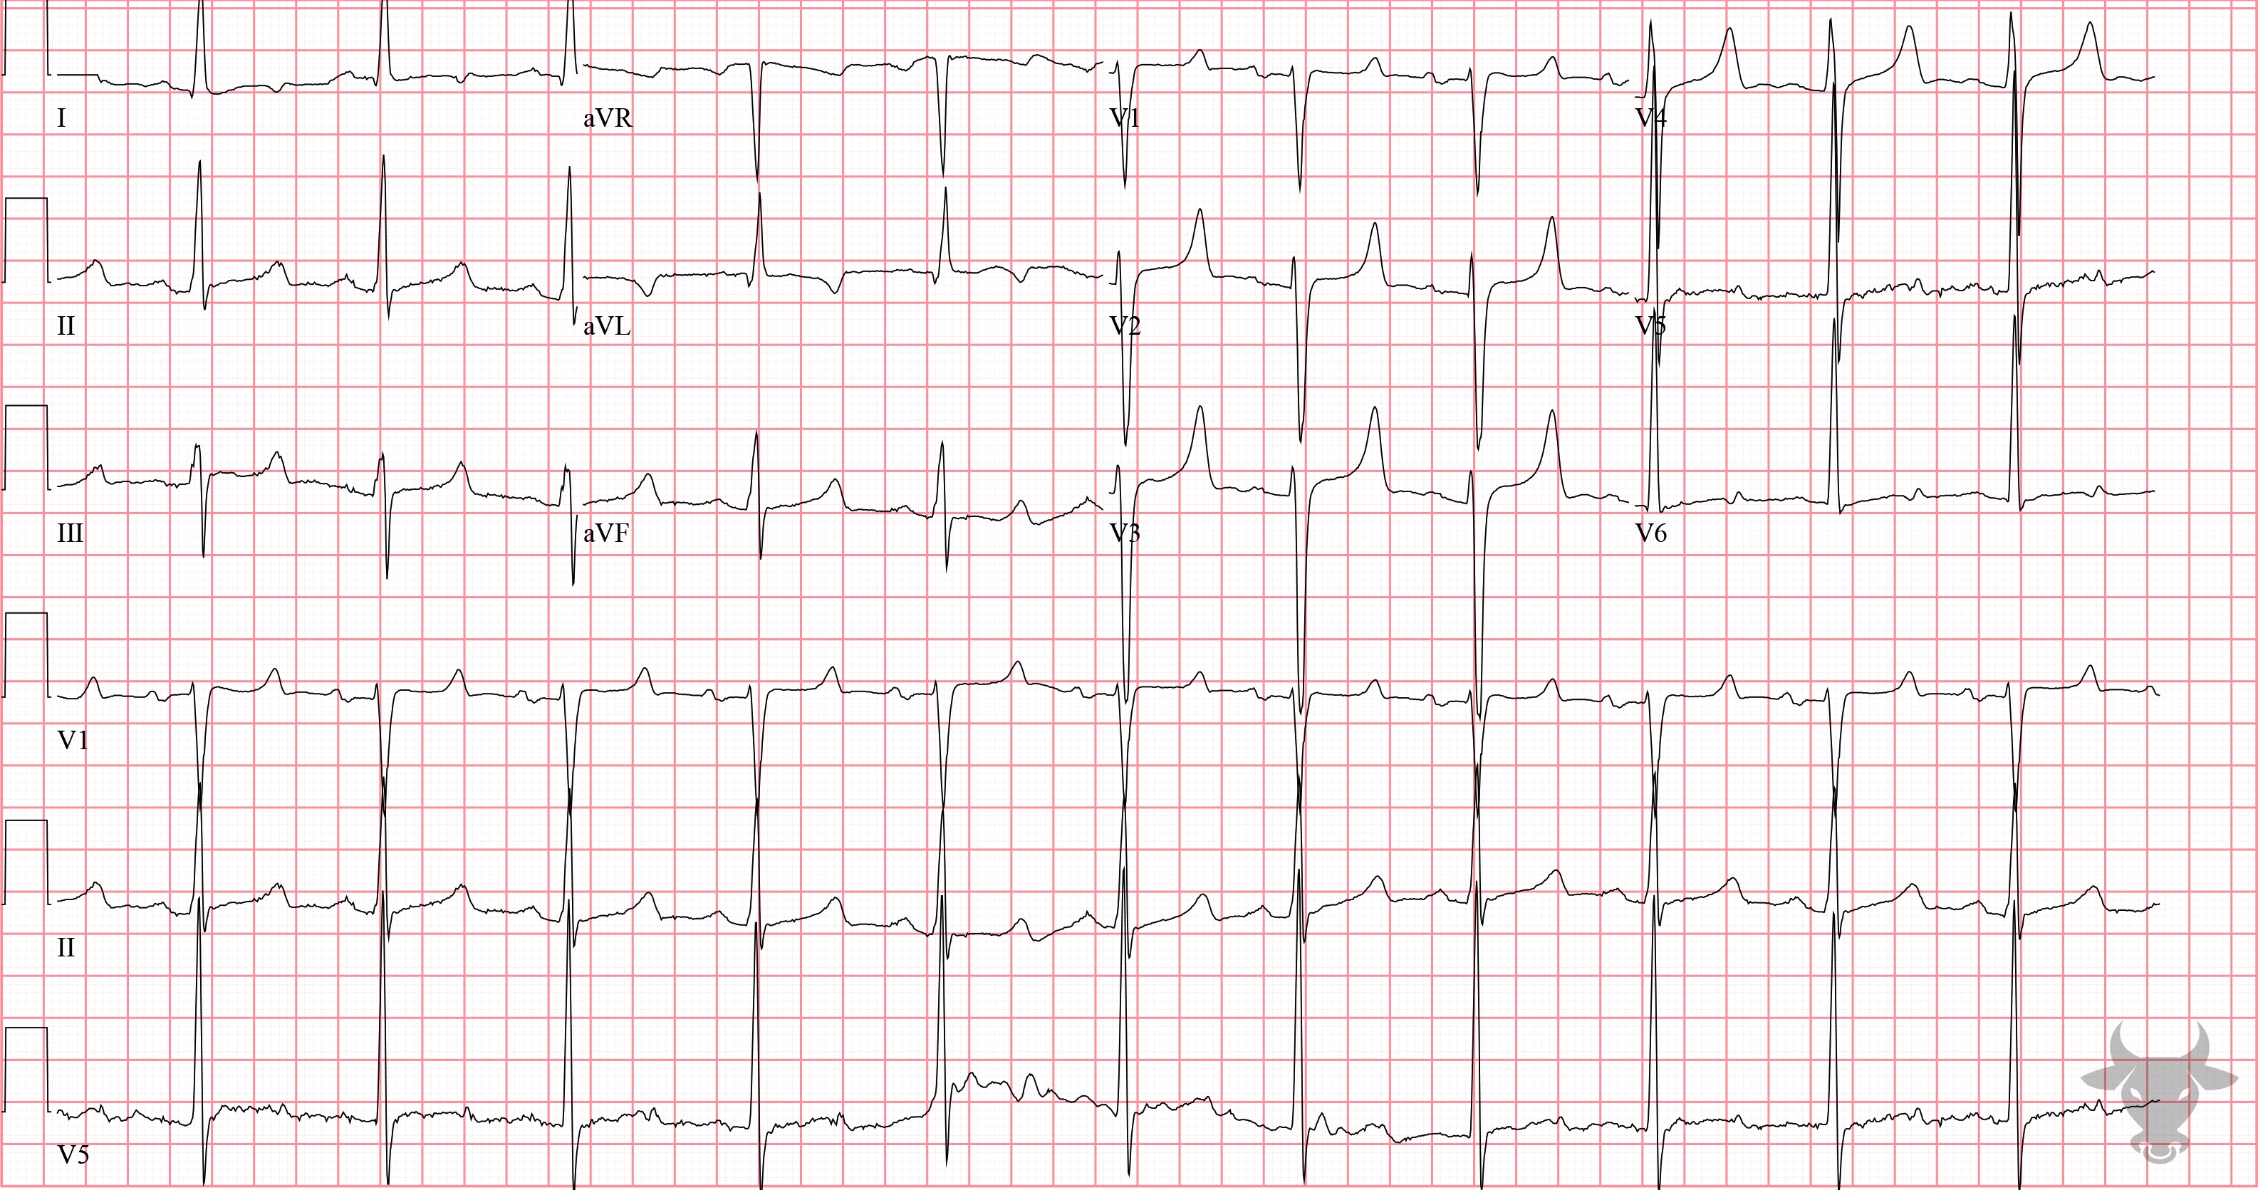
Notes:
Hypocalcemia.
Hypocalcemia, Hyperkalemia. Hypocalcemia characteristically increases the duration of the plateau phase of the cardiac action potential, manifesting as increased length of the ST-segment (Figure 57). This form of QT prolongation is unique and distinctly different than the delayed repolarization phase experienced during hypokalemia or with QT-prolonging medications. The presence of peaked T waves also suggests hyperkalemia. The combination of electrocardiographic findings of hypocalcemia (i.e., lengthened ST-segment) and hyperkalemia (i.e., peaked T waves) is a classic manifestation of end-stage renal disease. The total calcium level was 5.2 mg/dL, and the potassium level was 6.5 mEq/L.

Slide 10
42-year-old female presents with agg assault
144

Slide 11
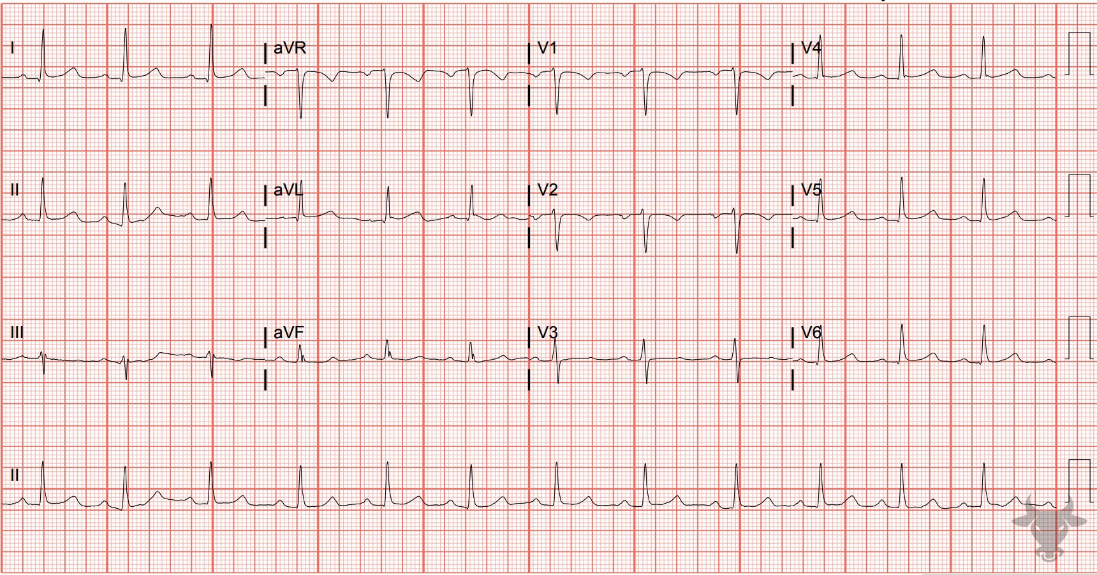
Notes:
First Degree Atrioventricular Block.
First Degree Atrioventricular Block. First degree atrioventricular block is caused by delayed conduction through the atrioventricular node. It is diagnosed when the PR interval exceeds 200 ms (Figure 58) and is considered “marked” when greater than 300 ms. It can be caused by atrioventricular nodal disease, enhanced vagal tone, ischemia (e.g., inferior myocardial infarction), infection (e.g., Lyme disease), inflammation, electrolyte abnormalities, or medications (e.g., calcium channel blockers, beta blockers, antiarrhythmics, and digoxin). In isolation, it is generally benign and asymptomatic; however, it can progress to higher level blocks.

Slide 12
58-year-old female presents with abdominal pain
145

Slide 13
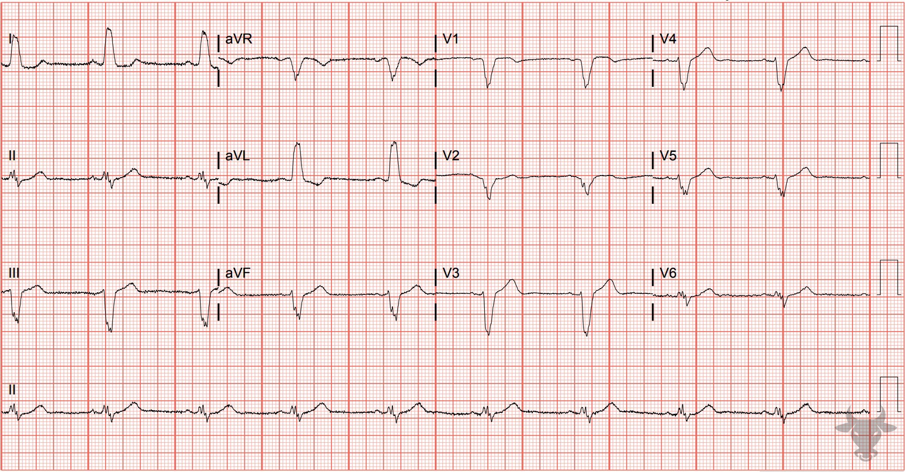
Notes:
Left Bundle Branch Block.
Left Bundle Branch Block, Sinus Bradycardia. Left bundle branch block pattern with a wide and down-going QRS complex in V1, and broad, notched R waves in I and aVL (Figure 23).

