Slide 1

Conference 26
ECG STAMPEDE

Slide 2
46-year-old male presents with chest pain
134

Slide 3
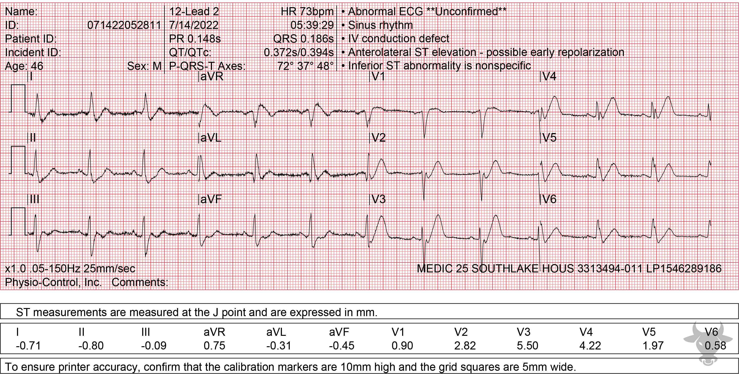

Notes:
Hyperacute T Waves, ST-elevation Myocardial Infarction.
Hyperacute T Waves, ST-elevation Myocardial Infarction. There are hyperacute 'de Winter T waves' that ultimately evolved into an anterior ST-elevation myocardial infarction (STEMI). Described in 2008 by de Winter, this pattern of upsloping ST depressions and hyperacute T waves in the precordial leads suggests proximal left anterior descending occlusion. While this pattern does not meet classic STEMI criteria, it does suggest the presence of an occlusive myocardial infarction and emergent reperfusion is recommended . This pattern is seen in just 2% of acute left anterior descending artery occlusions and is often misdiagnosed. Left heart catheterization revealed a distal left main occlusion and percutaneous coronary intervention was successful.

Slide 4
0-year-old male presents with cough found to be in atrial flutter at very fast rate
135

Slide 5
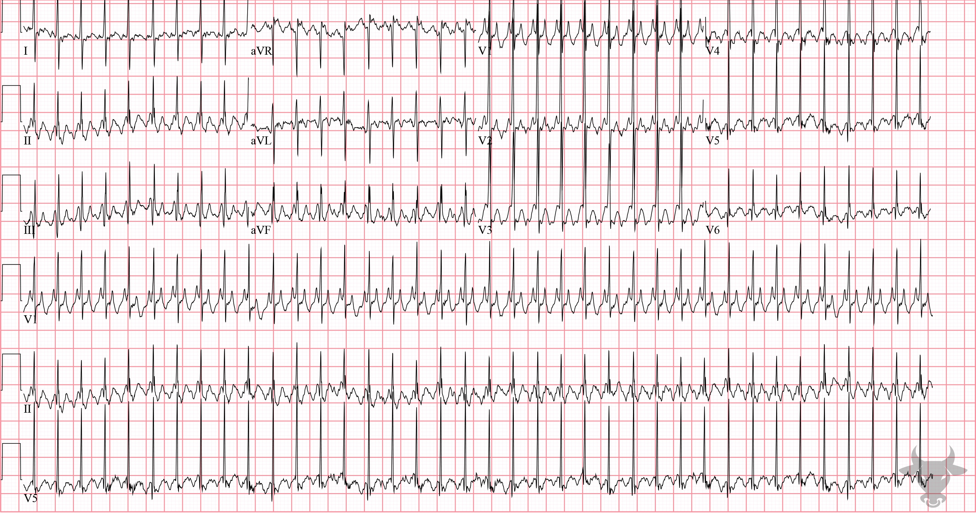
Notes:
Atrial Flutter with 2:1 Conduction.
Atrial Flutter with 2:1 Conduction. Atrial flutter occurs when a reentrant circuit forms in the right atrium. It more commonly occurs in a counterclockwise fashion, leading to inverted flutter waves in the inferior leads (II, III, and aVF). There is an atypical appearance to P waves in the limb leads (specifically II, III and aVF) where the usual isoelectric baseline is replaced by identical appearing “sawtooth” waves. Pediatric intervals tend to be shorter, and rates faster than in adults (e.g., > 200 beats per minute in this ECG). In the absence of treatment or atrioventricular block, the most common atrial to ventricular response is 2:1.

Slide 6
15-year-old male presents with syncope
136

Slide 7
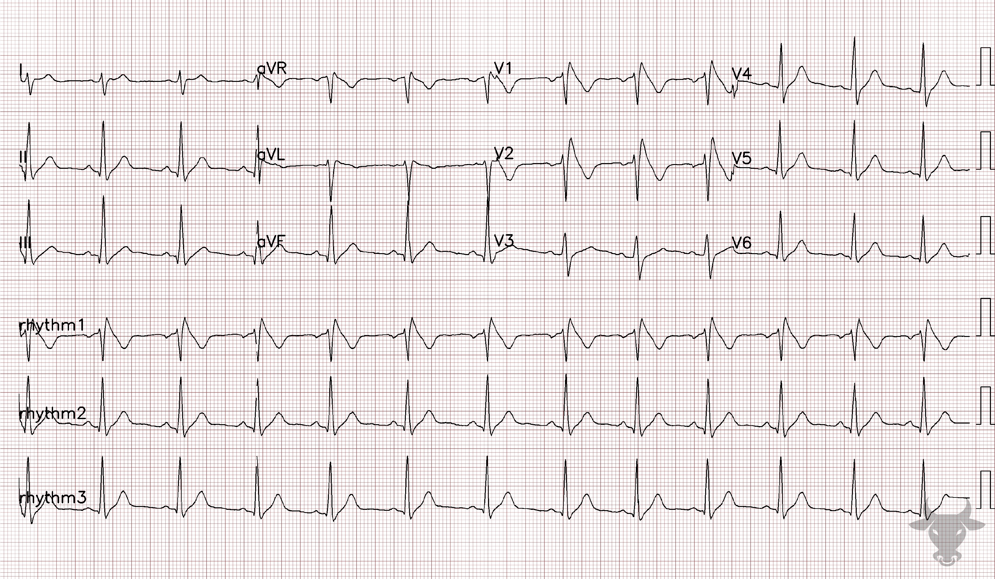
Notes:
Brugada Syndrome.
Brugada Syndrome. Type 1 or coved-type Brugada pattern in a patient presenting with syncope. Brugada syndrome was previously described in case 59. This patient received an implanted defibrillator.

Slide 8
53-year-old male presents with chest pain
137

Slide 9
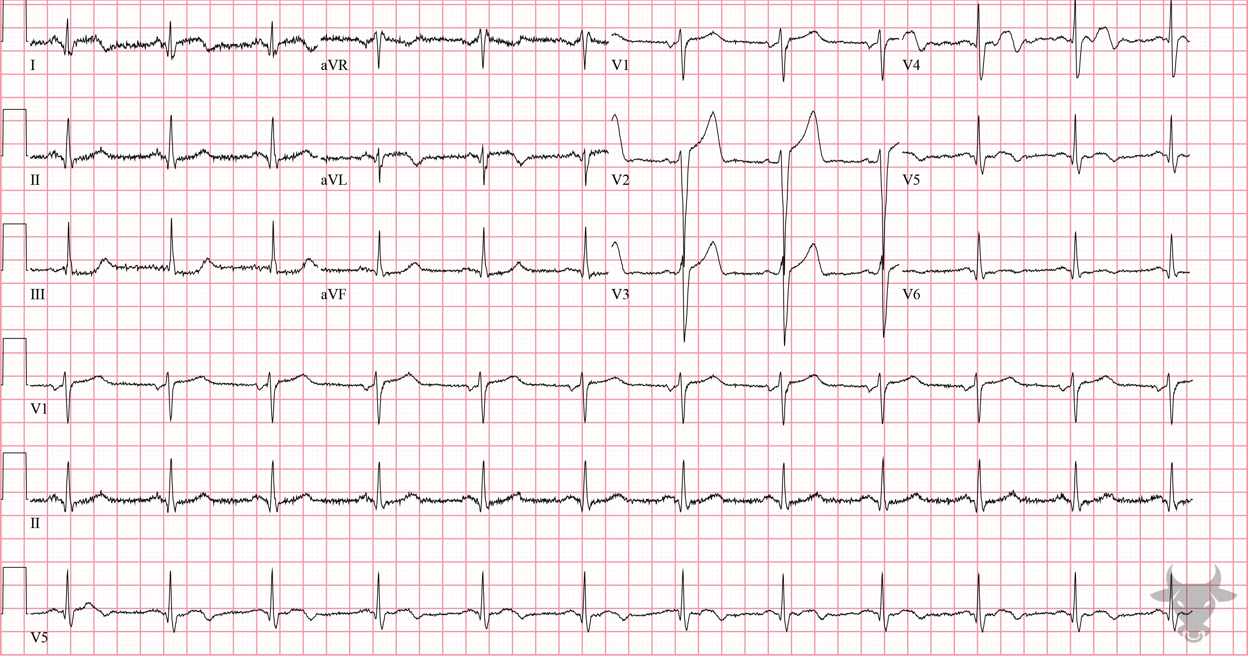
Notes:
High Lateral ST-elevation Myocardial Infarction.
High Lateral ST-elevation Myocardial Infarction. There is subtle ST-segment elevation in the high lateral leads (I, aVL) and V2, along with reciprocal ST-segment depressions in the inferior leads (II, III, aVF). This pattern of ST-elevation has been dubbed the “South African flag sign” because of its resemblance of the South African flag (Figure 56).
The T wave in V4 is biphasic with terminal negative deflection, which is specific for ischemia. Later, in the repeat ECG, the T wave in V4 "pseudonormalized" (i.e., became upright) which suggests acute infarct. Left heart catheterization revealed 80% proximal left anterior descending artery stenosis and acute occlusion of the second diagonal branch.

Slide 10
72-year-old female presents with confusion
138

Slide 11
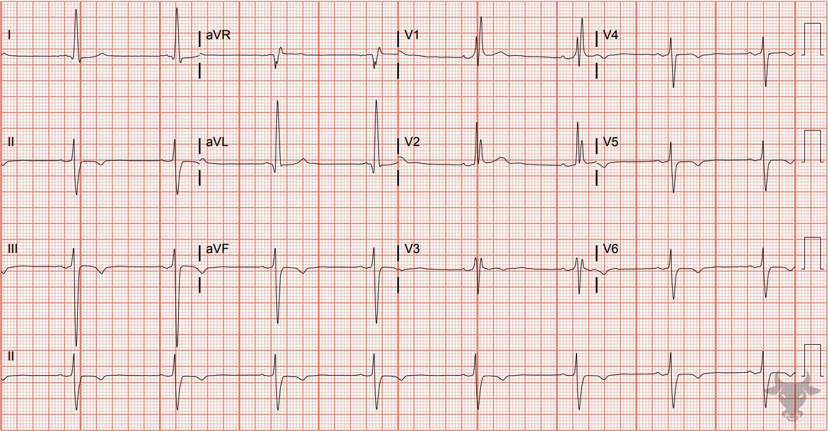
Notes:
Right Bundle Branch Block.
Right Bundle Branch Block, Left Anterior Fascicular Block. The wide QRS, rSR’ in the anterior precordial leads (V1, V2), and deep S-waves in the lateral leads (I, V6) indicate the presence of a right bundle branch block. The right bundle branch block, however, does not explain the left axis deviation. Causes of left axis deviation were previously described in case 3. This ECG demonstrates disruption of two fascicles, the right bundle and the left anterior fascicle, and is termed a “bifascicular” block.

Slide 12
16-year-old male presents with syncope
139

Slide 13
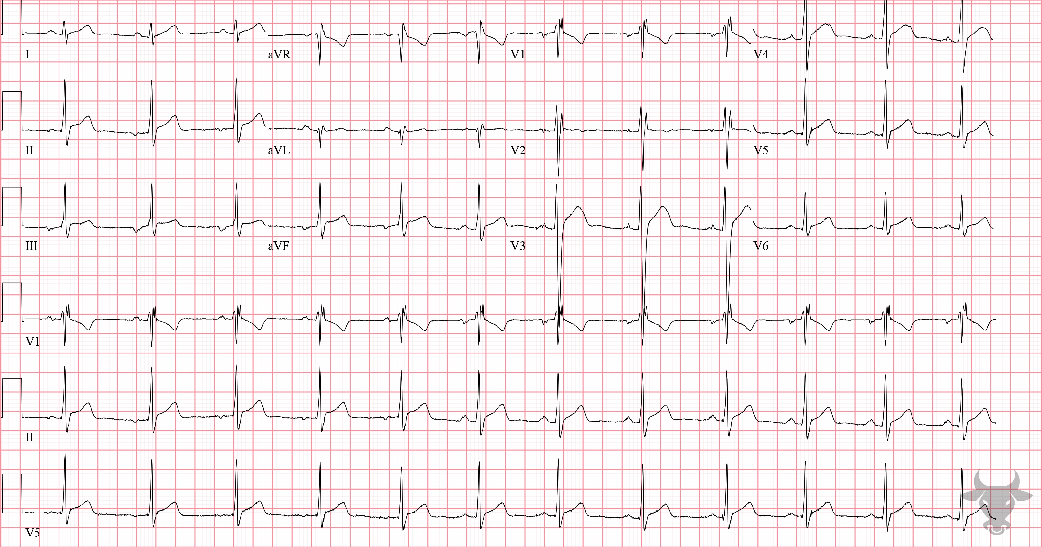
Notes:
Incomplete Right Bundle Branch Block.
Incomplete Right Bundle Branch Block. This is an example of an incomplete right bundle branch block. The morphology is similar to a complete right bundle branch block, including an rSR' in V1, but the width of the QRS is less than 120 ms; therefore, it is considered incomplete.

