Slide 1

Conference 25
ECG STAMPEDE

Slide 2
81-year-old male presents with syncope
129

Slide 3
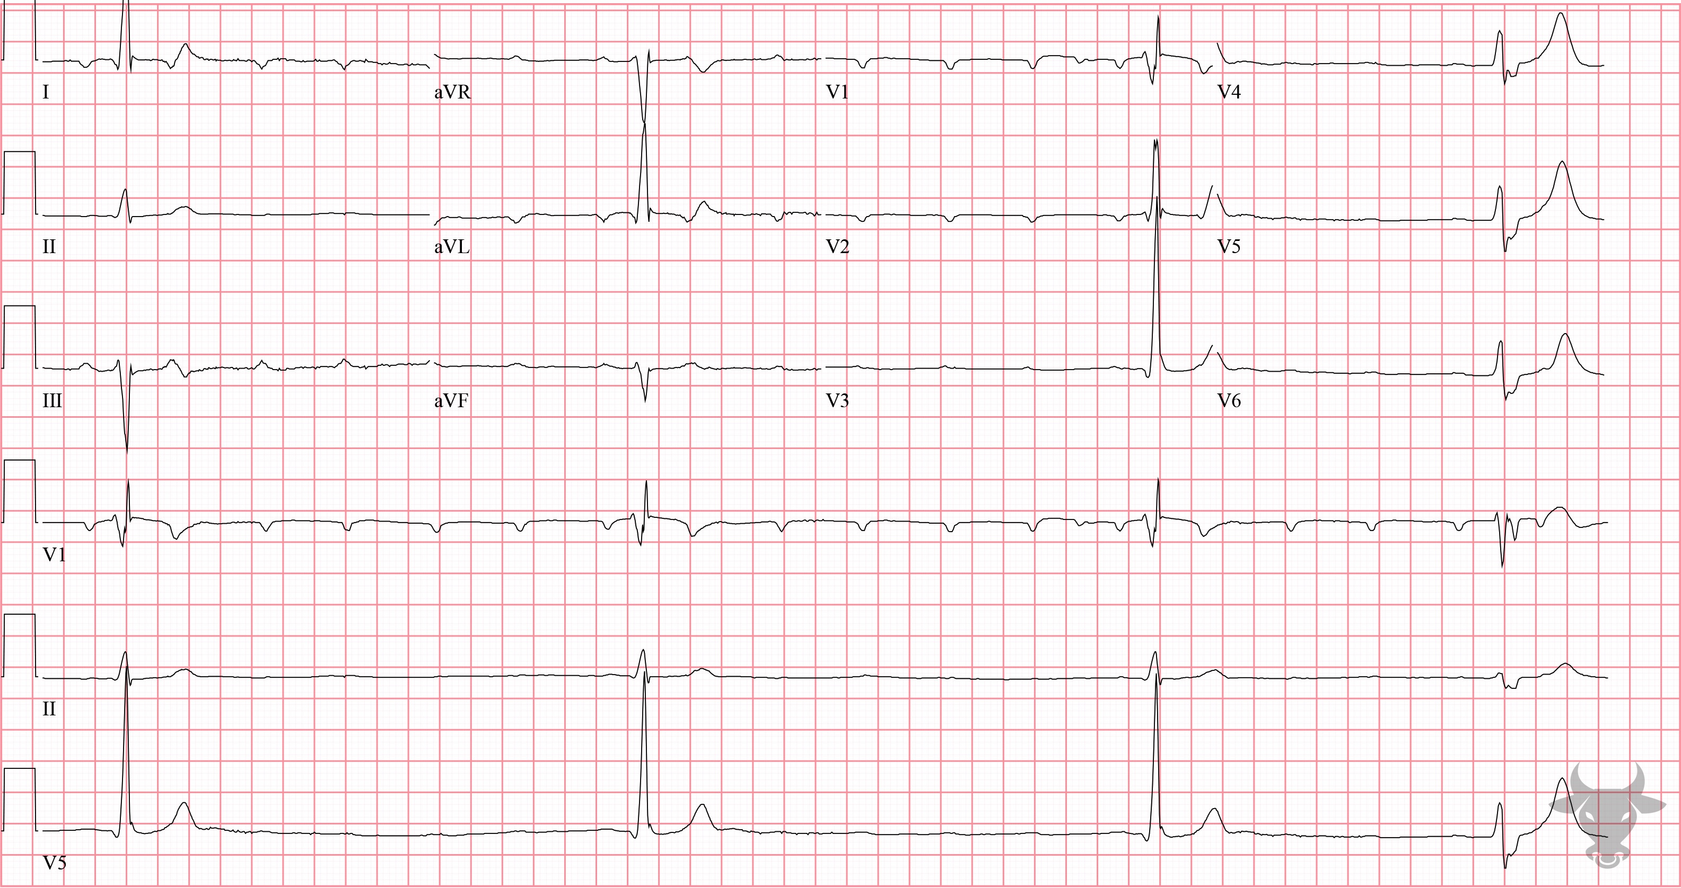

Notes:
Third Degree Atrioventricular Block.
Third Degree Atrioventricular Block. Atrioventricular dissociation with a ventricular escape rhythm. The term atrioventricular dissociation refers to the independent contraction of the atria and ventricles and suggests a disturbance in the normal conduction pathway; in this case, third degree (i.e., complete) atrioventricular block. The wide (>120 ms), and slow (<40 beats per minute) QRS complexes suggest a ventricular escape rhythm.

Slide 4
26-year-old male presents with overdose
130

Slide 5
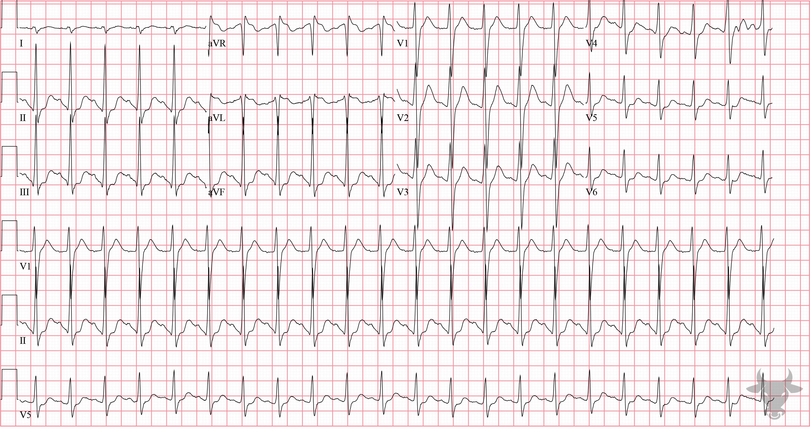
Notes:
Sodium Channel Toxicity.
Sodium Channel Toxicity. Sodium channel toxicity from a tricyclic antidepressant overdose. Note the triad of right axis deviation, tall terminal R wave in aVR, and widened QRS (Figure 55). This patient was successfully treated with sodium bicarbonate.

Slide 6
27-year-old female presents with dyspnea
131

Slide 7
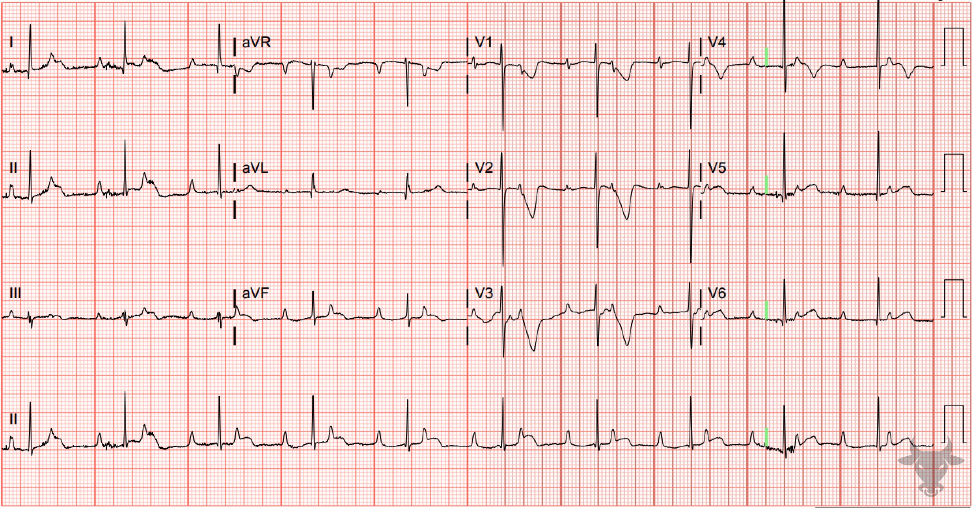
Notes:
Persistent Juvenile T Wave Pattern.
Persistent Juvenile T Wave Pattern. The T waves in the right precordial leads (V1 through V3) are asymmetrically inverted in childhood and become upright (except for V1 and occasionally V2) by adulthood. In predominantly black women under the age of 40, this juvenile T wave pattern may persist in the absence of cardiac abnormalities.

Slide 8
75-year-old male presents with confusion
132

Slide 9
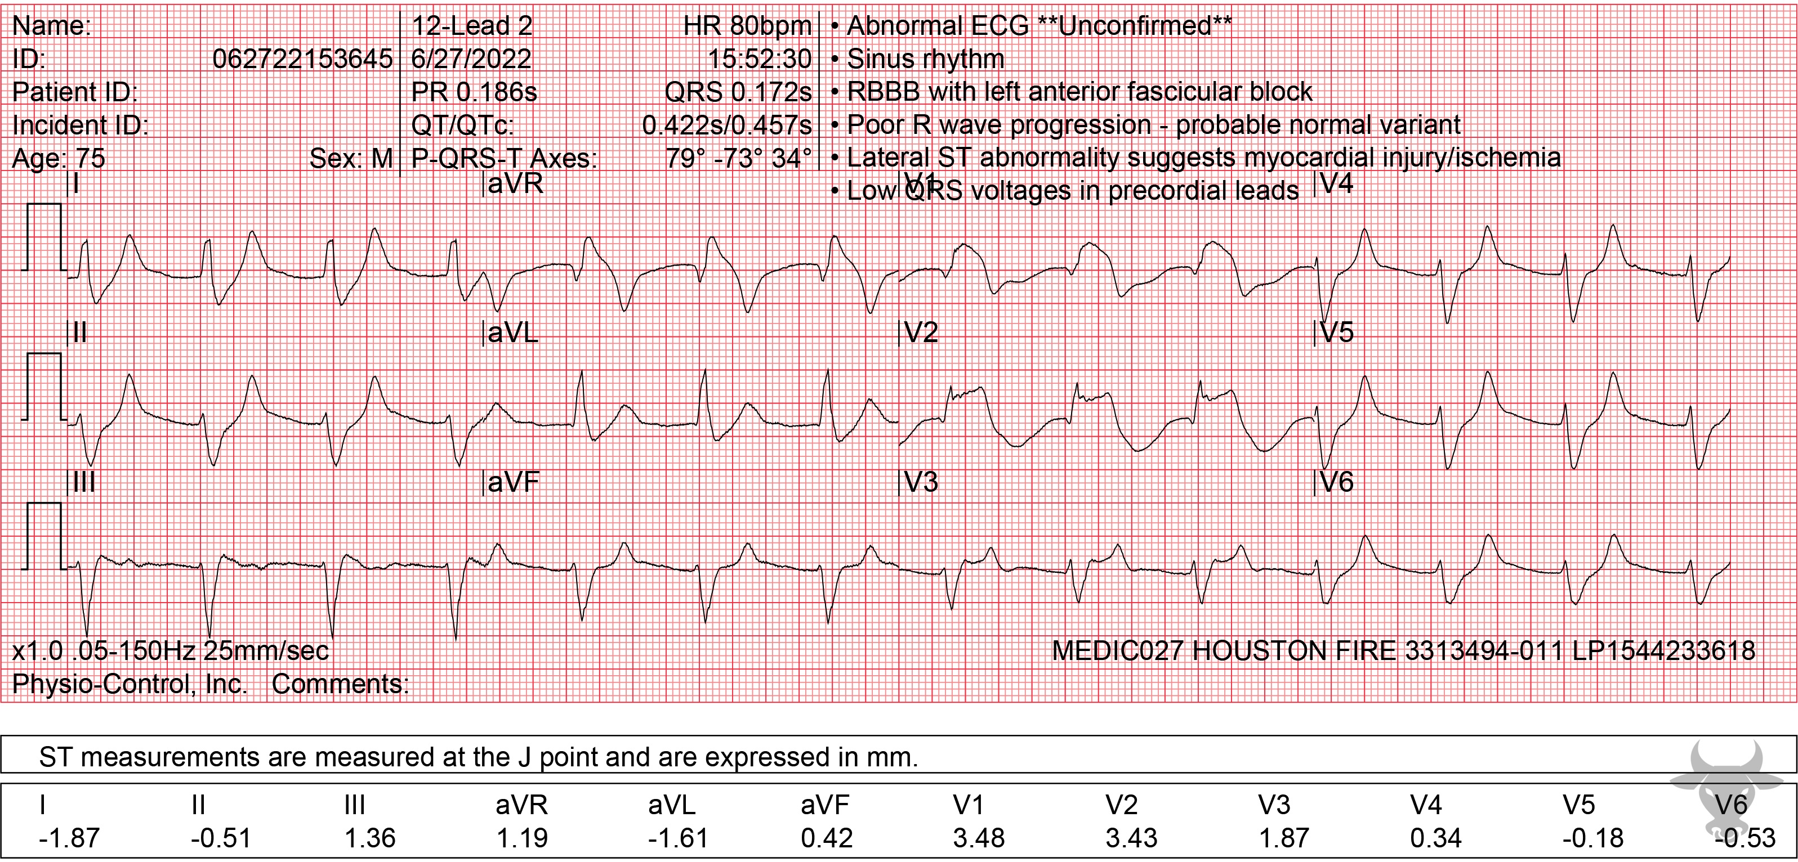
Notes:
Hyperkalemia.
Hyperkalemia. Hyperkalemia can mimic STEMI, especially in leads V1 and V2, as with this case. Hyperkalemic changes include widened QRS complexes and peaked T waves. It is not uncommon for hyperkalemia to produce findings similar to sodium channel toxicity including right axis deviation and a tall terminal R in aVR. This patient was mistaken for having an anterior myocardial infarction, and was taken emergently for cardiac catheterization, which failed to reveal an obstructive lesion. The potassium resulted later, and was 9.1 mEq/L.

Slide 10
65-year-old female presents with chest pain
133

Slide 11
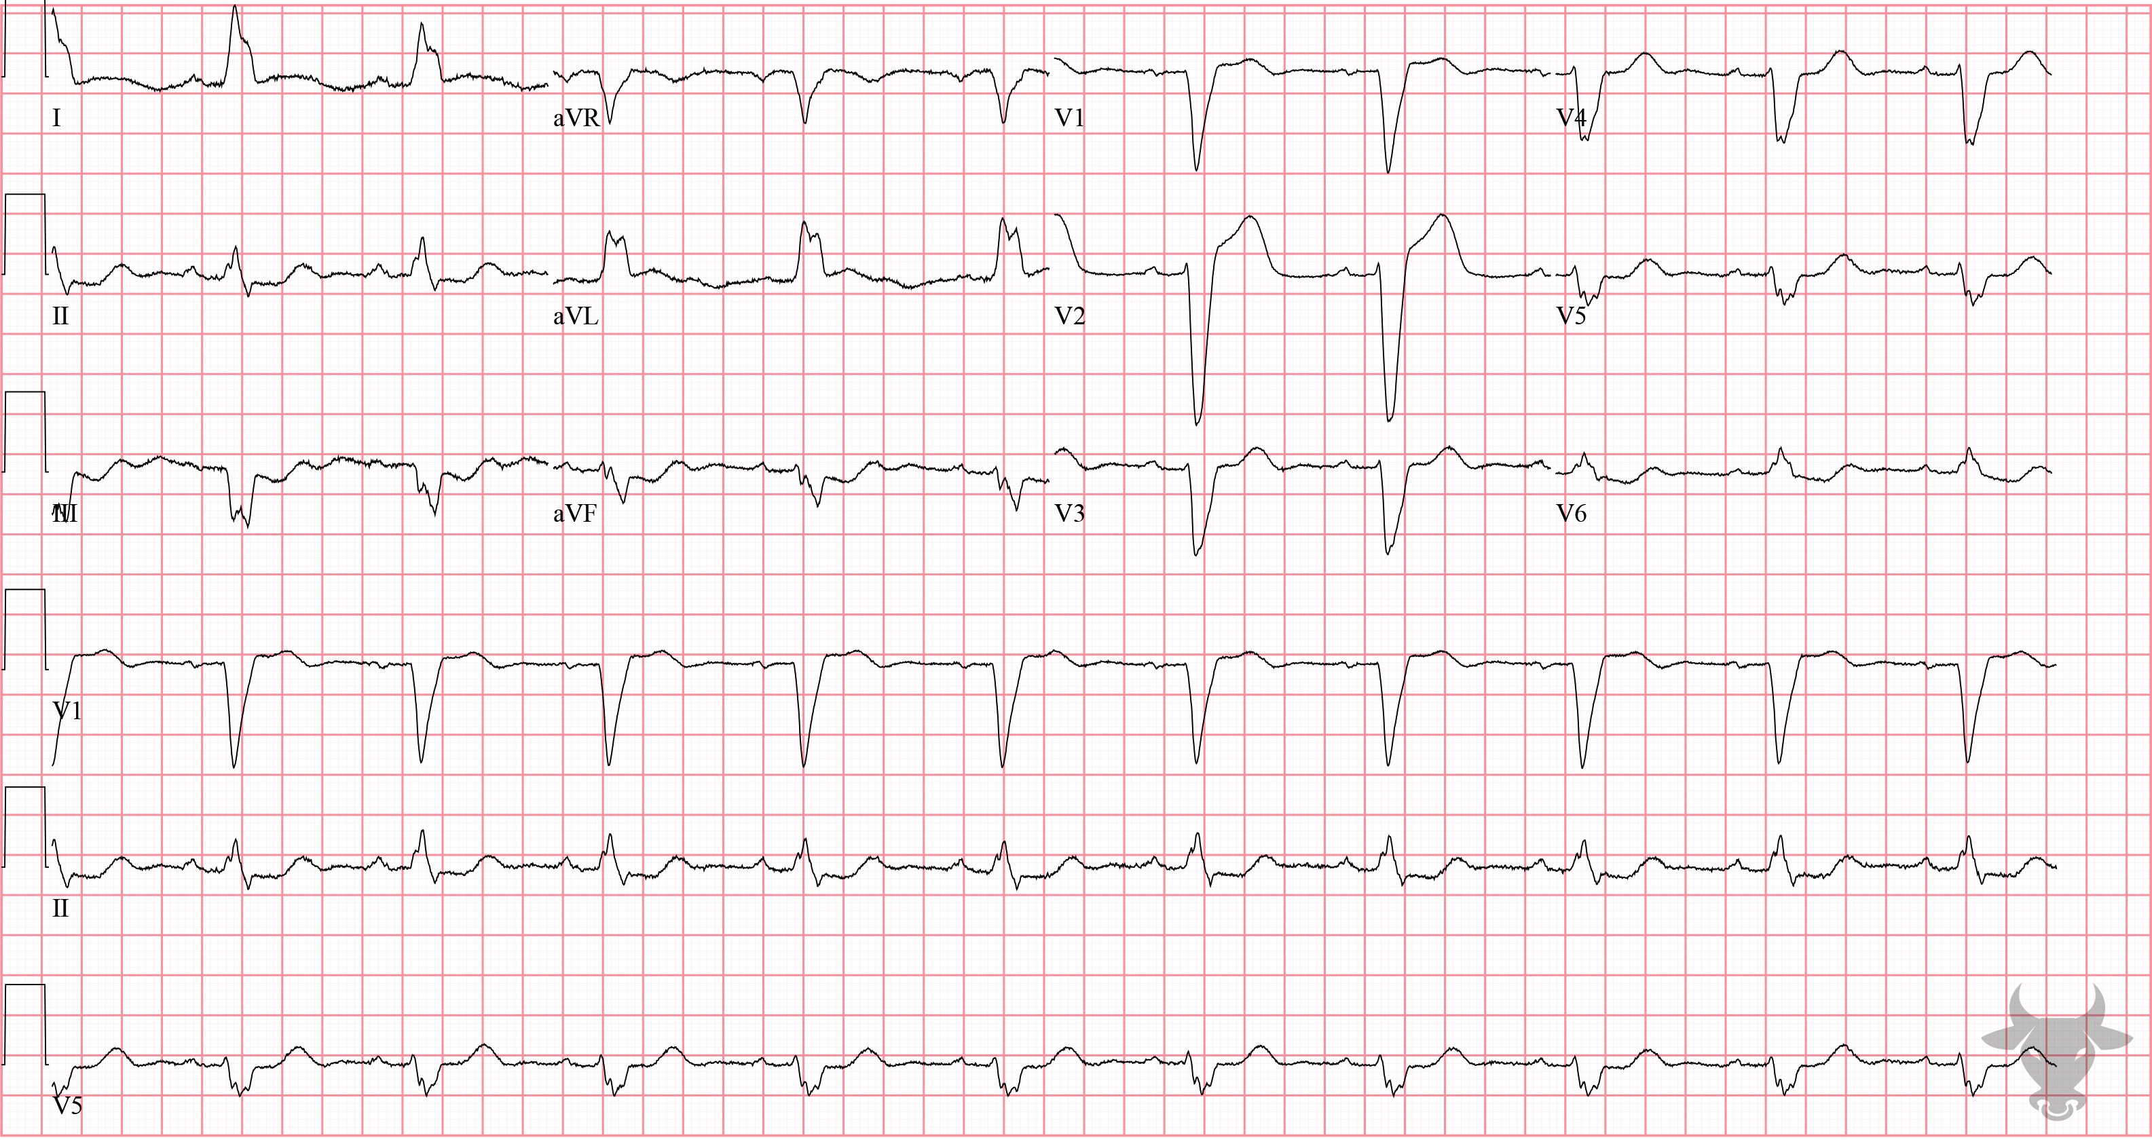
Notes:
Sgarbossa Criteria.
Sgarbossa Criteria, ST-elevation Myocardial Infarction. The Sgarbossa criteria are a set of rules to help identify acute myocardial infarction in the setting of a left bundle branch block and were previously described in case 49. This ECG demonstrates concordant ST-elevation in leads I and aVL, and concordant ST-depression in V3. Left heart catheterization revealed an occluded first diagonal branch of the left anterior descending artery.

Slide 12
46-year-old male presents with chest pain
134

Slide 13
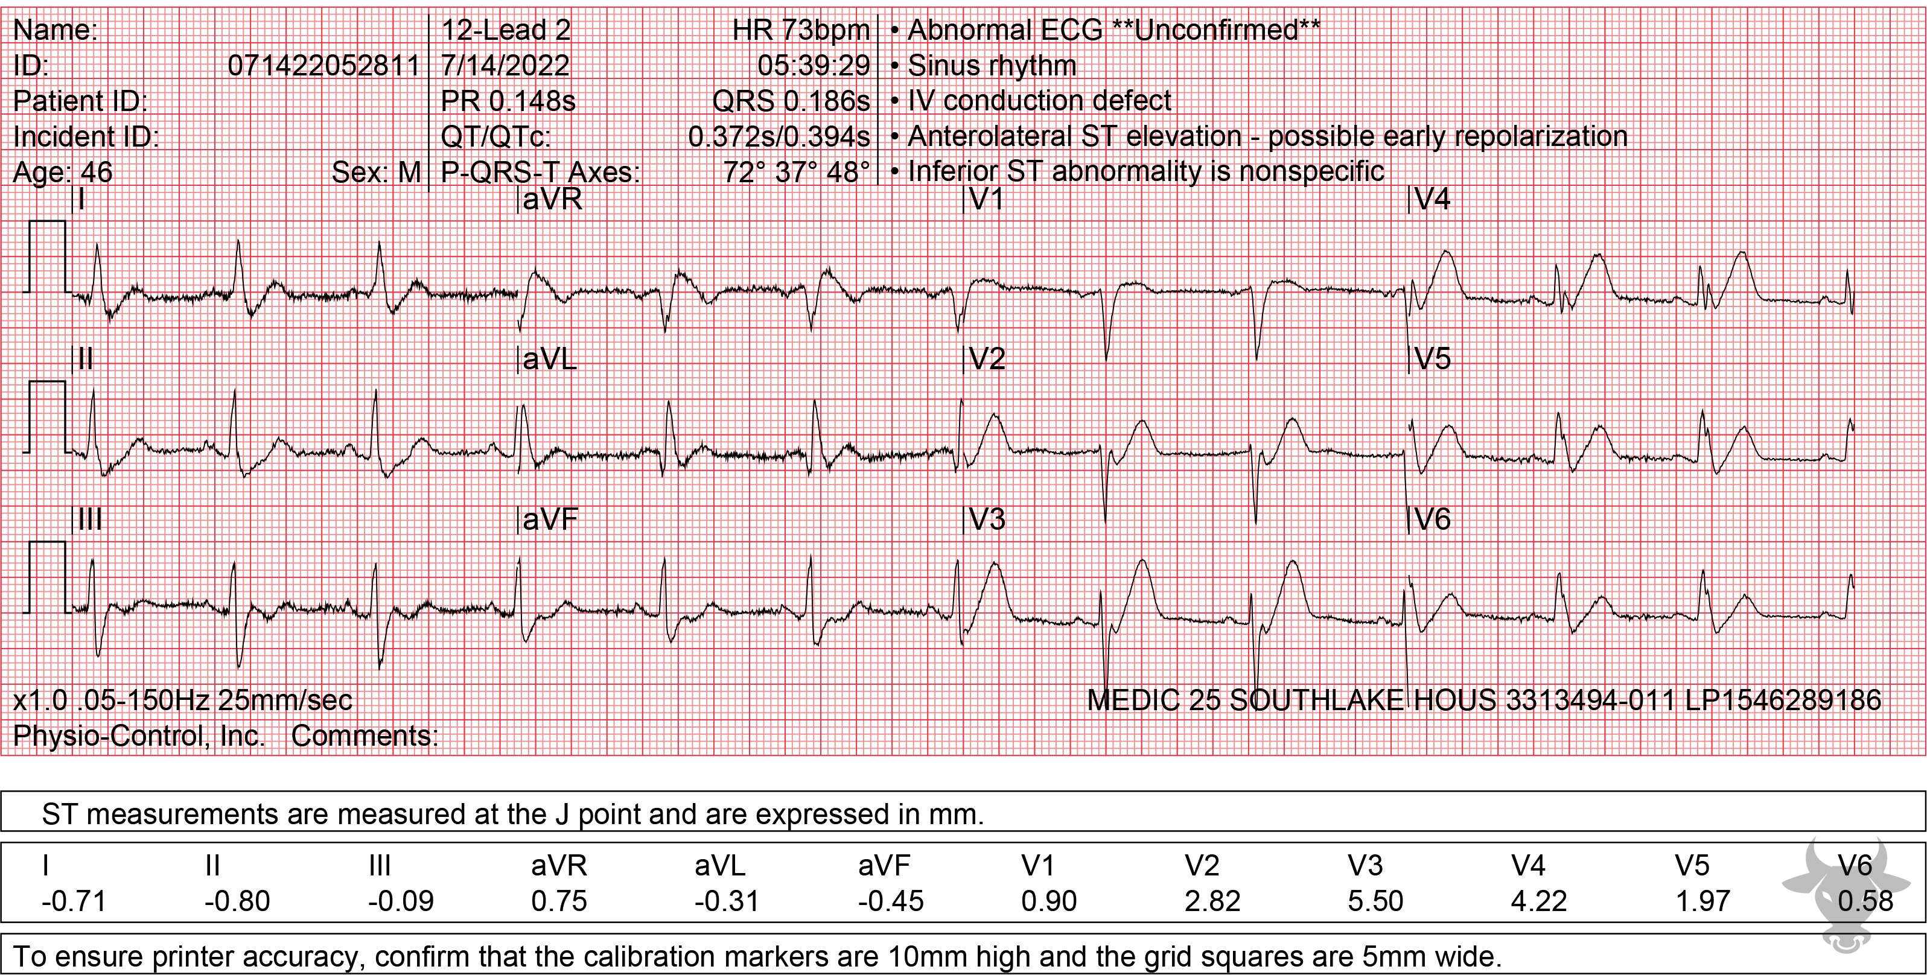
Notes:
Hyperacute T Waves, ST-elevation Myocardial Infarction.
Hyperacute T Waves, ST-elevation Myocardial Infarction. There are hyperacute 'de Winter T waves' that ultimately evolved into an anterior ST-elevation myocardial infarction (STEMI). Described in 2008 by de Winter, this pattern of upsloping ST depressions and hyperacute T waves in the precordial leads suggests proximal left anterior descending occlusion. While this pattern does not meet classic STEMI criteria, it does suggest the presence of an occlusive myocardial infarction and emergent reperfusion is recommended . This pattern is seen in just 2% of acute left anterior descending artery occlusions and is often misdiagnosed. Left heart catheterization revealed a distal left main occlusion and percutaneous coronary intervention was successful.

