Slide 1

Conference 24
ECG STAMPEDE

Slide 2
45-year-old female presents with palpitations
123

Slide 3
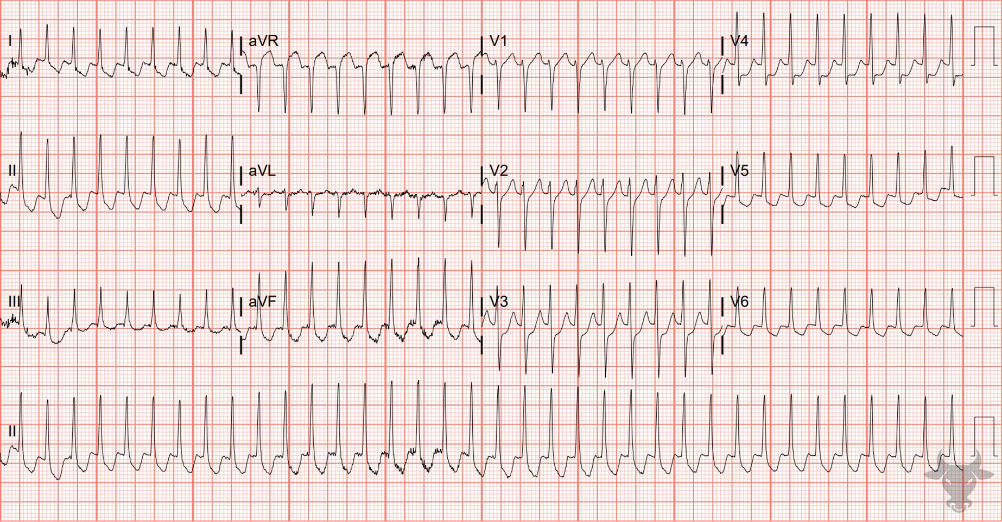

Notes:
Orthodromic Atrioventricular Reentrant Tachycardia.
Orthodromic Atrioventricular Reentrant Tachycardia. This narrow complex tachycardia converted to sinus rhythm with adenosine. She was subsequently discovered to have a left-sided lateral accessory pathway with retrograde conduction that was successfully ablated (i.e., orthodromic atrioventricular reentrant tachycardia or orthodromic reciprocating tachycardia, Figure 8). This tachycardia is virtually indistinguishable from atrioventricular nodal reentrant tachycardia and can be safely treated with atrioventricular nodal blocking agents. It is important to keep orthodromic accessory conduction on the differential for narrow complex tachycardia and always obtain a post-conversion ECG to look for evidence of pre-excitation.

Slide 4
55-year-old male presents with chest pain
124

Slide 5
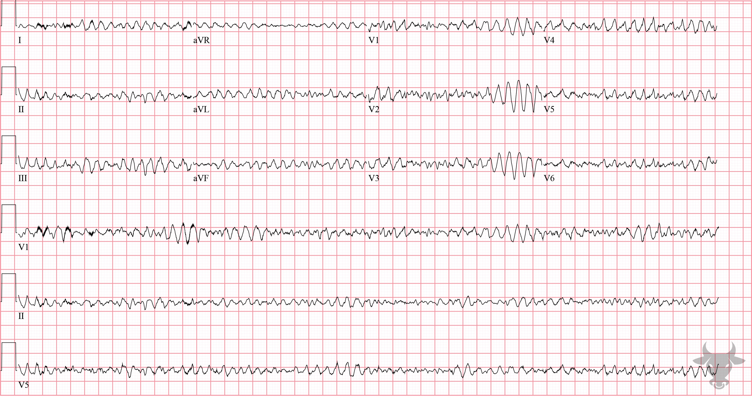
Notes:
Ventricular Fibrillation.
Ventricular Fibrillation. A 12-lead of ventricular fibrillation should never be obtained on an unconscious patient. This patient had a left ventricular assist device and was, therefore, awake and alert. The rhythm still warrants defibrillation because the left ventricular assist device is preload dependent and relies on right ventricular output.

Slide 6
13-year-old female presents with chest pain
125

Slide 7
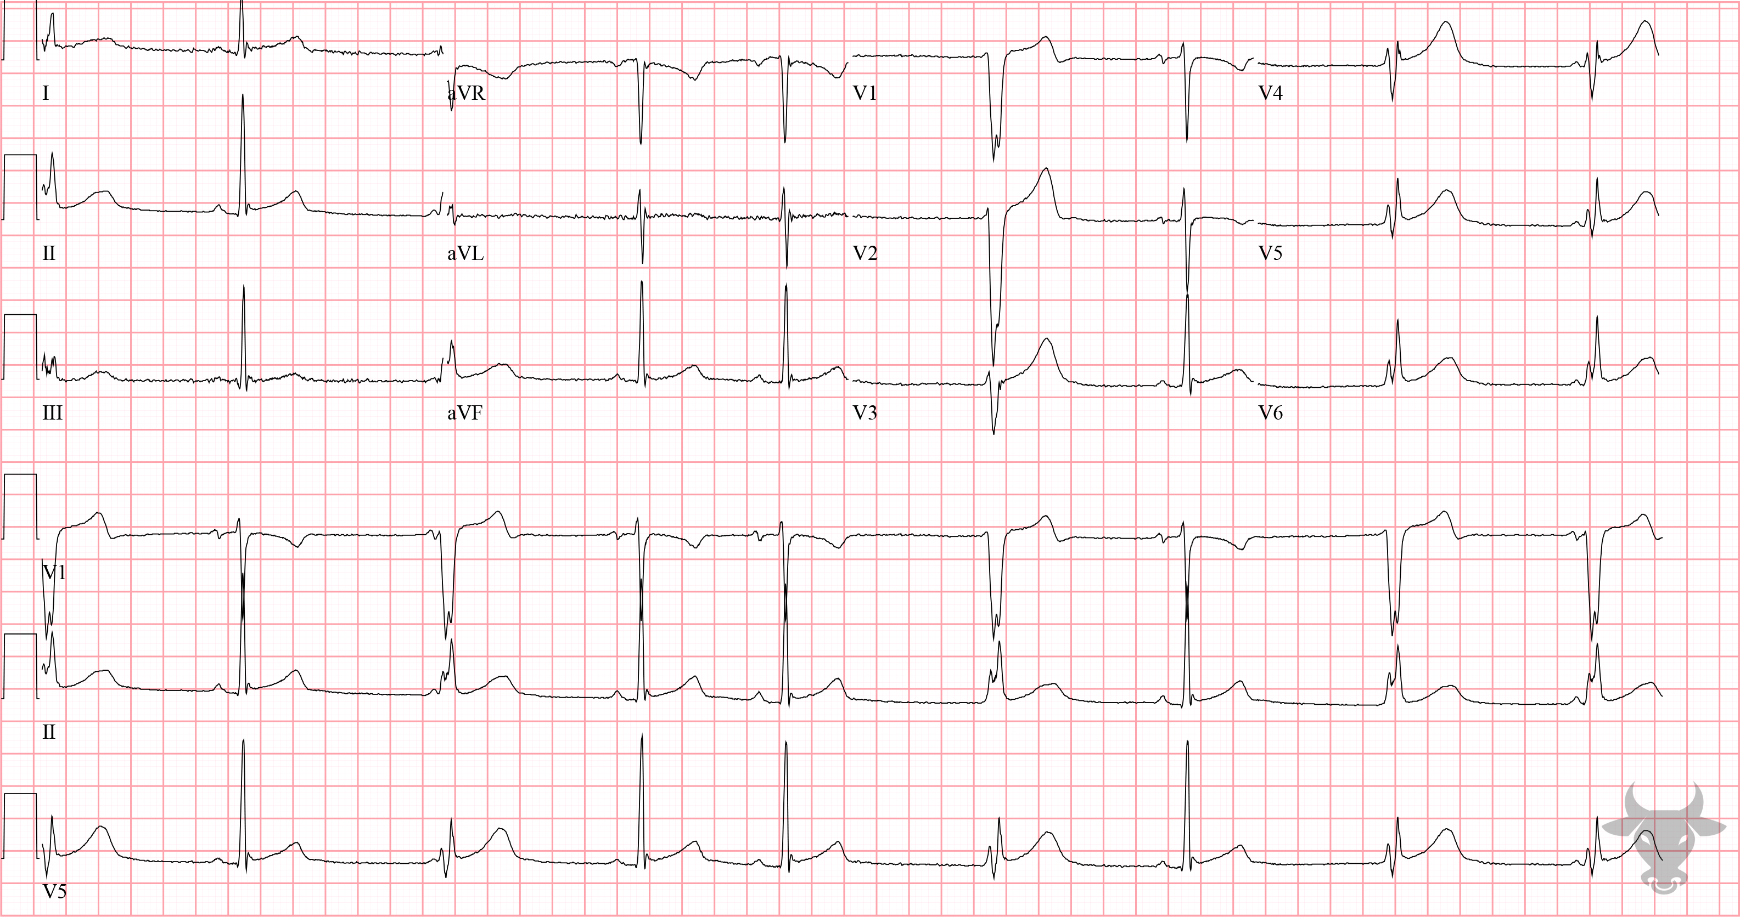
Notes:
Ventricular Escape Complexes.
Ventricular Escape Complexes. The wide complexes are ventricular escape complexes, not premature ones (Figure 52). Pacemakers “escape” from suppression when a superior one fails or is too slow. In this case, the 13-year-old female had high vagal tone, and the finding is not clinically significant.

Slide 8
17-year-old male presents with palpitations
126

Slide 9
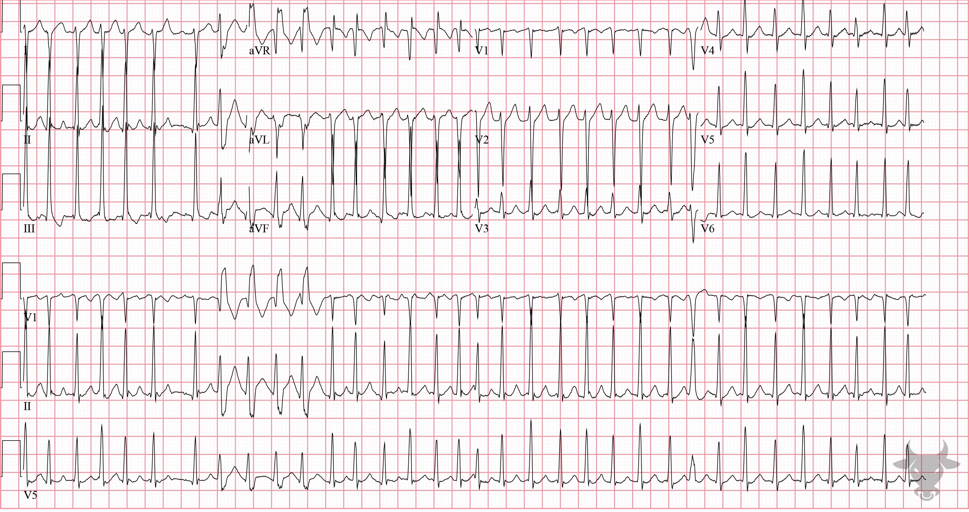
Notes:
Ashman Phenomenon.
Ashman Phenomenon. There is a series of aberrantly conducted beats with wide QRS complexes and unifocal morphology near the beginning of the rhythm strip consistent with Ashman phenomenon. Ashman phenomenon is aberrant conduction when a short cycle is preceded by a longer one. It can be mistaken for non-sustained ventricular tachycardia when it occurs in series, as with this case; instead, these beats are not ectopic but aberrantly conducted.

Slide 10
83-year-old male presents with bradycardia
127

Slide 11
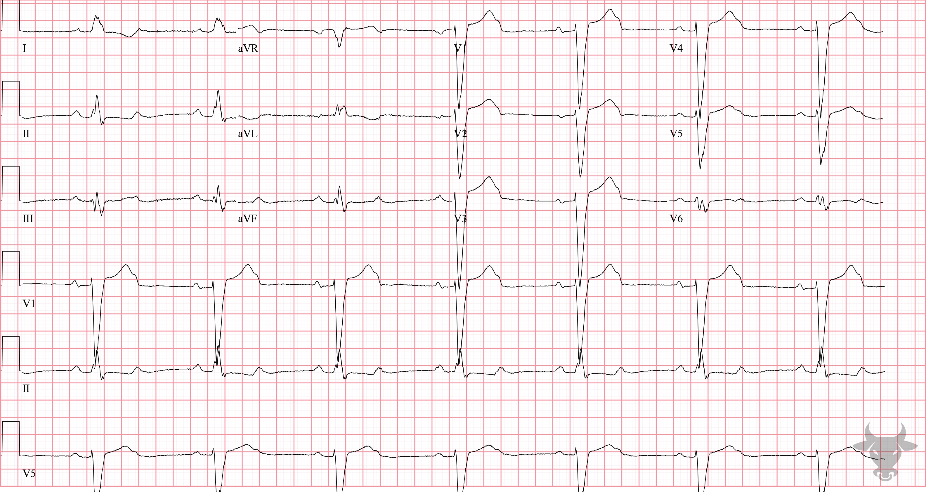
Notes:
Second Degree Atrioventricular Block with 2:1 Conduction.
Second Degree Atrioventricular Block with 2:1 Conduction. P waves are conducted to the ventricular system in a 2:1 ratio, with every other P wave being “dropped”, or failing to conduct to the ventricles. When atrioventricular block occurs in a 2:1 ratio, it is impossible to distinguish between Mobitz I and Mobitz II; therefore, it is simply referred to as “2:1 atrioventricular block.” Mobitz I and Mobitz II conduction was previously described in case 77. The repeat ECG confirms Mobitz II conduction (Figure 54. When consecutive P waves are non-conducted, it is referred to as "high grade" atrioventricular block and should be treated the same as complete heart block (i.e., pacemaker placement is indicated).

Slide 12
57-year-old male presents with syncope
128

Slide 13
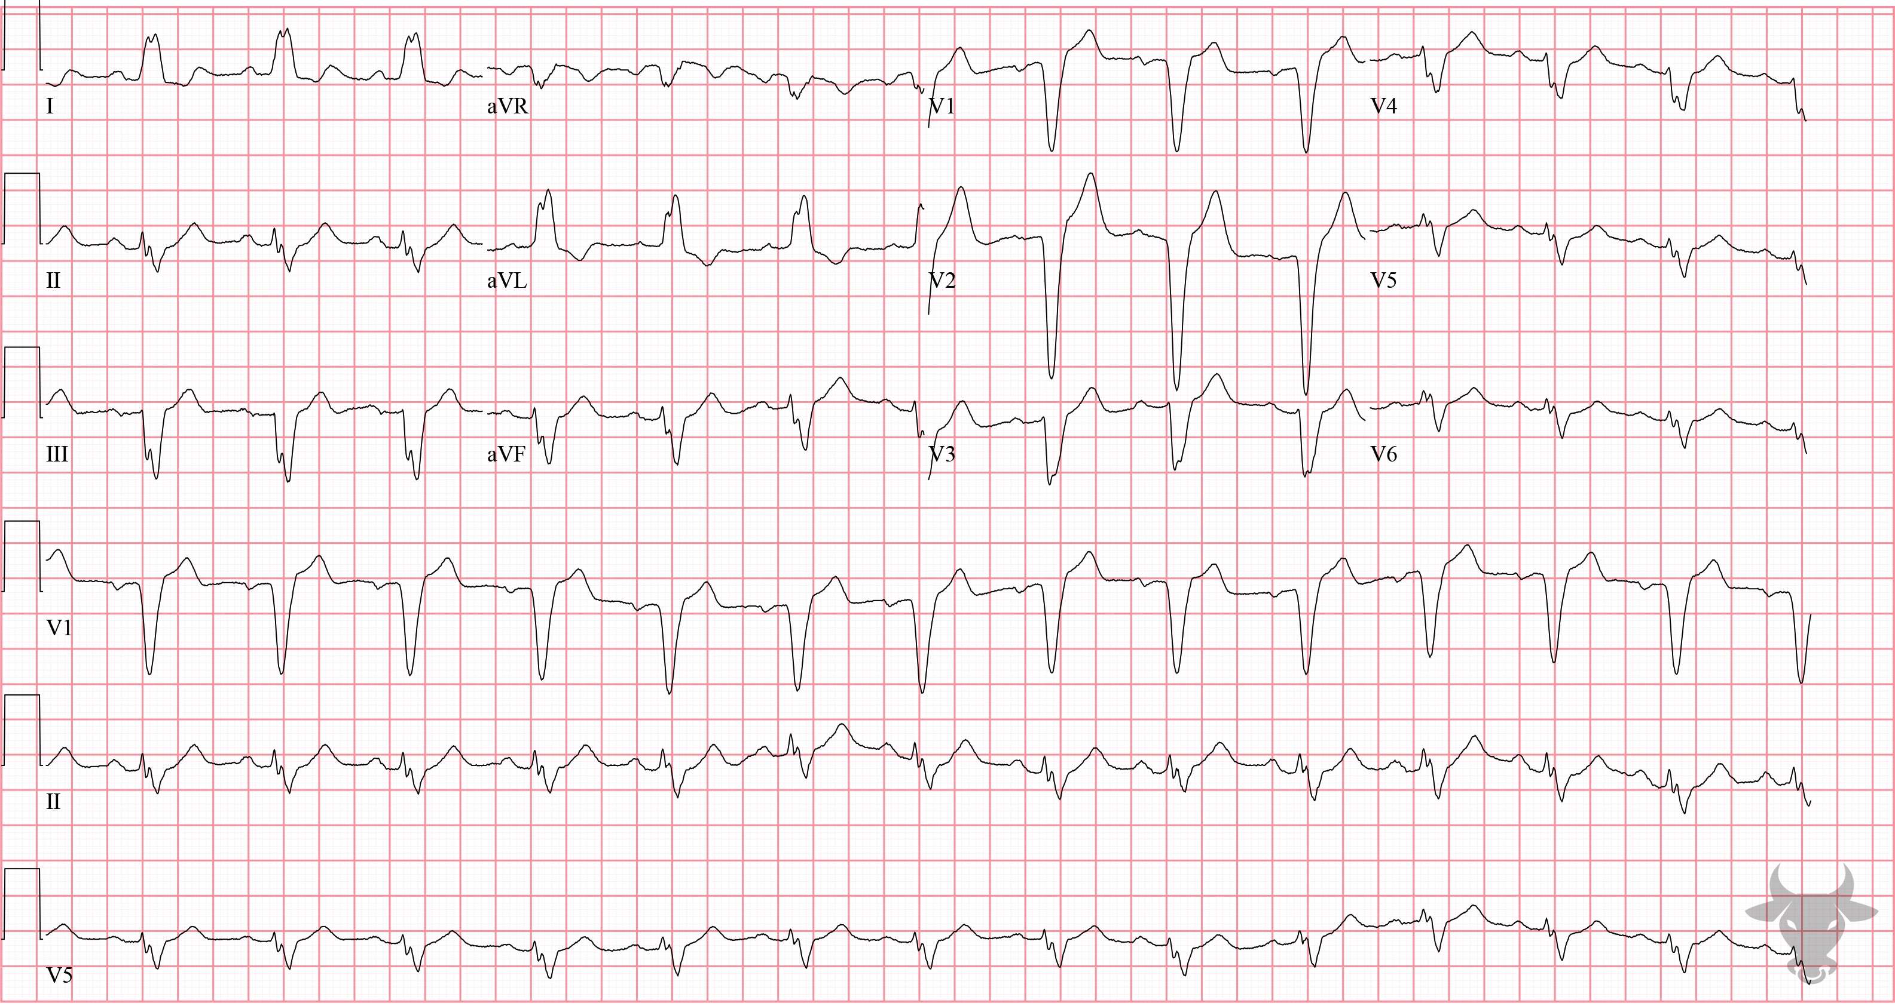
Notes:
Left Bundle Branch Block.
Left Bundle Branch Block, First Degree Atrioventricular Block. There is a left bundle branch block (Figure 23), and the PR interval is borderline prolonged (i.e., 200 ms). When a left bundle branch block accompanies first-degree atrioventricular block, it suggests trifascicular disease. First-degree blocks are usually seen it active, healthy patients without heart disease, and represent delayed conduction within the atrioventricular node itself. First-degree blocks are unlikely to progress to complete heart block. However, when accompanied by preexisting conduction disease (e.g., right bundle branch block, left bundle branch block, or bifascicular block), it can indicate severe infranodal conduction disease. This patient subsequently developed third-degree (i.e., complete) heart block and lost consciousness.

