Slide 1

Conference 23
ECG STAMPEDE

Slide 2
38-year-old male presents with sharp chest pain
118

Slide 3
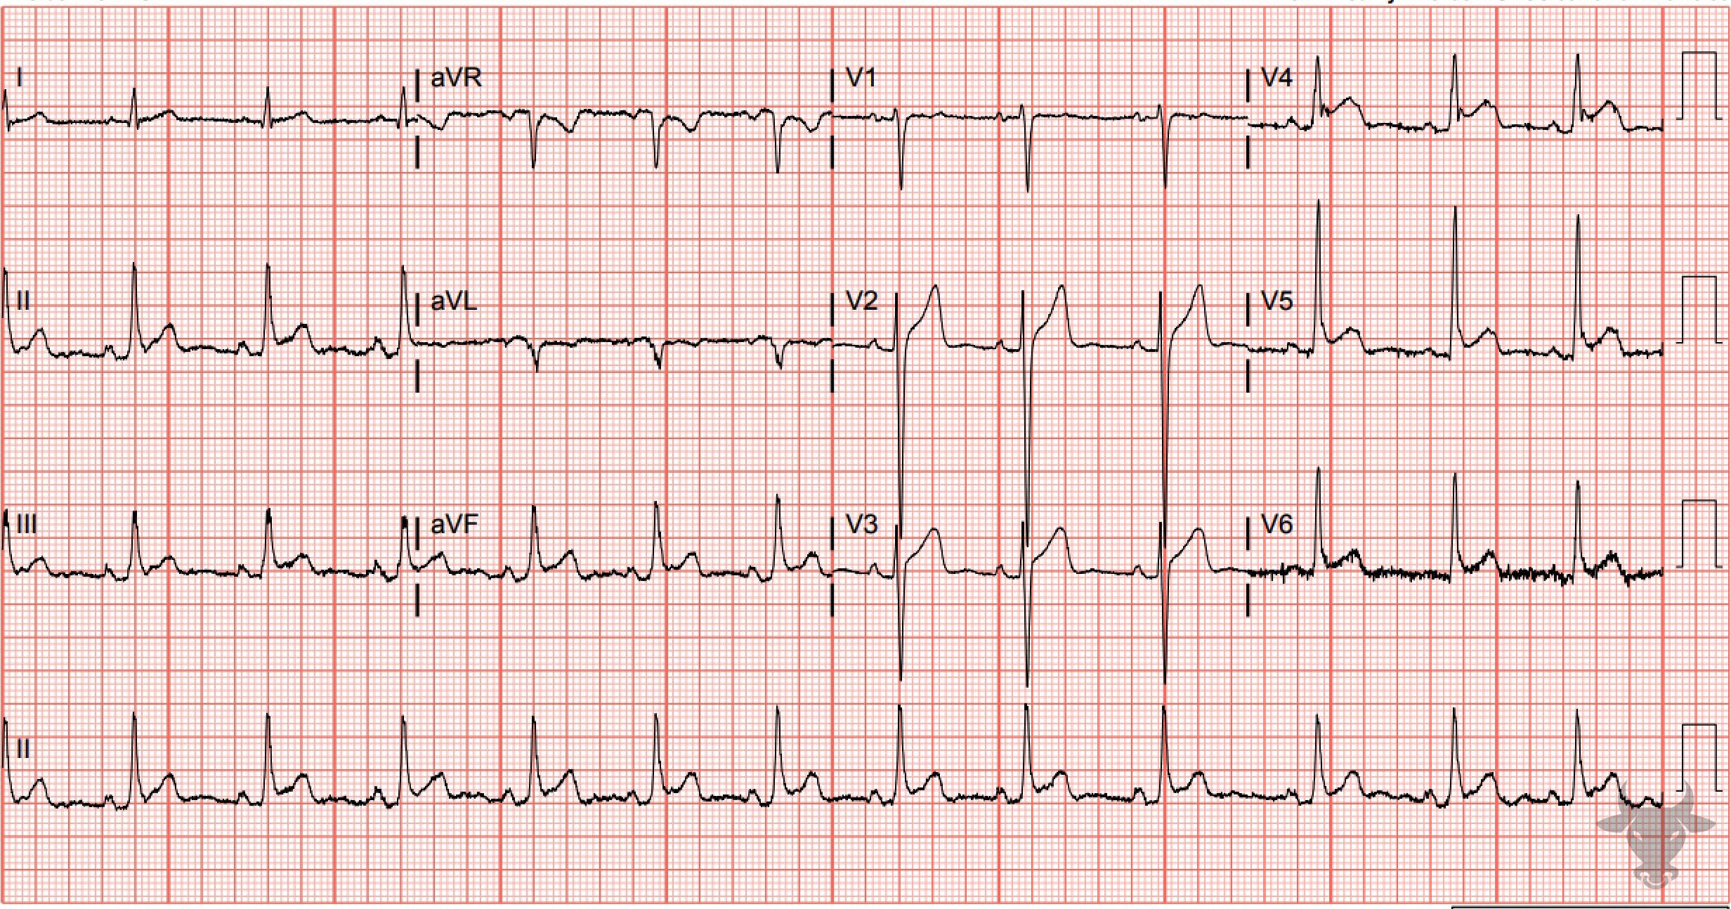
Notes:
Acute Pericarditis.
Acute Pericarditis. There are diffuse concave ST-segment elevations without reciprocal ST-segment depressions. Other electrocardiographic findings of acute pericarditis include PR-segment depressions, PR-segment elevation in aVR, and down-sloping of the TP segment (Spodick’s sign, Figure 51). This patient had typical symptoms of pericarditis (i.e., sharp, pleuritic chest pain relieved when leaning forward), a new pericardial effusion on echocardiography, and a friction rub on exam. Diagnostic criteria were previously described in case 33.

Slide 4
STEMI vs Pericarditis Odds Ratios
ST Dep
Witting, M. D., Hu, K. M., Westreich, A. A., Tewelde, S., Farzad, A., & Mattu, A. (2020). Evaluation of Spodick’s Sign and Other Electrocardiographic Findings as Indicators of STEMI and Pericarditis. The Journal of Emergency Medicine. https://doi.org/10.1016/j.jemermed.2020.01.017

Slide 5
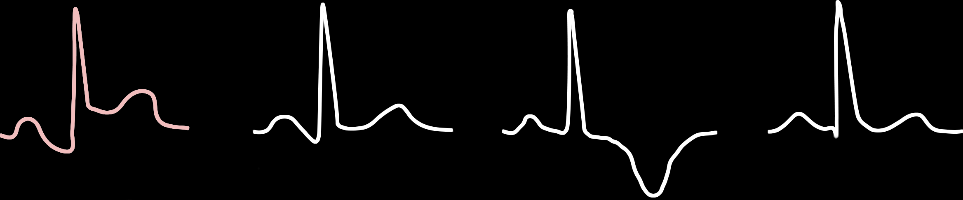
ECG Stages of Pericarditis
Stage 1
Stage 2
Stage 3
Stage 4

Slide 6
55-year-old male presents with syncope
119

Slide 7
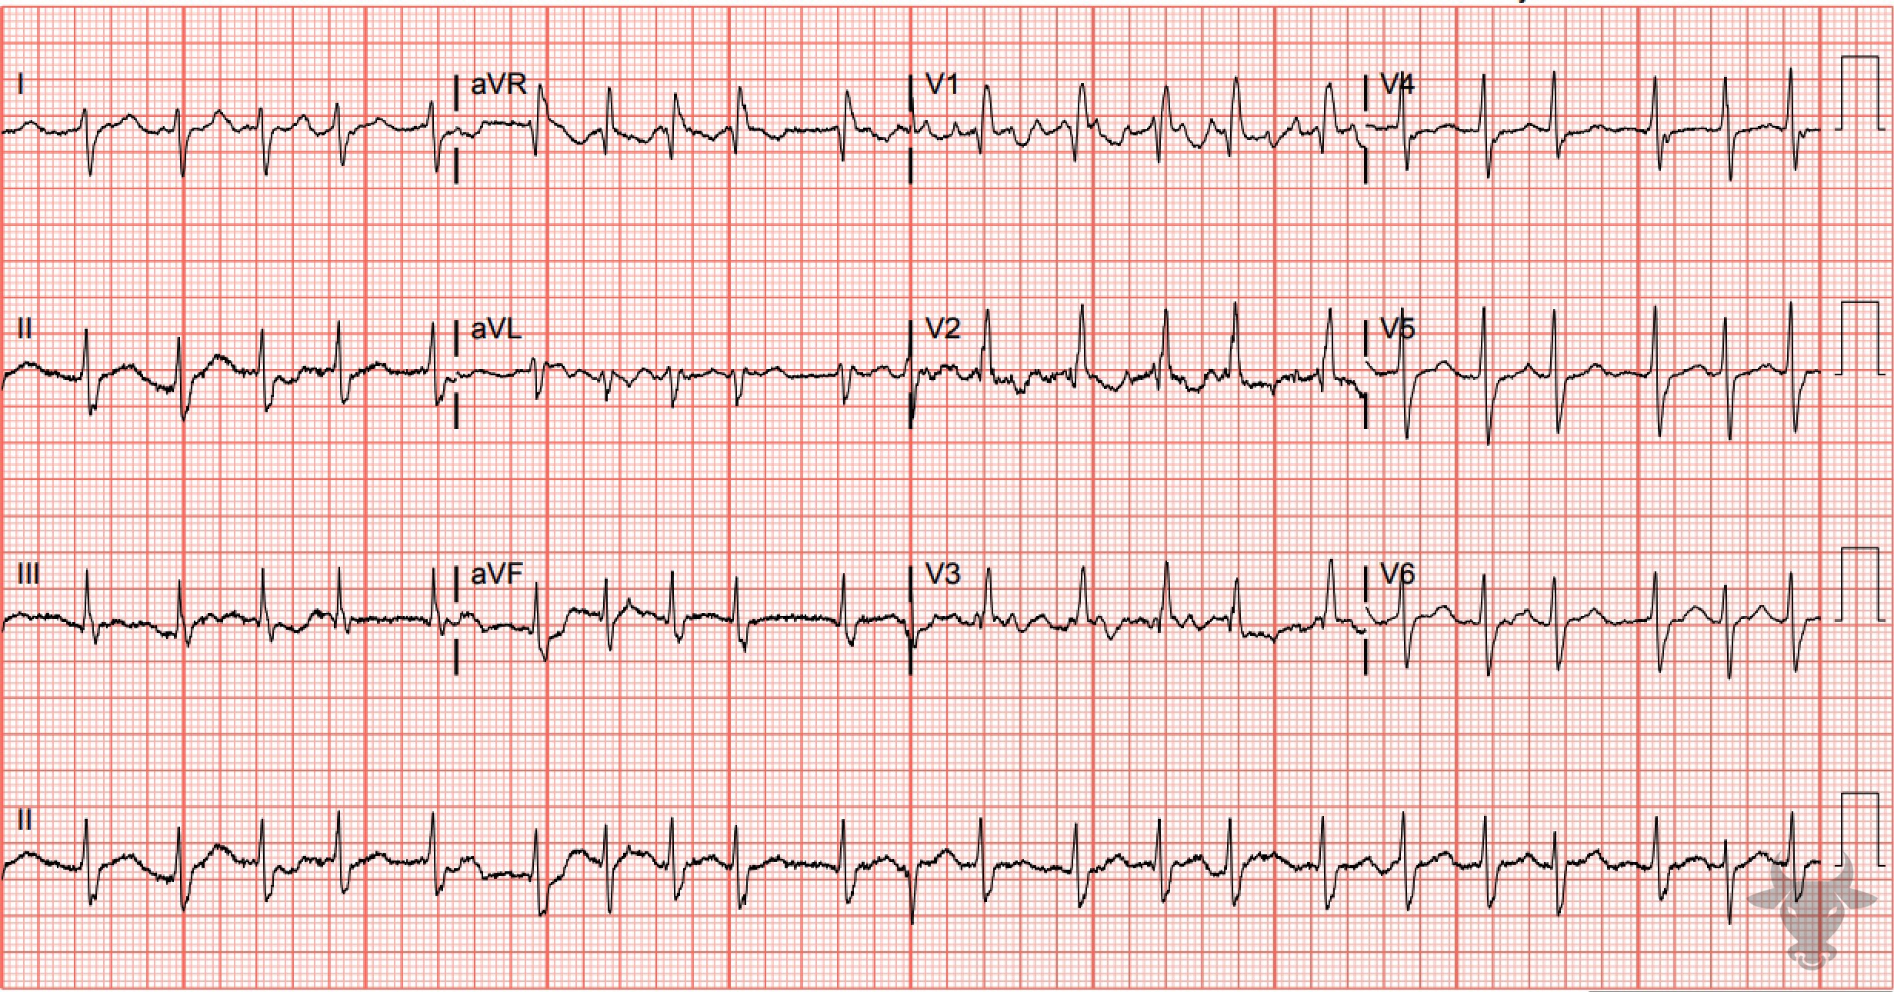
Notes:
Right Bundle Branch Block.
Right Bundle Branch Block, Left Posterior Fascicular Block, Atrial Fibrillation. The rhythm is irregularly irregular and without discernable P waves (i.e., atrial fibrillation). The wide QRS, rSR’ in the anterior precordial leads (V1, V2), and deep S-waves in the lateral leads (I, V6) indicate the presence of a right bundle branch block (Figure 2). Right bundle branch blocks, in isolation, do not cause right axis deviation. The right axis deviation is most likely due to a left posterior fascicular block (Figure 50). This ECG demonstrates disruption of two fascicles, the right bundle and the left posterior fascicle, and is termed a “bifascicular” block.

Slide 8

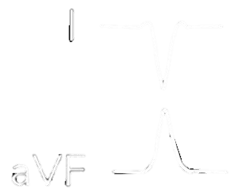
Causes of right axis deviation
1. Ventricular ectopy
2. Lateral myocardial infarction
3. Right ventricular hypertrophy
4. Accessory Pathway/Wolf-Parkinson-White
5. Left posterior fascicular block
6. Hyperkalemia
7. Sodium channel toxicity
8. Pulmonary embolism
9. Chronic lung disease (e.g., COPD)
10. Normal in children

Slide 9
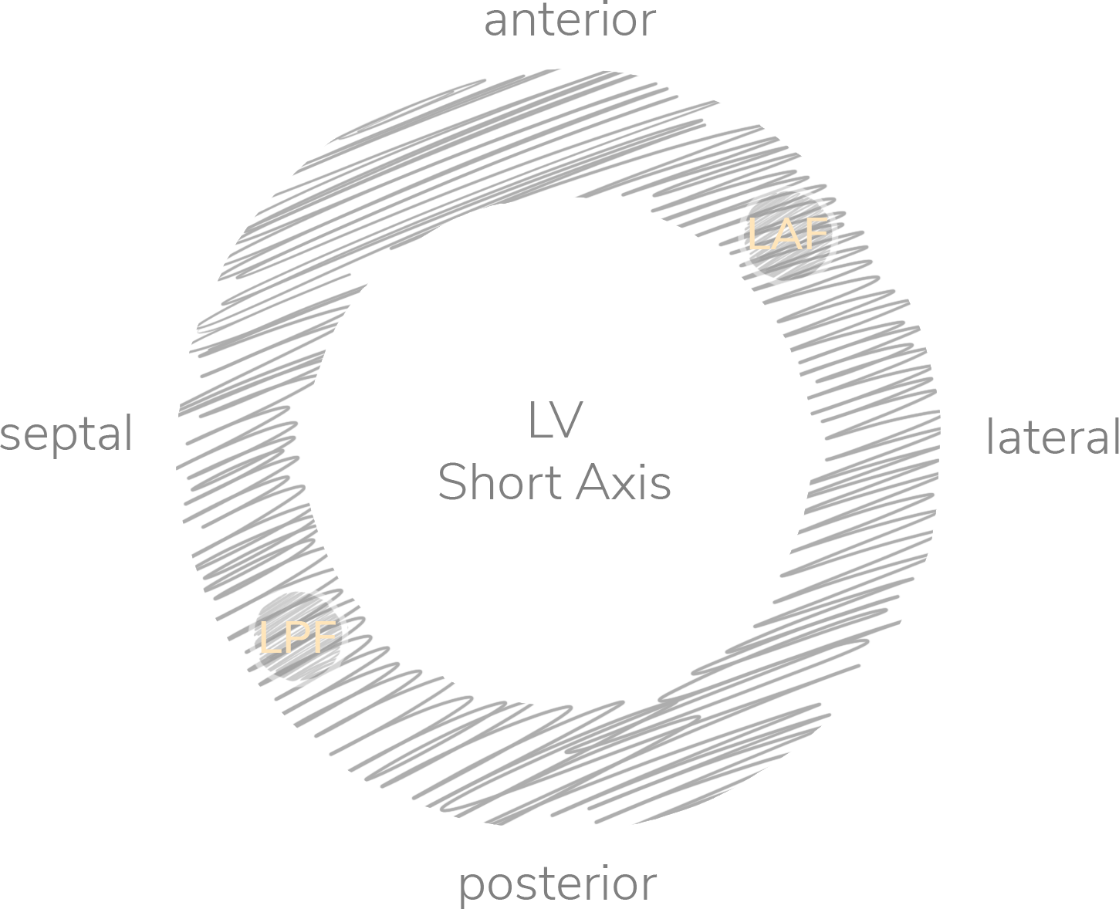
Conduction System Fascicular Blocks

Slide 10
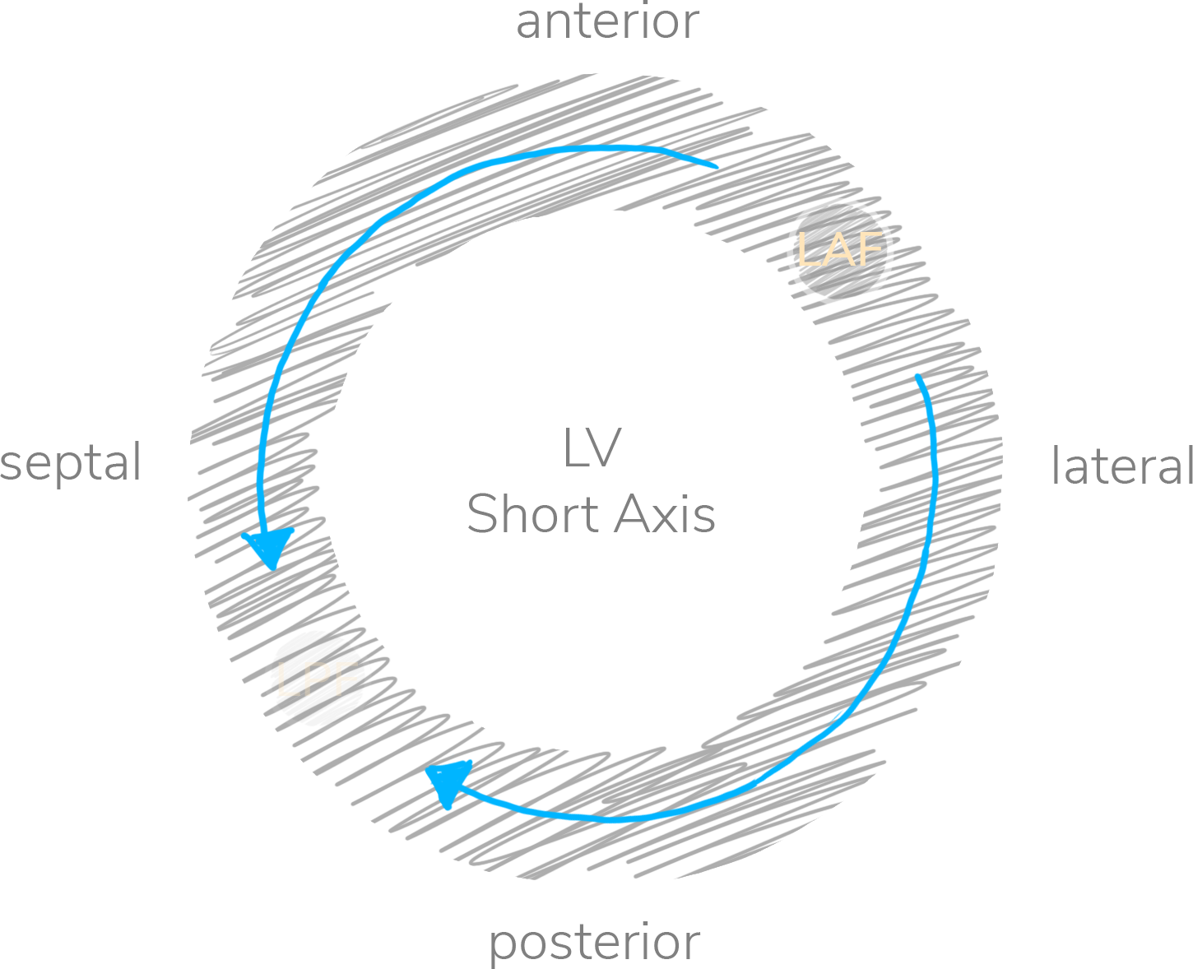


Conduction System Fascicular Blocks
QRS < 100 ms
RAD > 90 deg
I, aVL
II, III, aVF

Slide 11
74-year-old male presents with chest pain
120

Slide 12
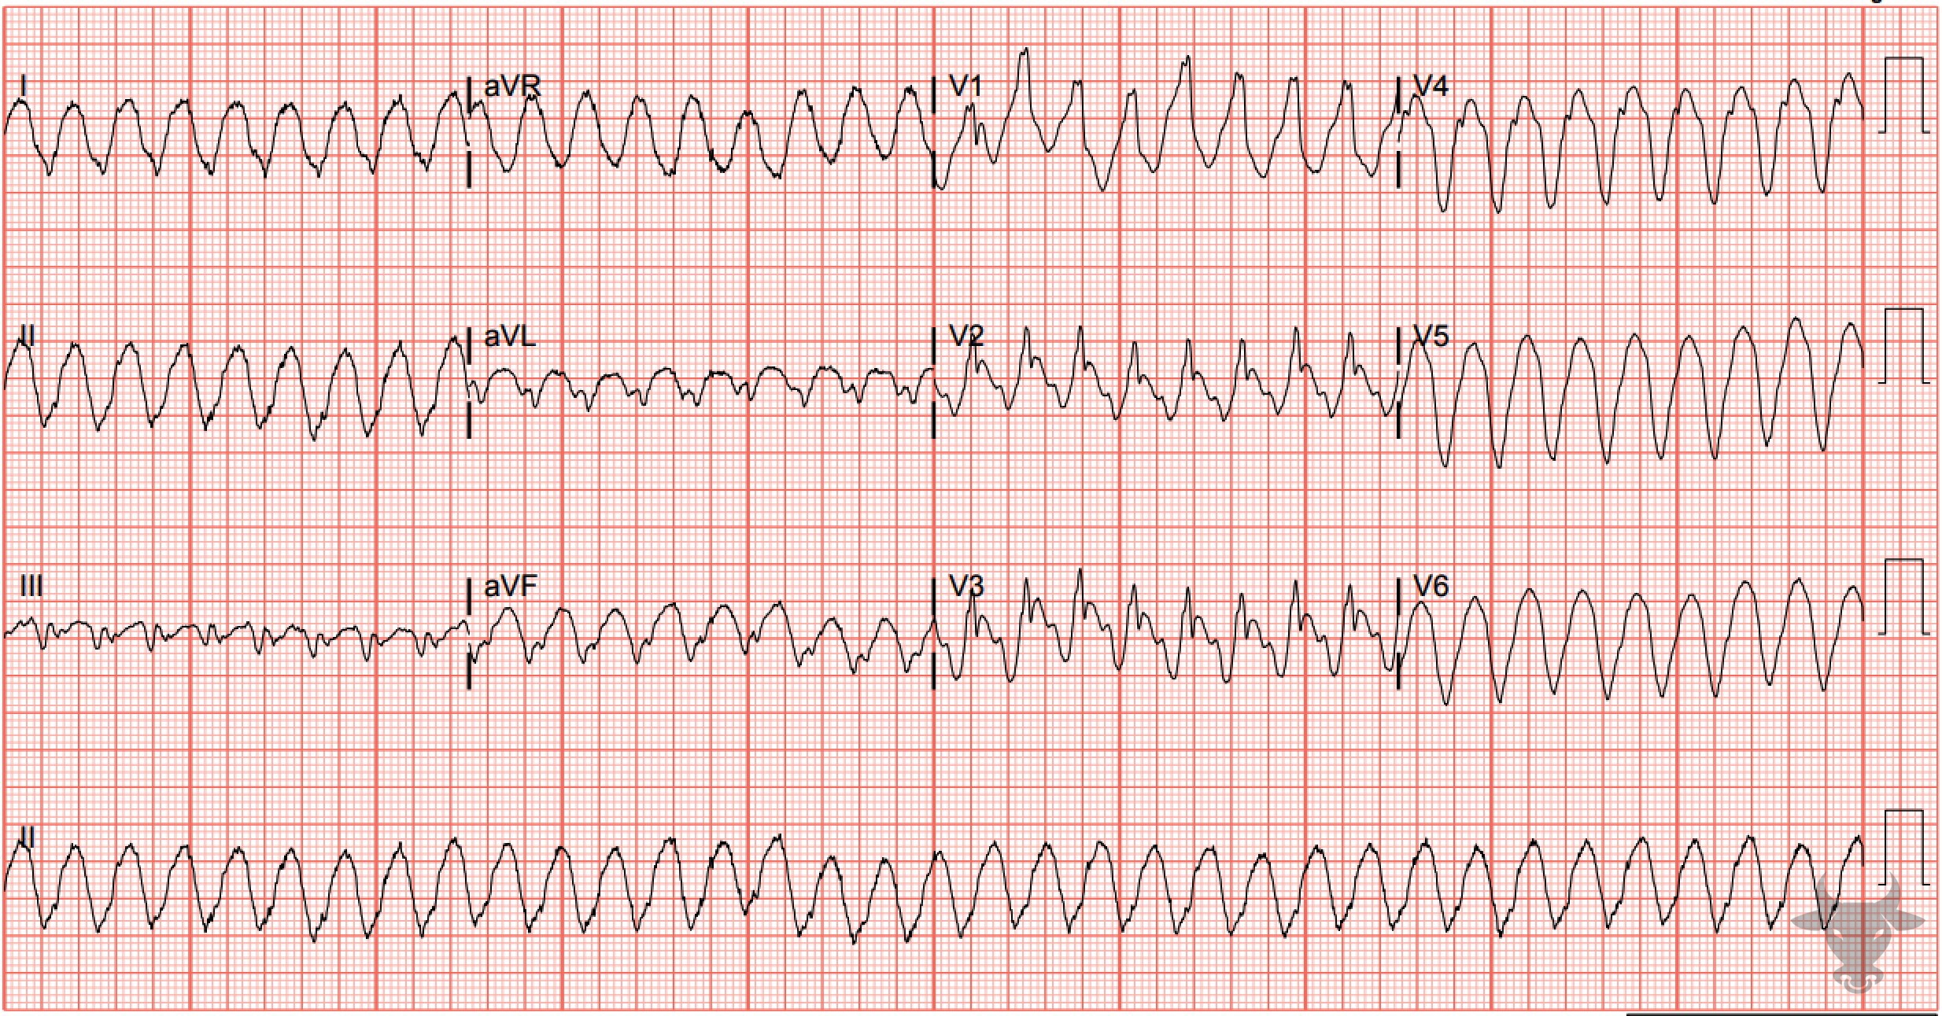
Notes:
Ventricular Tachycardia.
Ventricular Tachycardia. The extreme right axis (i.e., negatively deflected QRS complexes in both leads I and aVF) strongly favors ventricular tachycardia (Figure 5).

Slide 13
88-year-old female presents with confusion
121

Slide 14
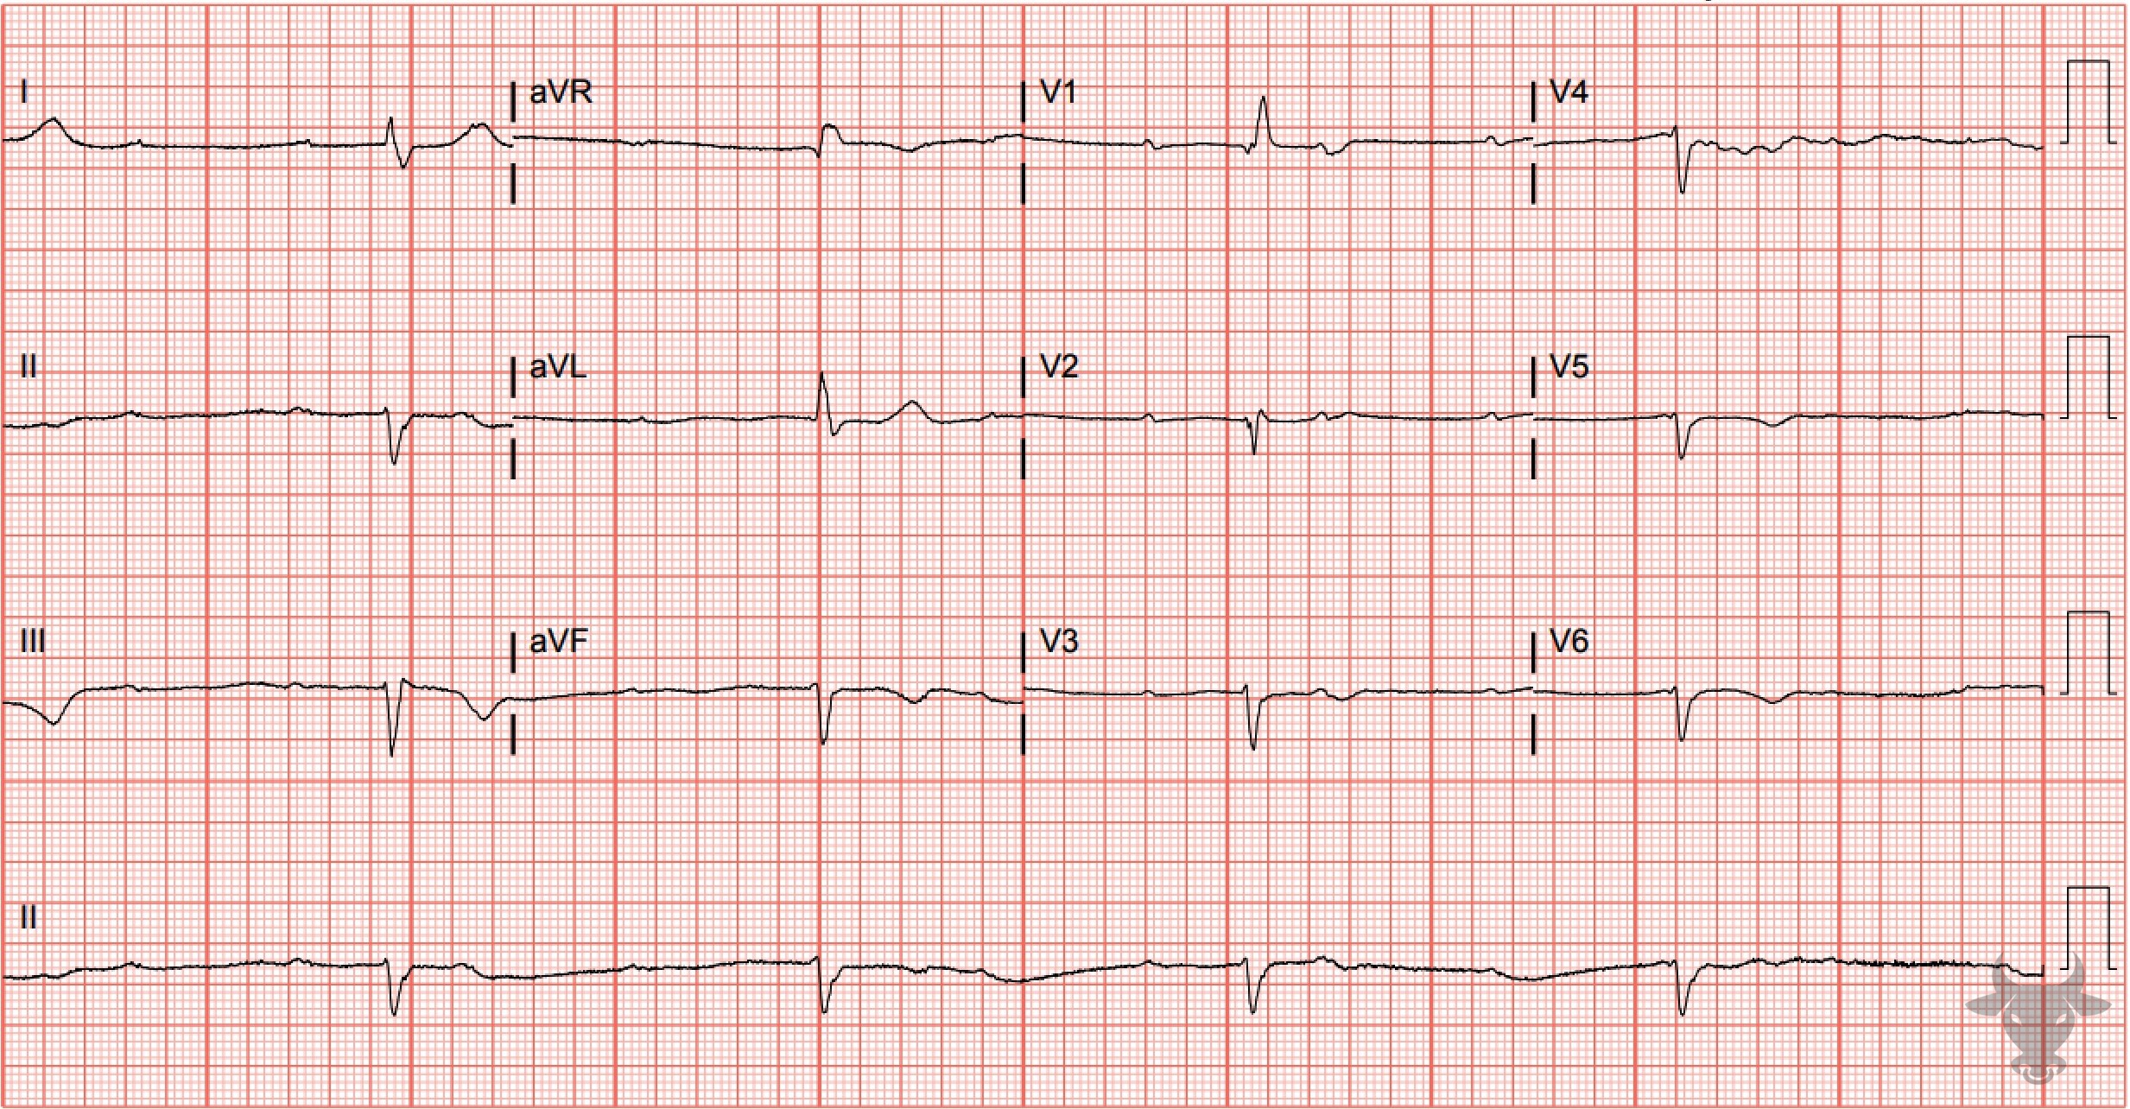
Notes:
Third Degree Atrioventricular Block.
Third Degree Atrioventricular Block. There is atrioventricular dissociation and a severely bradycardic ventricular escape rhythm. The term atrioventricular dissociation refers to the independent contraction of the atria and ventricles and suggests a disturbance in the normal conduction pathway; in this case, third degree (i.e., complete) atrioventricular block. The wide (>120 ms), and slow (<40 beats per minute) QRS complexes are consistent with ventricular escape.

Slide 15
75-year-old female presents with dizziness
122

Slide 16
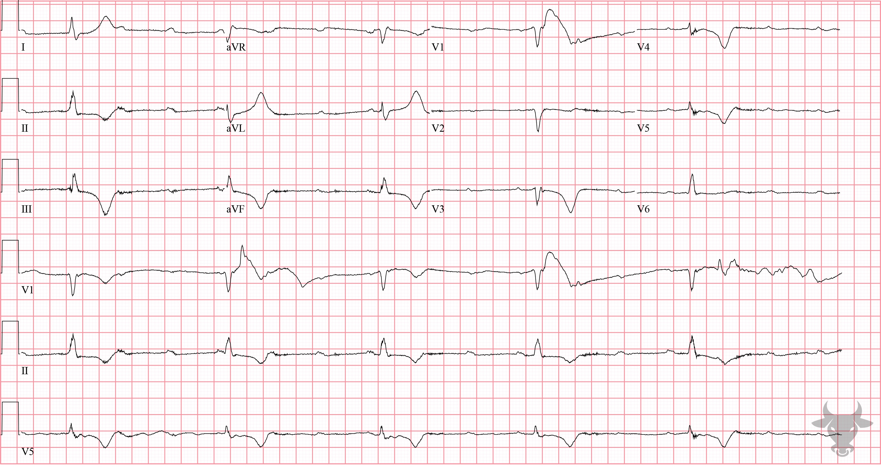
Notes:
Third Degree Atrioventricular Block.
Third Degree Atrioventricular Block. Again, there is atrioventricular dissociation and a severely bradycardic ventricular escape rhythm.

