Slide 1

Conference 22
ECG STAMPEDE

Slide 2
75-year-old male presents with wrist pain
111

Slide 3
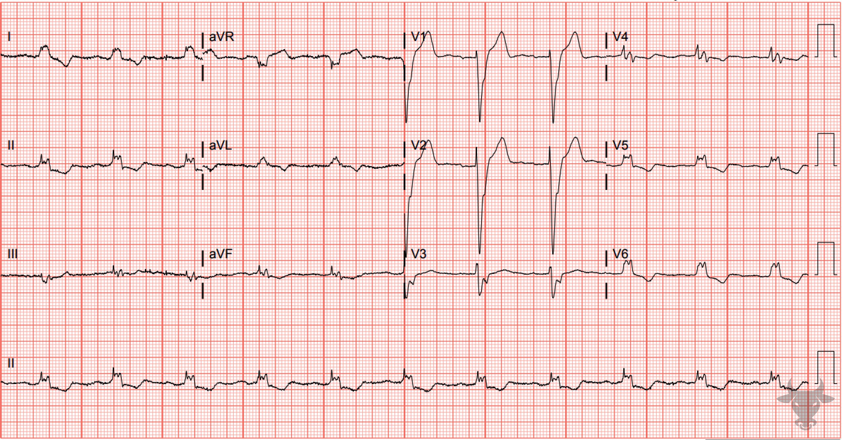

Notes:
Left Bundle Branch Block.
Left Bundle Branch Block. Left bundle branch block pattern with a wide and down-going QRS complex in V1, and broad, notched R waves in the lateral leads (I, aVL, V5, V6). Expected repolarization waves (i.e., T waves in the opposite direction as the QRS complexes) and appropriate discordance (ST-segments in the opposite direction as the QRS complexes) are present.

Slide 4
21-year-old male presents with chest pain
112

Slide 5
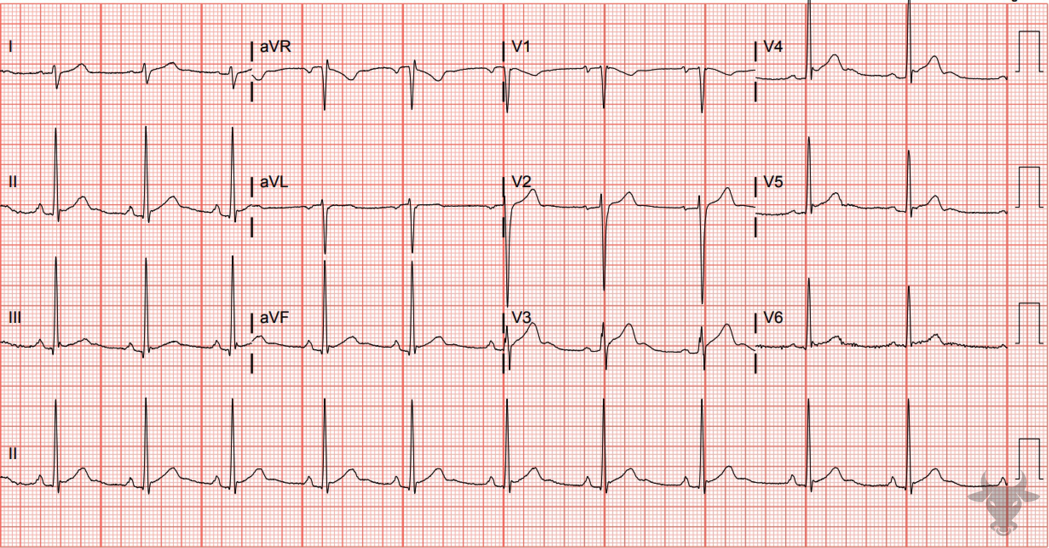
Notes:
Early Repolarization.
Early Repolarization. There are diffuse, concave, (predominantly) precordial ST-segment elevations without reciprocal changes in a young patient. The precordial leads V3, V4, and V5 have the J wave notching (e.g., "fishhook" appearance) characteristic of early repolarization (see case 75).

Slide 6
36-year-old male presents with light-headedness
113

Slide 7
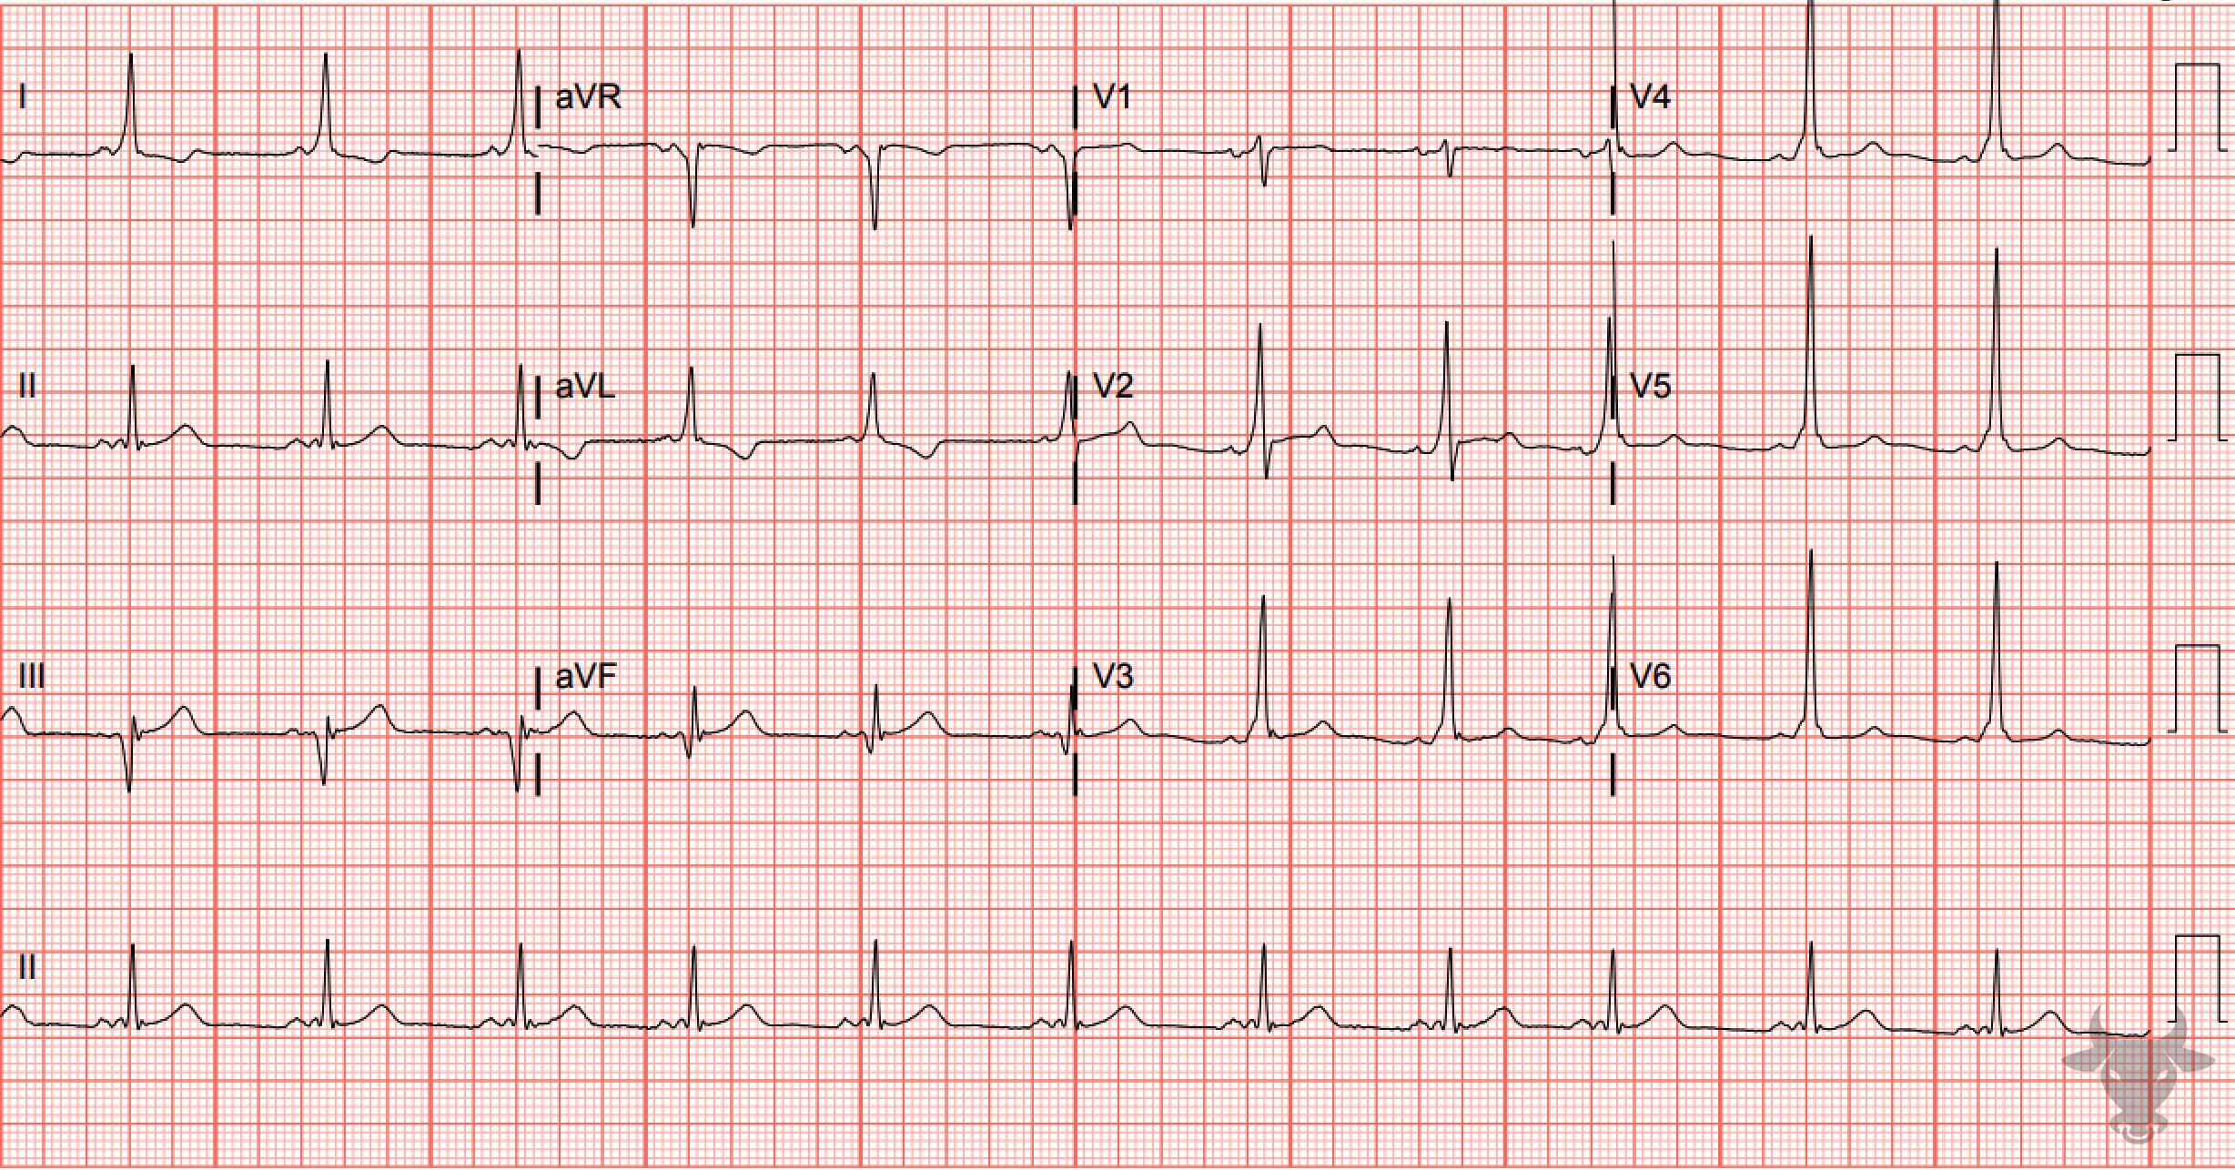
Notes:
Ventricular Pre-excitation.
Ventricular Pre-excitation. Ventricular preexcitation with shortened PR, delta waves, and slightly prolonged QRS (Figure 49). Pre-excitation is a condition in which an accessory pathway exists between the atria and the ventricles, often referred to as the bundle of Kent. When the accessory pathway conducts in an anterograde direction, the ventricles are “pre-excited,” yielding the characteristic delta wave on the ECG. When dysrhythmias occur involving the accessory pathway, it is referred to as the Wolf-Parkinson-White syndrome (Figure 8).

Slide 8
60-year-old male presents with chest pain
114

Slide 9
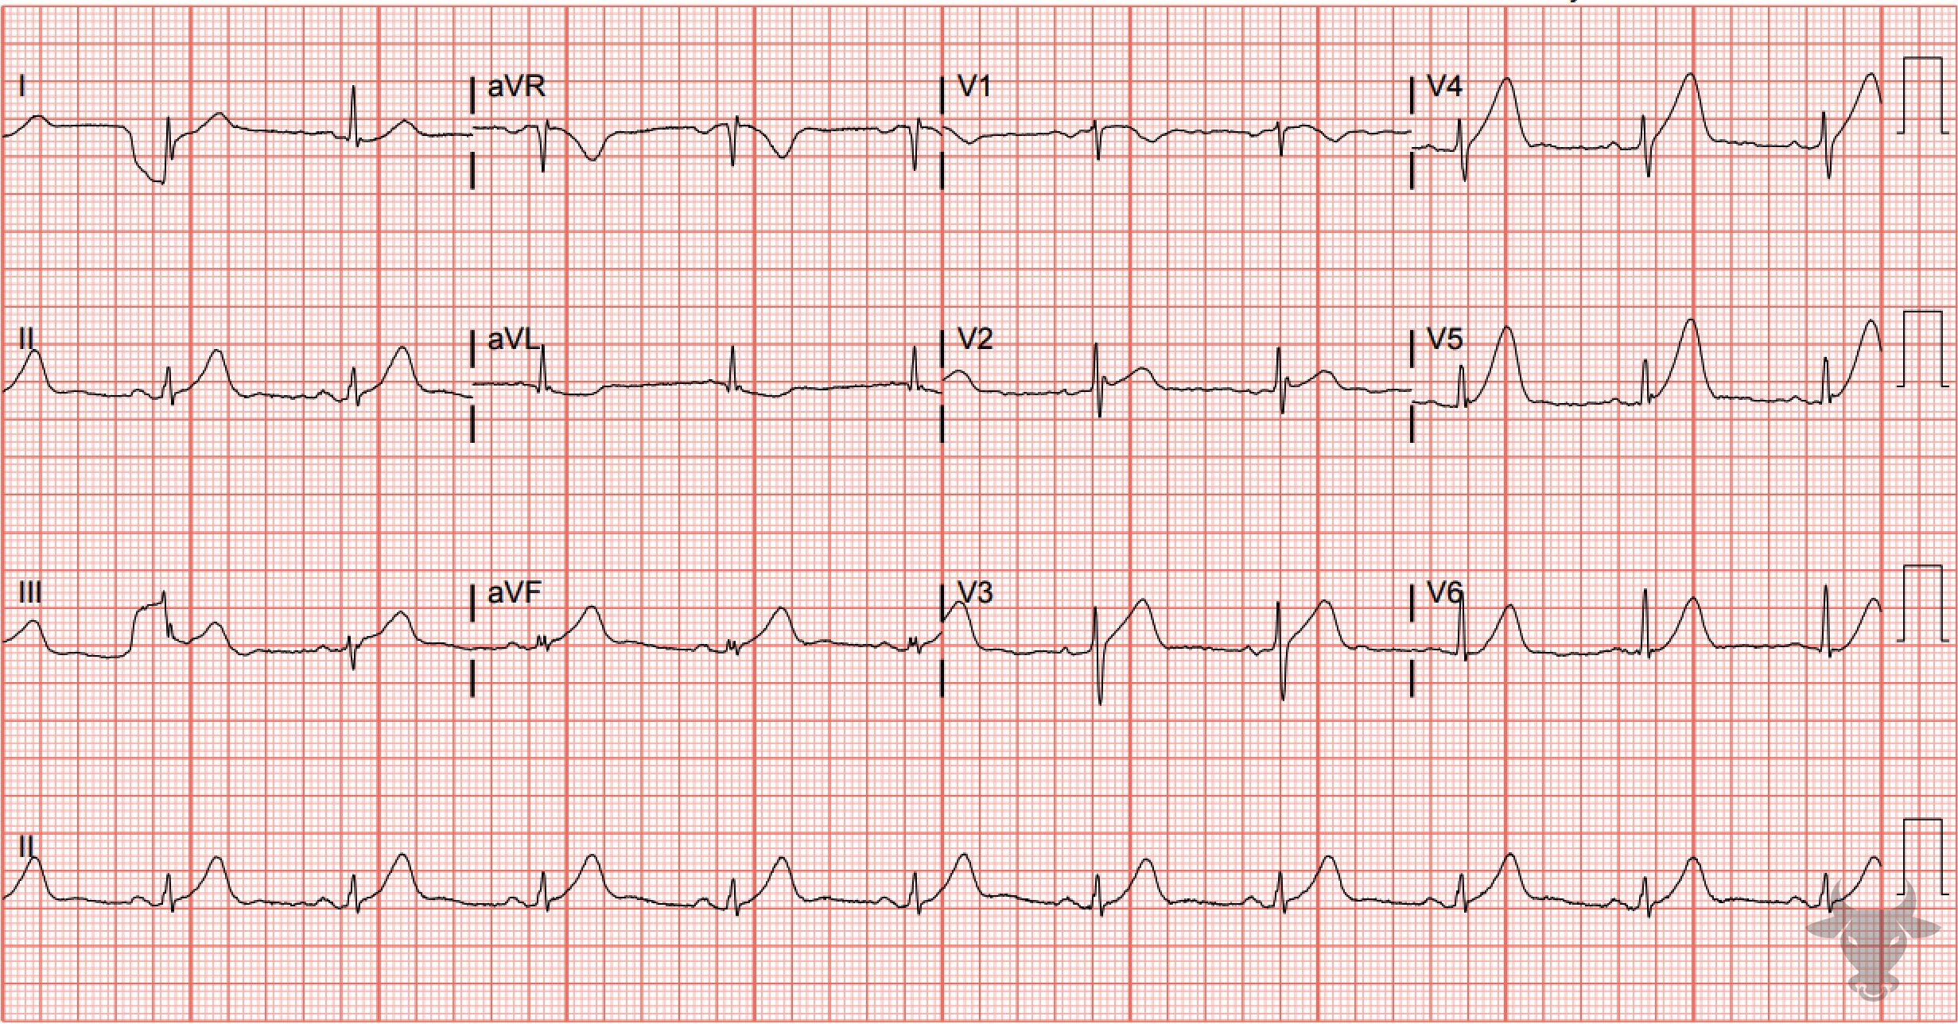
Notes:
Hyperacute T Waves.
Hyperacute T Waves, ST-elevation Myocardial Infarction. Notice that the amplitude of the T waves exceeds that of the QRS complexes in some leads. Some authors have proposed identifying hyperacute T waves using proportional T-wave “bulk,” defined by the increased area under the curve (AUC) of the T-wave relative to the QRS amplitude. Left heart catheterization revealed a completely occluded left anterior descending artery and percutaneous coronary intervention was successful.

Slide 10
33-year-old male presents with neck pain
115

Slide 11
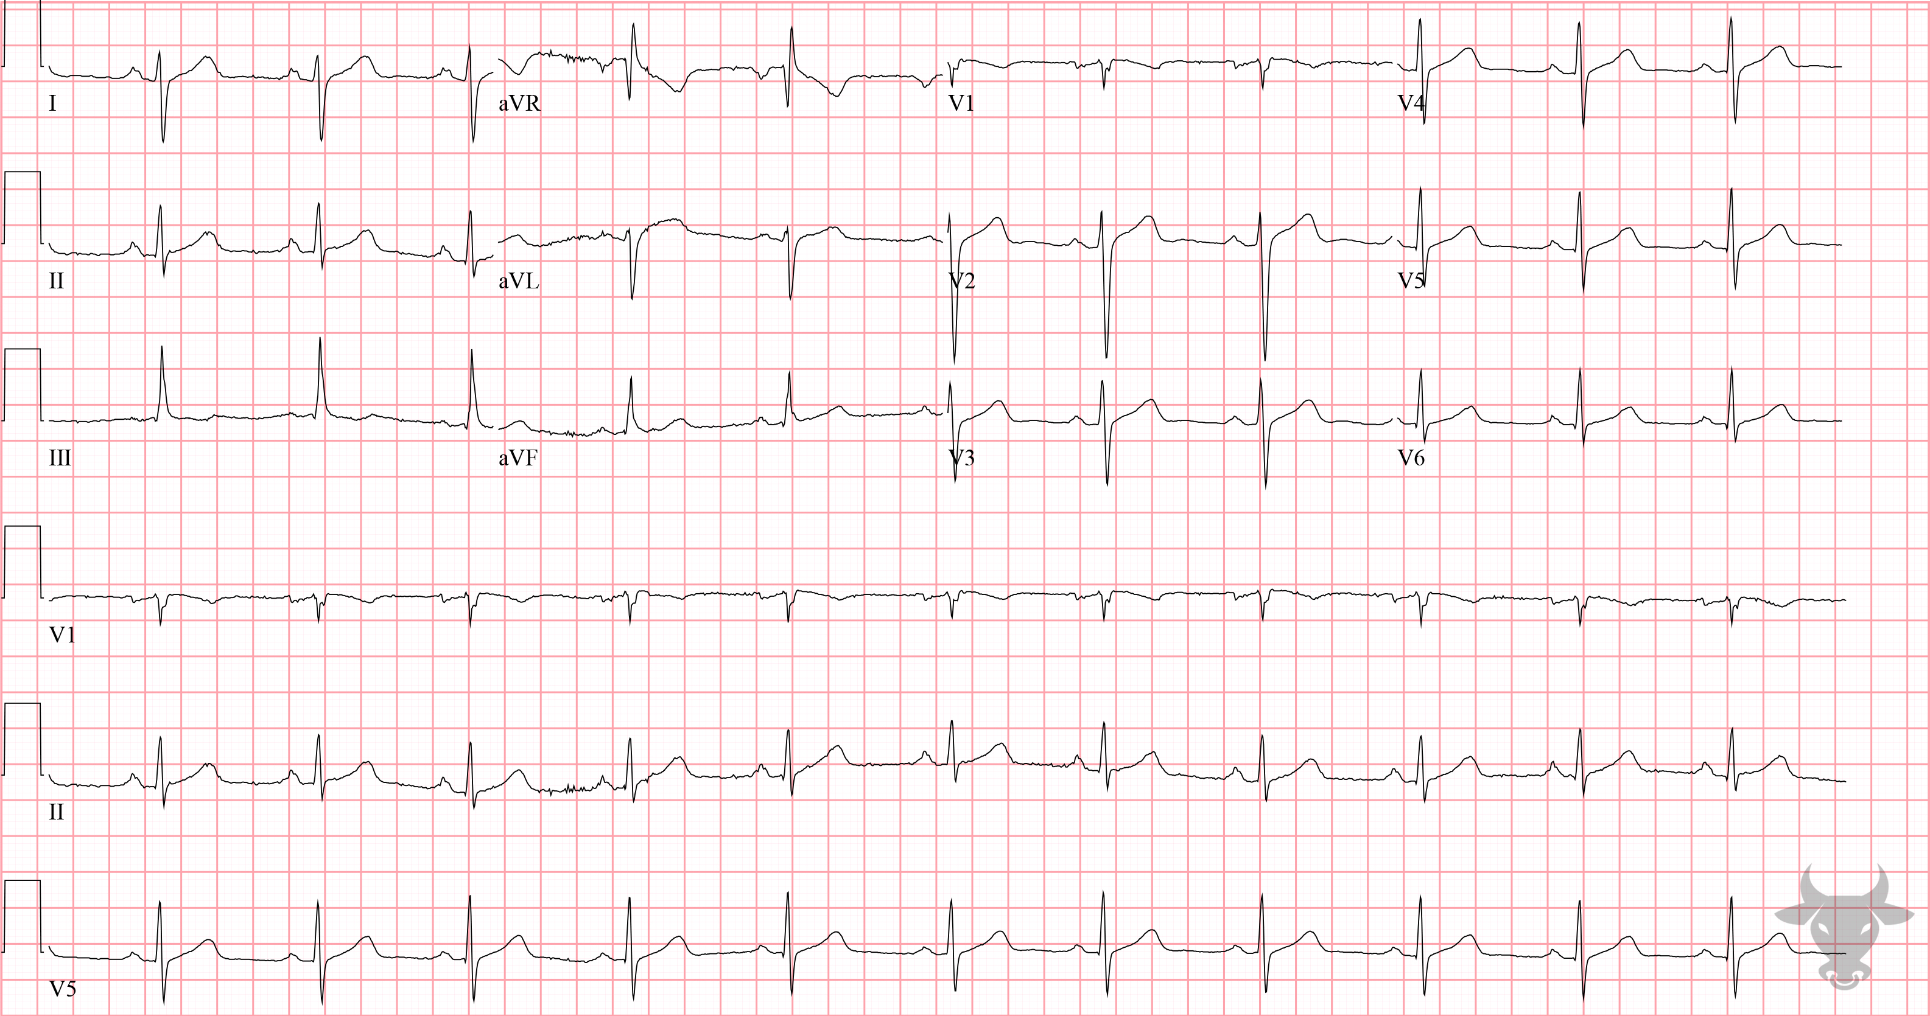
Notes:
Left Posterior Fascicular Block.
Left Posterior Fascicular Block. The normal infranodal conduction divides into the right and left bundles, and the latter is further subdivided into anterior and posterior divisions or “fascicles.” Disruption of both fascicles produces the familiar left bundle branch block pattern, but each fascicle can be affected independently - resulting in either left anterior fascicular block or left posterior fascicular block. Left posterior fascicular block results in depolarization in a rightward/downward direction and produces right axis deviation (Figure 50). Isolated left posterior fascicular block is rare due to its robust blood supply and is demonstrated by right axis deviation, rS complexes in the lateral leads (I, aVL) and qR complexes in the inferior leads (II, III, aVF).

Slide 12
68-year-old female presents with palpitations
116

Slide 13
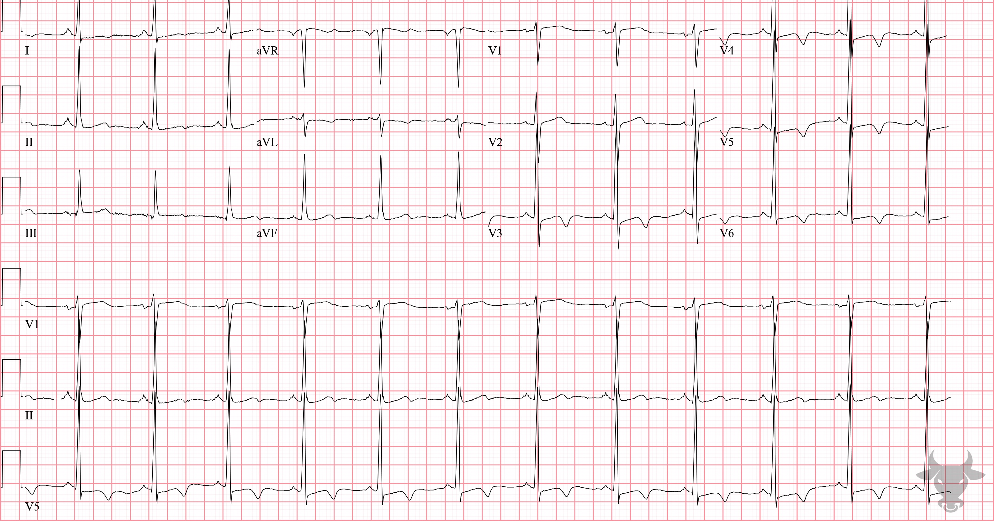
Notes:
Hypertrophic Cardiomyopathy.
Hypertrophic Cardiomyopathy. Hypertrophic Cardiomyopathy is the most common cause of sudden cardiac death in individuals under 40 years of age. Common ECG findings were previously described in case 105. This patient has known apical hypertrophic cardiomyopathy, a condition known to cause ischemic-appearing repolarization abnormalities (i.e., symmetric T wave inversion) in the precordial leads.

