Slide 1

Conference 21
ECG STAMPEDE

Slide 2
18-year-old male presents with chest pain
105

Slide 3
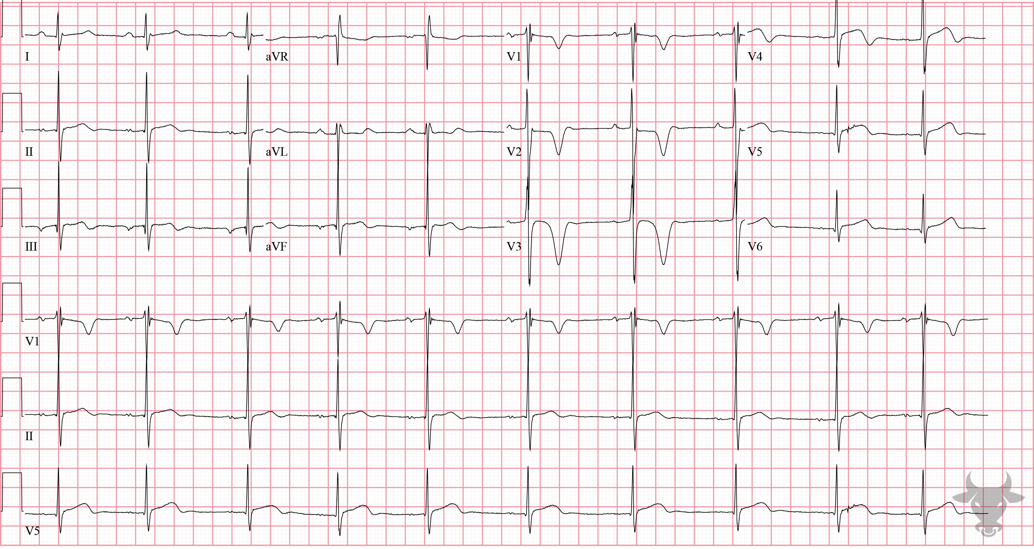

Notes:
Hypertrophic Cardiomyopathy.
Hypertrophic Cardiomyopathy. Hypertrophic Cardiomyopathy (HCM) is the most common cause of sudden cardiac death in individuals under 40 years of age. HCM can have a variable appearance and it's not uncommon to see repolarization abnormalities like the ones seen here. Common ECG findings include large QRS complexes of left ventricular hypertrophy, T wave inversions (especially in lateral leads), and narrow, “dagger” Q waves in the lateral leads (I, aVL, V5, V6). Symmetric T-wave inversions in the precordial leads (as seen with this ECG) is suggestive of apical HCM, although this patient had septal hypertrophy.

Slide 4
43-year-old male presents with episodic chest pain
106

Slide 5
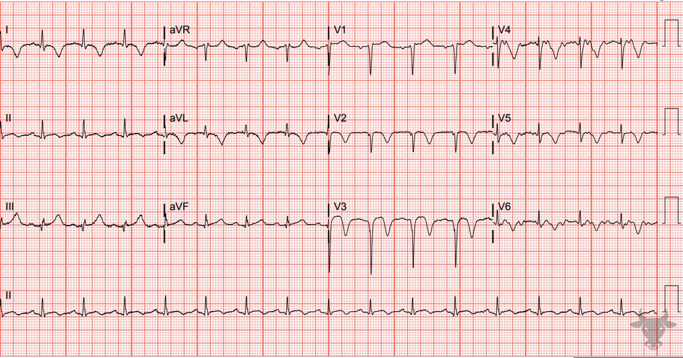
Notes:
Wellens Syndrome.
Wellens Syndrome. This is type B Wellens pattern with deeply inverted precordial T waves. Wellens syndrome was previously described in case 18. This patient had a 95% proximal left anterior descending stenosis.

Slide 6
90-year-old male presents with dyspnea
107

Slide 7
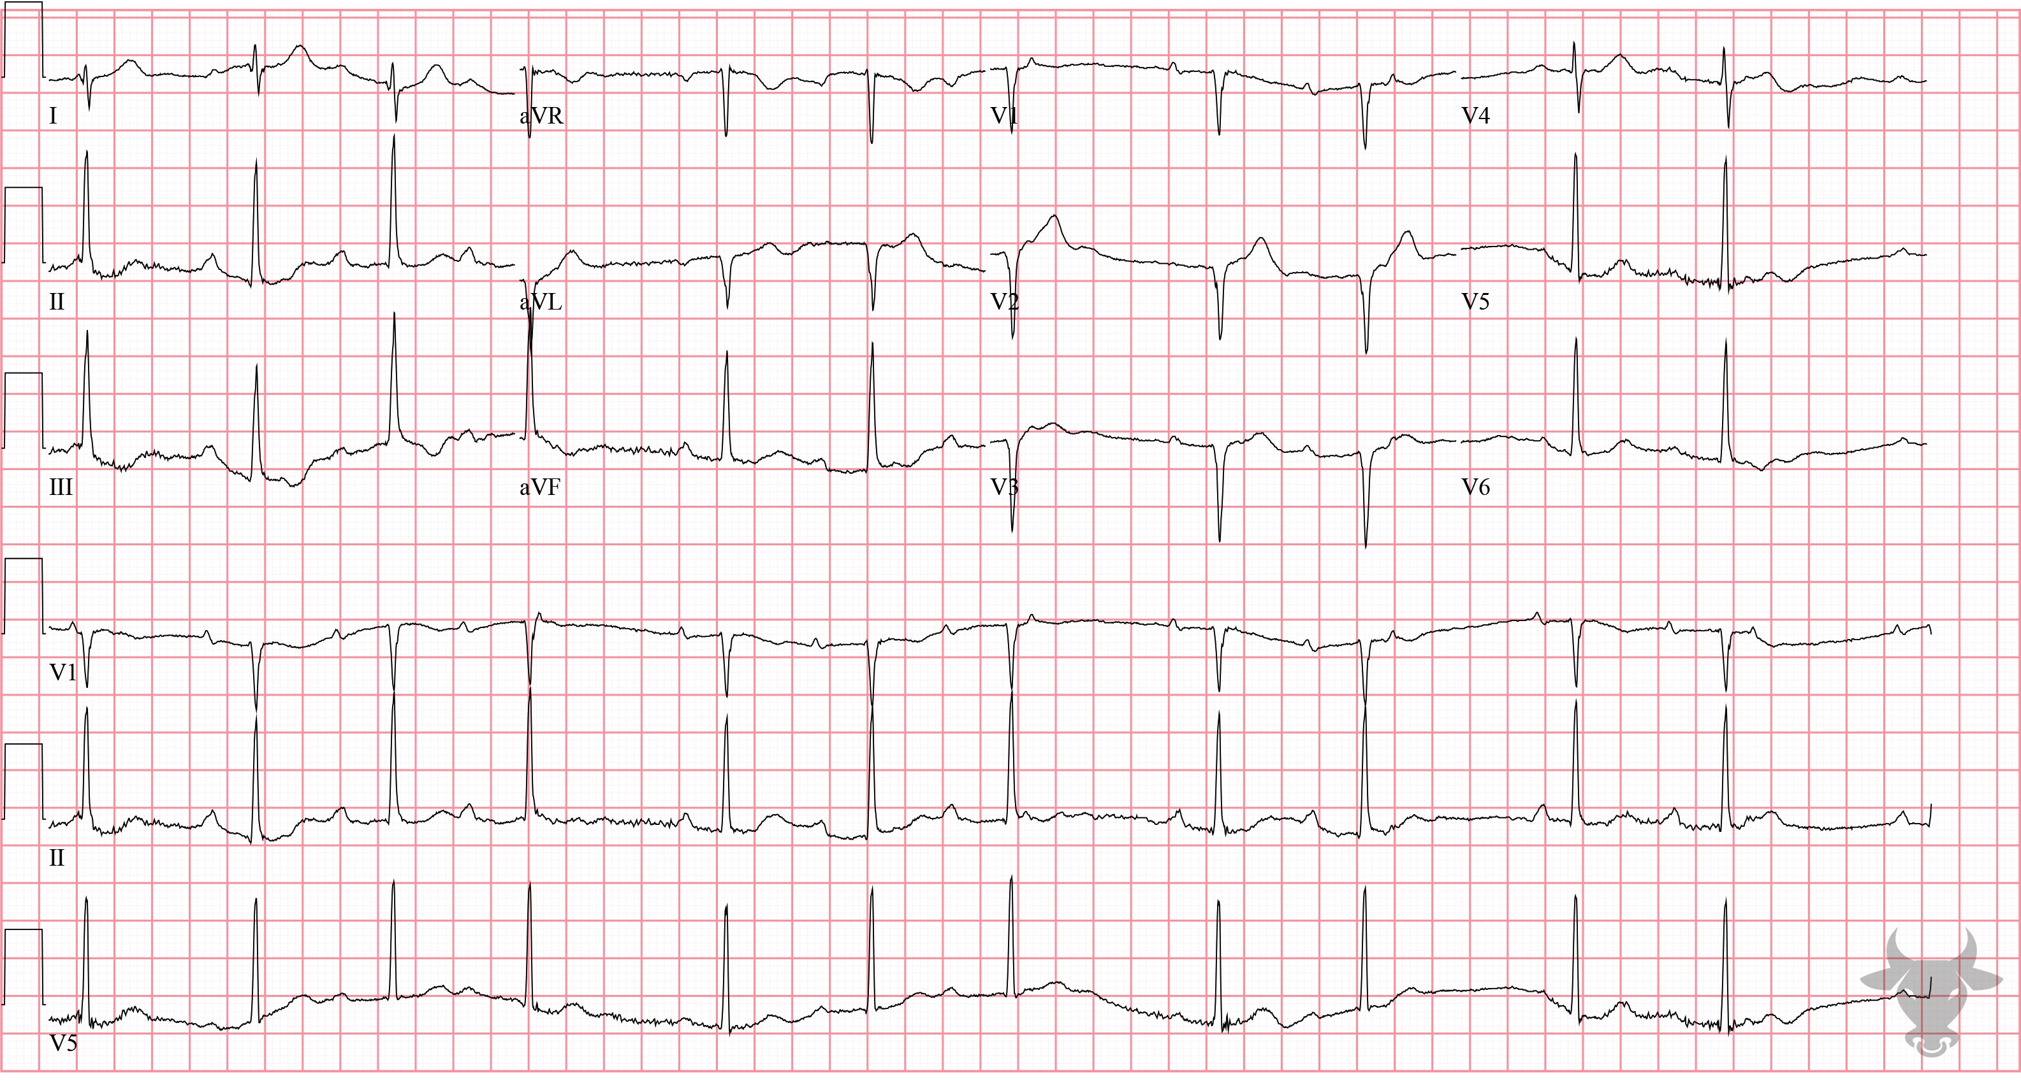
Notes:
Second Degree Atrioventricular Block - Mobitz I.
Second Degree Atrioventricular Block - Mobitz I. There is variable decremental conduction through the atrioventricular node (i.e., progressively prolonging PR interval) that ultimately results in a dropped P wave (Figure 47).

Slide 8
62-year-old male presents with chest pain
108

Slide 9
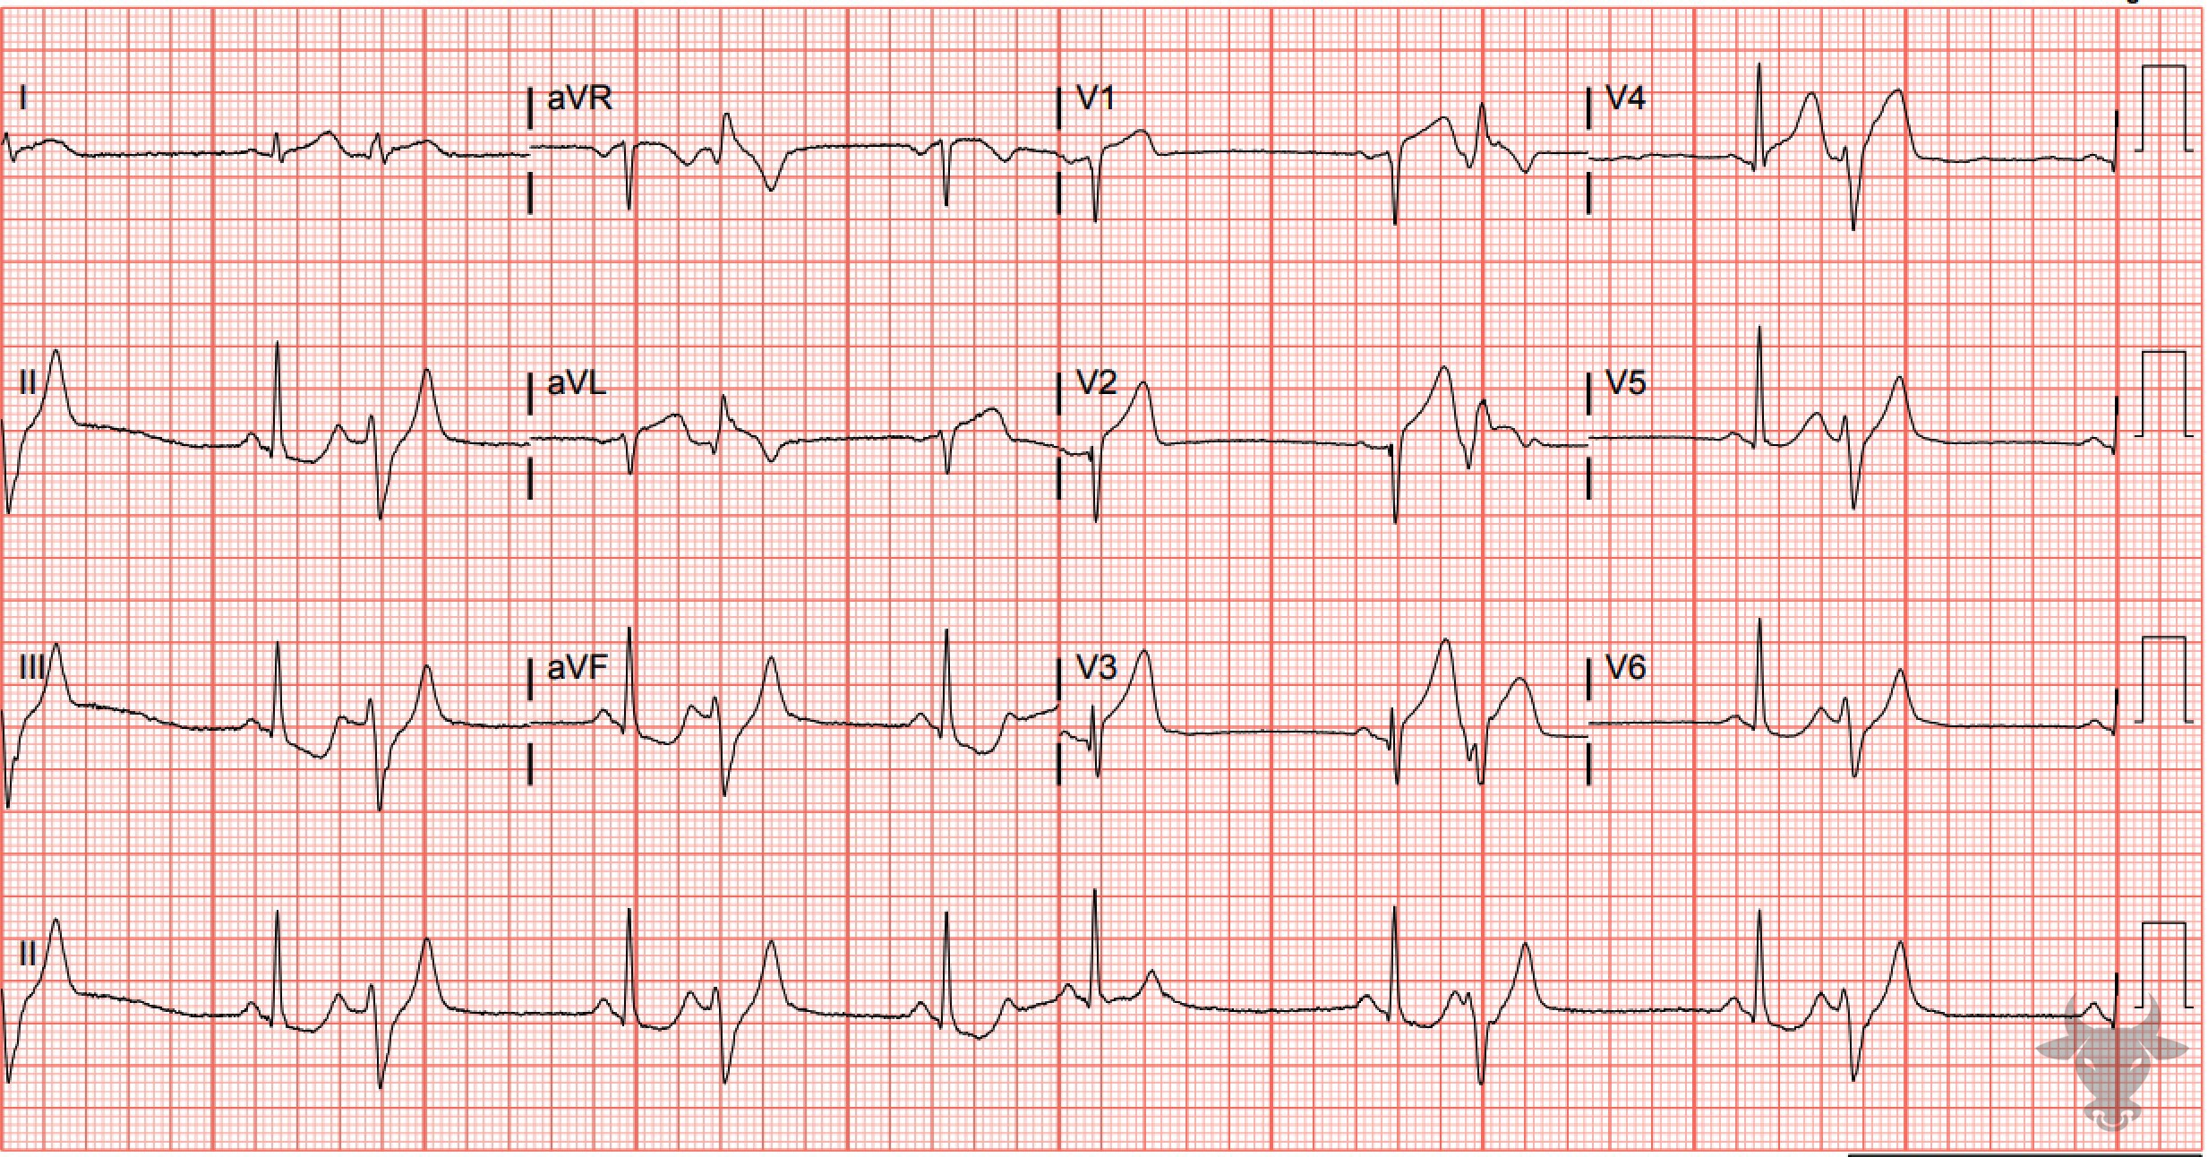
Notes:
Anterior ST-elevation Myocardial Infarction.
Anterior ST-elevation Myocardial Infarction. Pay attention to the natively conducted complexes and ignore the premature ventricular complexes when looking for acute ischemic findings (Figure 48). There are anterior ST-segment elevations and hyperacute T waves in V1 through V4 and reciprocal ST-segment depressions in the inferior leads (II, III, and aVF). Left heart catheterization revealed left anterior descending artery occlusion.

Slide 10
59-year-old male presents with chest pain
109

Slide 11
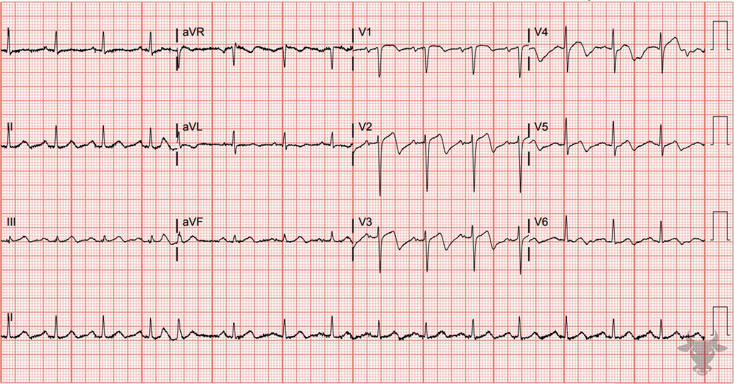
Notes:
Wellens Syndrome.
Wellens Syndrome. This is type A Wellens pattern – biphasic T waves with negative terminal deflections. This patient had a 90% proximal left anterior descending artery stenosis. (See case 18 for further explanation of Wellens syndrome).

Slide 12
48-year-old male presents with chest pain
110

Slide 13
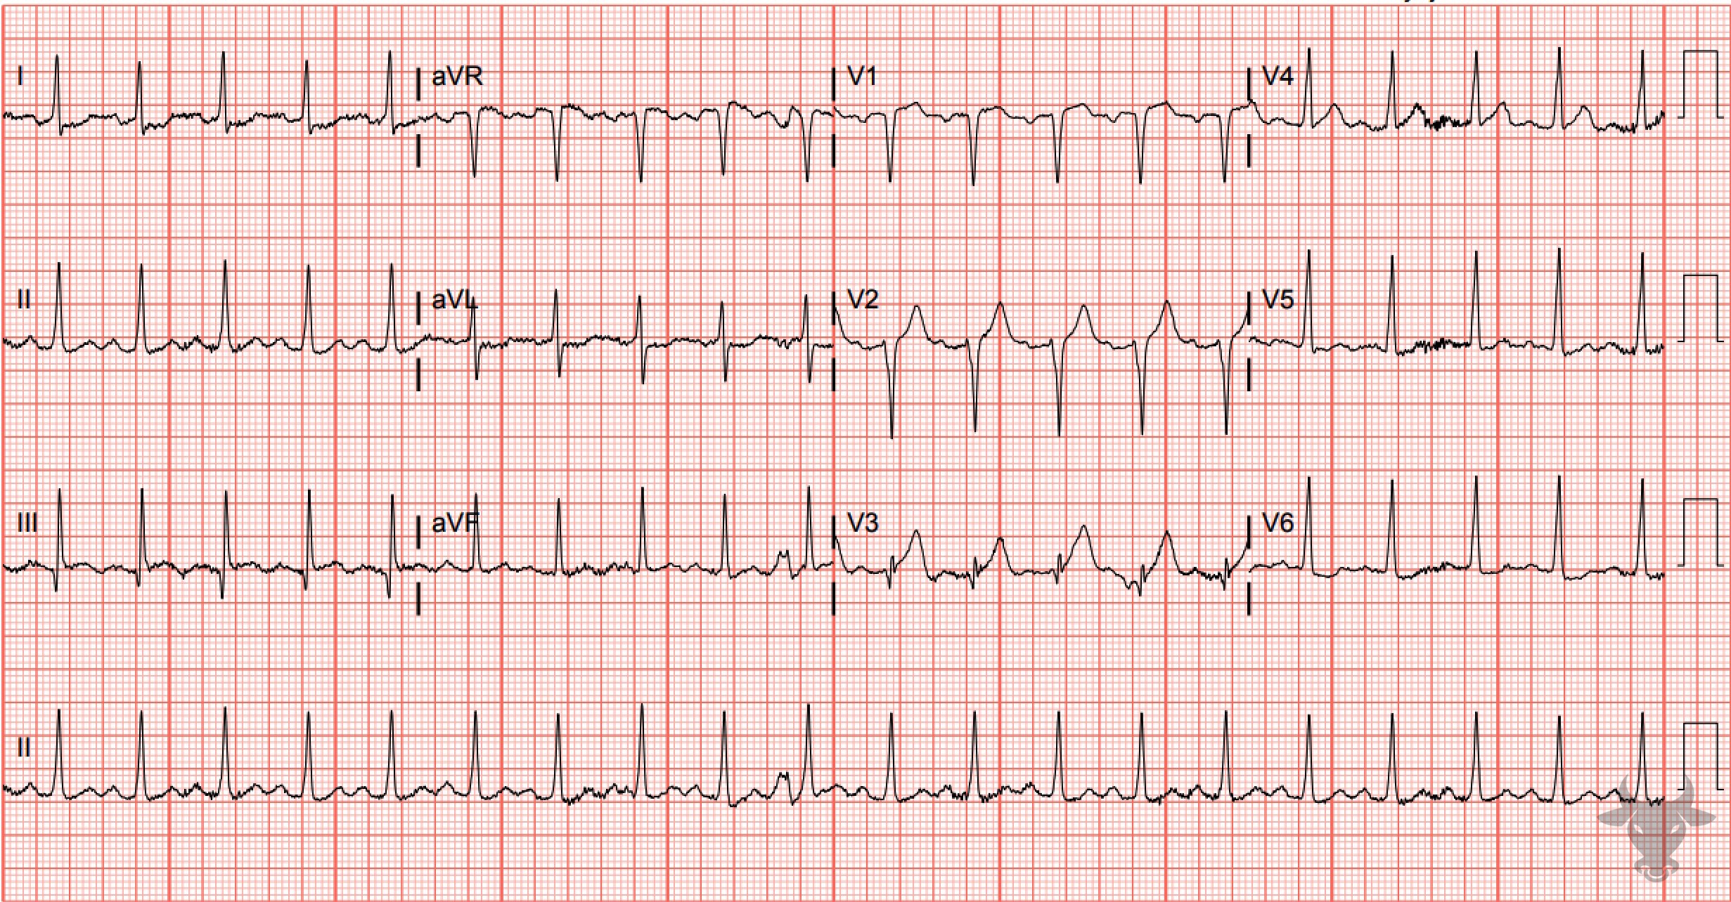
Notes:
Anterior ST-elevation Myocardial Infarction.
Anterior ST-elevation Myocardial Infarction, Sinus Tachycardia. Notice the slight reciprocal ST depressions in the high lateral leads (i.e., I and aVL) and the presence of terminal QRS distortion in V3 (i.e., the absence of an S wave or a J notch) – a very specific finding for ST-elevation myocardial infarction (see case 44). Left heart catheterization revealed a 90% mid-left anterior descending artery culprit lesion and percutaneous coronary intervention was successful.

