Slide 1

Conference 20
ECG STAMPEDE

Slide 2
58-year-old male presents with chest pain
99

Slide 3
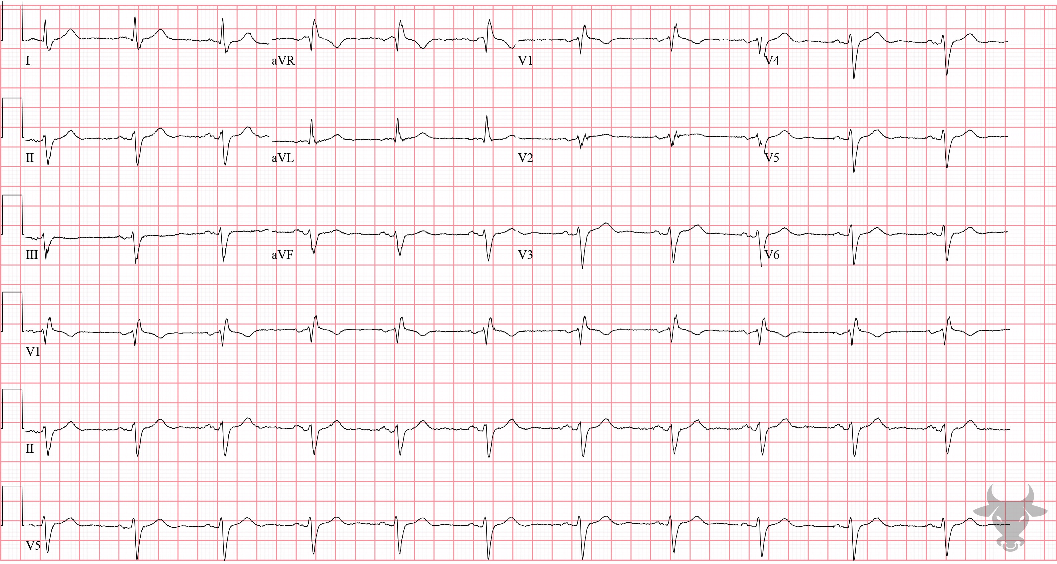

Notes:
Right Bundle Branch Block.
Right Bundle Branch Block, Left Anterior Fascicular Block. The wide QRS, rSR’ in the anterior precordial leads (V1, V2), and deep S-waves in the lateral leads (I, V6) indicate the presence of a right bundle branch block. The right bundle branch block, however, does not explain the left axis deviation (recall the causes of left axis deviation from case 3). When the left anterior fascicle is disrupted, current passes along the posterior fascicle and the left ventricle is depolarized in a leftward/upward direction - producing left axis deviation and often extreme left axis deviation (Figure 3). This ECG demonstrates disruption of two fascicles – the right bundle and the left anterior fascicle – and is termed a “bifascicular” block.

Slide 4
39-year-old male presents with chest pain
100

Slide 5
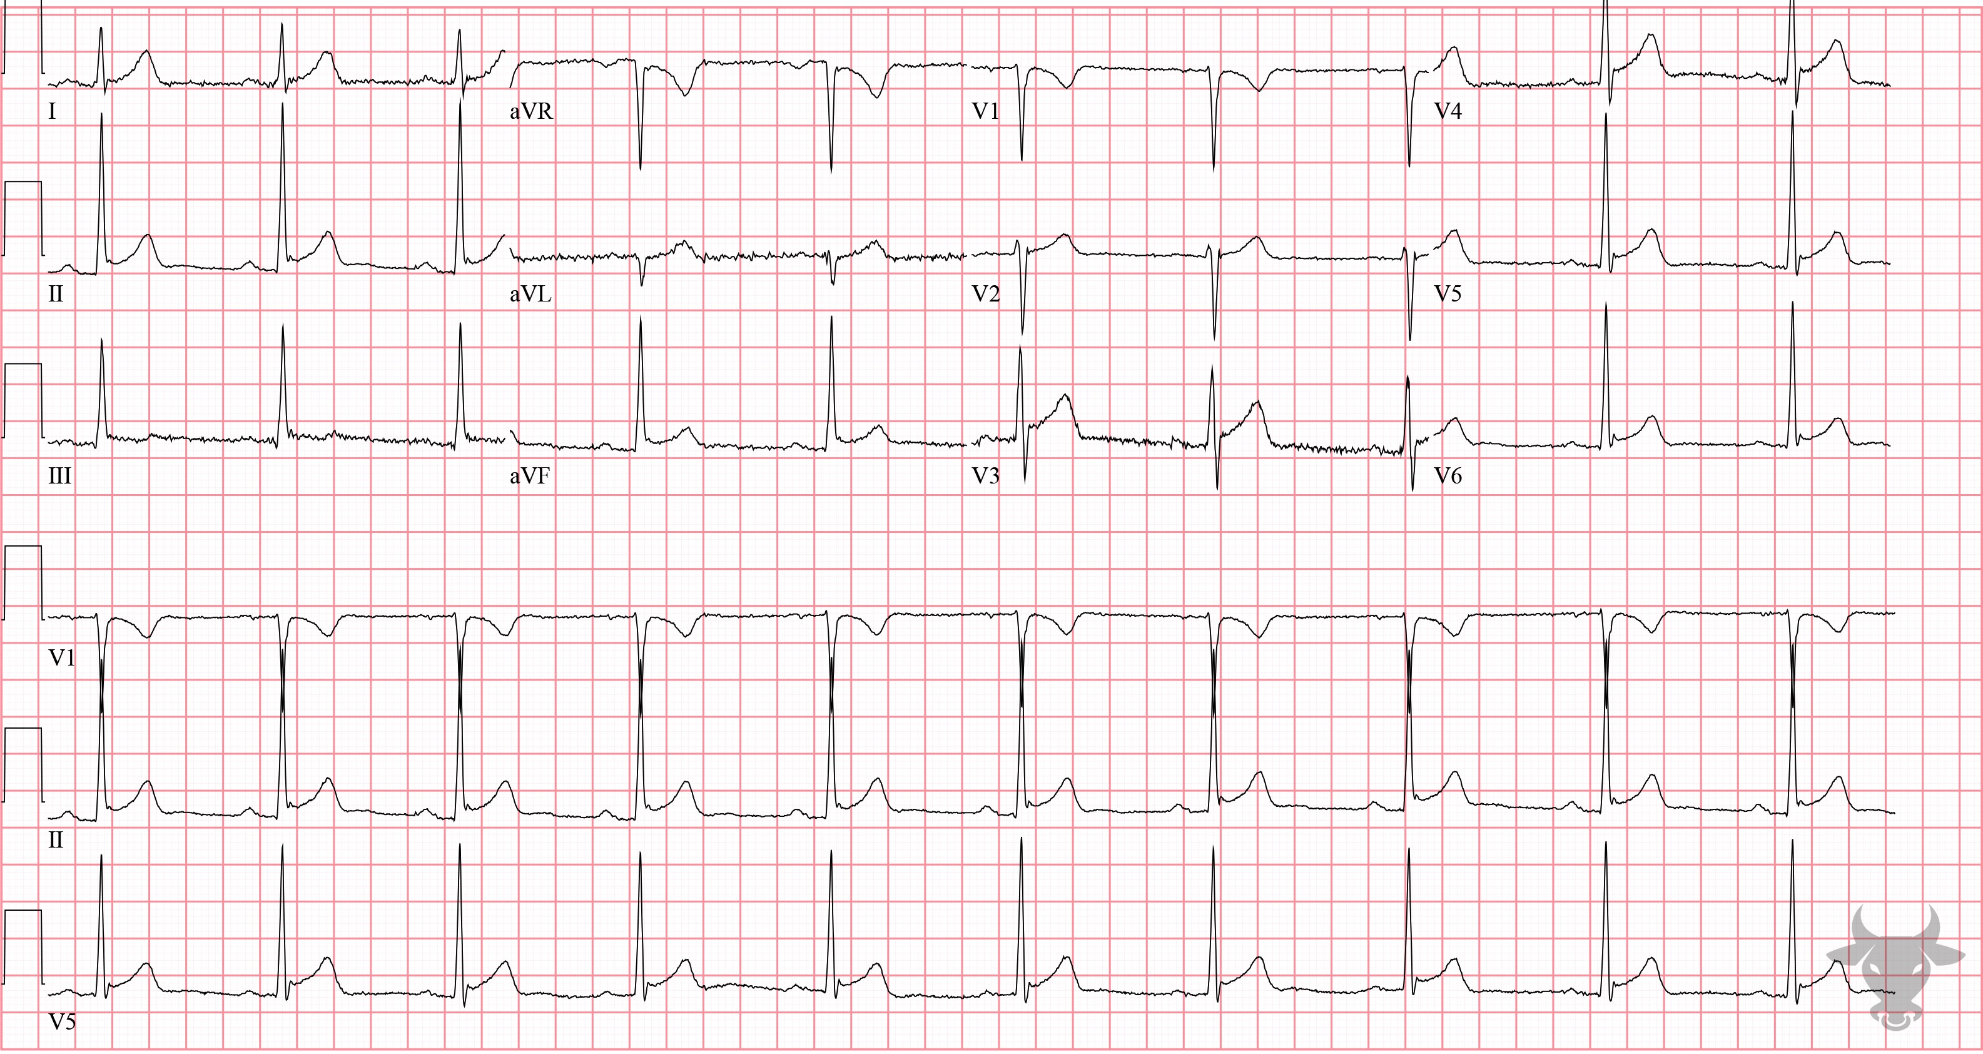
Notes:
Early Repolarization.
Early Repolarization. There are diffuse, mild, concave ST-segment elevations with J-point notching (Figure 43) and absence of reciprocal depressions.

Slide 6
45-year-old male presents with dyspnea
101

Slide 7
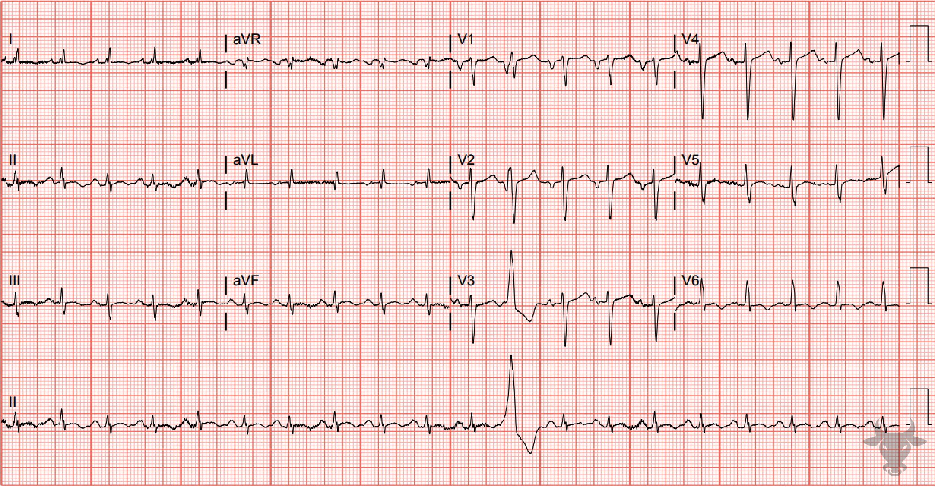
Notes:
Sinus Tachycardia.
Sinus Tachycardia, Left Atrial Enlargement. Atrial enlargement can be determined by analyzing the P waves in leads II and V1. The first half of the P wave represents right atrial depolarization, while the second half represents left atrial depolarization. There are deeply inverted P waves in V1 and wide P waves in II (Figure 44). Left atrial enlargement occurs with increased pressure or volume overload and is a precursor to atrial fibrillation. It is classically seen in mitral stenosis or conditions that lead to left ventricular hypertrophy as was the case with this patient.

Slide 8
20-year-old female presents with palpitations
102

Slide 9
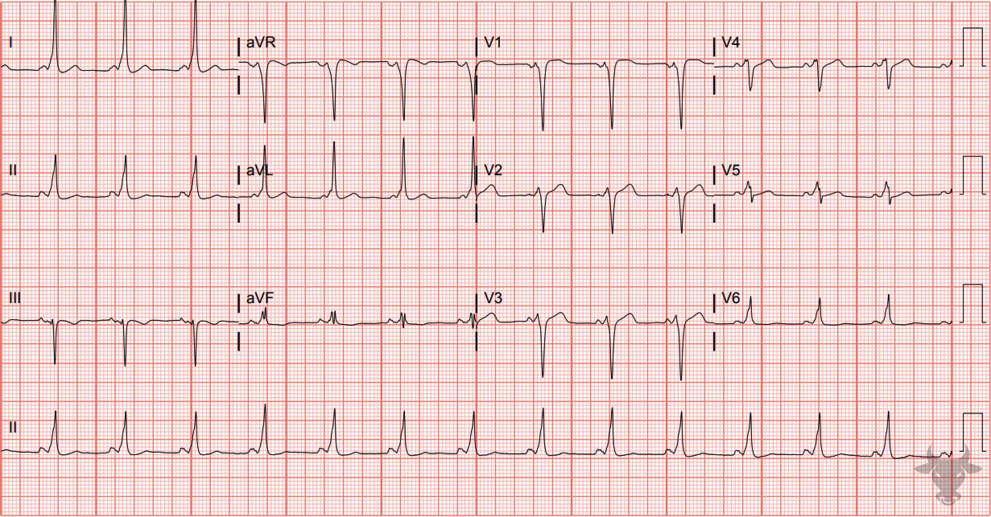
Notes:
Pre-excited Atrial Fibrillation.
Pre-excited Atrial Fibrillation. The irregularly irregular rhythm and faster-than-usual rate are the result of atrial fibrillation with pre-excitation (i.e., the Wolf-Parkinson-White syndrome). There are inconsistent QRS morphologies resulting from variable transmission of signals from the atria to the ventricles via anterograde conduction through the atrioventricular node and the accessory pathway. The rate approaches 300 beats per minute at times (Figure 45). Rates this fast are not seen with atrial fibrillation unless an accessory pathway exists.
These patients should not receive medications that block the atrioventricular node as they can precipitate ventricular fibrillation. This patient was electrically cardioverted.

Slide 10
64-year-old male presents with chest pain
103

Slide 11
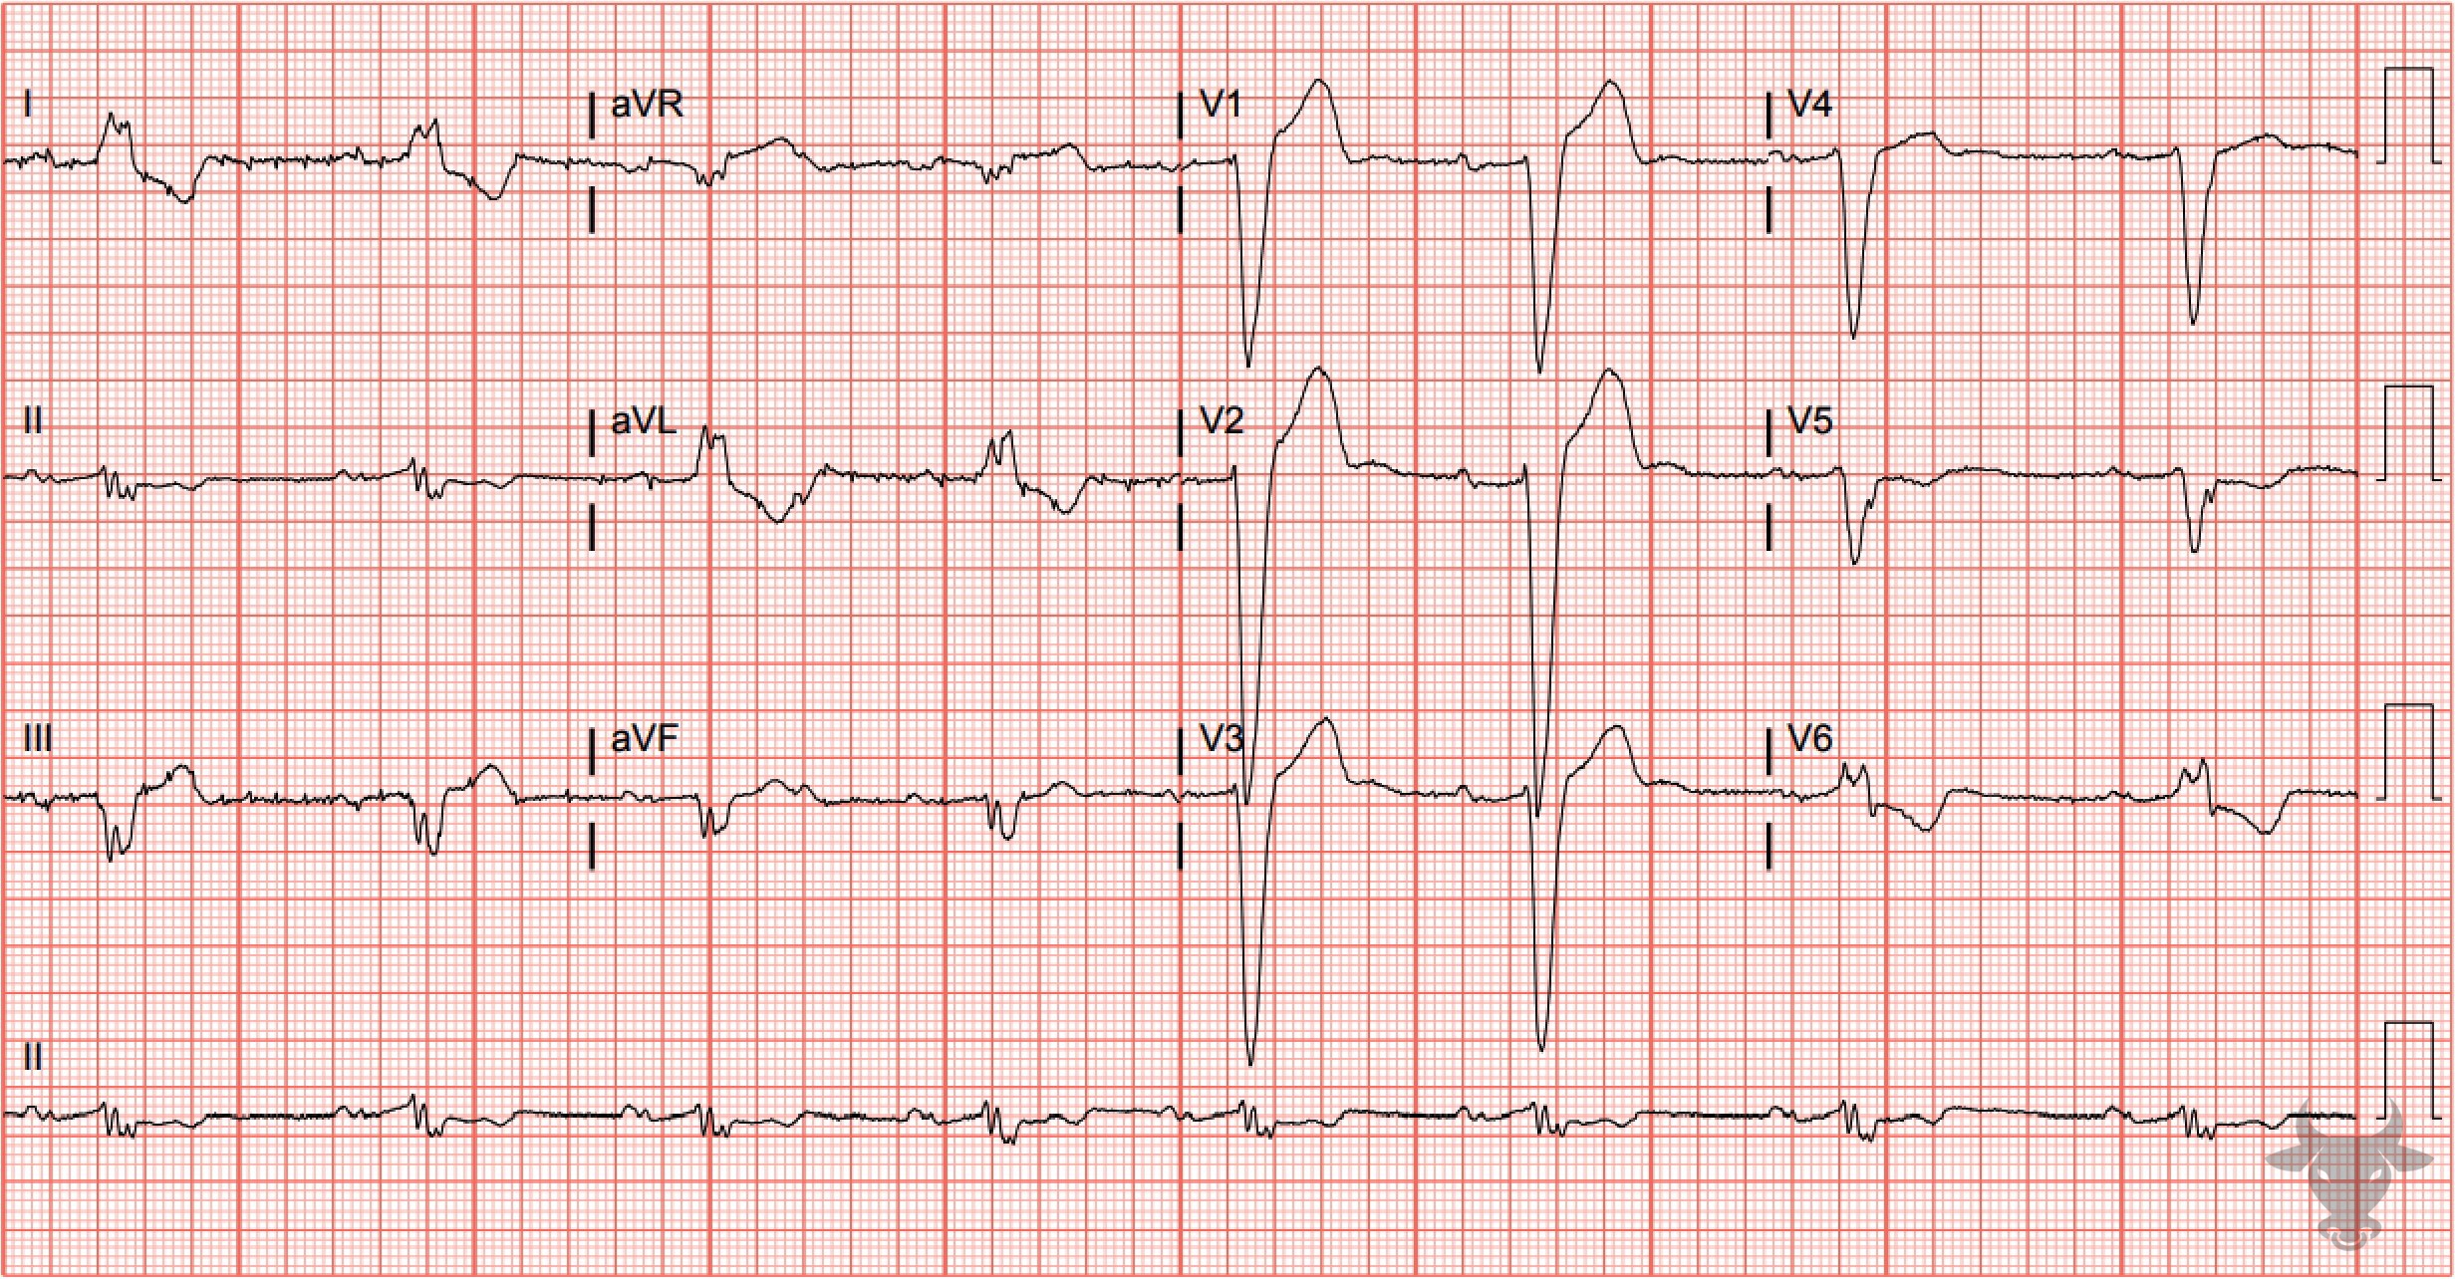
Notes:
Left Bundle Branch Block, First Degree Atrioventricular Block.
Left Bundle Branch Block, First Degree Atrioventricular Block. The wide QRS complex, dominant S wave in V1, broad notched R wave in the lateral leads (I, aVL, V6) and left axis deviation are all characteristic of a left bundle branch block (Figure 23). The prolonged PR interval represents a first-degree atrioventricular block. These disturbances coupled together suggest trifascicular disease.

Slide 12
80-year-old male presents with dyspnea
104

Slide 13
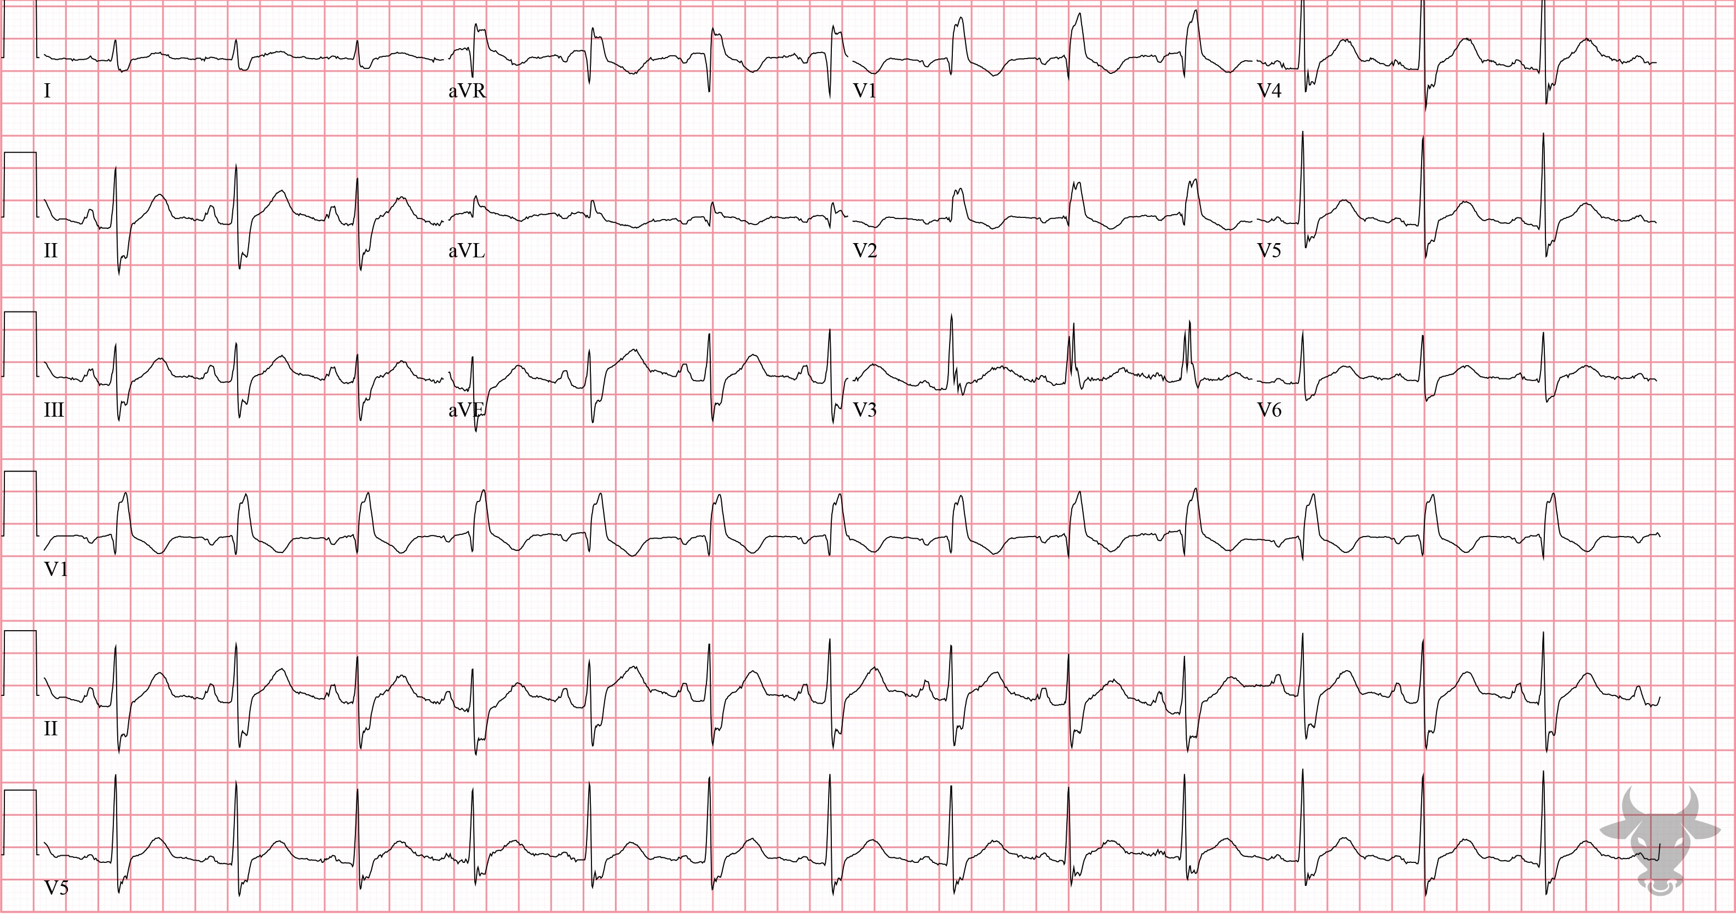
Notes:
Right Bundle Branch Block.
Right Bundle Branch Block. This right bundle branch block pattern has an atypical appearance. The rsR' in V1 can have a qR appearance in some right bundle branch blocks (Figure 46). The expected wide S is present in the lateral leads (I, V5, V6).

