Slide 1

Conference 2
ECG STAMPEDE

Slide 2
72-year-old female presents with chest pain
5

Slide 3
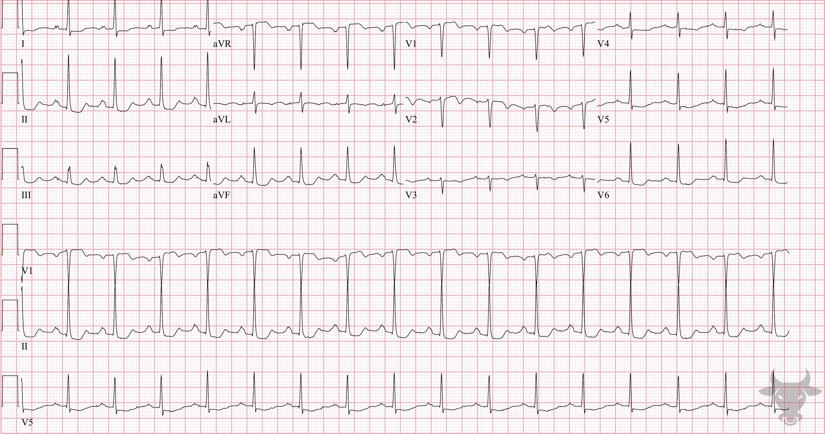
Notes:
Global Subendocardial Ischemia.
Global Subendocardial Ischemia. This pattern of multilead ST-segment depressions and ST-segment elevation in aVR has been recognized as a predictor of triple vessel and/or left main disease; however, this pattern can be seen with any pathology that causes a supply/demand mismatch. Differential considerations include acute pulmonary embolism, hypoxic respiratory failure, sepsis, severe anemia, hypokalemia, and left ventricular hypertrophy. This patient presented with cardiac chest pain and was discovered to have diffuse disease on left heart catheterization. The patient underwent coronary artery bypass grafting.

Slide 4
58-year-old male presents with palpitations for 12 hours
6

Slide 5
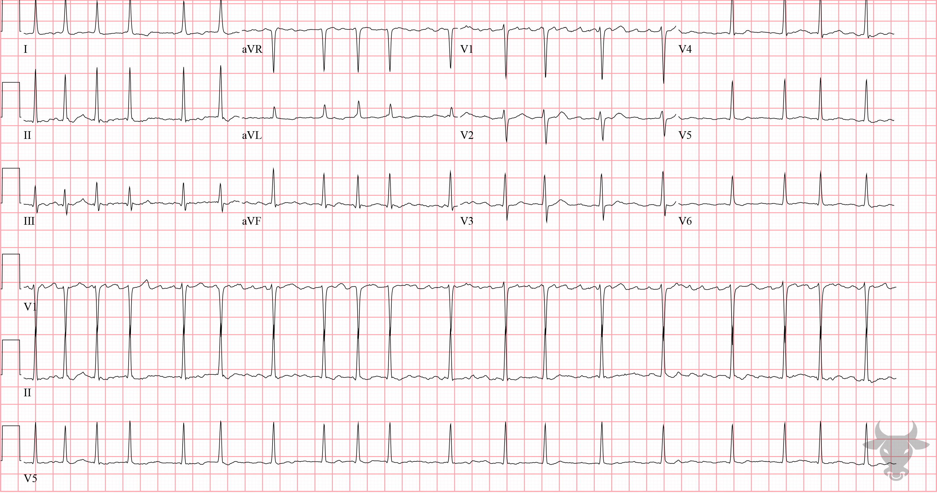
Notes:
Atrial Fibrillation.
Atrial Fibrillation with Rapid Ventricular Response. The differential for an irregularly irregular rhythm includes atrial fibrillation, atrial flutter with variable conduction, and multifocal atrial tachycardia. The apparent atrial activity in V1, at first glance, appears to represent flutter waves, but flutter waves are regular in appearance and cause ventricular activation (R-R intervals) at intervals that are multiples ofatrial activation (P-P interval) - not the case here. Therefore, the apparent atrial activity in V1 is just baseline artifact and this is atrial fibrillation.

Slide 6
71-year-old male presents with altered mental status
7

Slide 7
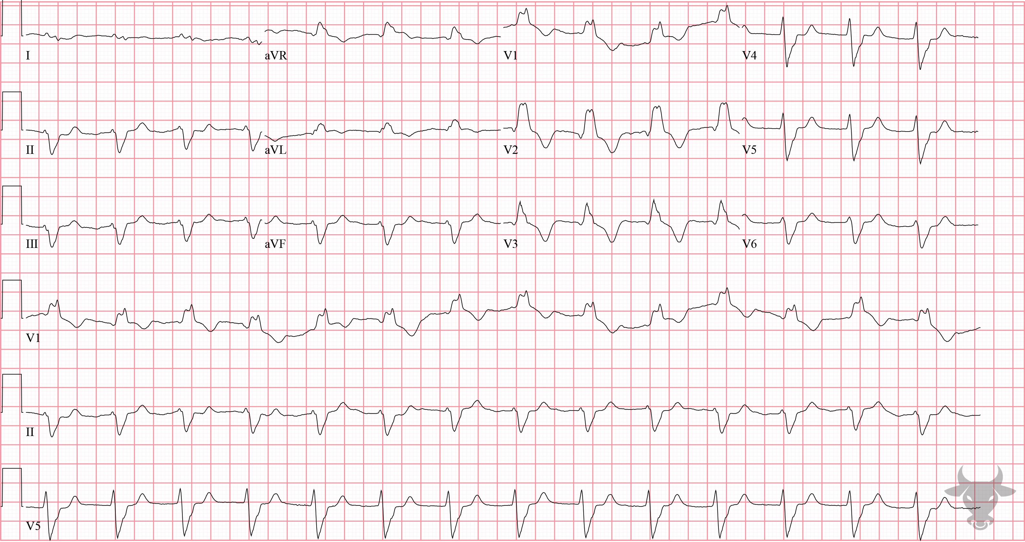
Notes:
Right Bundle Branch Block.
Right Bundle Branch Block, Left Anterior Fascicular Block, Hyperkalemia. The rSR’ pattern in V1 and wide S wave in V5 and V6 indicates the presence of a right bundle branch block (Figure 2), while the extreme left axis deviation suggests the presence of a left anterior fascicular block (Figure 3). The potassium level was 6.3 mEq/L. Hyperkalemia can, itself, cause conduction disturbances like bundle branch or fascicular blocks; however, this patient’s conduction disturbances were known. Relative to prior ECGs, the QRS complex is wider and P waves are absent – both features of hyperkalemia.

Slide 8
60-year-old male presents with defibrillator firing
8

Slide 9
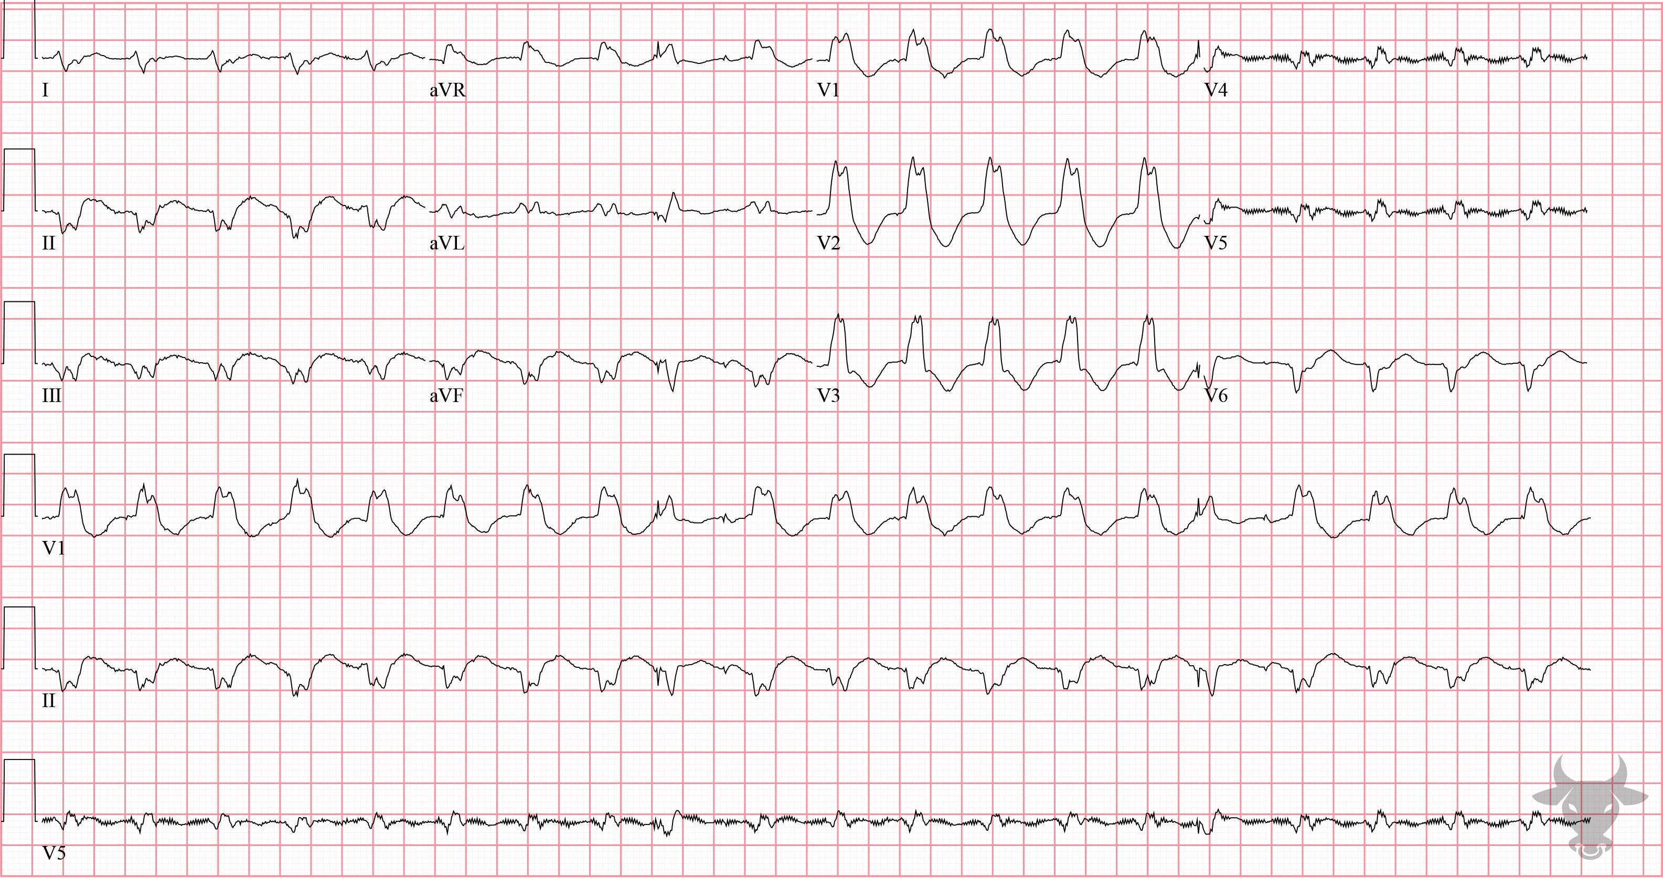
Notes:
Ventricular Tachycardia.
Ventricular Tachycardia. The differential for regular, wide complex tachycardia includes ventricular tachycardia, supraventricular tachycardia with aberrancy, antidromic atrioventricular reentrant tachycardia, toxicologic/metabolic disturbances, and ventricular paced rhythm. Although the rate is slower than typical ventricular tachycardia, features favoring ventricular tachycardia include RSr' (left R taller than the right r' in V1) and extreme right axis (Figure 5).
This rhythm was confirmed to be ventricular tachycardia by electrophysiology and the patient was electrically cardioverted.
While 80% of wide complex tachycardia is ventricular tachycardia, several algorithms including the Brugada algorithm, the Vereckei algorithm, and, more recently, the Basel algorithm have been developed to differentiate ventricular tachycardia from supraventricular tachycardia with aberrancy. It is worth noting that their use in the clinical setting has shown low reproducibility, and it is safest to presume ventricular tachycardia in the absence of compelling information to suggest otherwise.

