Slide 1

Conference 19
ECG STAMPEDE

Slide 2
63-year-old male presents with syncope
92

Slide 3
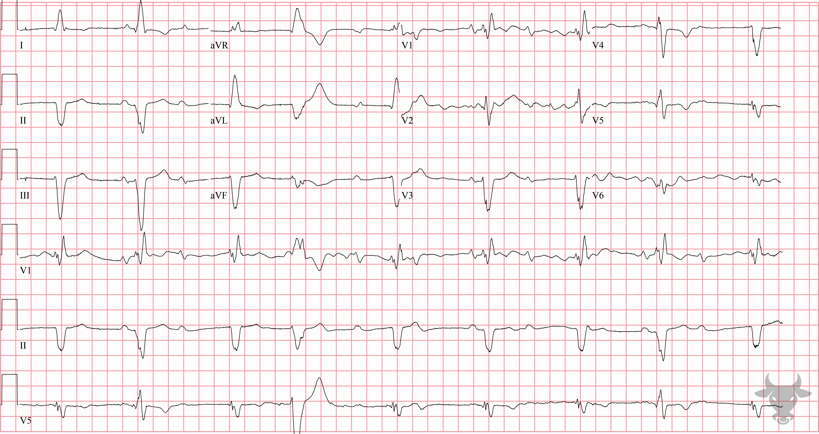

Notes:
Second Degree Atrioventricular Block – Mobitz II.
Second Degree Atrioventricular Block – Mobitz II. This rhythm is challenging but there are two conducted P waves and the rest are dropped. Intermittent failure of conduction is defined as second degree atrioventricular block. Mobitz II conduction is due to infranodal conduction disease and is characterized by constant PR intervals. The PR intervals for the conducted P waves are constant, therefore, this rhythm is most likely second degree atrioventricular block with Mobitz II conduction (Figure 39).

Slide 4
57-year-old female presents with dyspnea
93

Slide 5
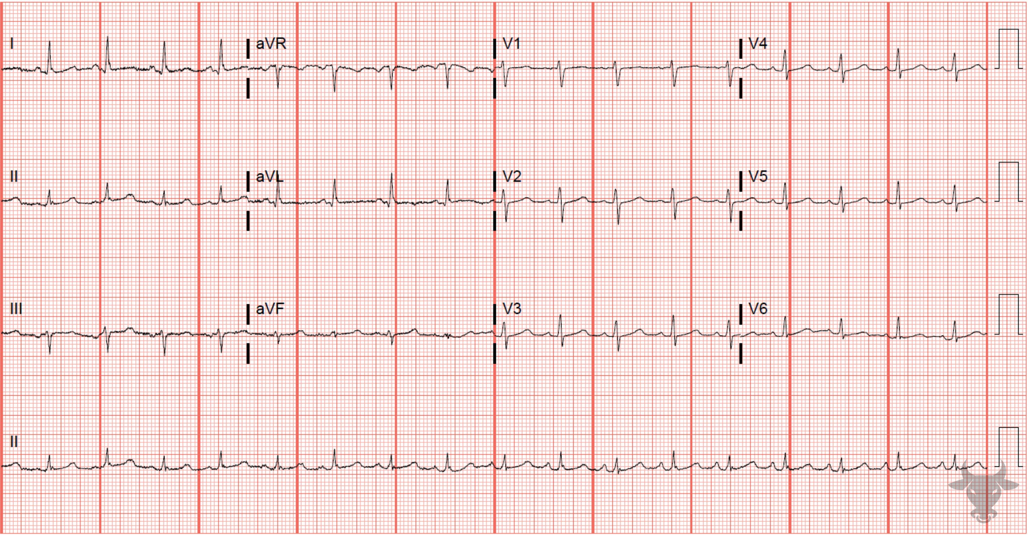
Notes:
Low Voltage.
Low Voltage, Cardiac Tamponade. Low voltage is defined as:
All limb lead amplitudes less than 5 mm, or
All precordial lead amplitudes less than 10 mm.
This ECG meets the precordial low voltage criteria as the largest amplitude precordial QRS complex is 7 mm (in V2 and V3). The differential diagnosis for low voltage was previously described in case 51. The QRS amplitudes in the rhythm strip of lead II can be seen to alternate between larger and smaller complexes, a phenomenon known as electrical alternans. Electrical alternans often results from the pendulous-like swinging of the heart inside a fluid-filled pericardium. The presence of electrical alternans and low voltage is specific for cardiac tamponade.

Slide 6
58-year-old male presents with palpitations
94

Slide 7
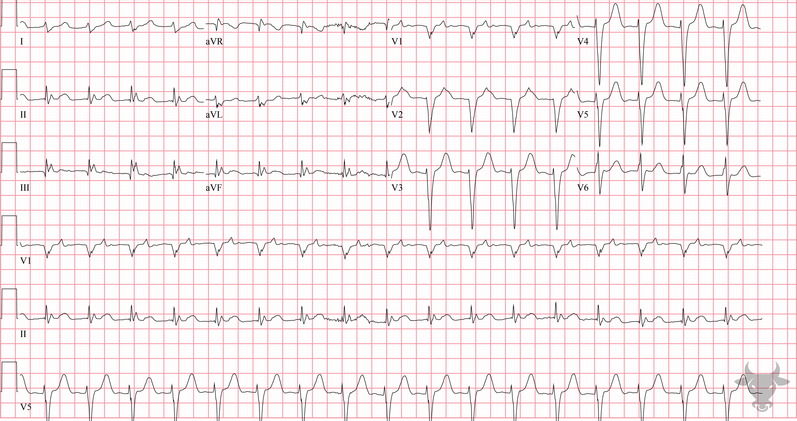
Notes:
Ventricular Tachycardia.
Ventricular Tachycardia. The presence of atrioventricular dissociation confirms ventricular tachycardia. P waves can be seen marching through the rhythm strip in V1 (look for the pointed complexes preceding every third QRS complex (Figure 41). This patient was successfully treated via synchronized electrical cardioversion.

Slide 8
64-year-old male presents with chest pain
95

Slide 9
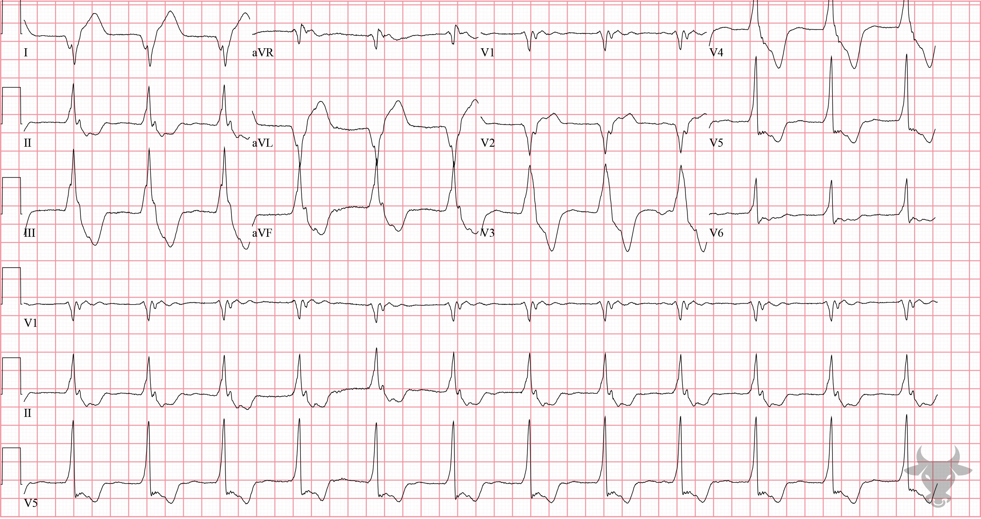
Notes:
Accelerated Idioventricular Rhythm.
Accelerated Idioventricular Rhythm. Accelerated Idioventricular Rhythm (AIVR) is a rhythm that occurs under conditions of enhanced automaticity. An enhanced ectopic ventricular pacemaker outpaces more superior pacemakers (e.g., sinus node) and, thus, becomes the dominant pacemaker by usurping control. It occurs at a rate faster than ventricular escape, but slower than ventricular tachycardia (i.e., between 50 and 110 beats/min). AIVR can occur for many reasons including electrolyte abnormalities and drug toxicity (e.g., digoxin), however, it occurs most commonly in the setting of reperfusion – that is, after myocardial infarction or cardiac arrest. This patient was confirmed to have a 90% occluded obtuse marginal culprit lesion.

Slide 10
42-year-old male presents with dyspnea
97

Slide 11
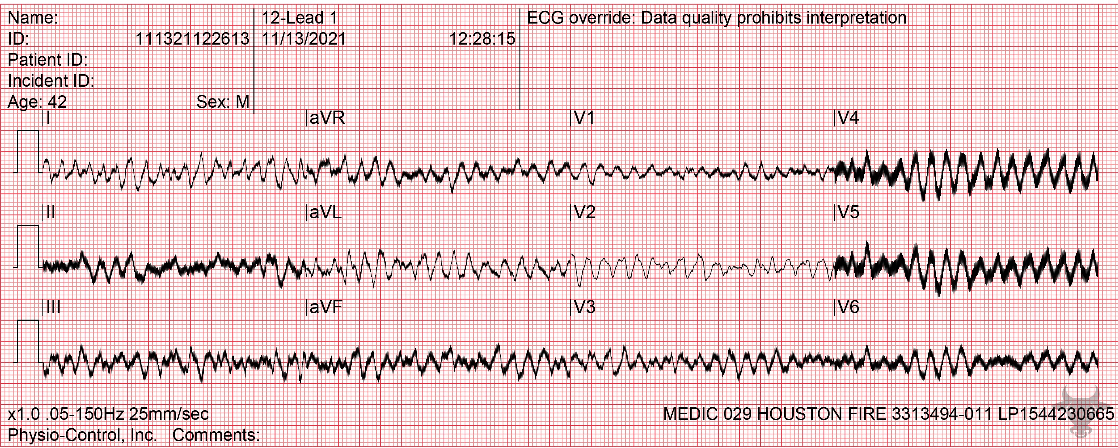
Notes:
Unknown.
Ventricular Fibrillation. A 12-lead of ventricular fibrillation should never be obtained on an unconscious patient. This patient had a left ventricular assist device and was awake and alert. The rhythm still warrants defibrillation because the left ventricular assist device is preload dependent and relies on right ventricular output. This patient was successfully defibrillated.

Slide 12
58-year-old male presents with abdominal pain
98

Slide 13
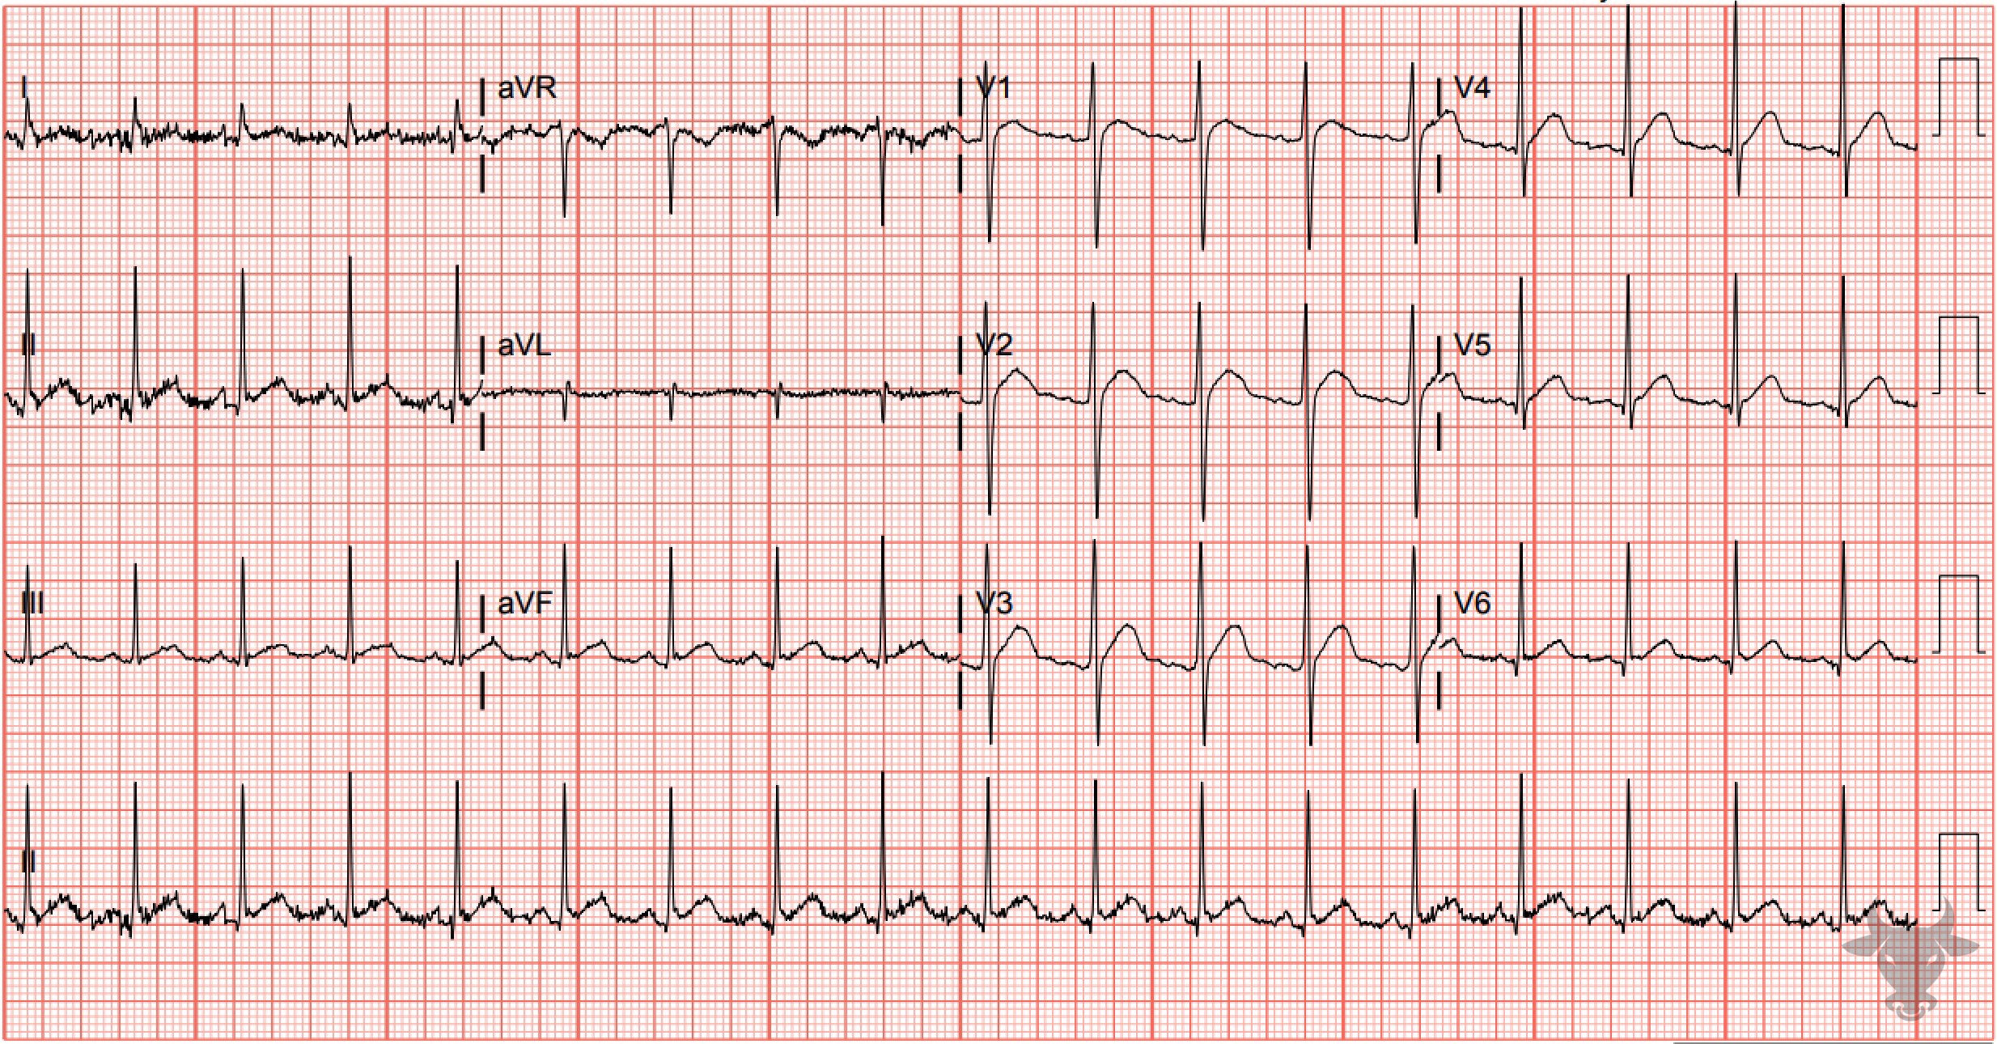
Notes:
Hypercalcemia.
Hypercalcemia. Hypercalcemia causes shortening of the QT interval, which can result in a “high-takeoff” of the ST-segment, mimicking myocardial ischemia or infarction. The QT interval normalized after treatment of hypercalcemia.

