Slide 1

Conference 18
ECG STAMPEDE

Slide 2
57-year-old male presents with dyspnea
86

Slide 3
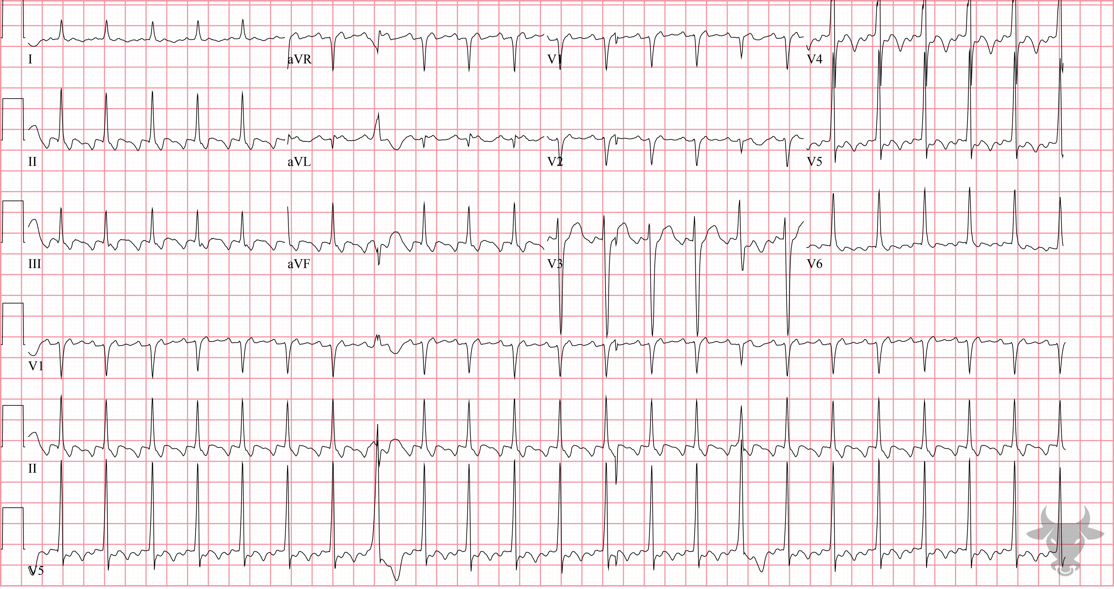

Notes:
Atrial Flutter with 2:1 Conduction.
Atrial Flutter with 2:1 Conduction. There is an atypical appearance to P waves in the limb leads (specifically II, III and aVF) where the usual isoelectric baseline is replaced by identical appearing “sawtooth” waves. These atrial flutter waves occur at a rate of approximately 300 beats per minute, complemented by a ventricular rate of 150 beats per minute. In the absence of treatment or atrioventricular block, the most common atrial to ventricular response is 2:1.

Slide 4
65-year-old female presents with chest pain
87

Slide 5
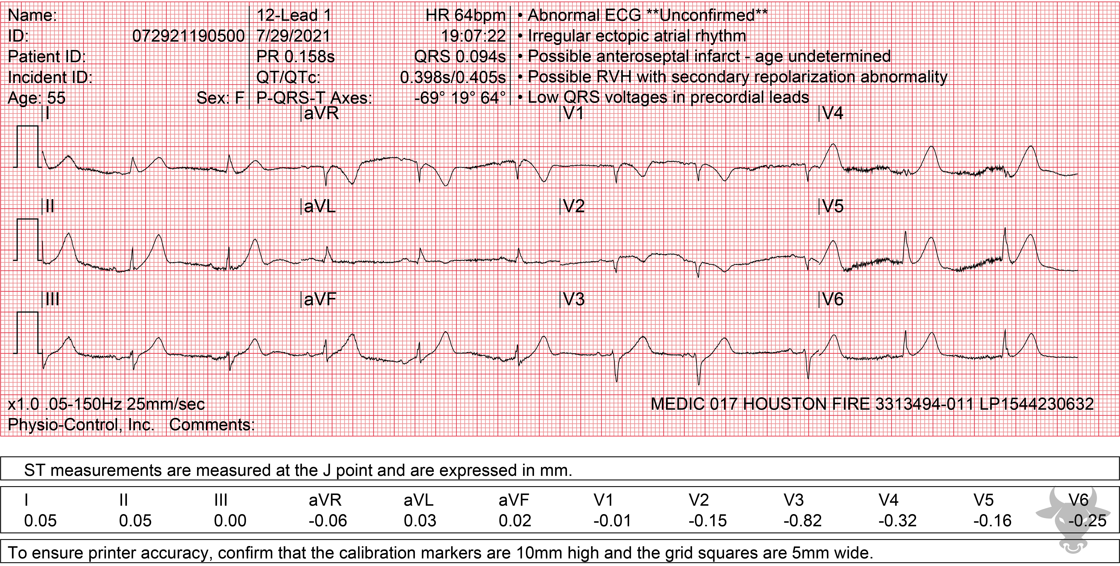
Notes:
Hyperacute T Waves.
Hyperacute T Waves, ST-elevation Myocardial Infarction. The presence of large T waves in the inferolateral leads (II, III, aVR, V4, V5, V6), especially in proportion to their corresponding QRS complexes, suggests that they are hyperacute – an early finding of coronary occlusion. Left heart catheterization revealed a mid-left anterior descending artery occlusion.

Slide 6
77-year-old male presents with syncope
88

Slide 7
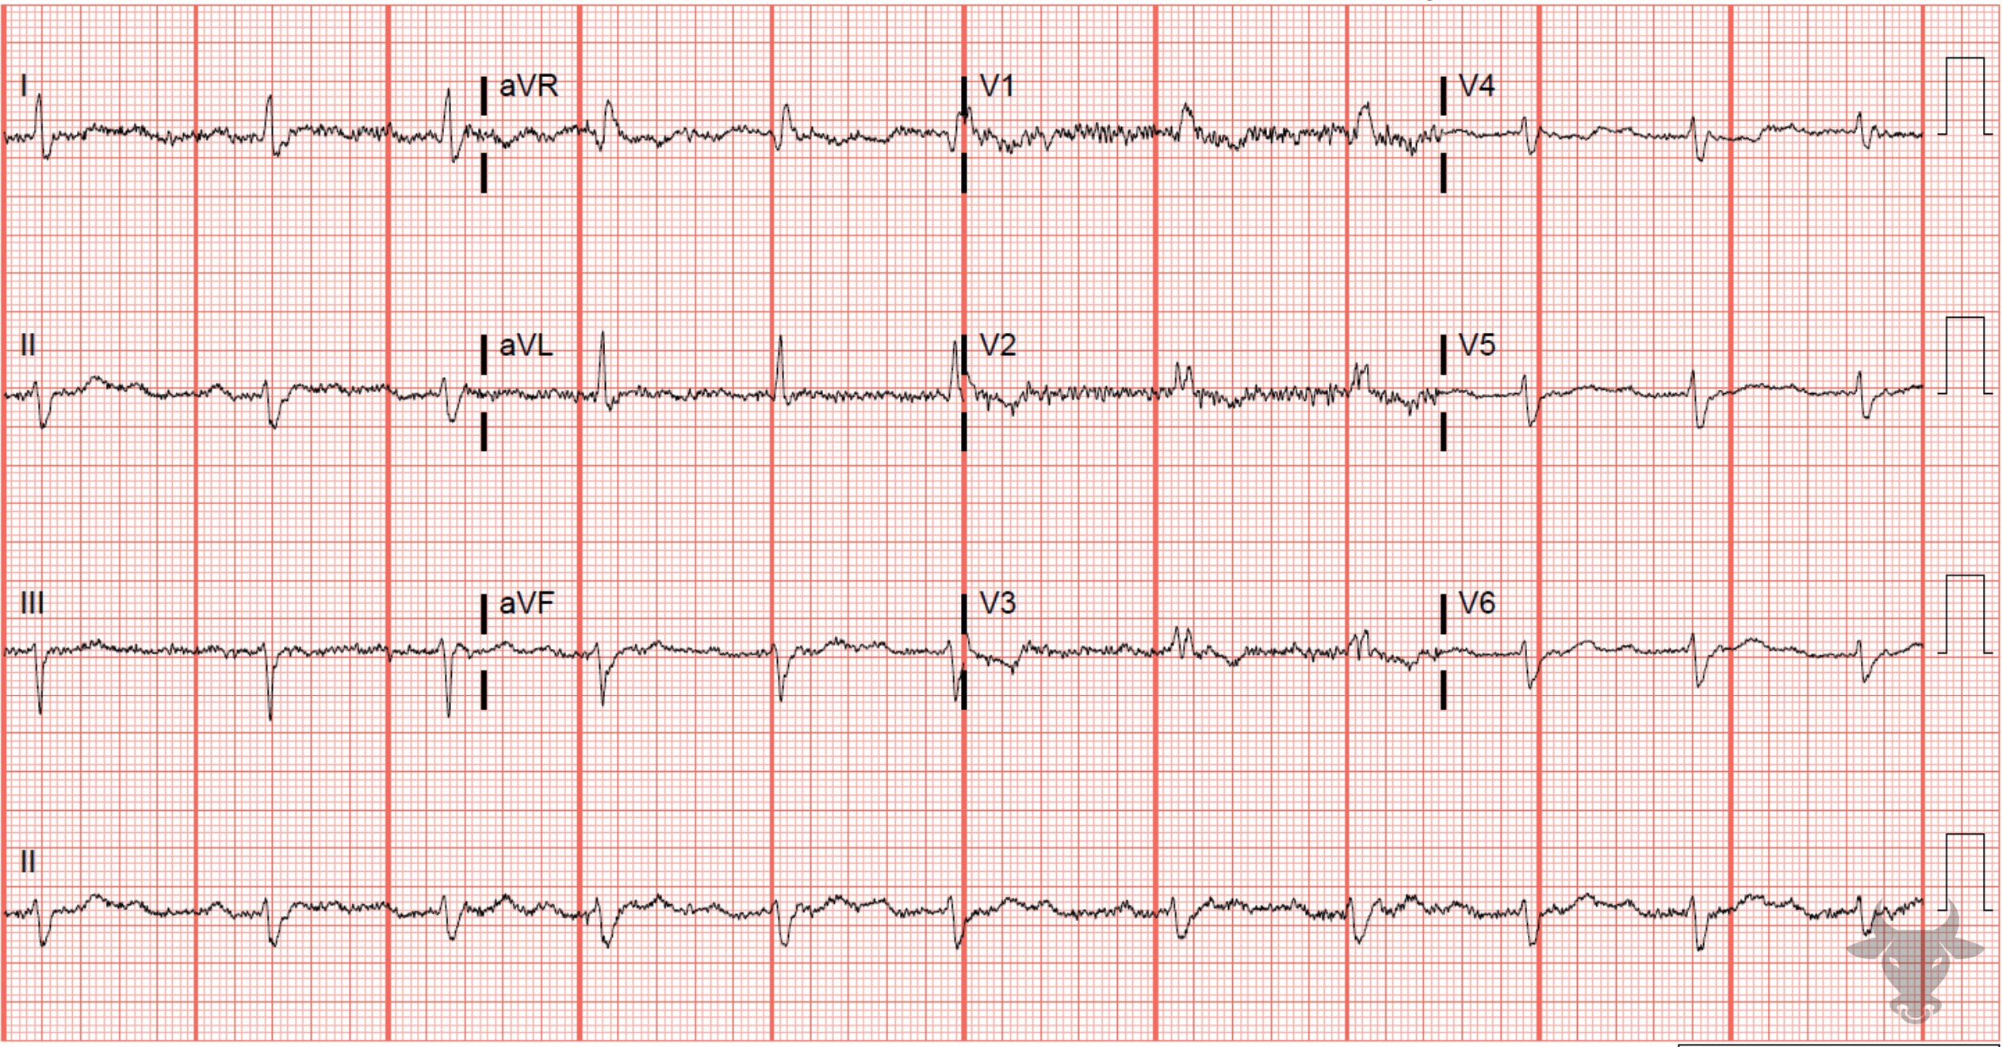
Notes:
Second Degree Atrioventricular Block - Mobitz II.
Second Degree Atrioventricular Block - Mobitz II. Second degree atrioventricular block Mobitz II is characterized by intermittently blocked P waves and constant PR intervals (Figure 36); the block is usually infranodal (as previously described in case 77). The presence of a right bundle branch and left anterior fascicular blocks indicates severe infranodal conduction disease (see case 3).

Slide 8
63-year-old male presents with chest pain
89

Slide 9
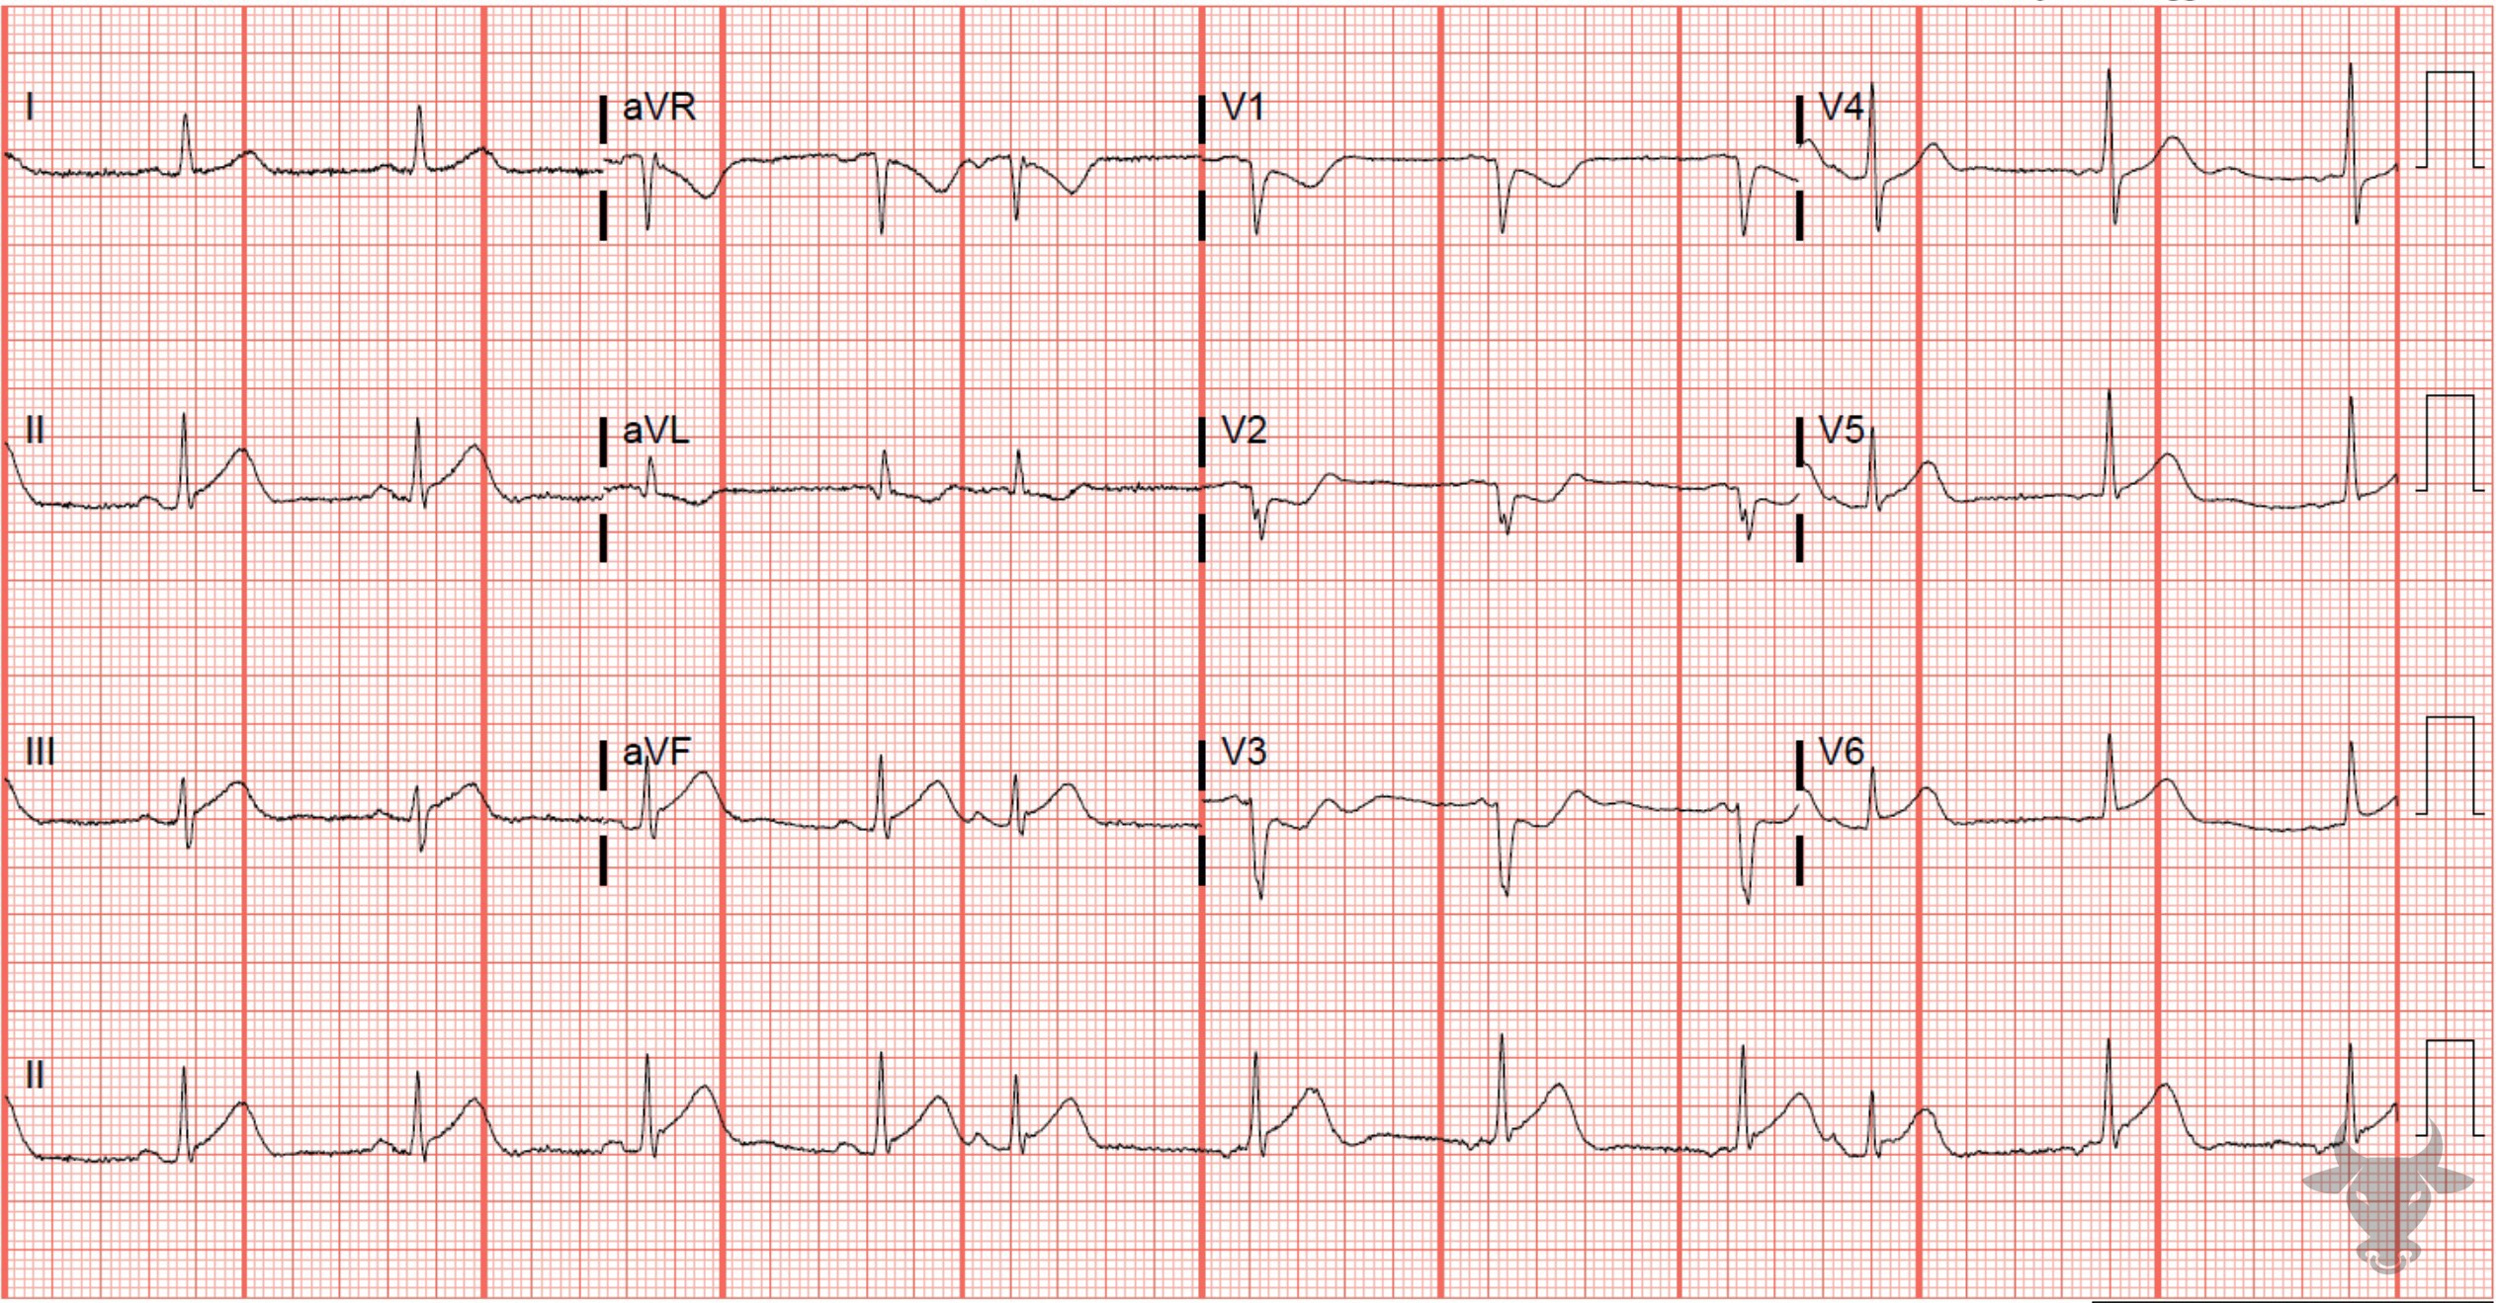
Notes:
Inferior ST-elevation Myocardial Infarction.
Inferior ST-elevation Myocardial Infarction. Subtle inferior ST-segment elevation with reciprocal ST-segment depression in V1 through V3. Note the change in P wave axis indicating the presence of a competing ectopic atrial pacemaker. Left heart catheterization revealed a mid-left circumflex occlusion.

Slide 10
87-year-old male presents with chest pain and dyspnea
90

Slide 11
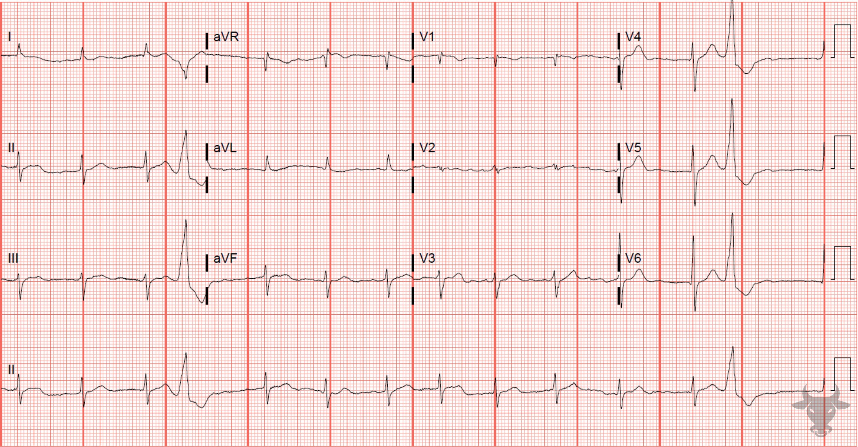
Notes:
Atrial Fibrillation.
Atrial Fibrillation, Ashman Phenomenon. There are two aberrantly conducted beats with wide QRS complexes and unifocal morphology. In both instances, a long R-R interval is followed by a relatively short R-R interval, which is then terminated by an aberrant beat. Ashman phenomenon is aberrant conduction when a short cycle is preceded by a longer one (Figure 37). This occurs because the refractory period of the His-Purkinje system is proportional to the length of the preceding R-R interval, so longer R-R intervals result in longer refractory periods and vice versa. Typically, the aberrant beat will have a right bundle branch block pattern because the right bundle has a longer refractory period than the left.

Slide 12
58-year-old male presents with dizziness
91

Slide 13
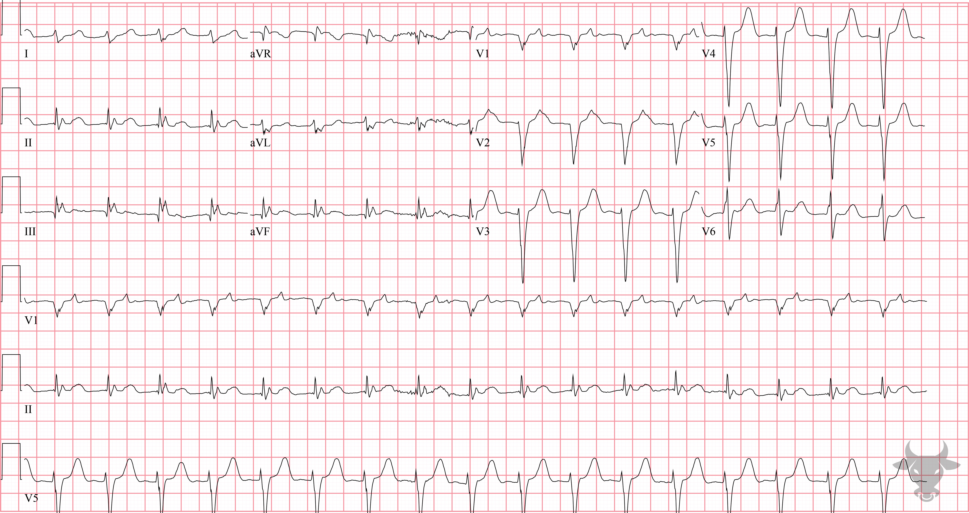
Notes:
Ventricular Tachycardia.
Ventricular Tachycardia. The R-S time is greater than 100 ms strongly favors ventricular tachycardia (Figure 38).

