Slide 1

Conference 17
ECG STAMPEDE

Slide 2
79-year-old male presents with left shoulder pain
80

Slide 3
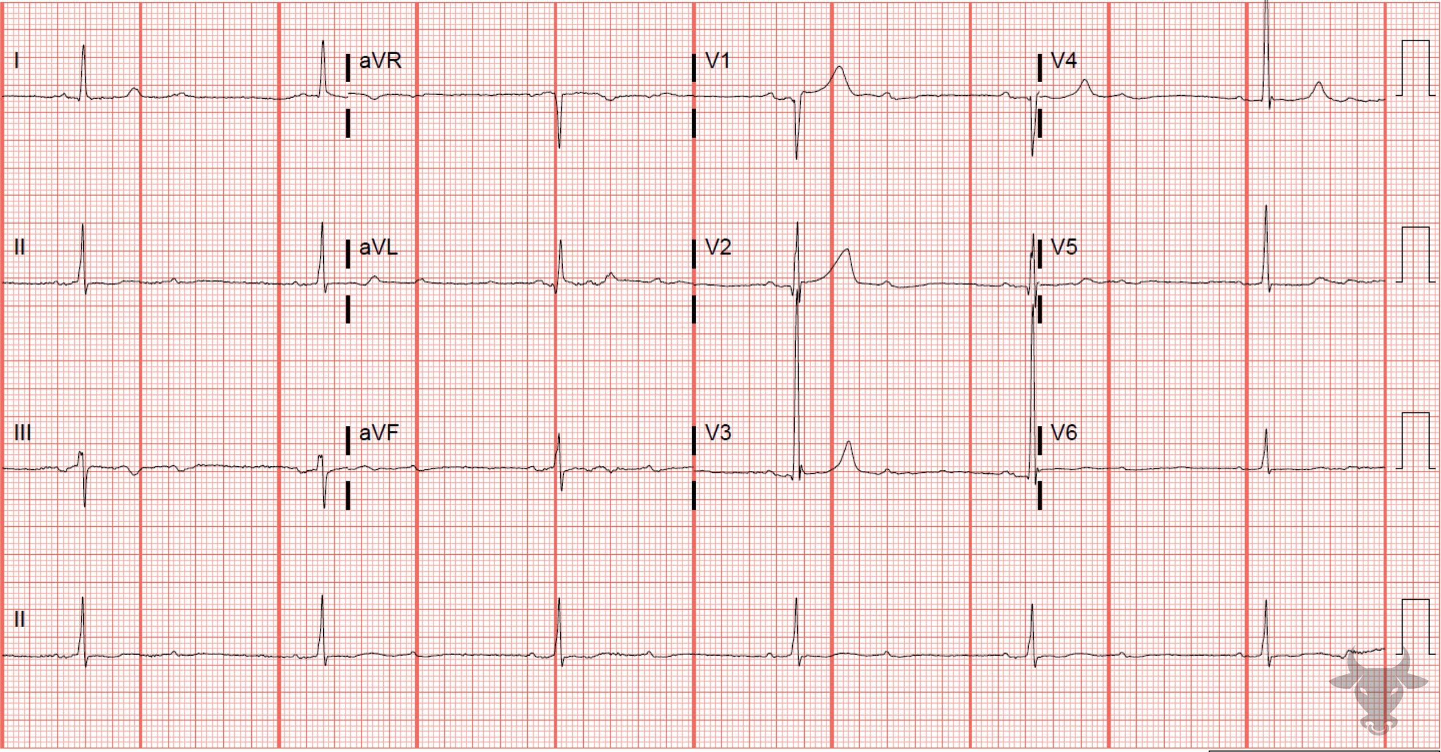
Notes:
Second Degree Atrioventricular Block - Mobitz I.
Second Degree Atrioventricular Block - Mobitz I. The initial ECG is second degree atrioventricular block with 2:1 conduction. On the repeat ECG, conduction is 2:1 at times, but there are two series (one near the beginning and the other near the end) of 3:2 conduction, confirming Mobitz I conduction (Figure 33).
Mobitz I conduction occurs when conduction is progressively delayed through the atrioventricular node and eventually fails. It is represented by progressively prolonging PR intervals followed by a “dropped” P wave. It does not always represent pathology, particularly when seen in younger or physically fit individuals with high vagal tone.

Slide 4
65-year-old male presents with altered mental status
81

Slide 5
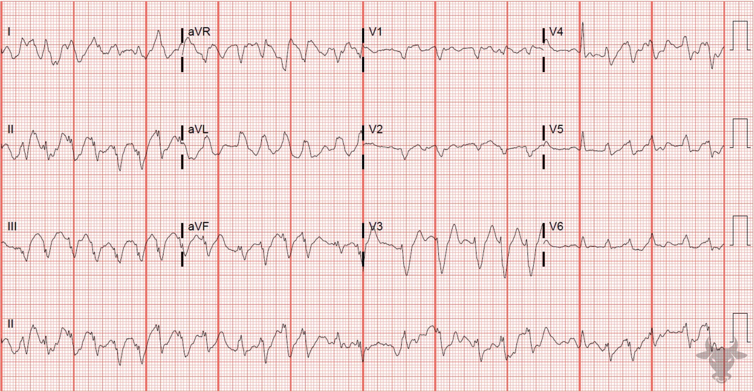
Notes:
Left Bundle Branch Block.
Left Bundle Branch Block, Atrial Fibrillation. This rhythm is irregularly irregular and the QRS is wide with left bundle branch block morphology (i.e., deep S wave in V1 and broad R wave in V6, see case 49 for further explanation of left bundle branch block morphology). The left bundle branch block was rate-dependent and resolved after rate control. In most cases, rate-related bundle branch blocks occur due to a prolonged refractory period of a diseased bundle. When a critical heart rate is exceeded, the diseased bundle fails. Rate-related bundle branch blocks can be especially challenging to diagnose when the rate is regular and fast, creating a regular, wide complex tachycardia that appears like ventricular tachycardia.

Slide 6
39-year-old female presents with abdominal pain
82

Slide 7
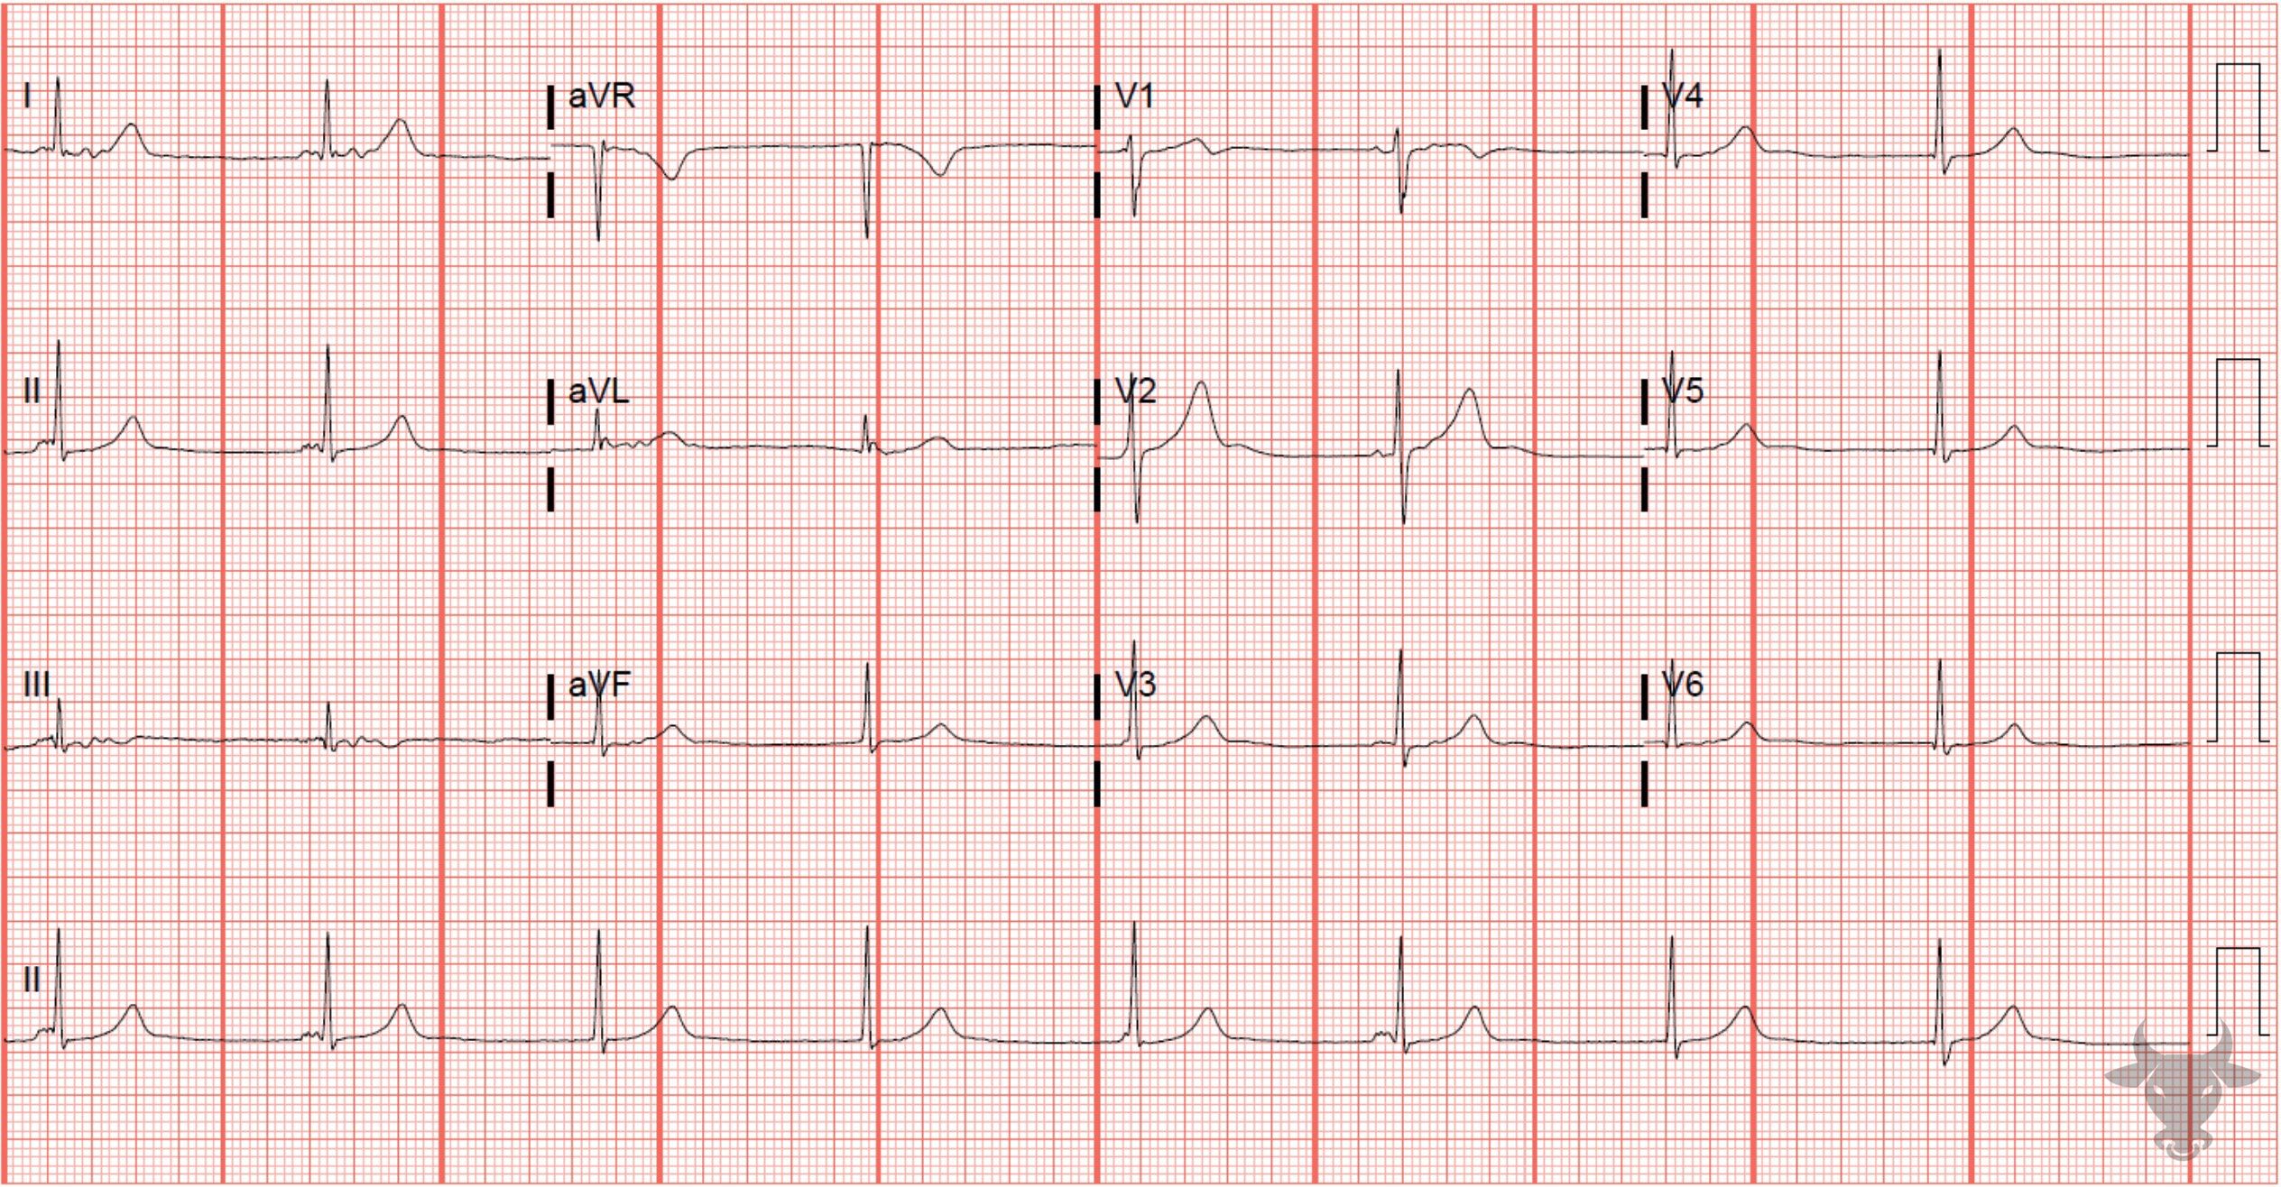
Notes:
Atrioventricular Dissociation.
Atrioventricular Dissociation, Junctional Bradycardia. This ECG shows atrioventricular dissociation, a condition in which the atria and ventricles act independently. The P waves appear to be sinus in origin, variable in rate, and non-conducted. There are presumably more P waves buried within the QRST complexes, and, therefore, unable to be visualized on this surface ECG (Figure 34). There is junctional bradycardia with a ventricular rate of 48 beats per minute.
When a superior pacemaker fails to generate impulses at a rate faster than an inferior one, then the faster, more inferior, one will “escape.” In this case, the sinus node failed to generate a rate that outpaced the junction, which led to a junctional escape rhythm and atrioventricular dissociation.

Slide 8
47-year-old male presents with dizziness
83

Slide 9
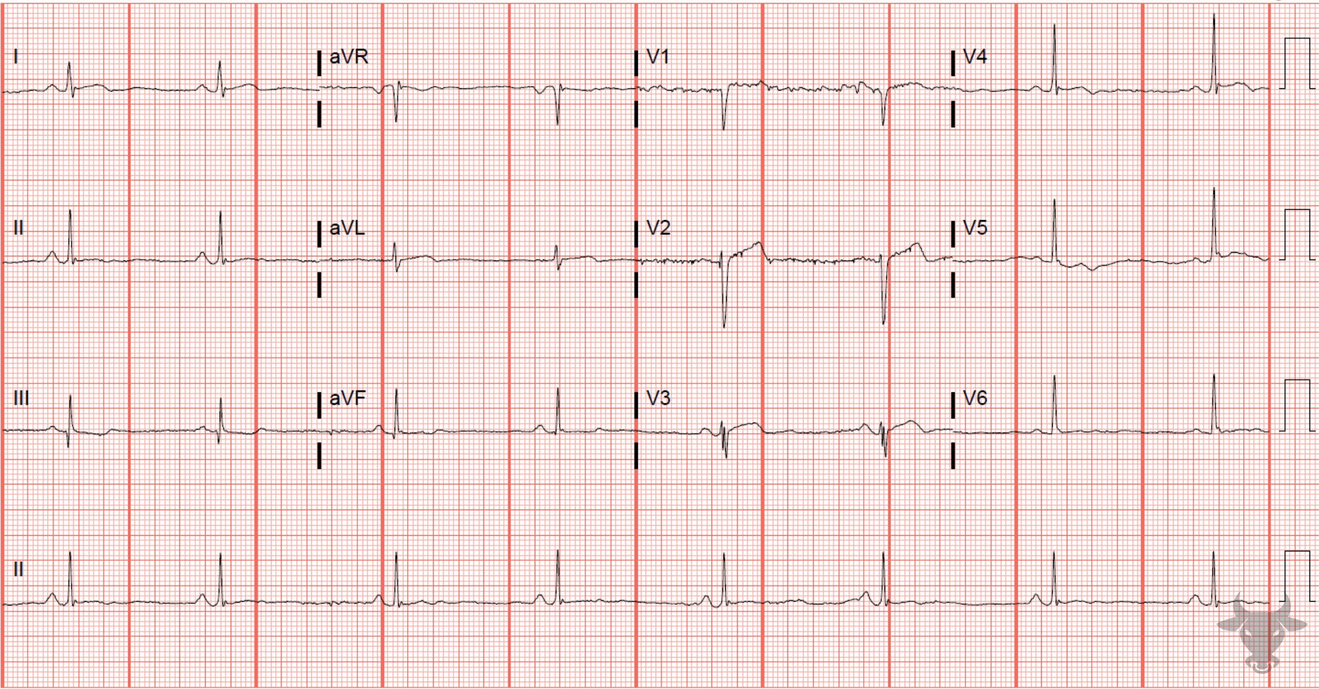
Notes:
Sinus Bradycardia.
Sinus Bradycardia. When the atrial wave of depolarization originates in the sinoatrial node (as is normal), the atria depolarize from superior to inferior, creating an upright P wave in the inferior leads. The sinoatrial node can depolarize more slowly than usual when the person is a well-conditioned athlete, as a normal variant, due to increased vagal tone, or from the use of beta-blocking or calcium-channel blocking agents. The rate of 48 beats per minute is unlikely to be hemodynamically significant.

Slide 10
50-year-old male presents with chest pain
84

Slide 11
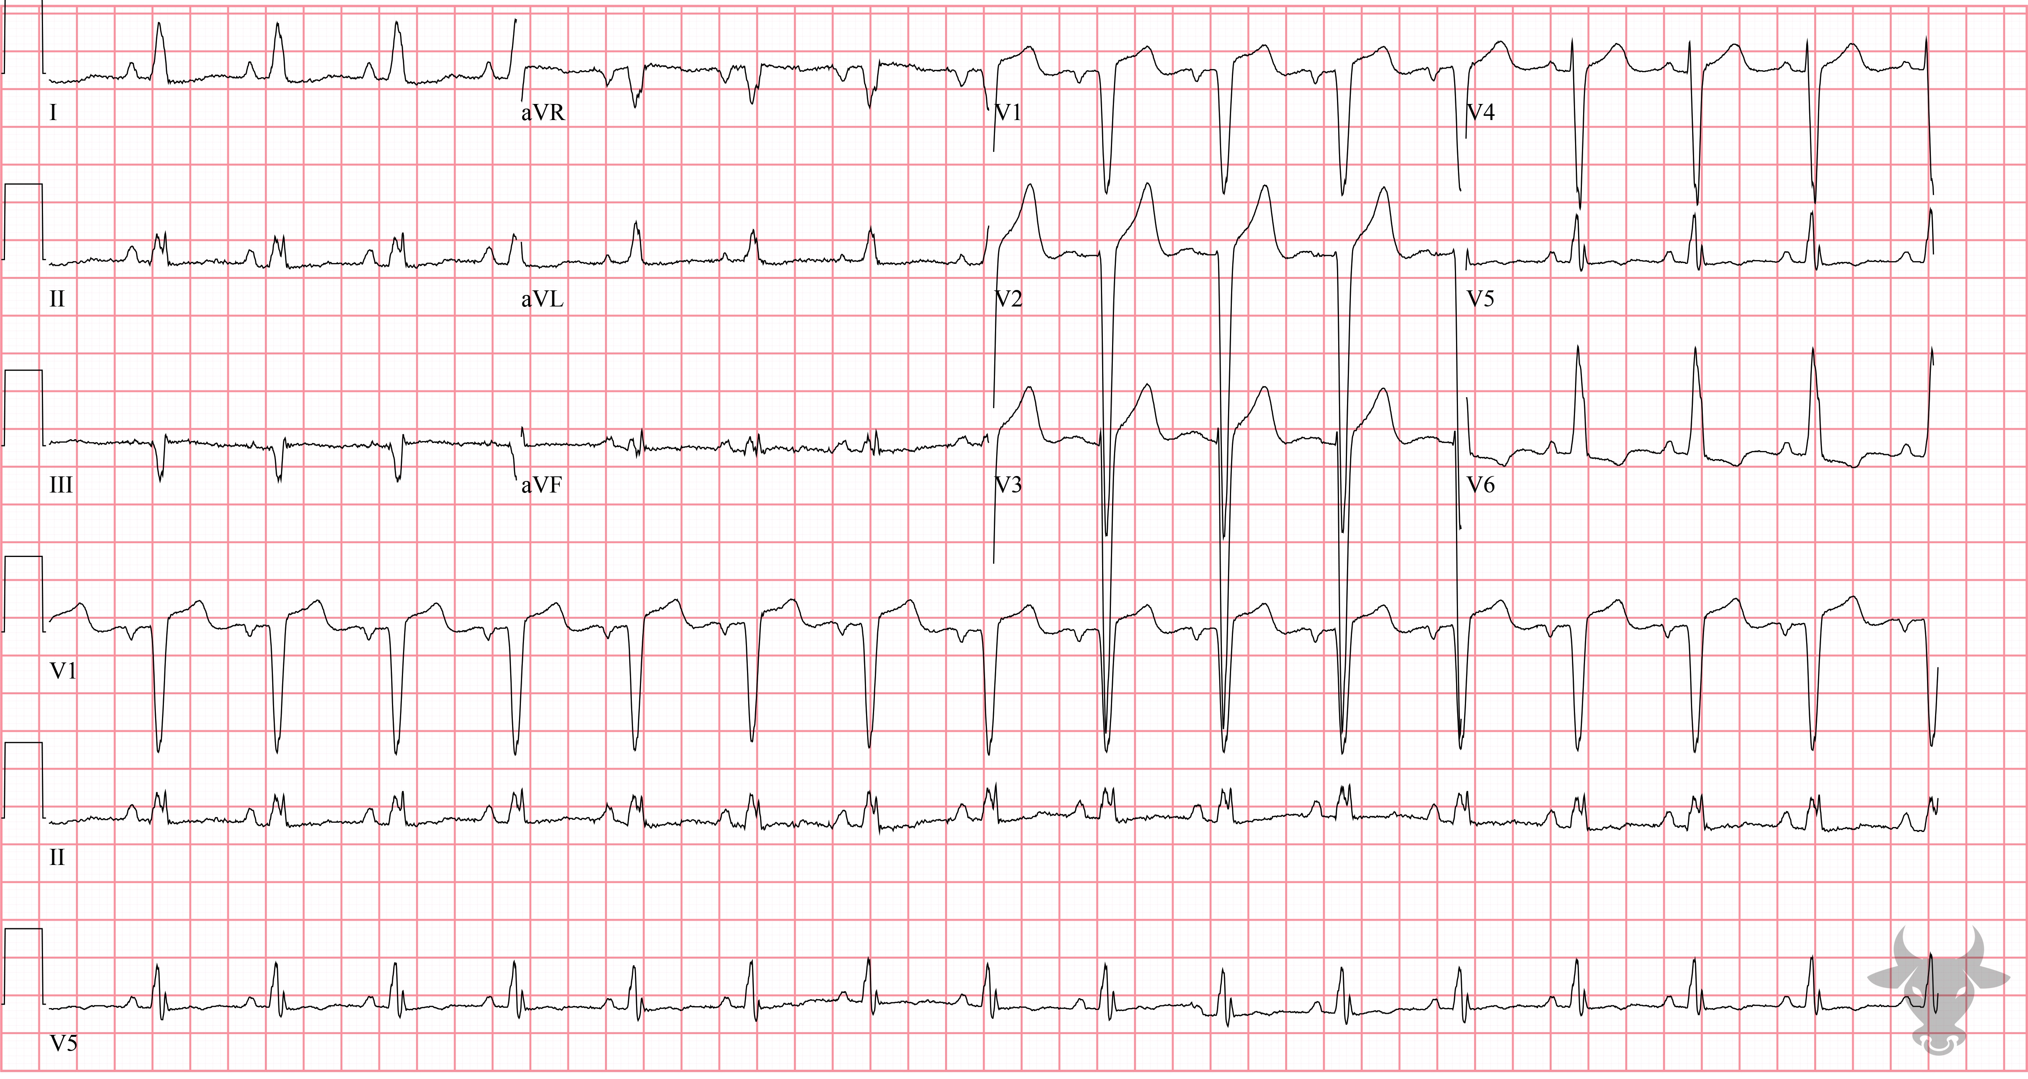
Notes:
Left Ventricular Hypertrophy.
Left Ventricular Hypertrophy, T-wave Inversions. Classic findings of left ventricular hypertrophy include large amplitude QRS complexes and associated repolarization abnormalities (e.g., asymmetric T-wave inversion in V6). The most cited criteria for diagnosing left ventricular hypertrophy are the Sokolow-Lyon and the Cornell criteria:
Sokolow-Lyon Criteria: SV1 + RV5,6 > 35 mm OR RaVL > 11 mm
Cornell Criteria: RaVL + SV3 > 28 mm for men OR > 20 mm for women

Slide 12
False Positive Activation
Left Ventricular Hypertrophy
McCabe JM, Armstrong EJ, Kulkarni A, et al. Prevalence and factors associated with false-positive ST-segment elevation myocardial infarction diagnoses at primary percutaneous coronary intervention–capable centers: a report from the Activate-SF registry. Arch Intern Med. 2012;172(11):864-871.

Slide 13
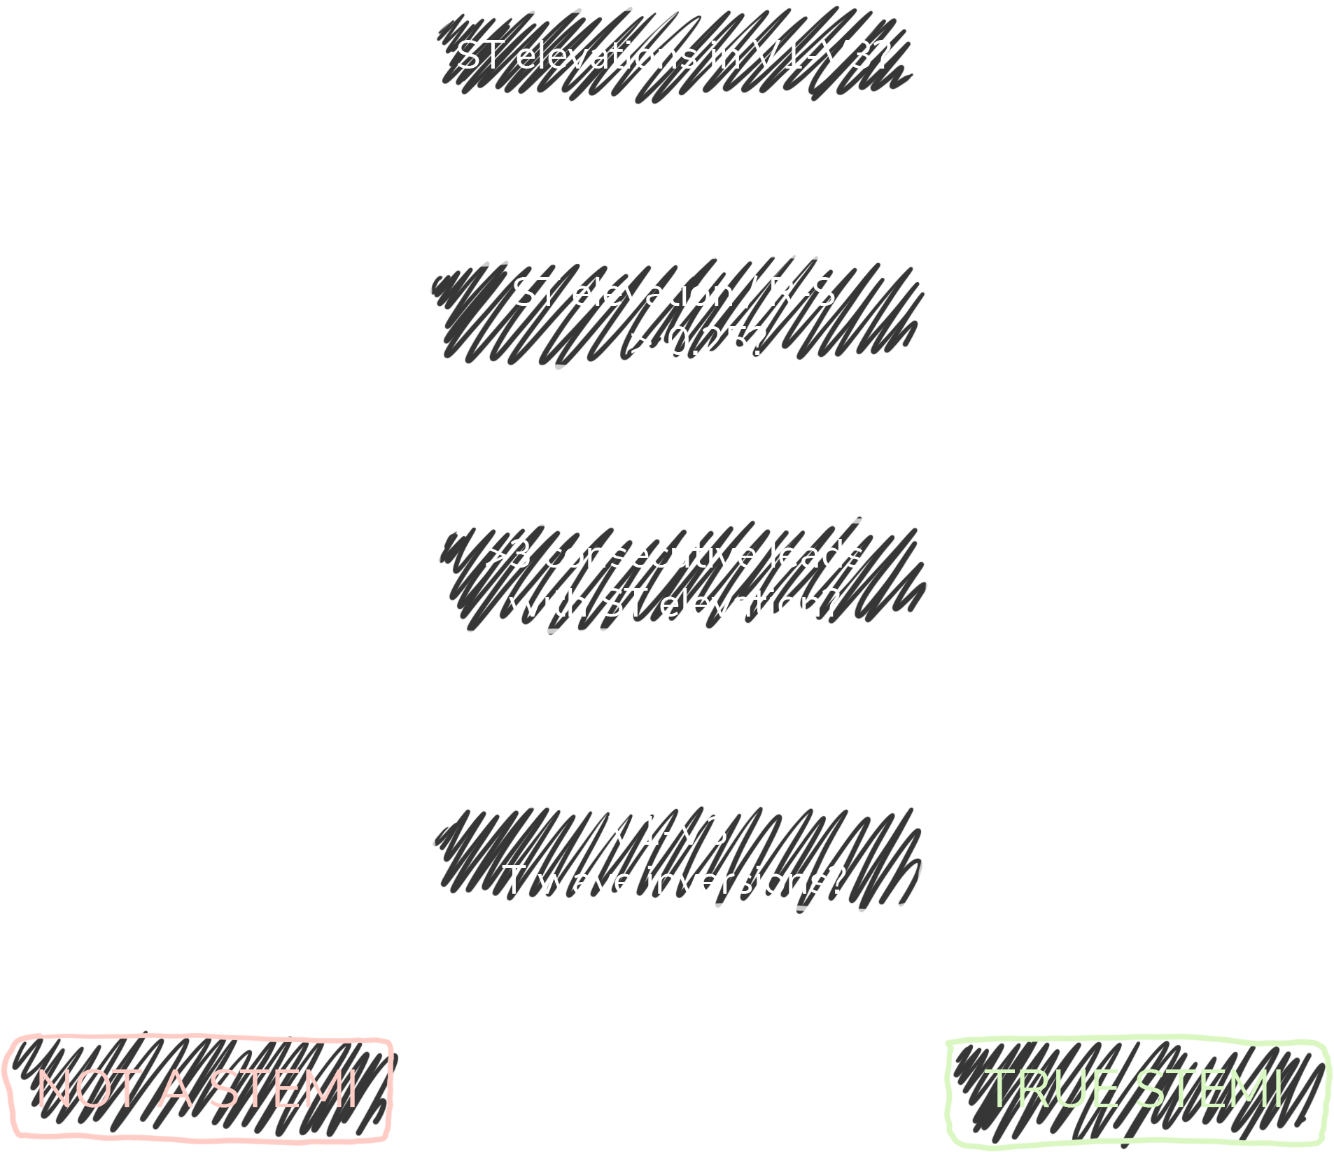
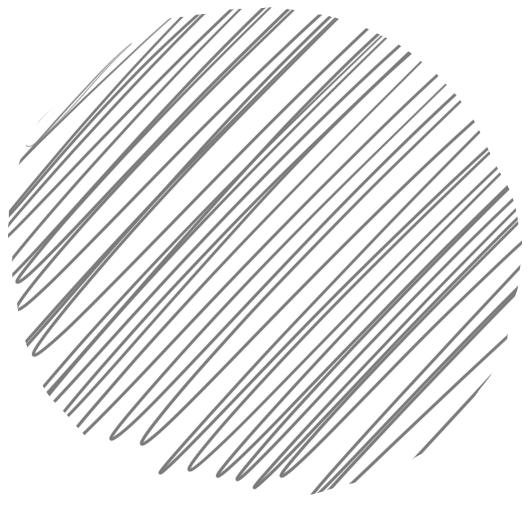
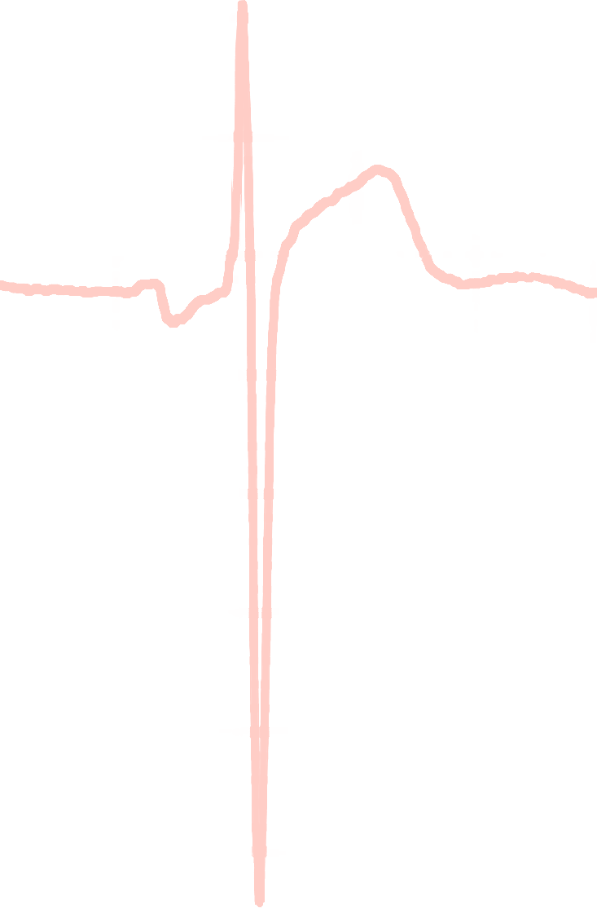
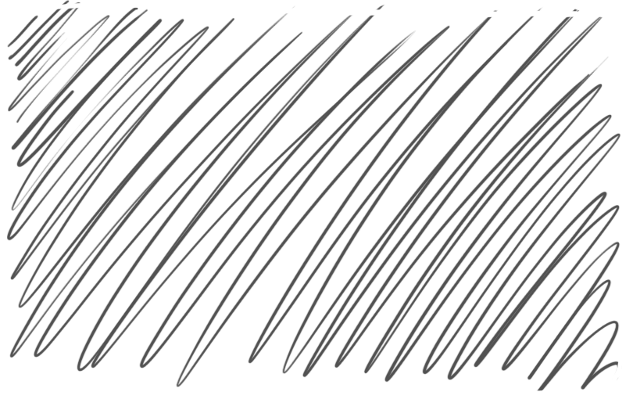
Armstrong Algorithm for STE in LVH
V1-V3
91%
Specificity
STE
R-S
STE/R-S
> 0.25?
77%
Sensitivity
Armstrong EJ, Kulkarni AR, Bhave PD, et al. Electrocardiographic criteria for ST-elevation myocardial infarction in patients with left ventricular hypertrophy. Am J Cardiol. 2012;110(7):977-983.
Notes:
Sensitivity 77%
Specificity 91%

Slide 14
83-year-old female presents with confusion
85

Slide 15
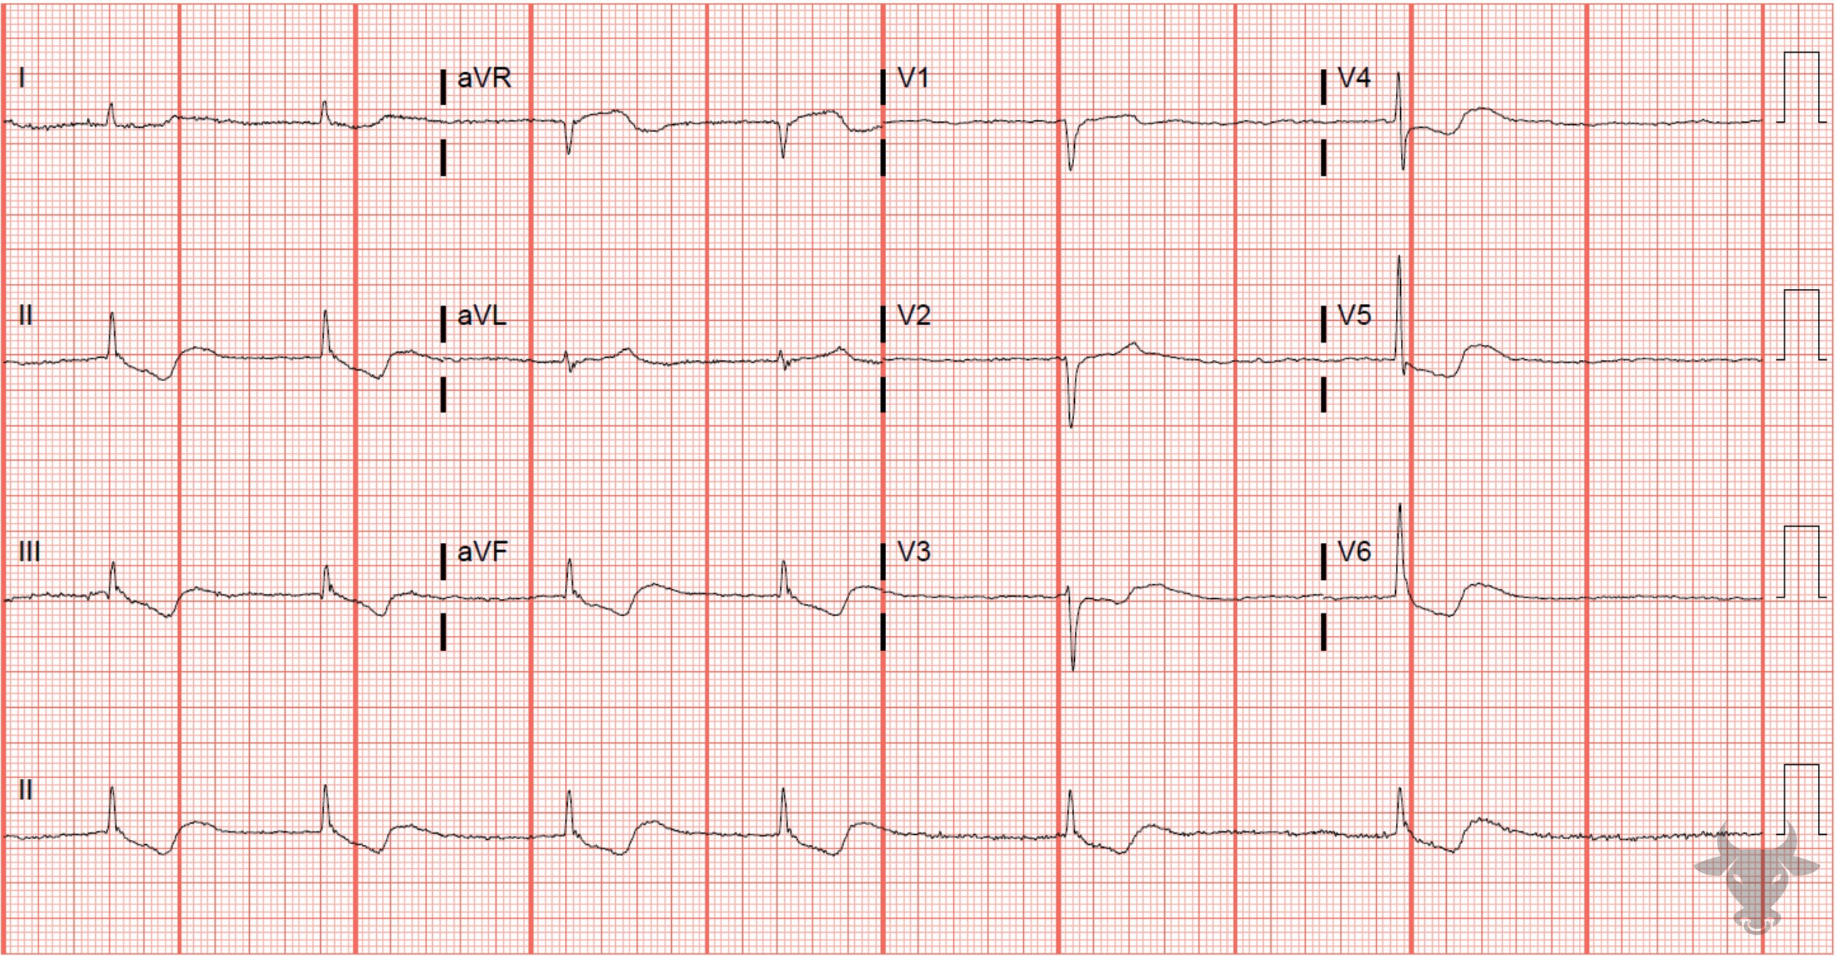
Notes:
Atrial Fibrillation.
Atrial Fibrillation, Digoxin Toxicity. Differential considerations for slow atrial fibrillation include drug toxicity (e.g., atrioventricular nodal blocking agents like digoxin, beta blockers, or non-dihydropyridine calcium channel blockers), hypothermia, hypothyroidism, hyperkalemia, or conduction block. Digoxin slows conduction through the atrioventricular node and increases automaticity. Note the "scooped" ST-segments typical of the digoxin-effect (Figure 35).

