Slide 1

Conference 16
ECG STAMPEDE

Slide 2
70-year-old male presents with altered mental status
74

Slide 3
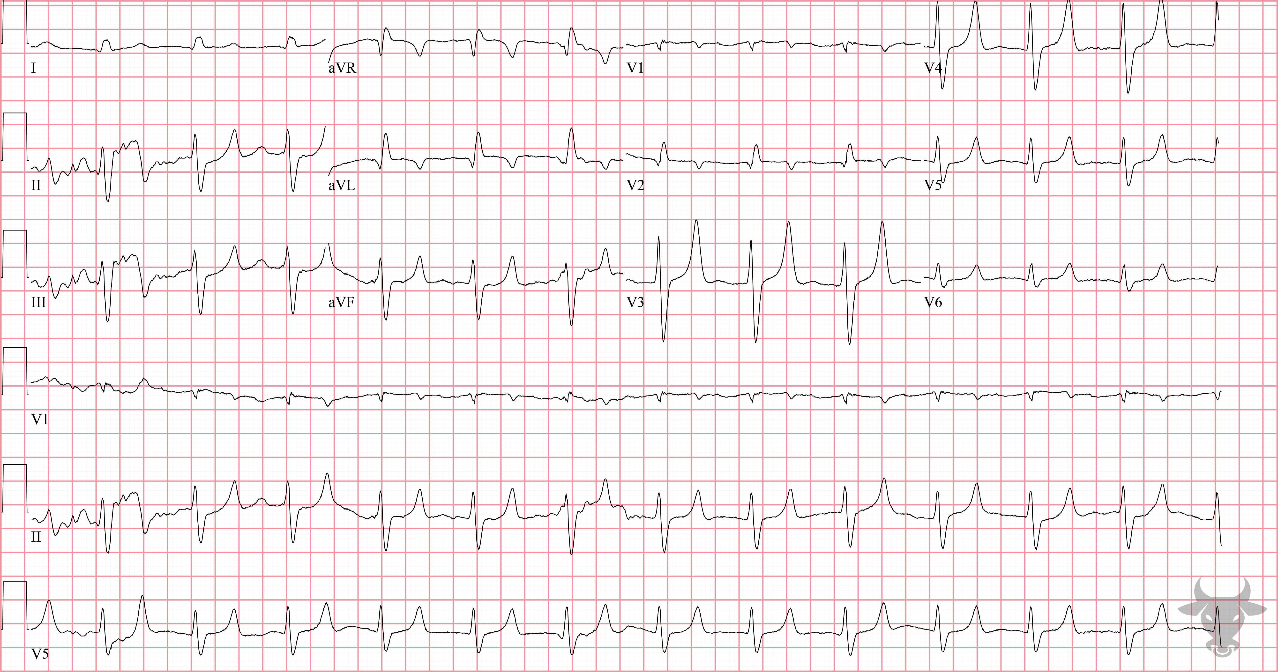

Notes:
Hyperkalemia.
Hyperkalemia. Electrocardiographic findings of hyperkalemia tend to follow a progression as toxicity progresses. Often, the earliest finding is narrow-based, peaked T waves. Additional features of hyperkalemia seen on this ECG include a widened QRS and flat, or absent, P waves (Figure 30).

Slide 4
30-year-old male presents with altered mental status
75

Slide 5
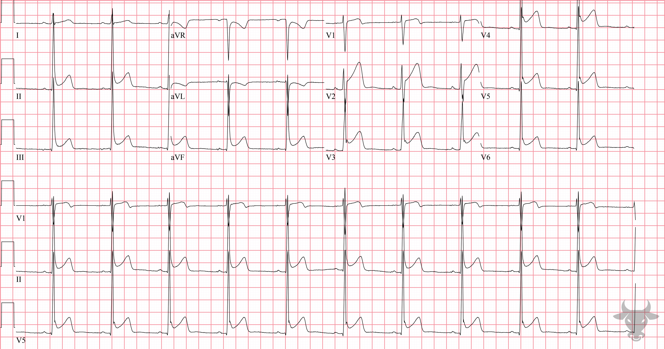
Notes:
Early Repolarization.
Early Repolarization. Early repolarization is considered a normal variant in young men. It is characterized by concave ST-segment elevation, usually greatest in the precordial leads, and J wave notching. This ECG is classic for early repolarization with J wave notching and diffuse ST-segment elevation (Figure 31). Early repolarization is generally considered benign and requires no follow up.

Slide 6
74-year-old male presents with altered mental status
76

Slide 7
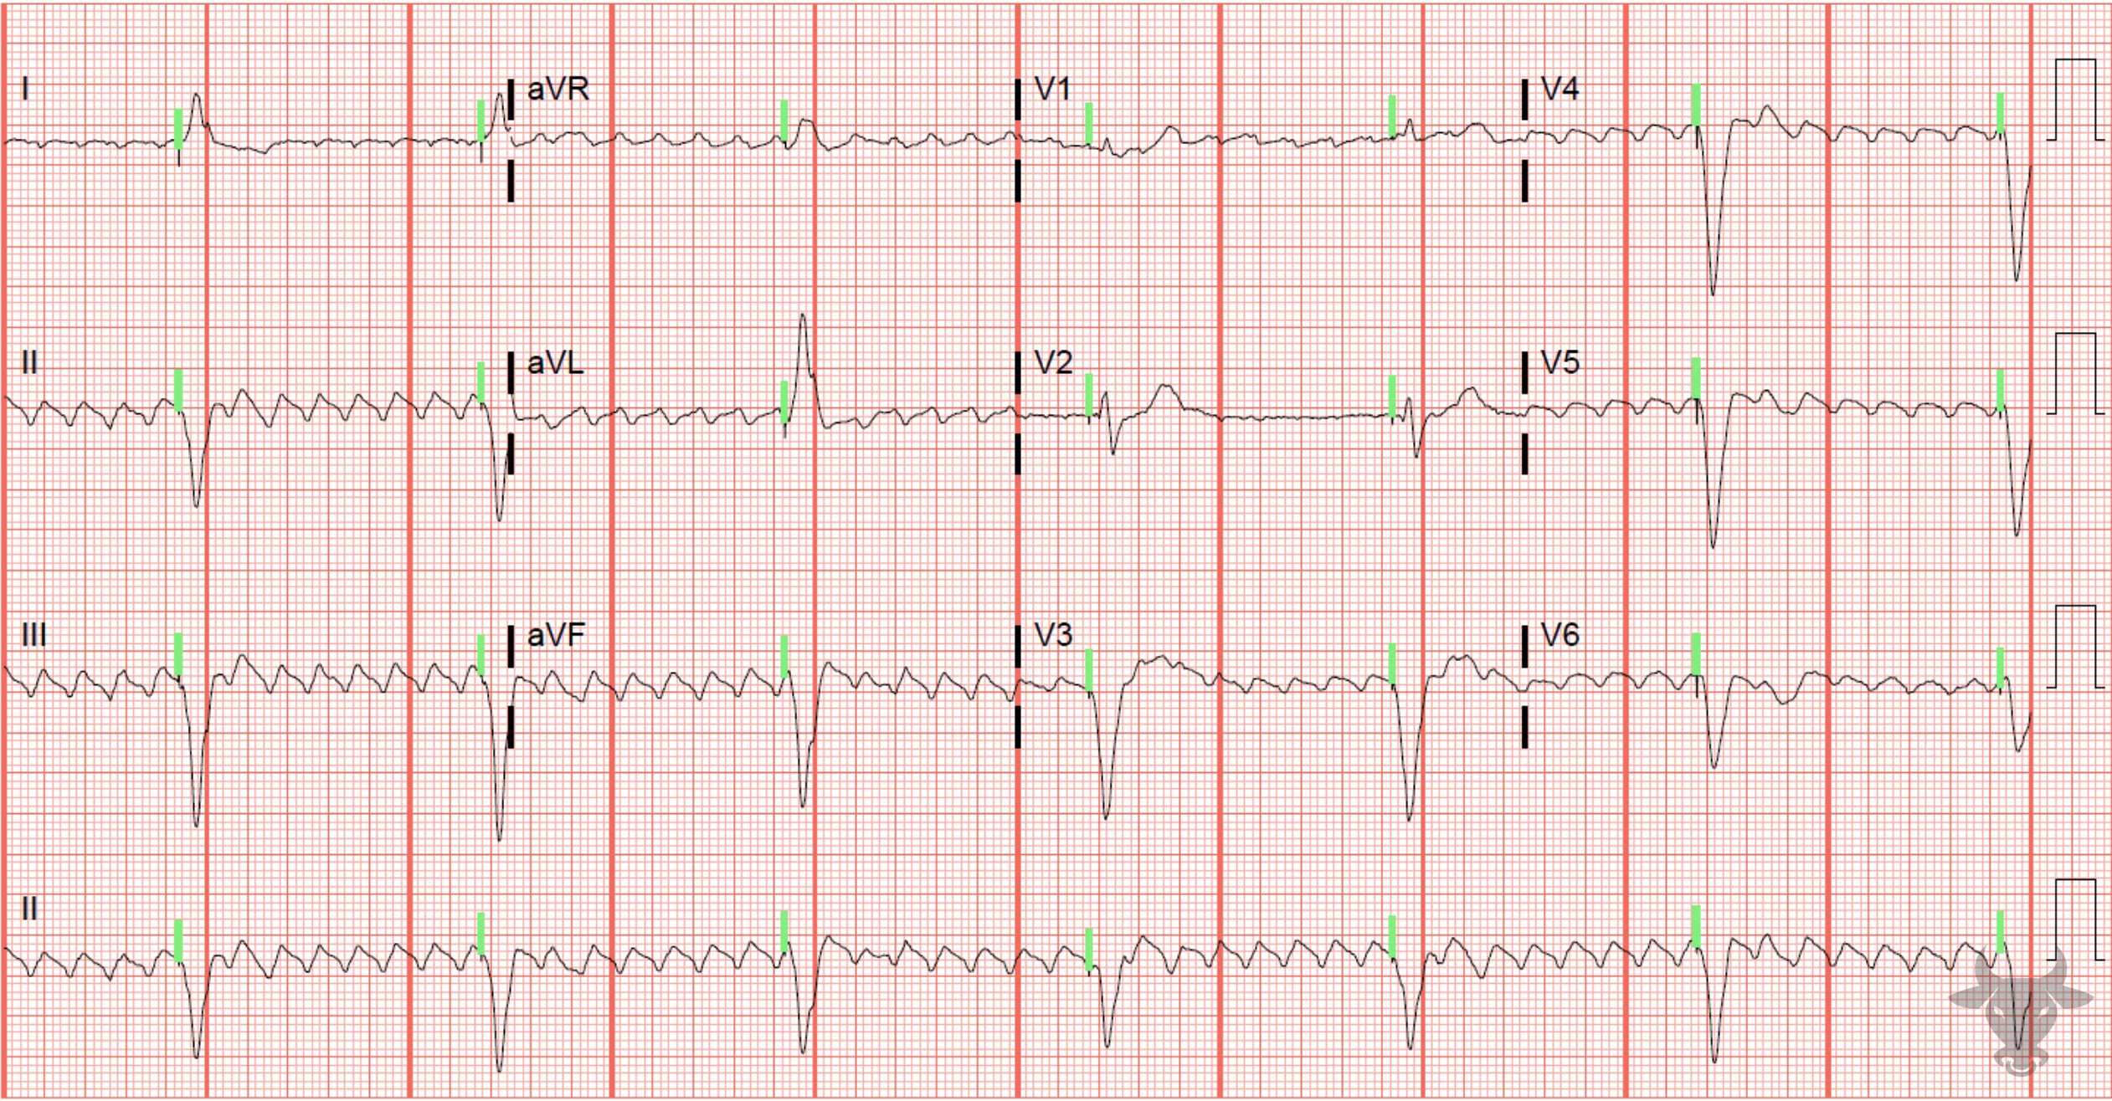
Notes:
Paced Rhythm, Atrial Flutter.
Paced Rhythm, Atrial Flutter. Atrial flutter occurs from a reentrant circuit in the right atrium. It is an organized rhythm that is generally characterized by an atrial rate of approximately 300 beats per minute. It more commonly occurs in a counterclockwise fashion, leading to inverted flutter waves in the inferior leads (II, III, and aVF). This ECG demonstrates atrial flutter without native ventricular conduction and with paced ventricular activity (i.e., the vertical green bars represent pacing spikes). The pacemaker threshold was set to 40 beats per minute and was later increased to 60 beats per minute.

Slide 8
83-year-old female presents with dizziness
77

Slide 9
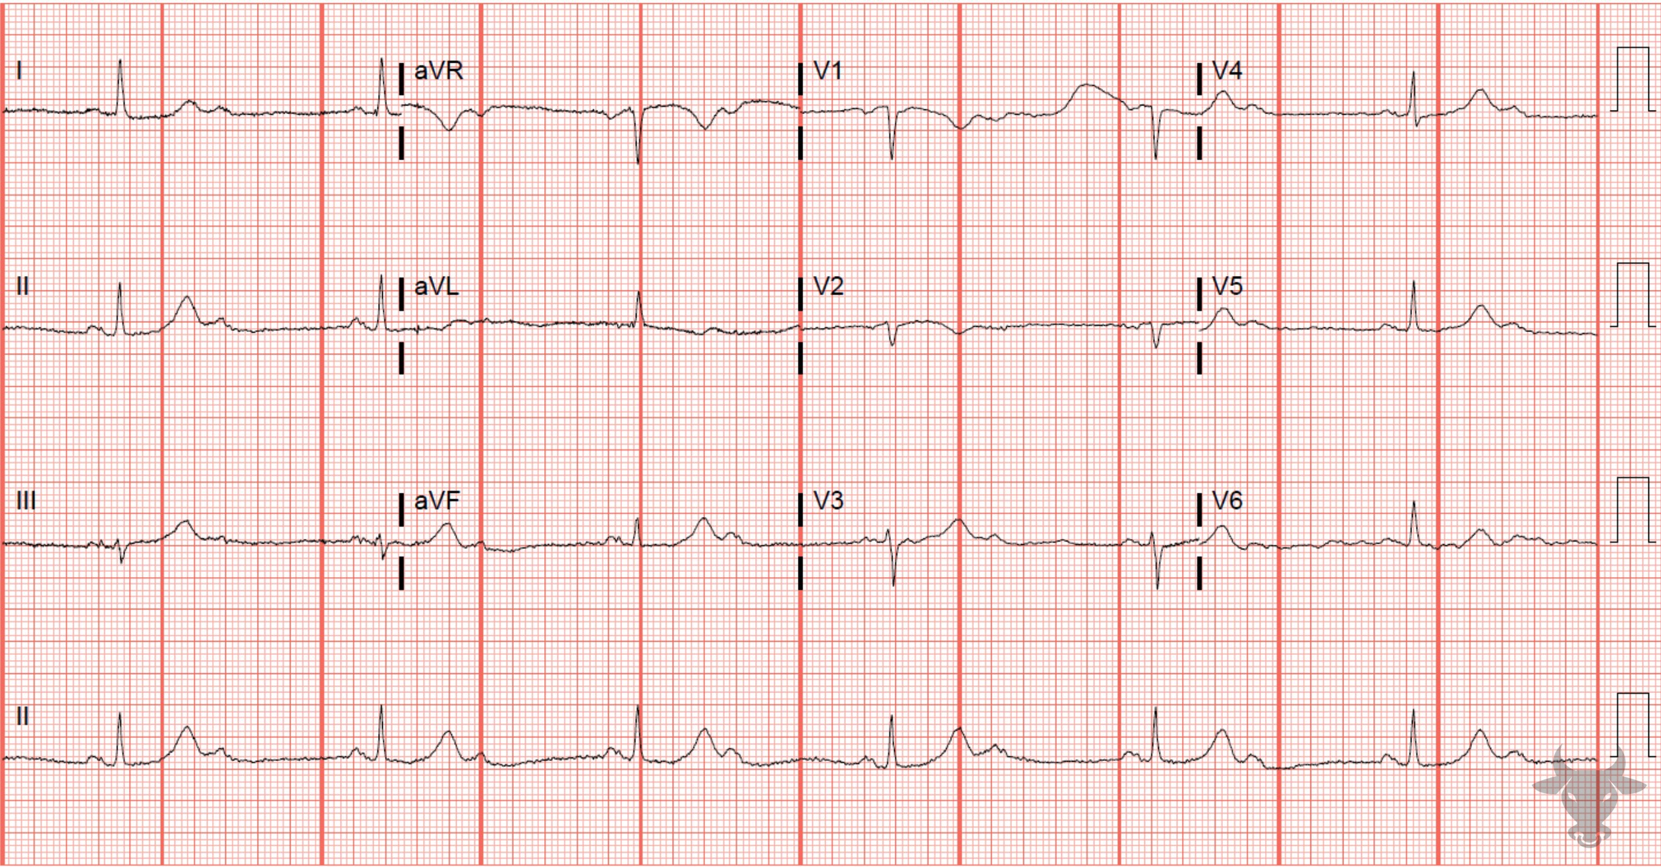
Notes:
Second Degree Atrioventricular Block with 2:1 Conduction.
Second Degree Atrioventricular Block with 2:1 Conduction. P waves are conducted in a 2:1 ratio, with every other P wave “dropped”, or failing to conduct through the atrioventricular (AV) node. When P waves are conducted but intermittently “dropped,” it is referred to as second degree atrioventricular block, which comes in two varieties - Mobitz I (or Wenckebach) and Mobitz II. Mobitz I occurs when conduction is progressively delayed through the atrioventricular node and eventually fails. It is represented by progressively prolonging PR intervals followed by a “dropped” P wave. It does not always represent pathology, particularly when seen in younger or physically fit individuals with high vagal tone. Mobitz II occurs when the infranodal conduction system intermittently fails, resulting in intermittently “dropped” P waves but consistent PR intervals when conducted. Mobitz II usually occurs with preexisting conduction disease (e.g., combination of bundle branch and fascicular blocks), is always pathologic, and more likely to progress to complete heart block. When atrioventricular block occurs in a 2:1 ratio, it is impossible to distinguish between Mobitz I and Mobitz II; therefore, 2:1 atrioventricular block is simply referred to as “second degree atrioventricular block with 2:1 conduction” (Figure 32). When the QRS is narrow, as in this case, Mobitz I is more likely; however, it is prudent to assume the worst scenario (i.e., Mobitz II).

Slide 10
58-year-old female presents with chest pain
78

Slide 11
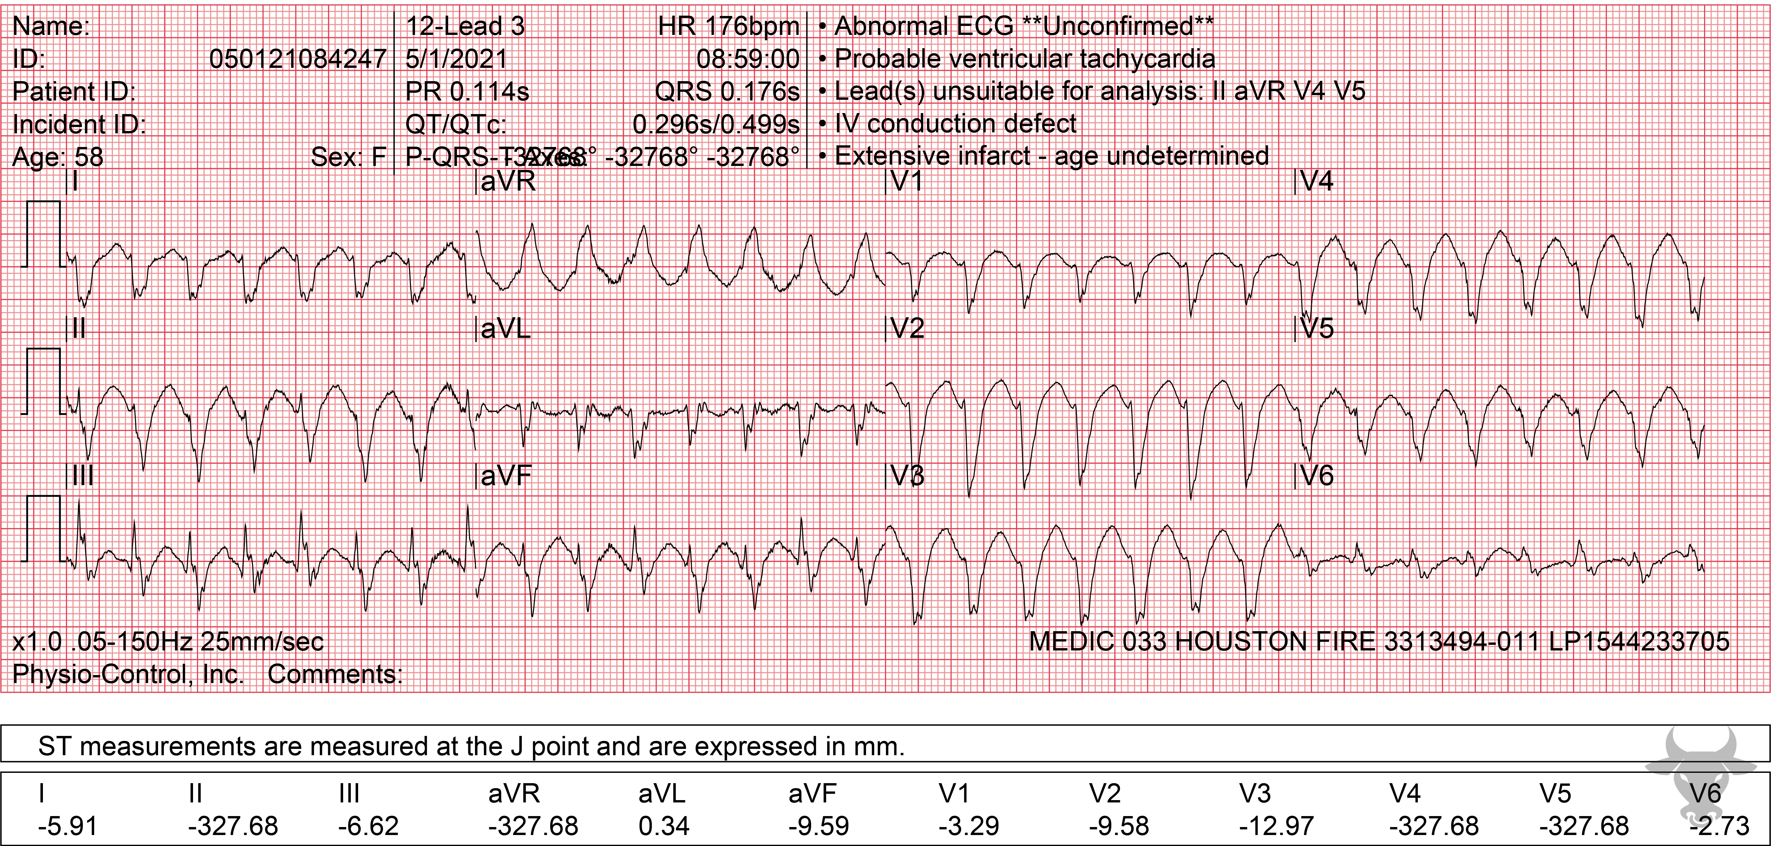
Notes:
Ventricular Tachycardia.
Ventricular Tachycardia. Features that suggest ventricular tachycardia include an extreme right axis, concordance of the QRS complexes across the precordium, and an initial R wave in aVR. There are established algorithms to help differentiate supraventricular tachycardia with aberrancy versus ventricular tachycardia, but none of the established criteria perform well in the acute setting. It is safest to assume a regular wide complex tachycardia is ventricular tachycardia unless there is overwhelming evidence to the contrary.

Slide 12
59-year-old male presents with chest pain
79

Slide 13
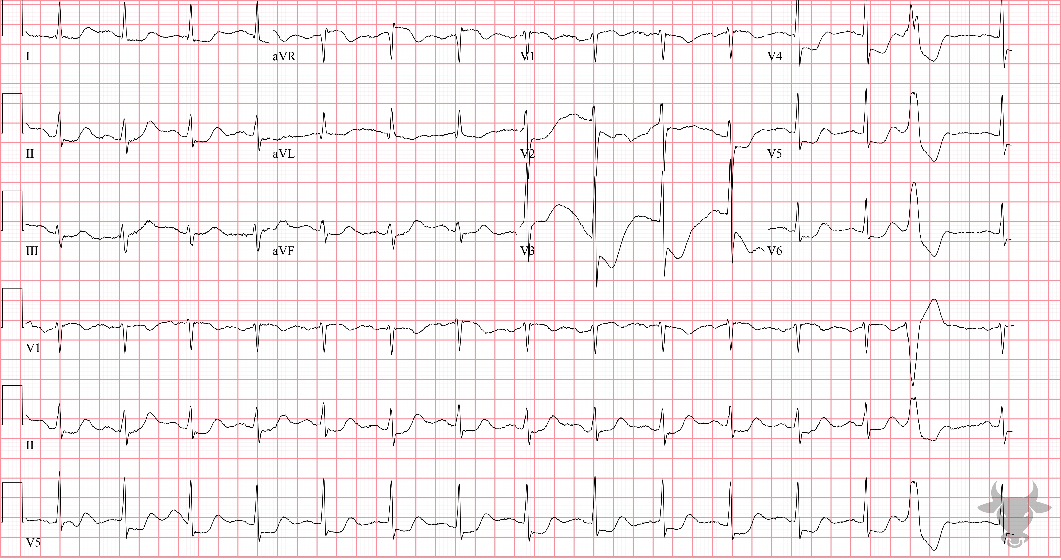
Notes:
Global Subendocardial Ischemia.
Global Subendocardial Ischemia. This patient with multilead ST-segment depressions and ST-segment elevation in aVR had an acute type A aortic dissection. The differential diagnosis for this pattern is broad and was previously described in case 5.

