Slide 1

Conference 15
ECG STAMPEDE

Slide 2
41-year-old male presents with cardiac arrest
68

Slide 3
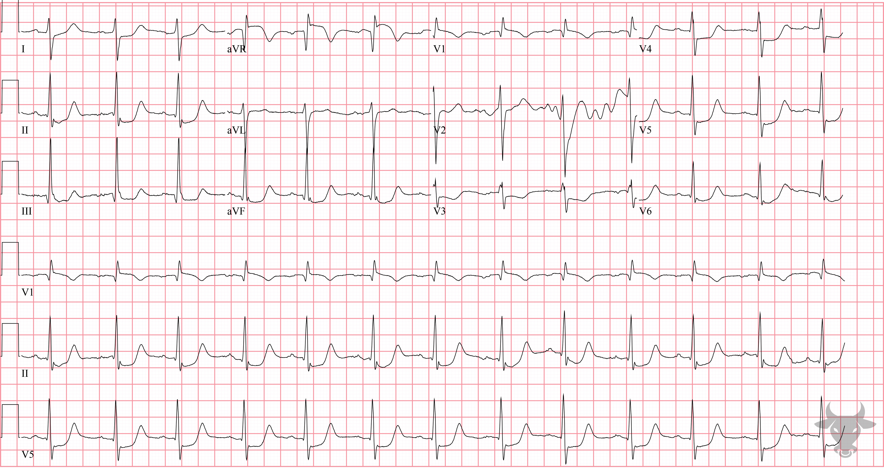

Notes:
Global Subendocardial Ischemia.
Global Subendocardial Ischemia. Remember to keep a broad differential with this pattern of multilead ST-segment depression and ST-segment elevation in aVR, as any pathology that creates a supply/demand mismatch can cause it (as previously described in case 5). In this case, the pattern was the result of cardiac arrest.

Slide 4
31-year-old male presents with chest pain
69

Slide 5
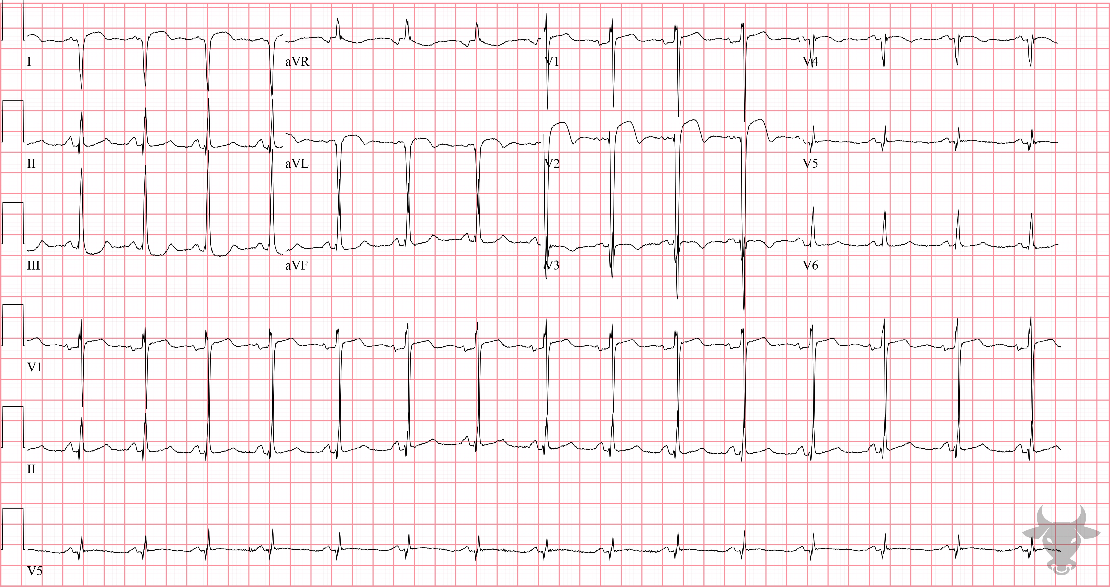
Notes:
Left Ventricular Aneurysm.
Left Ventricular Aneurysm. The usual ECG findings of left ventricular aneurysm include ST elevation that persists more than two weeks after myocardial infarction, deep Q waves, and the absence of reciprocal ST depressions. In the age of reperfusion, left ventricular aneurysms have become quite rare, but in the absence of reperfusion, it is a common structural complication of anterior myocardial infarctions. The convex ST-elevation in V2 was consistent with prior ECGs.

Slide 6
0-year-old female presents with cough, vomiting, diarrhea
70

Slide 7
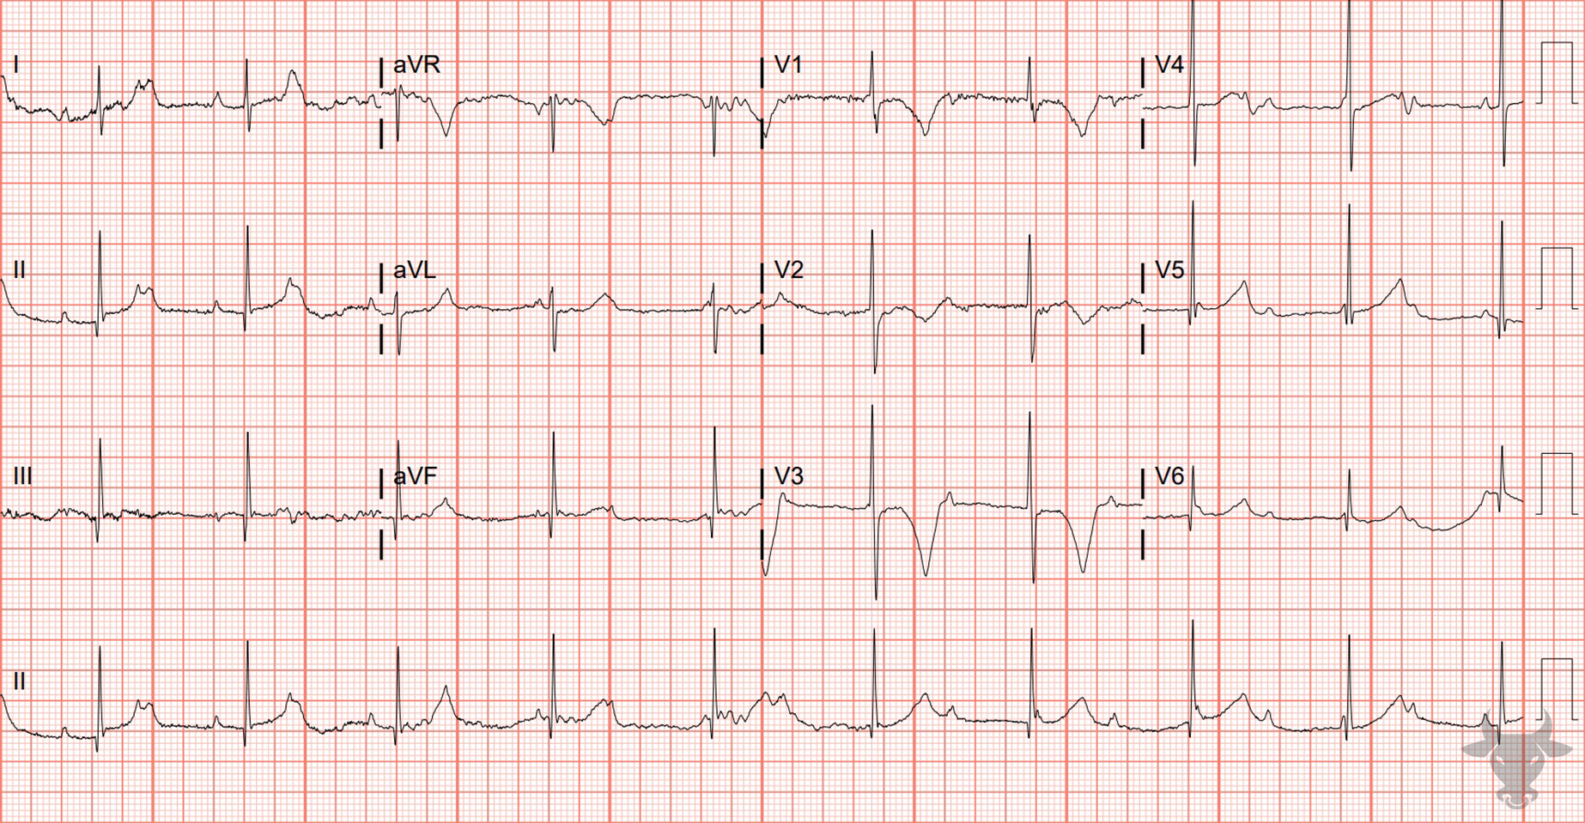
Notes:
Third Degree Atrioventricular Block.
Third Degree Atrioventricular Block. This is complete atrioventricular block with a junctional escape rhythm in an infant. The junction is the only part of the conduction system capable of producing a narrow escape rhythm, and rates typically range from 40 to 60 beats per minute. Infants with junctional escape tend to tolerate atrioventricular block well.

Slide 8
41-year-old male presents with chest pain
71

Slide 9
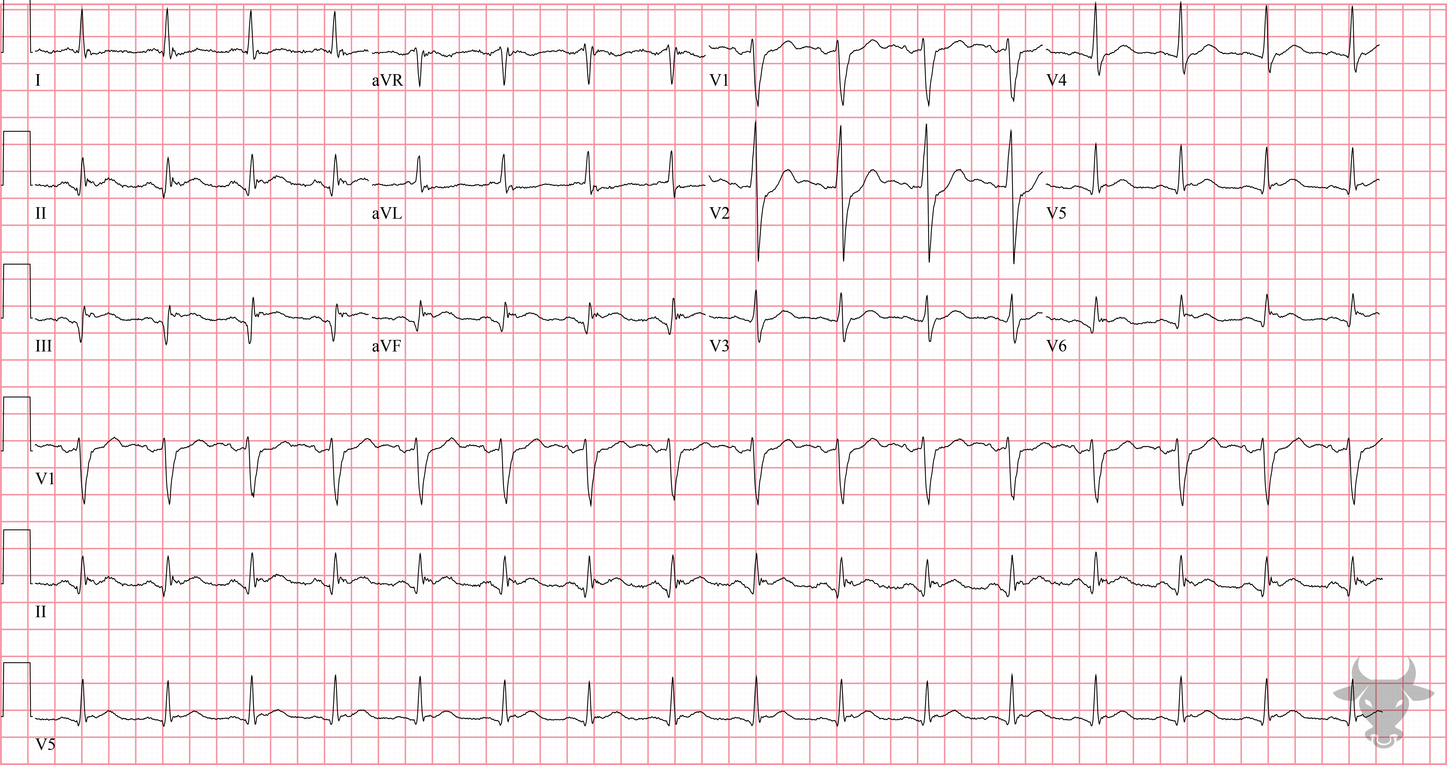
Notes:
Inferolateral ST-elevation Myocardial Infarction.
Inferolateral ST-elevation Myocardial Infarction. Inferolateral ST-segment elevation with reciprocal ST-segment depression in aVL and V2. Left heart catheterization revealed left circumflex occlusion.

Slide 10
63-year-old male presents with dyspnea
72

Slide 11
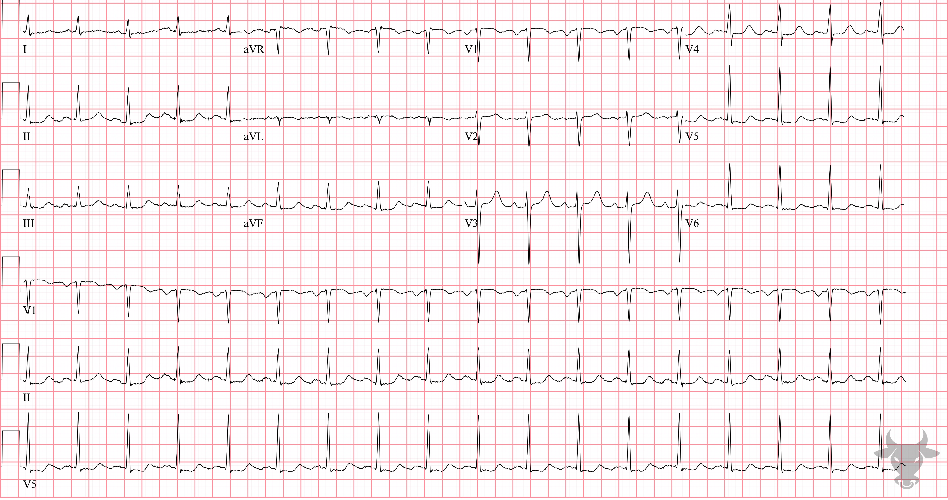
Notes:
Global Subendocardial Ischemia.
Global Subendocardial Ischemia. This patient had an upper gastrointestinal bleed and was severely anemic, accounting for the multilead ST-segment depression and ST-segment elevation in aVR. The differential diagnosis for this pattern is broad and was previously described in case 5.

Slide 12
89-year-old male presents with episodic dizziness
73

Slide 13
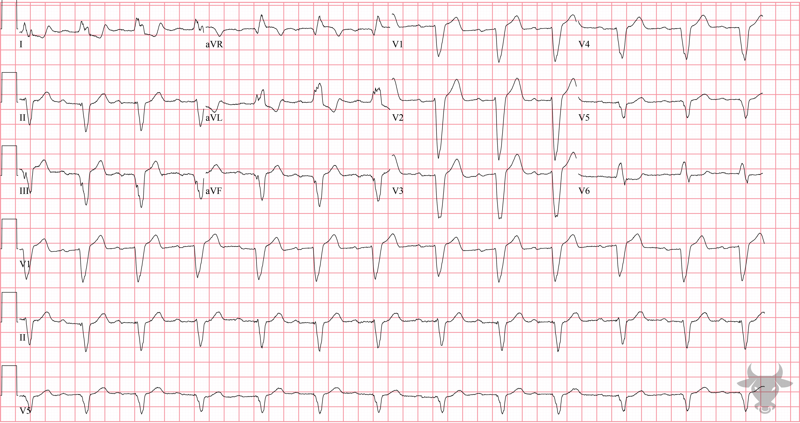
Notes:
Left Bundle Branch Block.
Left Bundle Branch Block, First Degree Atrioventricular Block. While not classically referred to as a "trifascicular block," a left bundle branch block indicates failure of two fascicles - the left anterior and posterior fascicles - and, when associated with first-degree atrioventricular block (i.e., prolonged PR interval), likely represents a diseased right bundle branch (i.e., trifascicular disease). The term “trifascicular block” is a misnomer as a true block of all three fascicles (the right bundle branch, left anterior fascicle and left posterior fascicle) would result in complete heart block. Instead, the term references the presence of diseased conduction in all three fascicles with sufficient sparing of one fascicle that results in delayed conduction and manifests as a prolonged PR interval. The American Heart Association guidelines suggest that use of the term “trifascicular block” be abandoned in favor of a description of the identified blocks independently. Patients with multiple fascicle disease are more likely to progress to third degree atrioventricular block. This patient presented with syncope and subsequently received a permanent pacemaker after telemetry revealed intermittent high-grade atrioventricular block while inpatient.

