Slide 1

Conference 14
ECG STAMPEDE

Slide 2
62-year-old female presents with chest pain
62

Slide 3
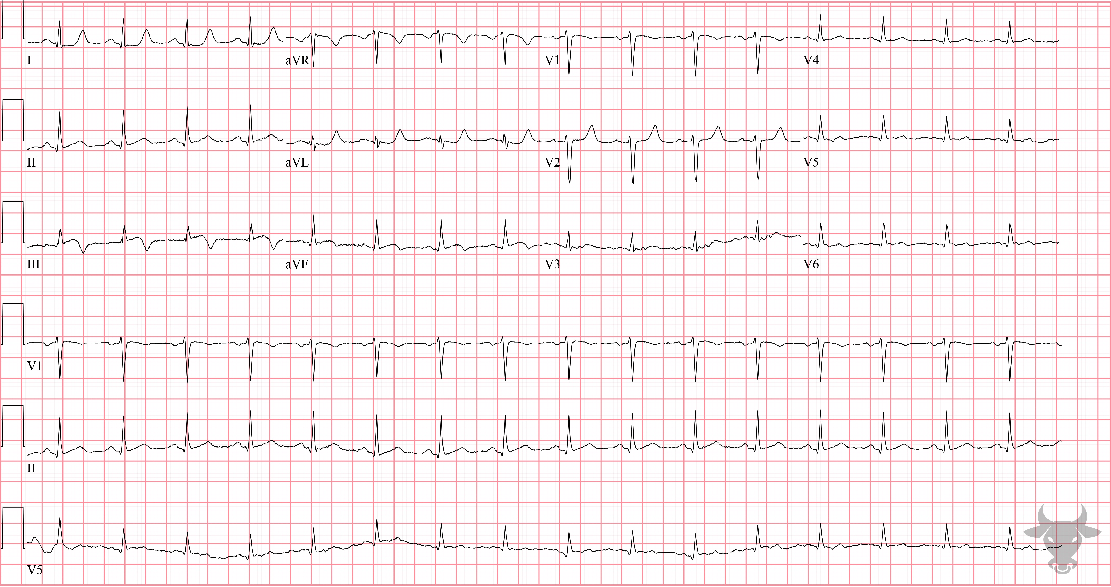

Notes:
Inferior ST-elevation Myocardial Infarction.
Inferior ST-elevation Myocardial Infarction. Subtle inferior ST straightening with negative terminal T wave deflection in lead III suggests myocardial infarction (Figure 28). While this ECG does not meet classic ST-elevation myocardial infarction criteria, it should prompt serial ECGs, early cardiology consultation, and possible emergent catheterization. Left heart catheterization revealed 90% stenosis of the left circumflex and occlusion of the second obtuse marginal branch.

Slide 4
70-year-old female presents with altered mentation
63

Slide 5
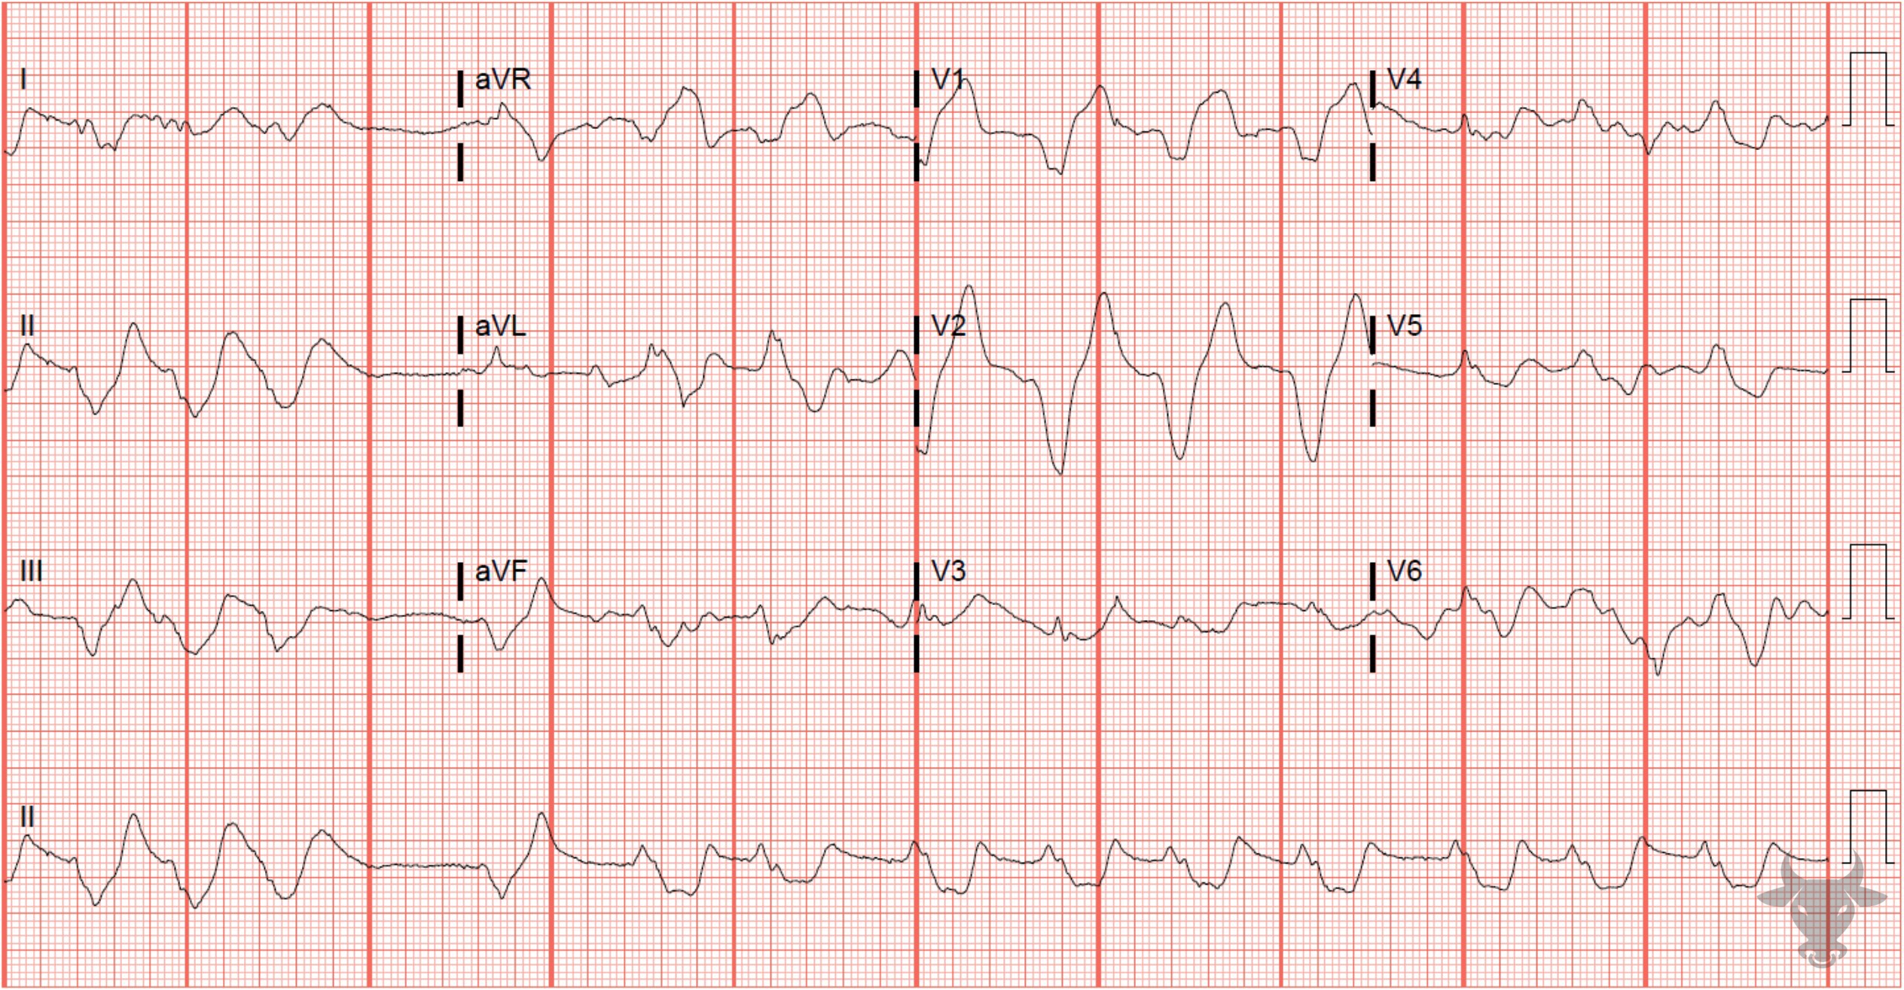
Notes:
Hyperkalemia.
Hyperkalemia. Electrocardiographic findings of hyperkalemia tend to follow a progression as toxicity progresses. Often, the earliest finding is narrow-based, peaked T waves. At the extreme end of the hyperkalemia spectrum, sine wave morphology is a harbinger of impending ventricular fibrillation. This ECG has a very wide QRS approaching sine wave morphology.

Slide 6
50-year-old female presents with vomiting
64

Slide 7
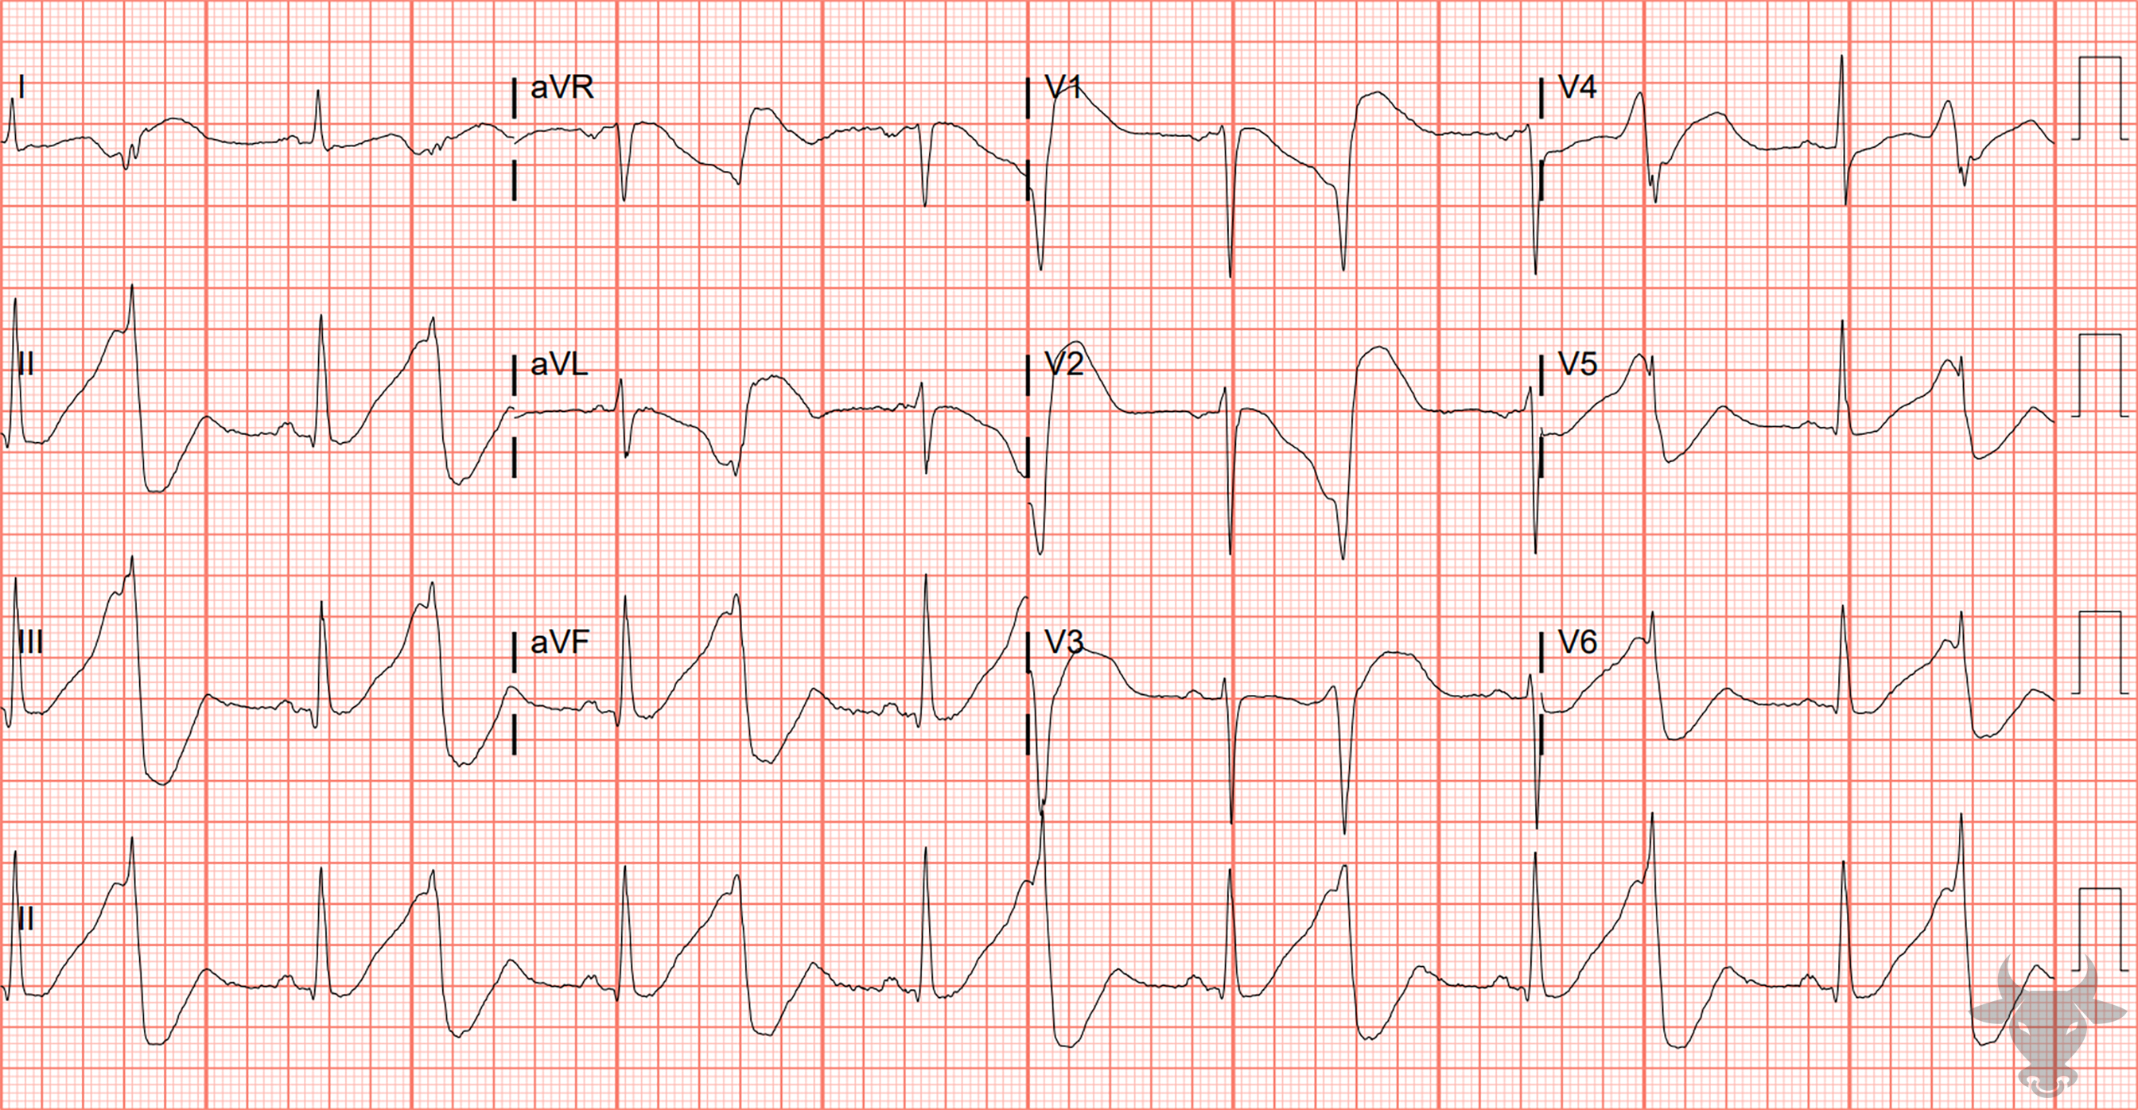
Notes:
Hypokalemia.
Hypokalemia, Prolonged QT. While there is quite a bit of baseline artifact, a prolonged QT interval with broad-based T waves is evident. This patient was severely hypokalemic (2.4 mEq/L) and intermittently went into polymorphic ventricular tachycardia. Overdrive pacing via a temporary transvenous pacer was initiated to avoid further episodes of polymorphic ventricular tachycardia.

Slide 8
90-year-old male presents with weakness
65

Slide 9
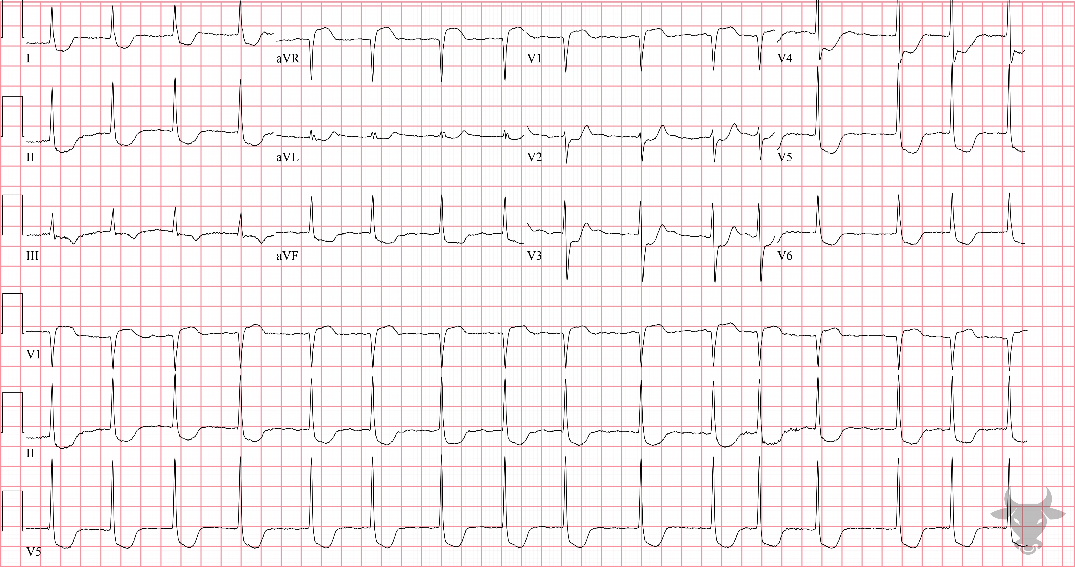
Notes:
Global Subendocardial Ischemia.
Global Subendocardial Ischemia. Any pathology that creates a supply/demand mismatch can cause this pattern of multilead ST-segment depressions and ST-segment elevation in aVR. The differential diagnosis for this pattern was previously described in case 5. In the right clinical context, this pattern is recognized as a predictor of triple vessel and/or left main disease. This patient had elevated troponins and left heart catheterization revealed diffuse disease not amenable to percutaneous coronary intervention; coronary bypass grafting was successful.

Slide 10
19-year-old female presents with altered mentation
66

Slide 11
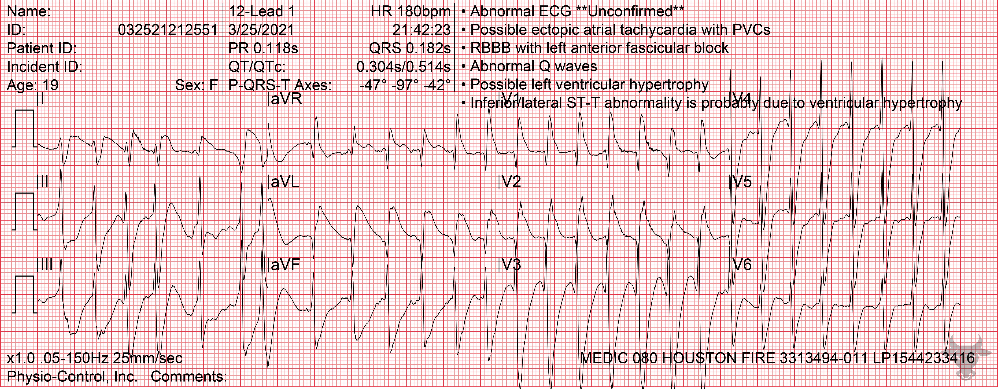
Notes:
Ventricular Tachycardia.
Ventricular Tachycardia. A fusion beat near the beginning of the rhythm strip (Figure 29) represents the fusion of a normally conducted complex with a ventricular complex and indicates the presence of atrioventricular dissociation - in this case, the result of ventricular tachycardia.

Slide 12
44-year-old female presents with chest pain
67

Slide 13
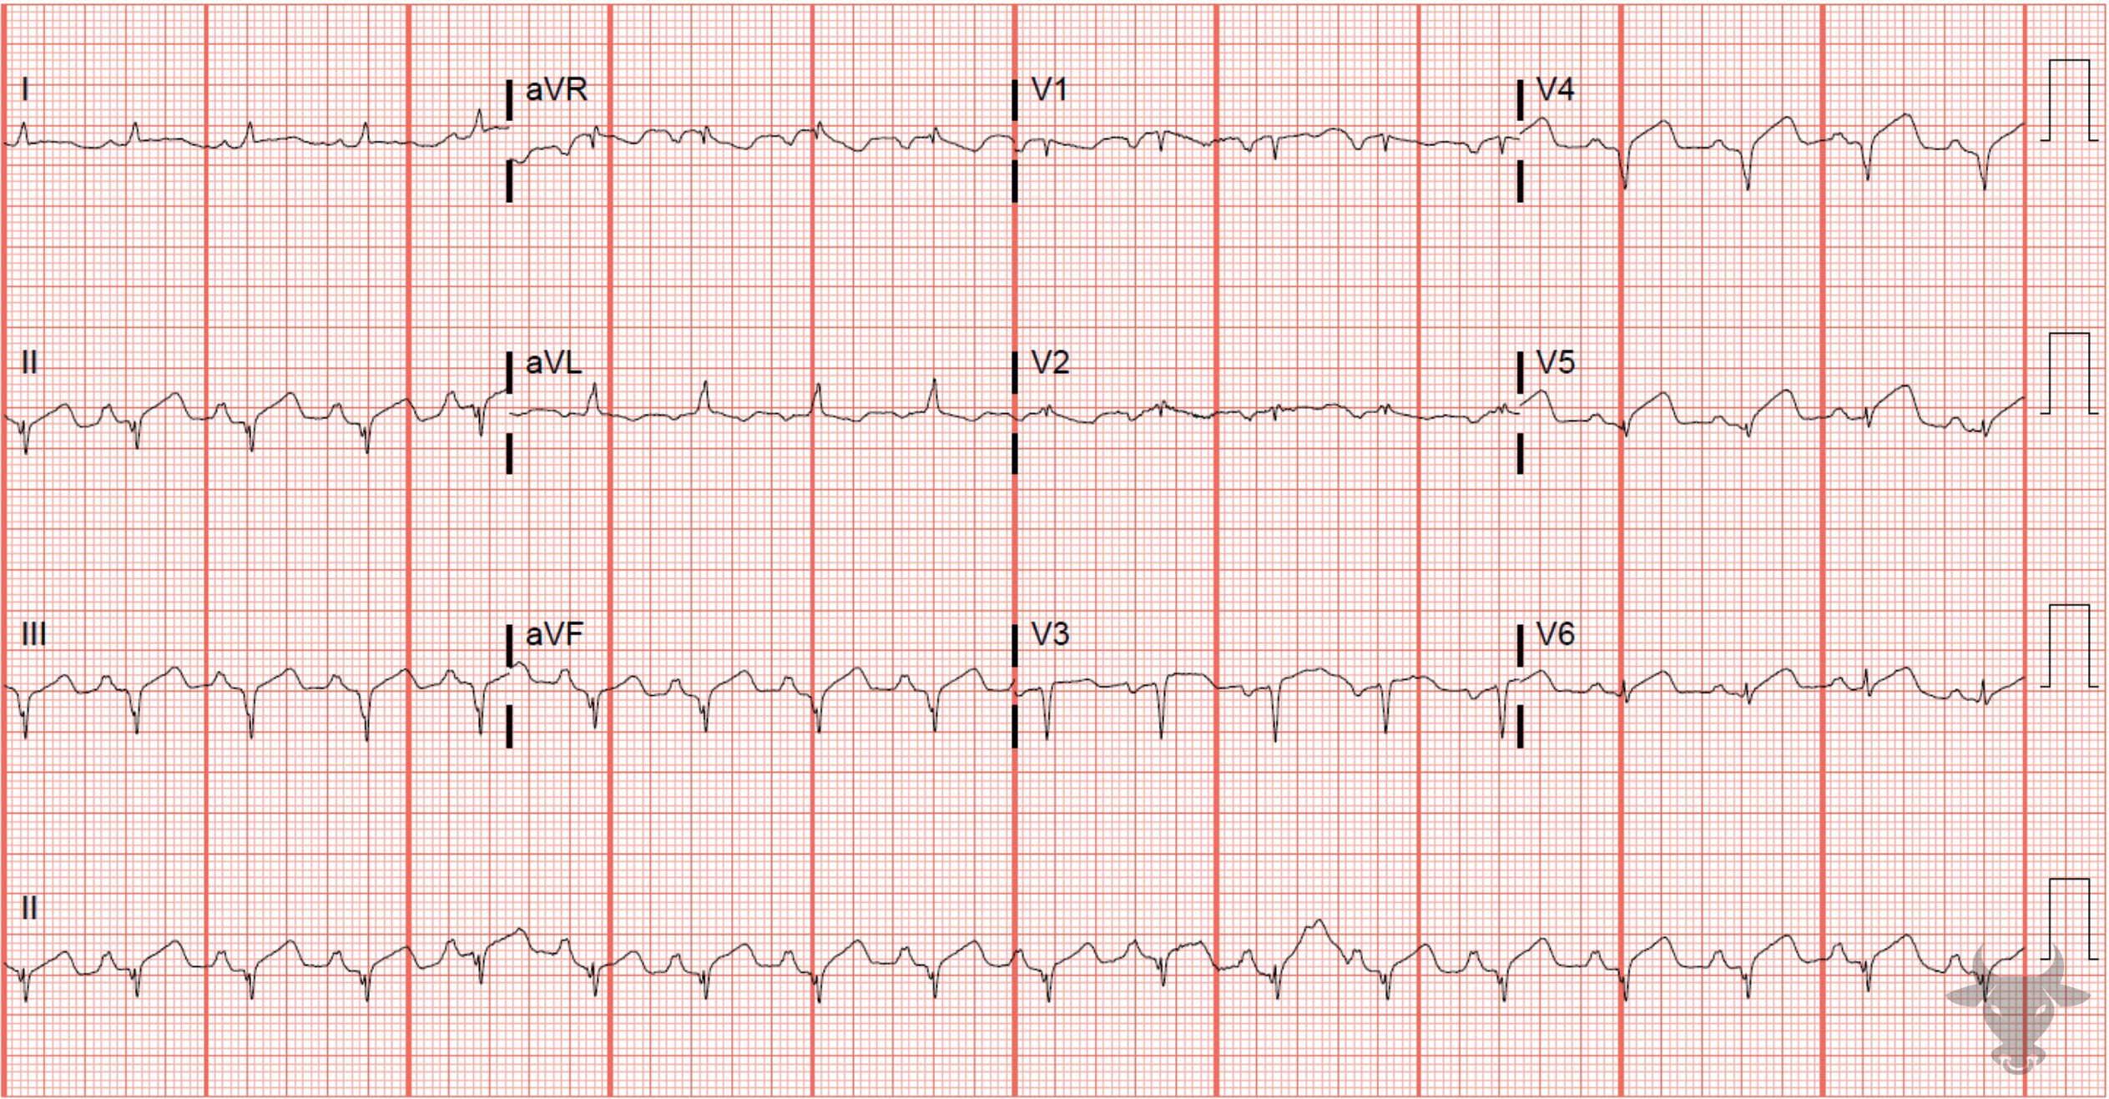
Notes:
Hyperacute T Waves.
Hyperacute T Waves, ST-elevation Myocardial Infarction. While not particularly large in amplitude, the T waves in V5 and V6 are broad-based and larger than their associated QRS complexes. This ECG evolved into a more obvious ST-elevation myocardial infarction on the subsequent ECG. Leart heart catheterization revealed an occluded left anterior descending artery.

