Slide 1

Conference 13
ECG STAMPEDE

Slide 2
67-year-old male presents with dyspnea
56

Slide 3
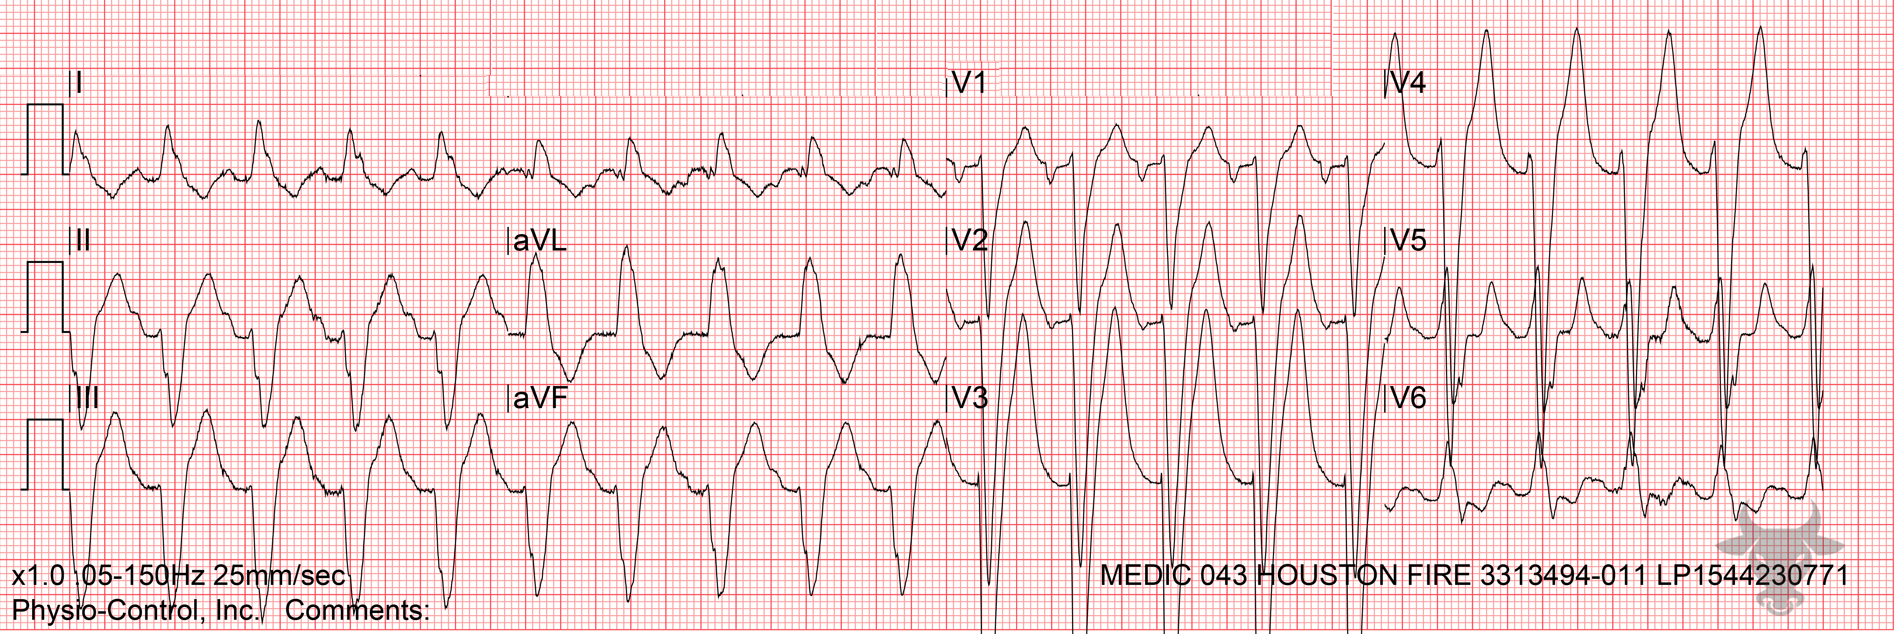

Notes:
Sinus Tachycardia.
Sinus Tachycardia, Left Bundle Branch Block. A left bundle branch block can be misinterpreted as ventricular tachycardia, or an accelerated idioventricular rhythm, at faster rates when the P wave is buried by the preceding T wave, masking the atrial activity. This patient was in sinus tachycardia; P waves are most clearly seen in V1 (Figure 25).

Slide 4
61-year-old female presents with palpitations
57

Slide 5
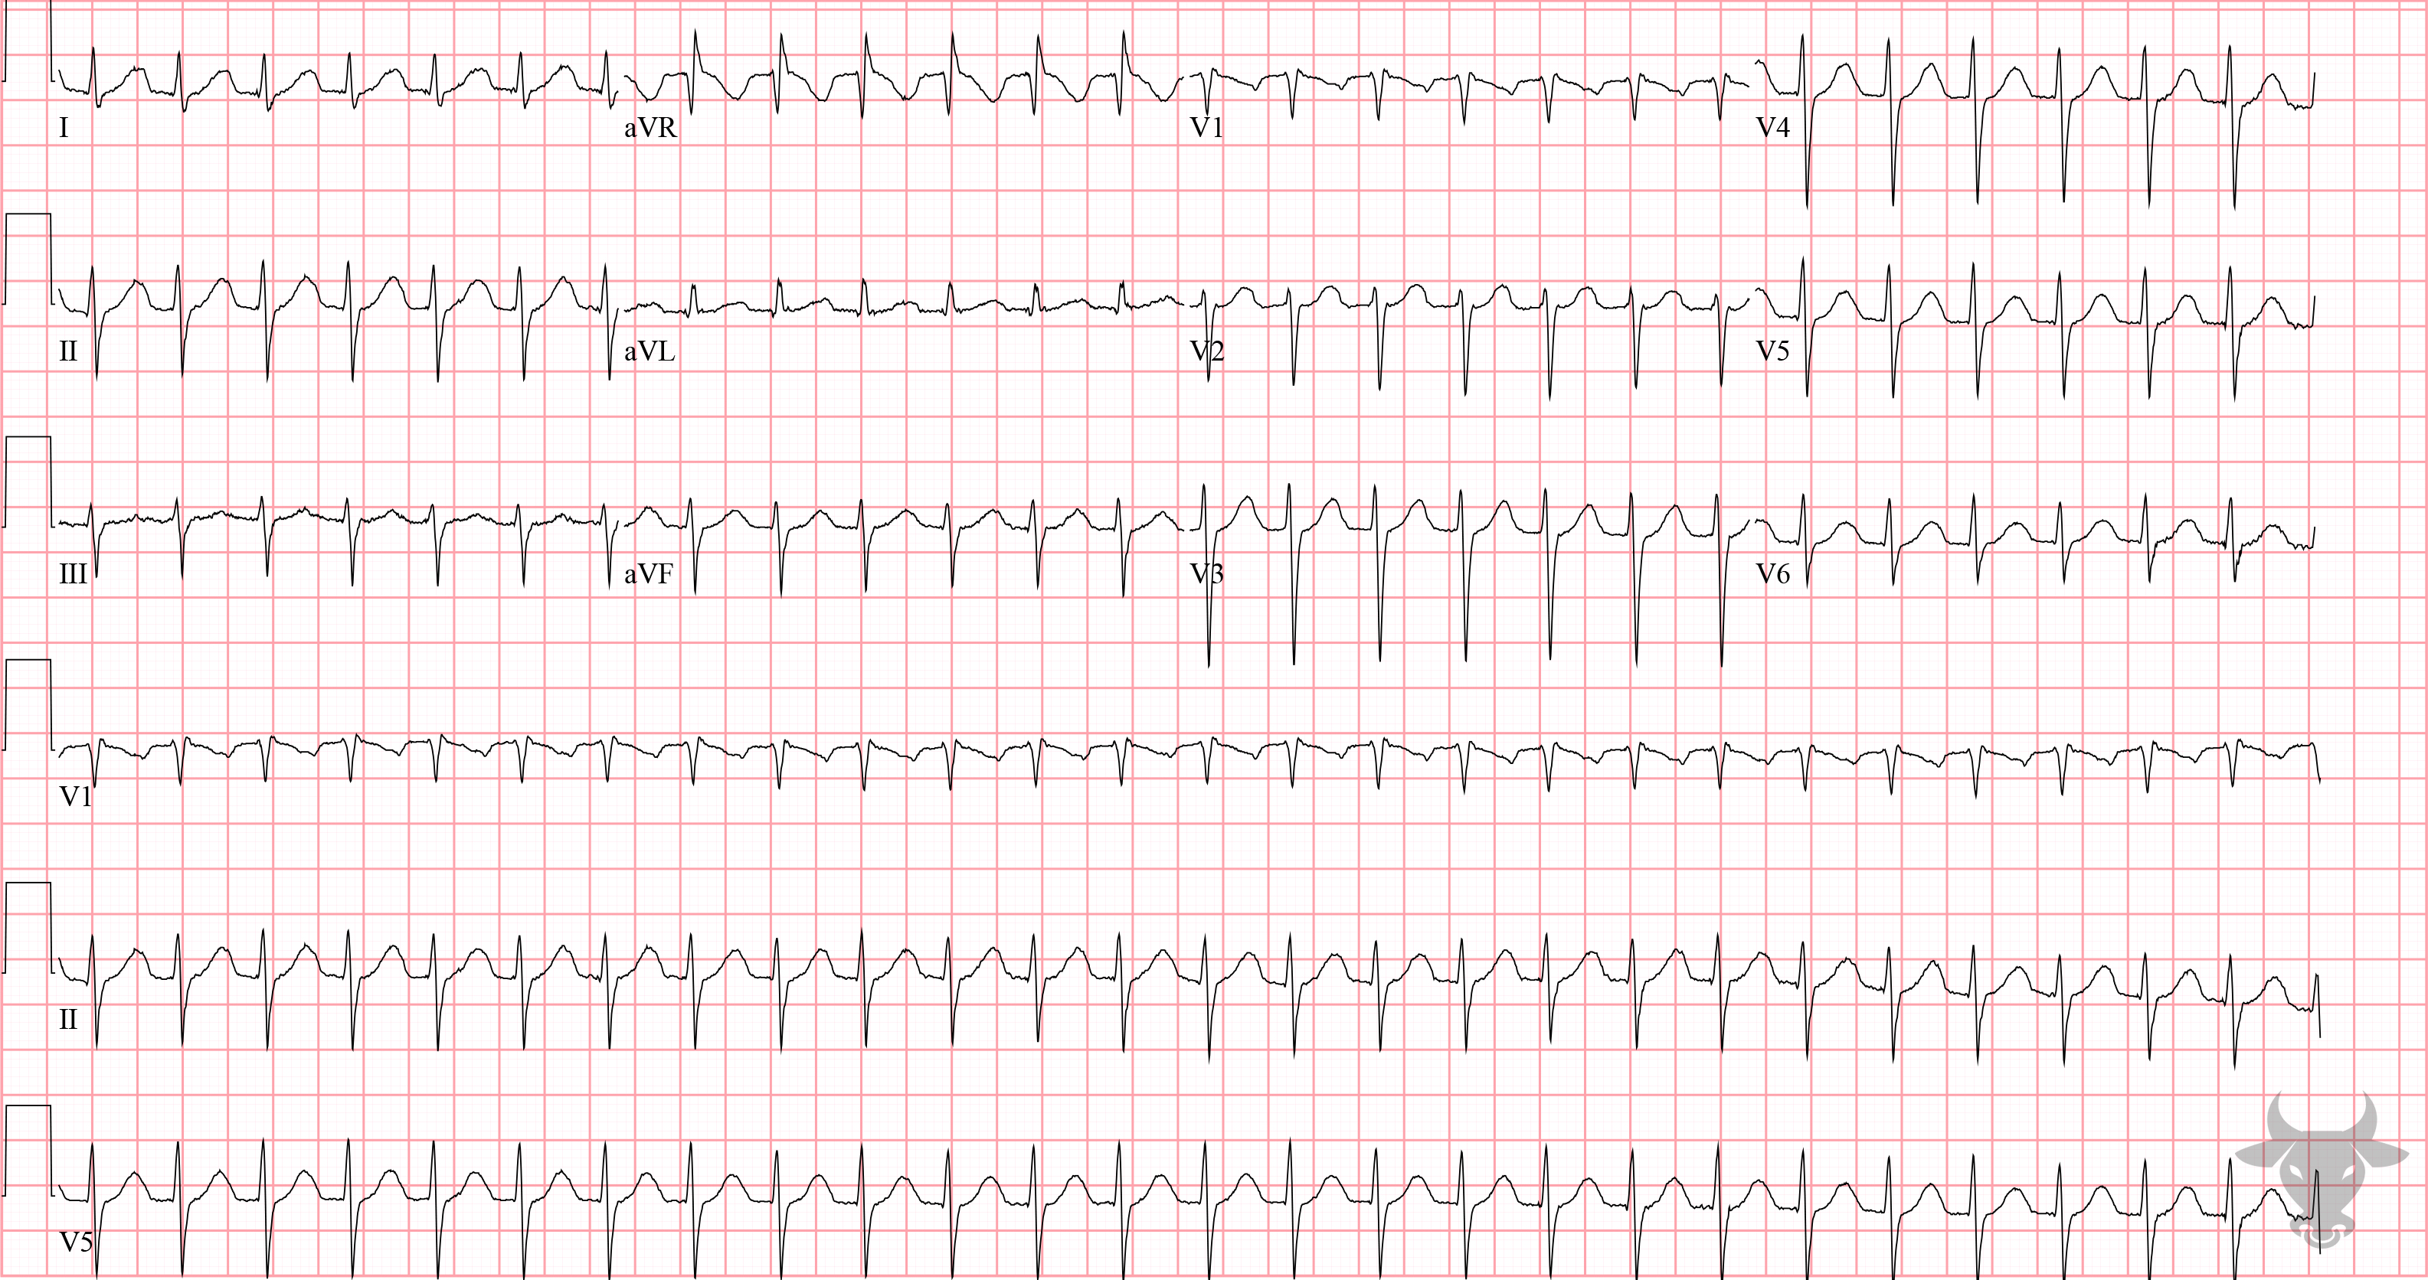
Notes:
Atrioventricular Nodal Reentrant Tachycardia.
Atrioventricular Nodal Reentrant Tachycardia. This is a regular, narrow complex tachycardia with a rate of 160 beats per minute. The differential includes sinus tachycardia, atrial flutter with 2:1 conduction, atrioventricular reentrant tachycardia with orthodromic conduction, and atrial tachycardia. Atrioventricular nodal reentrant tachycardia usually ranges between 140 and 220 beats per minute and occurs when a reentrant circuit is formed within the atrioventricular node (Figure 18). This case converted to sinus rhythm with adenosine, confirming the diagnosis.

Slide 6
61-year-old female presents with palpitations
58

Slide 7
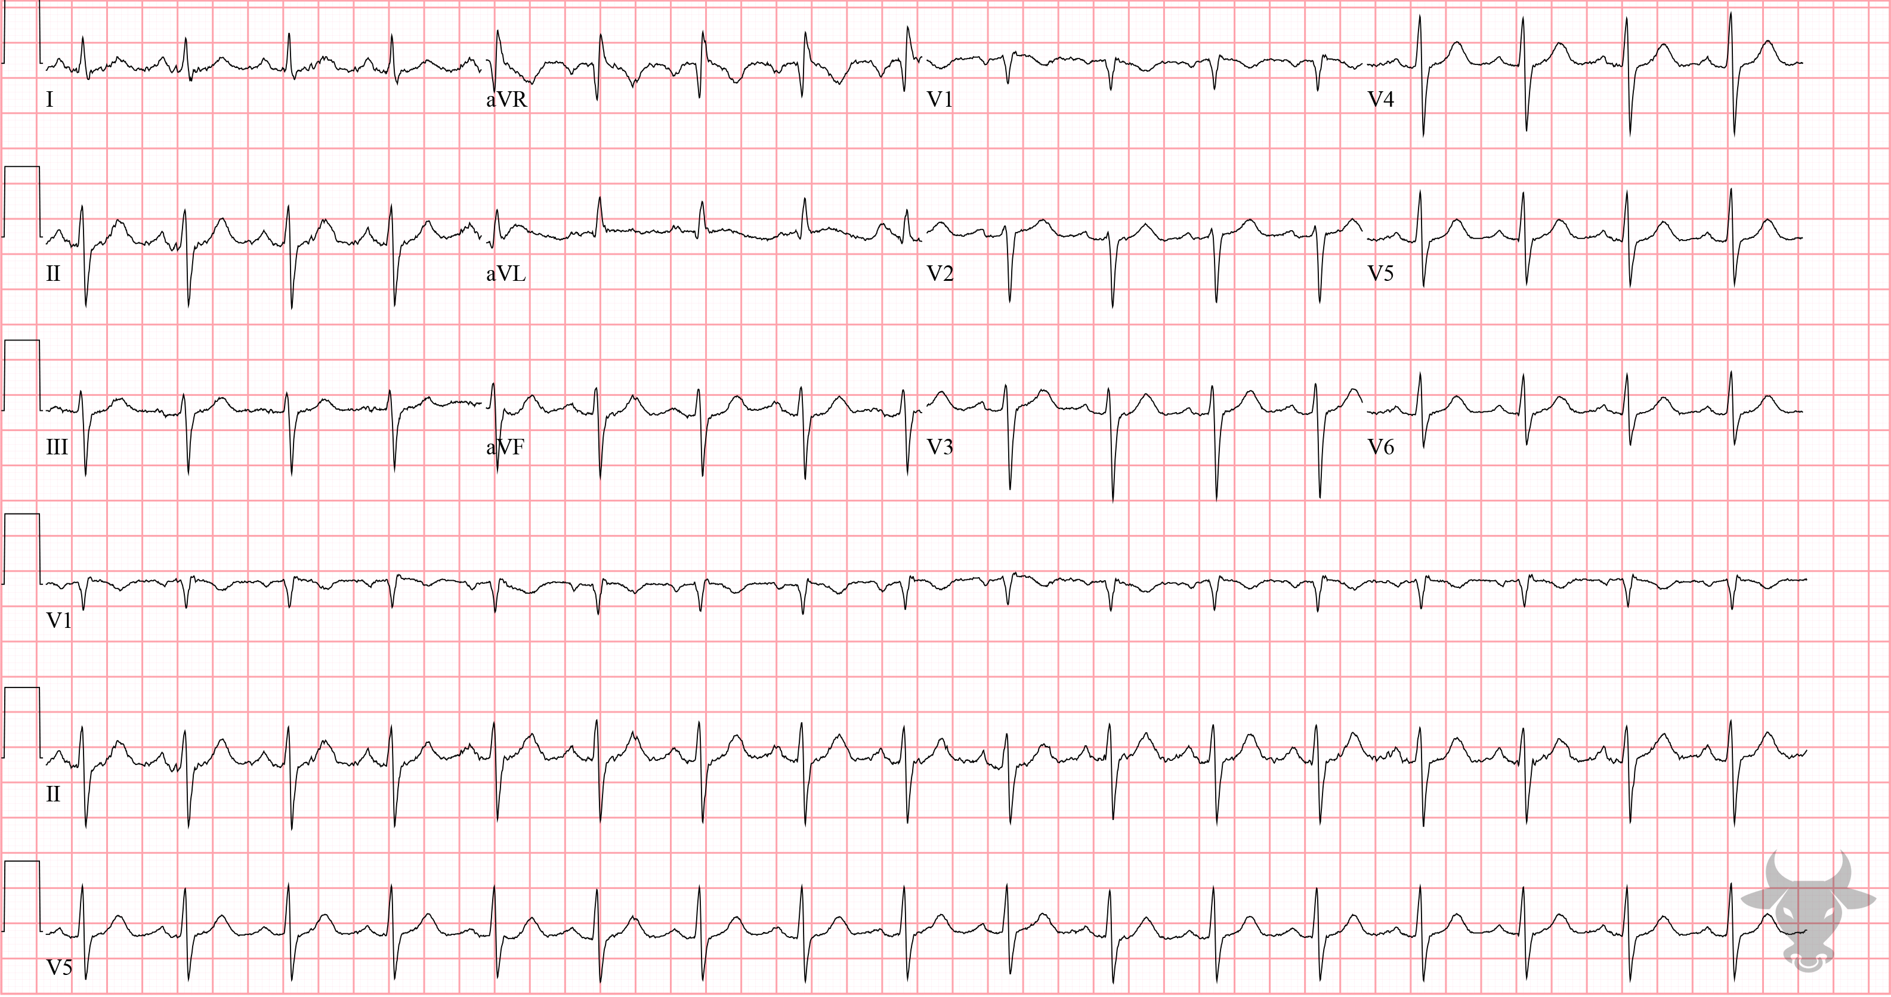
Notes:
Left Anterior Fascicular Block, Sinus Tachycardia.
Left Anterior Fascicular Block, Sinus Tachycardia. This is the post-conversion ECG from the prior case. The extreme left axis deviation, qR complexes in aVL, and rS complexes in the inferior leads (II, III, aVF) are diagnostic for left anterior fascicular block (Figure 3).

Slide 8
39-year-old female presents with syncope
59

Slide 9
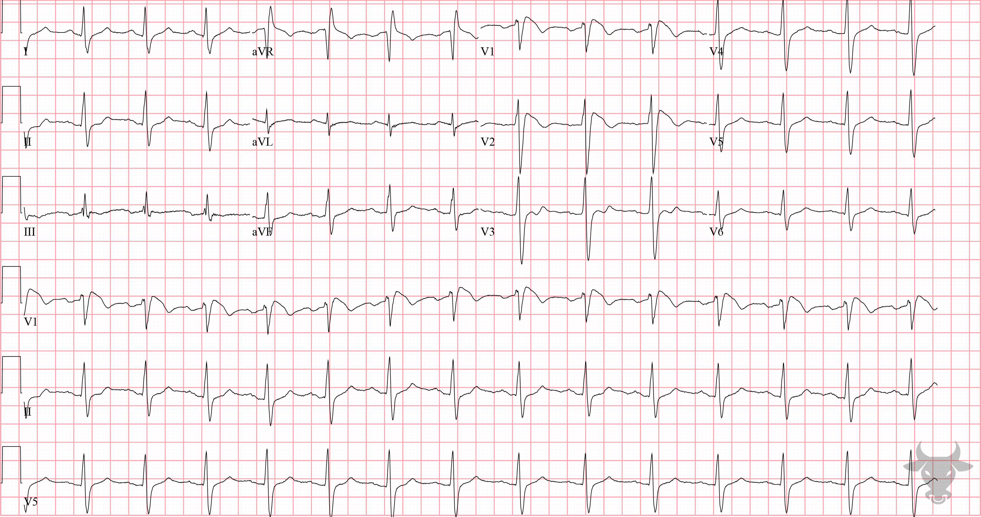
Notes:
Brugada Syndrome.
Brugada Syndrome. Type 1 or coved-type Brugada pattern in a patient presenting with syncope. Brugada syndrome is an inherited sodium channel mutation with a characteristic ECG pattern and increased risk of sudden cardiac death in the absence of structural disease. The Brugada pattern has at least two variants:
Type 1, coved-type: ST-segment elevation of ≥2 mm with a coved-type morphology followed by a negative T wave in ≥1 right precordial lead (Figure 26). Type 1 establishes the diagnosis.
Type 2, saddleback-type: J point elevation of ≥2 mm gives rise to a gradually descending ST-segment that remains 1 mm above the baseline followed by a positive T wave that gives a saddleback appearance in ≥1 right precordial lead (Figure 26).
This patient was formally diagnosed with Brugada syndrome and had an implantable defibrillator placed.

Slide 10
40-year-old male presents with Found down outside a convenient store. T 79F, osborn waves and bradycardia present on ECG
60

Slide 11
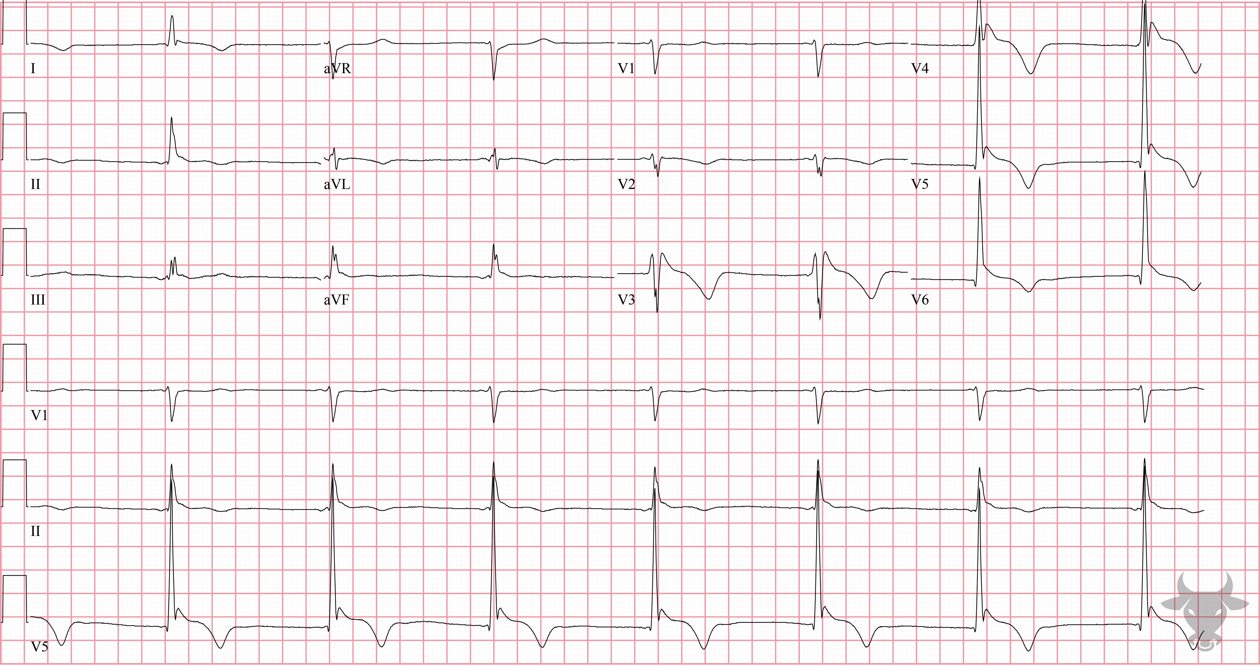
Notes:
Hypothermia.
Hypothermia, Junctional Bradycardia. Electrocardiographic findings of hypothermia have been a subject of interest for over 100 years and include sino-atrial exit block, PR and QT prolongation, QRS widening, ST-segment depression, and atrial and ventricular fibrillation. Osborn waves are J point elevations immediately following the QRS complex are more specific (Figure 27). This patient’s core temperature was 26.1 °C (79 °F). Rewarming is the mainstay treatment of choice.

Slide 12
53-year-old female presents with found down, bradycardic and hypotensive
61

Slide 13
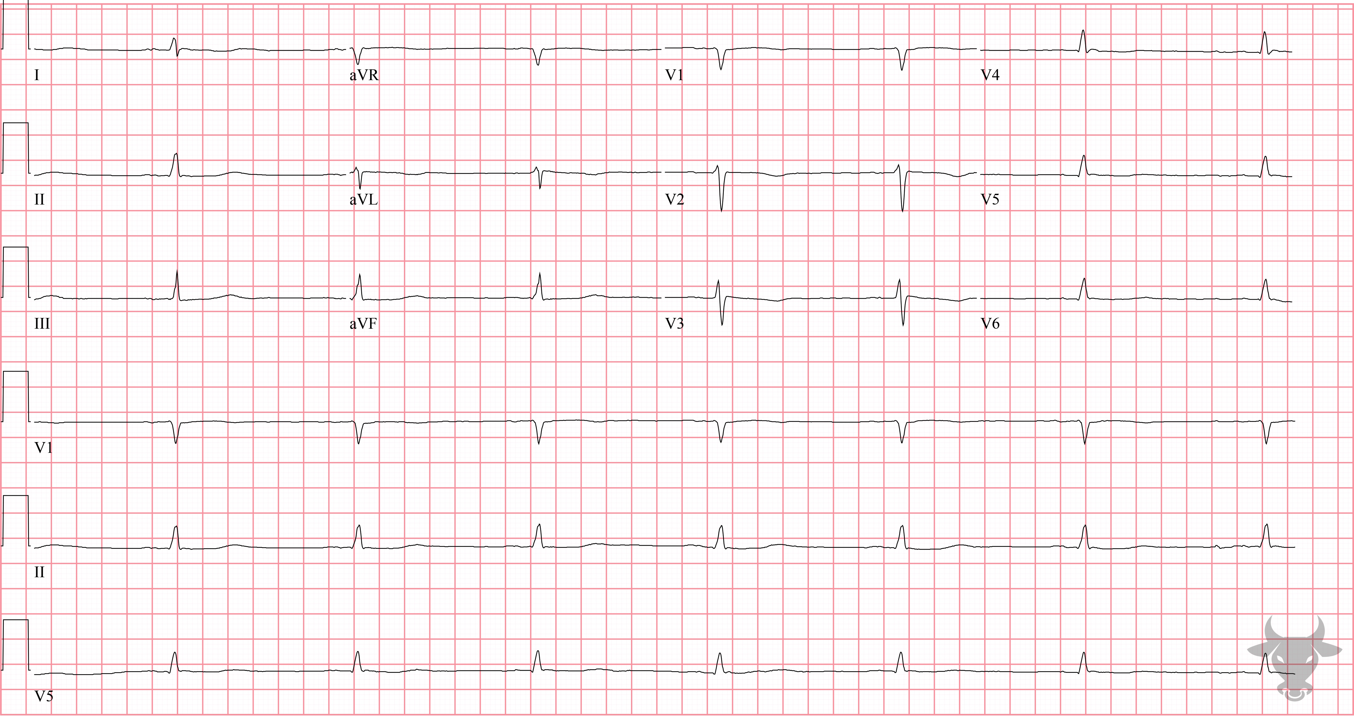
Notes:
Low Voltage due to Myxedema.
Low Voltage due to Myxedema. The bradycardia, prolonged QT, and low voltage are all due to myxedema. This patient had a large pericardial effusion. Hypothyroidism can cause low voltage through two mechanisms: the direct effects of hormonal deficiency on the generation of cardiac action potentials and via the presence of a pericardial effusion, seen in up to one third of patients with hypothyroidism and, rarely, leading to tamponade. Patients with tamponade or large effusions due to hypothyroidism will characteristically lack a compensatory tachycardic response. The differential diagnosis for low voltage was previously described in case 51.

