Slide 1

Conference 12
ECG STAMPEDE

Slide 2
51-year-old female presents with chest wall spasms
50

Slide 3
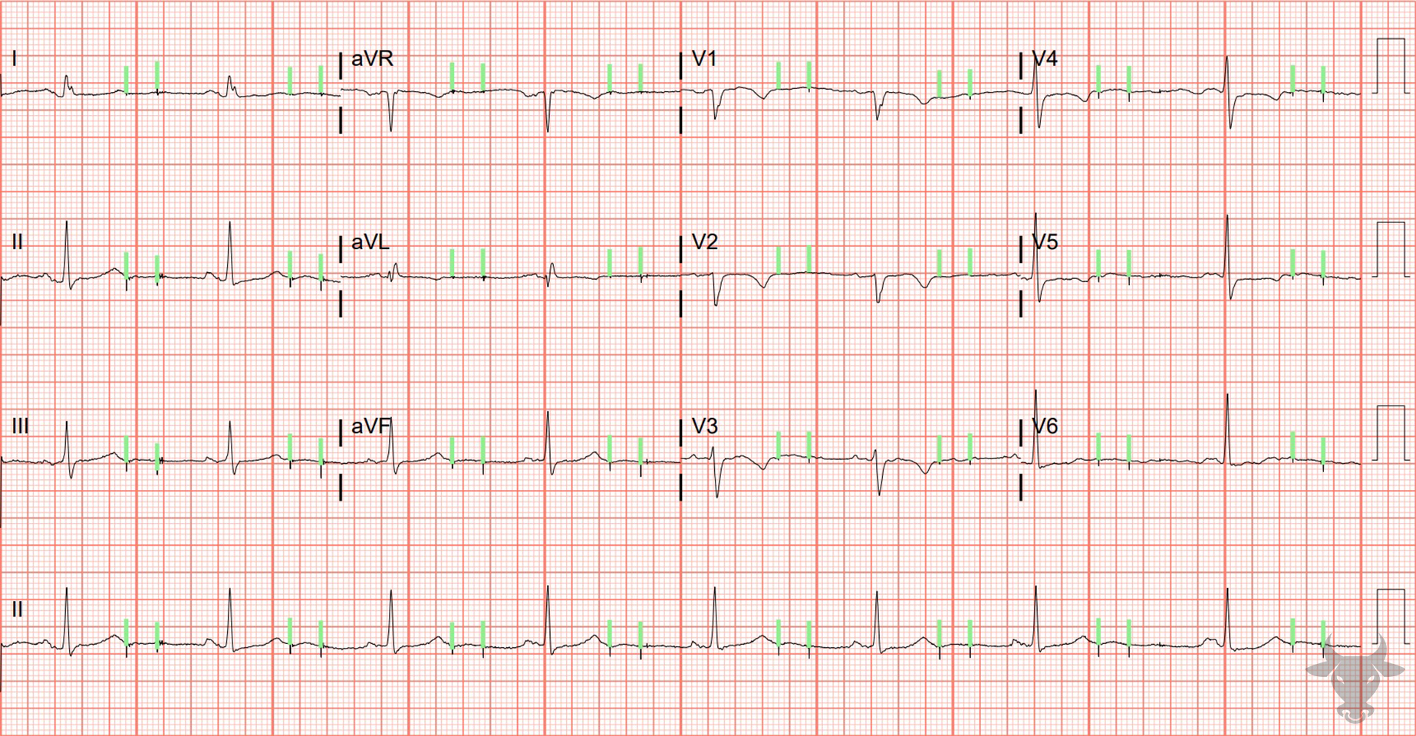
Notes:
Pacemaker Malfunction.
Pacemaker Malfunction. Failure to capture in a patient with a dual chamber pacemaker diagnosed with Twiddler's syndrome, a rare condition in which the pacemaker malfunctions due to coiling of the device in the skin pocket with resultant lead displacement. Pacemaker spikes (green) are seen without associated QRS complexes.

Slide 4
72-year-old male presents with dizziness
51

Slide 5
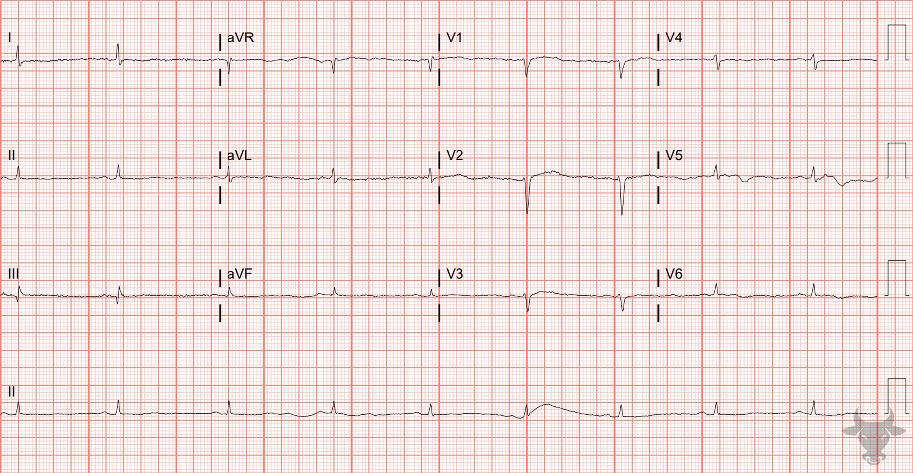
Notes:
Low Voltage Due to Myxedema.
Low Voltage Due to Myxedema. The traditional definition of low voltage is QRS amplitudes less than 5 mm in all limb leads or less than 10 mm in all precordial leads. The differential for low voltage can be broken down into two categories:
Cardiac abnormalities resulting in diminished impulse generation (e.g., prior infarcts, infiltrative cardiomyopathies like amyloidosis, and hypothyroidism).
Increased impedance related to attenuating substances between the heart and surface leads (fluid, air, or adipose).
The combination of low voltage and bradycardia should raise the concern for hypothyroidism/myxedema, as was the case with this patient.

Slide 6
58-year-old female presents with chest pain
52

Slide 7
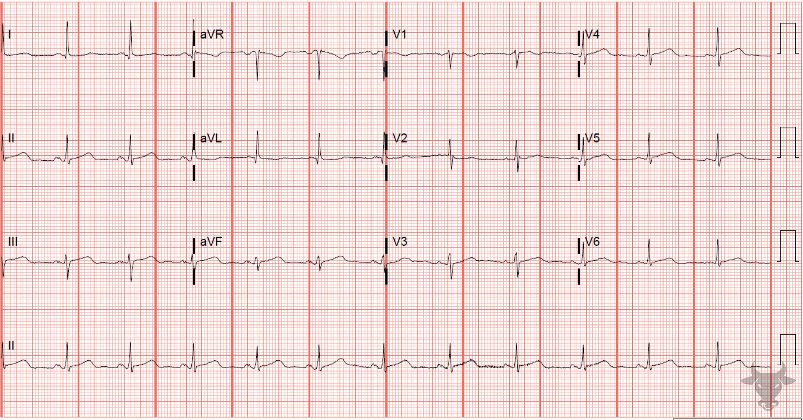
Notes:
Wellens Syndrome.
Wellens Syndrome. Wellens syndrome (previously described in case 18) with deep, symmetric T wave inversions in the precordial leads. Left heart catheterization revealed 99% proximal left anterior descending artery stenosis.

Slide 8
81-year-old male presents with chest pain
53

Slide 9
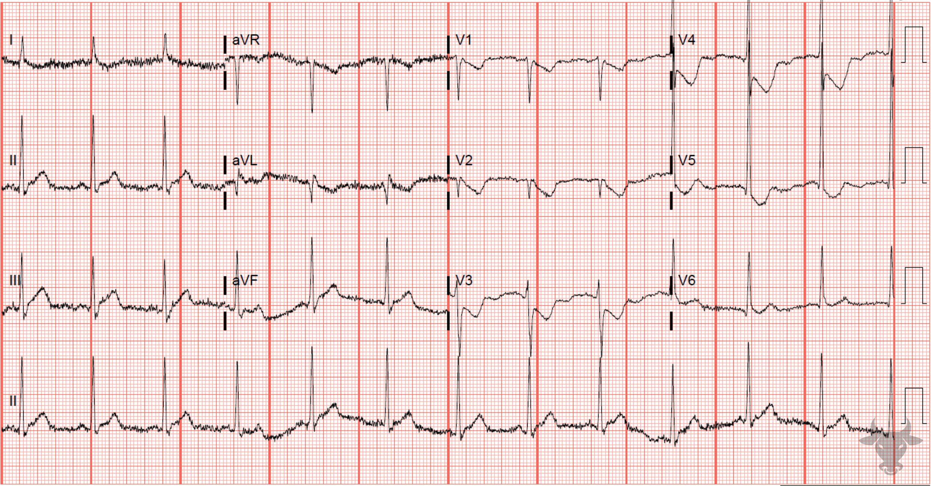
Notes:
Posterior Myocardial Infarction.
Posterior Myocardial Infarction. Features of posterior wall myocardial infarction include R wave amplitude greater than the S wave amplitude in V1-2 with “mirror” ST-segment depression (especially horizontal or down-sloping) and upright T waves (Figure 24). Posterior myocardial infarction is commonly confused with anterior subendocardial ischemia; however, the T waves are usually negatively deflected with anterior subendocardial ischemia. This ECG shows ST-segment depression and upright T waves in the precordial leads V2 through V4. In the subsequent ECG, V4-V6 represent posterior leads. At least 0.5 mm ST-segment elevation in any posterior lead is diagnostic of posterior wall infarction and can be seen in V6.
This patient received successful percutaneous coronary intervention to an occluded left circumflex artery.

Slide 10
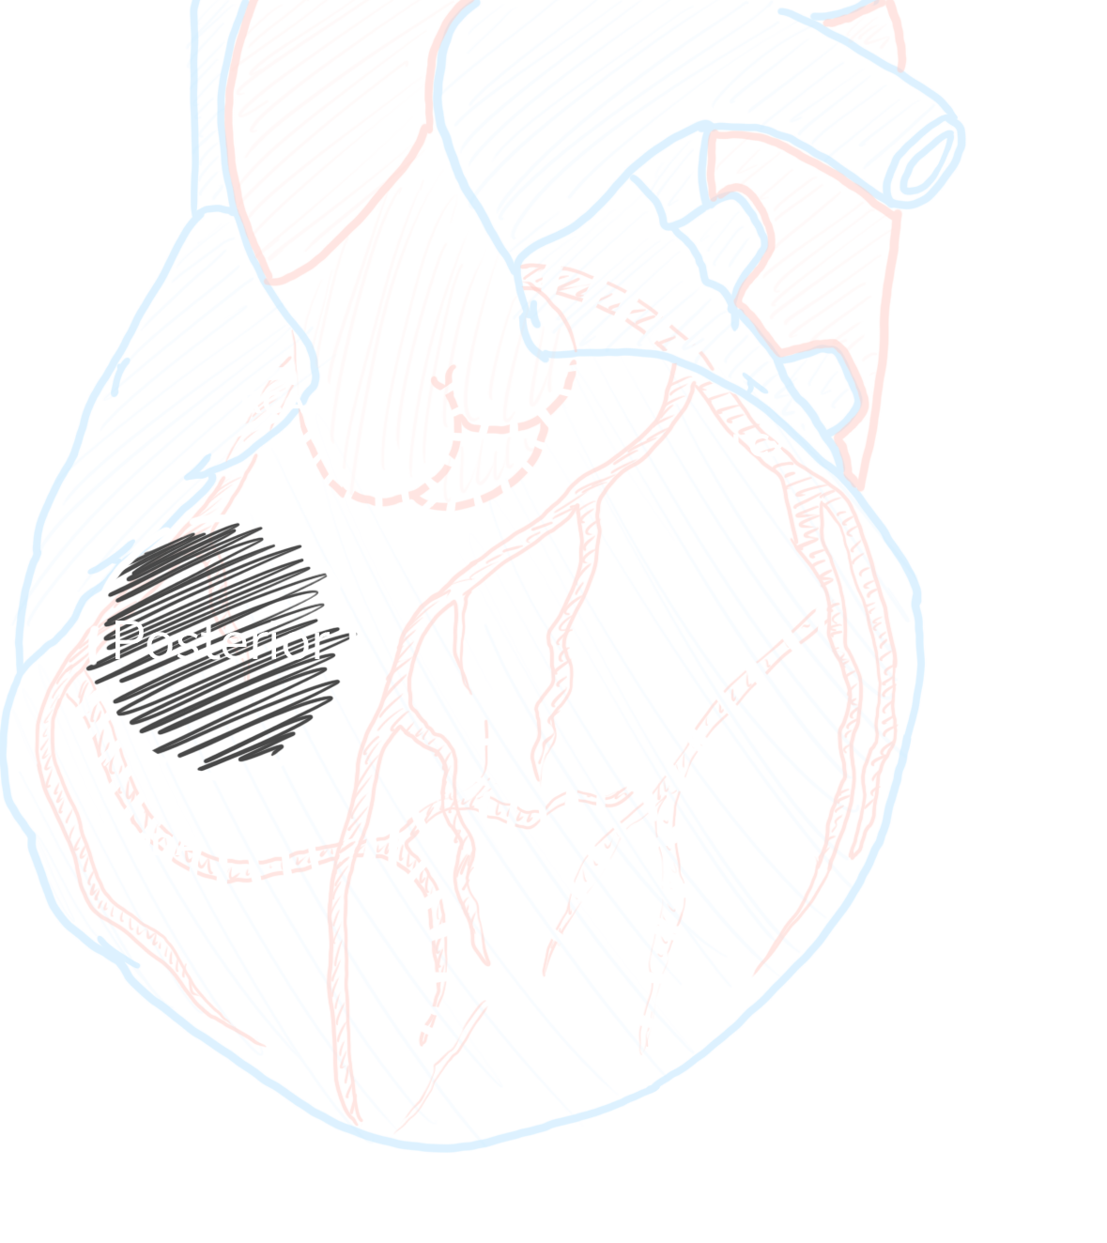
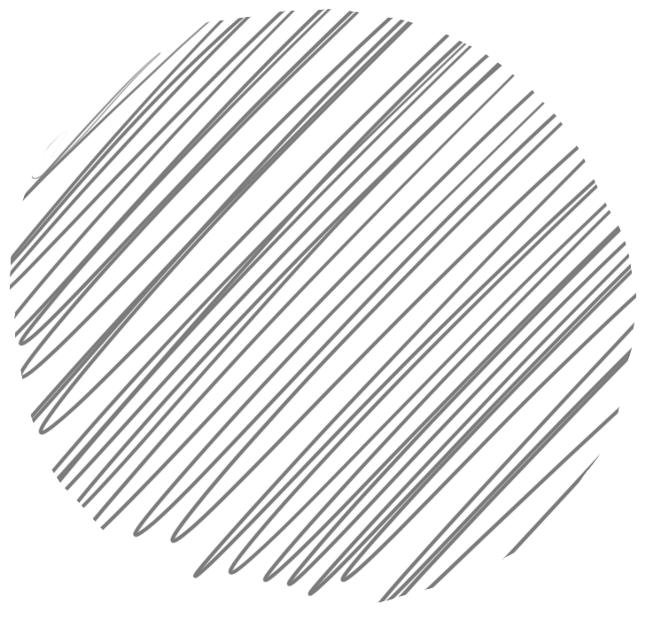
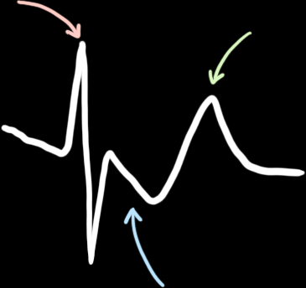
Posterior STEMI
V2 or V3
6%
Isolated Posterior
R/S ≥ 1
↑ t wave
30%
Reperfusion
< 90 min
STD
Waldo SW, Armstrong EJ, Kulkarni A, et al. Clinical characteristics and reperfusion times among patients with an isolated posterior myocardial infarction. J Invasive Cardiol. 2013;25(8):371-5.

Slide 11
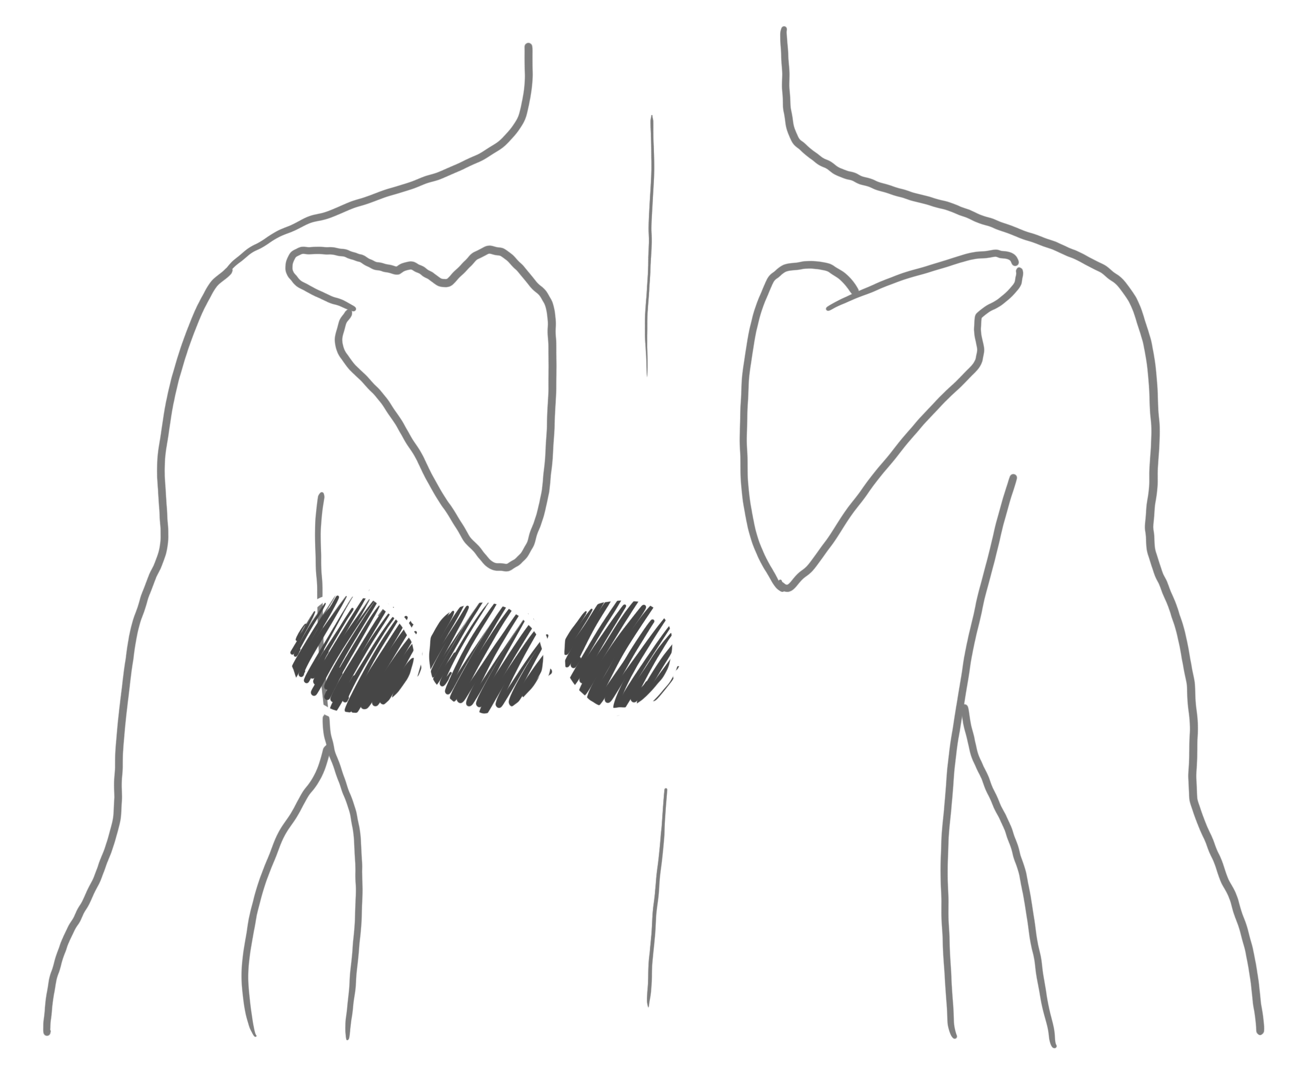
Posterior Lead Placement
V7
V8
V9

Slide 12
81-year-old male presents with chest pain
54

Slide 13
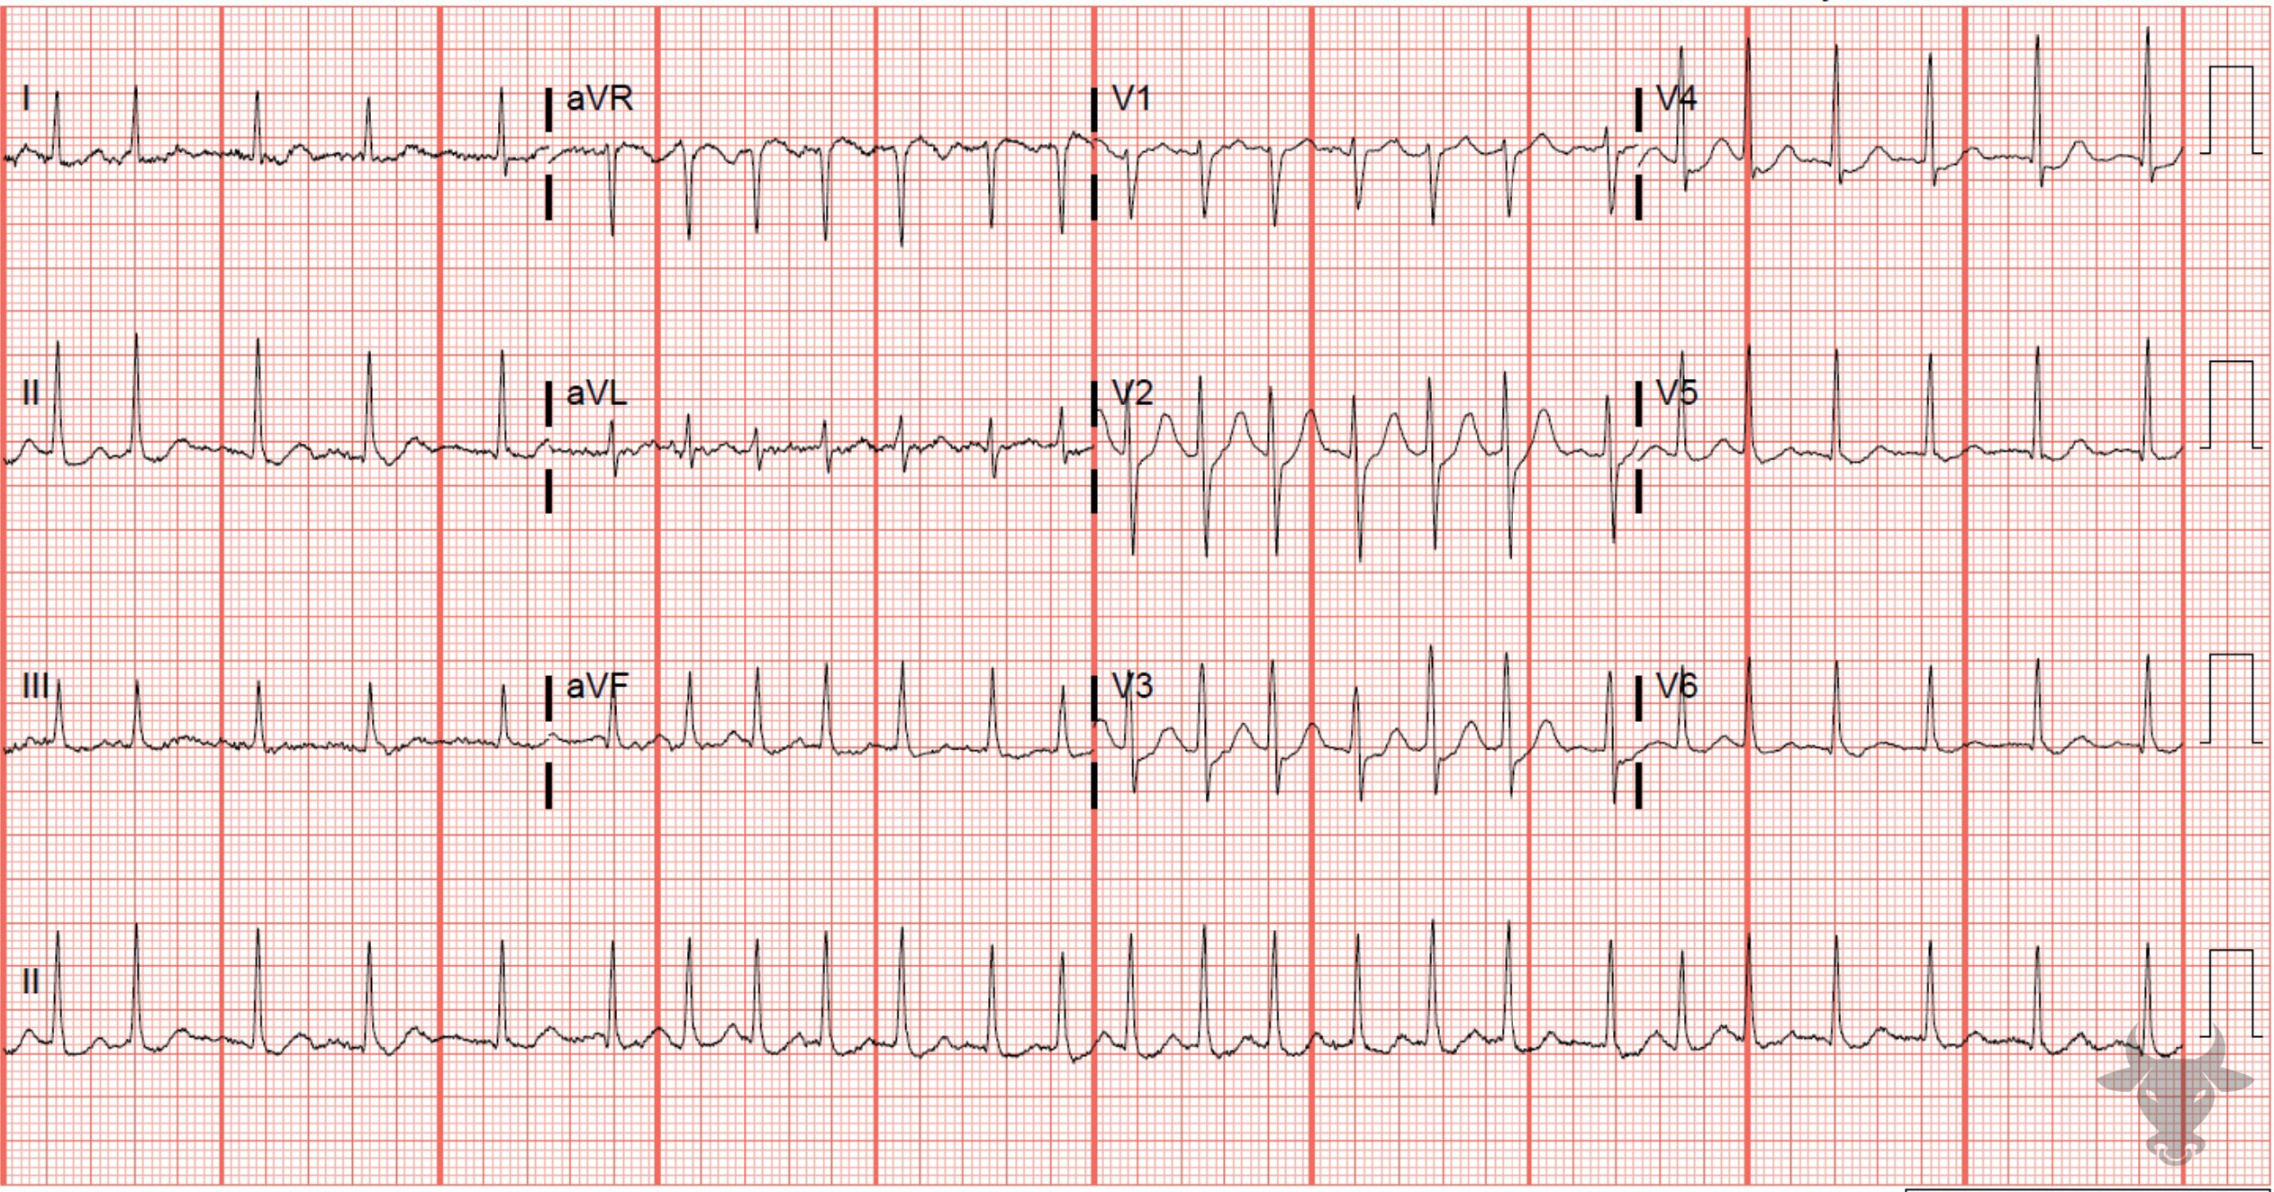
Notes:
Atrial Fibrillation with Rapid Ventricular Response.
Atrial Fibrillation with Rapid Ventricular Response. The differential for irregularly irregular rhythms includes at least three entities: atrial fibrillation (most common), atrial flutter with variable conduction, and multifocal atrial tachycardia. The latter two diagnoses produce coordinated atrial activity that can be visualized on the surface ECG, while the former does not. Since there are no discernable P waves, the rhythm is atrial fibrillation.

Slide 14
71-year-old male presents with palpitations
55

Slide 15
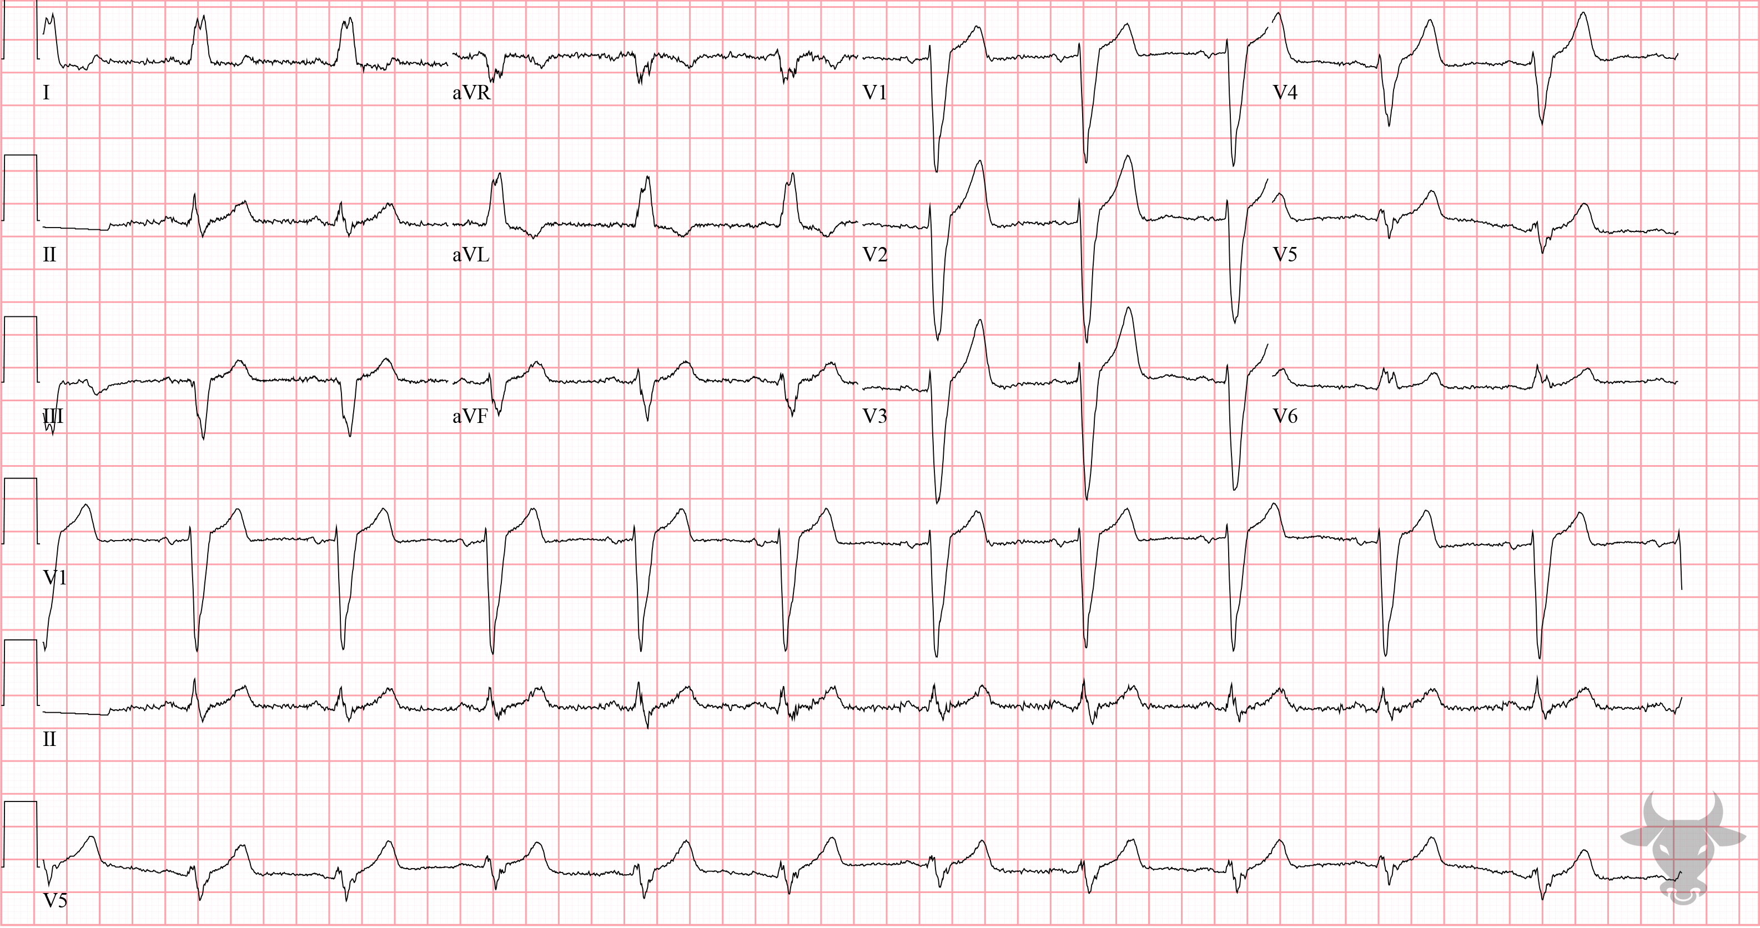
Notes:
Left Bundle Branch Block.
Left Bundle Branch Block. Classic left bundle branch block pattern with a wide and down-going QRS complex in V1, and notched, positively deflected QRS complex in I, aVL, and V6, and left axis deviation (see Figure 23 for further explanation of left bundle branch blocks).

