Slide 1

Conference 11
ECG STAMPEDE

Slide 2
53-year-old female presents with chest pain
44

Slide 3
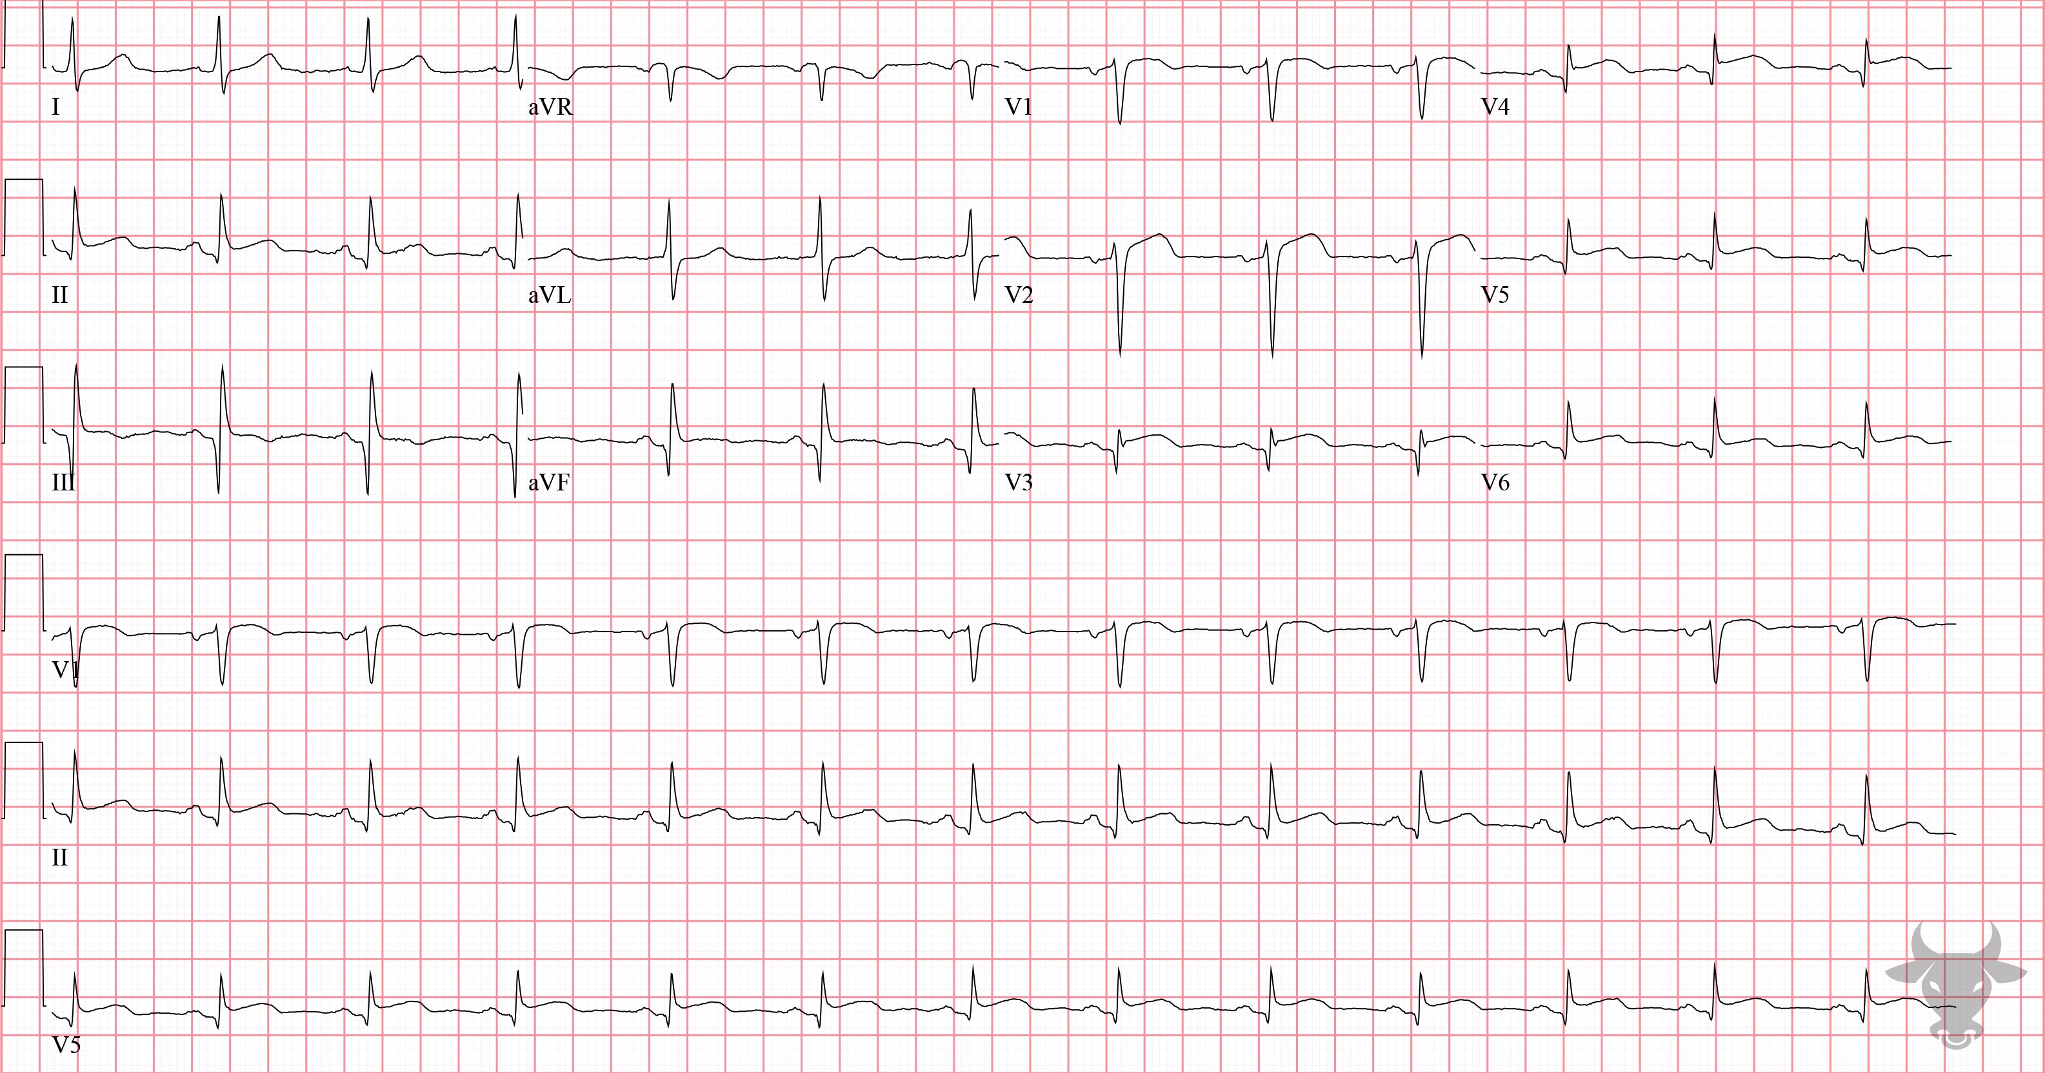

Notes:
Anterior ST-elevation Myocardial Infarction.
Anterior ST-elevation Myocardial Infarction. There is ST-segment elevation associated with terminal QRS distortion in lead V3, a highly specific for ST-elevation Myocardial Infarction Terminal QRS distortion is the absence of both an S and J wave in either V2 or V3 (Figure 20). Left heart catheterization revealed a 100% mid left anterior descending artery occlusion.

Slide 4
76-year-old male presents with right leg edema
45

Slide 5
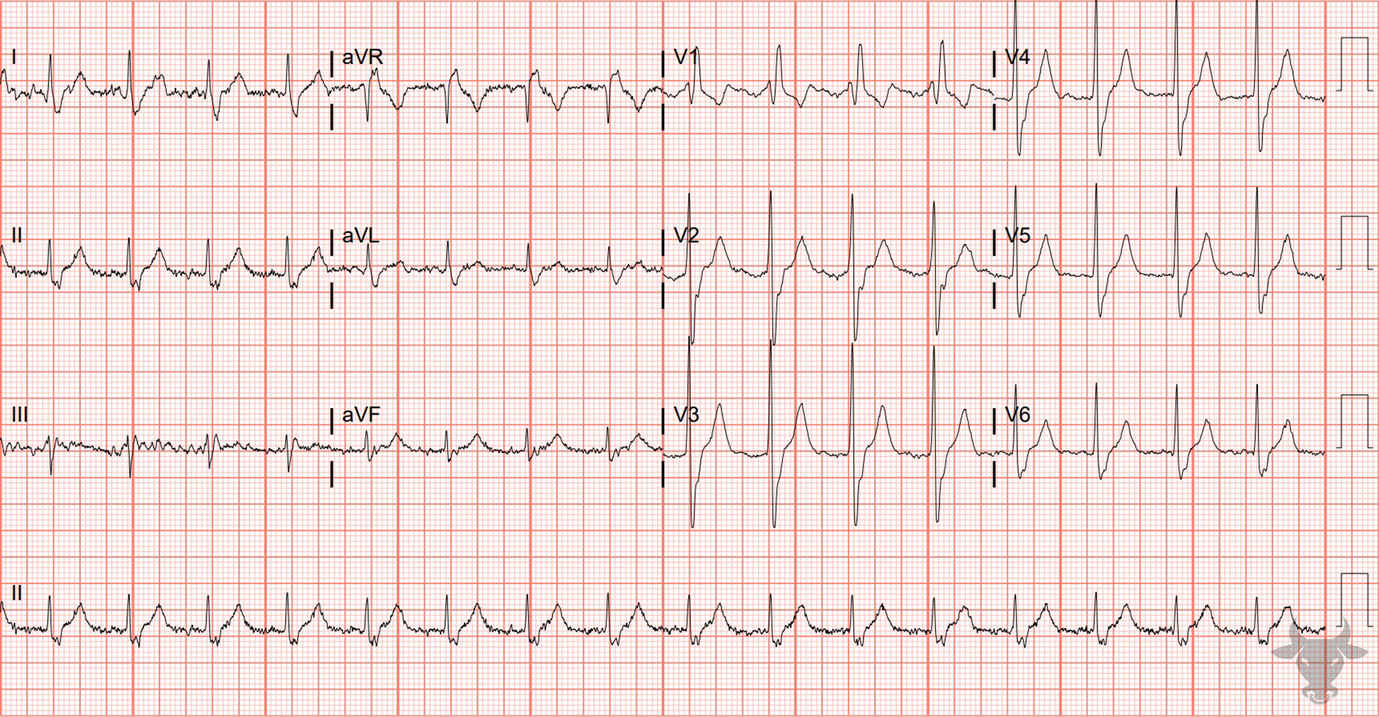
Notes:
Right Bundle Branch Block.
Right Bundle Branch Block. Classic right bundle branch block pattern with rSR' in V1 and a wide S wave in the lateral leads (Figure 21).

Slide 6
51-year-old male presents with supratherapeutic INR
46

Slide 7
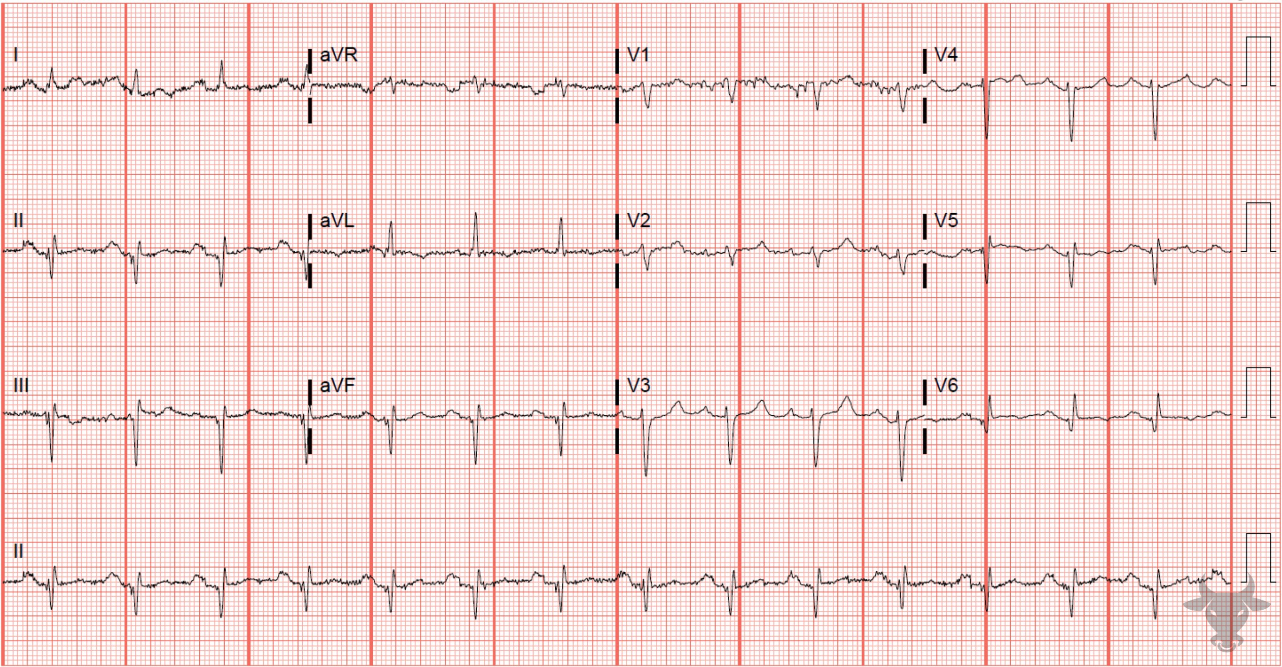
Notes:
Prior Inferior Myocardial Infarction.
Prior Inferior Myocardial Infarction. Causes of left axis deviation were previously reviewed in case 3. In this case, the left axis deviation is due to large Q waves from a prior infraction in the inferior leads (II, III, aVF).

Slide 8
36-year-old male presents with chest pain
47

Slide 9
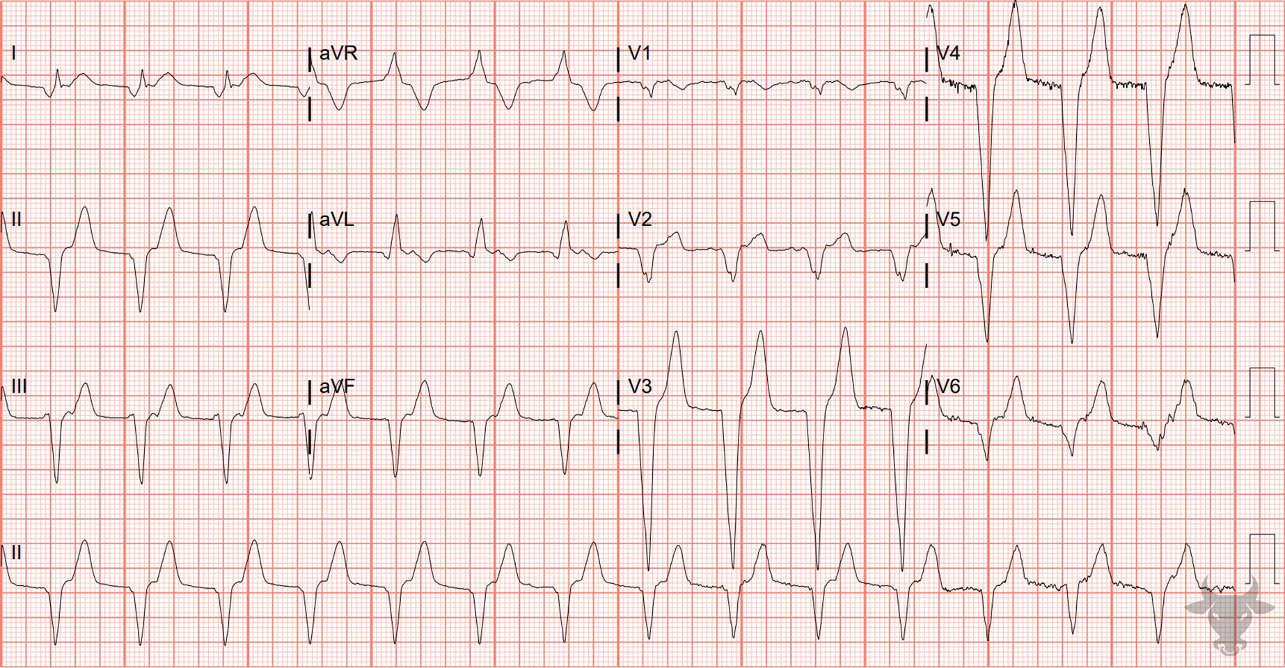
Notes:
Accelerated Idioventricular Rhythm.
Accelerated Idioventricular Rhythm. Accelerated idioventricular rhythm (AIVR) occurs under conditions of enhanced automaticity. An enhanced ectopic ventricular pacemaker outpaces superior pacemakers (e.g. sinus node) and, thus, becomes the dominant pacemaker by usurping control. AIVR occurs at rates faster than ventricular escape, but slower than ventricular tachycardia (i.e. between 50 and 110 beats/min). It can occur for many reasons including electrolyte abnormalities and drug toxicity (e.g. digoxin), however, it occurs most commonly in the setting of reperfusion – that is, after intervention for myocardial infarction or cardiac arrest. AIVR is frequently mistaken for ventricular tachycardia since both have wide, regular complexes and can have signs of atrioventricular dissociation (e.g. fusion and/or capture beats), especially when only viewed from the telemetry monitor. The feature that distinguishes the two rhythms is the rate. Rates greater than 110 beats/min are likely to be ventricular tachycardia. The distinction between AIVR and ventricular tachycardia is of paramount importance since the management differs significantly. AIVR is a self-terminating and well-tolerated rhythm that does not require intervention, unlike ventricular tachycardia. Left heart catheterization confirmed a proximal left anterior descending artery occlusion and percutaneous coronary intervention was successful.

Slide 10
61-year-old female presents with stuttering chest pain
48

Slide 11
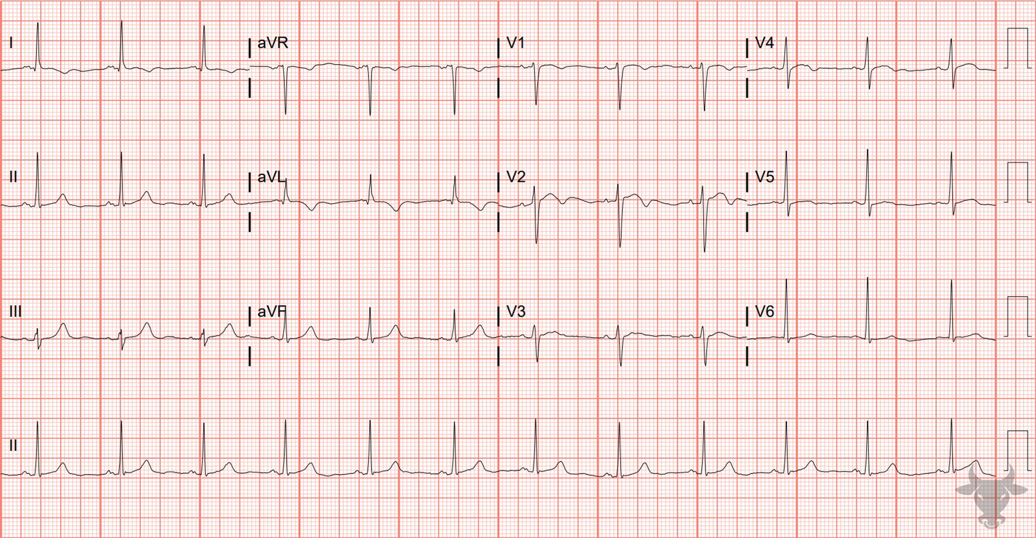
Notes:
High Lateral Ischemic T Wave Inversions.
High Lateral Ischemic T Wave Inversions. The symmetric morphology of the T wave inversions seen in I, aVL, and V2 (biphasic with negative terminal deflection) suggests ischemia (Figure 22). Left heart catheterization revealed 95% mid-left anterior descending artery stenosis.

Slide 12
70-year-old female presents with chest pain
49

Slide 13
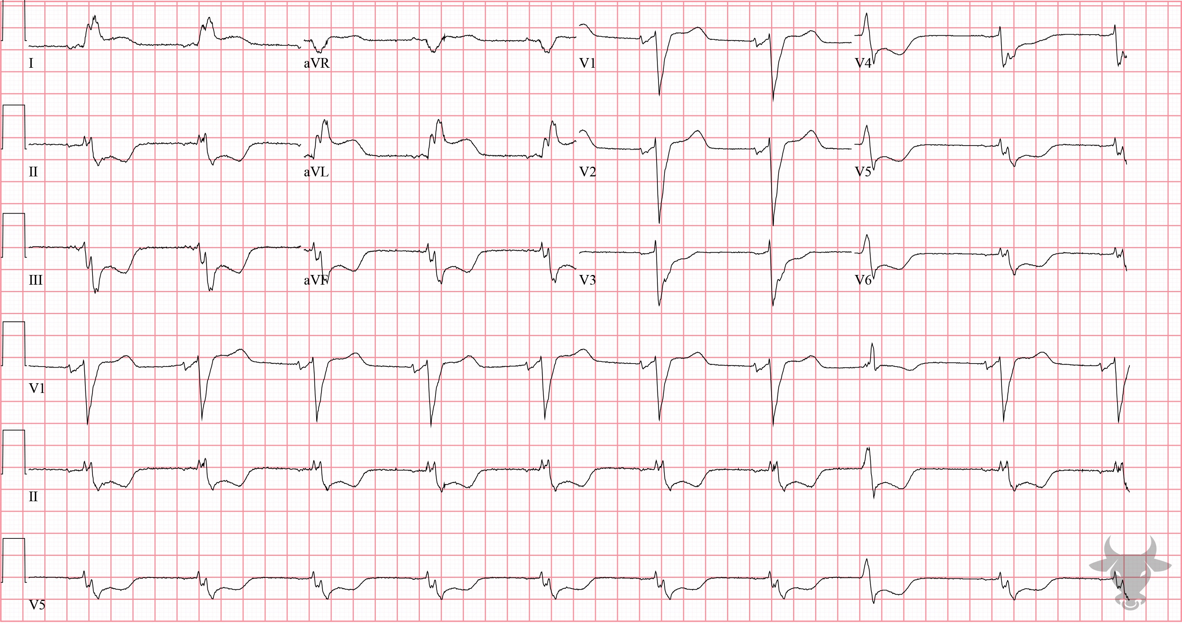
Notes:
ST-elevation Myocardial Infarction.
ST-elevation Myocardial Infarction, Left Bundle Branch Block. A left bundle branch block occurs when the left bundle no longer conducts, and the signal must pass to the left ventricle via myocyte-to-myocyte conduction. This pattern of conduction is slower than via the specialized conduction system, and results in a wide QRS complex (Figure 23).
Normally, a left bundle branch block demonstrates characteristic discordant changes – ST segments tend to deflect in the opposite direction from the QRS complex. In leads with primarily down-going QRS complexes (i.e. V1, V2, V3), ST-elevation is expected; and in leads with primarily up-going QRS complexes (i.e. I, aVL, V5, V6), ST-depression is expected. ST-segment deviation in a direction concordant with the QRS complex is specific for acute myocardial infarction and warrants emergent reperfusion. The (modified) Sgarbossa criteria were developed to identify acute myocardial infarction in the setting of left bundle branch block, and is considered positive if any of the following criteria are met:
Concordant ST elevation of ≥ 1 mm
Concordant ST depression of ≥ 1 mm in V1, V2, or V3, or
Excessively discordant ST elevation defined as the ST/S ratio greater than 0.25.
This ECG demonstrates concordant ST-segment elevation in I and aVL. Left heart catheterization revealed diffuse disease and percutaneous intervention was performed to the left anterior descending and left circumflex arteries.

