Slide 1

Conference 10
ECG STAMPEDE

Slide 2
96-year-old male presents with palpitations
39

Slide 3
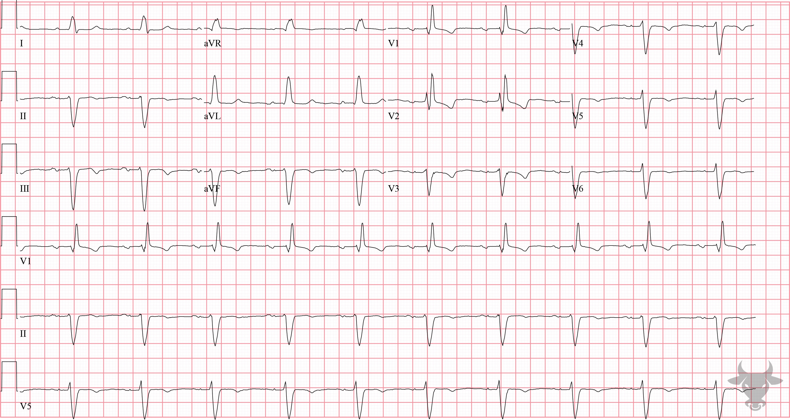

Notes:
Supraventricular Tachycardia with Aberrancy.
Supraventricular Tachycardia with Aberrancy, Right Bundle Branch Block, Left Anterior Fascicular Block. The differential for regular wide complex (i.e., QRS > 120 ms) tachycardia includes ventricular tachycardia, supraventricular tachycardia with aberrancy, antidromic atrioventricular reentrant tachycardia, and toxicologic/metabolic disturbances. This patient had known right bundle branch and left anterior fascicular blocks with the identical morphology, at baseline, that is seen here in this ECG. The patient was successfully cardioverted with adenosine. Unless compelling evidence exists to the contrary, as with this case, ventricular tachycardia should be the presumptive diagnosis for regular wide complex tachycardia.

Slide 4
65-year-old male presents with dyspnea
40

Slide 5
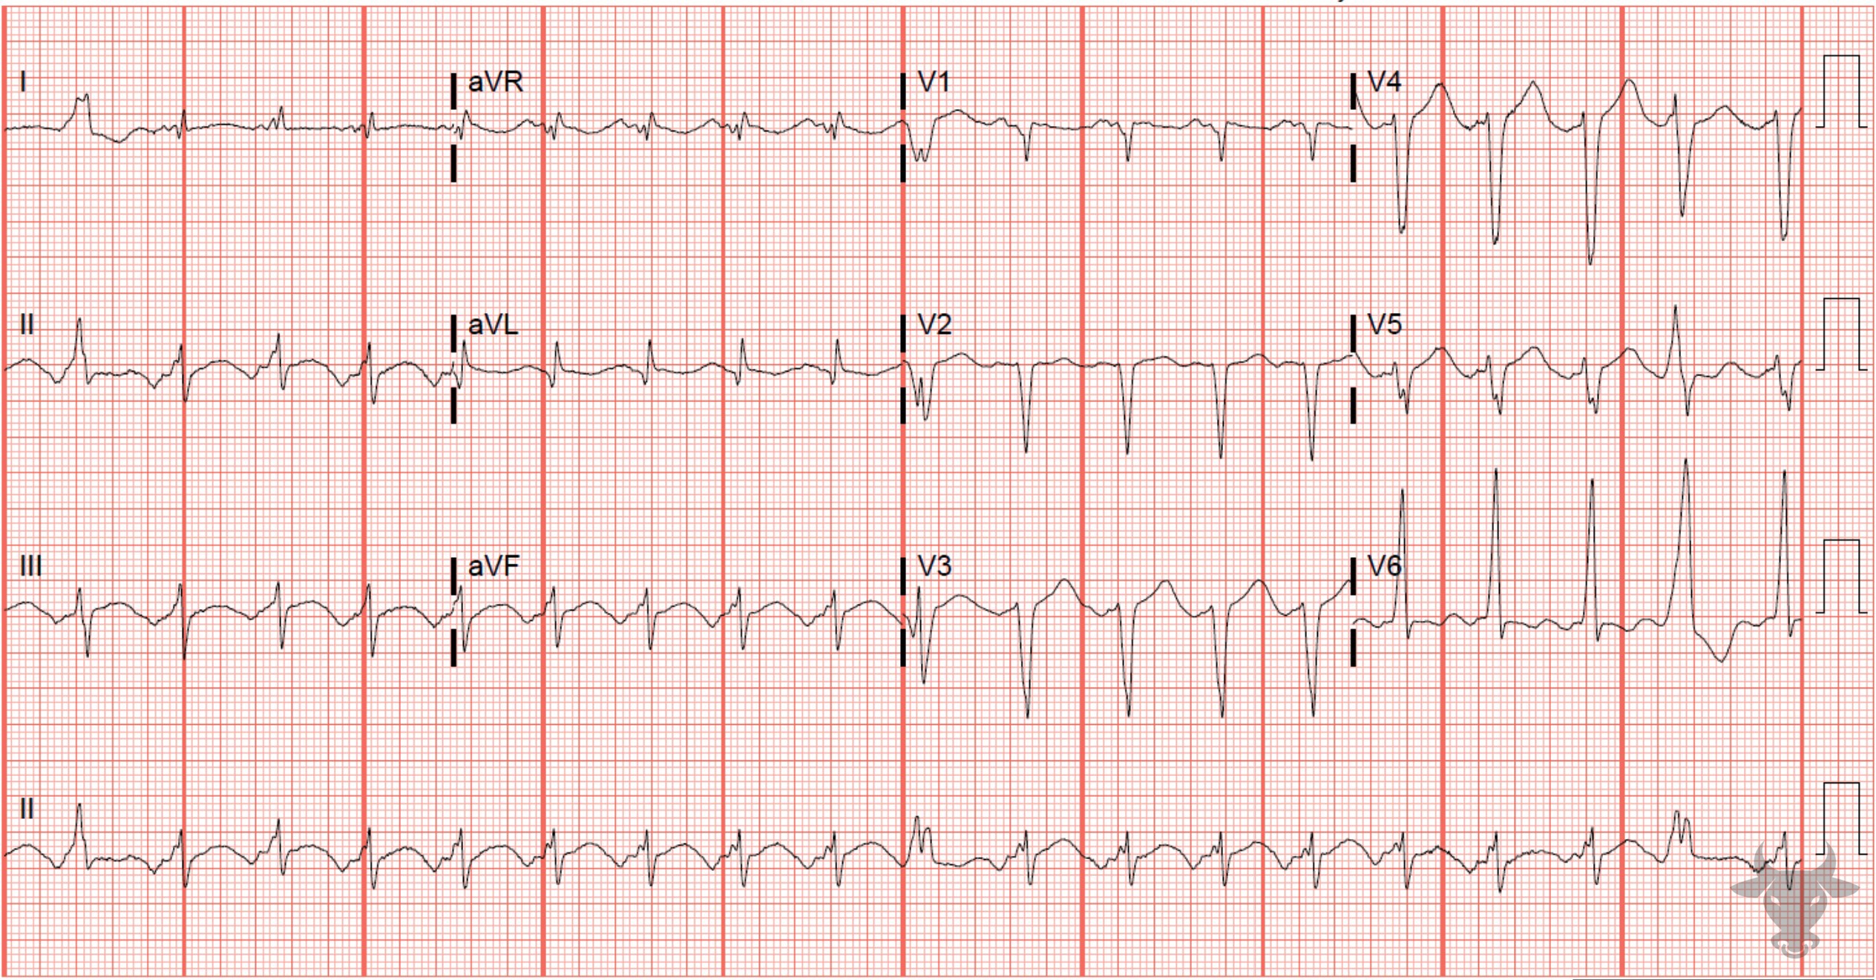
Notes:
Atrial Tachycardia.
Atrial Tachycardia. Atrial tachycardia occurs when an ectopic atrial focus delivers impulses, typically at a rate of 150 to 250 beats per minute. Normally, the P wave axis is down in lead V1 and up in lead II. The abnormal P wave axis in this ECG suggests an ectopic atrial source (Figure 17).

Slide 6
69-year-old female presents with foot pain
41

Slide 7
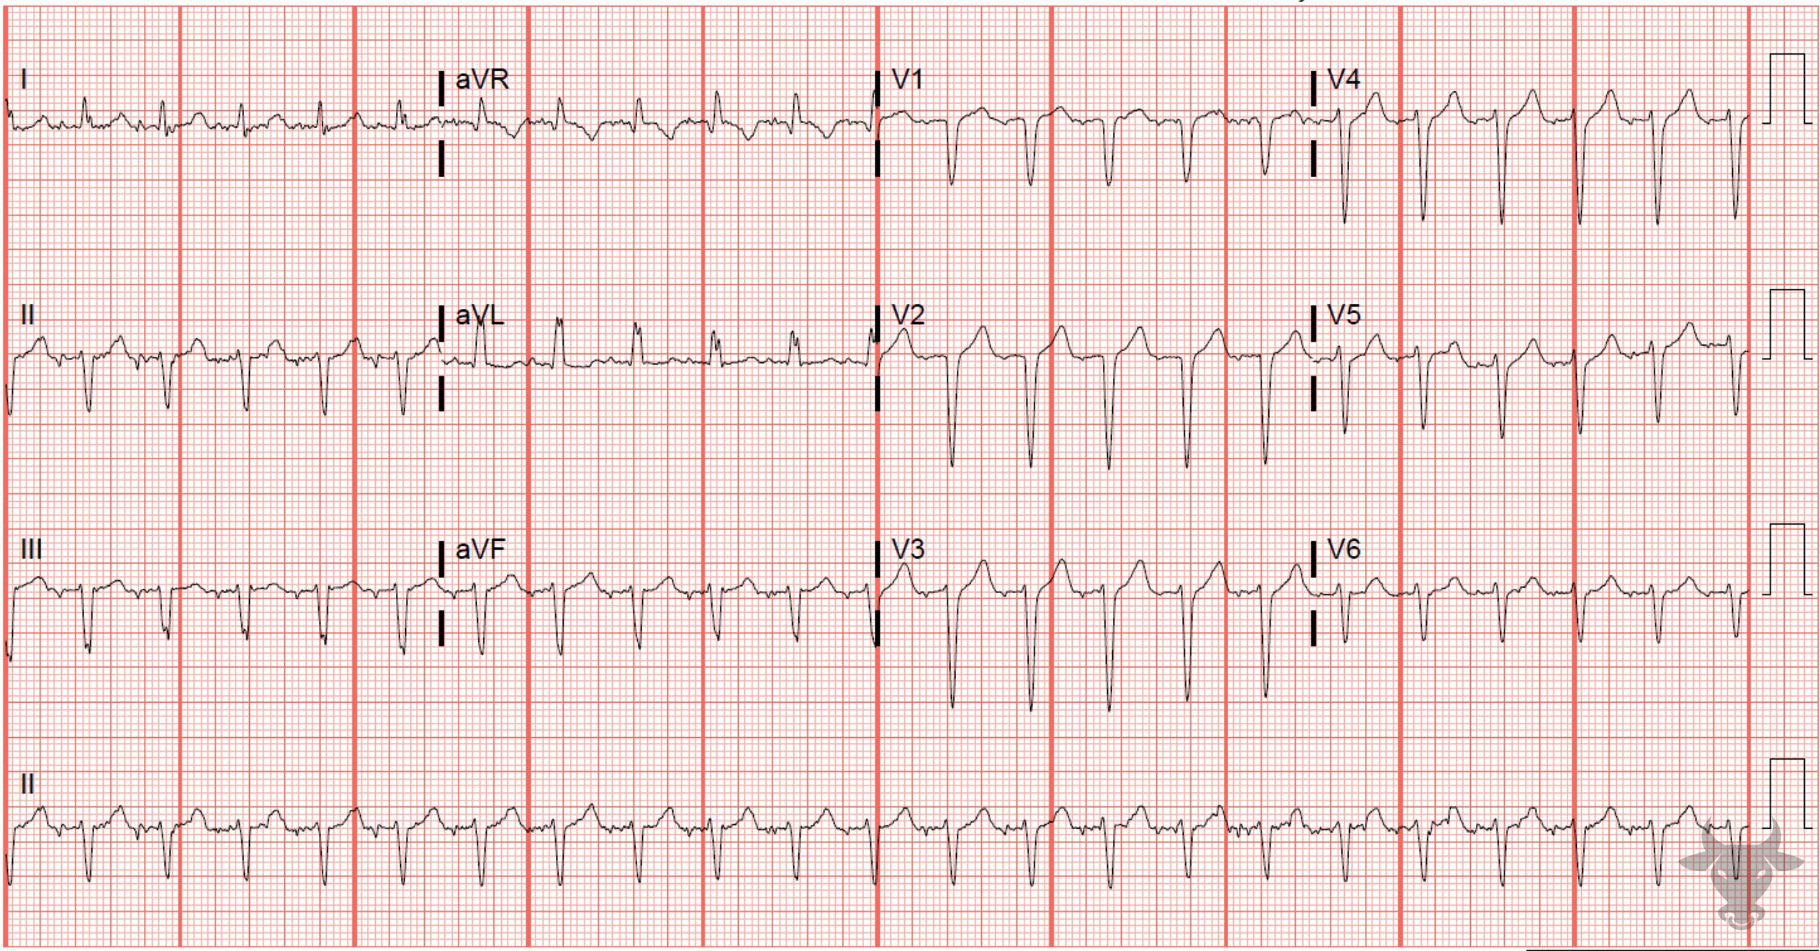
Notes:
Atypical Atrioventricular Nodal Reentrant Tachycardia.
Atypical Atrioventricular Nodal Reentrant Tachycardia. Atrioventricular nodal reentrant tachycardia is a regular, narrow complex tachycardia usually between 140 and 220 beats per minute (but can be slower as with this case) in which a reentrant circuit is formed within the atrioventricular node. Fast and slow pathways are the necessary substrate to establish the circuit. In typical atrioventricular nodal reentrant tachycardia, the conduction travels down the slow pathway and up the fast pathway within the atrioventricular node, and retrograde P’ waves can occasionally be seen immediately following the QRS complex. In atypical atrioventricular tachycardia, which conducts down the fast and up the slow pathway, retrograde atrial activity can occasionally be seen prior to or in between QRS complexes as with this case (Figure 18, Figure 19). This patient converted with adenosine, helping to confirm the diagnosis of atypical atrioventricular nodal reentrant tachycardia.

Slide 8
31-year-old female presents with arrest
42

Slide 9
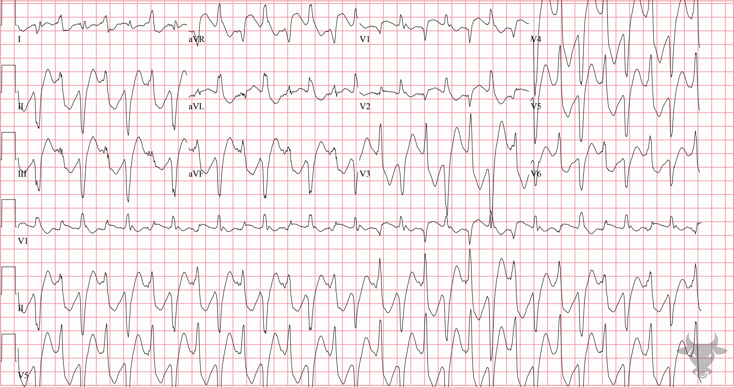
Notes:
Bidirectional Ventricular Tachycardia.
Bidirectional Ventricular Tachycardia, Digoxin Toxicity. Bidirectional ventricular tachycardia is near pathognomonic for digoxin toxicity. The mainstay of treatment is digoxin-specific antibody fragments and is indicated with cardiac manifestations of toxicity.

Slide 10
44-year-old male presents with syncope
43

Slide 11
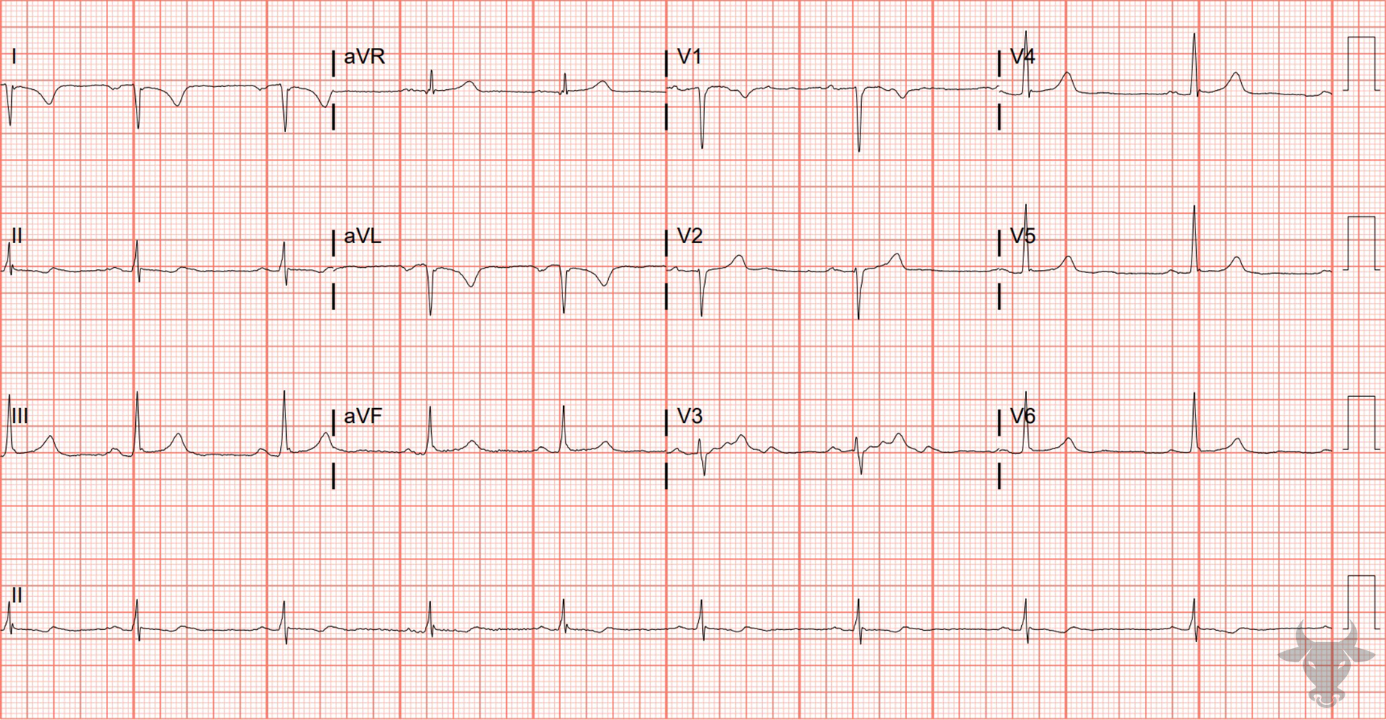
Notes:
Limb Lead Reversal.
Limb Lead Reversal. The presence of negative P-QRS complexes in lead I is unusual, and the P-wave axis is abnormal – with an inverted P-wave in lead I and upright in aVR (where the inverse would be expected for sinus node origin). The presence of negative P-QRS-T complexes in lead I combined with positive deflections in aVR are suspicious for LA/RA reversal. A repeat ECG was obtained, and the axis normalized. Some key electrocardiographic features of limb lead reversal are:
Opposing directions of P-QRS complexes between I and V6 (limb and precordial leads with shared axes)
Positive P-QRS in aVR
Extreme axis deviation (+180° and -90°)
P-wave amplitude greater in lead I than II
Very-low amplitude in isolated limb lead (I, II, III).

