Slide 1

Conference 1
ECG STAMPEDE

Slide 2
63-year-old female presents with weakness
1

Slide 3
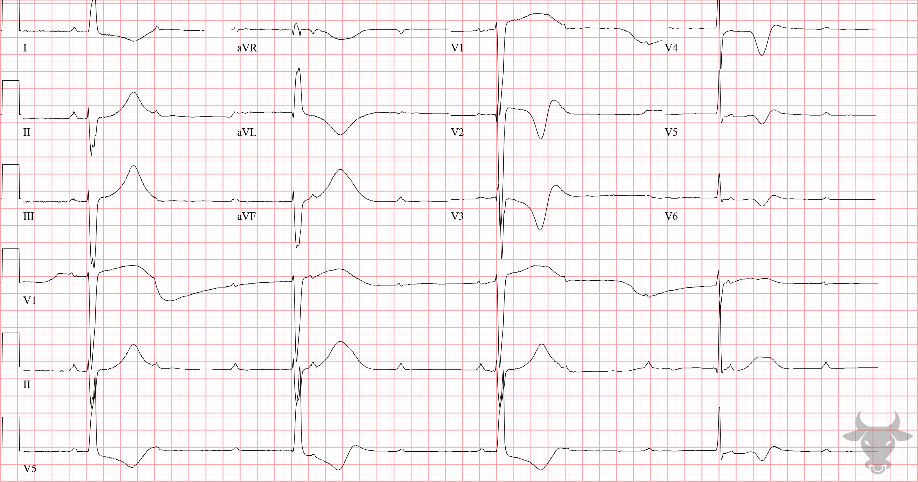

Notes:
Third Degree Atrioventricular Block with Ventricular Escape.
Third Degree Atrioventricular Block with Ventricular Escape. There is atrioventricular dissociation and a severely bradycardic ventricular escape rhythm. The term atrioventricular dissociation refers to the independent contraction of the atria and ventricles and suggests a disturbance in the normal conduction pathway; in this case, third degree (i.e., complete) atrioventricular block. The conduction system contains a series of intrinsic pacemaker cells, all suppressed by the most superior one (i.e., the sinus node under normal circumstances). When signals fail to transmit distally, pacemaker cells can “escape” their suppression. The more distal the escape rhythm, the slower and less reliable it is. Junctional escape rhythms tend to be narrow complex (<120 ms) with rates between 40 and 60 beats per minute. Here, the wide (>120 ms), and slow (<40 beats per minute) QRS complexes suggest a ventricular escape rhythm (Figure 1).

Slide 4
57-year-old male presents with chest pain
2

Slide 5
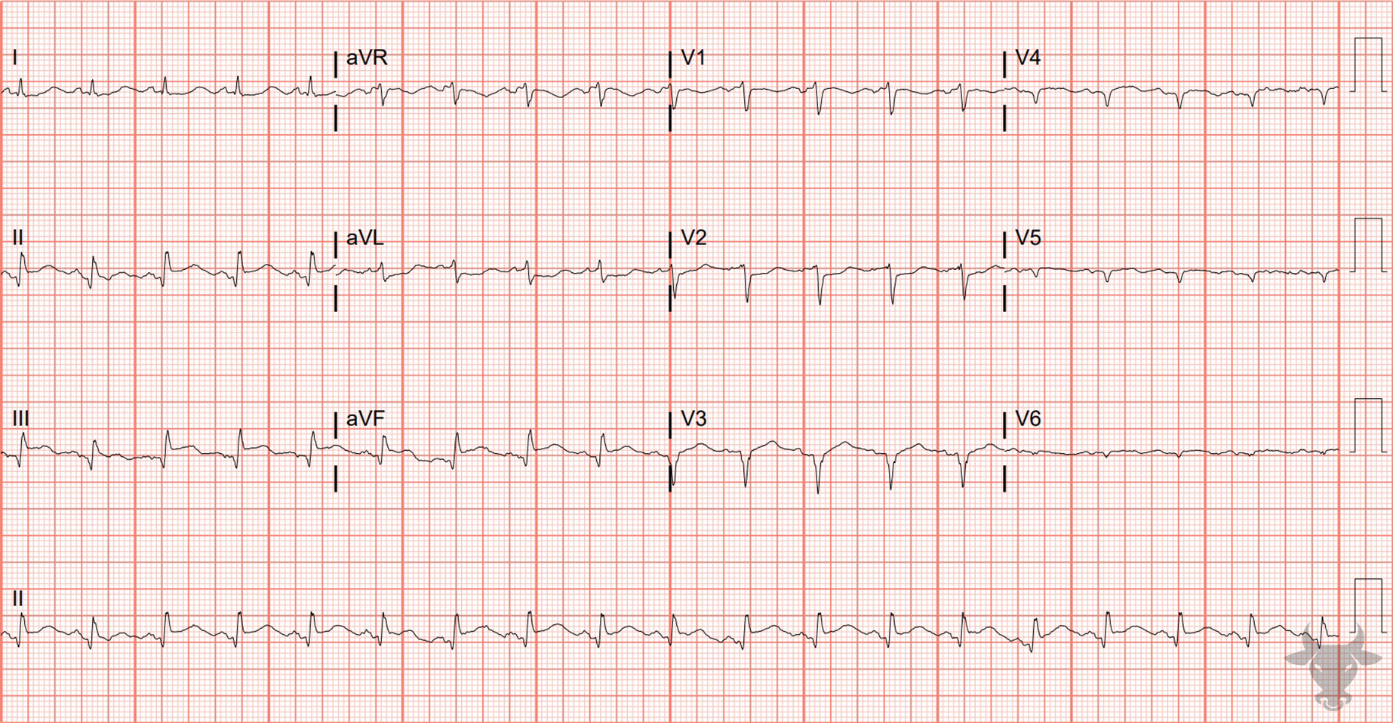
Notes:
Inferior ST-elevation Myocardial Infarction.
Inferior ST-elevation Myocardial Infarction. Inferior ST-segment elevation with reciprocal changes in aVL. Reciprocal changes refer to ST-segment depression in leads opposing the infarct region and are strong predictors of occlusion. Left heart catheterization revealed proximal right coronary artery occlusion and percutaneous coronary intervention was performed.

Slide 6
63-year-old male presents with lower back pain
3

Slide 7
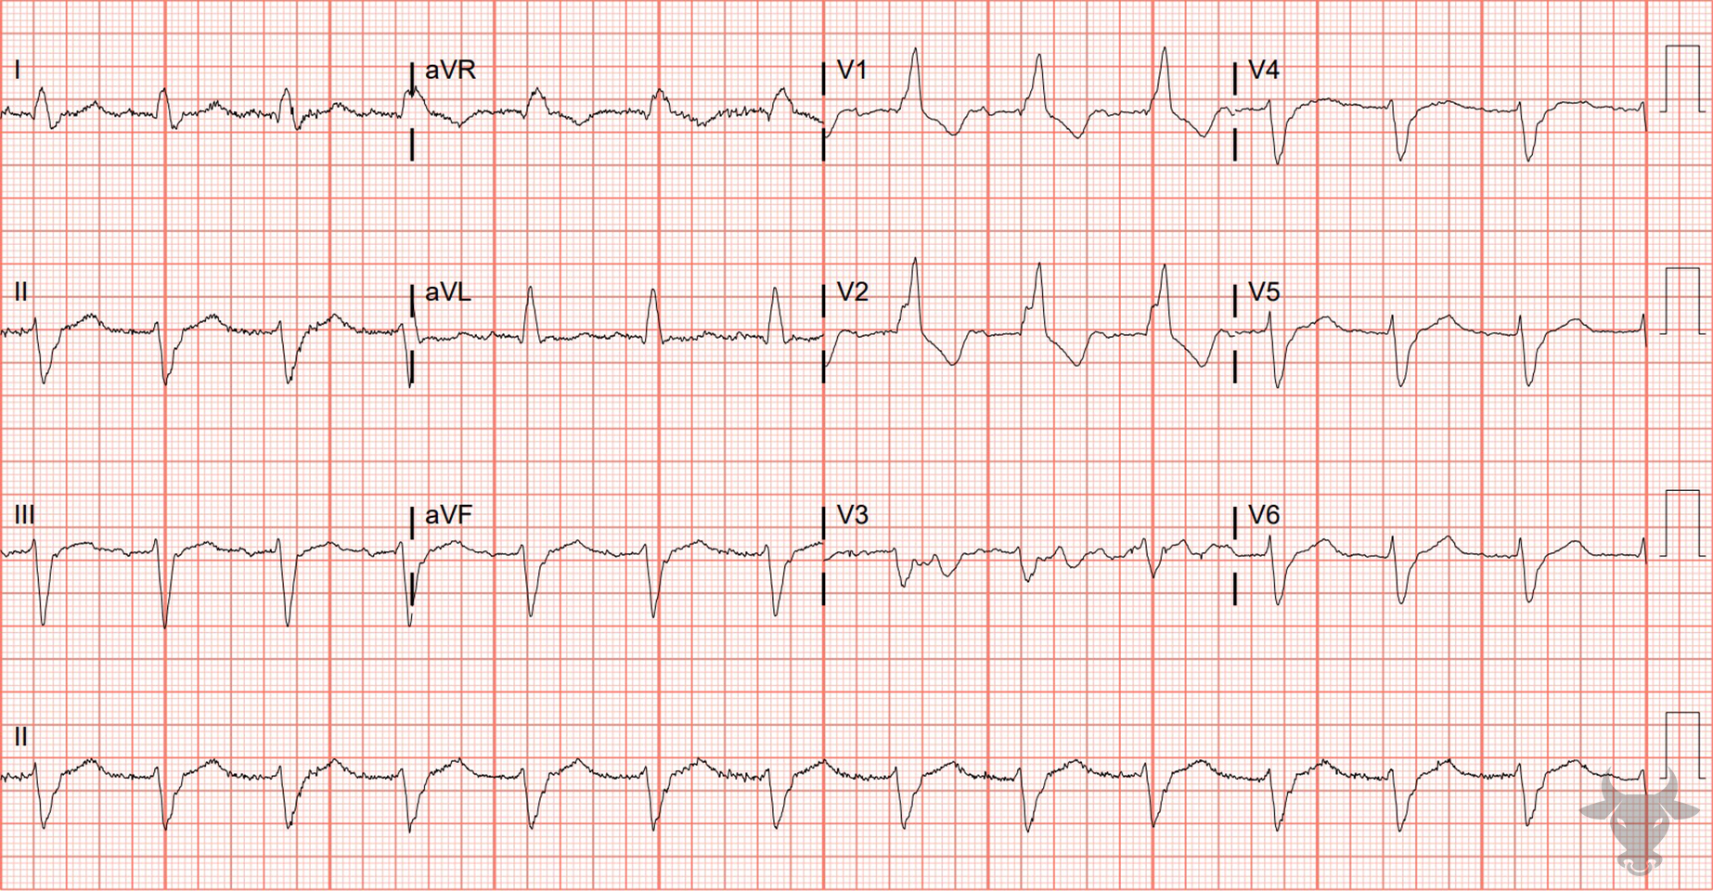
Notes:
Trifascicular Disease.
Trifascicular Disease, Right Bundle Branch Block, Left Anterior Fascicular Block. The wide QRS, rSR’ in the anterior precordial leads (V1, V2), and deep S-waves in the lateral leads (I, V6) indicate the presence of a right bundle branch block (Figure 2).
QRS greater than 120 ms
rSR’ pattern in V1-3 (‘M-shaped’)
Wide/slurred S wave in the lateral leads (I, aVL, V5-6)
The right bundle branch block, however, does not explain the left axis deviation. Causes of left axis deviation are:
Left bundle branch block or paced rhythm,
Prior inferior myocardial infarction (inferior Q waves),
Left ventricular hypertrophy,
Ventricular preexcitation, and, finally,
Left anterior fascicular block.
When the left anterior fascicle is disrupted, current passes along the posterior fascicle and the left ventricle is depolarized in a leftward/upward direction - producing an extreme left axis deviation (i.e., more than 45 degrees, Figure 3).
This ECG demonstrates failure of two fascicles, the right bundle, and the left anterior fascicle, but there is also an associated first-degree atrioventricular block (i.e., prolonged PR interval). In the setting of severe conduction disease, first-degree atrioventricular block is likely to represent delayed conduction through a diseased third fascicle (i.e., trifascicular disease). During sinus tachycardia, trifascicular disease can mimic ventricular tachycardia, but at slower rates, sinus conduction is confirmed. The prior ECG demonstrates atrial activity that can be more clearly seen in leads I and III (Figure 4).

Slide 8
94-year-old male presents with dyspnea
4

Slide 9
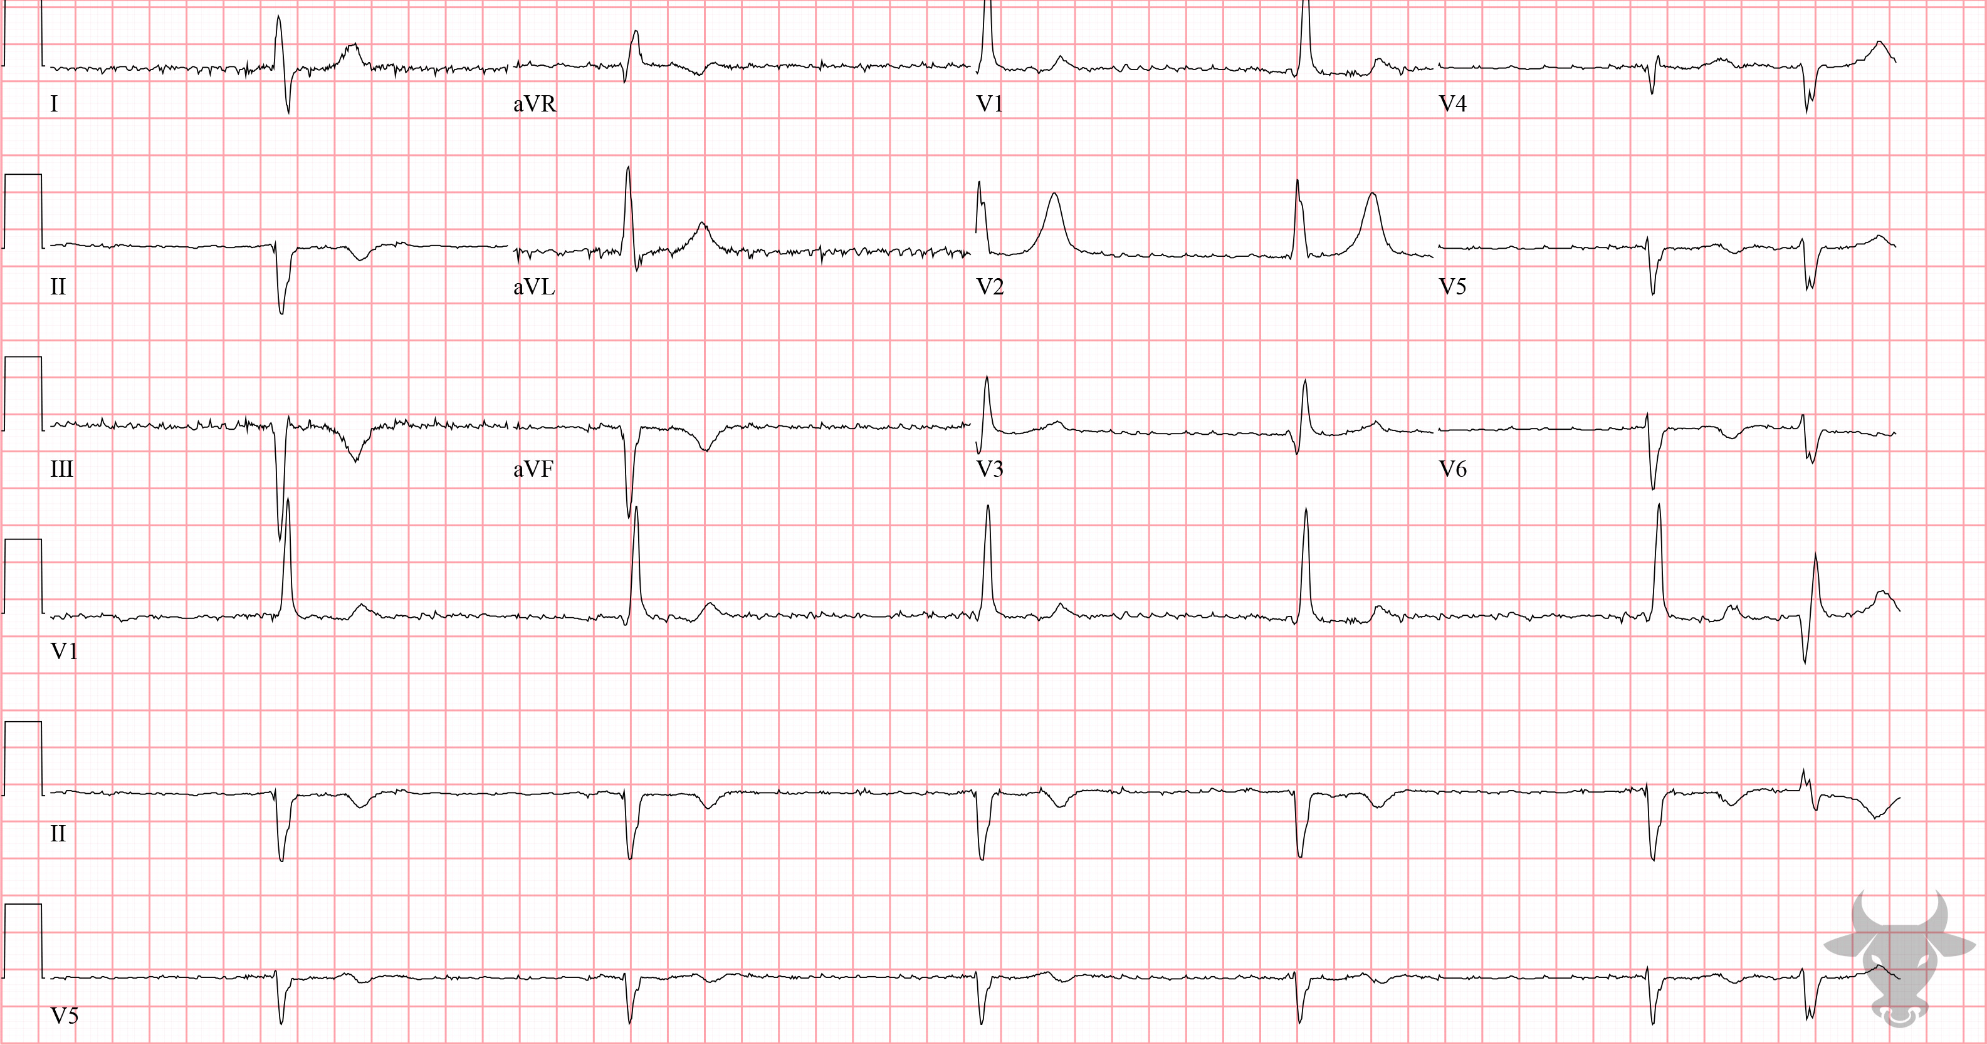
Notes:
Third Degree Atrioventricular Block.
Third Degree Atrioventricular Block, Atrial Fibrillation. This patient had known atrial fibrillation yet has a regular rhythm (aside from the final premature complex). Atrial fibrillation with complete heart block will characteristically have a fibrillatory baseline and absent P waves but a regular escape rhythm. When impulses from a superior pacemaker fail to transmit distally, an inferior one will “escape” it’s usual suppression, leading to an “escape” rhythm. It is difficult to discern, but this patient also had known right bundle branch and left anterior fascicular blocks whose morphologies exactly match the complexes in this ECG, making the junction the most plausible site for the escape rhythm.

